Slide 1
Welcome to Year 5
Mrs Shaw
Mrs Edwards

Slide 2
P.E. Information
PE WILL BE ON:
Thursday
Friday
Please ensure your child has a PE kit in school on a
Monday for the week, this can be brought home on Friday if needed or kept in school.
Correct P.E kit:
Red t-shirt
Blue shorts/leggings/joggers
Trainers or pumps

Slide 3
Homework
Homework will be given out on a Monday.
Maths – family activity
English
Homework will need to be returned by the Friday.

Slide 5
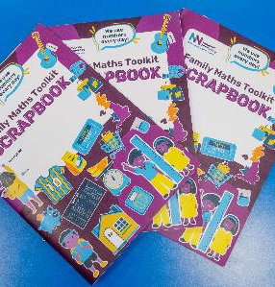
Family Maths Scrapbook
How can you help at home?
Enjoy the challenge with your child
Write comments/ draw pictures/ take photos and put in the scrapbook
Send the scrapbook back to school

Slide 6
Reading
Home Reading:
Some children will be choosing their own books to bring home and others will have an appropriate levelled book chosen for them
Children can return their book when they have finished reading it and it will be changed
Please read with your child as well as giving them the time to read independently - please encourage your child to read for at least 15 minutes each night
Challenge your child to enjoy reading books by new authors and encourage them to talk about the books they are reading
Remember - you have a fantastic library in Blacon for the children to use

Slide 7
EGPS
English Grammar Punctuation and Spelling
This will be a focus throughout the year and so quite a bit of the homework will be revision on what we have covered in previous years and in class.

Slide 8
Spellings
New spellings every Wednesday to be tested the following week.
Ed Shed to practice

Slide 9
Passwords
TTRS for times tables
Edshed for spellings
Children will have access in school as well as at home.
Passwords will be sent home

Slide 10
Allergies
Nuts and Shellfish
Please do not send any into school and check ingredients

Slide 11
Walking home
You must give permission for your child to walk home alone, without adult supervision.
This can be done either using the survey sent out at the start of the term or by emailing written permission to the office.
Your child will not be allowed to walk home alone without permission.

Slide 12
Mobile Phone
If your child needs to bring their mobile phone into school, it MUST be handed in at the start of the day. I will then keep the phone safe throughout the day and give it back to your child at the end of the day.
Phones MUST NOT be kept in their bag or pockets in school.

Slide 13
Music
10 weeks – 1 lesson per week
Begin to learn how to play an instrument
They will be able to bring them home with written permission from parents/ carers

Slide 14
Cooking with a chef
Royal Academy of Culinary Arts – Adopt a chef programme
1 session per term with a chef
£3 per child through ParentPay
Chef’s apron and hat
Letter to be sent out soon

Slide 15
School Website
https://www.st-theresas.cheshire.sch.uk/

Slide 16
ANY QUESTIONS?

