Slide 1

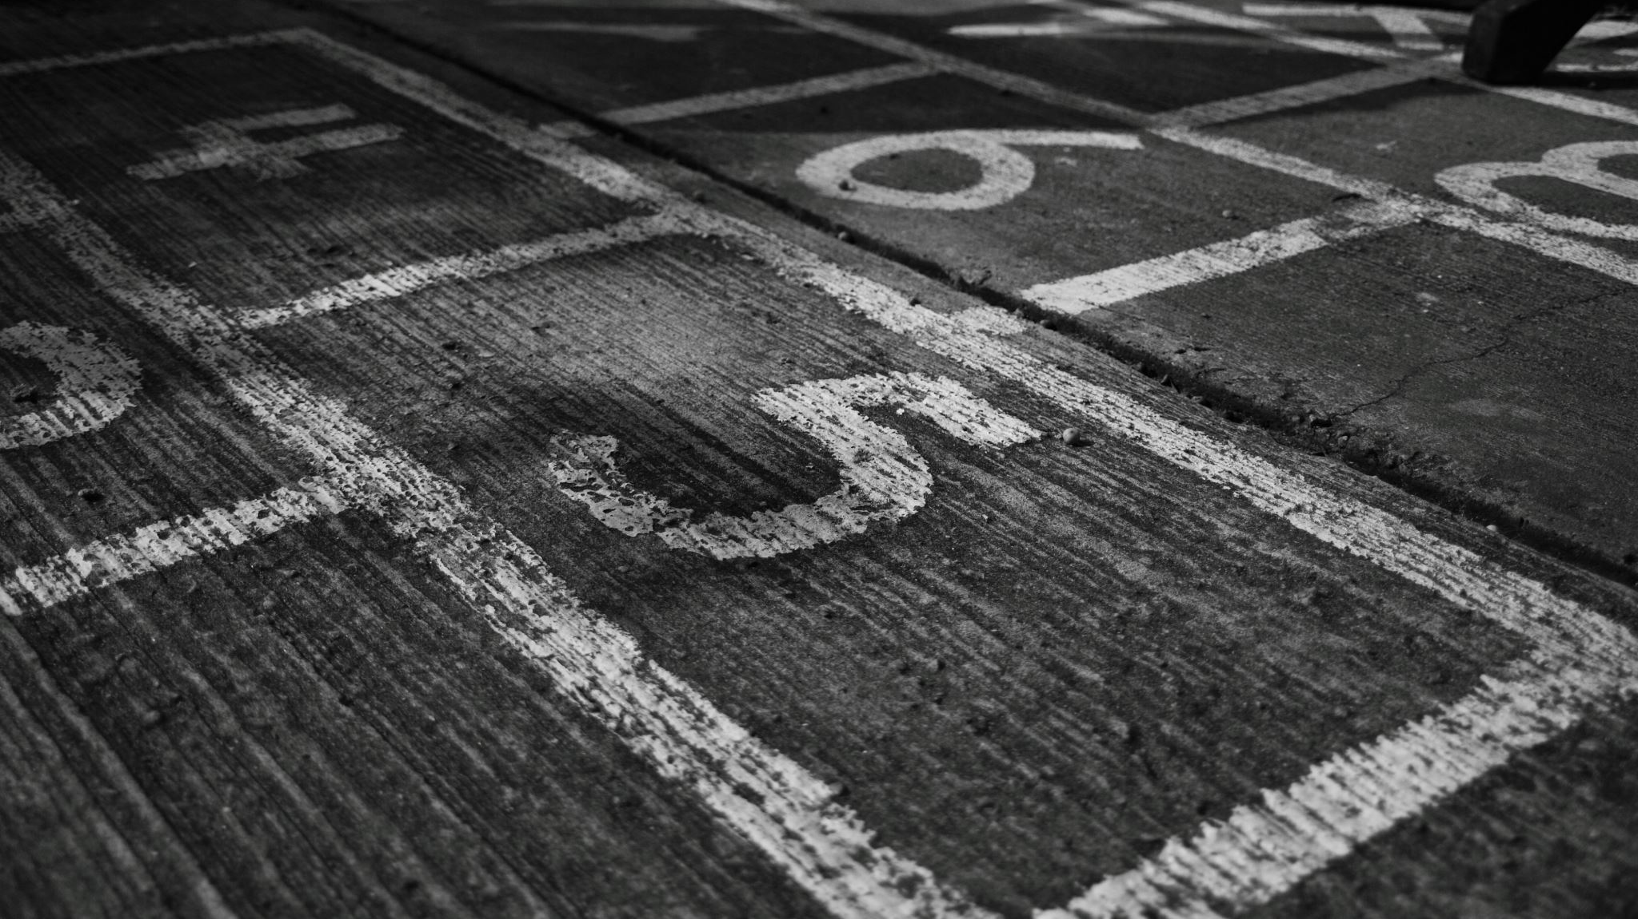
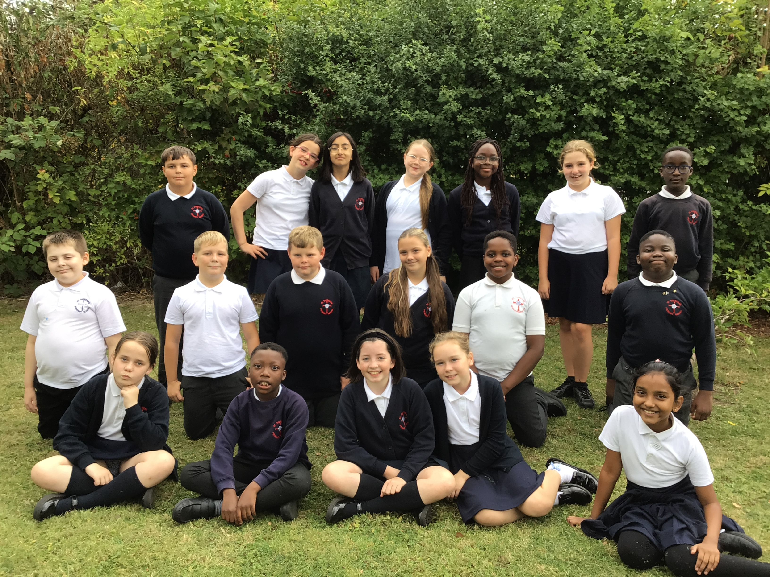
Year 6
2025-2026 MRs Rhodes

Slide 2
Staff: Mrs Rhodes – Class Teacher Mrs Hill – Class Teaching Assistant (HLTA)

Slide 3
Days to remember:
* PE Kit – Monday/Friday (Basketball/Tag Rugby)
* Spellings – Spelling Shed - Wednesday test
* Homework – Given out on a Wednesday, due in the following Monday
* Water bottles every day please
* Reading books – change as and when completed

Slide 4

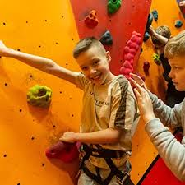

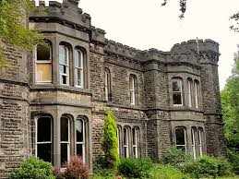
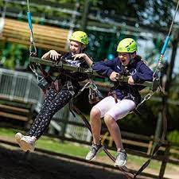
Trips – Robinwood, Wrexham
Fun, outdoor activities
Residential – Mon 16th – Wed 18th March 2026

Slide 5
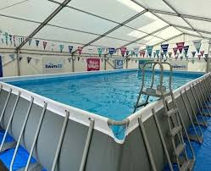
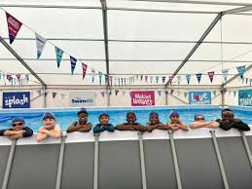
Swimming - Summer Term(dates to follow)

Slide 6
SATs
What are SATs?
When are SATs?
How can I help my child with SATs?
SATs are a series of standardised assessments that children complete at the end of Key Stage 1 and Key Stage 2.
SATs are due to take place in May 2026.
The published dates at the moment are the week beginning 11th May 2026.
PLEASE DO NOT BOOK A HOLIDAY
Please encourage your child to do their weekly homework as this will often be SATs revision.
Learning weekly spellings
Reading
Booster Classes

Slide 7
Useful websites:
https://thirdspacelearning.com/blog/sats-2022-guide/ This website is very useful if parents want to know more about SATs
https://www.bbc.co.uk/bitesize/articles/zrybvk7 This website is full of great games and activities for SATs age children
http://www.crickweb.co.uk/ks2literacy.html This website is a useful tool for grammar revision

Slide 8
High School
Blacon High Visit – Date TBC
Head of Y7 from Blacon High will come into school to meet the children
Blacon High School – Open Evening TONIGHT
Chester Catholic High School – Open Evening 18th Sept 6pm-8pm
Bishops Blue Coat- Open Evening 23rd Sept 5:45-8pm
Mr Greene from CCHS will come into school to meet the children
Visitors from Chester University to help with transition
PSHE lessons will ease worries linked to transition

Slide 9
Home School Agreement – Please take one home and go through it with your child. Sign it and send it back into school and hand to Mrs Rhodes. Any questions welcome….

