Slide 1



Reception 2027 September Starters
Great Sankey Primary School
Welcomes You
Great Sankey Primary School
‘Together We Learn and Grow’

Slide 2



Introductions
45 pupil intake
Part of a Multi Academy Trust (The Challenge Academy Trust)
Ofsted inspected in Nov 2025 – STRONG in all 7 areas
Run our own successful wrap around school hours club - Treetops
Children are at the of everything we do
Great Sankey Primary School
‘Together We Learn and Grow’

Slide 3


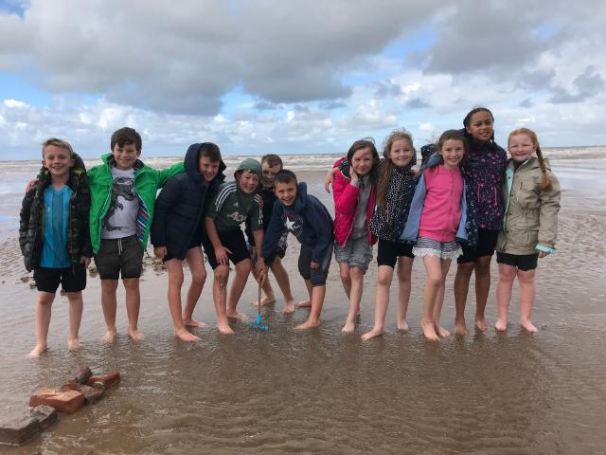
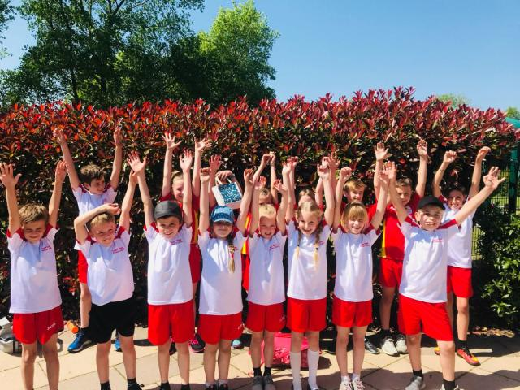
Our mission is to inspire, challenge and support young people to excel in learning and in life.
Our school motto is important to us:
‘Together We Learn and Grow’
#TeamGSP
staff
children
families
Great Sankey Primary School
‘Together We Learn and Grow’

Slide 4

Great Sankey Primary School
‘Together We Learn and Grow’

Slide 5

Great Sankey Primary School
‘Together We Learn and Grow’

Slide 6

Great Sankey Primary School
‘Together We Learn and Grow’

Slide 7
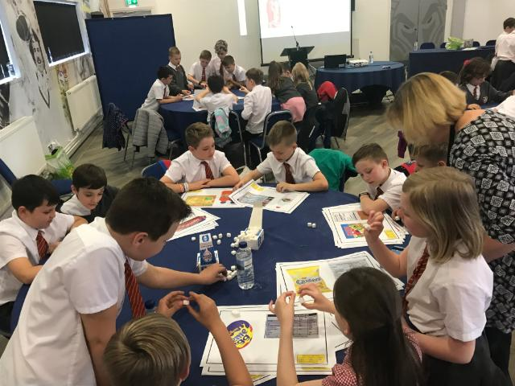
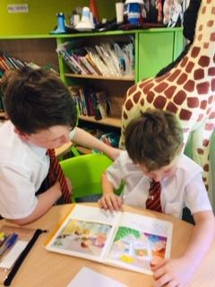
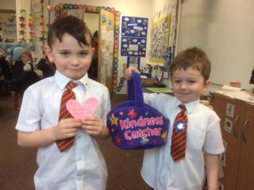
How do we Inspire, Challenge and Support our children?
The inspirational GSP Curriculum
At the heart of our curriculum lies three main drivers which help to shape our bespoke curriculum:
Growth
Mindfulness
Community
Great Sankey Primary School
‘Together We Learn and Grow’

Slide 8

The GSP Curriculum
Meets the needs of all learners
High expectations
Exciting, relevant and brings learning to life
Visitors, visits, whole school trips, residentials in Y2, 4 and 6
Knowledge acquisition
Transferable skills across other areas of the curriculum
Teach how to be a good citizen to make positive contributions to society
Values: Honesty, Acceptance, Responsibility, Resilience, Kindness
Don’t scrimp on subjects! No curriculum narrowing.
Offer enrichment within and beyond the school curriculum
Supports wellbeing and positive mental health
Great Sankey Primary School
‘Together We Learn and Grow’

Slide 9

School Outcomes 2026
Foundation Stage
Good Level of Development at the end of Reception year | 93% (72% National Figure)
Phonics Screening
Year 1 pass rate 93% (82% National Figure)
Year 2 re-sit pass rate 100% (91% National Figure)
Year 4 Multiplication Check
Pupils achieving a score of 25/25 50% (44% National Figure)
End of Key Stage 2
Subject | Working at/above the Expected Level (national) | Achieving ‘Higher Standard’ (2026 national)
Reading | 91% (75%) | 32% (31%)
Writing | 86% (73%) | 30% (13%)
Maths | 95% (75%) | 55% (27%)
English Grammar, Punctuation and Spelling | 91% (74%) | 45% (30%)
R, W, M combined | 80% (63%) | 20% (9%)
Great Sankey Primary School
‘Together We Learn and Grow’

Slide 10

Parents say:
    'Fantastic school which fosters a love of learning. Excellent opportunities for the children beyond the usual curriculum and classroom. We couldn’t be happier with the progress our children are making.'
‘The class teacher has been brilliant – very supportive of my child and all feedback given is constructive and helpful.
‘Everyone in the school truly cares about the children and wants the best for them. The fact that the children are happy and thriving is proof of this. It’s such a welcoming environment and this is noticed by everyone who walks in.'
'The school has a positive happy approach for both students and staff alike. Thus, creating a conducive environment for strong attendance and natural learning and growth.'
'My children are happy in school and love the range of activities and opportunities made available through the curriculum, trips and visitors. My children are doing extremely well academically. I love how both of my children come home with a story to tell from their day, often telling me things they have enjoyed from their lessons.'
'Thank you for being such an excellent school and for making my child feel happy and safe. My child proudly tells everyone that he goes the best school in the world.'
Great Sankey Primary School
‘Together We Learn and Grow’

Slide 11
Ofsted Nov 2025 say:
Bullying of any kind is not tolerated. Older pupils act as positive role models to others. Pupils thrive in this caring and calm environment.
    Pupils do very well from their starting points. They are consistently well prepared for their next stage of education. Pupils enjoy their learning and take great pride in their work. Lessons are highly engaging and matched well to pupils’ needs.
Children make a really strong start to this school. They achieve well, develop high levels of independence and are fully ready for their next steps.
The school's curriculum is of high quality. There is a consistent approach to teaching. Pupils receive the support that they need and do well.
Every pupil is valued, cared for and thrives at Great Sankey Primary School. Staff build strong, trusting relationships with pupils and their families. This creates a culture of respect
Great Sankey Primary School
‘Together We Learn and Grow’

Slide 12
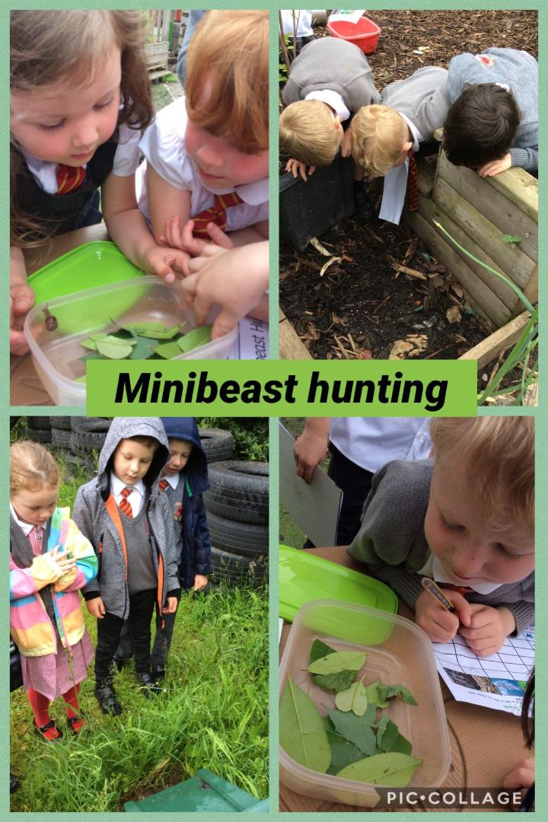
Early Years Foundation Stage
We have a highly experienced team
We build strong relationships with our families
We provide a nurturing place for your child to flourish
We treat each child as an individual and take time to get to know them
We have lots of fun as we learn
We have high expectations of our staff and our children
Smaller Reception class sizes
Great Sankey Primary School
‘Together We Learn and Grow’

Slide 13
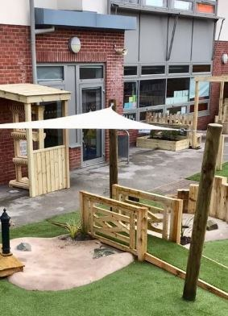
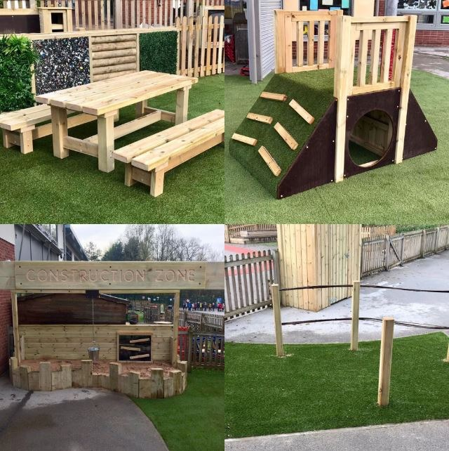
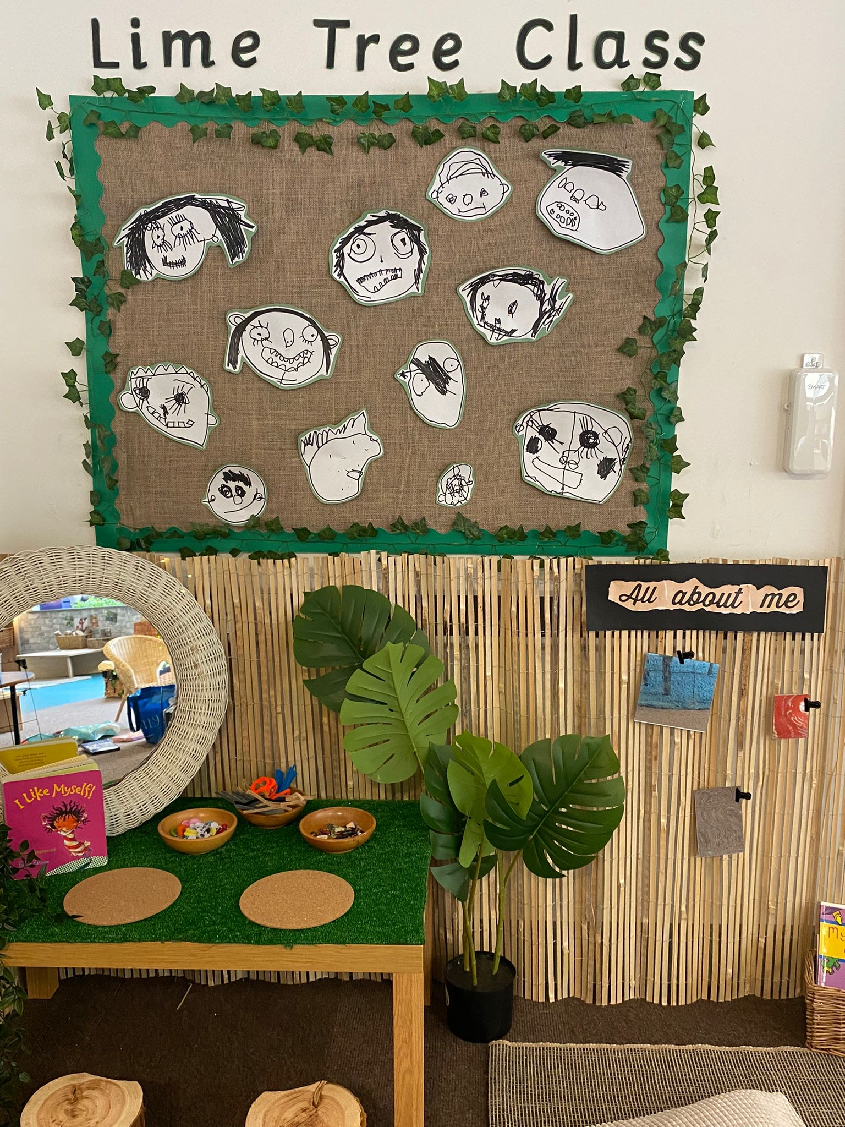
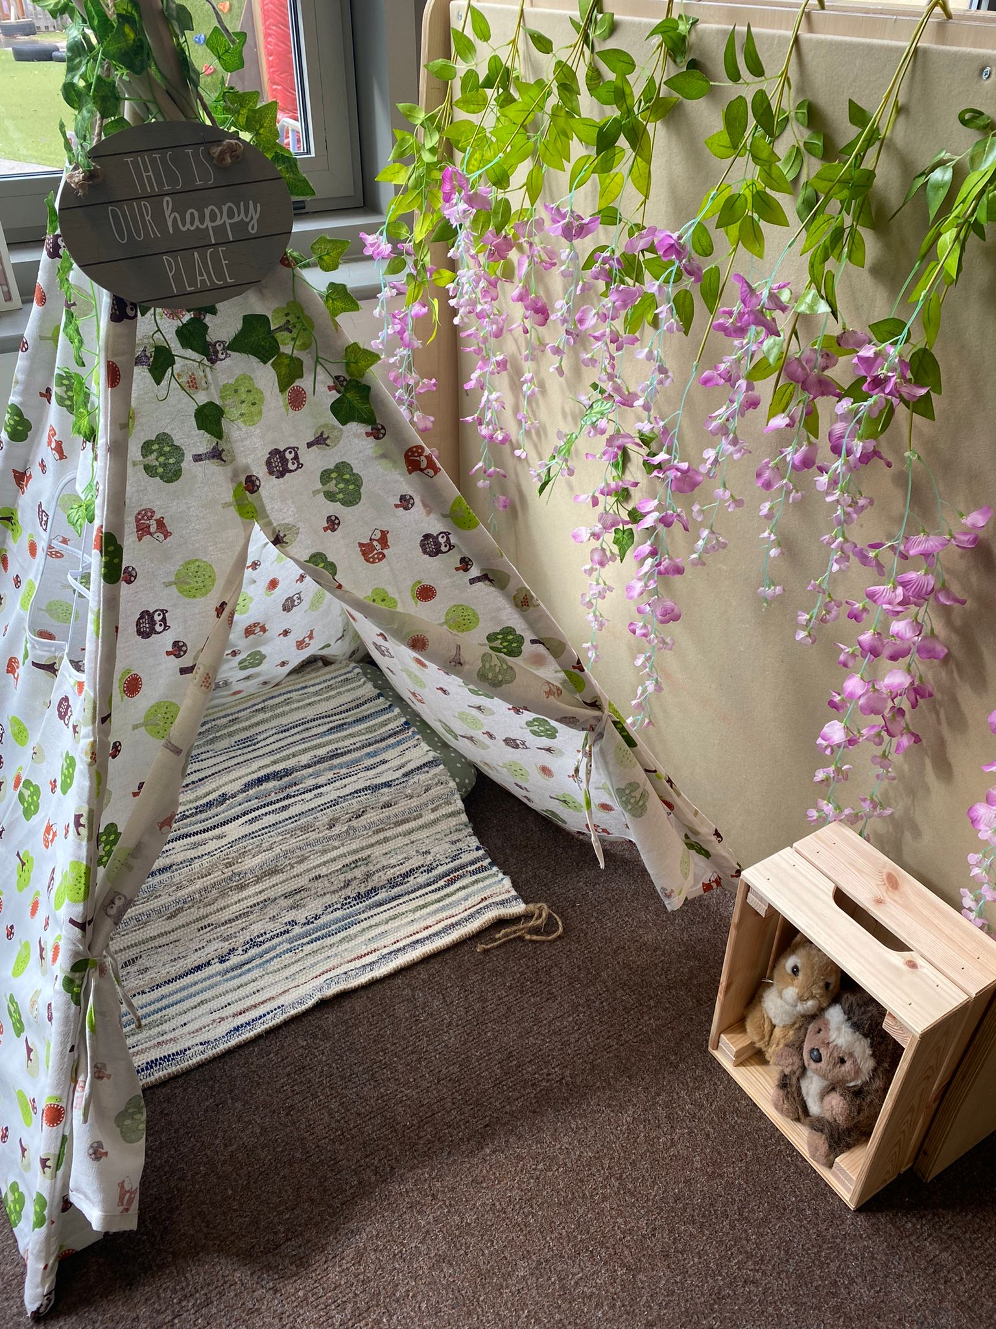
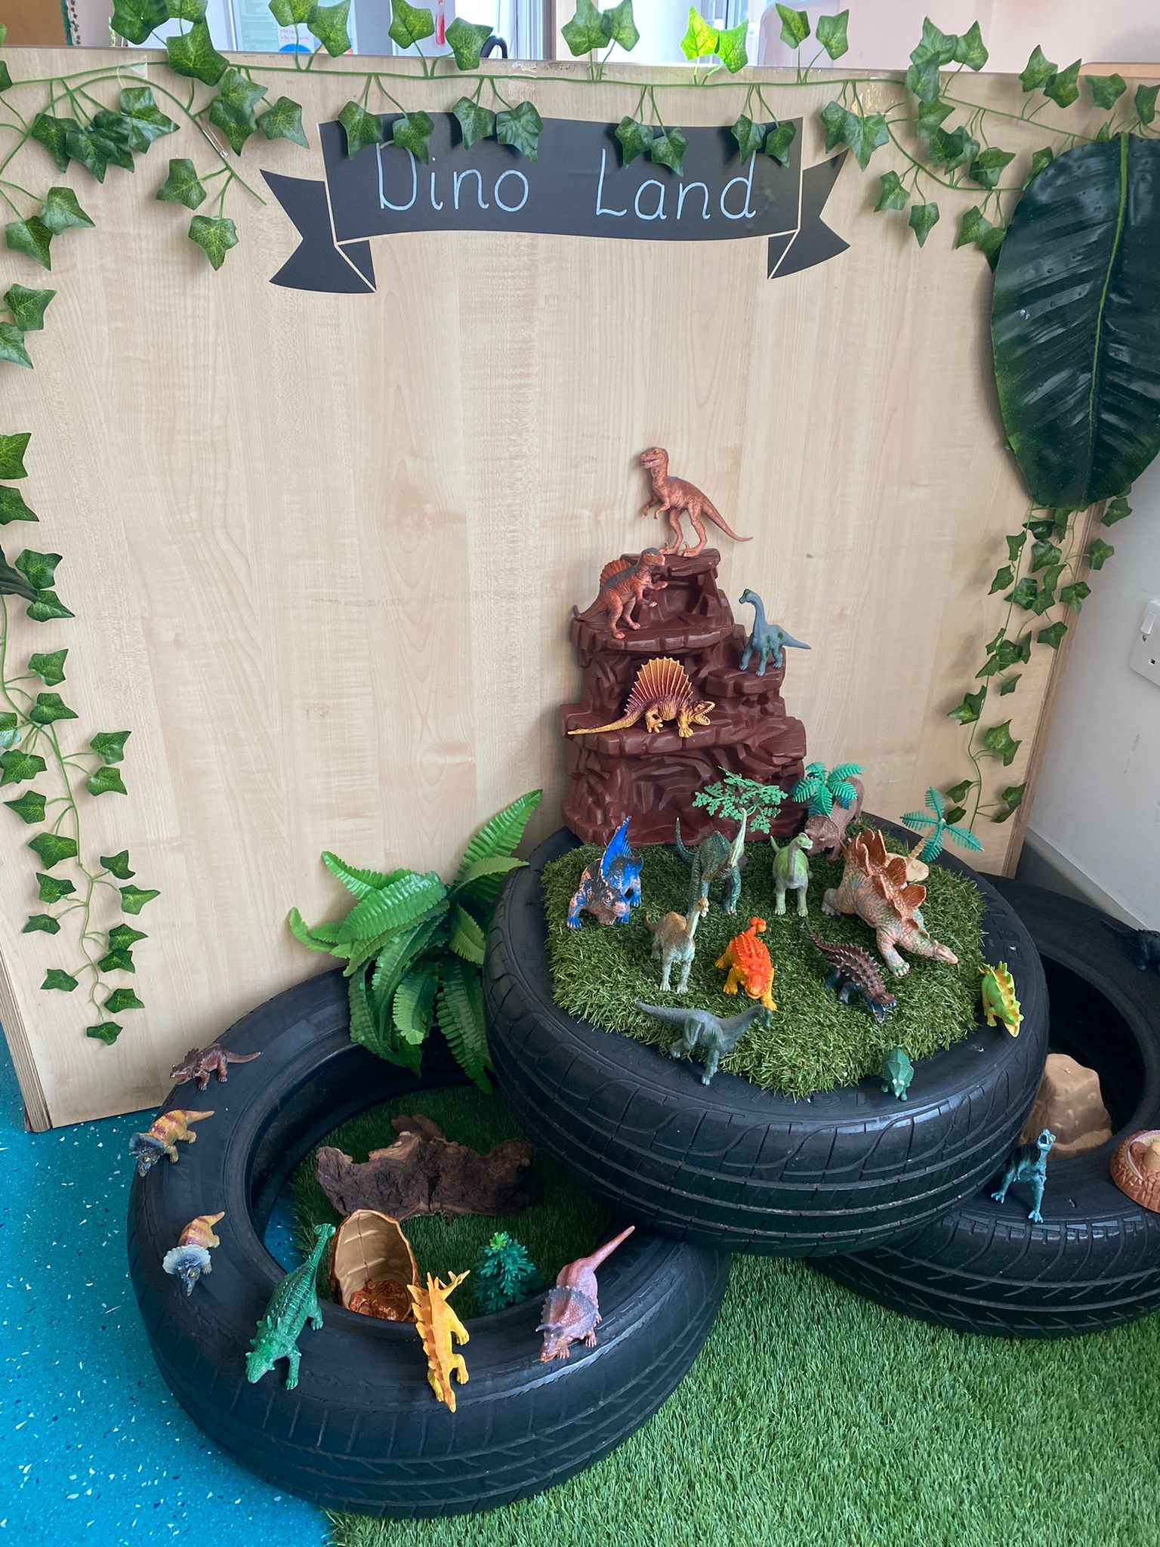
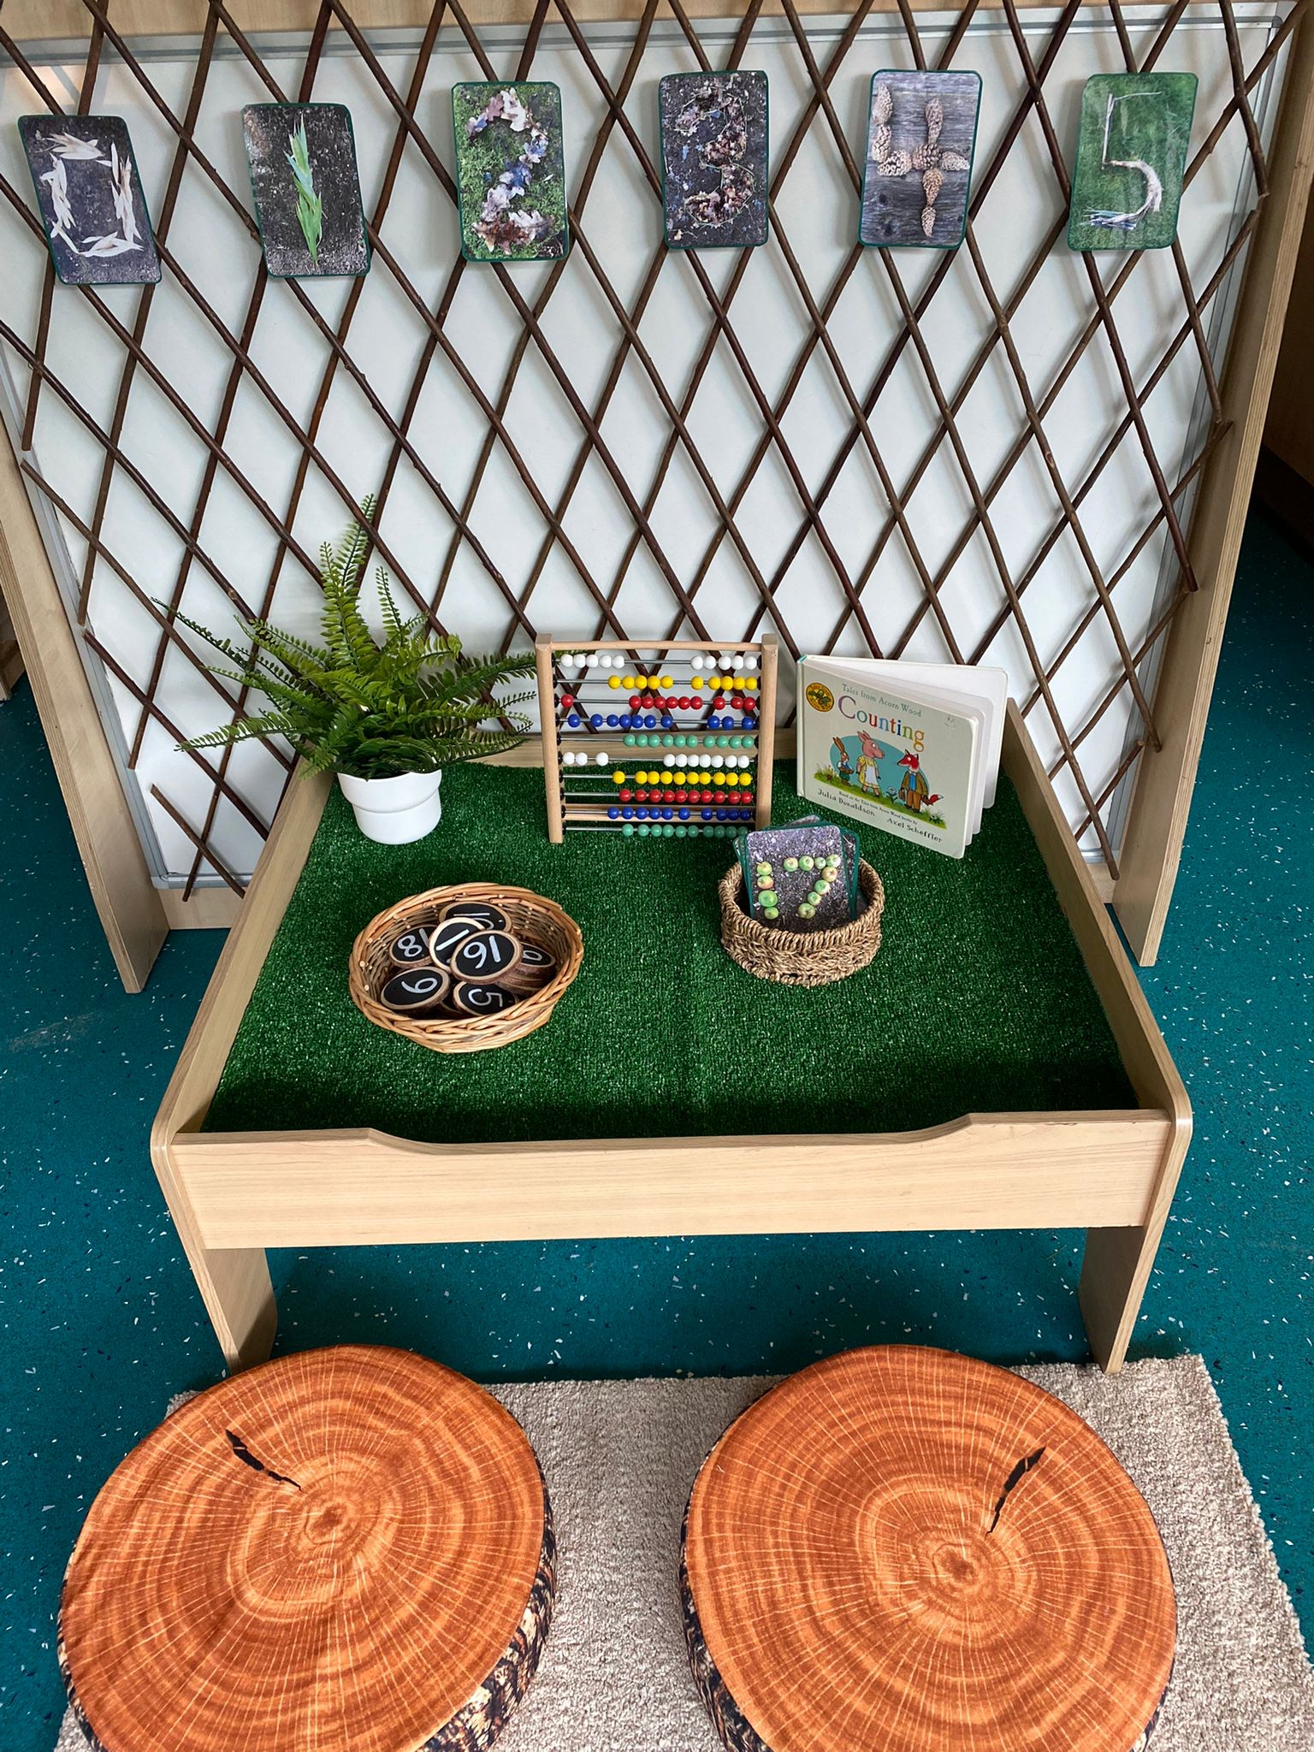
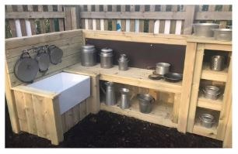
The Environment
High quality learning environments both indoors and outdoors.
Great Sankey Primary School
‘Together We Learn and Grow’

Slide 14
Next Steps
Speak to parents in the local community who have children already in school
Visit all schools in your area
Ensure they align with your own vision and ethos
Choose three schools
Follow the Warrington Admission guidance
Complete form by midnight 15th January 2027
Guidance
https://www.warrington.gov.uk/primary-school-admissions
Great Sankey Primary School
‘Together We Learn and Grow’

Slide 15

Contact us:
Tel: 01925 728176
Email: admin@greatsankeyprimary.tcat.uk.com
Great Sankey Primary School
‘Together We Learn and Grow’

Slide 16

Red group led by Mrs Grigg and St George’s Captains (start at Year 3)
Green group led by Mrs Wrangles and St Patrick’s Captains (start in Nursery)
Yellow group led by Mrs Williams and St David’s Captains (start at Year 2)
Blue group led by Mrs Wilding and Mr Hennessey and St Andrew’s Captains (start at Year 6)
Great Sankey Primary School
‘Together We Learn and Grow’

