Slide 1



Reception 2026 September Starter Meeting
Welcome to Team GSP
Great Sankey Primary School
Great Sankey Primary School
‘Together We Learn and Grow’

Slide 2
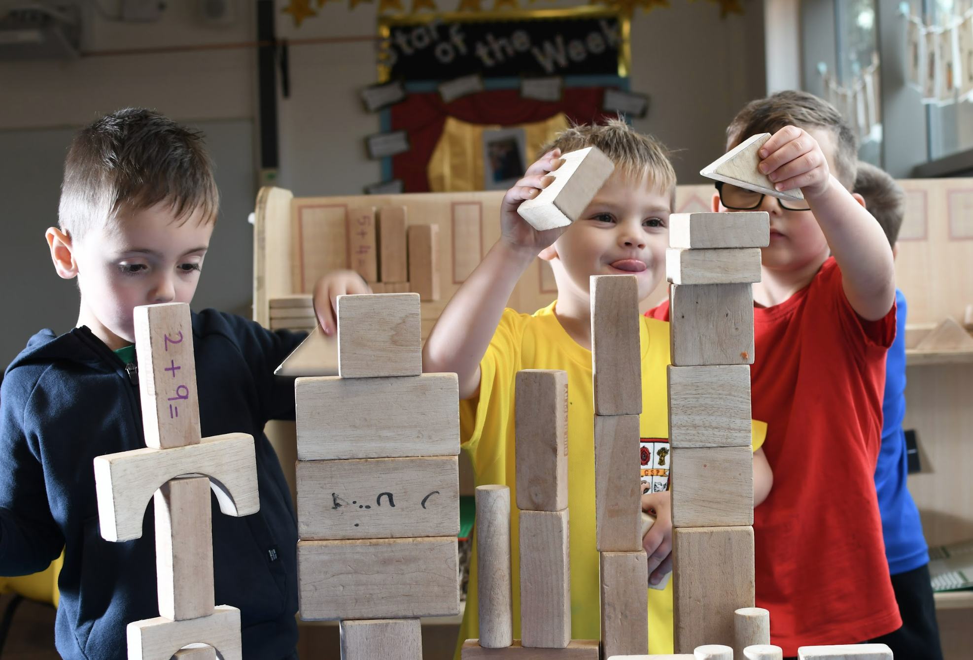
Outline for the evening
Meet the team
The GSP vision and values
The transition pack
How to prepare your child for September
Time for questions
Visiting the Reception learning environments
Great Sankey Primary School
‘Together We Learn and Grow’

Slide 3
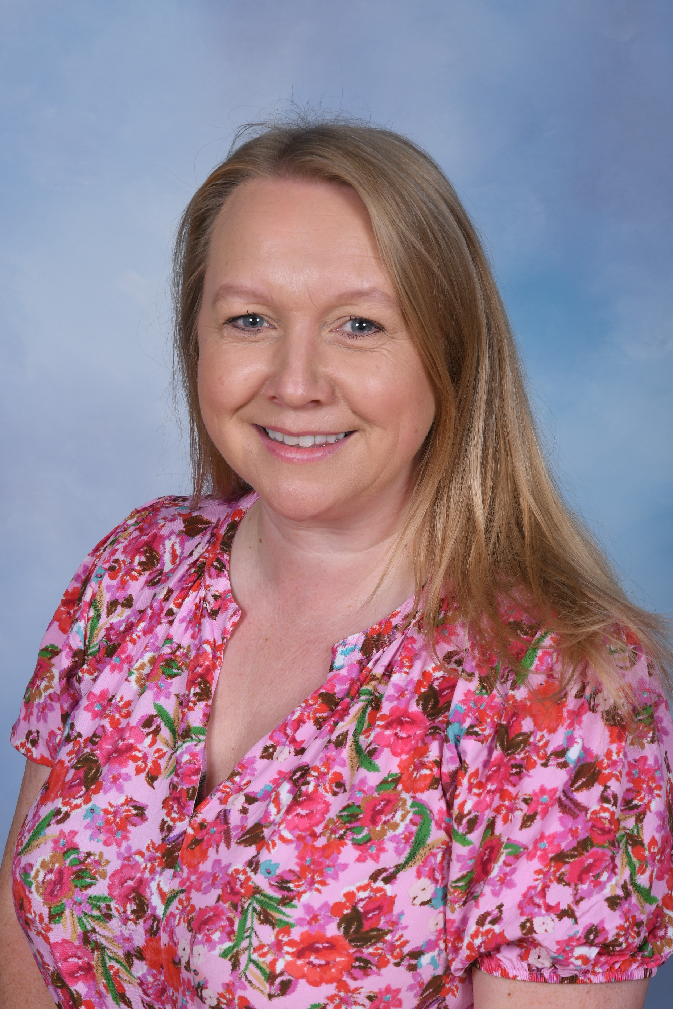
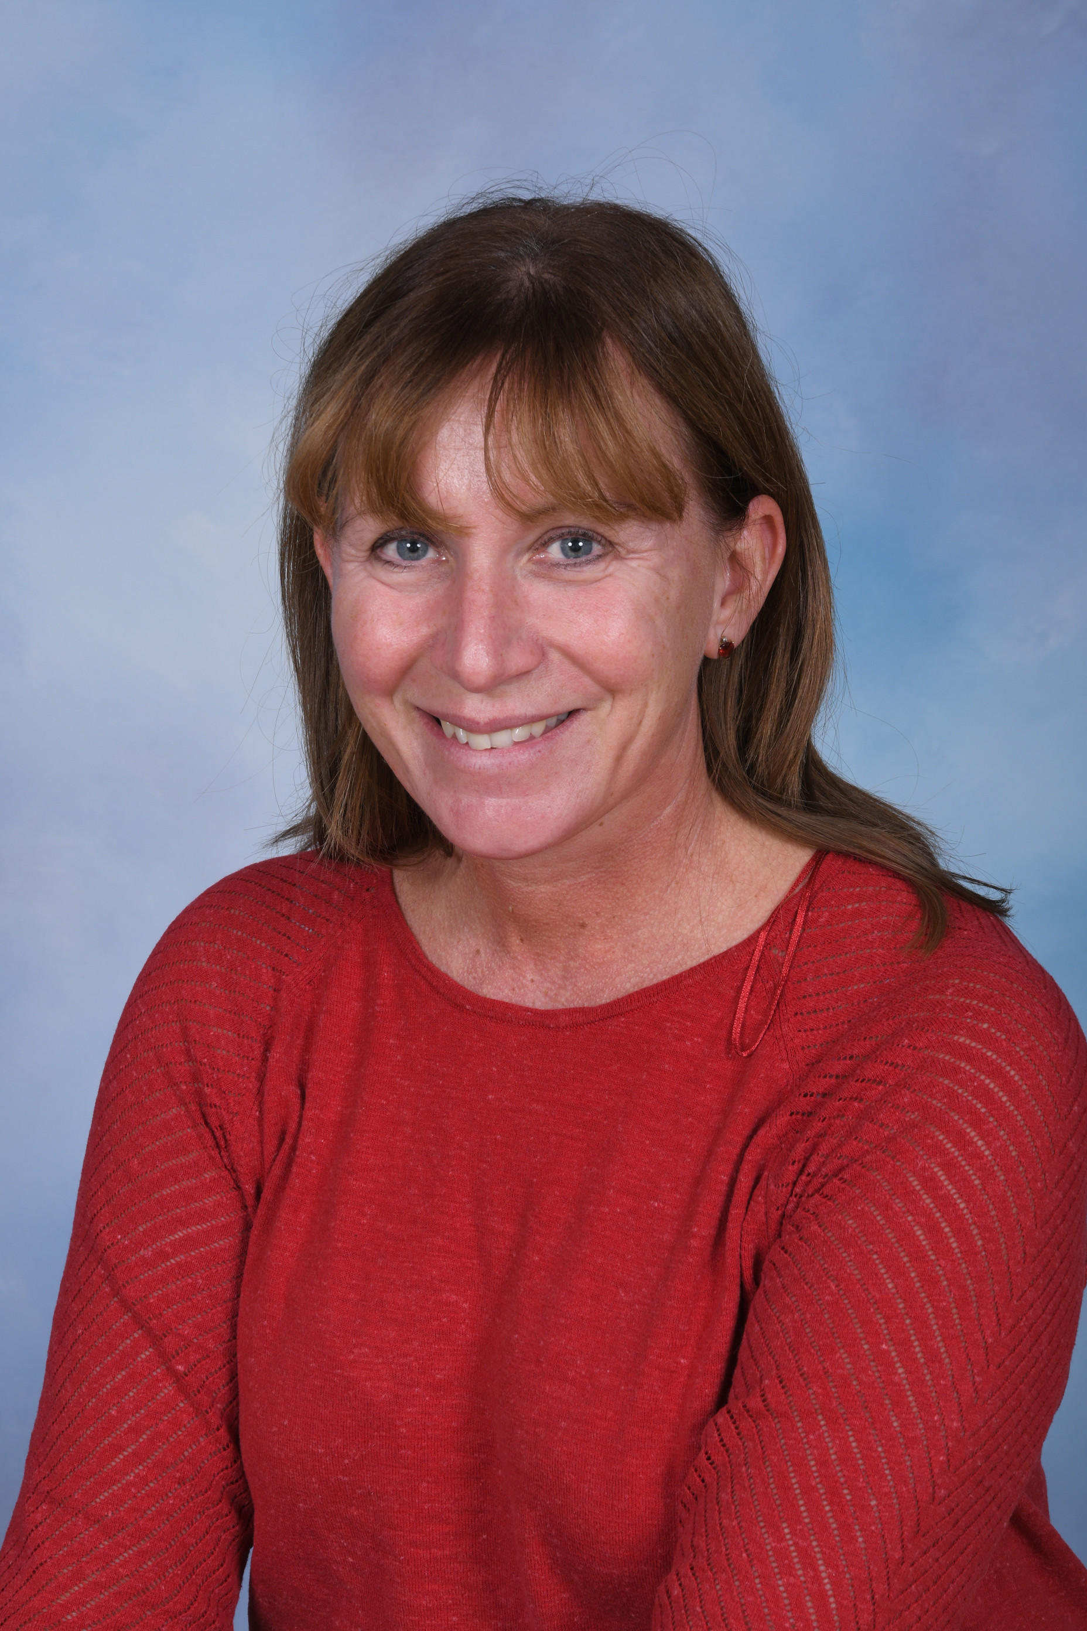
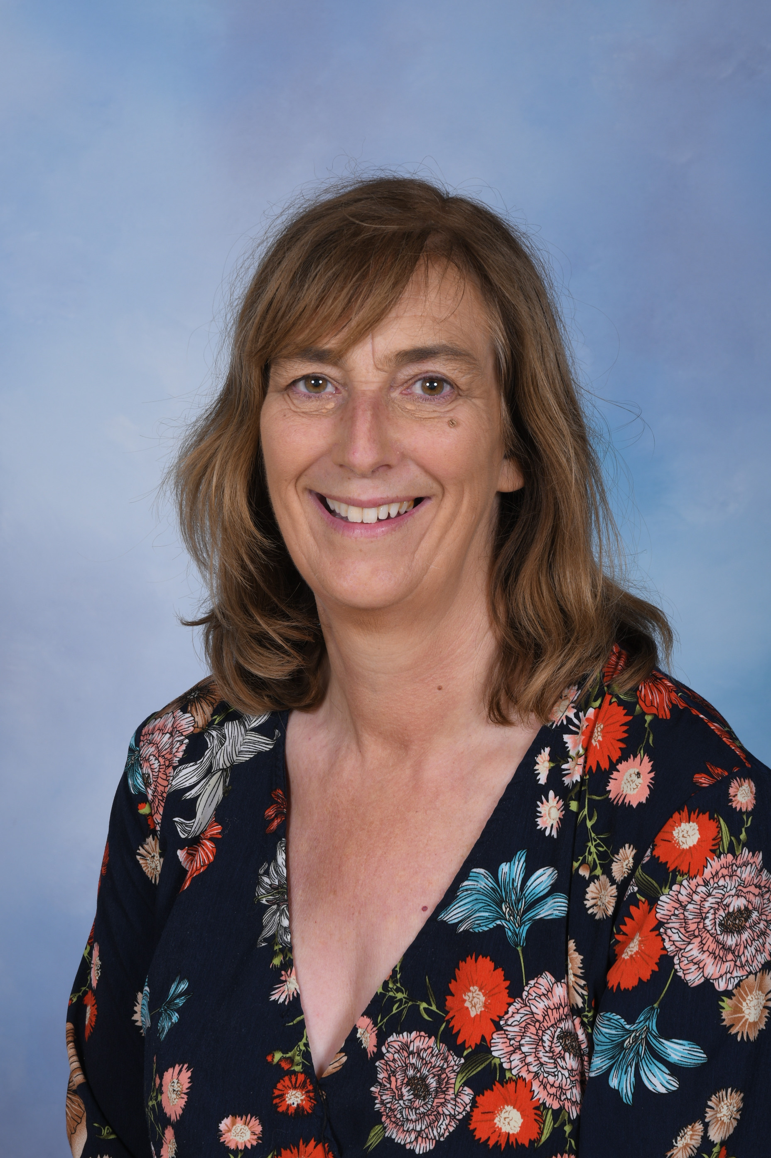
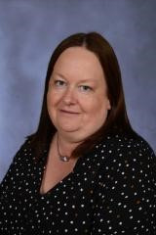

Meet the Reception Team
Mrs Jayne Wrangles
Early Years Leader
Cherry Tree Class Teacher
Mrs Claire Garvey
Cherry Tree Class Teacher
Mrs Karen Gow
Lime Tree Class Teacher
Mrs Paula Wilks
Cherry Tree Class TA
Lime Tree Class TA
Great Sankey Primary School
‘Together We Learn and Grow’

Slide 4
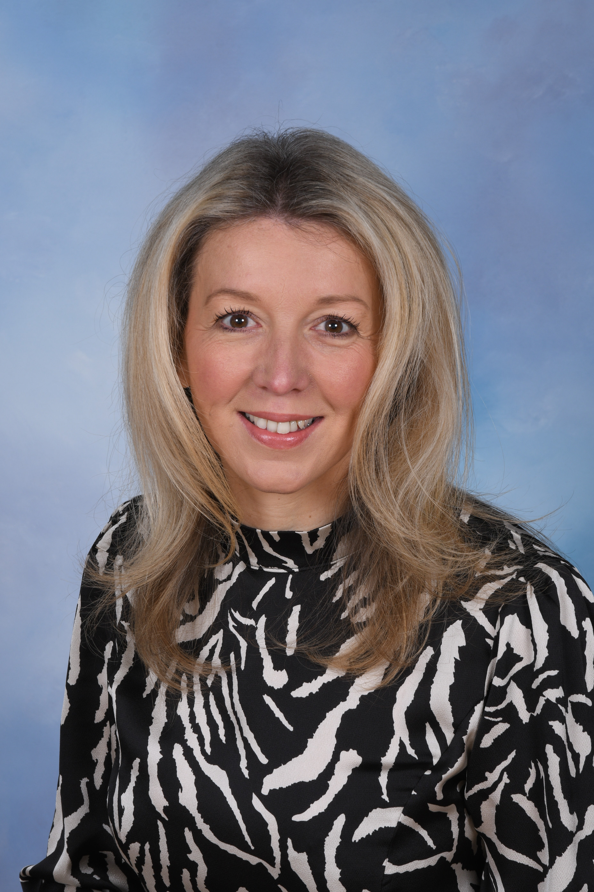
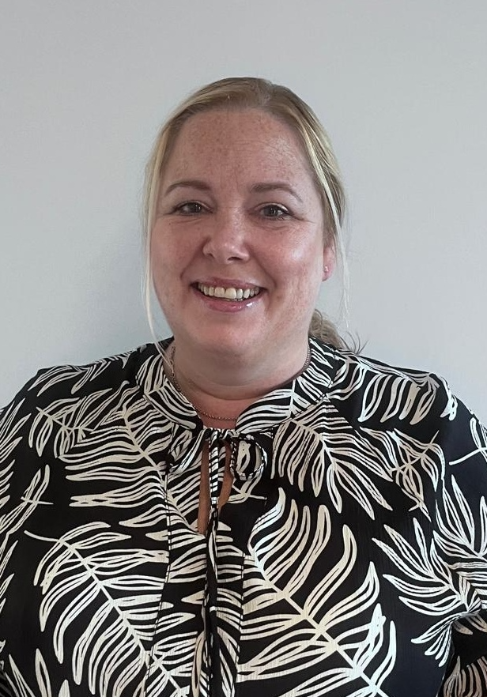
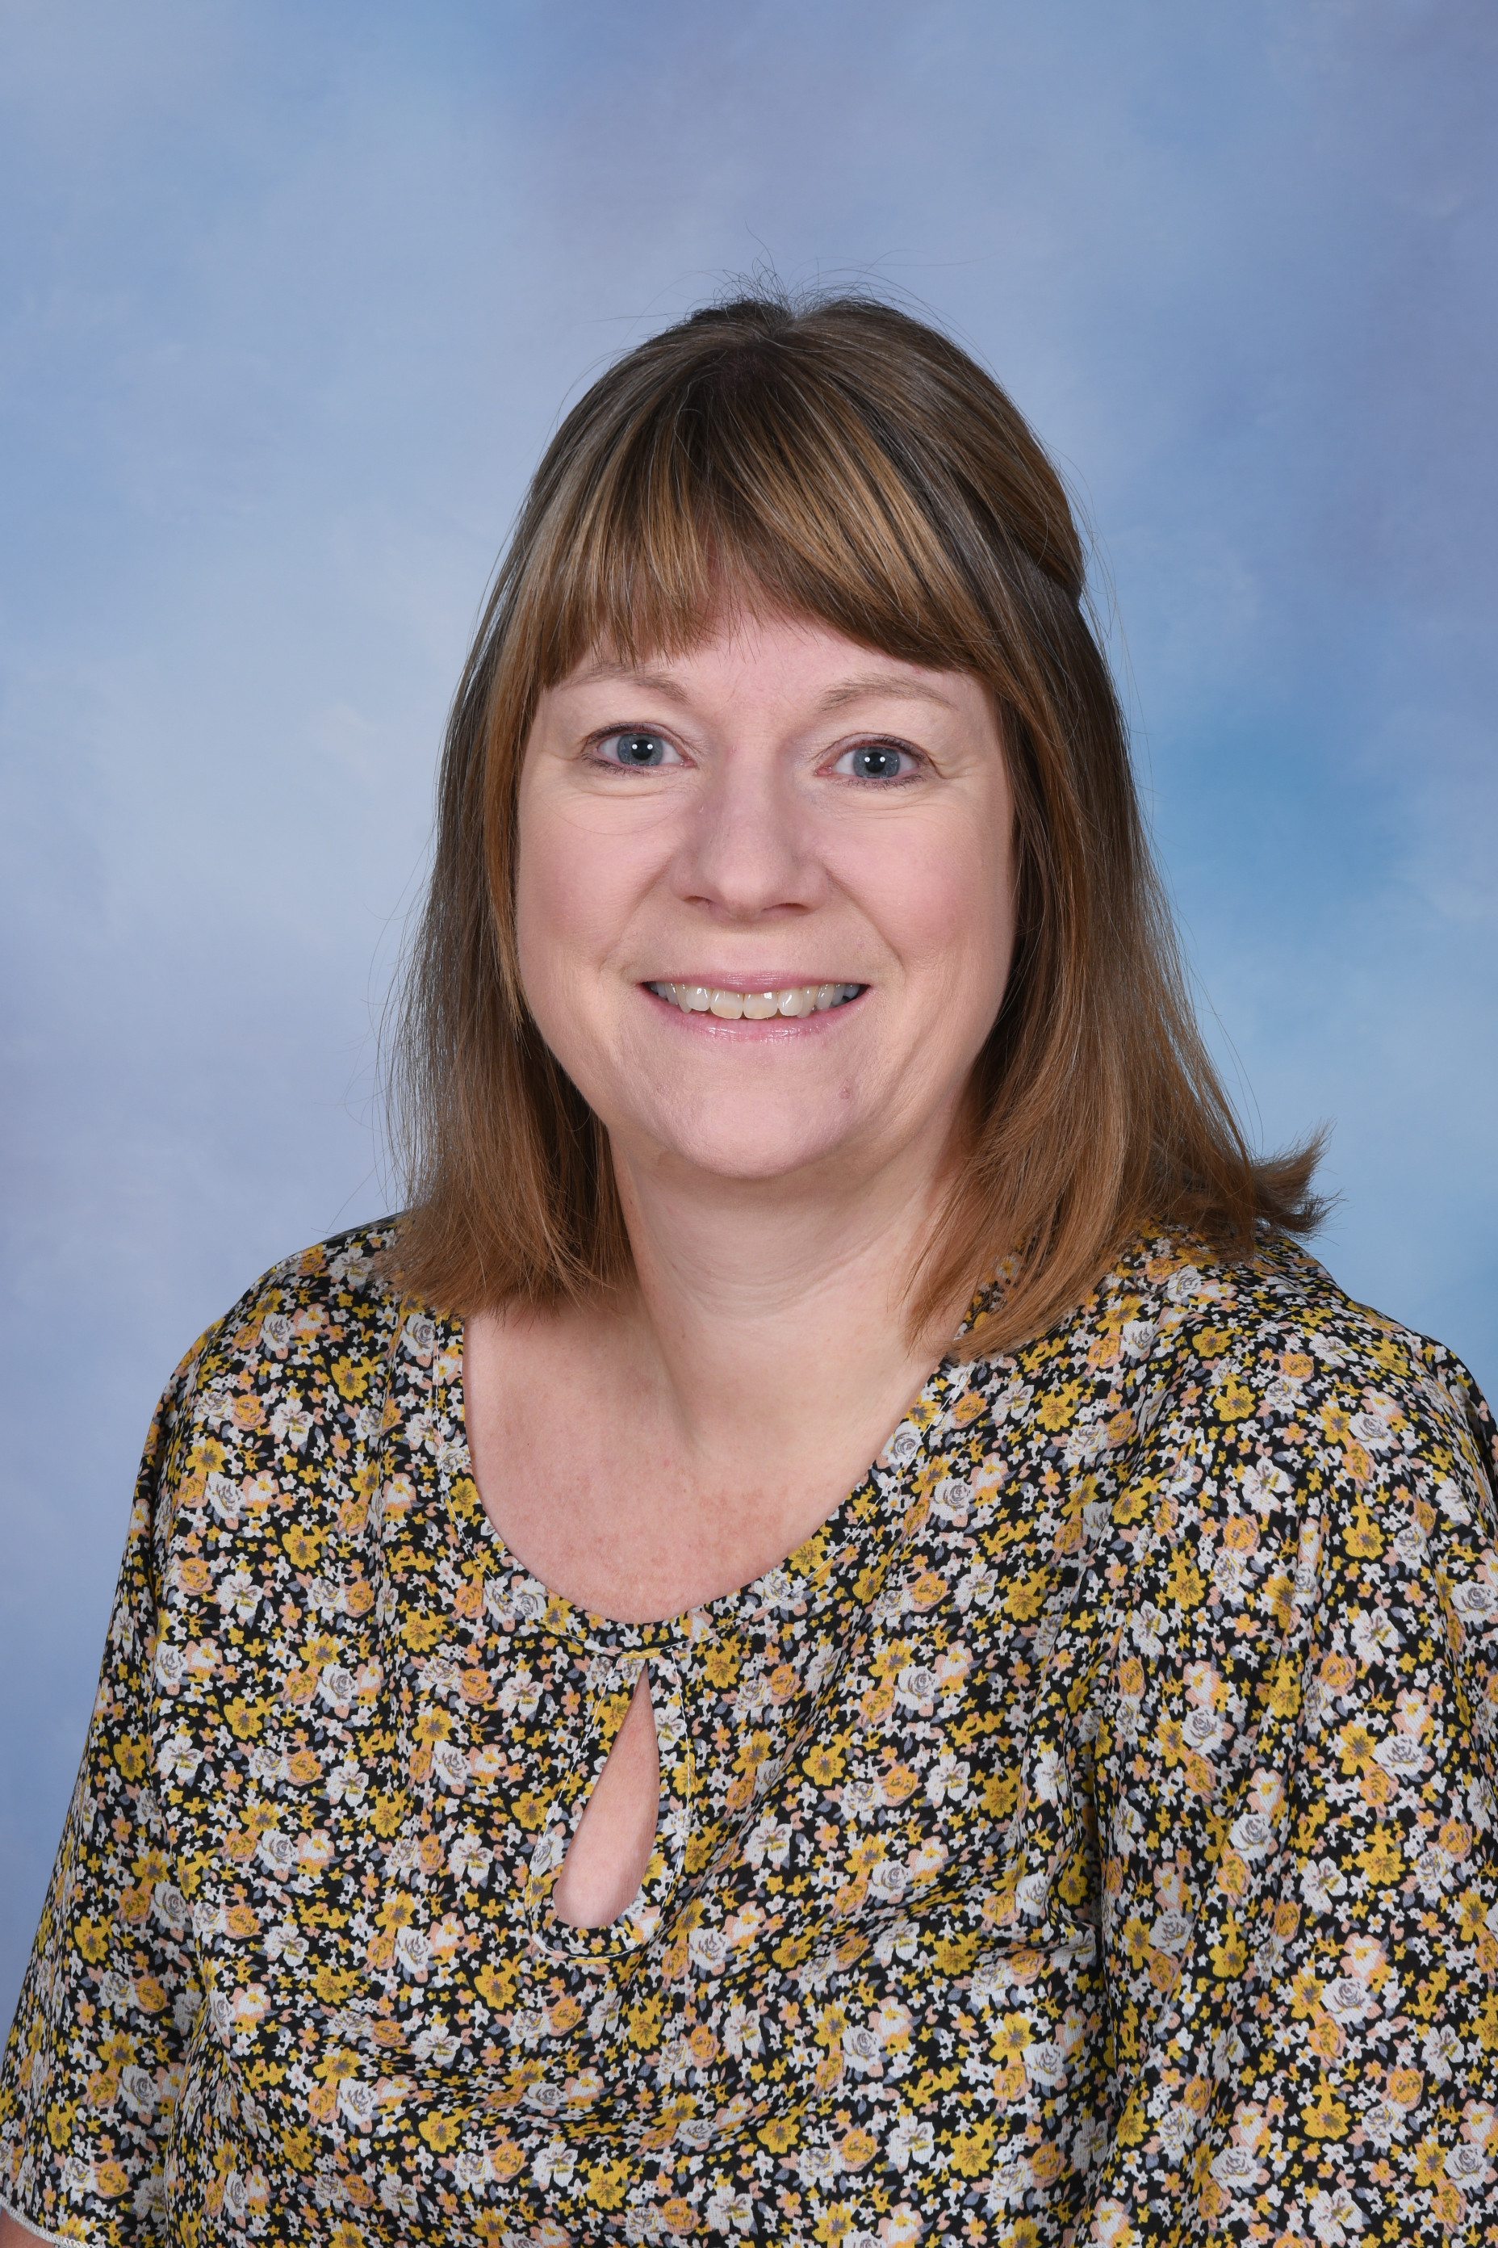

Meet the Team
Mrs Lisa Wilding
Headteacher
Mrs Lindsay Grigg
Deputy Headteacher
Mrs Nia Williams
SENDCo
Mr Matthew Hennessey
Senior Leader
(from September 26)
Great Sankey Primary School
‘Together We Learn and Grow’

Slide 5
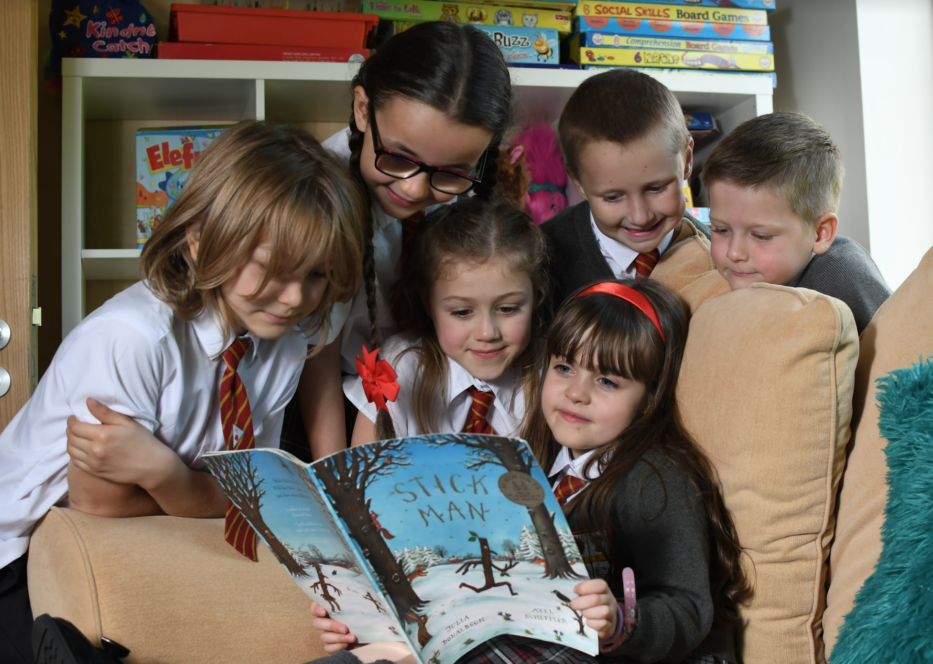
‘Together We Learn and Grow’
Inspire, Challenge, Support
Great Sankey Primary School
‘Together We Learn and Grow’

Slide 6

The GSP Core Values
Great Sankey Primary School
‘Together We Learn and Grow’

Slide 7

Your Transition Pack
A brief overview of contents
Great Sankey Primary School
‘Together We Learn and Grow’

Slide 8
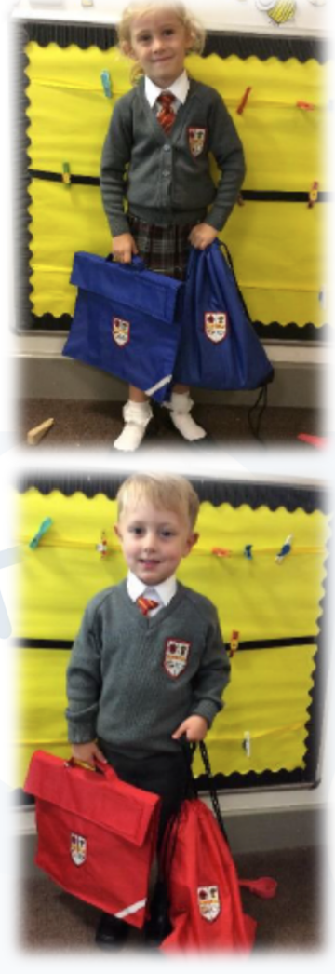




School Uniform
Website link to School Uniform Page
Great Sankey Primary School
‘Together We Learn and Grow’

Slide 9

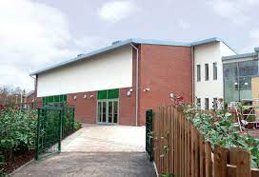
The School Day
School gates open from 8.30am
School starts at 8.45am and register is taken at 8.55 and closes at 9am
End of the day – 3.15pm
Information on how to report a pupil absence is in
the transition pack.
Great Sankey Primary School
‘Together We Learn and Grow’

Slide 10





Communication
How do we communicate with you?
Arbor
Weekly Digital Newsletters
Website
Google Classroom
Social Media
Face-to-Face
Parents’ Evenings
Academic Progress Formally Reported 3 x per year
Great Sankey Primary School
‘Together We Learn and Grow’

Slide 11
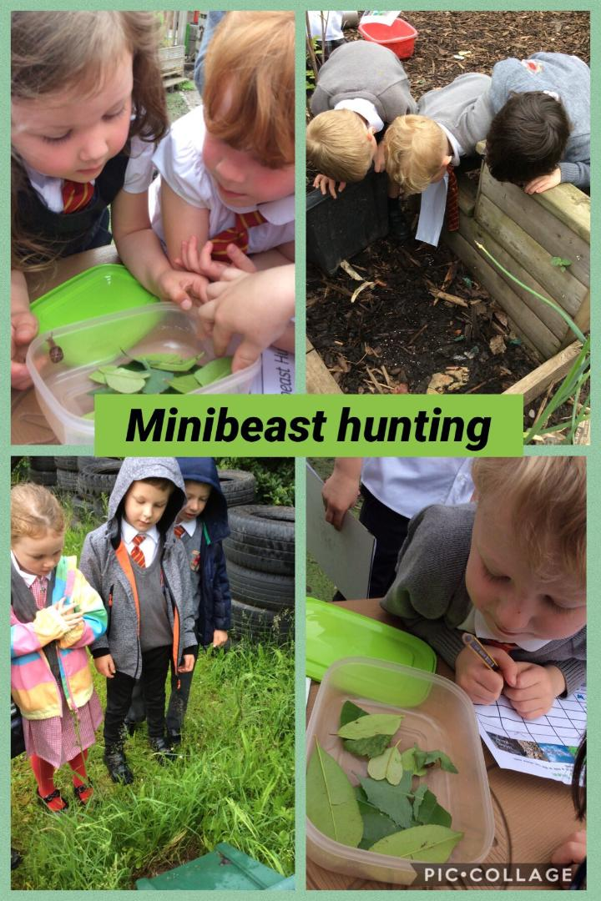
What to expect in the EYFS
Curriculum and learning
Centres around the 7 Areas of Learning
Teachers model positive interactions and communication
Establish secure daily routines
Build secure, respectful relationships
Learn to socialise: turn-taking, sharing
Carefully planned activities in the outdoor and indoor provision to allow the children to learn through high-quality play
Build in opportunities for daily phonics and maths focused teaching
Small group and 1:1 teaching
High-quality texts drive teacher-led learning
Child-led learning allows us to respond to pupils’ interest
Great Sankey Primary School
‘Together We Learn and Grow’

Slide 12


What to expect in the EYFS
Home Learning
Home learning in the Early Years centres around the core skill of reading
Share daily stories with your child if possible
Talk is important as it extends vocabulary and supports reading comprehension
When your child starts to bring reading books home, aim to read with them for 10 minutes daily or at least 3 times a week
‘Key’ word keyrings will be sent home to practise – 5 minutes a day if possible
Work on phonic sounds to reinforce classroom learning
Ten Town - online maths program to practise core number skills
Great Sankey Primary School
‘Together We Learn and Grow’

Slide 13
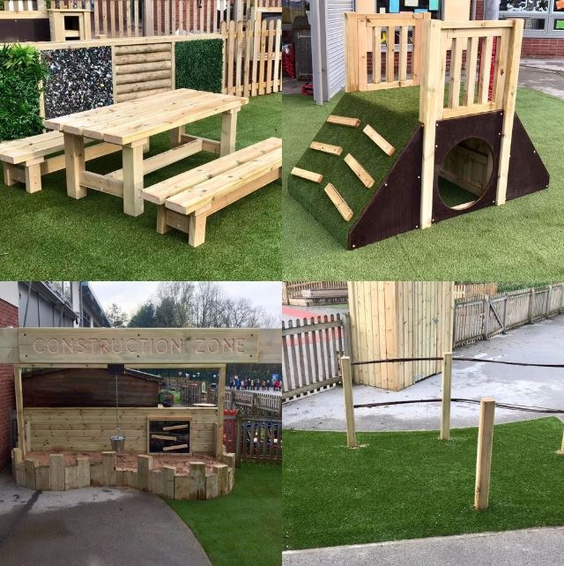
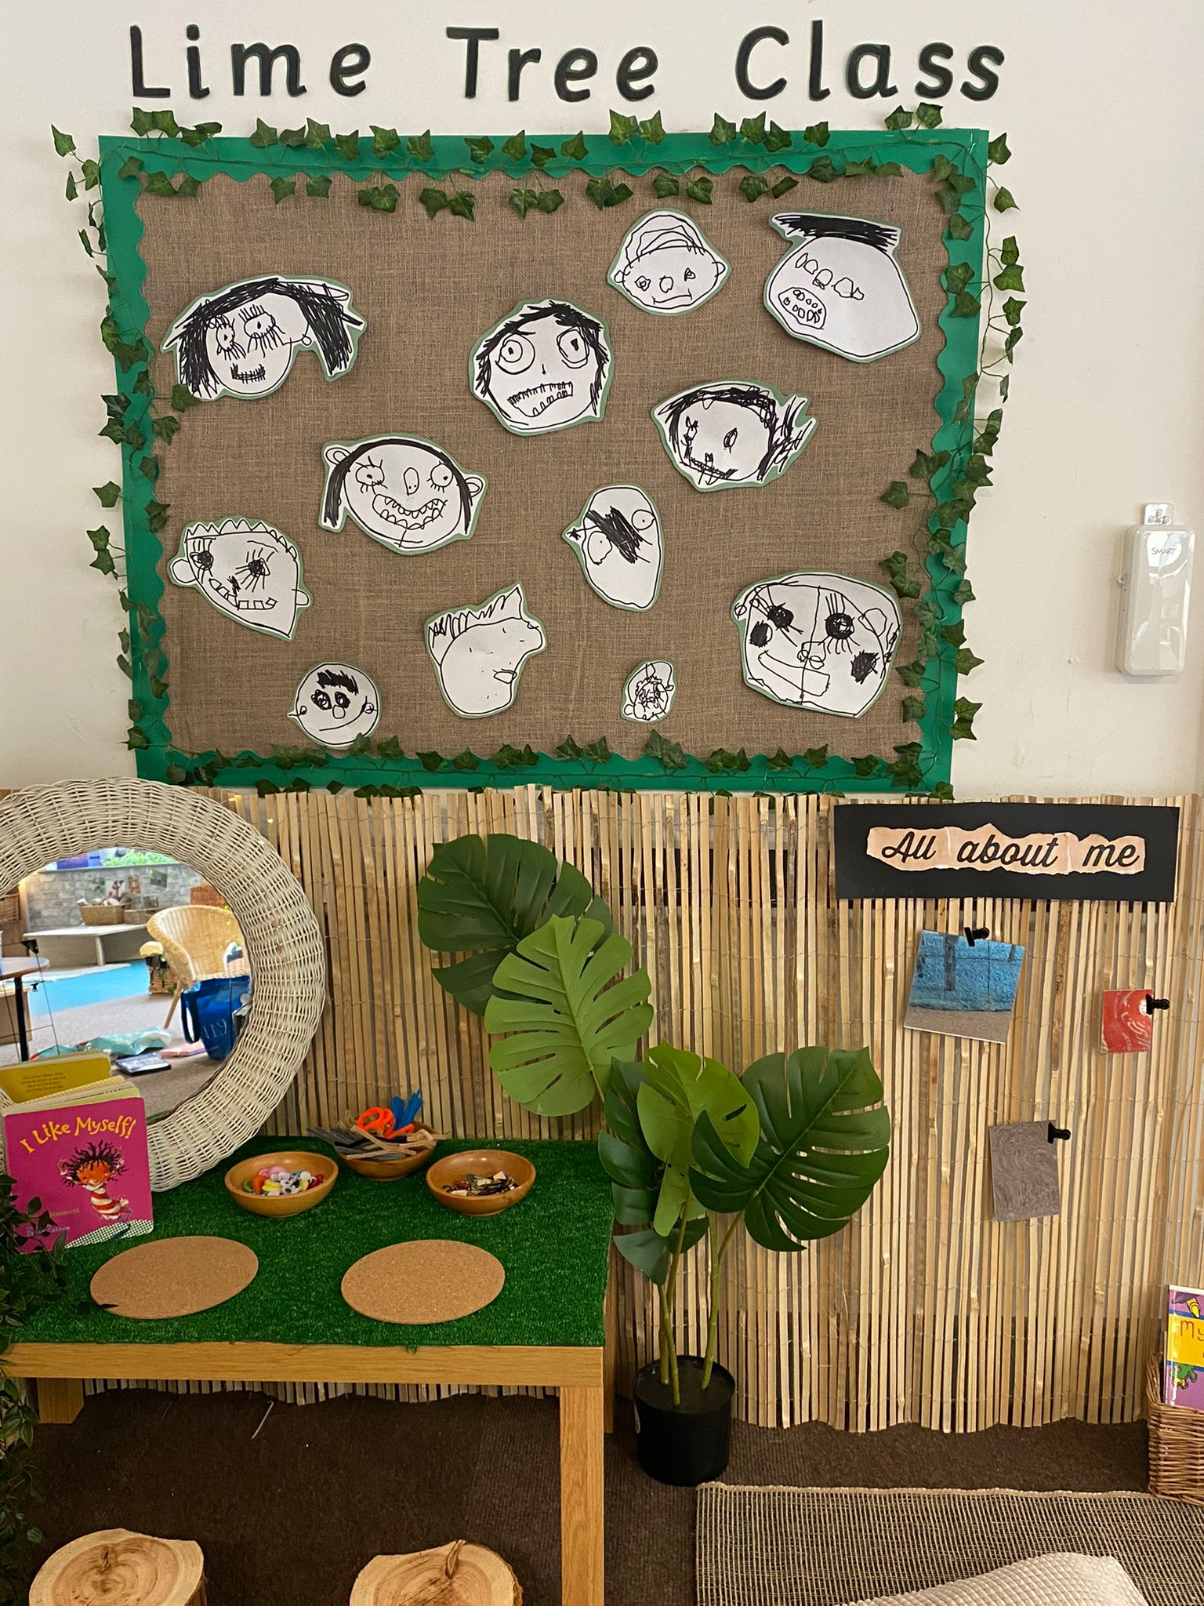
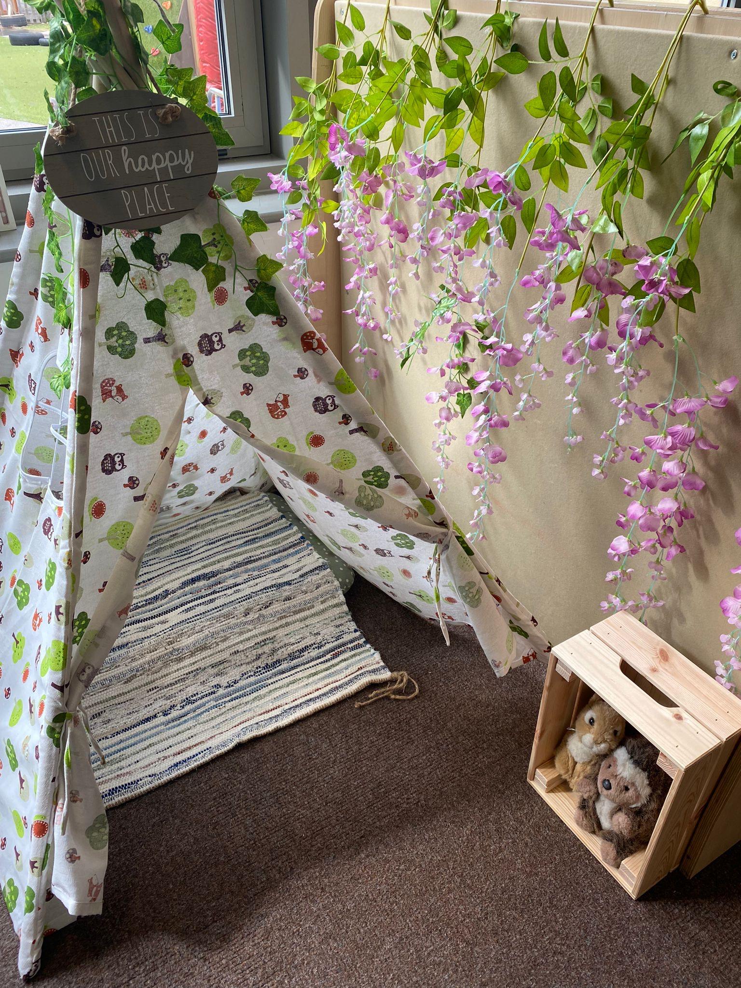
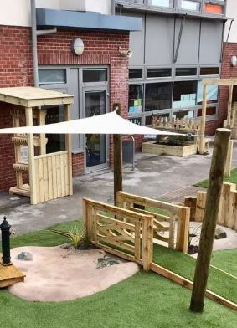
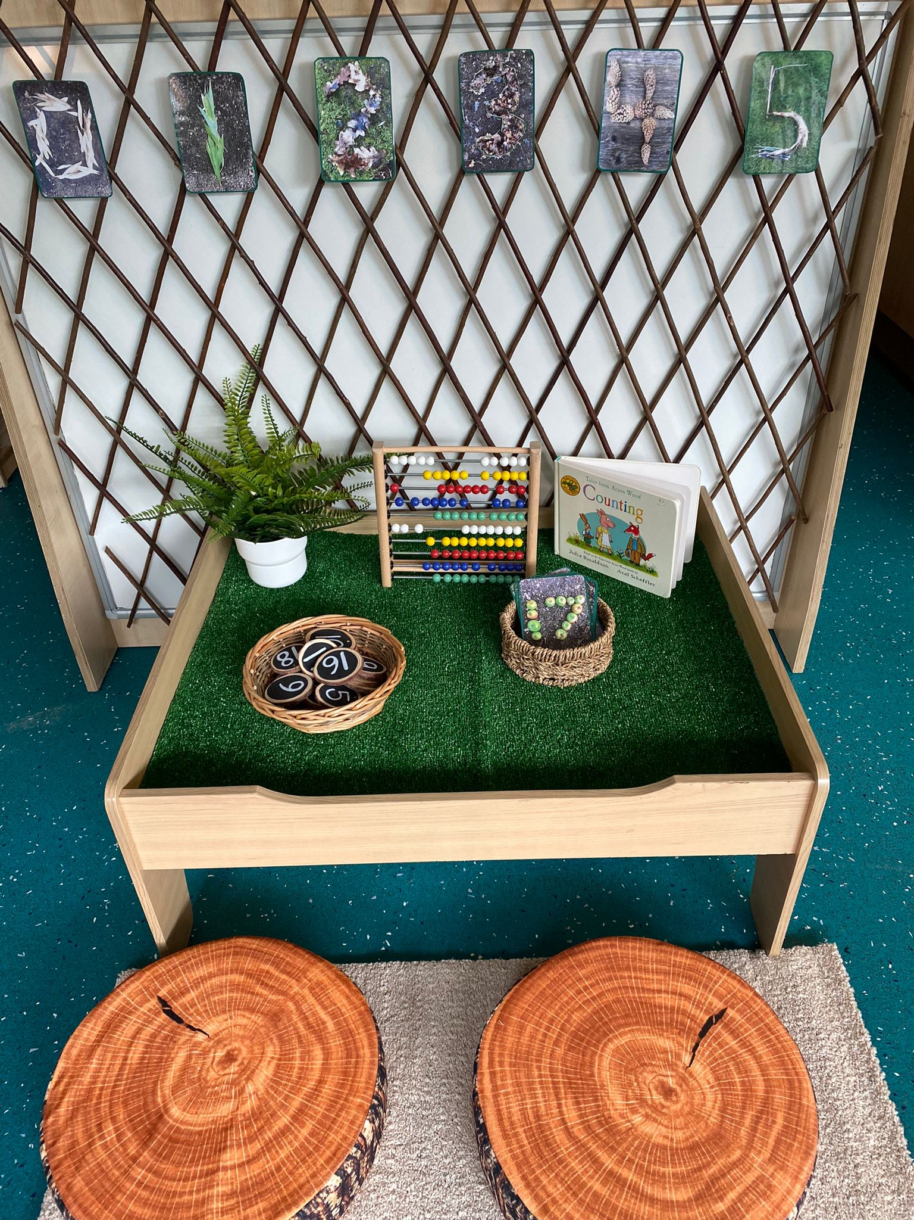
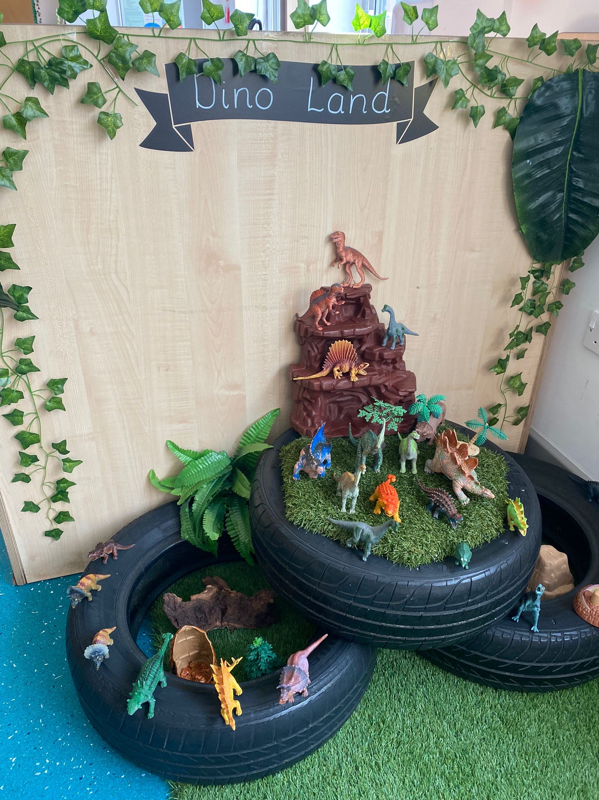
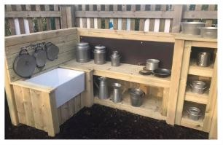
The Environment
Great Sankey Primary School
‘Together We Learn and Grow’

Slide 14
How to help prepare your child for school
Visit our website and look at the Cherry Tree / Lime Tree class pages to see the fun things we do
Add us on social media to see what the children in our Reception classes are learning about
Talk to the children about how they will make lots of new friends and have lots of fun
Walk / drive past school making it a familiar place to the children
Discuss all the fun things you did at school yourselves
Explain to the children that at the moment you read their bedtime story but very soon they will be able to read stories to them
Great Sankey Primary School
‘Together We Learn and Grow’

Slide 15

How to help prepare your child for school
Practise putting on their own coat / cardigan / jumper / shoes
Ensure that children can use the bathroom independently
Play turn taking and sharing games
Share stories daily
Point out numbers and letters / words in the environment
Teach children how to use a knife and fork independently
Help your child to recognise their name so that they can identify their own belongings
Great Sankey Primary School
‘Together We Learn and Grow’

Slide 16
Data Sheets
Data sheets - please return these on the July visit
House groups, your transition pack details which house your child will be in and this dictates the colour of book bag and PE top
Holiday dates - please refer to this when booking family holidays, we cannot authorise any holidays taken in term time
Photo / video consent - in order to post pictures on our social media pages and newsletters or to record performances such as our school Nativity, we require your consent, please complete and return with the data sheet
Great Sankey Primary School
‘Together We Learn and Grow’

Slide 17
Information and transition dates
Tonight is an opportunity for you to tell us anything you feel we need to know about your child’s individual needs.
Reception staff have already been / are contacting nurseries / childcare providers to discuss your children.
Dates when your child can visit school in July can be found in your pack. Please try to attend these each of these sessions if you can.
There will be a short, staggered start to school in September to allow children to settle into their new environment smoothly and calmly. Dates for these settling days can be found in your pack.
Great Sankey Primary School
‘Together We Learn and Grow’

Slide 18


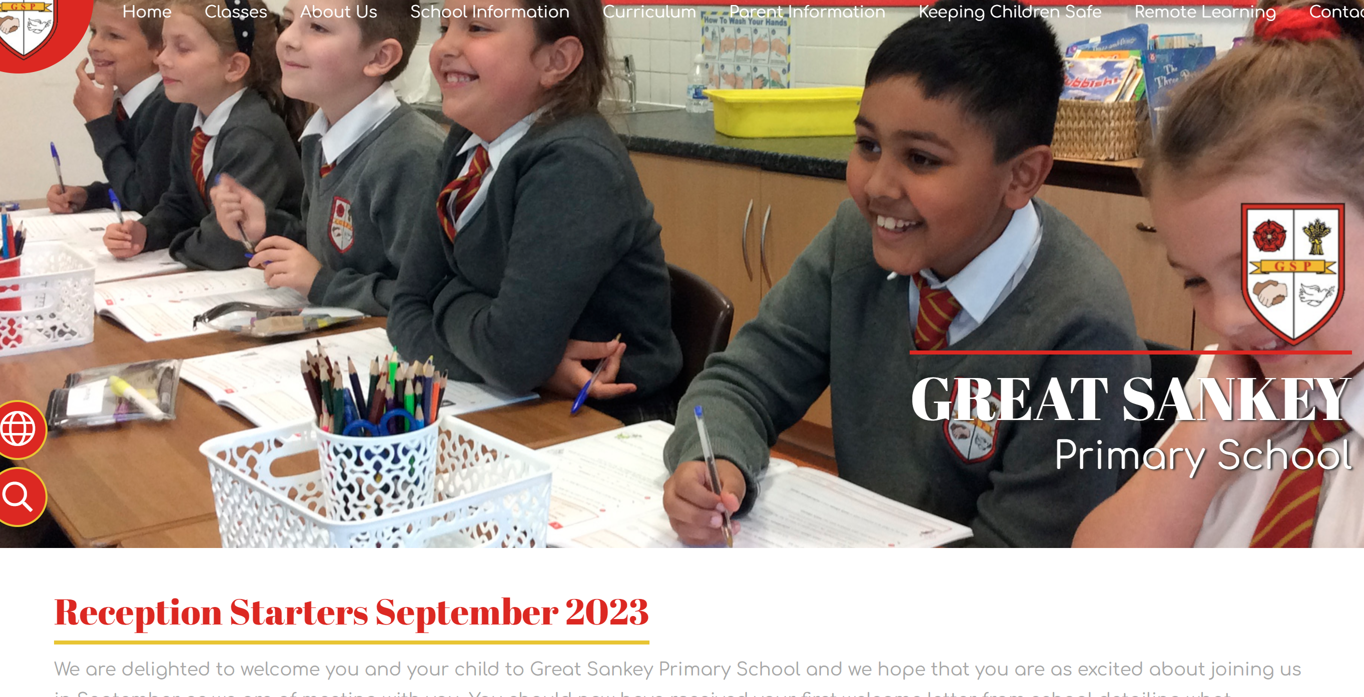
Need to know more?
Start to follow us on Twitter:
@Cherrytreeclass
@lime_class
@GtSankeyPrimary
https://www.greatsankeyprimaryschool.co.uk/
School Prospectus
Website Link to New Reception Starters Information
Great Sankey Primary School
‘Together We Learn and Grow’

Slide 19

Contact us:
Tel: 01925 728176
Email: admin@greatsankeyprimary.tcat.uk.com
Great Sankey Primary School
‘Together We Learn and Grow’

