Slide 1


Welcome to Reception
Stay and Play - PSED
Feb 2025
Great Sankey Primary School
‘Together We Learn and Grow’

Slide 2
Thank you for your coming to see us this morning, we really appreciate you taking the time to come into school.
As with all aspects of school life, partnership working is essential to give our children the best possible start.
Today as it is the start of Children’s Mental Health Week, so we are going to be thinking about
Personal, Social and Emotional Development.
Great Sankey Primary School
‘Together We Learn and Grow’
Notes:
Welcome back
Hope you’ve had a great summer, well rested, relaxed.
Great to see so many of your photos on FB, Steph’s tik toks!
Congratulations to Granny Jo – Brody
Run through the day

Slide 3

What is PSED?
Why is it so important?
How does it look in school?
How can you support with this at home?
Great Sankey Primary School
‘Together We Learn and Grow’
Notes:
Welcome back
Hope you’ve had a great summer, well rested, relaxed.
Great to see so many of your photos on FB, Steph’s tik toks!
Congratulations to Granny Jo – Brody
Run through the day

Slide 4
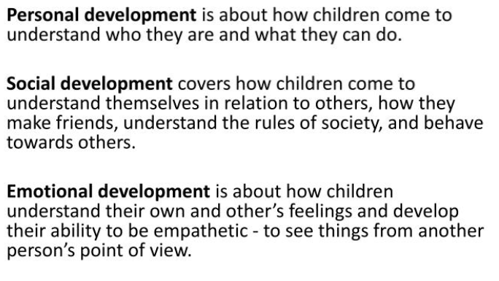
What is PSED?
Great Sankey Primary School
‘Together We Learn and Grow’
Notes:
Welcome back
Hope you’ve had a great summer, well rested, relaxed.
Great to see so many of your photos on FB, Steph’s tik toks!
Congratulations to Granny Jo – Brody
Run through the day

Slide 5
What does PSED look like in school?
Managing Self
Be confident to try new activities and show independence, resilience and perseverance in the face of challenge;
Explain the reasons for rules, know right from wrong and try to behave accordingly;
Manage their own basic hygiene and personal needs, including dressing, going to the toilet and understanding the importance of healthy food choices.
Self-Regulation
Show an understanding of their own feelings and those of others, and begin to regulate their behaviour accordingly;
Set and work towards simple goals, being able to wait for what they want and control their immediate impulses when appropriate;
Give focused attention to what the teacher says, responding appropriately even when engaged in activity, and show an ability to follow instructions involving several ideas or actions.
Building Relationships
Children at the expected level of development will:
Work and play cooperatively and take turns with others;
Form positive attachments to adults and friendships with peers;
Show sensitivity to their own and to others’ needs.
Great Sankey Primary School
‘Together We Learn and Grow’
Notes:
Welcome back
Hope you’ve had a great summer, well rested, relaxed.
Great to see so many of your photos on FB, Steph’s tik toks!
Congratulations to Granny Jo – Brody
Run through the day

Slide 6
How can you help to develop your child’s PSED at home?
When you remind children to ask for something politely you are helping them to become socially competent.
By reminding children to thank people who help them you are passing on important social skills.
Helping your child to do things for others eg:- making a card for somebody who has a birthday or giving away toys they no longer play with.
Talk to your child about feelings - it may be that they are afraid of something they have seen, or a noise they have heard. Dismissing fears often creates bigger ones.
When you help a child to express their feelings, they understand that their feelings are only temporary. Sharing your own feelings and explaining how you feel helps a child to understand that feelings can be managed.
Children love to observe how we treat others and emulate this in their own play ☺
We follow a programme “My Happy Mind” to support positive mental health, this can be accessed from home.
Great Sankey Primary School
‘Together We Learn and Grow’
Notes:
This is the new Team GSP
Very proud to be the new HT of this school and to work alongside you all.
Thank you for all the lovely messages before the summer, meant a great deal to know you’re all behind me and supporting me and I hope I serve you all well
Jane de Foy ‘ you’re not one of those are you, you know a new broom sweeps clean?’ made me laugh but on reflection made me think about how you all must be feeling. A significant change such as a new HT can lead to some of you feeling unsettled and a bit nervous – reassurance. Strength of the team.
Book Imperfect leadership ‘page 55’. Great book and has some great advice for new Headteachers.

Slide 7
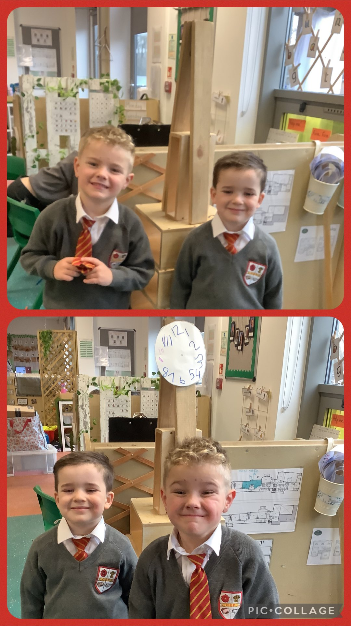
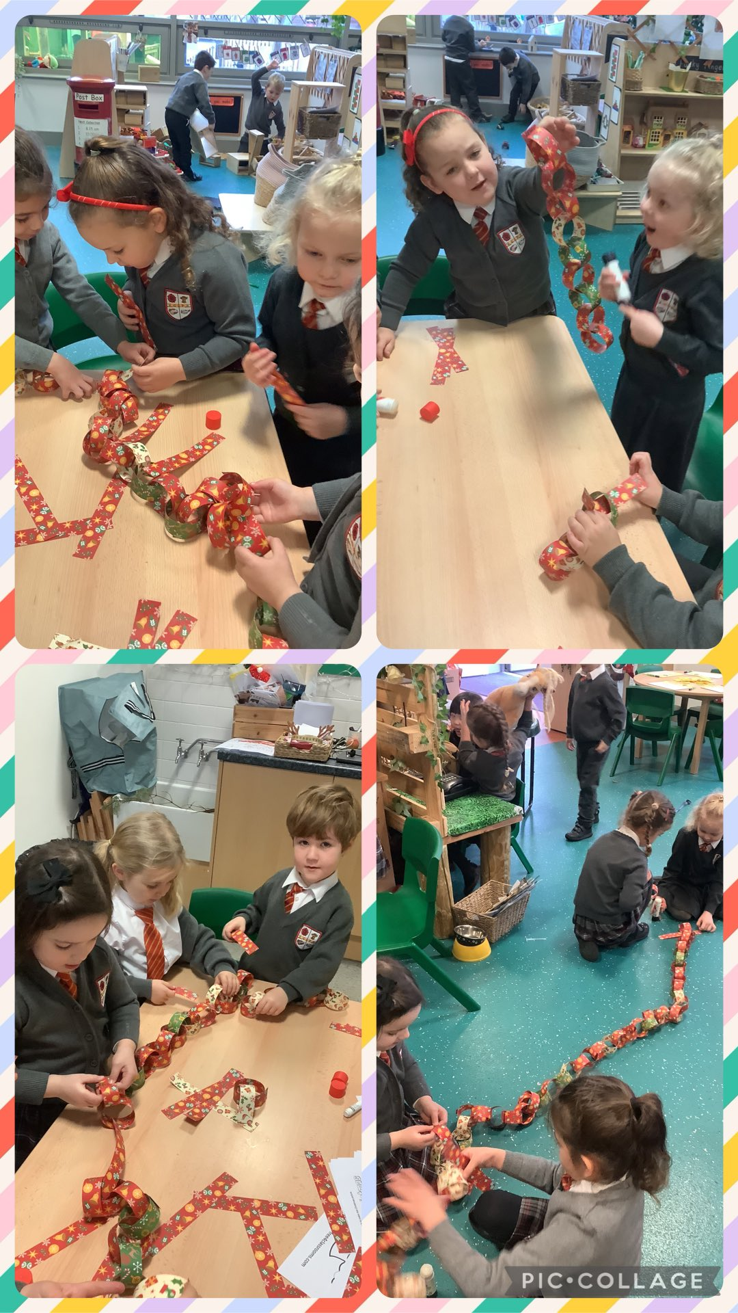
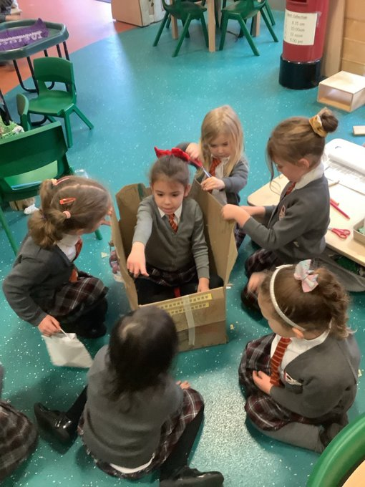
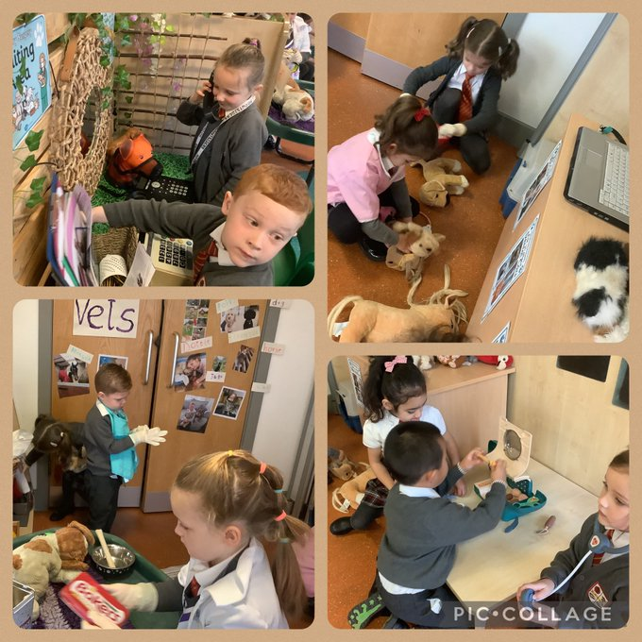
Great Sankey Primary School
‘Together We Learn and Grow’
Notes:
This is a time of change for our school so it’s a good time to stop and take stock and reflect. We’ll start with our vision. The school’s vision should be a shared vision where everyone buys into it – when was the last time we looked at it collectively? Today is a good opportunity.
Read through
Children are at the heart as they always should be. Everything we do comes down to benefit them. Could this be an opportunity to stop, reflect and to tweak some of our practice?
Do we do some of the things we do because we’ve always done them? Is there a better way? Referred to in the book as the Christmas tree effect – not saying this is what we do but sometimes – any changes we make or additions have been measured and based on research and this needs to continue. Now is a good time to shape our practice so we’re going to carry out a short exercise in teams.

Slide 8
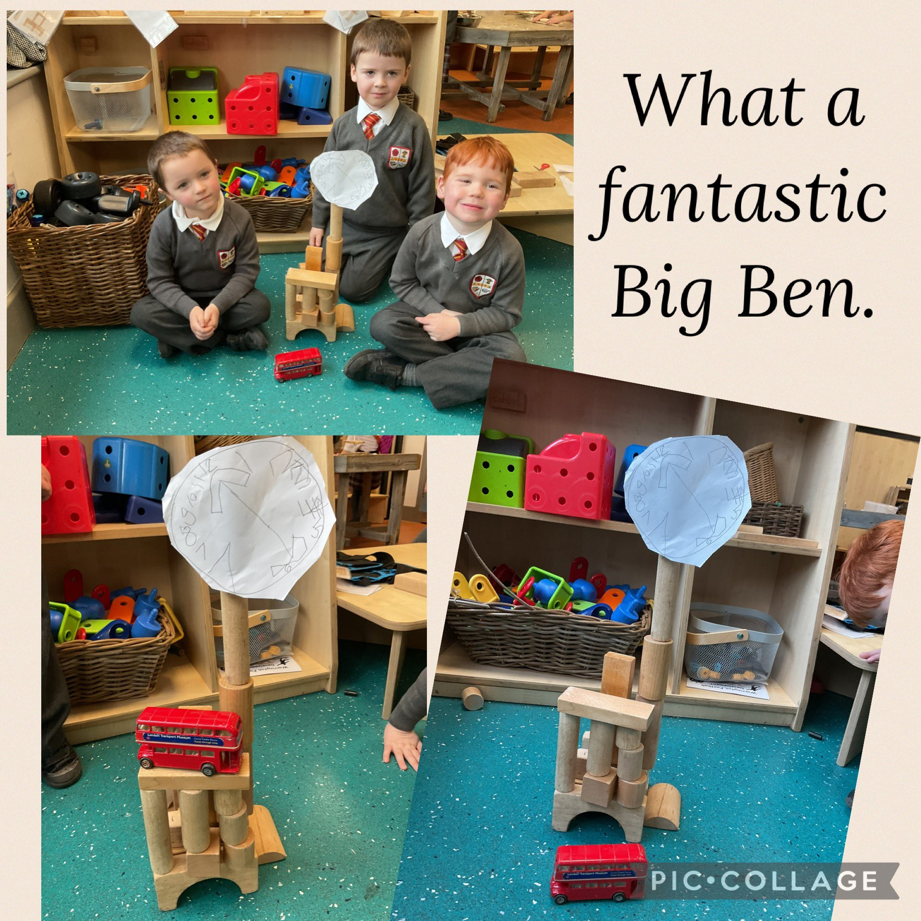
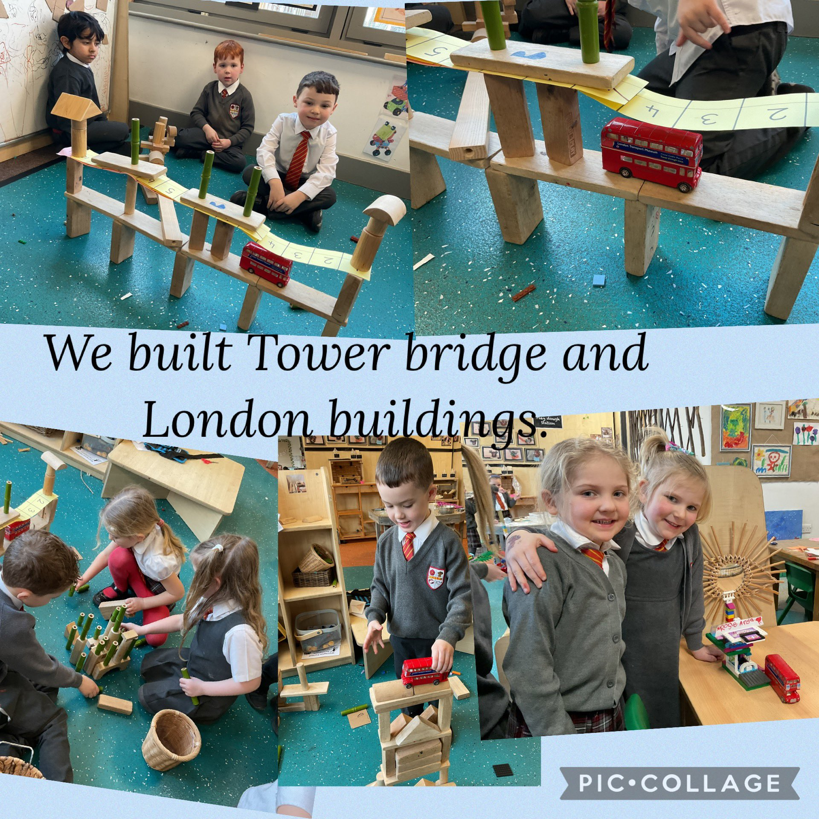
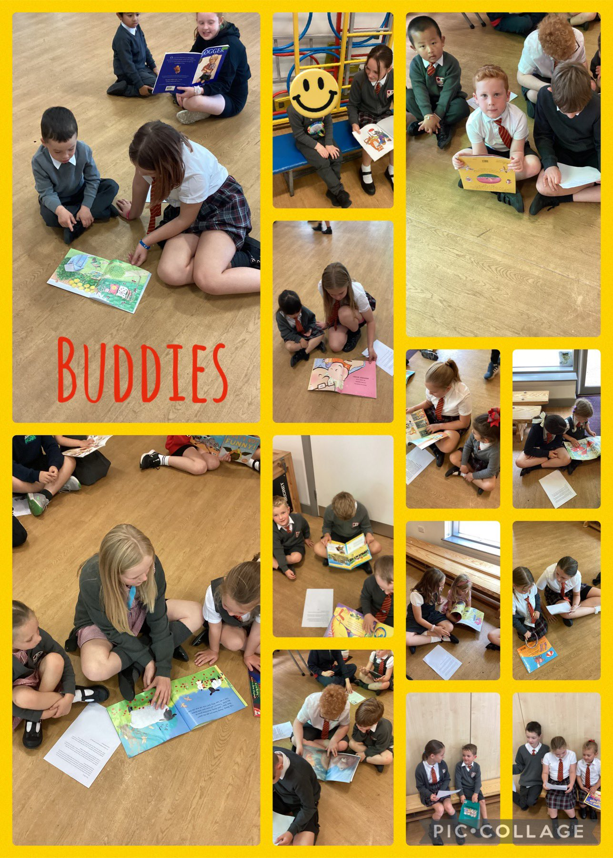
Great Sankey Primary School
‘Together We Learn and Grow’
Notes:
This is a time of change for our school so it’s a good time to stop and take stock and reflect. We’ll start with our vision. The school’s vision should be a shared vision where everyone buys into it – when was the last time we looked at it collectively? Today is a good opportunity.
Read through
Children are at the heart as they always should be. Everything we do comes down to benefit them. Could this be an opportunity to stop, reflect and to tweak some of our practice?
Do we do some of the things we do because we’ve always done them? Is there a better way? Referred to in the book as the Christmas tree effect – not saying this is what we do but sometimes – any changes we make or additions have been measured and based on research and this needs to continue. Now is a good time to shape our practice so we’re going to carry out a short exercise in teams.

Slide 9
PSED underpins everything we do in class. We are developing our PSED when we:-
Share and take turns
Invite a friend to play
Show empathy towards others
Show resilience when we find things tricky
Follow the golden rules
Make a healthy food choice
Speak to an adult about how we are feeling
Great Sankey Primary School
‘Together We Learn and Grow’
Notes:
This is the new Team GSP
Very proud to be the new HT of this school and to work alongside you all.
Thank you for all the lovely messages before the summer, meant a great deal to know you’re all behind me and supporting me and I hope I serve you all well
Jane de Foy ‘ you’re not one of those are you, you know a new broom sweeps clean?’ made me laugh but on reflection made me think about how you all must be feeling. A significant change such as a new HT can lead to some of you feeling unsettled and a bit nervous – reassurance. Strength of the team.
Book Imperfect leadership ‘page 55’. Great book and has some great advice for new Headteachers.

Slide 10
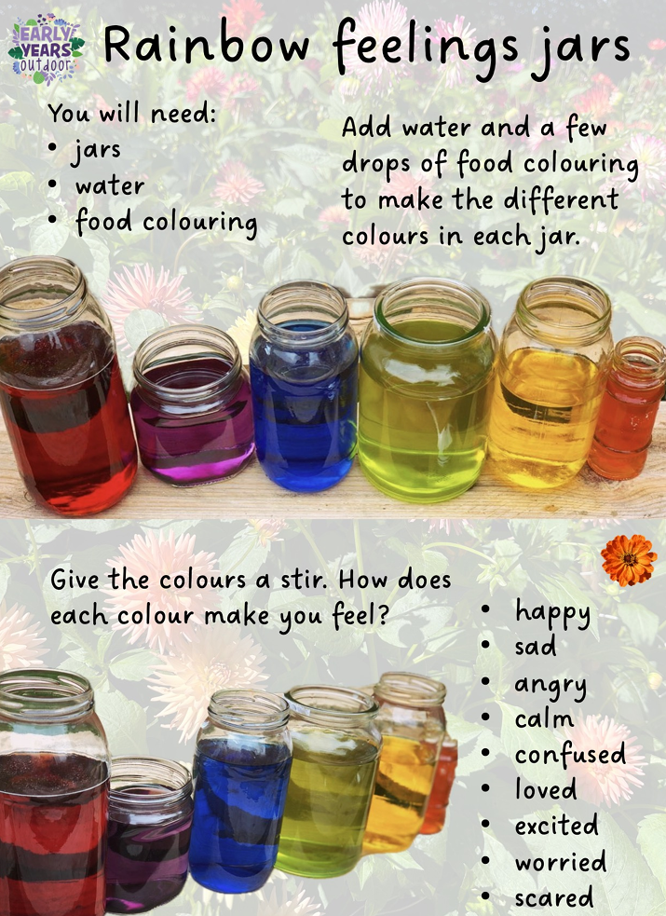
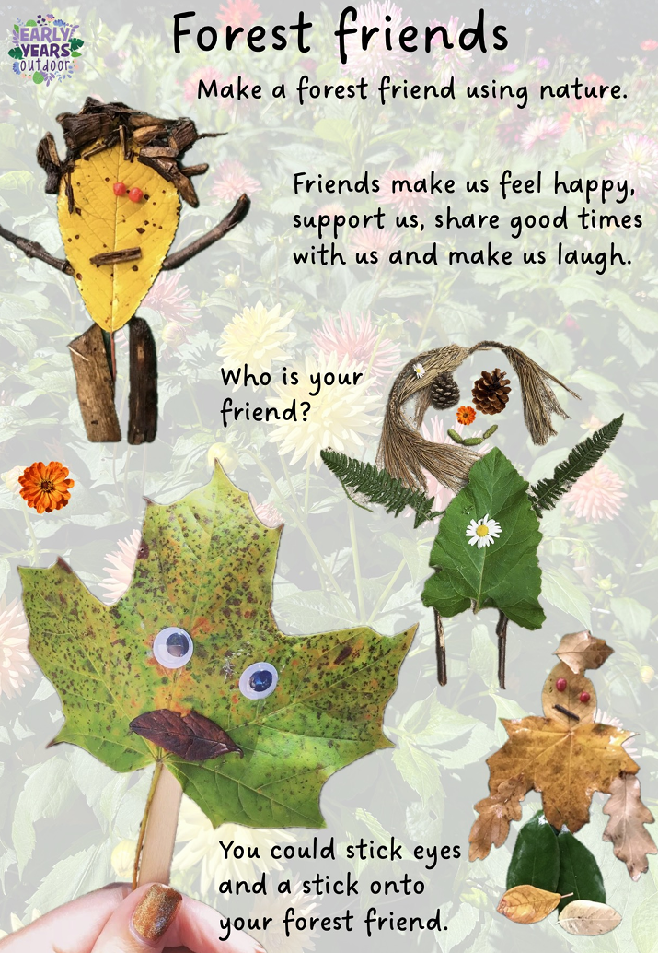
Great Sankey Primary School
‘Together We Learn and Grow’
Notes:
This is a time of change for our school so it’s a good time to stop and take stock and reflect. We’ll start with our vision. The school’s vision should be a shared vision where everyone buys into it – when was the last time we looked at it collectively? Today is a good opportunity.
Read through
Children are at the heart as they always should be. Everything we do comes down to benefit them. Could this be an opportunity to stop, reflect and to tweak some of our practice?
Do we do some of the things we do because we’ve always done them? Is there a better way? Referred to in the book as the Christmas tree effect – not saying this is what we do but sometimes – any changes we make or additions have been measured and based on research and this needs to continue. Now is a good time to shape our practice so we’re going to carry out a short exercise in teams.

Slide 11
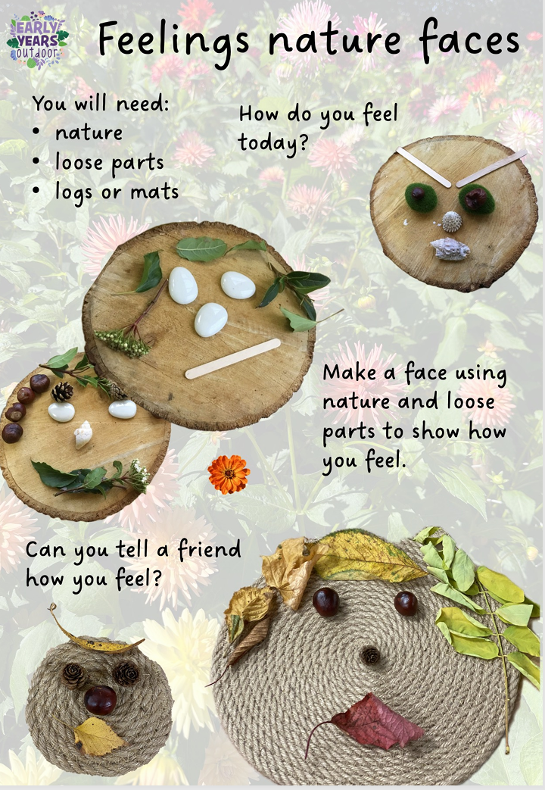
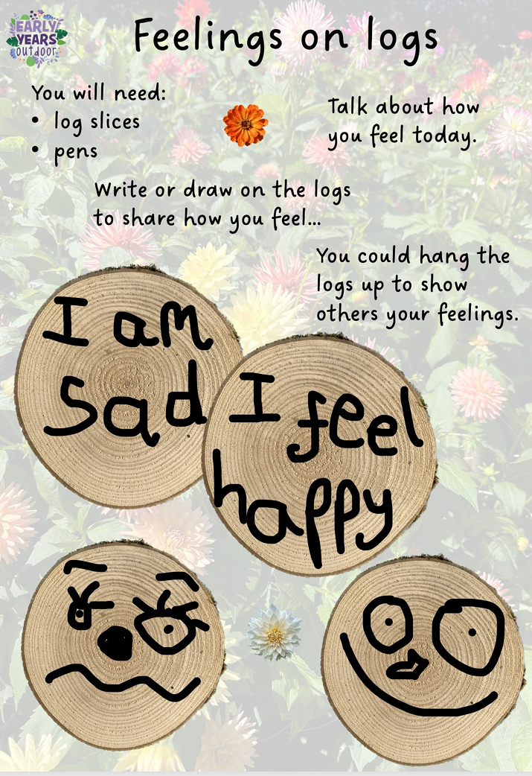
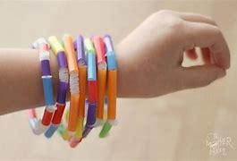
A few of the fun activities awaiting you in class ☺
Great Sankey Primary School
‘Together We Learn and Grow’
Notes:
This is a time of change for our school so it’s a good time to stop and take stock and reflect. We’ll start with our vision. The school’s vision should be a shared vision where everyone buys into it – when was the last time we looked at it collectively? Today is a good opportunity.
Read through
Children are at the heart as they always should be. Everything we do comes down to benefit them. Could this be an opportunity to stop, reflect and to tweak some of our practice?
Do we do some of the things we do because we’ve always done them? Is there a better way? Referred to in the book as the Christmas tree effect – not saying this is what we do but sometimes – any changes we make or additions have been measured and based on research and this needs to continue. Now is a good time to shape our practice so we’re going to carry out a short exercise in teams.

