Slide 1

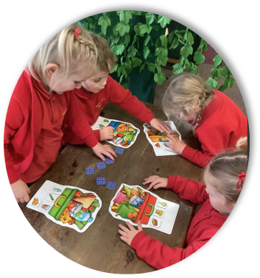

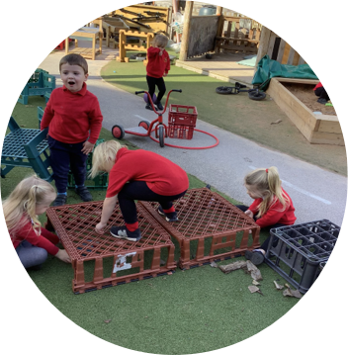


Nursery 2025-26 September Starters
Great Sankey Primary School & Nursery
Welcomes You
Great Sankey Primary and Nursery School
‘Together We Learn and Grow’

Slide 2


Introductions
25 place Nursery
Part of a Multi Academy Trust (The Challenge Academy Trust)
Session timings 8.30-11.30 and 12.15-3.15 (there is an option to stay for lunch and complete a full day)
Children are at the of everything we do
Great Sankey Primary & Nursery School
‘Together We Learn and Grow’

Slide 3
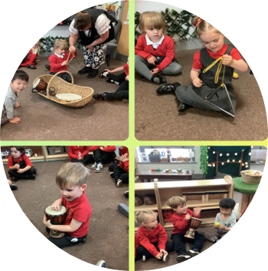

Our mission is to inspire, challenge and support young people to excel in learning and in life.
Our school motto is important to us:
‘Together We Learn and Grow’
#TeamGSP
staff
children
families
Great Sankey Primary & Nursery School
‘Together We Learn and Grow’

Slide 4

Great Sankey Primary & Nursery School
‘Together We Learn and Grow’

Slide 5
Why Choose Us?
We have a highly experienced team which includes experienced and qualified teachers
We build strong relationships with our families
We provide well-resourced, nurturing and stimulating environments for your child to flourish
We treat each child as an individual and take time to get to know them
We have lots of fun as we learn
We have high expectations of our staff and our children
Our children are very much part of the wider school community and are involved in school events. The vast majority of our Nursery children go on to attend our primary school.
Great Sankey Primary & Nursery School
‘Together We Learn and Grow’

Slide 6

Admissions to Great Sankey Primary School
Pupils who attend Great Sankey Nursery School for a minimum of 15 hours per week are number 3 in the oversubscription criteria in our Admissions Policy.
Our School has a Published Admissions Number of 45.
Great Sankey Primary & Nursery School
‘Together We Learn and Grow’

Slide 7

School Outcomes 2024
End of Key Stage 2 | Working at/above the Expected Level All figures are in % (brackets 2024 national) | Achieving ‘Higher Standard’ All figures are in % (brackets 2024 national)
Reading | 83% (74%) | 35% (28%)
Writing | 81% (72%) | 31% (13%)
Maths | 88% (73%) | 38% (24%)
English Grammar, Punctuation, Spelling | 79% (72%) | 54% (32%)
R, W, M combined | 79% (61%) | 19% (8%)
Good Level of Development | Phonics | Y4 Multiplication Check
80% (67%) | 89% (80%) | 47% of pupils scored 25/25 (35% )
Great Sankey Primary School
‘Together We Learn and Grow’

Slide 8
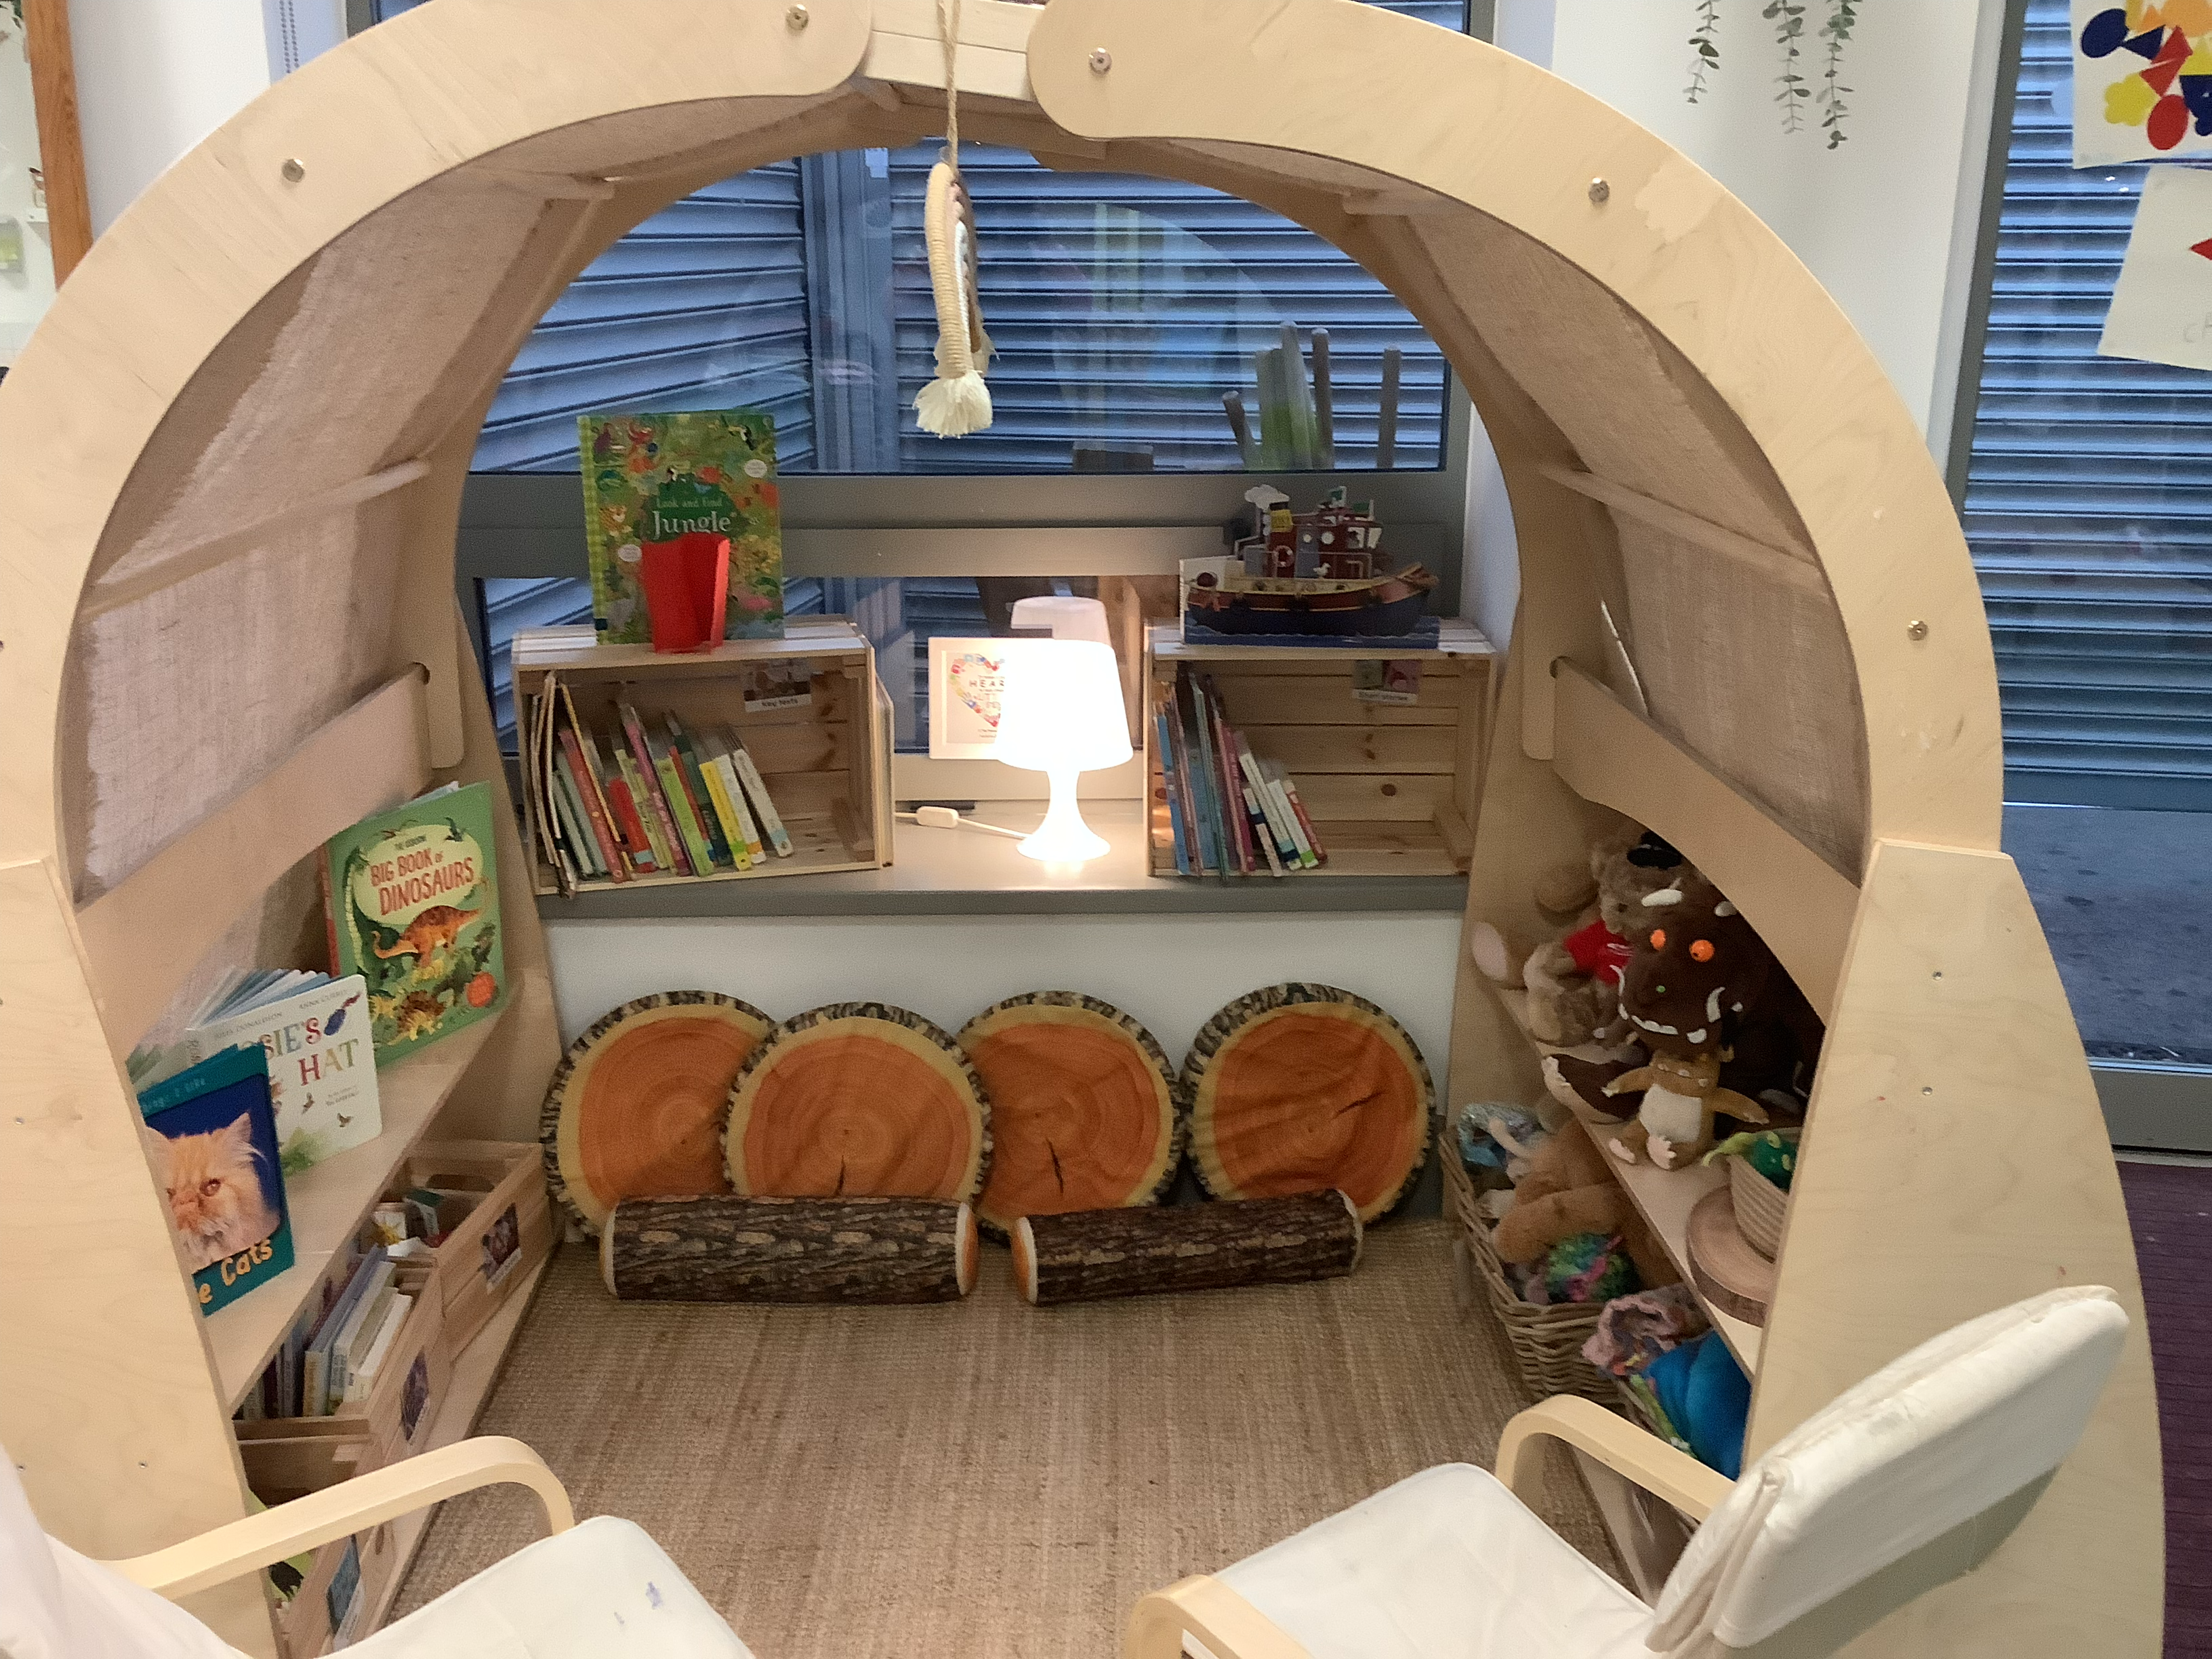
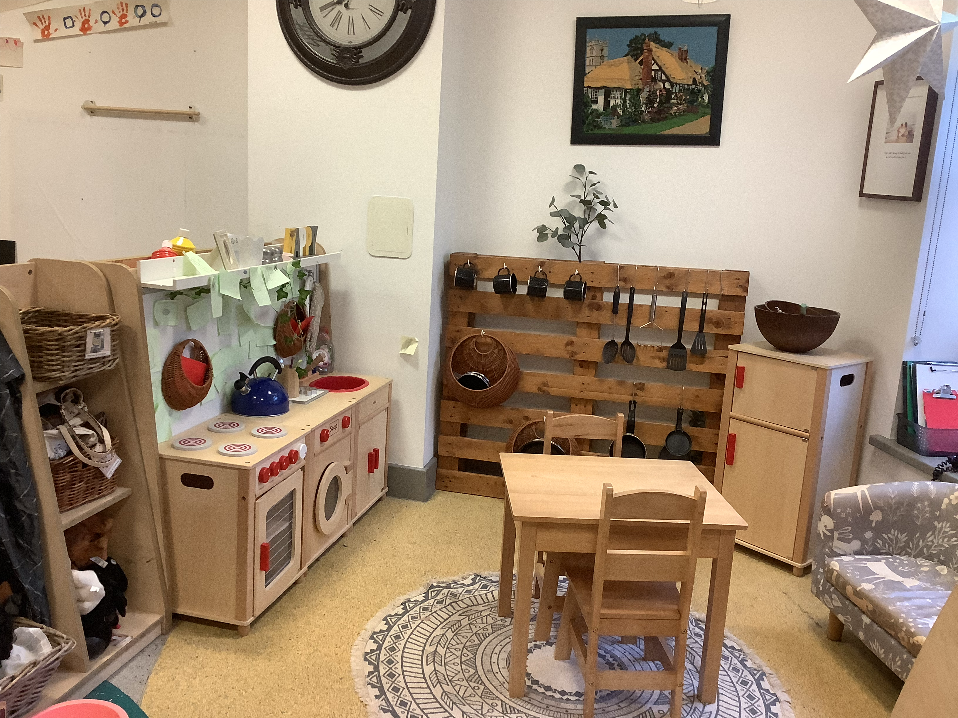
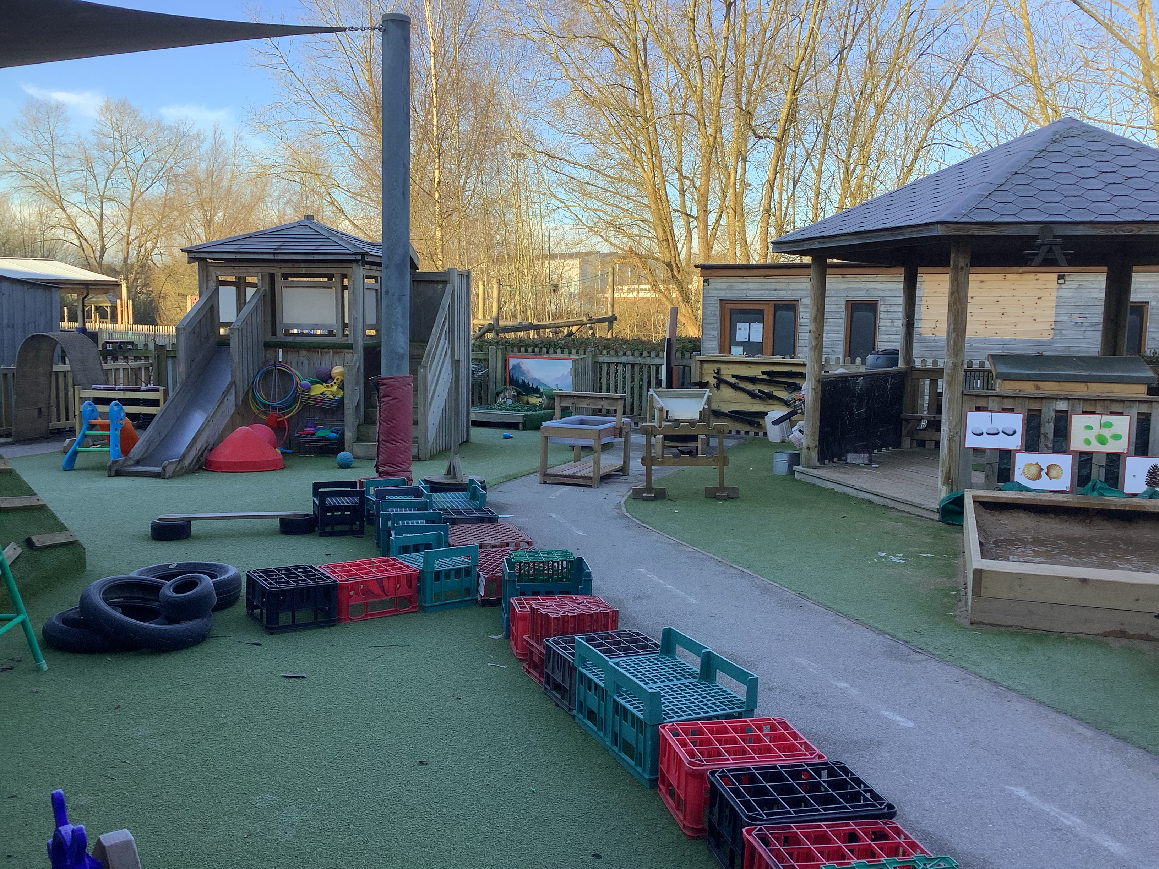
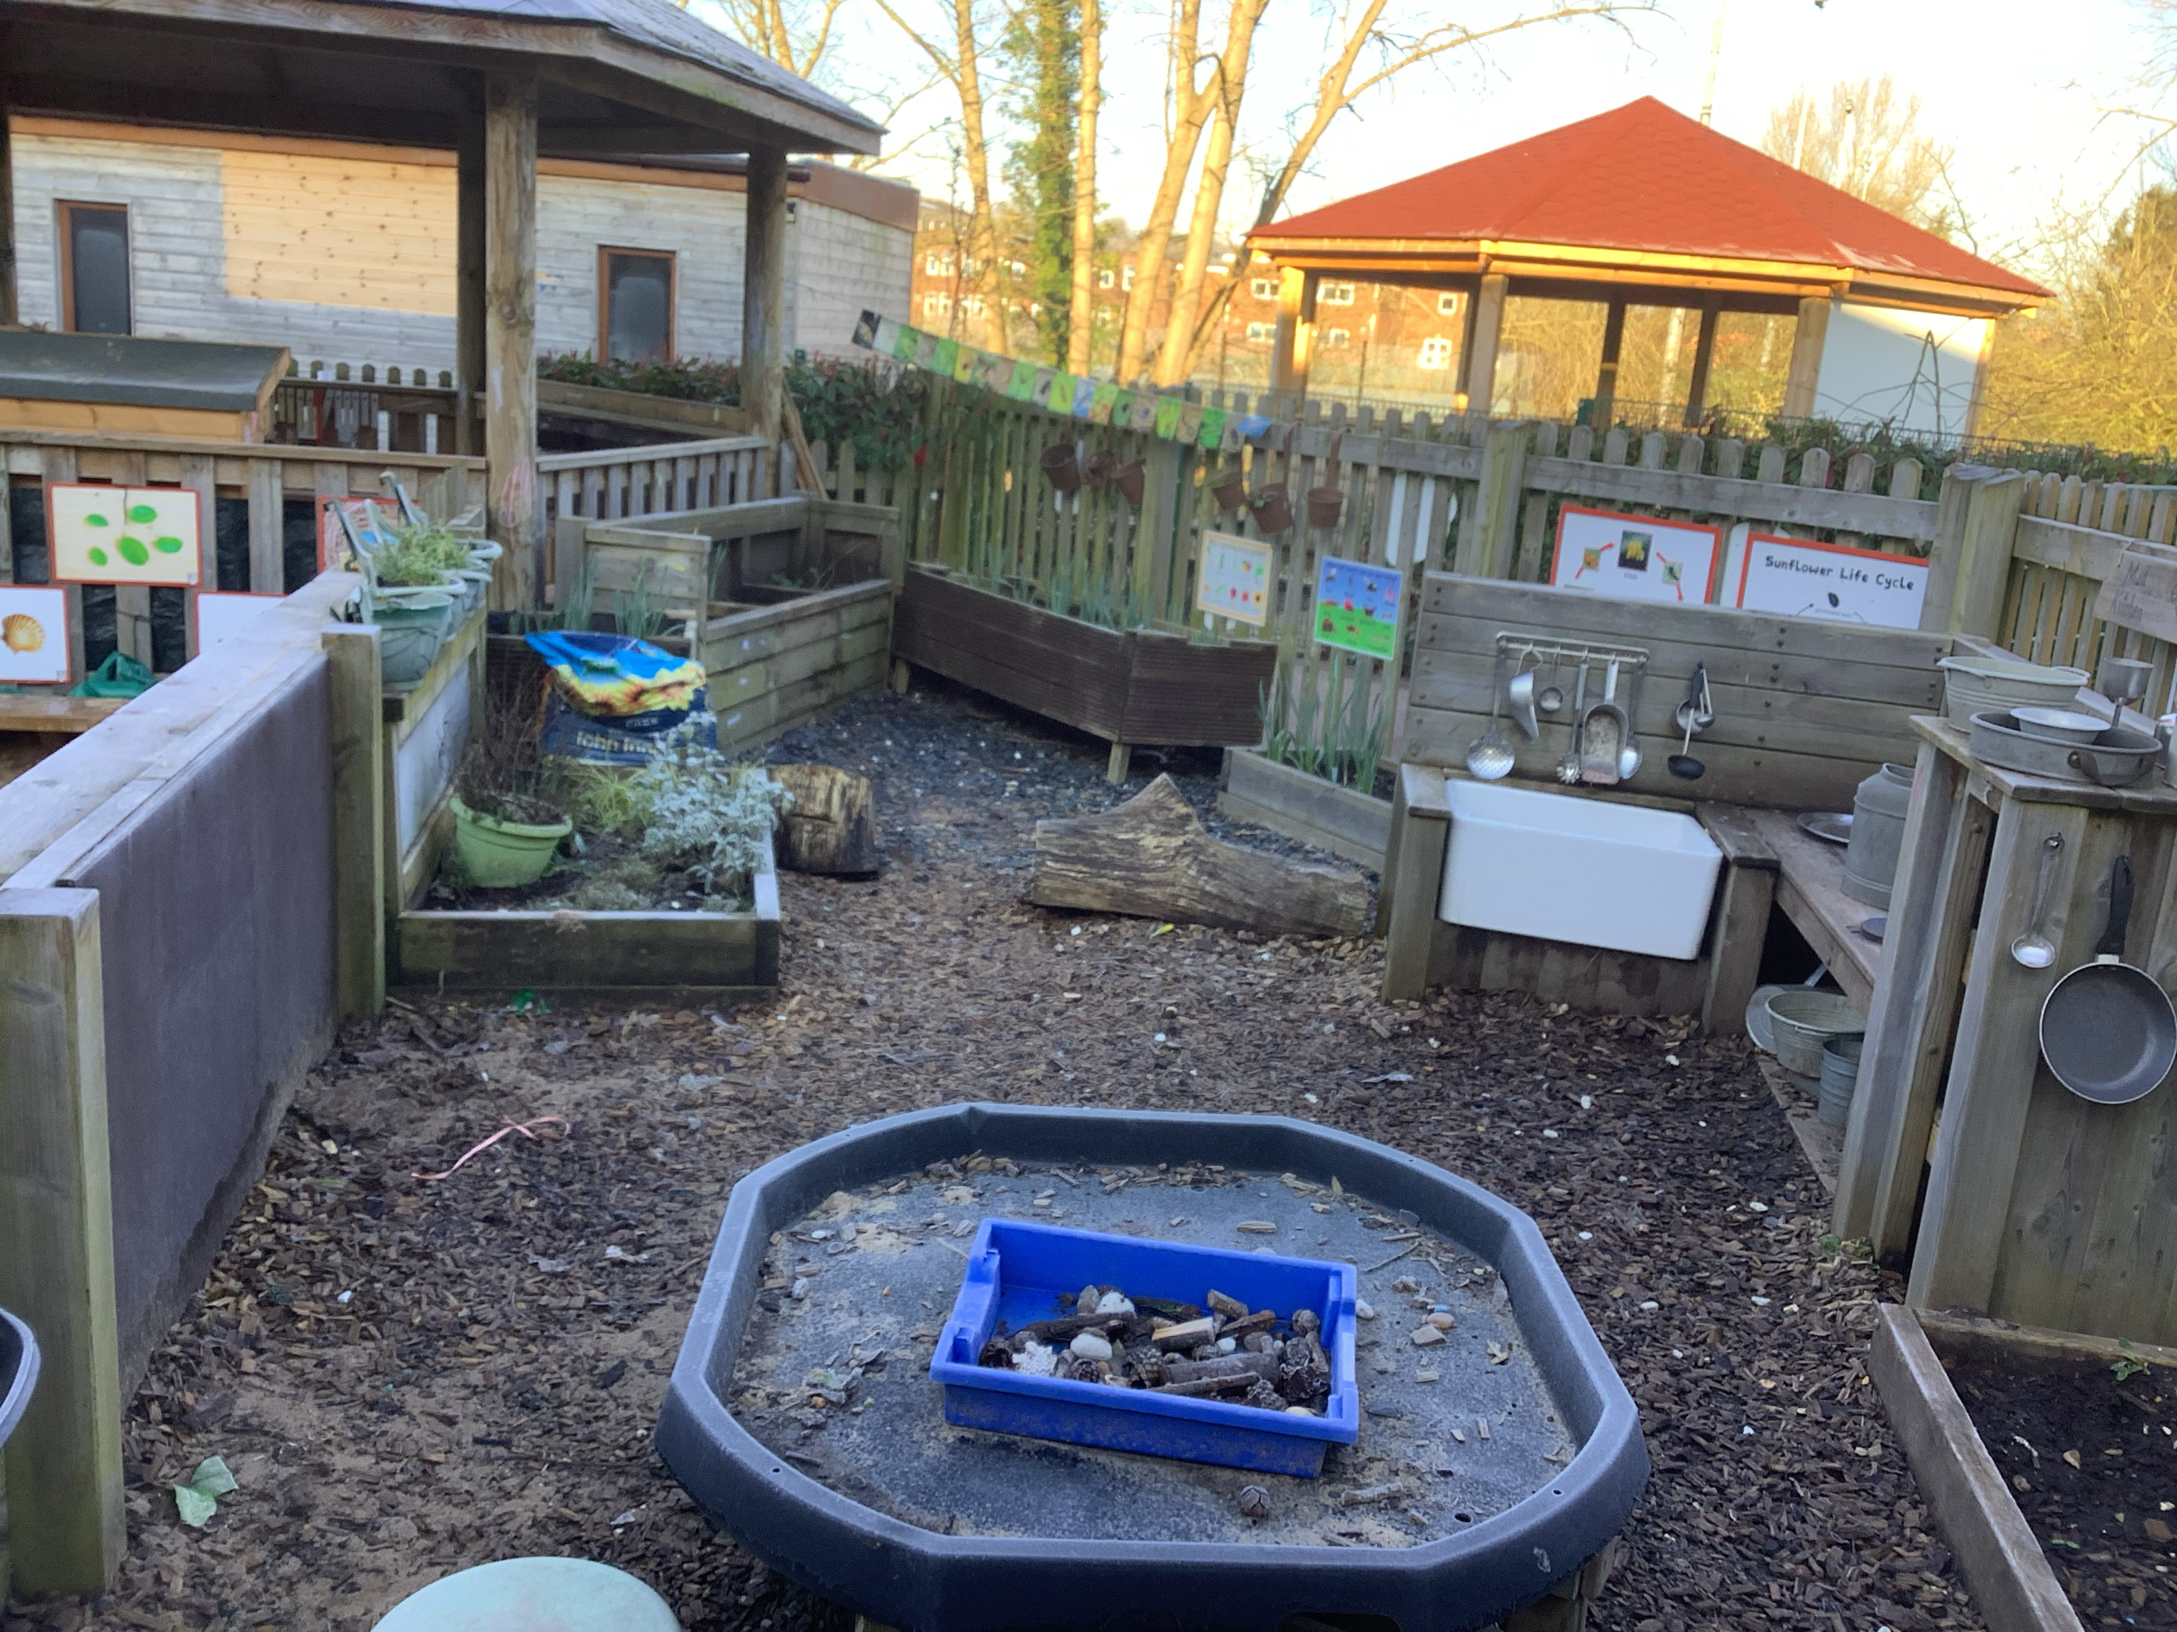
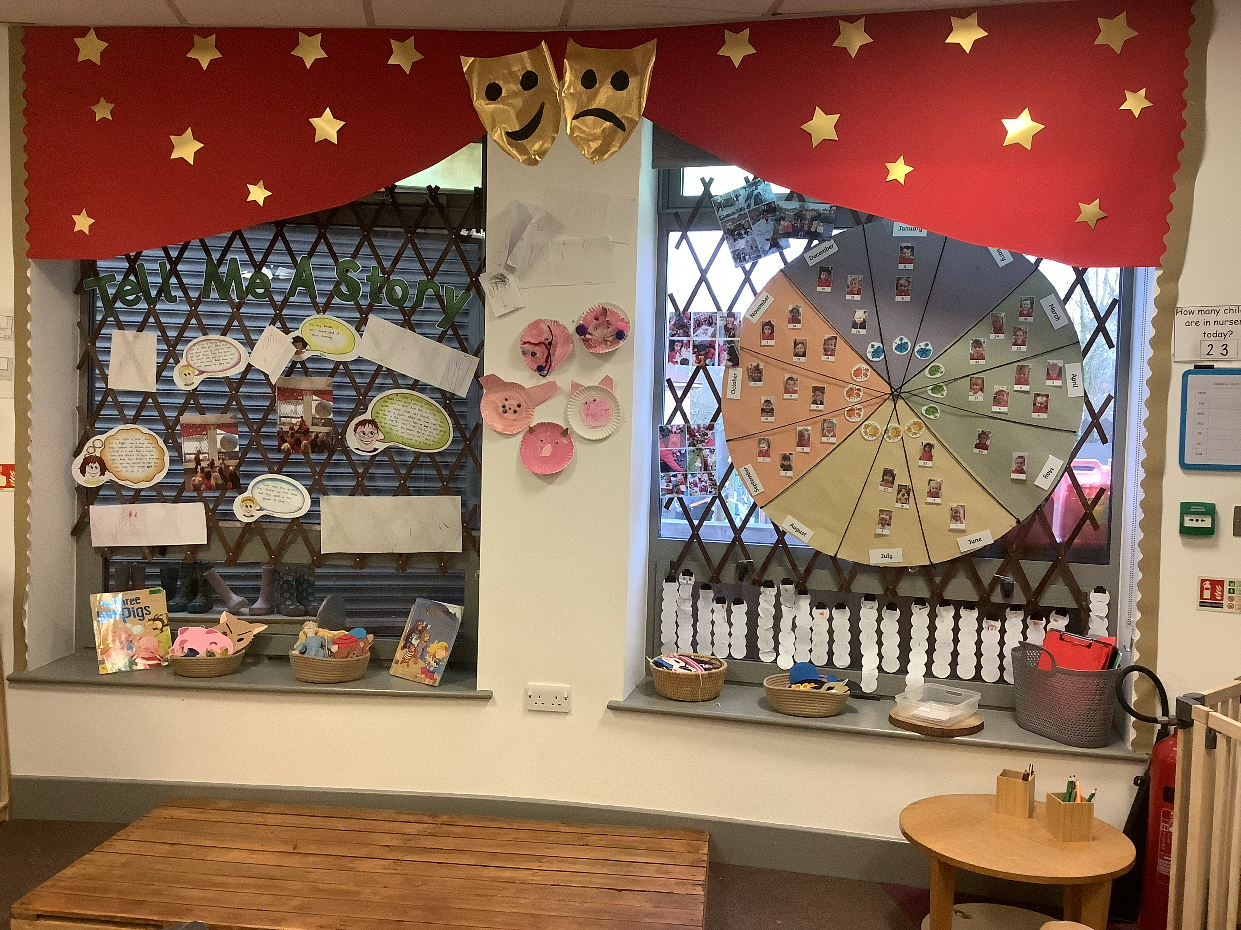
The Environment
High quality learning environments both indoors and outdoors.
Great Sankey Primary & Nursery School
‘Together We Learn and Grow’

Slide 9
Next Steps
Visit the Nursery provision and speak with the experts
Visit the website to download the prospectus and the application form https://www.greatsankeyprimaryschool.co.uk/page/nursery/116304
Return the application form to the office as soon as possible with your preferences. Places are filling fast, and some sessions are already nearly at capacity.
Your place for September 2025 will be confirmed by 11th April (application forms to be returned by 7th March).
Great Sankey Primary & Nursery School
‘Together We Learn and Grow’

Slide 10

Contact us:
Tel: 01925 728176
Email: admin@greatsankeyprimary.tcat.uk.com
Great Sankey Primary School
‘Together We Learn and Grow’

