Slide 1

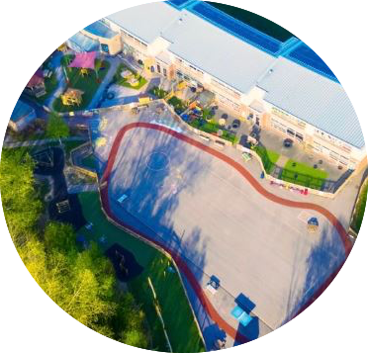

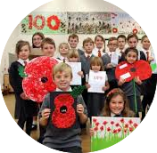

Great Sankey Primary
& Nursery School
Prospectus
2024 - 2025

Slide 2

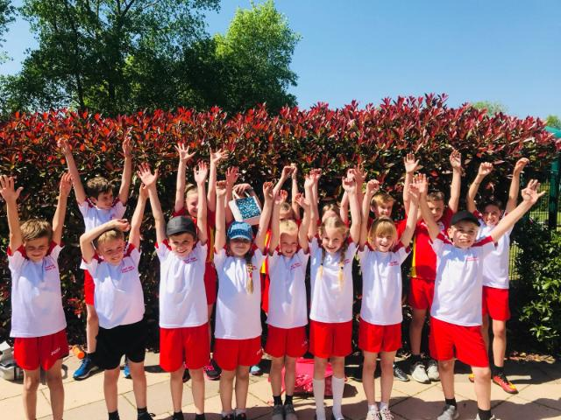

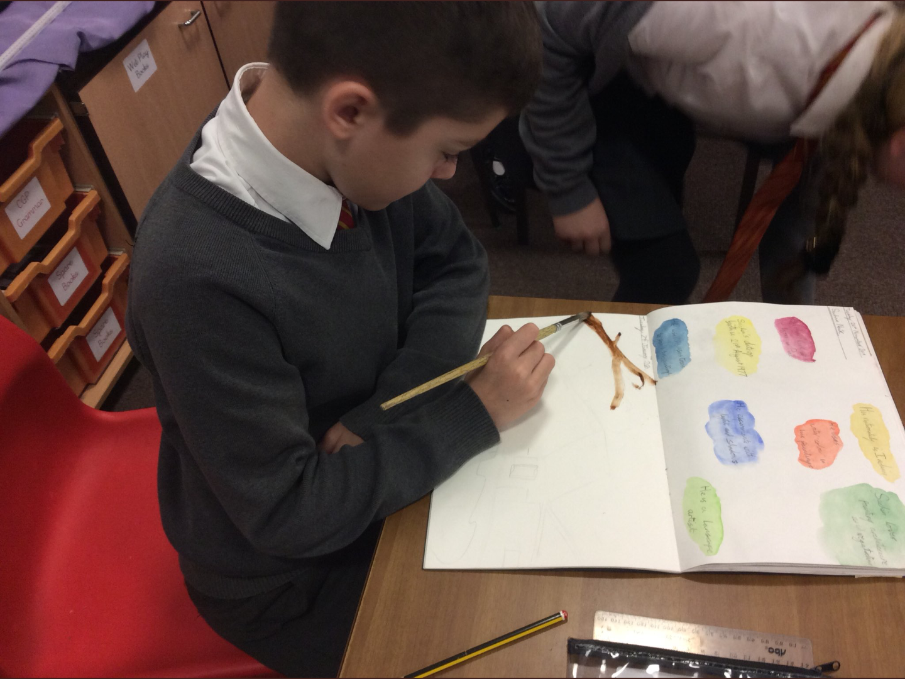

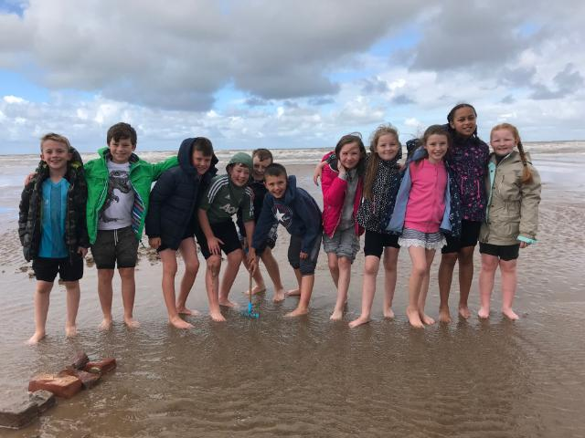

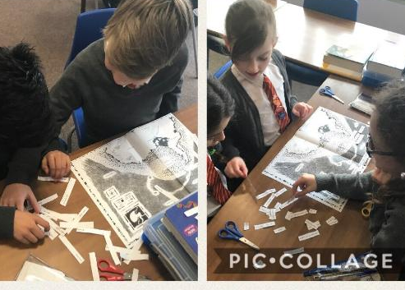
Introduction
Great Sankey Primary School is proud to be a founding member of The Challenge Academy Trust – a trust that has the vision to provide exciting and inclusive opportunities for every single learner entrusted into our care, from early years through to adulthood.
Children will receive an outstanding modern education, from motivated and talented staff, supported by innovative and collaborative partnerships.
TCAT will provide an environment where every learner is nurtured, challenged, and inspired to achieve the very best for themselves and their communities.

Slide 3
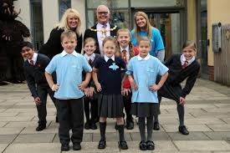
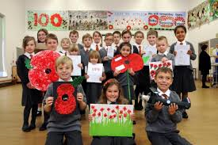
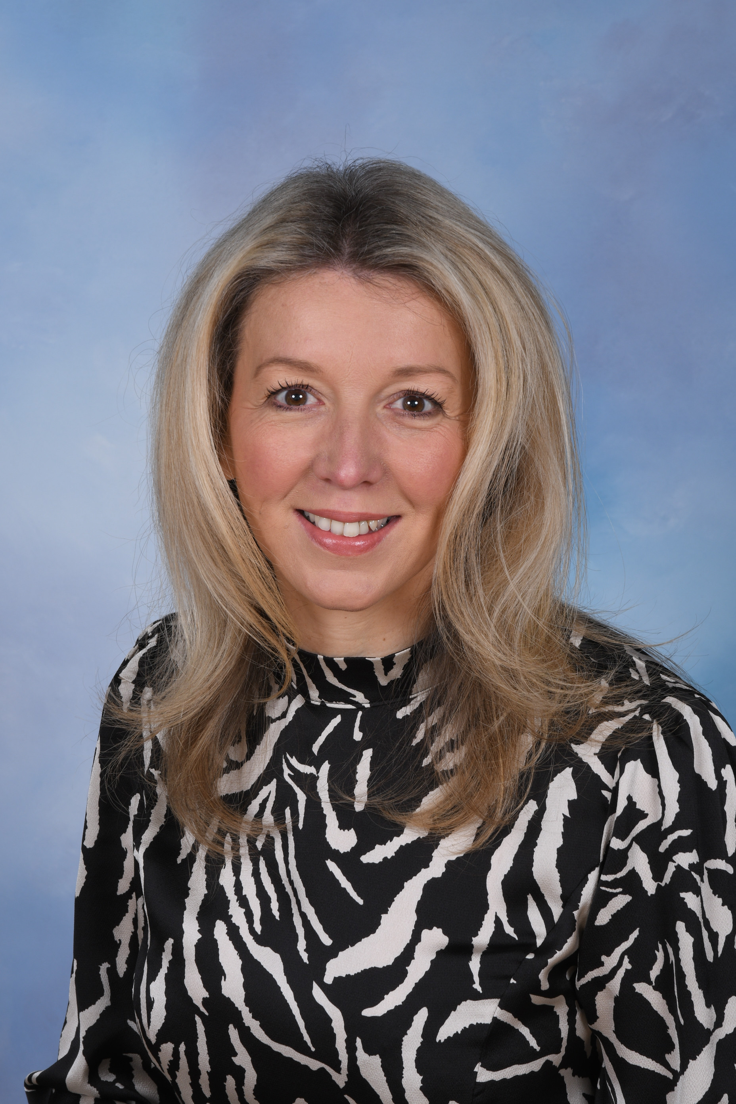

'Together We Learn and Grow’
A message from the Headteacher:
Great Sankey Primary and Nursery is a unique school in which children feel safe, are happy and learn effectively. Our established school motto, 'Together We Learn and Grow' is at the heart of GSP as we work together as a team, within our community, to ensure that every member of the school is nurtured, challenged and given exciting experiences and opportunities. As part of The Challenge Academy Trust our children receive an outstanding modern education, from motivated and talented staff, supported by innovative and collaborative partnerships.
At GSP we are particularly proud of the positive, strong relationships we hold with all members of our community and the wide ranging opportunities and enrichment we offer, whilst ensuring the highest standards of reading, writing and maths.
Our prospectus aims to provide you with a range of information that is designed to help you understand how we operate and gives you a feel for our school and our core values. I hope you enjoy viewing it, however, nothing replaces personal contact or seeing the school in action. Please do not hesitate to contact the school office for an appointment or visit our school website.
Kind regards,
https://www.greatsankeyprimaryschool.co.uk/
Mrs L J Wilding

Slide 4
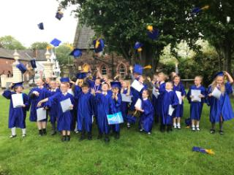
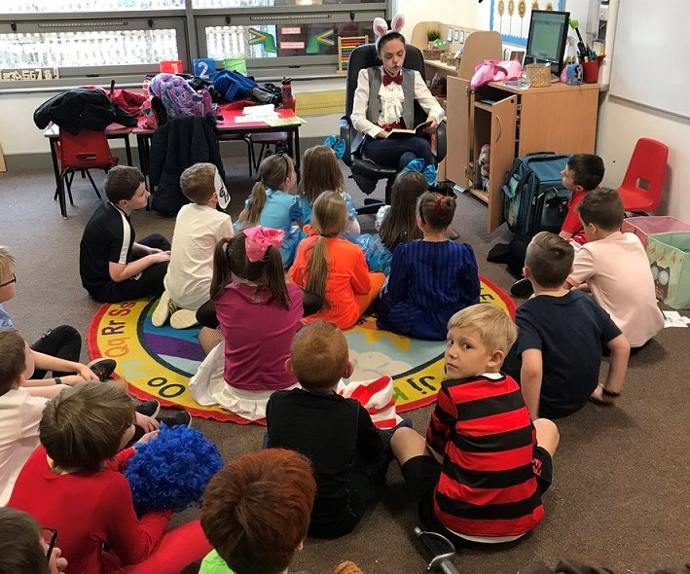
Vision & Values
Children are at the heart of everything we do at Great Sankey Primary. We are committed to providing a caring environment where every child can thrive and is supported to achieve their unique and amazing potential.
At GSP we are dedicated to:
Establishing excellent values & ethos;
Ensuring that relationships & behaviour are outstanding;
Raising achievement & attainment to the highest possible levels;
Proving that learning & teaching are of a consistently high standard.
We firmly believe that the education experience for our children will be holistic and fun-filled. In a calm and well ordered environment, based on kindness, mutual respect and empathy, all children will be valued as individuals and their moral and spiritual development encouraged as well as access to the highest teaching standards and curriculum.
The school will promote good health and fitness, perseverance, optimism and a “can-do” attitude in all. We will celebrate each child’s success and encourage them to take pride in their own, as well as others’, achievements. We will engage children in a creative curriculum that is tailored to their needs and reflects the context and community in which they live. At all times we will seek to inspire children with a love of learning which will remain with them throughout their lives. Together with our parents, governors and the wider community, we aim for all children to succeed to the very highest standards. Children will have opportunities to work both individually and collaboratively, giving them confidence, skills, independence and the self esteem needed to be successful in a rapidly developing world. In order to fulfil our school vision, we will seek to constantly adapt and improve, listen to parents and children and have ongoing evaluation and debate amongst stakeholders.

Slide 5

Vision & Values
The school values of honesty, acceptance, responsibility, resilience and kindness underpin all of the work we do at Great Sankey Primary and are referred to across our curriculum. Children earn ‘praise postcards’ for displaying their values and values are celebrated through our school rewards also.
Across the school, children hold positions of responsibility and you’ll be sure to see these values lived out when you visit us.

Slide 6
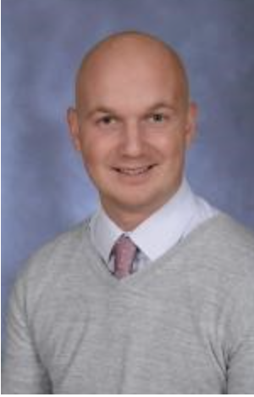
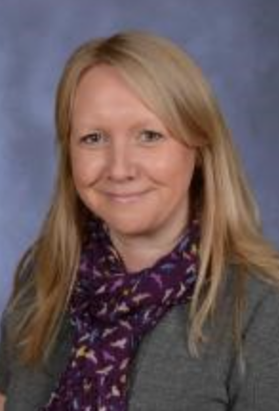
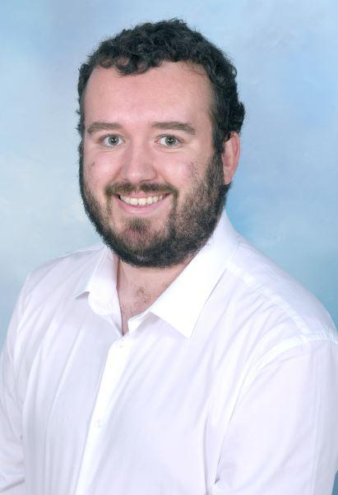
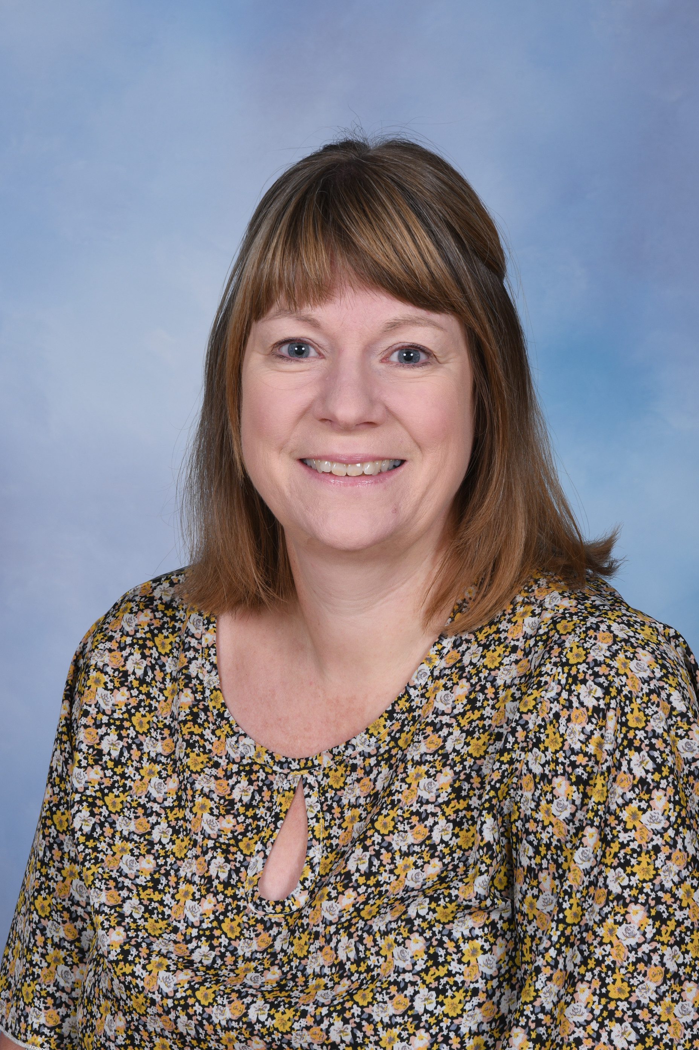
GSP Staff Team
Great Sankey Primary School is made up of a senior leadership team, teaching team, support staff team and wider school staff. The staff work together closely to ensure the very best experiences for all children that enter our school.
Senior Leadership Team
Mrs L. Wilding | Headteacher & DSL
Mr T. Gawne | Deputy Headteacher & DSL
Mrs J. Wrangles | Early Years / Foundation Stage Leader
Mr C. Waters | Senior Leader – Foundation Subjects & Assessment
Mrs N. Williams | SENDco
Mrs L. Wilding
Mr T. Gawne
Mrs J. Wrangles
Mr C. Waters
The Senior Leadership Team work closely together and are responsible for key areas of school life. Mrs Lisa Wilding is the Headteacher and has overall responsibility for Great Sankey Primary School. She is supported closely by Mr Gawne, the Deputy Headteacher, Governors and other senior leaders.
Mrs N. Williams

Slide 7

Governors
Great Sankey Primary School is a member of The Challenge Academy Trust (TCAT). The academy transferred on June 2017 having previously been a local authority maintained school. The Challenge Academy Trust is directly responsible to the Secretary of State for the operation of its member academies. It is a company limited by guarantee registered at Companies House. The company number is 10689247. The registered office is c/o Priestley College, Loushers Lane, Warrington, WA4 6RD.
The Local Governing Body meet six times a year. The full governing body meetings revolve around the educational provision and business, finance and personnel. As a board, they bring a wealth of experience in order to support and challenge school leaders to ensure the very best educational experiences for our young people.
Board of Governors
Chair of Governors | Phil McEwan
Co-opted Governors | Leanne Keavey, Toby Tyas, Will Chapman, Jane Hardman, John Barlow
Parent Governor | Sonal Patel-Murden , James Gartland
Staff Governor | Stuart Johnson, Tom Gawne (Deputy Headteacher)
Headteacher (Ex officio) | Lisa Wilding
Clerk | Katie Whitmore

Slide 8
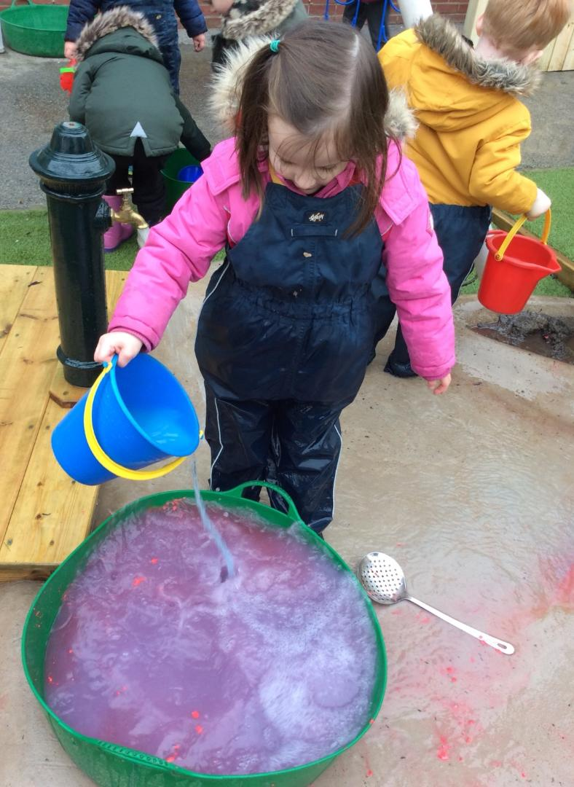
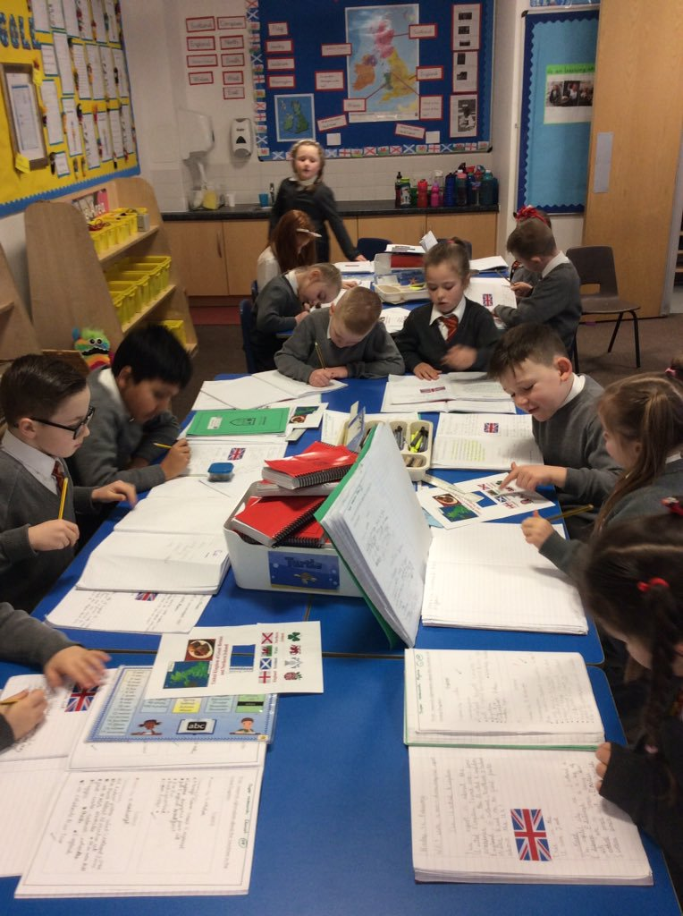
School Admissions
The Challenge Academy Trust is the admitting authority for Great Sankey Primary School and must allocate places in accordance with its determined admissions arrangements. In line with LA Policy, the school has one intake into Reception class in the September of each year. The school academic year runs from 1st September to 31st August and children are admitted in the September prior to their fifth birthday. Our official admission limit is 45, making us a one and a half form entry school.
ADMISSION ARRANGEMENTS FOR GREAT SANKEY PRIMARY
ACADEMIC YEAR 2025-26
Parents / carers of children can apply for a Reception class place for September 2025 by completing the Local Authority’s on-line application form. This can be found at Primary school admissions | warrington.gov.uk
Details of when the online application form opens are available online and this usually closes around midnight on 15th January or the nearest working day to this date. The on-line facility will not be available after this date so any parent/carer who applies late will have to contact the Admissions Team. Late applications will be processed after all those received on time, unless the child has changed address or recently been taken into care.
Before completing an application form, it is strongly advised that you read the parent information booklet which sets out the useful information about all primary schools in Warrington and important information about the admissions process and attend the school open events. To access the parent’s information booklet and online application form, please refer to:
Primary Schools Brochure 2025-26)

Slide 9
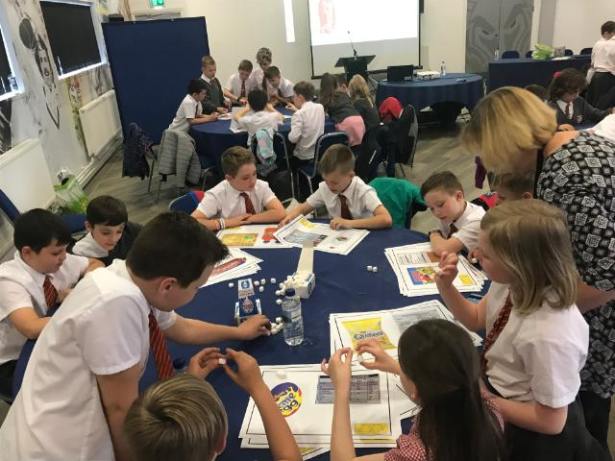
School Admissions
Further information on the Local Authority Guidelines for intake to Reception in September or in-year transfers and admissions can be found using the link below. The local authority is responsible for co-ordinating all admissions to the school. All relevant forms can also be found using this link:
https://www.warrington.gov.uk/primary-school-admissions
Or, contact:
School Admissions Team
East Annexe
Town Hall
Sankey Street
Warrington
WA1 2UH
Email: schooladmissions@warrington.gov.uk
More information about in-year admissions (transferring your child from one school to another) is available by visiting the Council’s website via the link below. Once you have spoken with the school admissions team, the Headteacher or a member of the Senior Leadership Team at our school will be happy to arrange a visit for you and your child to come and look around.
https://www.warrington.gov.uk/info/201094/school_admissions/675/transferring_your_child_to_another_school

Slide 10
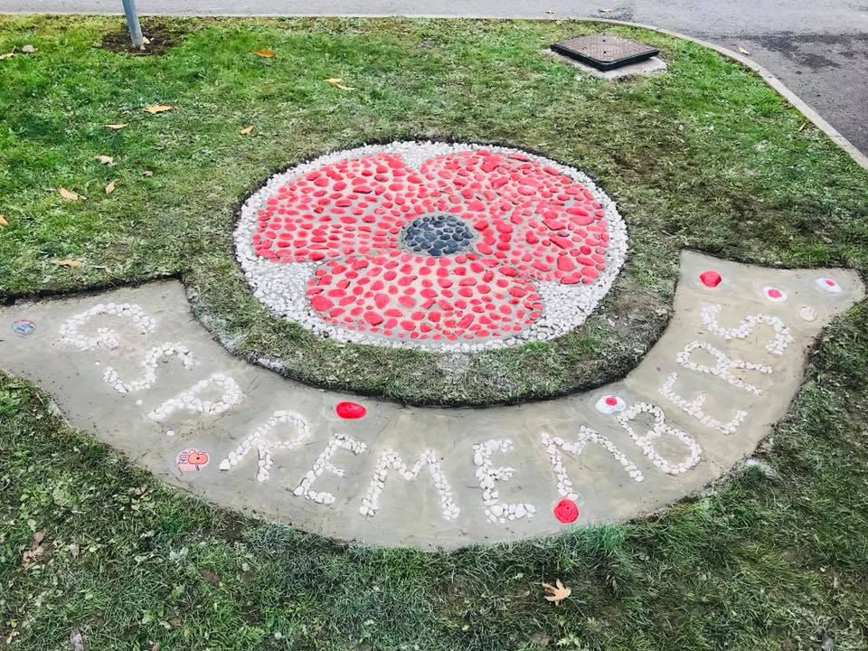
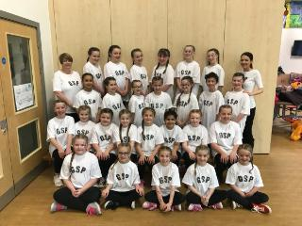
Our School Curriculum
Curriculum Design Statement:
At Great Sankey Primary School, we believe that all our children have the right to an inclusive and diverse curriculum that is exciting and relevant and will equip them with key skills for every stage in their educational lives and beyond. We have planned our curriculum to develop both knowledge and skills; it encourages curiosity, discovery, creativity, co-operation, resilience and independence; it produces leaders, innovators, collaborators and personal growth.
At GSP we follow The Early Years Foundation Stage Curriculum and The National Curriculum. However, we have developed a bespoke curriculum, based on the Chris Quigley Essentials Curriculum and the principles as set out in the OECD Learning Framework 2030, that drive the aims and values of our school and serves the needs of all our children and families.
It includes not only the formal requirements but also an abundance of extra-curricular activities and theme approaches that we carefully plan in order to enrich the children’s experiences. We place a strong emphasis on securing the basic skills of reading, writing and mathematics in every year group.
We want every child in our school to feel safe, cared for, valued and trusted. We want our school to nurture and foster curiosity in an environment that is safe and stimulating to their ever-changing interests.

Slide 11




Our School Curriculum
Every new topic is carefully planned to create memorable learning experiences which are also supported with educational visits and visitors to the school. Outdoor learning is also promoted throughout all subjects and we also deliver residential visits in Y2, Y4 and Y6.
English (reading, writing, spelling, grammar, punctuation, handwriting and phonics), Maths, Science, Religious Education, Physical Education, Computing are taught all year round, with links to the topic where relevant to enhance learning. Art and Design, Design Technology, History and Geography are currently taught in focus blocks linked to the topics across the half term as part of a two-year cycle across phases. This current blocking however, does include regular opportunities for children to review and revisit previously taught content. SMSC and PHSCE are taught discreetly on a weekly basis as well as being planned for across the whole school topics and through our monthly values. At Key Stage Two our children are taught French although, it is introduced subtly throughout Key Stage One also. In KS2 children also learn how to swim.
To further enhance the curriculum, we also have whole school topics throughout the year that allow for further in-depth development of knowledge, concepts and understanding across all subjects (see whole school topic plan) and link to community and current affairs.
As part of our Trust we also have regular access to specialist teachers to support and enhance in the delivery of the GSP curriculum.
Intent:
At the heart of our GSP curriculum lies three main drivers which help to shape our bespoke curriculum.
Growth - The strong emphasis we place on a team approach is based on our school motto of ‘Together We Learn and Grow.’ This creates a culture in which learners gain confidence, self-respect, feel valued and supported to take responsibility for their own learning and achieve their full potential. This further helps children to build aspirations and believe that anything is possible in their future lives.
Mindfulness – This helps our learners to concentrate, focus and to fully experience and find fulfilment in their lives. They also recognise the importance of supporting one another, being outward facing, and have a growing understanding of the impact they can have on themselves and others.
Community – This helps learners to be an active, responsible member of our school, the locality, our country and the world.

Slide 12
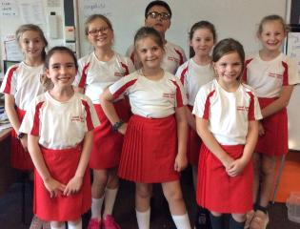
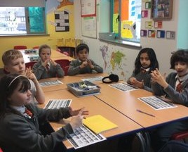
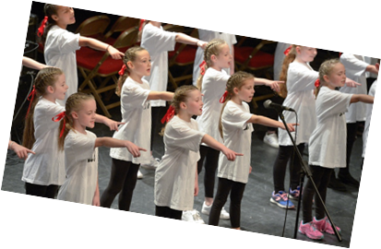
Enrichment
The school also runs many school trips throughout the year to support and enhance the children's curriculum learning. Our children in Years 2, 4 and 6 also enjoy a residential trip with their classmates each year.
At Great Sankey Primary School we pride ourselves in the exciting enrichment activities we offer to all our children. The clubs are wide ranging and cater for every age and interest and reflect our commitment in developing children at GSP into confident individuals with their own interests. We encourage every child to try our clubs and many of these can lead towards life-long hobbies and passions.
We also take part in competitions throughout the year and encourage everyone to get involved. These have included sporting victories and team achievements to choir and baking competitions. Recent successes have included our UKS2 Football team winning the School Games Football Tournament, our Rugby team reaching the finals and playing at Warrington Rugby team's Halliwell Jones stadium, Gold medal for our UKS2 Athletics team, successes for our Netball team and our cross country team completing their first ever competition. Of course we also must not forget our national success in winning The Guardian’s - School We Want competition and the resulting 'Splat Shed' now sits proudly in our school grounds for all to use.
Our enrichment activities are organised on a termly basis and may change.
Why Not Try?
Cross Country Club
British Sign Language Club
Football Club
Crafty Kids Club
Cookery Club
Gardening Club
Archery Club
Netball Club
Hockey Club
Colouring Club
Sewing Club
Science Club
Reading Club
+ many more!

Slide 13

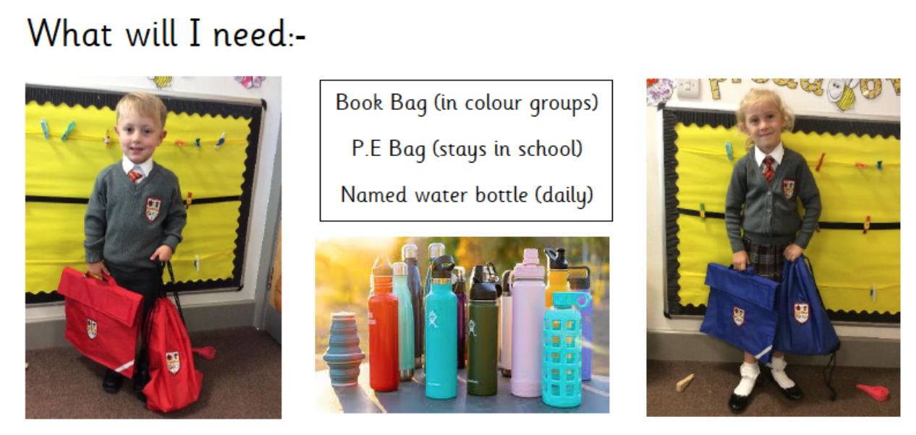
Our School Uniform
We are very proud of our GSP uniform and it is often commented upon positively by others. All children wear a uniform to instil a sense of pride in the school and parents and carers are asked to fully support this request.
It is our school policy that all children wear school uniform when attending school, or when participating in a school-organised event outside normal hours. We provide a complete list of the items needed for school uniform in our school on the school website.
When deciding on school uniform, every effort has been made to ensure that the cost to parents is minimised. The vast majority of items are available from a range of sources.

Slide 14



The School Day & Out of Hours Care
Treetops @ GSP is a school run breakfast and after school link club. We offer a welcoming, safe and comfortable facility for the children to have fun before and after school. As this is run by the school, we know the children and families well and the team work closely with the staff to ensure a smooth transition into and from classes.
Staff are highly trained and all have experience in childcare, first aid and food hygiene. The children are based in the small hall and we have a wide range of exciting resources and wider facilities to make their time at Treetops a fun and welcoming one.
Further information can be found on the following link and by accessing our Link Club Policy. Alternatively, contact the school on the main office who will be more than happy to advise.
Great Sankey Primary School: Out of School Hours Care
The school day at Great Sankey Primary School runs from 08:45 when our doors open but parents and children can access the school site from 08:30am when the gates are opened onto the playground and finishes at 3:15pm. We encourage all children to be in school before 08:55am which is when our registers open.
The school day ends for the children at 3:15pm and are collected from the school playground at this time. Throughout the day, children have breaks during both the morning and then at lunchtime when they have their dinner.
As a school, we do also offer a breakfast and after school club through our out of hours care, ‘Treetops @ GSP’, which is run and staffed by the school so that we know the children and families well.

Slide 15




Equal Opportunities
Equality Statement, Vision and Objectives
The commitment of the staff and Governors to promote equality resonates in every aspect of our inclusive school, providing fairness and equality for all. We are committed to embracing difference throughout every aspect of school life. We are also a member of the ‘No Outsiders’ Schools programme.
This involves tackling the barriers which could lead to unequal outcomes so that there is equality of access and that the diversity within the school community is promoted, celebrated and valued.
We believe that equality at our school should permeate all aspects of school life and is the responsibility of every member of the school and wider community. Every member of the school community should feel safe, secure, valued and of equal worth. At Great Sankey Primary School, equality is a key principle for treating all people the same irrespective of their gender, ethnicity, disability, religious beliefs/faith tradition, sexual orientation, age or any other of the protected characteristics (Single Equalities Act 2010).

Slide 16
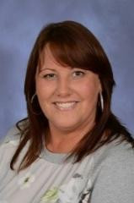





Safeguarding
At Great Sankey Primary safeguarding is EVERYONE's business.
Safeguarding runs through every strand of the work we do at GSP. We are committed to safeguarding and promoting the welfare of children and expect all staff and volunteers to share this commitment at all times.
We regularly review our child protection policy and procedures, with frequent training provided for all school staff in order to offer a consistent, high quality approach to child protection and safeguarding. Our policy can be found on our school website.
Our practice and procedures are informed and driven by the work of Warrington Safeguarding Partnership https://www.warrington.gov.uk/warrington-safeguarding-partnership and we work collaboratively within our Trust to ensure the very best practice and procedures.
Headteacher (Designated Safeguarding Lead)
Deputy DSL – Pastoral Lead
Deputy Headteacher (Deputy DSL)
Mental Health First Aider – Safeguarding Team
SENDco – Safeguarding Team
Governors also receive training and we have a dedicated and experienced Safeguarding governor who supports and reviews the school and team against safeguarding. Our named governor for Safeguarding and Prevent is Mr P McEwan.
We also have a children’s safeguarding team who meet regularly to discuss different ways to help keep our school and community safe. They have worked on lots of projects together, including: Warrington Wise Up Awards and E safety – looking at how we can keep ourselves safe online.

Slide 17
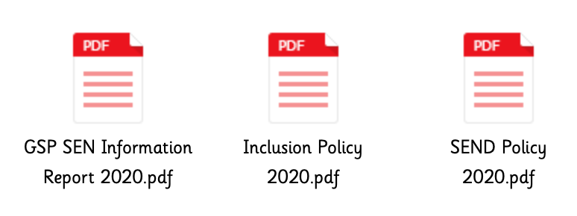
SEND – Special Educational Needs & Disabilities
If a concern is raised about your child's learning or behaviour their class teacher will keep you fully informed about the work being carried out to support your child and what you can do to help alongside any next steps.
Our Special Educational Needs and Disabilities lead (SENDco), Mrs Williams, works closely with our staff to support in writing and carrying out individual learning programmes.
If you have any questions with regards to any areas of S.E.N.D and how we plan for, identify and make provision for our children, please read our school offer, policy and information report in the first instance or contact the School office to speak to our SENDco.
Every child is different and we celebrate and embrace this at GSP. Our aim is to cater for each individual's needs in order for them to reach their potential and develop a positive self-image, regardless of ability. We treat our learners in ways that take account of their varied life experiences and needs.
There are some children in our school community that experience difficulties with their learning. We recognise that they may need additional work, support and equipment that is different from the rest of their peers. First, high quality teaching takes place in every class that is differentiated according to the needs and abilities for all the children.
We work closely in partnership with parents and carers to ensure that our children, regardless of any additional needs and disability, develop the attitudes, behaviours and skills to enable them to learn.
Mrs Nia Williams
School SENDco
The following information reports and policies can be found on our school website under the SEND section. Should you require paper copies of these, please contact the SENDco.

Slide 18

What Others Say …
Pupils become well rounded youngsters who achieve well. They take their additional responsibilities around school seriously.
Don’t just take our word for it! At Great Sankey Primary, we believe in regularly taking into account the views of all stake holders so we can continue to improve and provide the very best experiences to our children and families. Take a look at what others who have visited our school have had to say!
OFSTED, 2021
Pupils benefit from a wide range of opportunities through the personal development curriculum and said they wouldn’t change anything about the school.
Teachers foster a love of reading in pupils and they remember books and reading events with enthusiasm.
OFSTED, 2021
Teachers have high expectations of what all pupils can achieve, including those with SEND and EAL and they are supported well.
Inside and outside the classroom, pupils take part in a rich variety of activities.
OFSTED, 2021
OFSTED, 2021

Slide 19
What Others Say …
The school operates like a large family. Staff are friendly and approachable and the headteacher provides great leadership. The school places the children’s wellbeing at the centre of everything.
I am always treated like part of the GSP family.
GSP Volunteer, 2020
Parent Survey
The teachers are an absolute credit to the school, they support my child not only academically but socially too.
This is a happy school where pupils enjoy their learning and are well prepared for the next stage in their education and future lives.
OFSTED Report
Parent Survey

Slide 20
What Others Say …
Since my child has started at GSP he has experienced some great school trips to broaden his learning. Good choice of after school clubs including some from outside school.
Teaching at this school is good and outstanding. Pupils are eager to learn and try their very best to succeed, making good progress.
OFSTED Report
Parent Survey
Excellent learning environment where children are happy and want to get involved. The school is always aiming to get better!
Parent Survey
Great Sankey Primary School: Parent Surveys & Views
Visit the link above to see the results of our parent surveys and see more of what others say about our school!

Slide 21
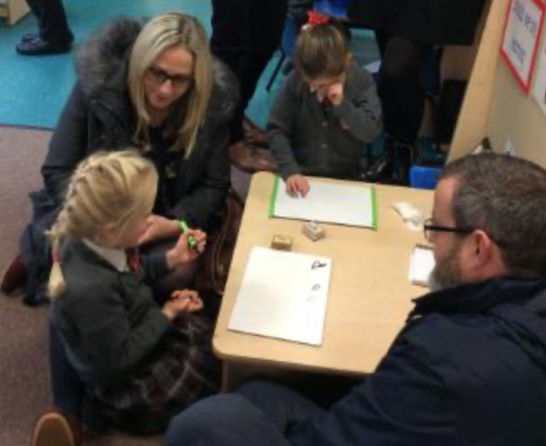
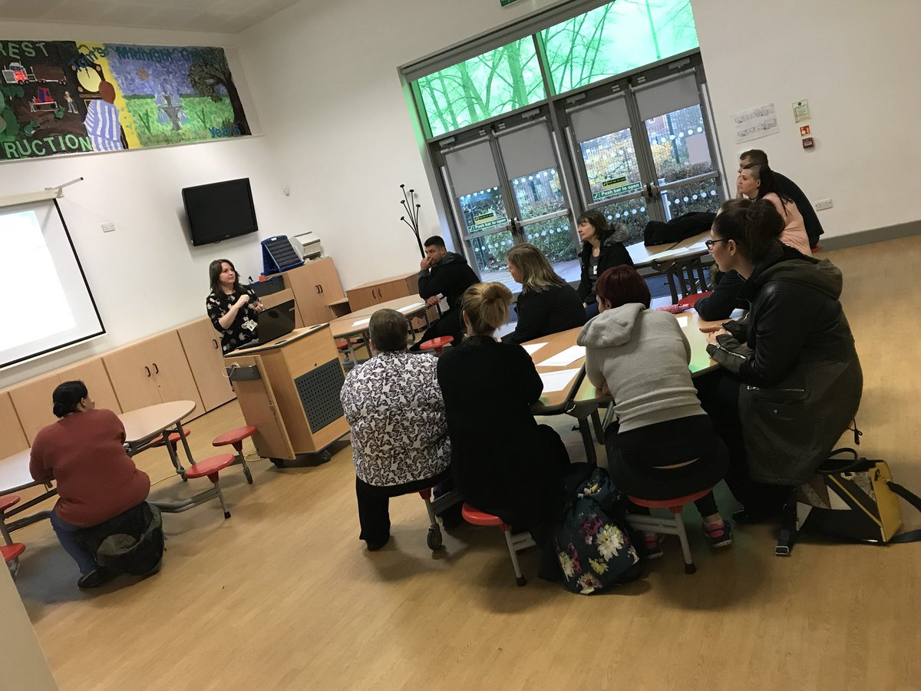
Have Your Say…
Ways To Communicate:
Weekly Newsletter / News Bulletin
School Office
Parent Mail
Speak to the class teachers / teaching assistants
Speak to Miss Leah (Pastoral lead)
Speak to the headteacher / deputy headteacher
PFA / Senior Leader Coffee Mornings
Parent Surveys
Parent workshops / Stay and Learn sessions.
admin@greatsankeyprimary.tcat.uk.com
At Great Sankey Primary School we are outward facing and are always looking for ways to improve. Your views are important to us and we are keen to hear your comments, answer any questions and listen to any concerns you may have. There are many ways you can do this at our school.
We have an open door policy and truly value your thoughts, so please feel free to speak to any member of our staff who would be happy to help.

Slide 22


Make A Complaint …
Complaints are very rare at Great Sankey Primary due to the excellent relationships and communications we have with our families. We have an excellent team of dedicated staff who are almost always available, along with the Executive Headteacher, Head of School and other Senior Leaders, so it is often easy to resolve any concerns or issues you may have quickly. However, if parents or carers feel that they need to make a formal complaint, it should be made in writing to the Executive Headteacher. A copy of our full complaints policy and procedures can be viewed under our complaint section.
As always, if you have a question, concern or idea please make contact with us.
Social Media – Find Out More!
School Website
Great Sankey Primary School
@GTSankeyPrimary
https://www.greatsankeyprimaryschool.co.uk/

Slide 23

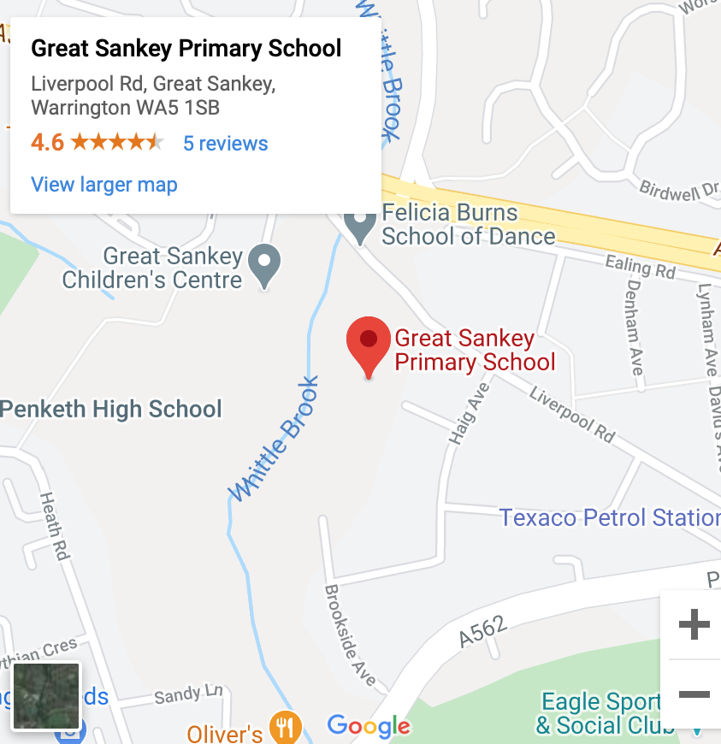
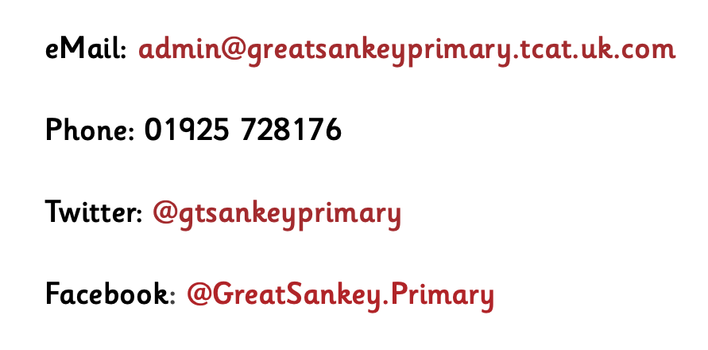
Contact Us:
Great Sankey Primary School
(A proud member of The Challenge Academy Trust)
Liverpool Road,
Great Sankey,
Warrington,
WA5 1SB.

Slide 24
