Slide 1

Welcome to KS1
Stay & Learn
Writing in Key Stage 1

Slide 2
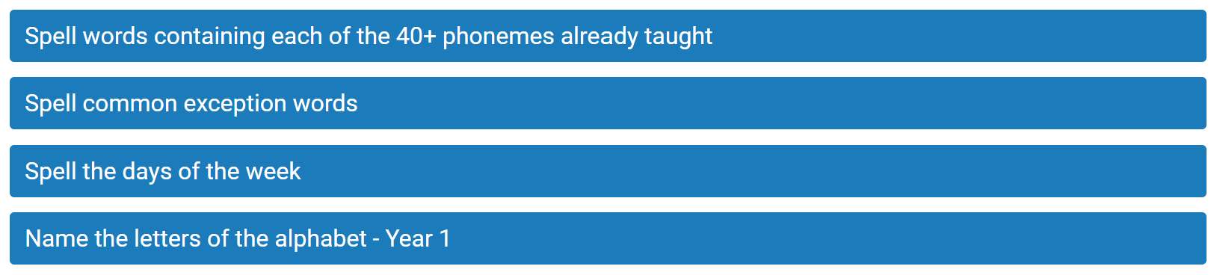
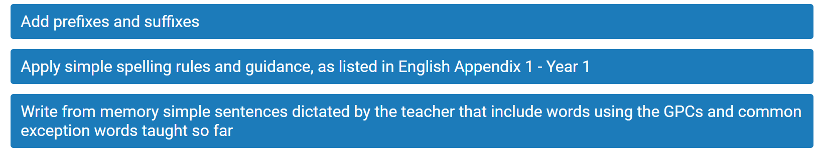
Expectations of the writing Curriculum Y1

Slide 3
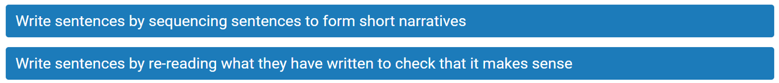
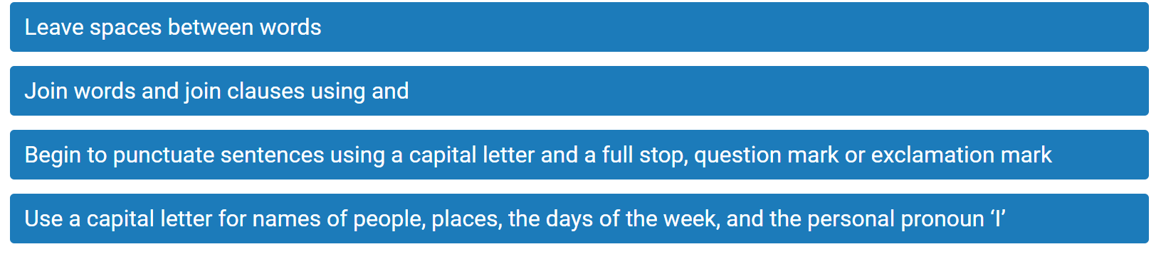

Expectations of the Writing Curriculum Y1

Slide 4
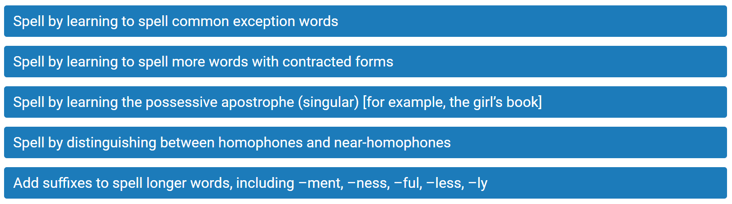
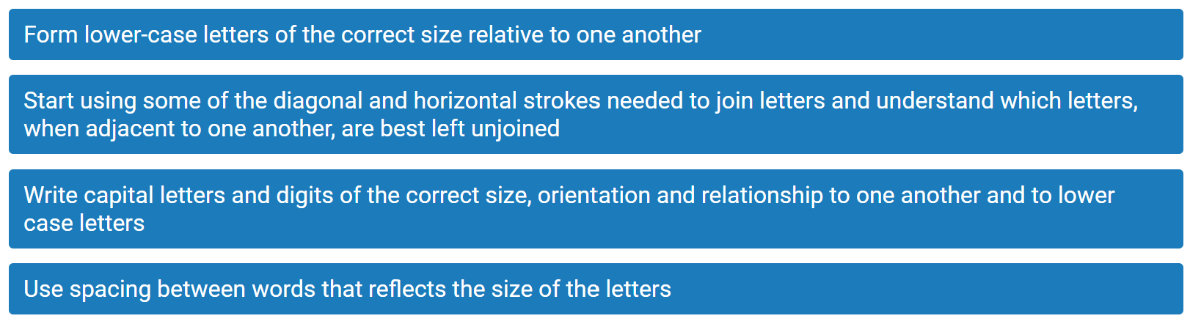
Expectations of the Writing Curriculum Y2

Slide 5
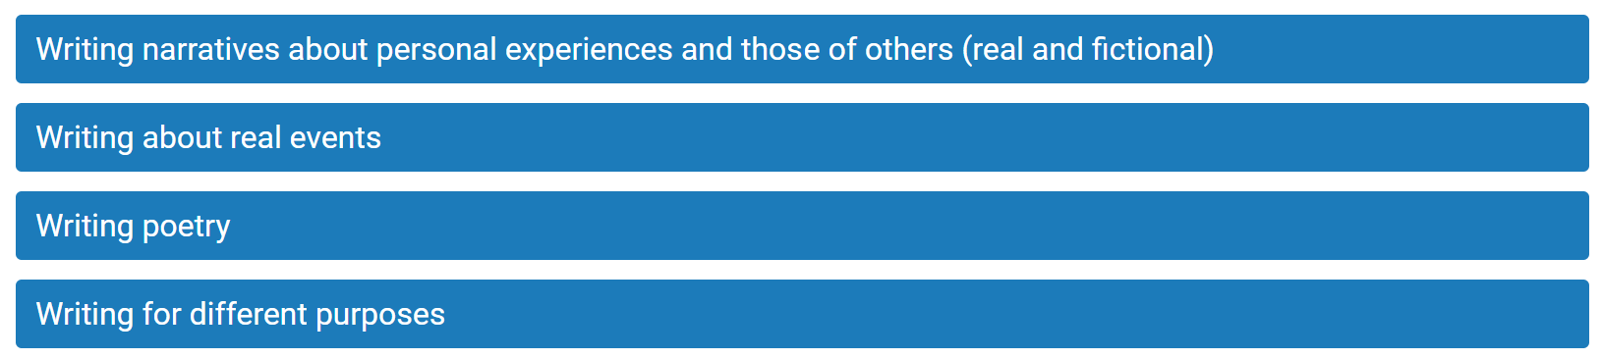
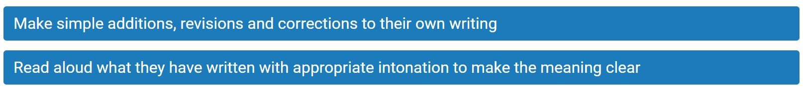
Expectations of the Writing Curriculum Y2

Slide 6
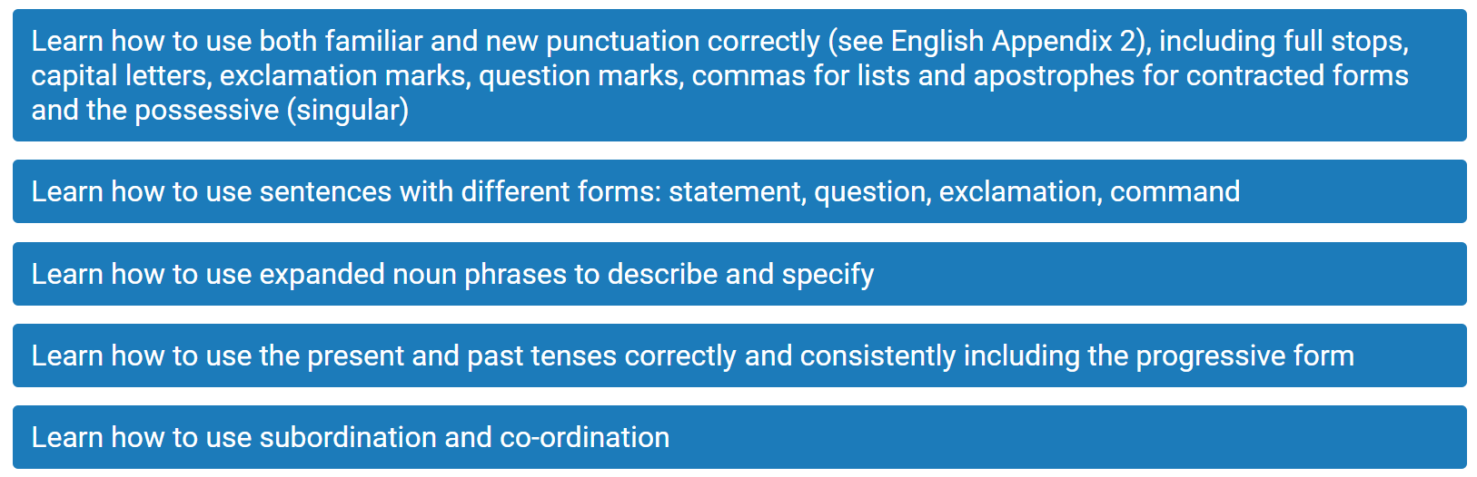
Expectations of the Writing Curriculum Y2

Slide 7
How do we teach writing at GSP?
Daily English lesson which incorporate writing, grammar and punctuation exercises.
English links to a high-quality text to give the writing a purpose and to inspire and engage pupils.
Opportunities for children to write pieces of fiction, non-fiction and poetry. This includes writing in the continuous provision in Year 1.
Writing and texts can link to areas of the wider curriculum to support with knowledge retention where appropriate.
Children encouraged to edit and improve their own writing.
Regular spelling lessons in school and opportunities for children to practise their spellings.

Slide 8

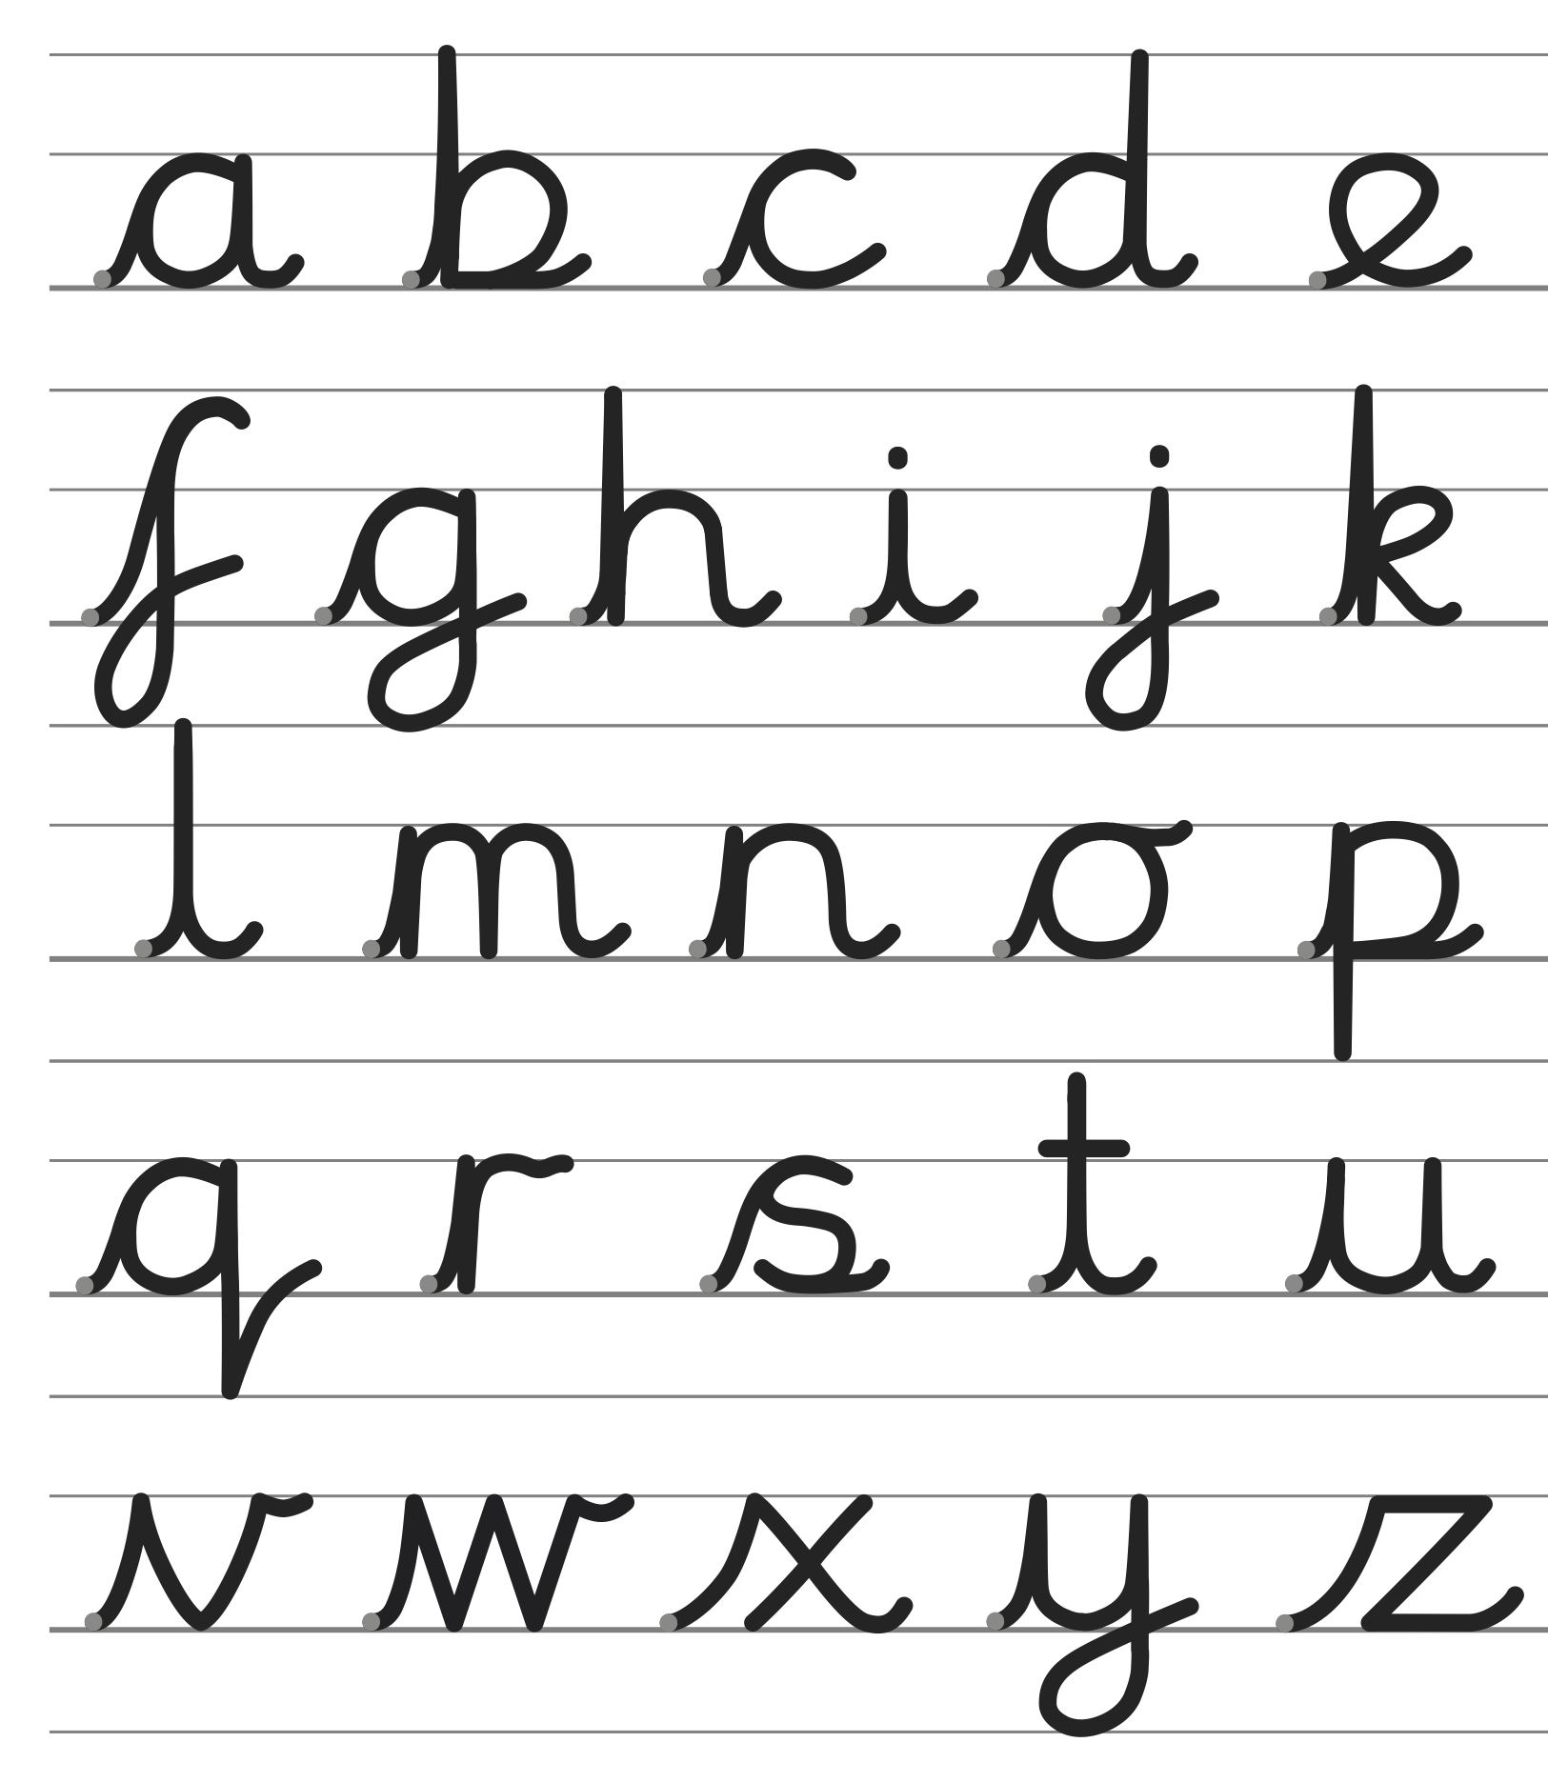
How do we teach handwriting at GSP?
Regular Handwriting Sessions using Letter-join
Support pupils to ensure their letter formation and digits 0-9 are accurate through regular practice and editing.
When pupils are ready, we introduce the lead-ins which support joined writing in Y2 and onwards.

Slide 9
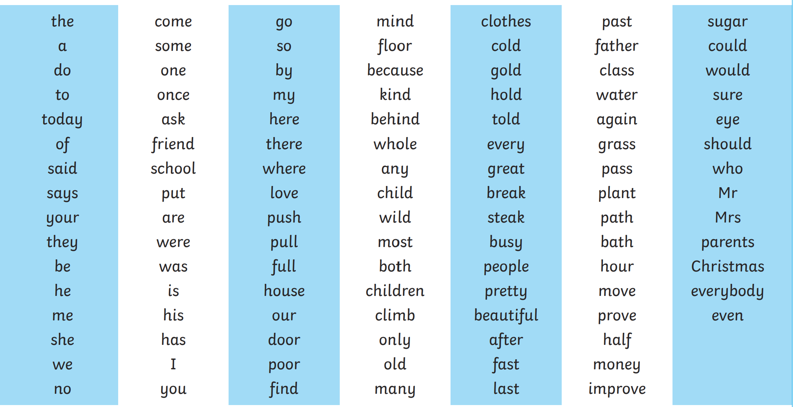
Year 1/2 Word List
By the end of KS1 children should be able to read and spell these words

Slide 10
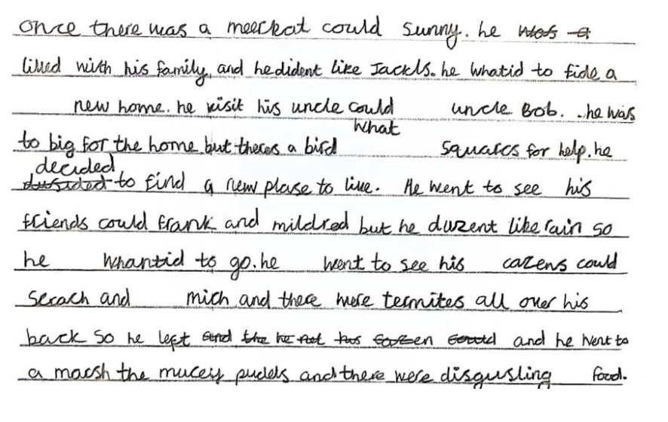
Expectations at the end of KS1
Working Towards the Expected Standard

Slide 11
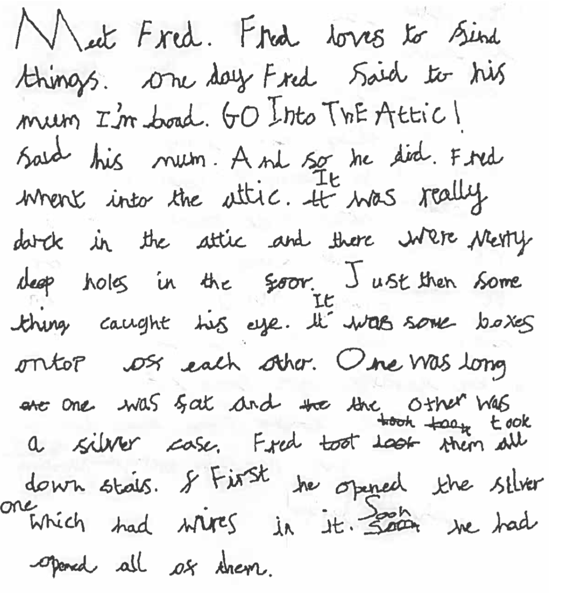
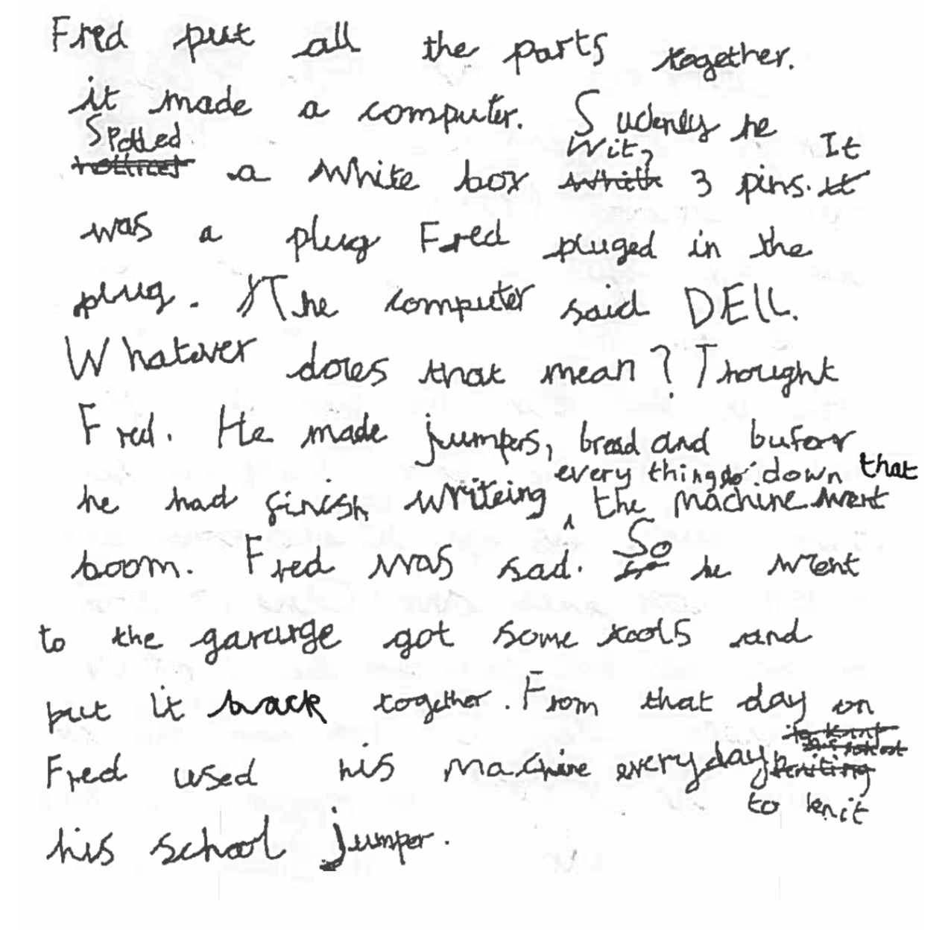
Expectations at the end of KS1
Working At the Expected Standard

Slide 12
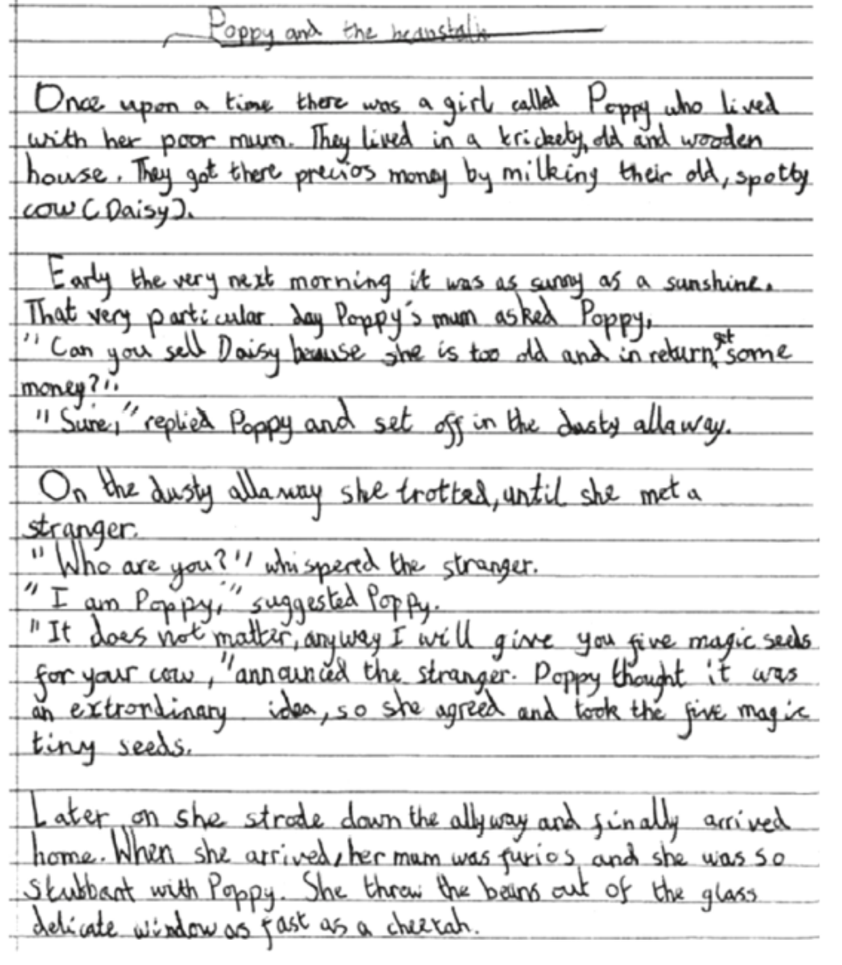
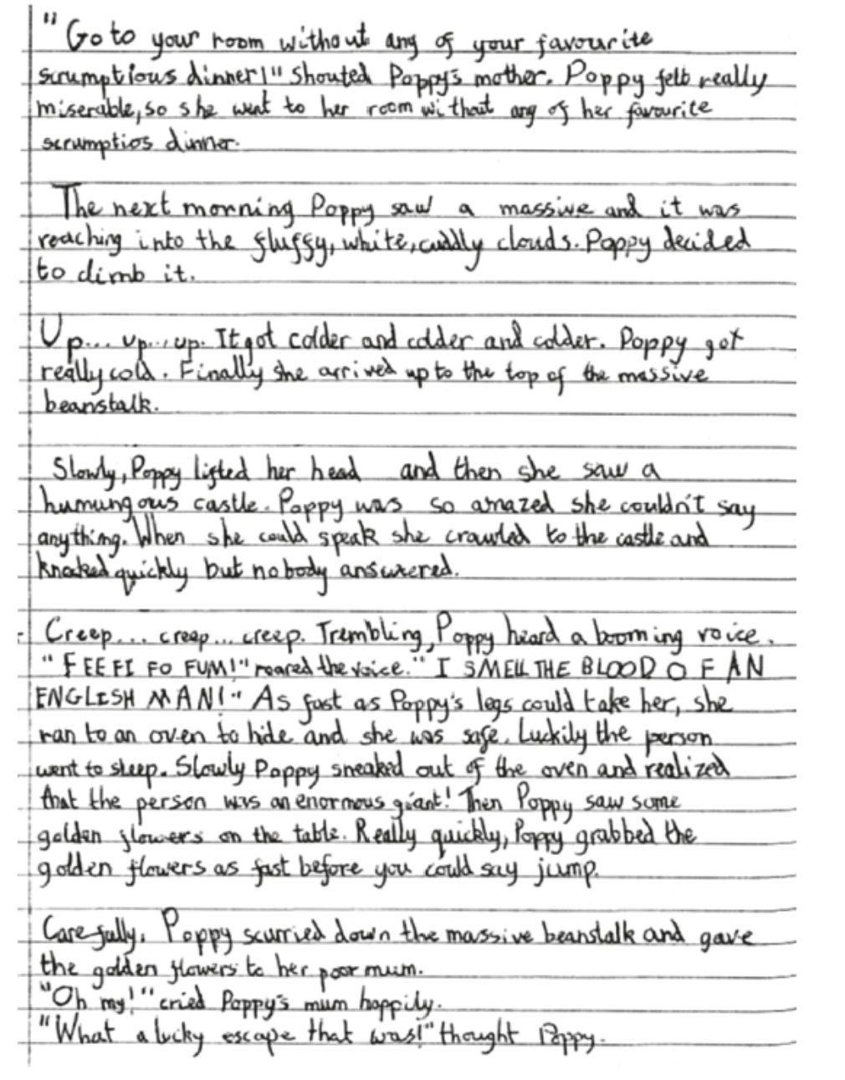
Expectations at the end of KS1
Working At Greater Depth of the Expected Standard

Slide 13
How can Parents support the development of writing at home?
Help your child to learn weekly spellings and practise handwriting / correct letter / digit formation at home.
Practise spelling of common exception words (back of reading journal).
Support with completion of any homework.
Encourage your child to check the use of capital letters and full stops and spellings in the written work they do at home.
Word games – examples of these on our school website English page. Googling 'spelling games for Year 1 / Year 2' should bring up some good examples.

Slide 14
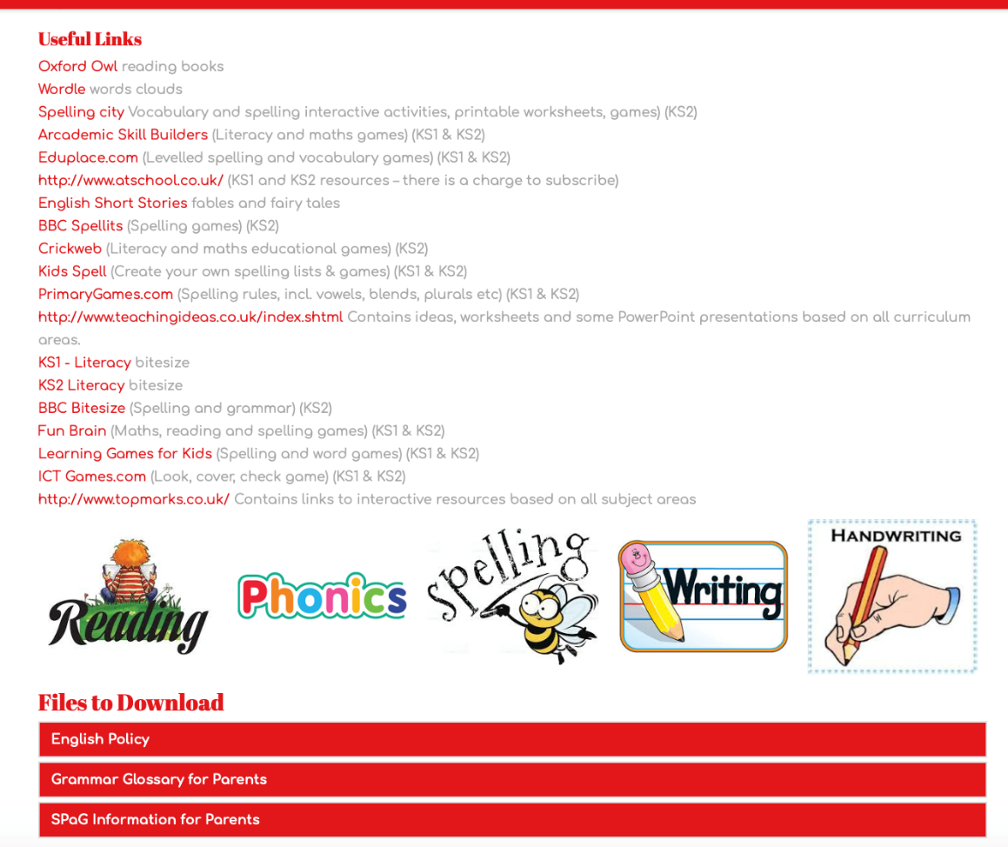
The Website:
Selection of useful links and pages about the school English curriculum.
https://www.greatsankeyprimaryschool.co.uk/page/english/116169

Slide 15
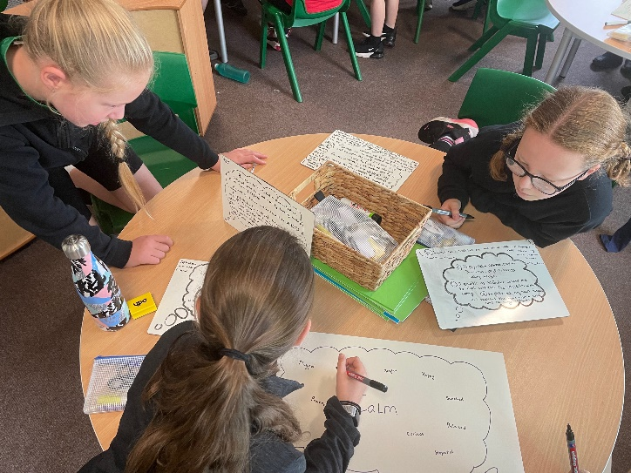
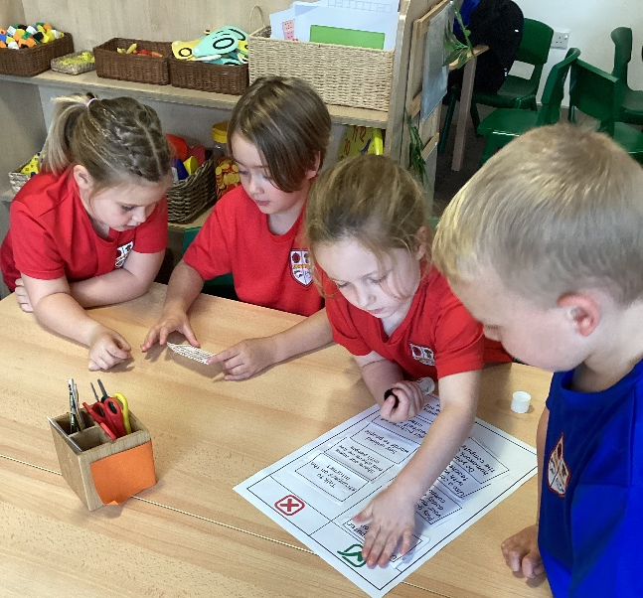
Classroom visits
KS1 classroom visits to see the children taking part in a range of writing and handwriting activities.
Hopefully provide you with practical ideas about how you can help to support the development of English writing skills at home too.
Feel free to move around the groups and interact with the children – ask the staff any questions you might have.

