Slide 1
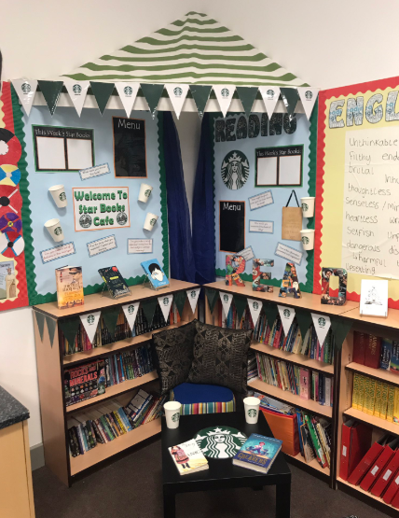


Stay & Read
How can we support
our children to become
confident readers?
Great Sankey Primary School
‘Together We Learn and Grow’

Slide 2
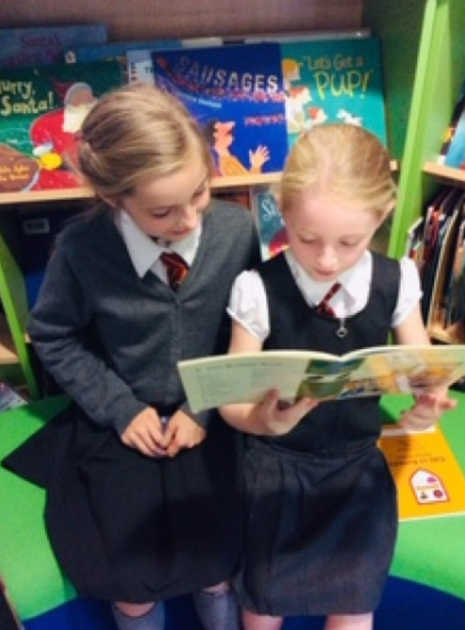
The Power of Reading!
Creating a love of reading in children is potentially one of the most powerful ways of improving academic standards in school.
There can be few better ways to improve pupils chances in school, or beyond in the wider world than to enable them to become truly independent readers.
Great Sankey Primary School
‘Together We Learn and Grow’

Slide 3
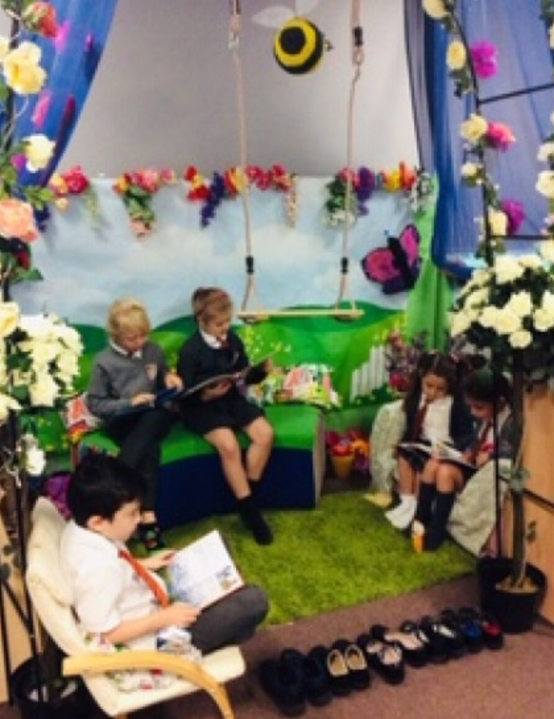
Why Is Reading Important?
Can have an impact on the success of a child’s education and into their adult life
Most aspects of the curriculum rely upon reading to a good extent – transferable vocabulary.
Promotes life-long skills
Promotes social skills
Great Sankey Primary School
‘Together We Learn and Grow’

Slide 4
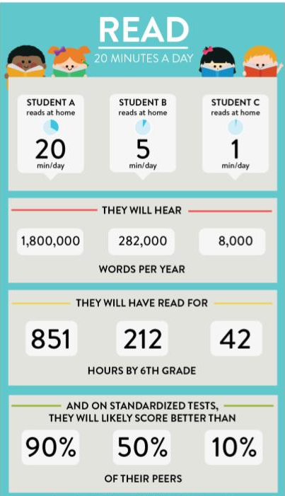
Why Is
Reading Important?
Impact on academic standards
Impact on vocabulary acquisition
Impact on wider curriculum understanding
Great Sankey Primary School
‘Together We Learn and Grow’

Slide 5
The First and Most Important Teacher …
As a parent or carer, you play the leading role in helping your child move through the stages of reading.
The link between home and school is such an important one – children who are encouraged, supported and taught in both environments will obviously have the best chance of success.
Great Sankey Primary School
‘Together We Learn and Grow’

Slide 6
How Can Parents Support Reading At Home?
Ensure that from a young age children observe positive examples of reading/books
Establish good reading habits for your children
Include reading into daily activities
Make reading fun
Expose your children to a wide range of subjects, authors, genres and themes
Great Sankey Primary School
‘Together We Learn and Grow’

Slide 7
How Can Parents Support Reading At Home?
Relate books to your children’s life experiences
Read with your children every day
Discuss the language used
Use direct and indirect questioning
‘Tell’ your children stories – you don’t always have to ‘read’ them
Great Sankey Primary School
‘Together We Learn and Grow’

Slide 8

What If My Child Is Stuck?
Use phonics first:
What sound does the word begin with? Can you
say the sounds in the word? Blend them together.
Read to the end of the sentence. What would make
sense?
What is the text about – what might fit here?
Does it sound right?
Look at the picture. Does it help?
Great Sankey Primary School
‘Together We Learn and Grow’

Slide 9
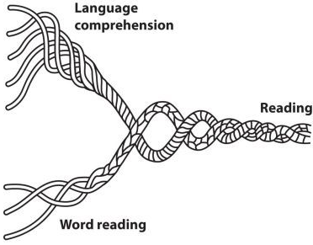
Teaching Reading
Reading requires two skills:
Phonic & Word Recognition:
The ability to recognise words presented in and out of context.
The ability to blend letter sounds (phonemes) together to read words.
Understanding:
The ability to understand the meaning of the words and sentences in a text.
The ability to understand the ideas, information and themes in a text
Great Sankey Primary School
‘Together We Learn and Grow’

Slide 10
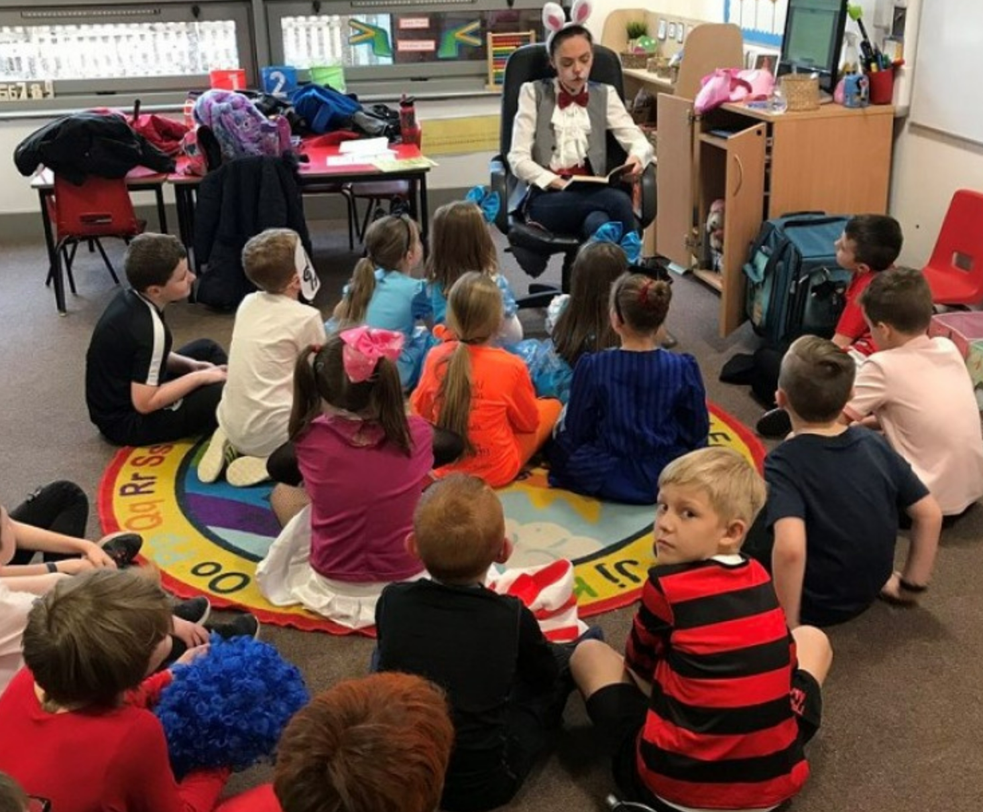
Developing Understanding
In KS2 our main focus of our explicit reading sessions is to develop the children’s understanding of the text. We do this through developing reading fluency and by teaching and practising a range of different questioning skills.
It is essential that the children have the opportunity to interact and engage with texts and move beyond literal comprehension. They need to consider questions that require them to deduce, infer, justify and evaluate.
Great Sankey Primary School
‘Together We Learn and Grow’

Slide 11
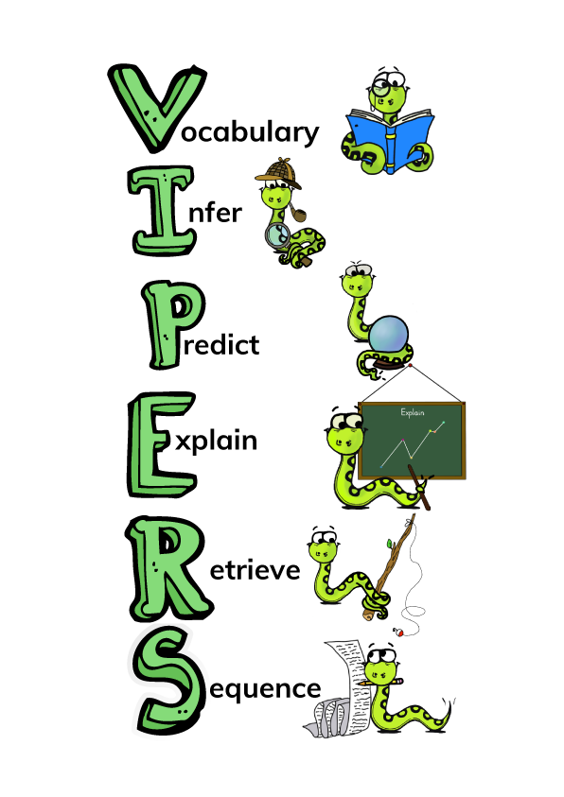
Strategies To Develop Understanding
Literal: repeating directly or in your own words what is in the text.
Inference: reading between the lines, drawing out conclusions which are based on, but go beyond, the information given in the text.
Deduction: drawing conclusions from the information given throughout the text.
Justification: finding evidence in the text to justify responses.
Evaluative : making critical judgements relating to the text.
Great Sankey Primary School
‘Together We Learn and Grow’

Slide 12

Promoting A Love Of Reading …
As a school and phase, our key priority is to promote and instil a love of reading in all children.
We provide children with many opportunities to read and be read to throughout the day.
Provide lots of exciting opportunities to promote reading – including:
Sponsored Reads
Reading Corner Competitions
School Book Fairs
100 Book challenge
Great Sankey Primary School
‘Together We Learn and Grow’

Slide 13
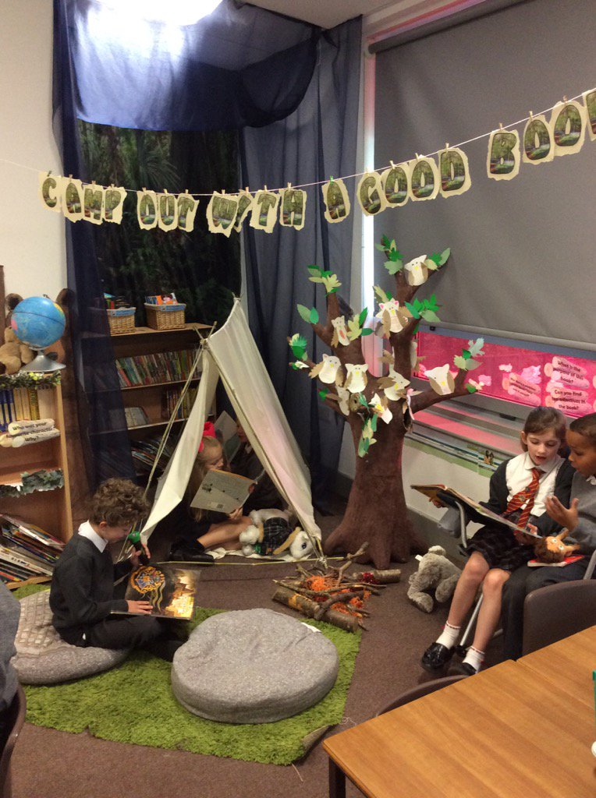
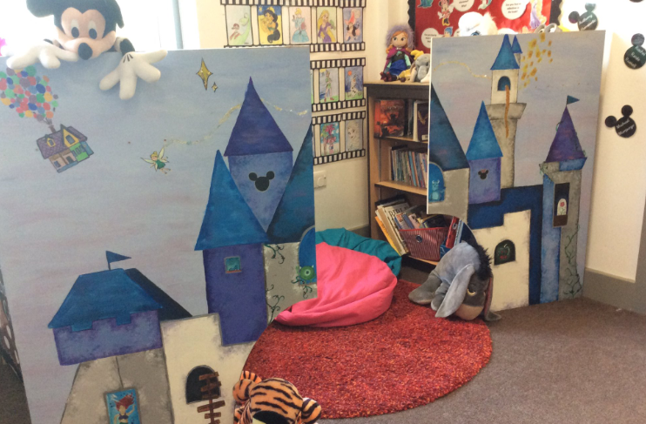
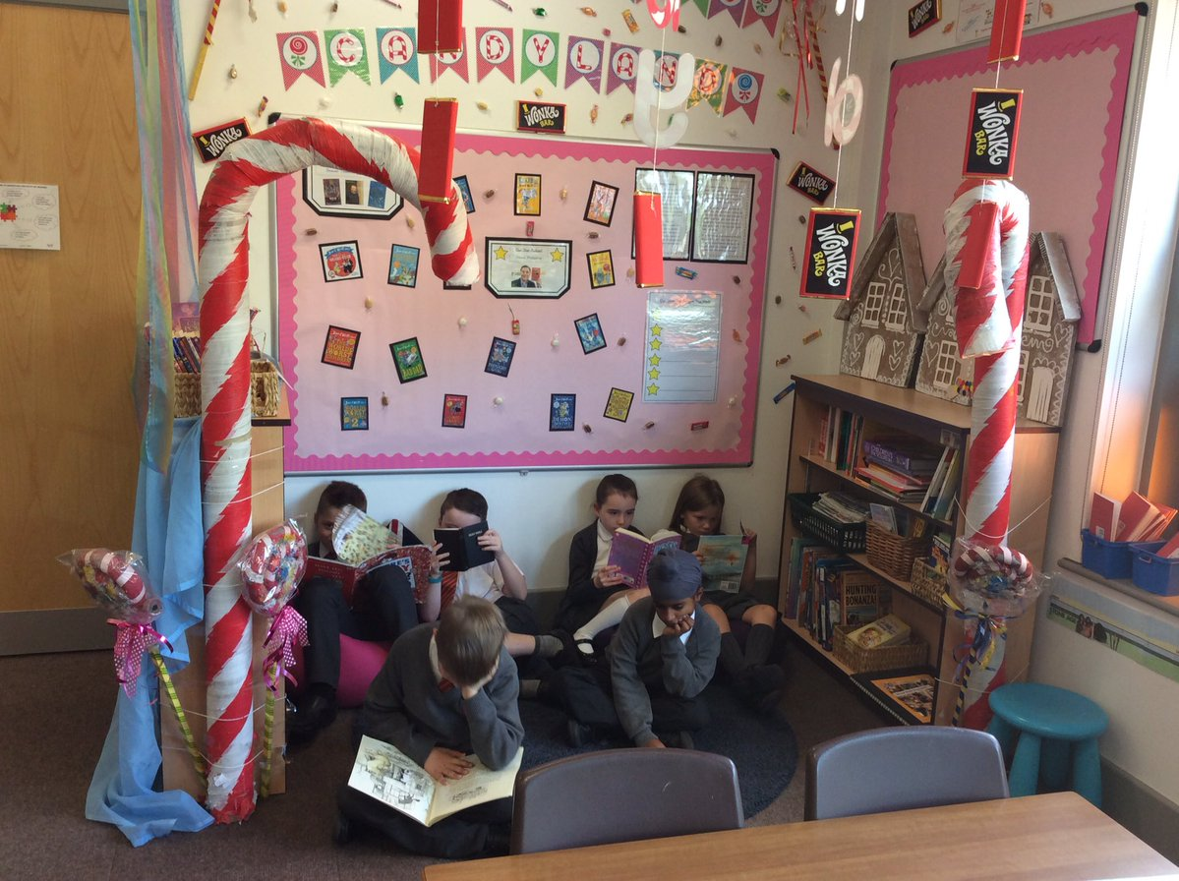
Reading Environments

Slide 14
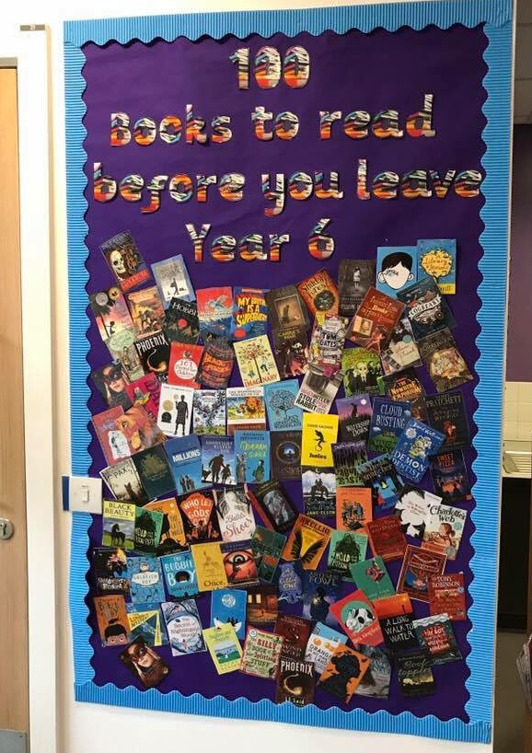
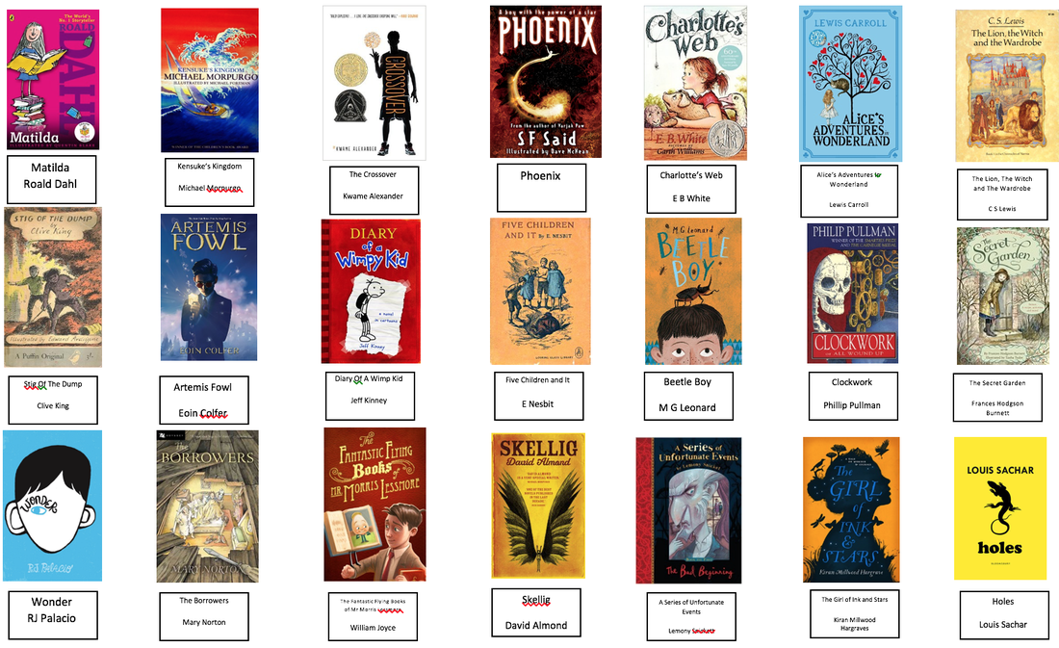
Recommended Reads!
Great Sankey Primary School
‘Together We Learn and Grow’

Slide 15
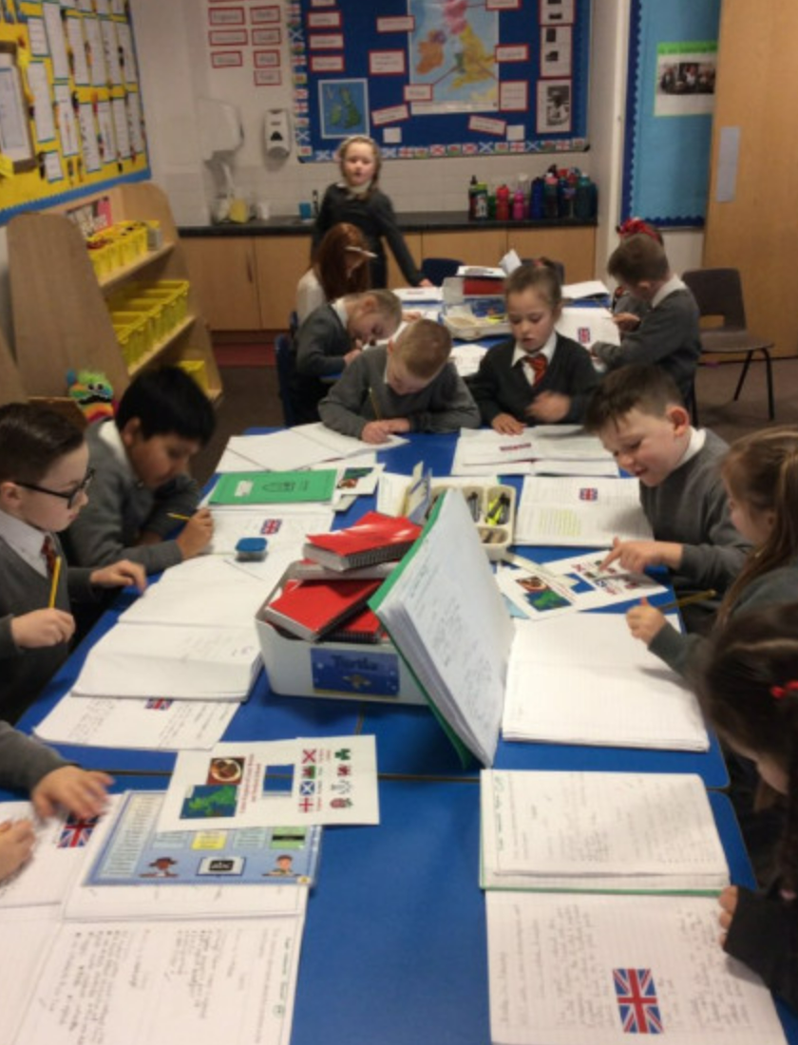
What does reading look like at GSP?
Shared Reading
Novel time
Whole Class Reading
Independent Reading
Reading intervention
Reading across the curriculum

Slide 16
KS2 Whole Class Reading
The children in Key Stage 2 engage in a specific 30-minute whole class reading session each day.
These sessions are centred around an age-appropriate text (fiction / non-fiction / poetry)
They focus on developing reading fluency, vocabulary and comprehension.
Great Sankey Primary School
‘Together We Learn and Grow’

Slide 17

What The National Curriculum Says?
Reading curriculum for KS2 is progressive – heavy weighting on inference and deduction in the end of key stage reading assessments.
As a school, we teach the skills of reading progressively as they move up the years through the key stage – ensuring a good coverage across a range of different text types.
Great Sankey Primary School
‘Together We Learn and Grow’

Slide 18

TCAT & GSP Reads
TCAT Reads: Supporting Your Child's Reading at Home (Primary) (office.com)
Great Sankey Primary School
‘Together We Learn and Grow’

Slide 19

Classroom Visits
Opportunity to visit your child’s classroom and see a selection of reading activities that your child completes in school.
Teachers are about who will model a guided reading session with a small group of children.
Opportunity to sit with your child and read a good book!
Great Sankey Primary School
‘Together We Learn and Grow’

