Slide 1
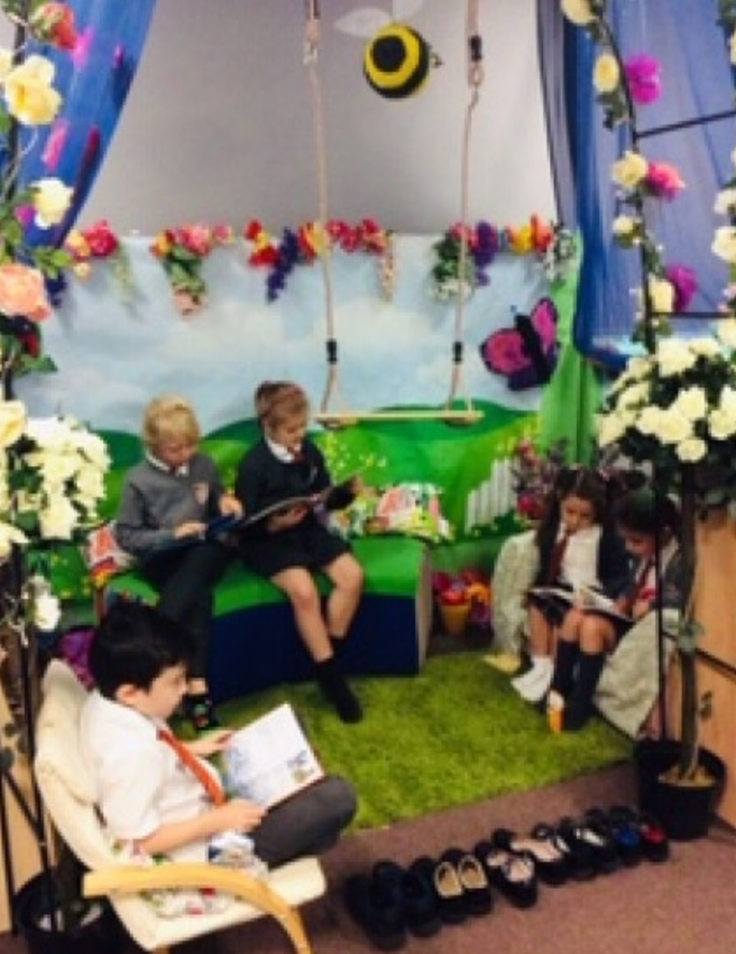

Stay & Read
How can we help children become confident and fluent readers?
Great Sankey Primary School
‘Together We Learn and Grow’

Slide 2

Why is reading so important?
What does the research say?
Creating a love of reading in children is potentially one of the most powerful ways of improving academic standards in school.
There can be few better ways to improve pupils' chances in school, or beyond in the wider world, than to enable them to become truly independent readers.
Promotes life-long skills.
Promotes social skills.
Expands vocabulary and supports oracy and writing.
Great Sankey Primary School
‘Together We Learn and Grow’

Slide 3
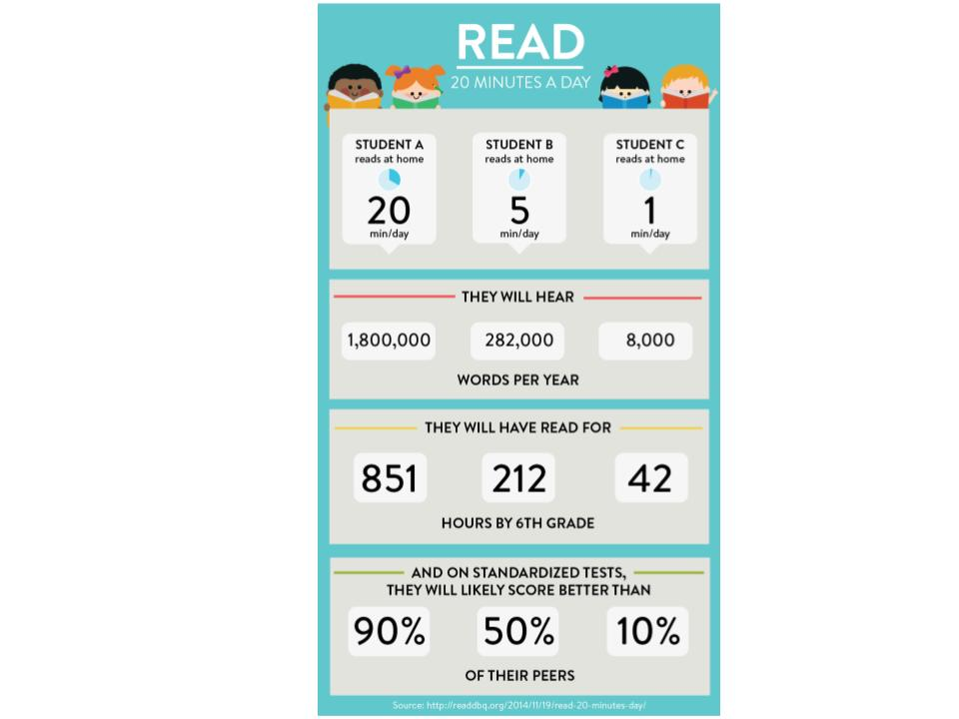
Why is reading so important?
What does the research say?
Great Sankey Primary School
‘Together We Learn and Grow’

Slide 4


You are the first and most important teacher
As a parent or carer, you play a leading
role in helping your child make progress
in reading.
The link between home and school is such an important one – children who are encouraged, supported and taught in both environments will obviously have the best chance of success.
Great Sankey Primary School
‘Together We Learn and Grow’

Slide 5

So, how can parents support reading at home?
Ensure that from a young age children observe positive examples of reading/books from you as the adult.
Establish good reading habits for your children, encouraging your child to read for at least 15 minutes per day.
Include reading into daily activities such as bedtime routines with a story or allowing your child to read independently in bed.
Make reading fun – comics, reading signs, instructions to help you make things, recipes etc.
Expose your children to a wide range of subjects, authors, genres and themes
Great Sankey Primary School
‘Together We Learn and Grow’

Slide 6

How Can Parents Support Reading At Home?
Read stories with and to your children regularly
Discuss the language used in the books – discuss word meanings
Use questioning to check their understanding
‘Tell’ your children stories – you don’t always have to ‘read’ them
Great Sankey Primary School
‘Together We Learn and Grow’

Slide 7

How Can Parents Support Reading At Home?
TCAT Reads package for supporting parents with their child's reading
TCAT Reads: Supporting Your Child's Reading at Home (Primary) (office.com)
Great Sankey Primary School
‘Together We Learn and Grow’

Slide 8
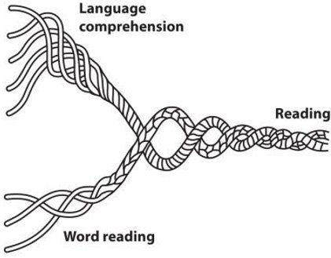

Understanding the Components of Reading
Reading requires two skills:
Phonic & Word Recognition:
The ability to recognise words presented in and out of context.
The ability to blend letter sounds (phonemes) together to read words.
Understanding:
The ability to understand the meaning of the words and sentences in a text.
The ability to understand the ideas, information and themes in a text
Great Sankey Primary School
‘Together We Learn and Grow’

Slide 9

What the National Curriculum says………..
It is expected that children in Years 3 and 4 can proficiently decode age-appropriate texts and the weighting of teaching, therefore, is towards comprehension and vocabulary.
As a school, we teach the skills of reading comprehension – ensuring the children are exposed to a range of text types such as fiction, non-fiction and poetry.
Great Sankey Primary School
‘Together We Learn and Grow’

Slide 10
Developing Understanding
In KS2 our main focus of our explicit reading sessions is to develop the children’s understanding of the text. We do this through developing reading fluency and by teaching and practising a range of different questioning skills.
It is essential that the children have the opportunity to interact and engage with texts and move beyond literal comprehension. They need to consider questions that require them to deduce, infer, justify and evaluate.
Great Sankey Primary School
‘Together We Learn and Grow’

Slide 11
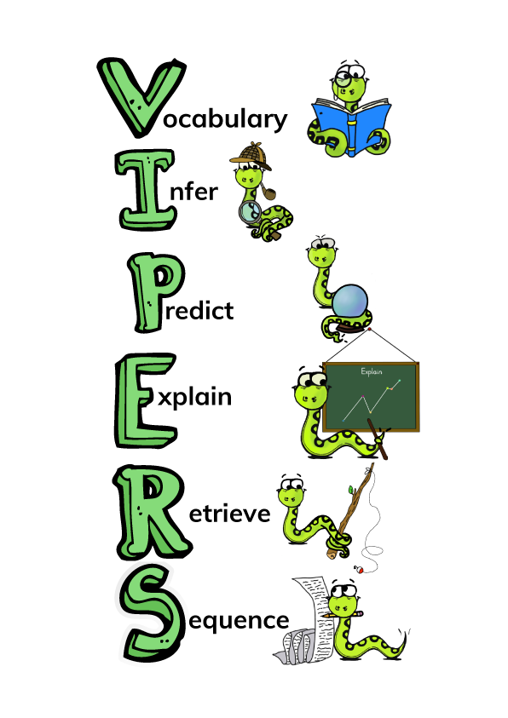
Strategies to Develop Children’s Understanding
Literal: repeating directly or in your own words what is in the text.
Inference: reading between the lines, drawing out conclusions which are based on, but go beyond, the information given in the text.
Deduction: drawing conclusions from the information given throughout the text.
Justification: finding evidence in the text to justify responses.
Evaluative : making critical judgements relating to the text.
Great Sankey Primary School
‘Together We Learn and Grow’

Slide 12
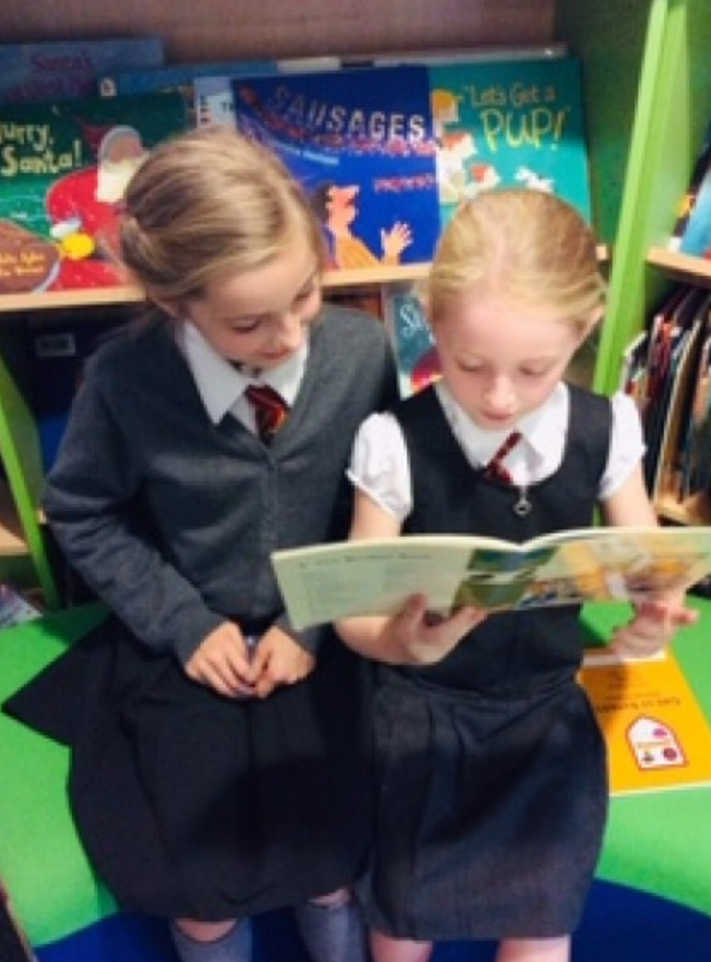
What does reading look like at GSP?
Shared Reading
Novel time
Whole Class Reading
Independent Reading
1:1 reading with an adult
Reading interventions
Reading across the curriculum
Great Sankey Primary School
‘Together We Learn and Grow’

Slide 13
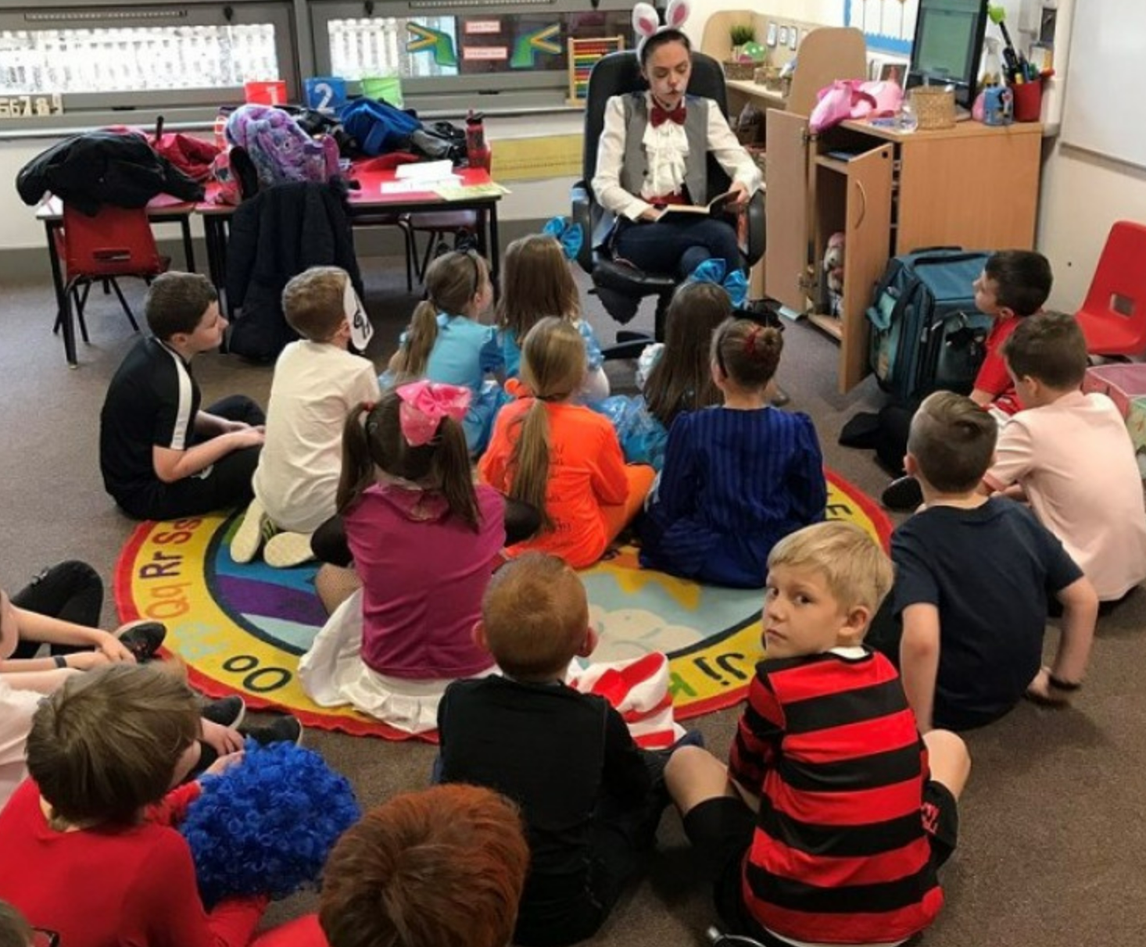
Whole Class Reading
The children in Key Stage 2 engage in a specific 30-minute whole class reading session each day.
These sessions are centred around an age-appropriate text (fiction / non-fiction / poetry)
They focus on developing reading
fluency, vocabulary and
comprehension.
Great Sankey Primary School
‘Together We Learn and Grow’

Slide 14

Promoting A Love Of Reading
As a school and phase, a key priority is to promote and instil a love of reading in all children.
We provide children with many opportunities to read and be read to throughout the day.
Provide lots of exciting opportunities to promote reading – including:
Sponsored Reads
Reading Corner Competitions
School Book Fairs
100 Reading Book challenge
World Book Day events
Great Sankey Primary School
‘Together We Learn and Grow’

Slide 15
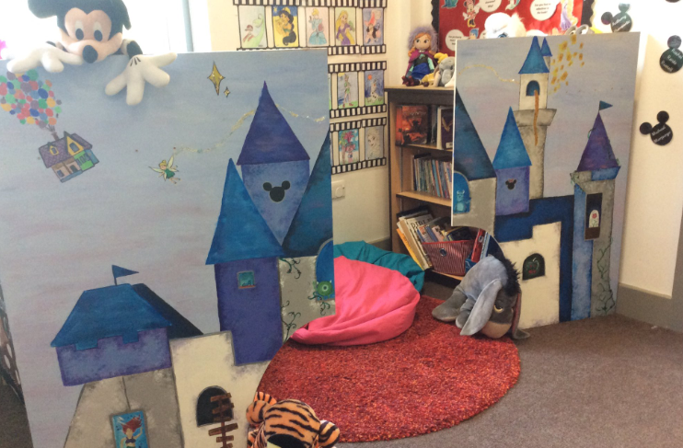
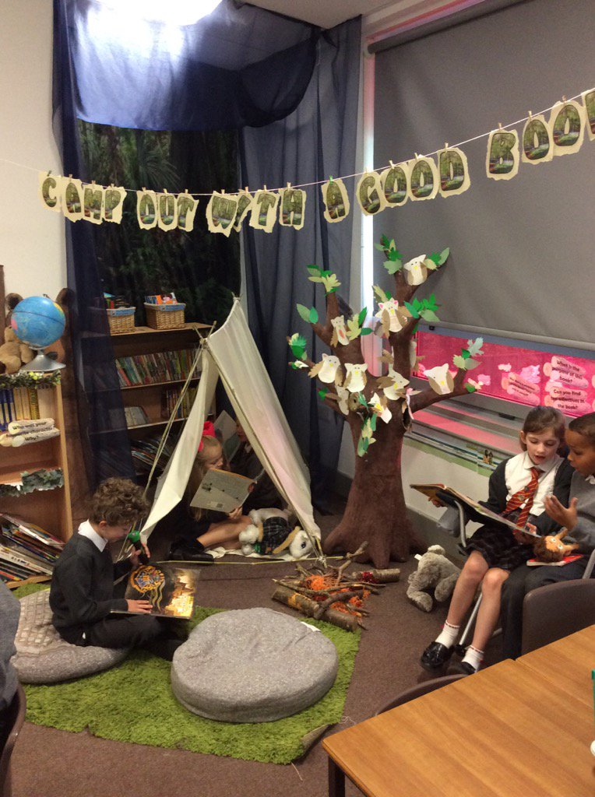
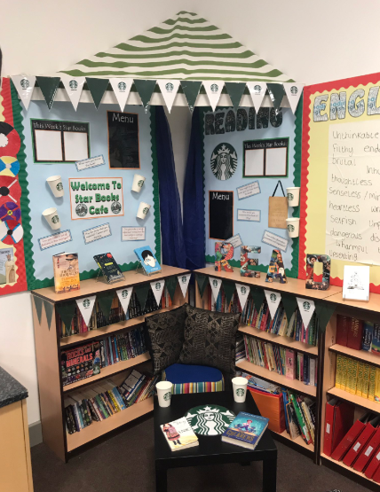
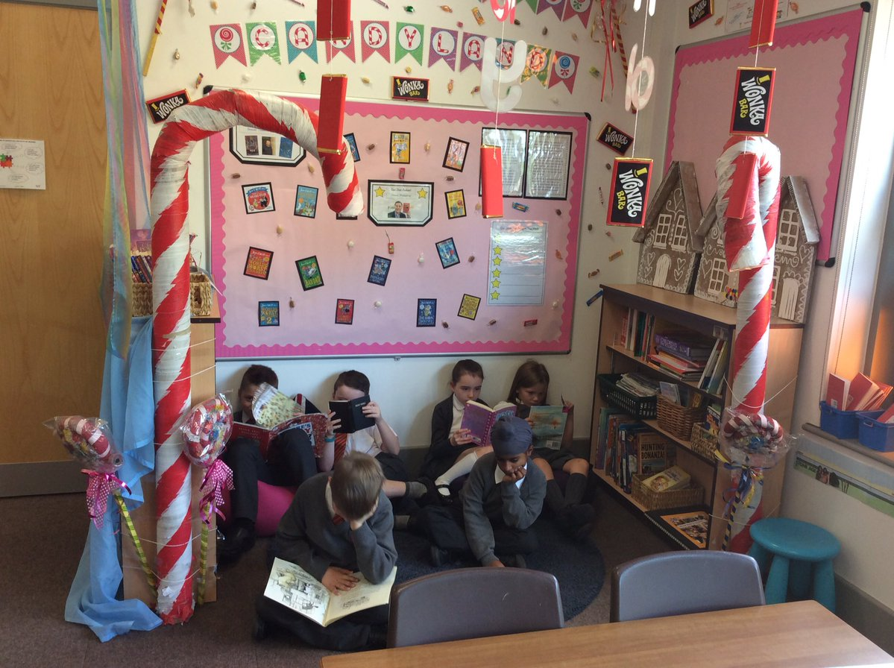
Reading
environments
Great Sankey Primary School
‘Together We Learn and Grow’

Slide 16
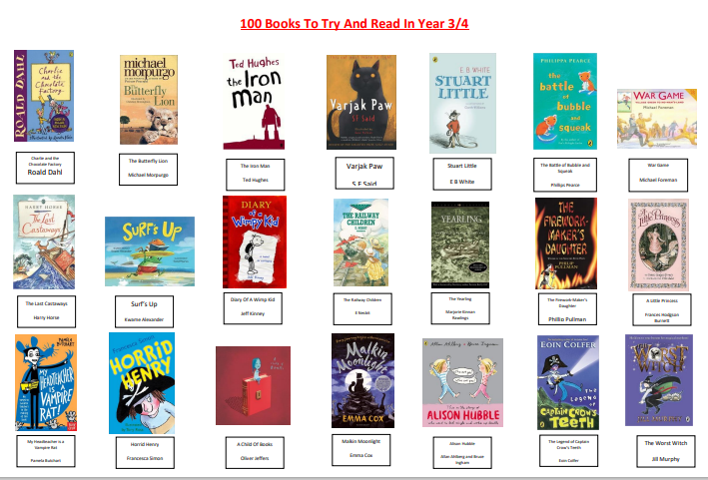
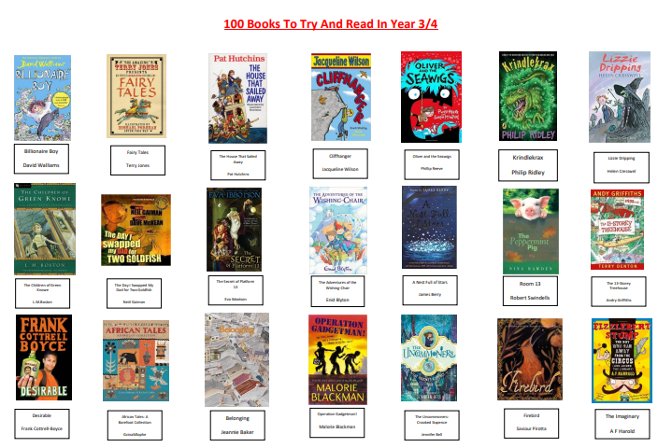

Recommended 100 books to try and read in Year 3&4
Great Sankey Primary School
‘Together We Learn and Grow’

Slide 17

Classroom Visits
An opportunity to visit your child’s classroom and see reading in action.
Great Sankey Primary School
‘Together We Learn and Grow’

