Slide 1



Stay & Read
How can we support
our children to become
confident readers?
Great Sankey Primary School
‘Together We Learn and Grow’

Slide 2
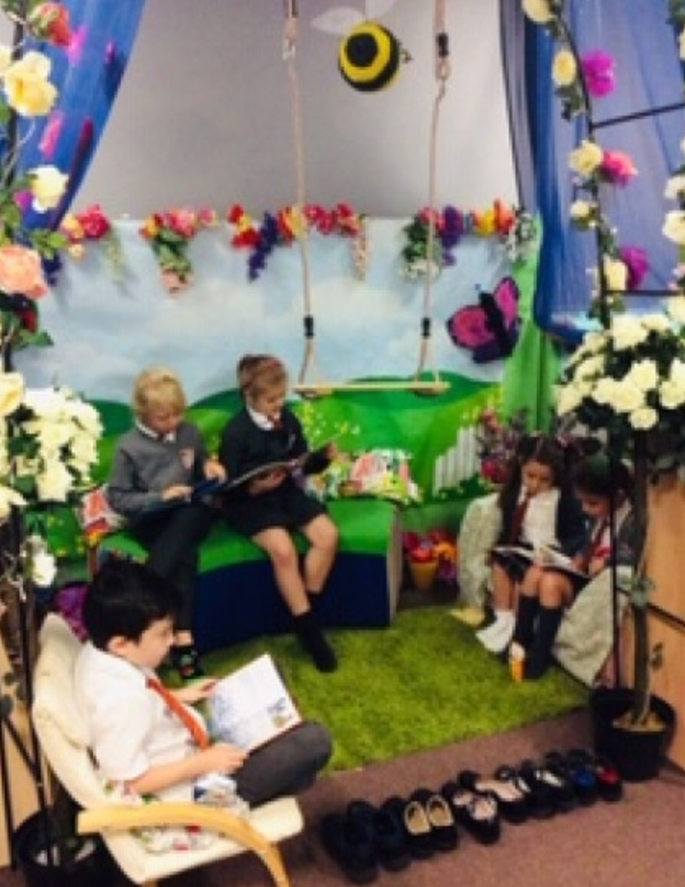
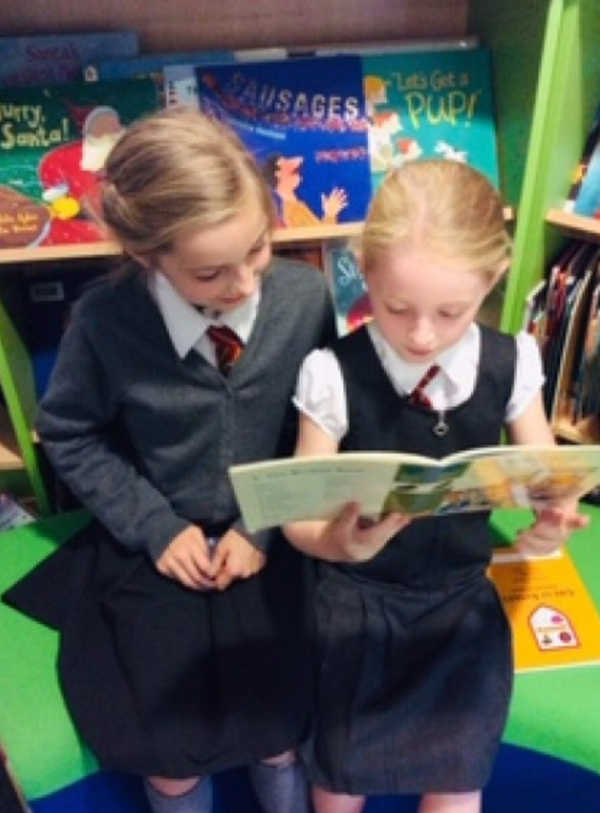
The Power of Reading!
Creating a love of reading in children is potentially one of the most powerful ways of improving academic standards in school.
There can be few better ways to improve pupils' chances in school, or beyond in the wider world than to enable them to become truly independent readers.
Promotes life-long skills
Promotes social skills
Expands vocabulary
Great Sankey Primary School
‘Together We Learn and Grow’

Slide 3
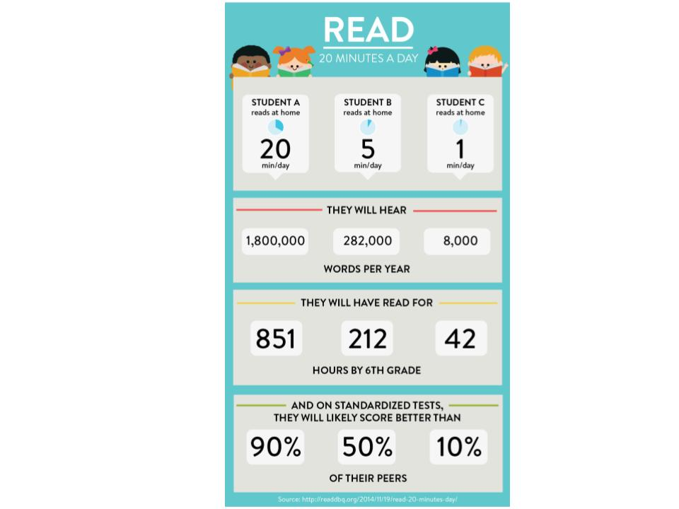
Why Is Reading Important?
Great Sankey Primary School
‘Together We Learn and Grow’

Slide 4
The First and Most Important Teacher …
As a parent or carer, you play the leading role in helping your child move through the stages of reading.
The link between home and school is such an important one – children who are encouraged, supported and taught in both environments will obviously have the best chance of success.
Great Sankey Primary School
‘Together We Learn and Grow’

Slide 5
How Can Parents Support Reading At Home?
Ensure that from a young age children observe positive examples of reading/books
Establish good reading habits for your children
Include reading into daily activities
Make reading fun
Expose your children to a wide range of subjects, authors, genres and themes
Tell your children stories – you don’t always have to read them!
Great Sankey Primary School
‘Together We Learn and Grow’

Slide 6

TCAT & GSP Reads
TCAT Reads: Supporting Your Child's Reading at Home (Primary) (office.com)
Great Sankey Primary School
‘Together We Learn and Grow’

Slide 7

What If My Child Is Stuck?
Use phonics first:
What sound does the word begin with? Can you
say the sounds in the word? Blend them together.
Read to the end of the sentence. What would make
sense?
What is the text about – what might fit here?
Does it sound right?
Look at the picture. Does it help?
Great Sankey Primary School
‘Together We Learn and Grow’

Slide 8
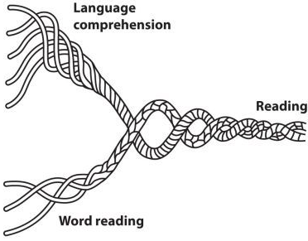
Teaching Reading
Reading requires two skills:
Phonic & Word Recognition:
The ability to recognise words presented in and out of context.
The ability to blend letter sounds (phonemes) together to read words.
Understanding:
The ability to understand the meaning of the words and sentences in a text.
The ability to understand the ideas, information and themes in a text
Great Sankey Primary School
‘Together We Learn and Grow’

Slide 9

Promoting A Love Of Reading …
As a school and phase, our key priority is to promote and instil a love of reading in all children.
We provide children with many opportunities to read and be read to throughout the day.
Provide lots of exciting opportunities to promote reading – including:
Sponsored Reads
Reading Corner Competitions
School Book Fairs
100 Book challenge
World Book Day
Great Sankey Primary School
‘Together We Learn and Grow’

Slide 10
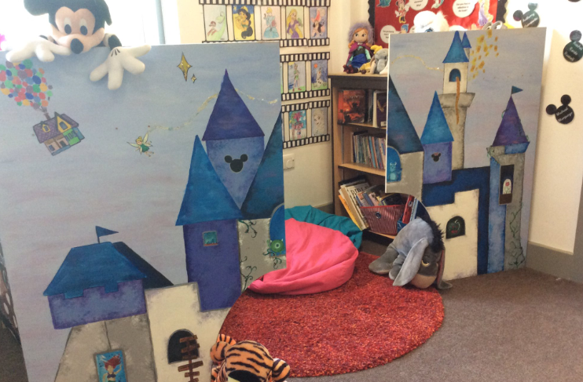
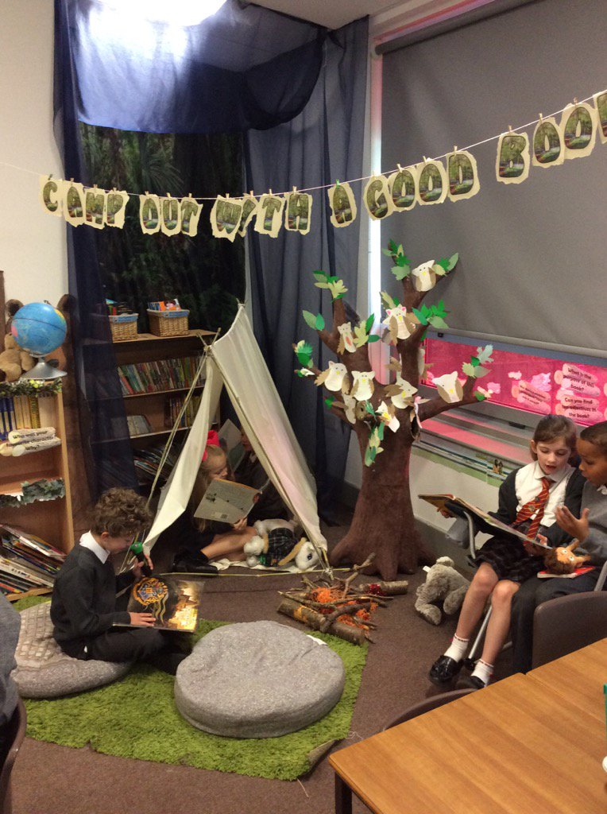
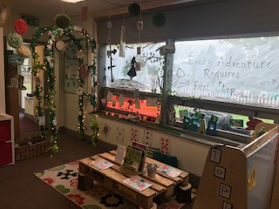
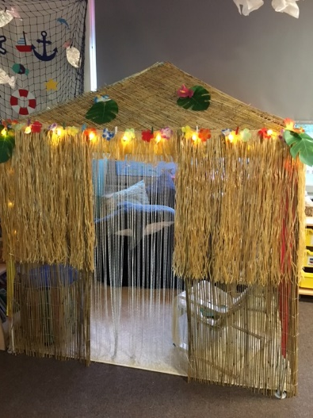
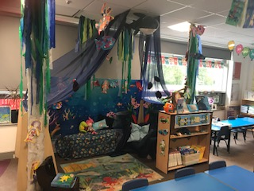
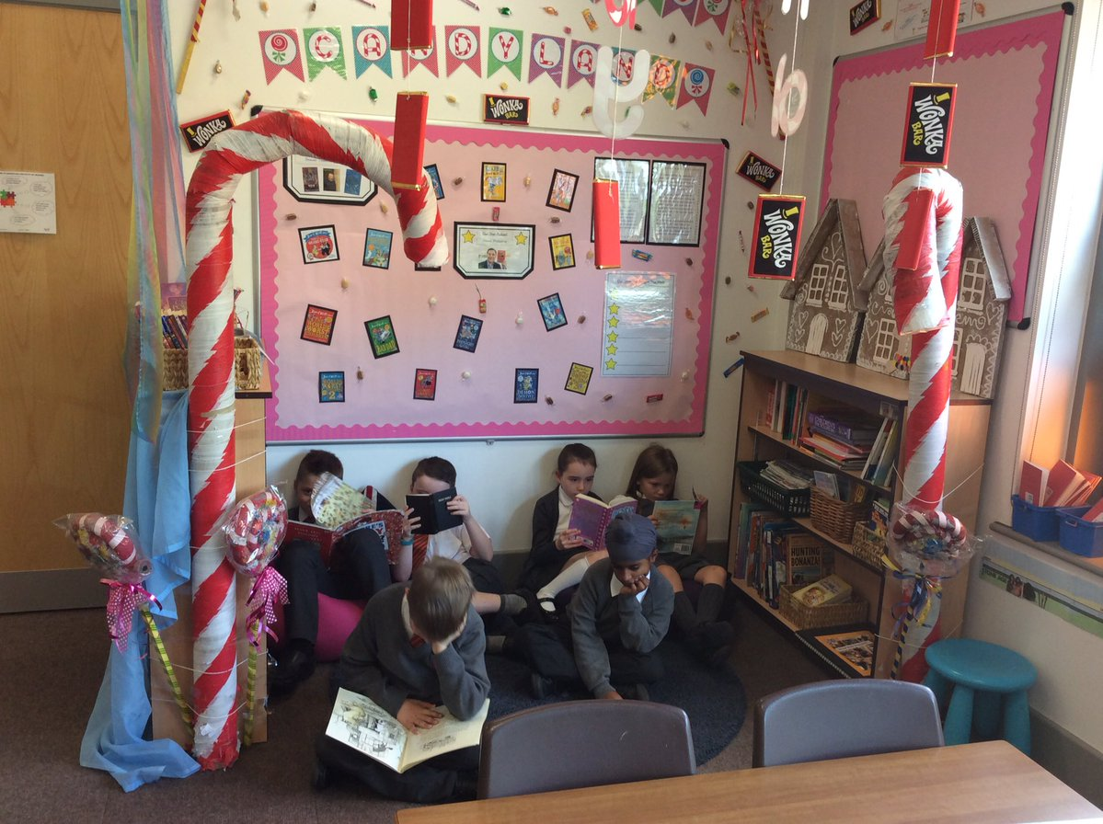
Reading Environments

Slide 11

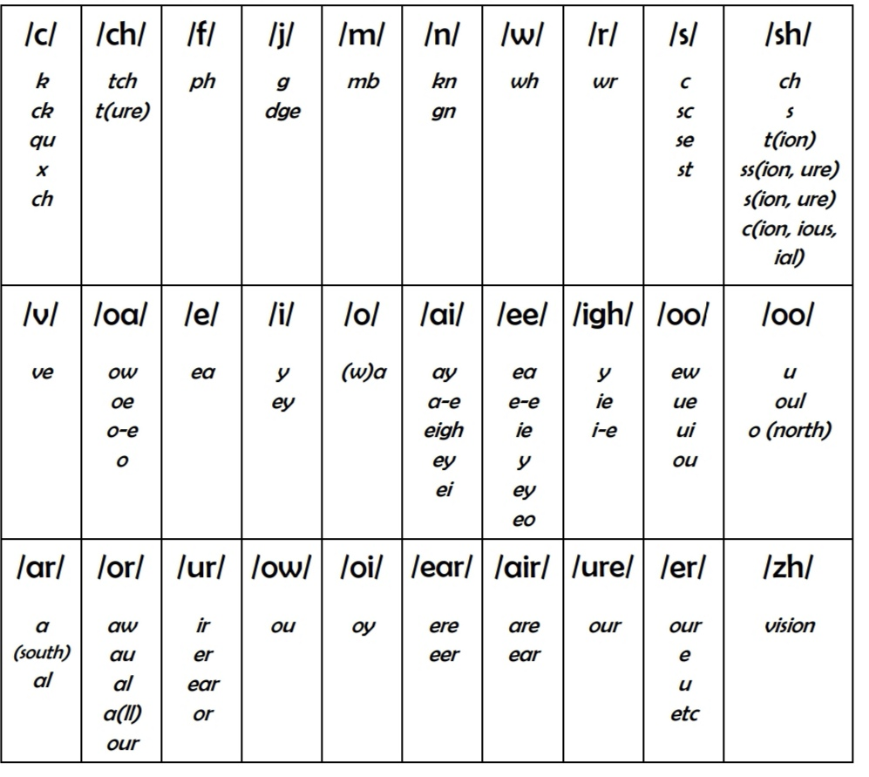
What does reading look like at GSP?
Phonics sessions (daily)
Shared reading (all sharing a text together)
Guided reading (a small group led by an adult)
Independent reading (reading books at their own level to gain pace, fluency and enjoyment of reading)
1:1 supported reading (with an adult in school)
Focused reading task (a variety of activities based around a book)
Reading across the curriculum

Slide 12
KS1 Guided Reading
Guided reading is a technique used to teach and model the skills of fluently decoding and understanding the text.
Throughout the week, children will complete a range of different reading activities on a carousel basis.
The children will work independently, in groups or in pairs.
Great Sankey Primary School
‘Together We Learn and Grow’

Slide 13
Example Timetable
 | Monday | Tuesday | Wednesday | Thursday | Friday
Group 1 | Guided Read | Follow-up Activity | Independent Reading | Reading Activity 1 | Reading Activity 2
Group 2 | Reading Activity 2 | Guided Read | Follow-up Activity | Independent Reading | Reading Activity 1
Group 3 | Reading Activity 1 | Reading Activity 2 | Guided Read | Follow-up Activity | Independent Reading
Group 4 | Independent Reading | Reading Activity 1 | Reading Activity 2 | Guided Read | Follow-up Activity
Group 5 | Follow-up Activity | Independent Reading | Reading Activity 1 | Reading Activity 2 | Guided Read
Great Sankey Primary School
‘Together We Learn and Grow’

Slide 14
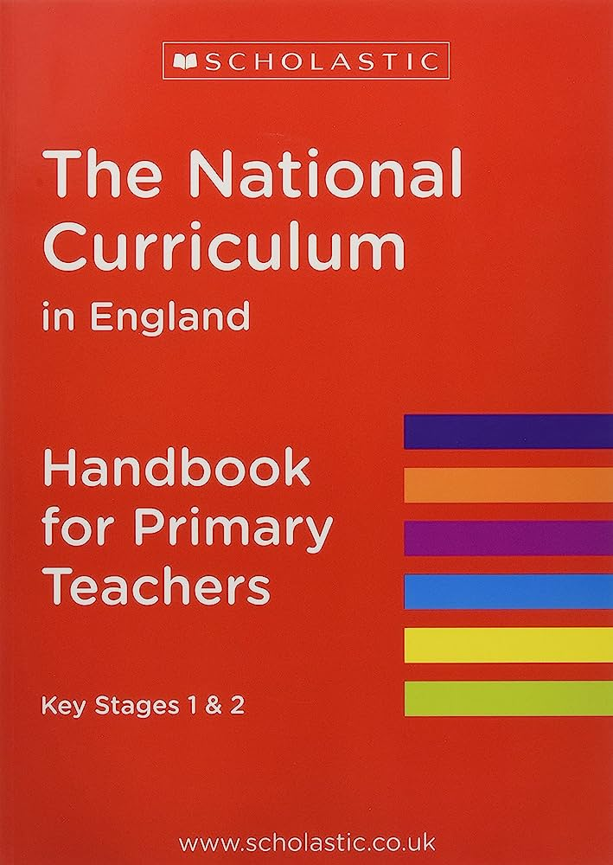
What The National Curriculum Says?
Children at the end of Key Stage 1 can :
read most common exception words
read most words containing common suffixes
from age-appropriate books (white / gold band), read words accurately and fluently without overt sounding and blending (90 words per minute)
sound out most unfamiliar words accurately without undue hesitation
check it makes sense to them
Answer questions and make some inferences (going beyond the literal).

Slide 15

Classroom Visits
An opportunity to visit your child’s classroom and see a selection of reading activities that your child completes in school.
Great Sankey Primary School
‘Together We Learn and Grow’

