Slide 1

Welcome to Reception
Stay and Play
June 2023
Great Sankey Primary School
‘Together We Learn and Grow’

Slide 2

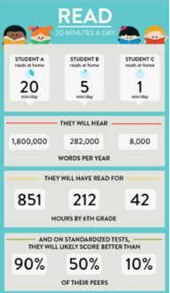
Great Sankey Primary School
‘Together We Learn and Grow’

Slide 3
Thank you for your support so far in your child’s reading journey. As with all aspects of school life, partnership working is essential in order to give our children the best possible opportunities.
We are extremely proud of how well the children have adapted to learning new skills in reading and phonics. The more often children can use their reading / phonic skills in games and play the better.
Every day the children have a phonic session with one of the members of the EYFS team, today you will be able to observe this in action ☺
Great Sankey Primary School
‘Together We Learn and Grow’
Notes:
Welcome back
Hope you’ve had a great summer, well rested, relaxed.
Great to see so many of your photos on FB, Steph’s tik toks!
Congratulations to Granny Jo – Brody
Run through the day

Slide 4
Children in Reception are working toward Early Learning Goals. The ELGs for Literacy are as follows…
Comprehension
Demonstrate understanding of what has been read to them by retelling stories using their own words and recently introduced vocabulary.
Anticipate key events in stories.
Use and understand recently introduced vocabulary during discussions about stories, non-fiction, rhymes and poems and during role-play.
Word Reading
• Say a sound for each letter in the alphabet and at least 10 digraphs.
• Read words consistent with their phonic knowledge by sound-blending.
• Read aloud simple sentences and books that are consistent with their phonic knowledge, including some common exception words.
Writing
• Write recognisable letters, most of which are correctly formed.
• Spell words by identifying sounds in them and representing the sounds with a letter or letters.
• Write simple phrases and sentences that can be ready by others.
Great Sankey Primary School
‘Together We Learn and Grow’
Notes:
This is the new Team GSP
Very proud to be the new HT of this school and to work alongside you all.
Thank you for all the lovely messages before the summer, meant a great deal to know you’re all behind me and supporting me and I hope I serve you all well
Jane de Foy ‘ you’re not one of those are you, you know a new broom sweeps clean?’ made me laugh but on reflection made me think about how you all must be feeling. A significant change such as a new HT can lead to some of you feeling unsettled and a bit nervous – reassurance. Strength of the team.
Book Imperfect leadership ‘page 55’. Great book and has some great advice for new Headteachers.

Slide 5
In order to reach these Early Learning Goals the children take part in a number of activities each day. Here are just a few:
We plan our themes / topics from a quality text. You may have heard about a few of them from the children ☺
We have a teacher focussed writing activity each day, along with opportunities to write for a purpose all around the classroom.
We read a range of fabulous stories with the children at every opportunity possible.
We role play and use puppets to re-enact stories in our outdoor classroom.
We practise our handwriting using pencils and paper but also strengthen our muscles using fine motor activities eg: play dough, pegs, malleable materials, scissor skills etc.
Great Sankey Primary School
‘Together We Learn and Grow’
Notes:
This is the new Team GSP
Very proud to be the new HT of this school and to work alongside you all.
Thank you for all the lovely messages before the summer, meant a great deal to know you’re all behind me and supporting me and I hope I serve you all well
Jane de Foy ‘ you’re not one of those are you, you know a new broom sweeps clean?’ made me laugh but on reflection made me think about how you all must be feeling. A significant change such as a new HT can lead to some of you feeling unsettled and a bit nervous – reassurance. Strength of the team.
Book Imperfect leadership ‘page 55’. Great book and has some great advice for new Headteachers.

Slide 6
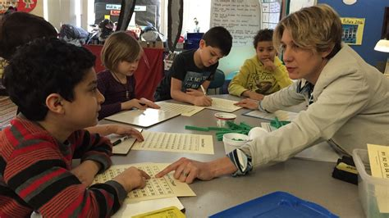
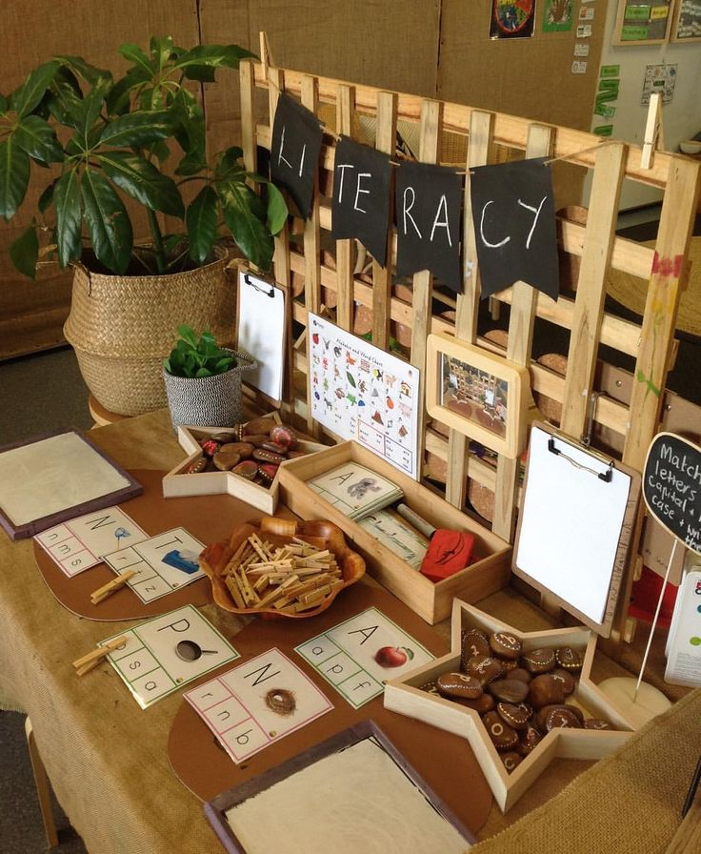
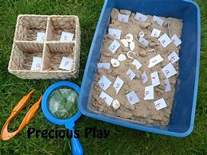
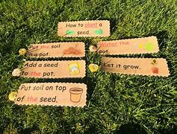
Learning in the Early Years
looks less like this.
and more like this …..
Now let’s go and see it in action! ☺
Great Sankey Primary School
‘Together We Learn and Grow’
Notes:
This is a time of change for our school so it’s a good time to stop and take stock and reflect. We’ll start with our vision. The school’s vision should be a shared vision where everyone buys into it – when was the last time we looked at it collectively? Today is a good opportunity.
Read through
Children are at the heart as they always should be. Everything we do comes down to benefit them. Could this be an opportunity to stop, reflect and to tweak some of our practice?
Do we do some of the things we do because we’ve always done them? Is there a better way? Referred to in the book as the Christmas tree effect – not saying this is what we do but sometimes – any changes we make or additions have been measured and based on research and this needs to continue. Now is a good time to shape our practice so we’re going to carry out a short exercise in teams.

