Slide 1


LKS2 Stay and Learn 2023
Great Sankey Primary School
‘Together We Learn and Grow’

Slide 2
Welcome!
Today we hope to:
Provide you with some information as to what the maths curriculum looks like for your child and what national end of year expectations are for each age group.
Explain to you how we teach maths at Great Sankey Primary School and share some of the strategies and methods we use with you.
Discuss how maths is assessed in your child’s year group.
Give you some ideas as to how you can support your child with their maths work at home.
Offer an insight into what a normal maths lesson looks like in school.
Great Sankey Primary School
‘Together We Learn and Grow’
Notes:
Welcome back
Hope you’ve had a great summer, well rested, relaxed.
Great to see so many of your photos on FB, Steph’s tik toks!
Congratulations to Granny Jo – Brody
Run through the day

Slide 3
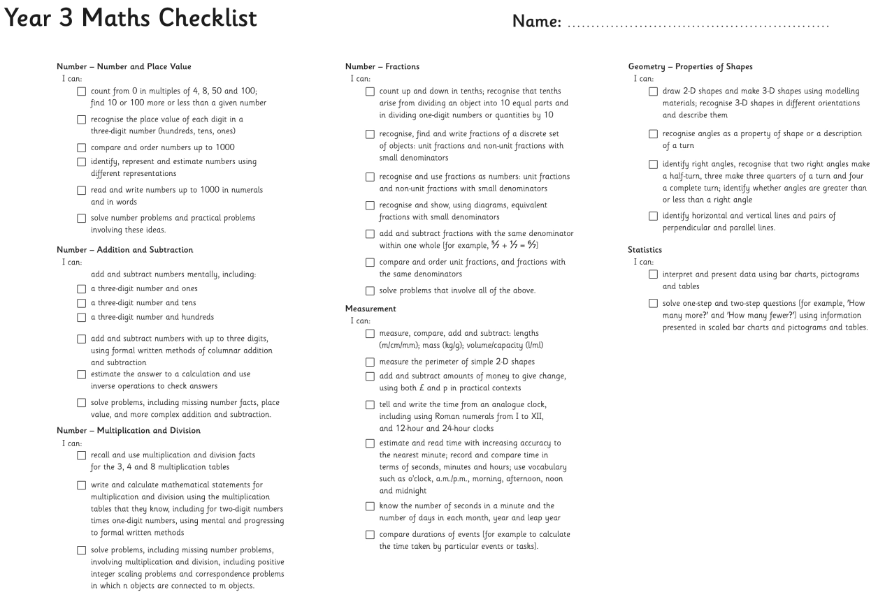
NC Aims & Objectives
Great Sankey Primary School
‘Together We Learn and Grow’
Notes:
This is the new Team GSP
Very proud to be the new HT of this school and to work alongside you all.
Thank you for all the lovely messages before the summer, meant a great deal to know you’re all behind me and supporting me and I hope I serve you all well
Jane de Foy ‘ you’re not one of those are you, you know a new broom sweeps clean?’ made me laugh but on reflection made me think about how you all must be feeling. A significant change such as a new HT can lead to some of you feeling unsettled and a bit nervous – reassurance. Strength of the team.
Book Imperfect leadership ‘page 55’. Great book and has some great advice for new Headteachers.

Slide 4

NC Aims & Objectives
Great Sankey Primary School
‘Together We Learn and Grow’
Notes:
This is the new Team GSP
Very proud to be the new HT of this school and to work alongside you all.
Thank you for all the lovely messages before the summer, meant a great deal to know you’re all behind me and supporting me and I hope I serve you all well
Jane de Foy ‘ you’re not one of those are you, you know a new broom sweeps clean?’ made me laugh but on reflection made me think about how you all must be feeling. A significant change such as a new HT can lead to some of you feeling unsettled and a bit nervous – reassurance. Strength of the team.
Book Imperfect leadership ‘page 55’. Great book and has some great advice for new Headteachers.

Slide 5
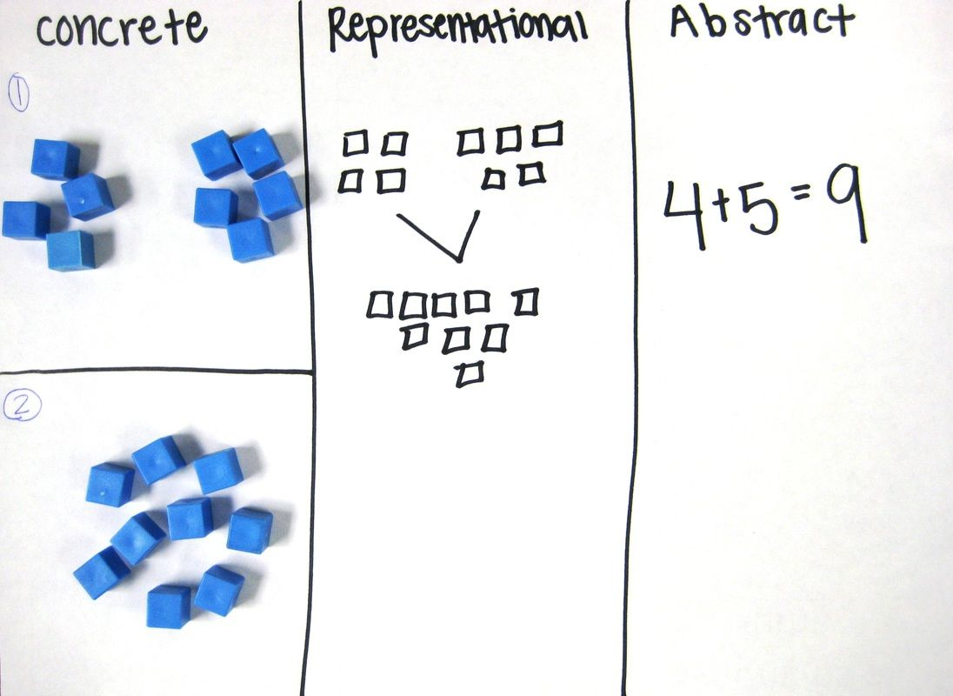

How is Maths taught at GSP?
All year groups follow the White Rose Maths scheme of learning.
Small steps approach (Concrete – Pictorial – Abstract). The building blocks of learning!
Great Sankey Primary School
‘Together We Learn and Grow’
Notes:
This is a time of change for our school so it’s a good time to stop and take stock and reflect. We’ll start with our vision. The school’s vision should be a shared vision where everyone buys into it – when was the last time we looked at it collectively? Today is a good opportunity.
Read through
Children are at the heart as they always should be. Everything we do comes down to benefit them. Could this be an opportunity to stop, reflect and to tweak some of our practice?
Do we do some of the things we do because we’ve always done them? Is there a better way? Referred to in the book as the Christmas tree effect – not saying this is what we do but sometimes – any changes we make or additions have been measured and based on research and this needs to continue. Now is a good time to shape our practice so we’re going to carry out a short exercise in teams.

Slide 6
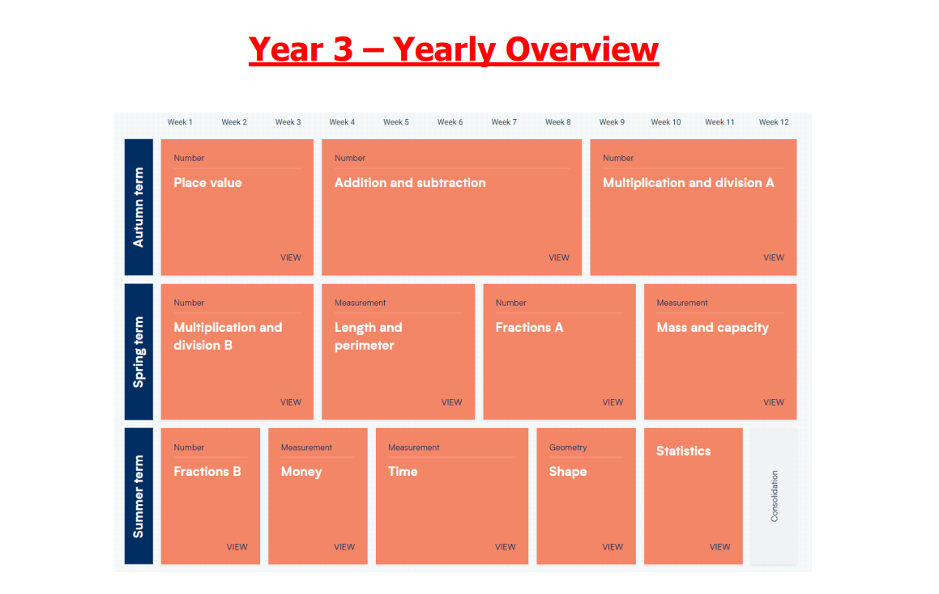
How is Maths taught at GSP?
Great Sankey Primary School
‘Together We Learn and Grow’

Slide 7
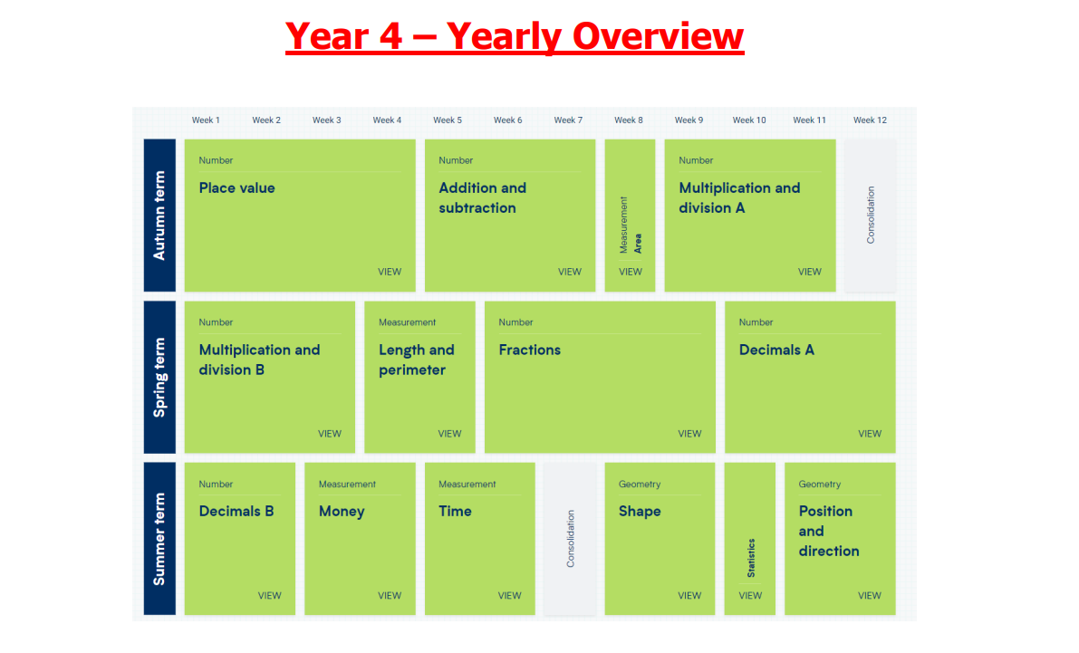
How is Maths taught at GSP?
Great Sankey Primary School
‘Together We Learn and Grow’

Slide 8
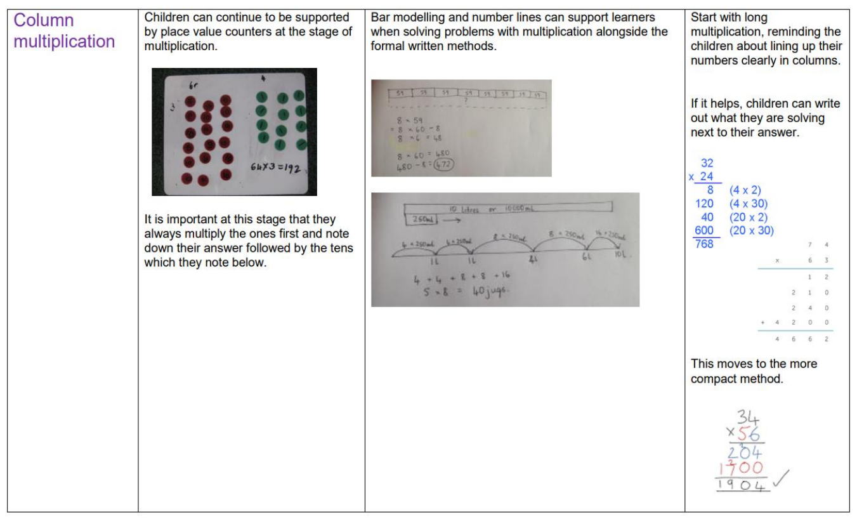
How is Maths taught at GSP?
Great Sankey Primary School
‘Together We Learn and Grow’
Notes:
This is the new Team GSP
Very proud to be the new HT of this school and to work alongside you all.
Thank you for all the lovely messages before the summer, meant a great deal to know you’re all behind me and supporting me and I hope I serve you all well
Jane de Foy ‘ you’re not one of those are you, you know a new broom sweeps clean?’ made me laugh but on reflection made me think about how you all must be feeling. A significant change such as a new HT can lead to some of you feeling unsettled and a bit nervous – reassurance. Strength of the team.
Book Imperfect leadership ‘page 55’. Great book and has some great advice for new Headteachers.

Slide 9
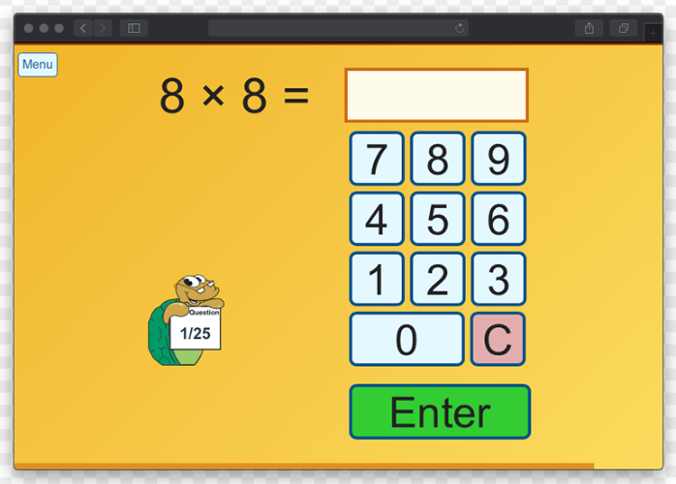

How is Maths assessed at GSP?
Assessment takes place every day, every lesson.
White Rose Maths end of unit assessments.
NFER assessments.
Statutory assessments – Y4 MTC (Multiplication Tables Check). Takes place at the start of June. Children must answer 25 questions and have 6 seconds to answer each question. There is a 3 second pause between each question.
Great Sankey Primary School
‘Together We Learn and Grow’
Notes:
This is the new Team GSP
Very proud to be the new HT of this school and to work alongside you all.
Thank you for all the lovely messages before the summer, meant a great deal to know you’re all behind me and supporting me and I hope I serve you all well
Jane de Foy ‘ you’re not one of those are you, you know a new broom sweeps clean?’ made me laugh but on reflection made me think about how you all must be feeling. A significant change such as a new HT can lead to some of you feeling unsettled and a bit nervous – reassurance. Strength of the team.
Book Imperfect leadership ‘page 55’. Great book and has some great advice for new Headteachers.

Slide 10


How can parents support at home?
Help your child learn their number bonds and times table facts. All children have access to online resources such as Numbots and Times Table Rock Stars to support with this.
Support with the completion of homework. These will always be consolidation tasks which your child should be able to access independently.
Maths games! The maths page on our school website has links to a wide variety of different maths games which you can play for free at home.
Great Sankey Primary School
‘Together We Learn and Grow’
Notes:
This is the new Team GSP
Very proud to be the new HT of this school and to work alongside you all.
Thank you for all the lovely messages before the summer, meant a great deal to know you’re all behind me and supporting me and I hope I serve you all well
Jane de Foy ‘ you’re not one of those are you, you know a new broom sweeps clean?’ made me laugh but on reflection made me think about how you all must be feeling. A significant change such as a new HT can lead to some of you feeling unsettled and a bit nervous – reassurance. Strength of the team.
Book Imperfect leadership ‘page 55’. Great book and has some great advice for new Headteachers.

Slide 11

Any Questions?
Great Sankey Primary School
‘Together We Learn and Grow’
Notes:
This is the new Team GSP
Very proud to be the new HT of this school and to work alongside you all.
Thank you for all the lovely messages before the summer, meant a great deal to know you’re all behind me and supporting me and I hope I serve you all well
Jane de Foy ‘ you’re not one of those are you, you know a new broom sweeps clean?’ made me laugh but on reflection made me think about how you all must be feeling. A significant change such as a new HT can lead to some of you feeling unsettled and a bit nervous – reassurance. Strength of the team.
Book Imperfect leadership ‘page 55’. Great book and has some great advice for new Headteachers.

