Slide 1


UKS2 Stay and Learn 2023
Great Sankey Primary School
‘Together We Learn and Grow’

Slide 2
Housekeeping
No planned fire drills – if the alarm does sound for whatever reason if you leave via the nearest fire exit on to the school playground, school staff will be accountable for the children.
No mobile phones. Please keep these on silent or low volume if needed for work / emergency purposes. Safeguarding reasons.
No photographs of children in classrooms. Not all got permission.
Welcome to visit classrooms – 10:00am
Great Sankey Primary School
‘Together We Learn and Grow’

Slide 3
Welcome!
Today we hope to:
Provide you with some information as to what the maths curriculum looks like for your child and what national end of year expectations are for each age group.
Explain to you how we teach maths at Great Sankey Primary School and share some of the strategies and methods we use with you.
Discuss how maths is assessed in your child’s year group.
Give you some ideas as to how you can support your child with their maths work at home.
Offer an insight into what a maths lesson looks like in school and the types of activity that take place.
Great Sankey Primary School
‘Together We Learn and Grow’

Slide 4
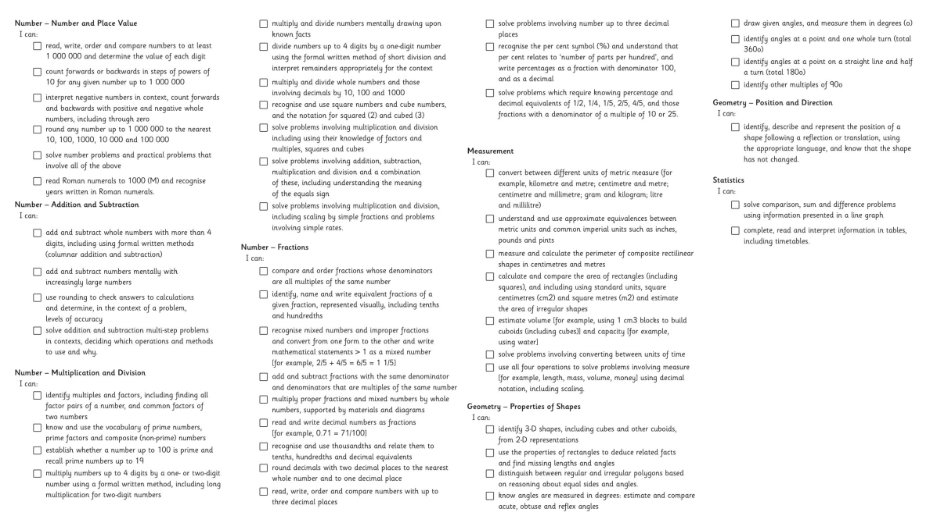
NC Aims & Objectives – Y5
Broad topic areas – broken into smaller chunks and objectives.
Regular revisiting and retrieval.
Great Sankey Primary School
‘Together We Learn and Grow’

Slide 5
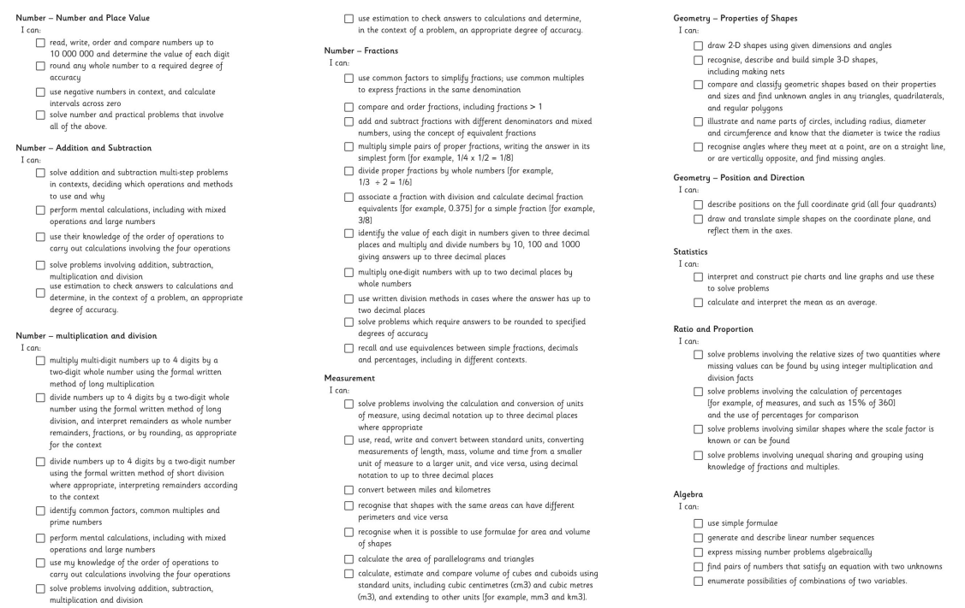
NC Aims & Objectives – Y6
Great Sankey Primary School
‘Together We Learn and Grow’

Slide 6
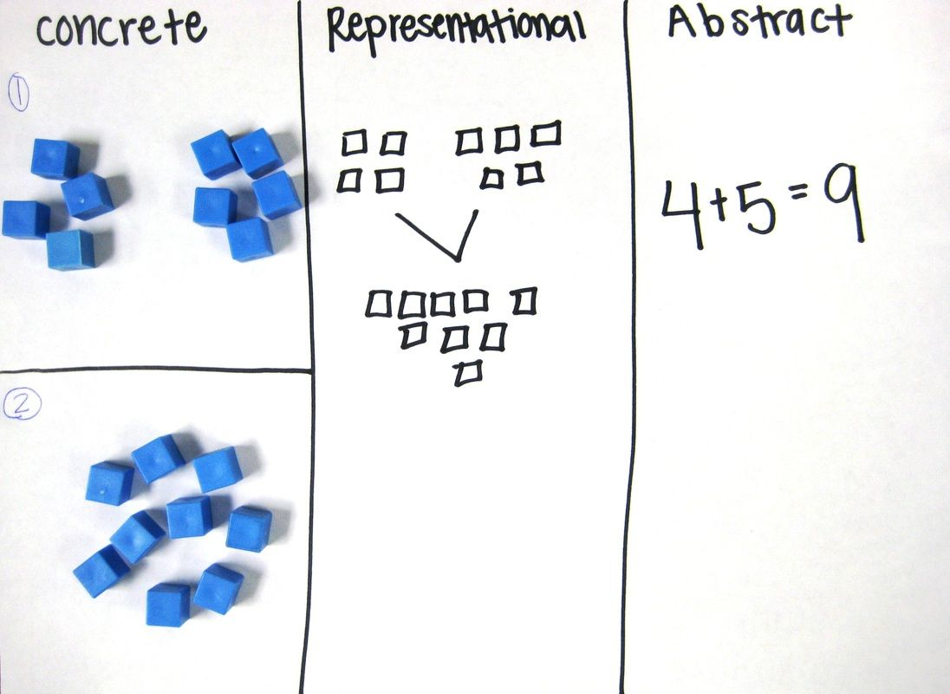

How is Maths taught at GSP?
All year groups follow the White Rose Maths scheme of learning.
Small steps approach (Concrete – Pictorial – Abstract). The building blocks of learning!
Great Sankey Primary School
‘Together We Learn and Grow’

Slide 7
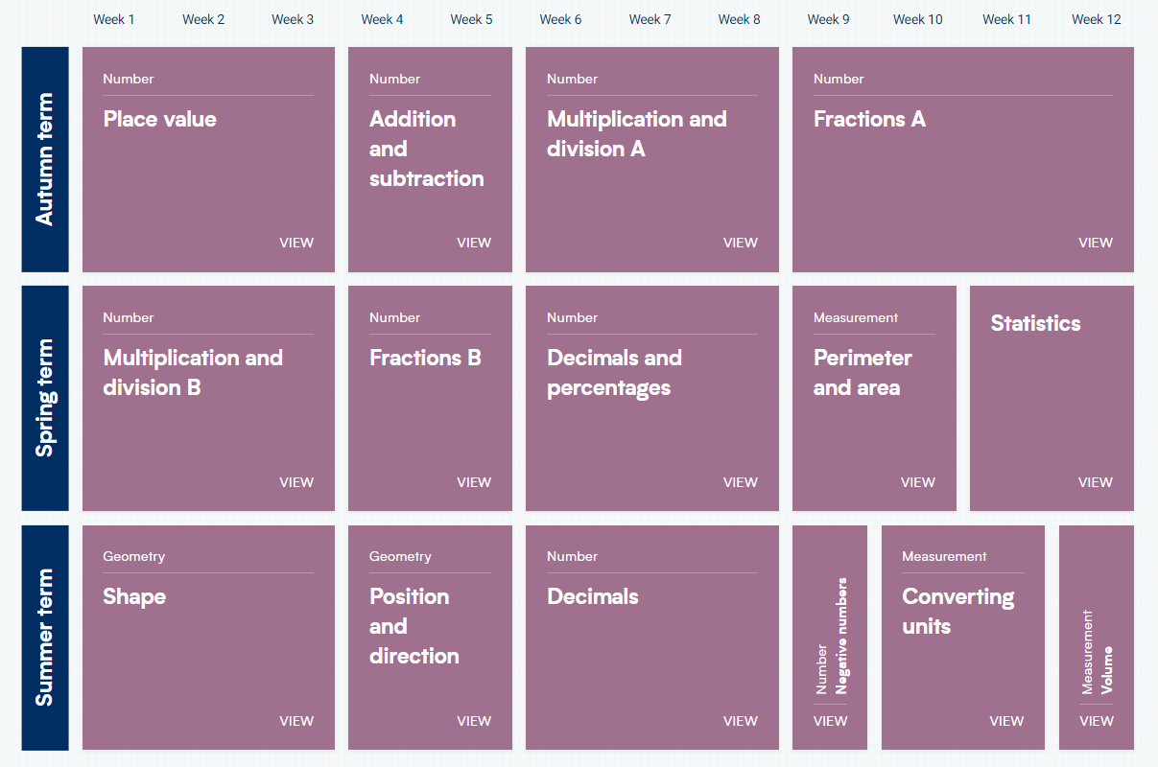
Y5
Great Sankey Primary School
‘Together We Learn and Grow’

Slide 8
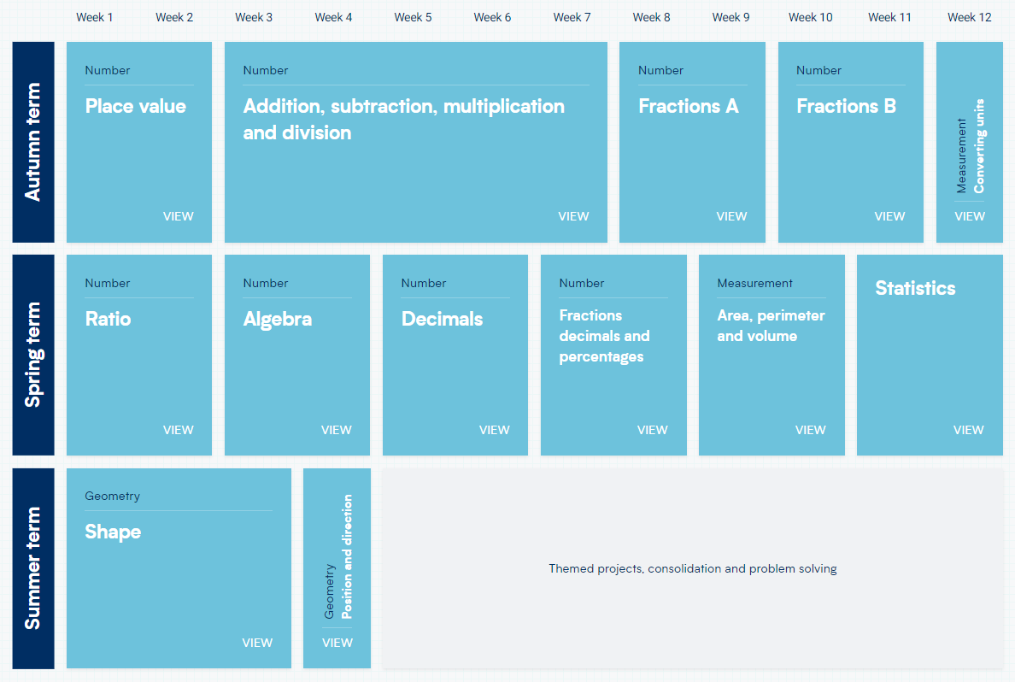
Y6
Great Sankey Primary School
‘Together We Learn and Grow’

Slide 9
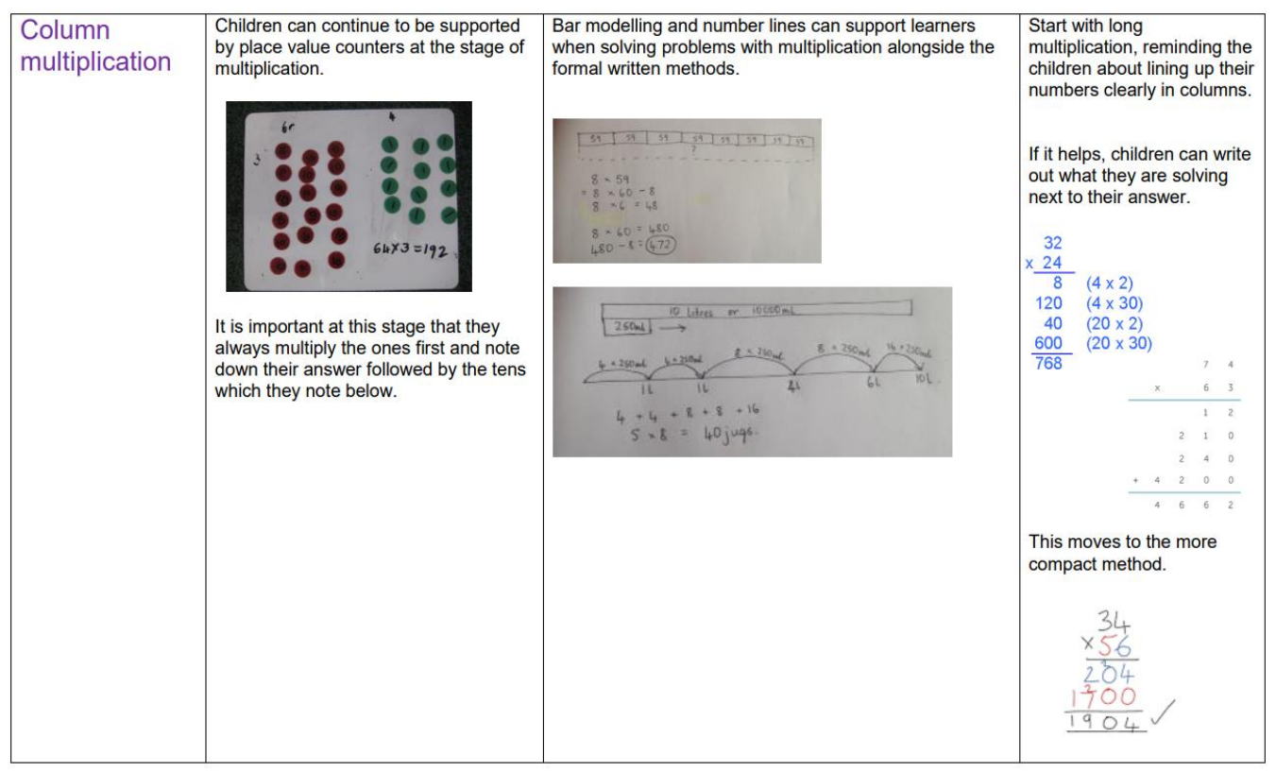
How is Maths taught at GSP?
Calculation policy – sets out how Maths is taught and through which strategies in each year.
Many of these are set by National Curriculum with an expectation children can complete the ‘formal and recognised methods’ at the end of Key Stage 2.
Great Sankey Primary School
‘Together We Learn and Grow’

Slide 10
Fluency – Reasoning & Problem Solving
Fluency:
76 + 24 = 100
Problem Solving:
A car has 76 cars in its showroom on a Monday evening. The following day, the number of cars increases so that they have 100 in total. How many more cars are there?
Varied Fluency:
100
76 | ?
Great Sankey Primary School
‘Together We Learn and Grow’

Slide 11
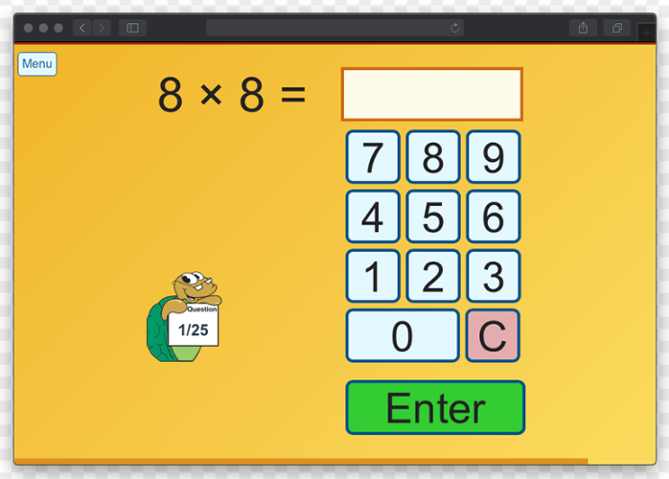

How is Maths assessed at GSP?
Assessment takes place every day, every lesson.
White Rose Maths end of unit assessments.
NFER assessments + Practise EOKS tests.
SATs End of Key Stage assessments. (Presentation evening later this month)
Great Sankey Primary School
‘Together We Learn and Grow’

Slide 12


How can parents support at home?
Help your child learn their number bonds and times table facts. All children have access to online resources such as Numbots and Times Table Rock Stars to support with this.
Support with the completion of homework. These will always be consolidation tasks which your child should be able to access independently.
Maths games! The maths page on our school website has links to a wide variety of different maths games which you can play for free at home.
Great Sankey Primary School
‘Together We Learn and Grow’

Slide 13

Any Questions?
Great Sankey Primary School
‘Together We Learn and Grow’

