Slide 1

Welcome to Reception
Stay and Play
Jan 2023
Great Sankey Primary School
‘Together We Learn and Grow’

Slide 2
Thank you!
We have had a great first term getting to know the children ☺
We really appreciate your support from home.
Today gives you all a chance to see what really does go on in Reception ☺
Today we will be specifically looking at Maths.
Great Sankey Primary School
‘Together We Learn and Grow’
Notes:
Welcome back
Hope you’ve had a great summer, well rested, relaxed.
Great to see so many of your photos on FB, Steph’s tik toks!
Congratulations to Granny Jo – Brody
Run through the day

Slide 3
Today we will be looking at how young children develop their Maths skills.
Number Early Learning Goal
• Have a deep understanding of number to 10, including the composition of each number
• Subitise (recognise quantities without counting) up to 5
• Automatically recall (without reference to rhymes, counting or other aids) number bonds up to 5 (including subtraction facts) and some number bonds to 10, including double facts.
Numerical Pattern Early Learning Goal
• Verbally count beyond 20, recognising the pattern of the counting system
• Compare quantities up to 10 in different contexts, recognising when one quantity is greater than, less than or the same as the other quantity
• Explore and represent patterns within numbers up to 10, including evens and odds, double facts and how quantities can be distributed equally
Great Sankey Primary School
‘Together We Learn and Grow’
Notes:
This is the new Team GSP
Very proud to be the new HT of this school and to work alongside you all.
Thank you for all the lovely messages before the summer, meant a great deal to know you’re all behind me and supporting me and I hope I serve you all well
Jane de Foy ‘ you’re not one of those are you, you know a new broom sweeps clean?’ made me laugh but on reflection made me think about how you all must be feeling. A significant change such as a new HT can lead to some of you feeling unsettled and a bit nervous – reassurance. Strength of the team.
Book Imperfect leadership ‘page 55’. Great book and has some great advice for new Headteachers.

Slide 4
How can I help my child at home?
Play games – Higher or Lower / Dominoes / Snakes and Ladders
When out shopping – Look at the price of different items / Compare weight or size
Notice numbers in the environment – Bus numbers / Door numbers / Speed signs
Daily routines – What time do you get up and go to bed / Which day comes before or after …
Collect items on a family walk – I have 6 sticks, could you find 1 more? How many altogether?
Weighing out ingredients for baking or making play dough
Singing number rhymes and counting in funny voices (not always starting from 1)
Each child will receive a Ten Town log in ☺
Great Sankey Primary School
‘Together We Learn and Grow’
Notes:
This is a time of change for our school so it’s a good time to stop and take stock and reflect. We’ll start with our vision. The school’s vision should be a shared vision where everyone buys into it – when was the last time we looked at it collectively? Today is a good opportunity.
Read through
Children are at the heart as they always should be. Everything we do comes down to benefit them. Could this be an opportunity to stop, reflect and to tweak some of our practice?
Do we do some of the things we do because we’ve always done them? Is there a better way? Referred to in the book as the Christmas tree effect – not saying this is what we do but sometimes – any changes we make or additions have been measured and based on research and this needs to continue. Now is a good time to shape our practice so we’re going to carry out a short exercise in teams.

Slide 5
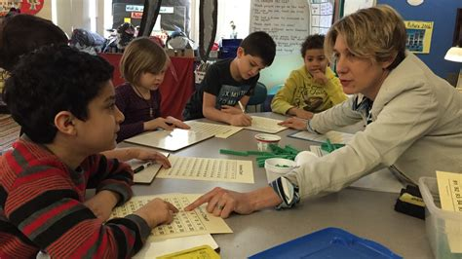
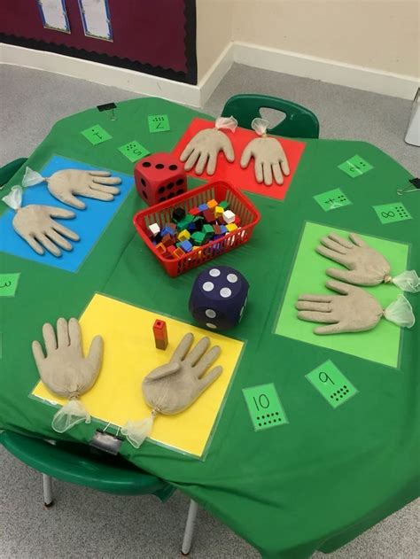
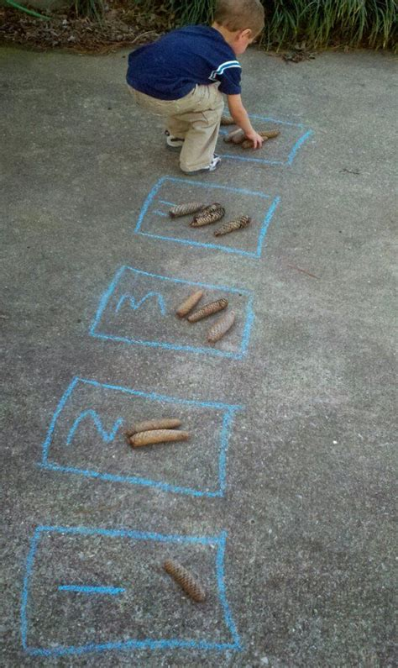
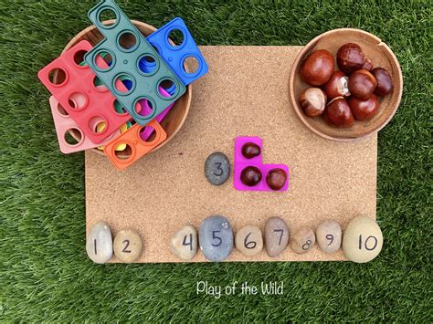
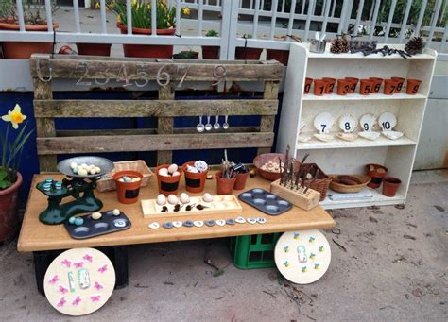
Learning in the Early Years
Looks less like this.
And more like this …..
Now let’s go and see it in action!
Great Sankey Primary School
‘Together We Learn and Grow’
Notes:
This is a time of change for our school so it’s a good time to stop and take stock and reflect. We’ll start with our vision. The school’s vision should be a shared vision where everyone buys into it – when was the last time we looked at it collectively? Today is a good opportunity.
Read through
Children are at the heart as they always should be. Everything we do comes down to benefit them. Could this be an opportunity to stop, reflect and to tweak some of our practice?
Do we do some of the things we do because we’ve always done them? Is there a better way? Referred to in the book as the Christmas tree effect – not saying this is what we do but sometimes – any changes we make or additions have been measured and based on research and this needs to continue. Now is a good time to shape our practice so we’re going to carry out a short exercise in teams.

