Slide 1





Slide 2
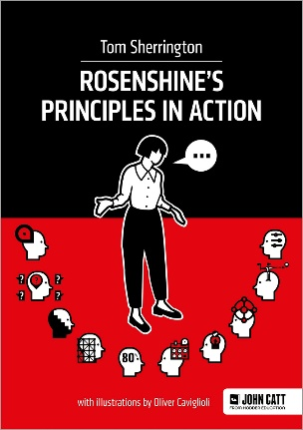

Why have we made the following choices for our curriculum?
Cognitive science and educational research is now at the forefront of all choices made within Teaching and Learning
We know that evidence-based teaching methods and high-quality resources have a value-added impact on learning – we have chosen ambitious schemes of work that incorporate this, alongside CPD for staff
In order to ensure every lesson has a structure in-line with this research we must invest in published schemes, written and resourced by experts
Providing teachers with these resources ensures progression and sequencing across the curriculum
We believe our teachers should spend their time planning HOW to ensure these resources meet the needs of the children in their classes, rather than spending their time planning WHAT to teach, finding diagrams etc

Slide 3

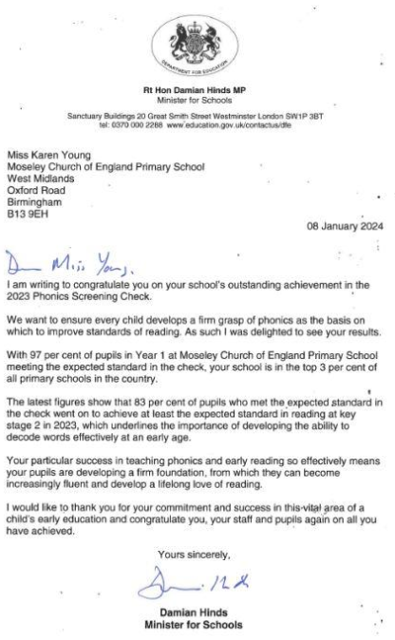
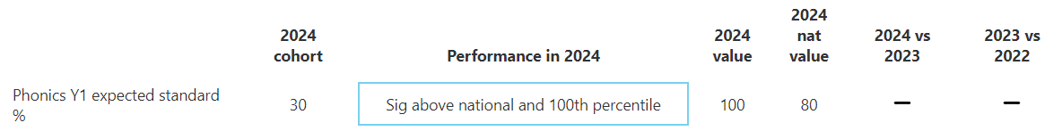
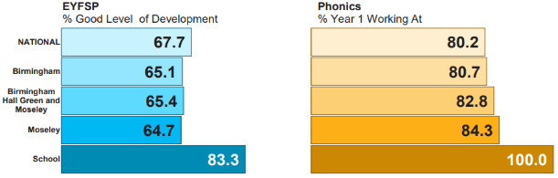
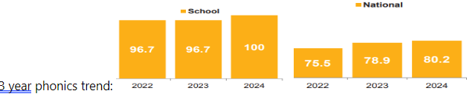
Phonics at Moseley CE Primary School lead Miss F Barker
Top 3%
100% pass rate July 2024
DfE accredited phonics scheme
Ensuring we remain in-line with best practices
Higher expectations (6 weekly assessments)

Slide 4


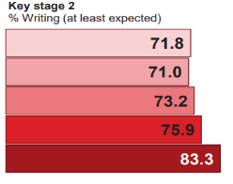

Writing at Moseley CE Primary School lead Mrs A Perry
School improvement priority 2023/24, following dip in KS2 writing results
Identified children lacked stamina and were not given enough opportunities to write, impact of Covid and home learning as well as lack of resourced writing scheme for teachers to plan from
Introduction of Plazoom Feb 2024, after successful trial in Y5
Children now complete one piece of extended writing every fortnight
Model texts are written by published authors, progressive based on grammar content of texts and genres
Ambitious scheme as it focuses on the different genres of writing

Slide 5
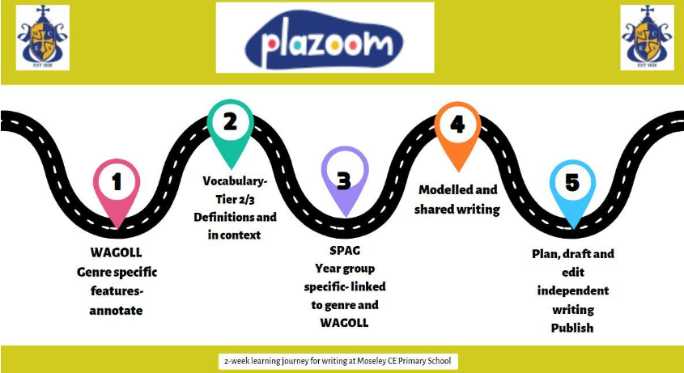
What do writing lessons look like?

Slide 6
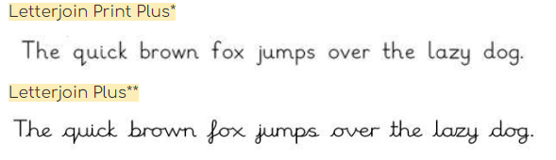
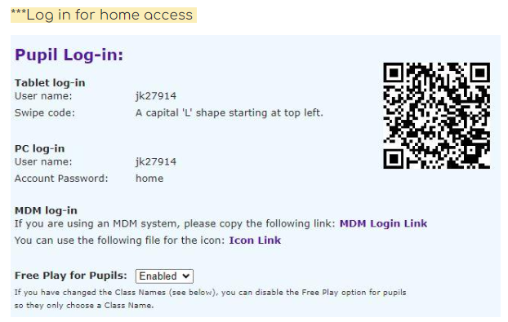
Handwriting as part of English lessons, alongside practice across the curriculum
Handwriting ‘guide lines’ in books across the curriculum
Writing sessions last 1 hour 15 minutes to allow enough time for some handwriting practice
Pencils are used by all children, children must demonstrate consistently neat handwriting to be given a pen to use in school (Y6)

Slide 7

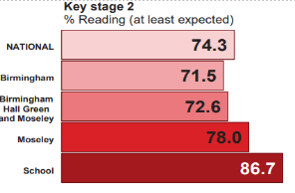
Reading at Moseley CE Primary School lead Mrs A Perry
YR and Y1 have daily phonics lessons and group reading sessions three times/week (linked to phonics assessments)
Y2-6 have 3 reading lessons each week (1.5 hours). These are skills-based and linked to class text from reading spine
We have recently reviewed and relaunched our reading spine. Recommended and age-appropriate.
Reading is a strength of our school

Slide 8
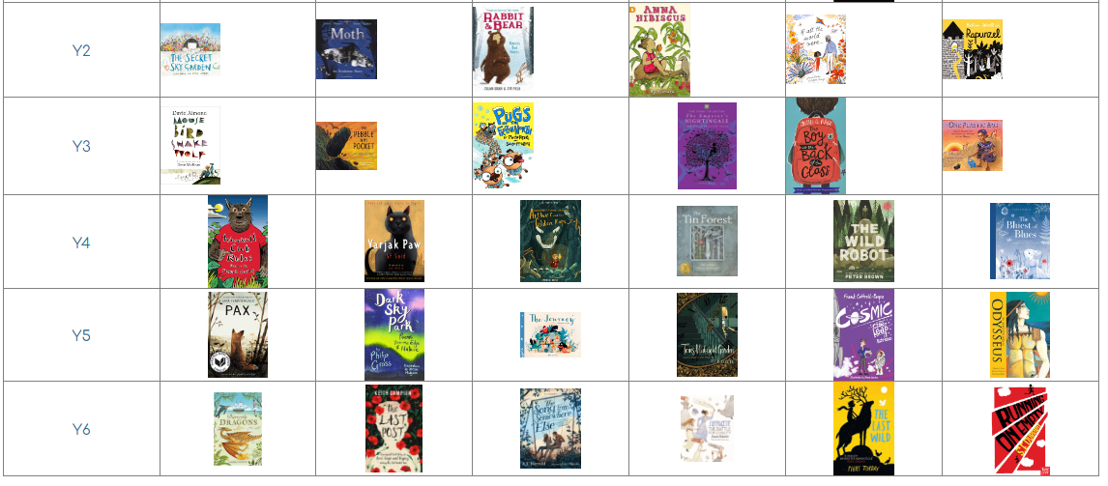
Y2-6 Reading Spine – basis of reading lessons

Slide 9
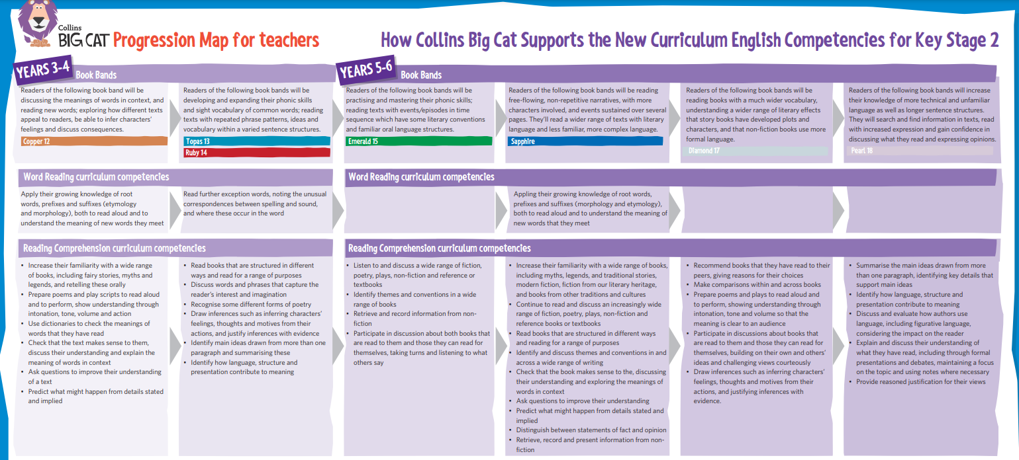
October 2024- Investment in ‘banded’ home reading books beyond phonics, from Y2-6

Slide 10

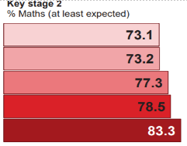

Maths at Moseley CE Primary School lead Mr J Boulton
White Rose Maths remains- we do follow updates as they are released
‘I see reasoning’ and NCETM used as key resource to challenge children in lessons. Focus is now on depth of understanding rather than ‘moving on’.
Parent feedback- more support with maths-focus of class workshops during 2024/25
20.11.24 @ 5pm – maths information session
22.1.25 – Y5 maths workshop
23.1.25- Y6 maths workshop
29.1.25- Y4 maths workshop
26.2.25- Y1 maths workshop
5.3.35- Y2 maths workshop
6.3.25- Y3 maths workshop

Slide 11

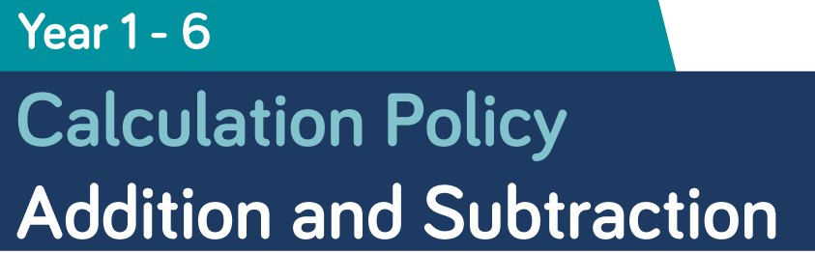

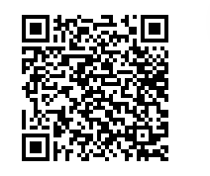

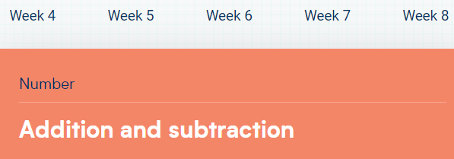
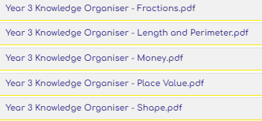

Maths at Moseley CE Primary School- Key resources
School Website
White Rose Maths
home learning videos
White Rose Maths
home learning videos

Slide 12
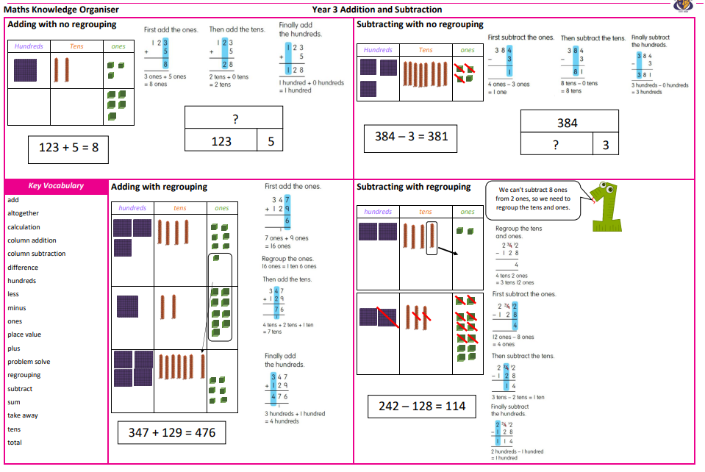
Check out our knowledge organisers…
128

Slide 13







Science at Moseley CE Primary School lead Mrs S Eden
‘Hands-on’ approach to learning science- practical investigations are integrated to provide opportunities for children to consolidate and deepen their understanding of taught skills and knowledge
White Rose Science units cover scientific questions around sustainability and the planet, and help children develop an empathy for the local and wider environment.

Slide 14

Non-core curriculum at Moseley CE Primary School
Art/DT- Mr A Sahed
History/Geography- Mrs A Perry
French- Miss R Stent
Art/DT taught weekly, subjects alternate each half term
History/Geography taught weekly, subjects alternate each half term
Music taught 30 minutes weekly (not taught during half term that class swim) + 30 minutes hymn practice
weekly
French taught 1 hour weekly Y3-6 (not taught during half term that class swim)

Slide 15
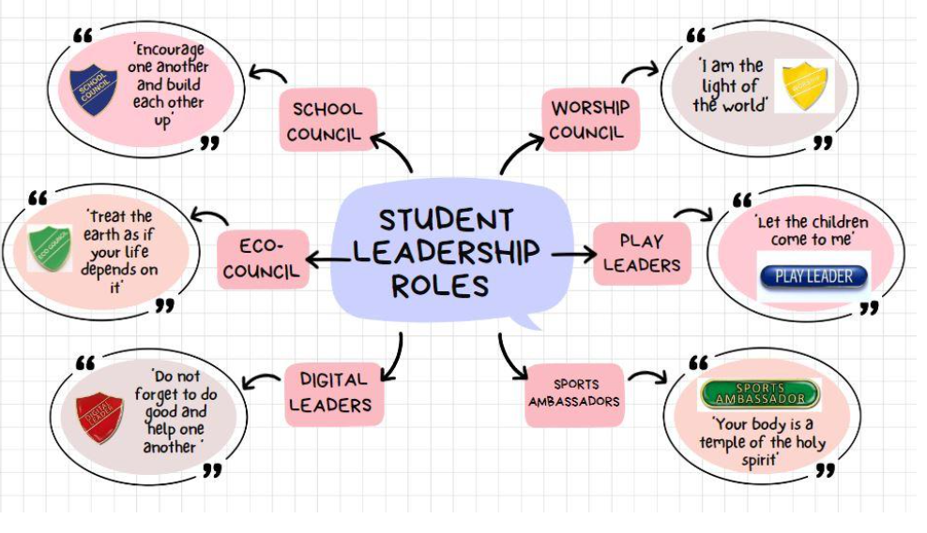
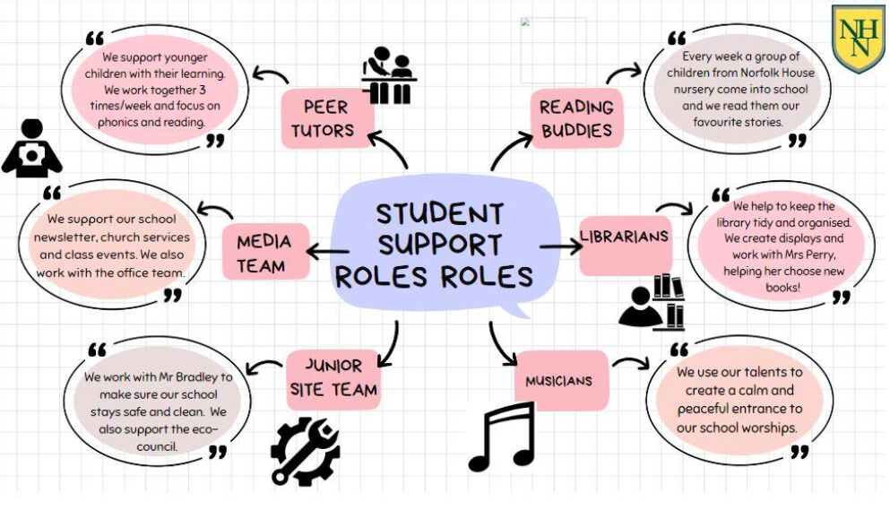
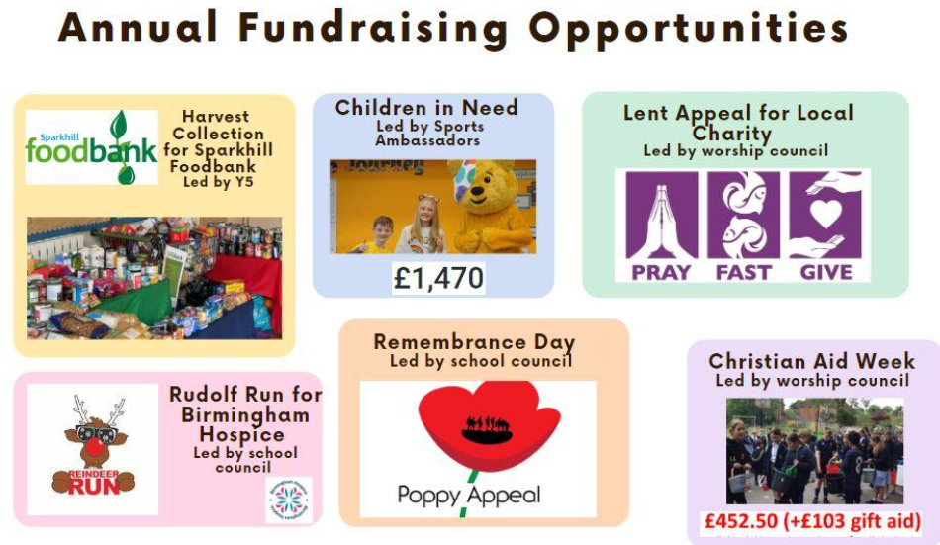
Personal Development is an important part of our curriculum at Moseley CE Primary School

Slide 16
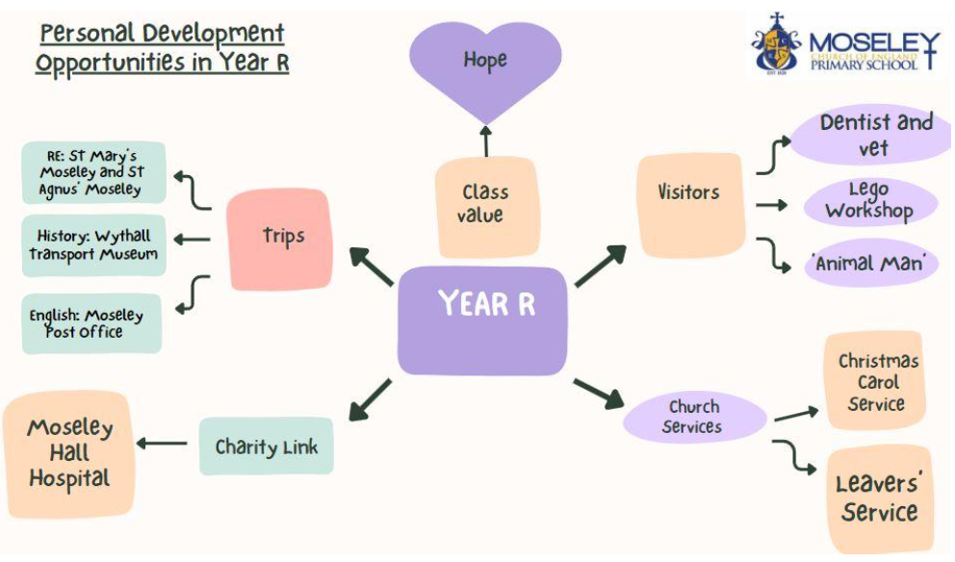
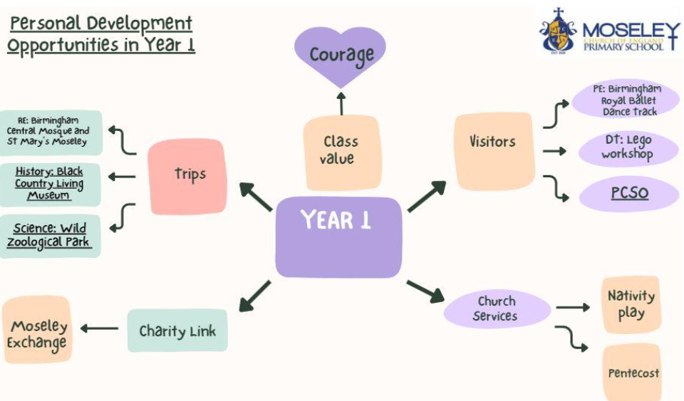
Personal Development is an important part of our curriculum at Moseley CE Primary School

Slide 17
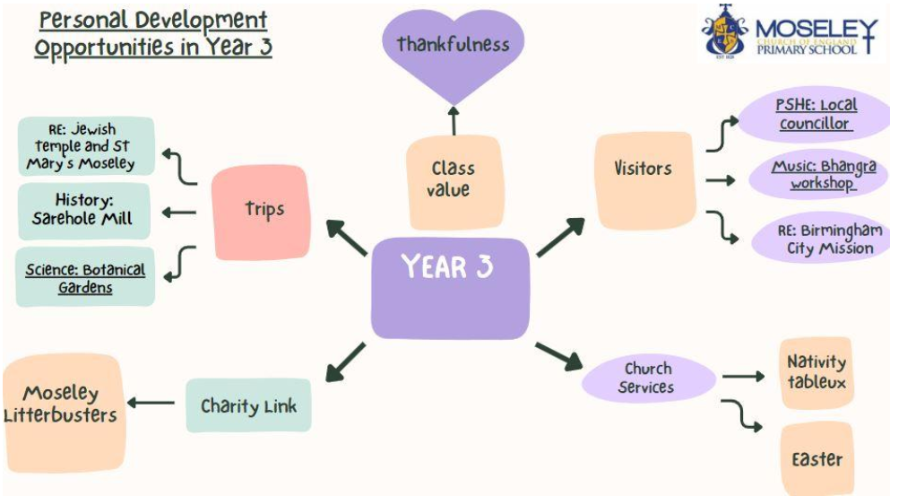
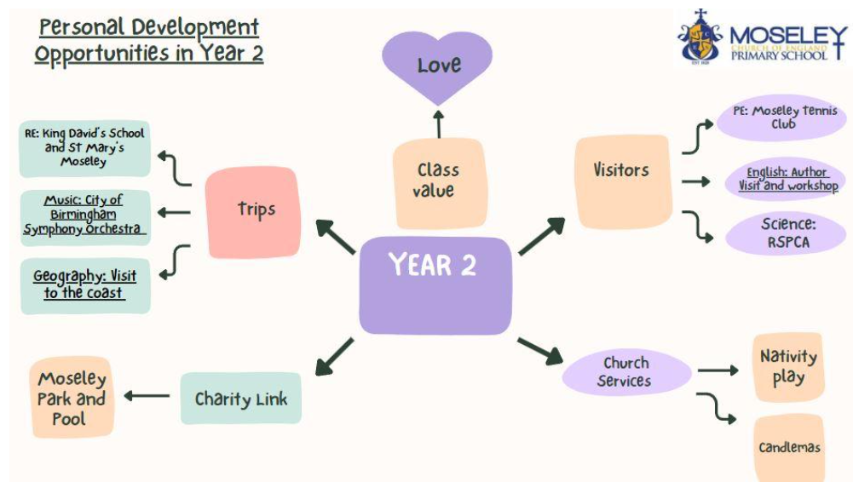
Personal Development is an important part of our curriculum at Moseley CE Primary School

Slide 18
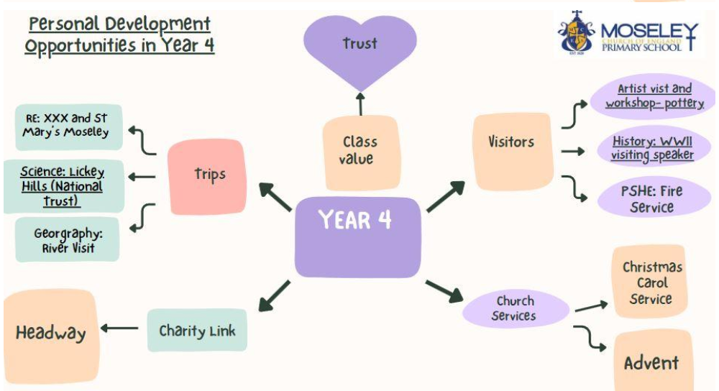
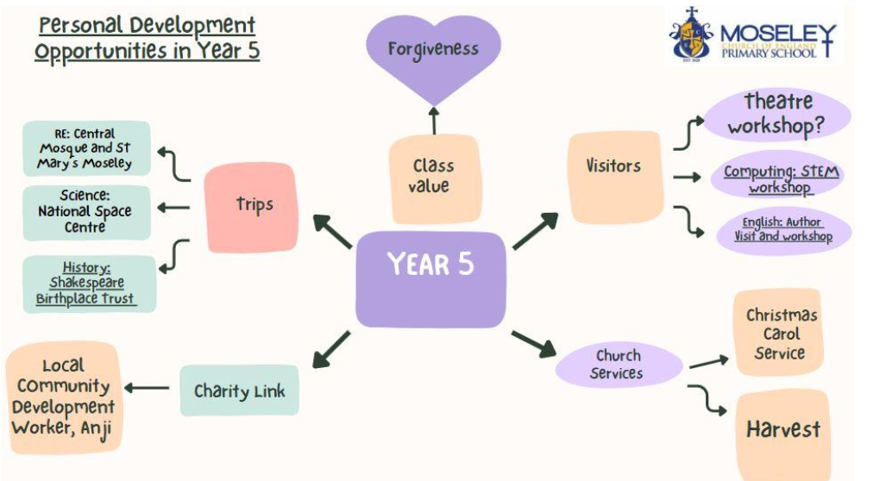
Personal Development is an important part of our curriculum at Moseley CE Primary School

Slide 19
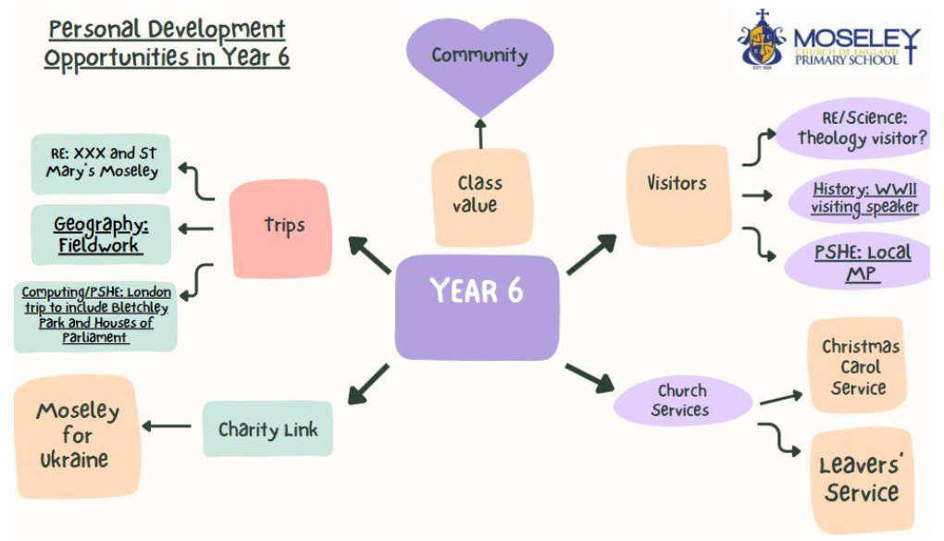
Personal Development is an important part of our curriculum at Moseley CE Primary School

