Slide 1
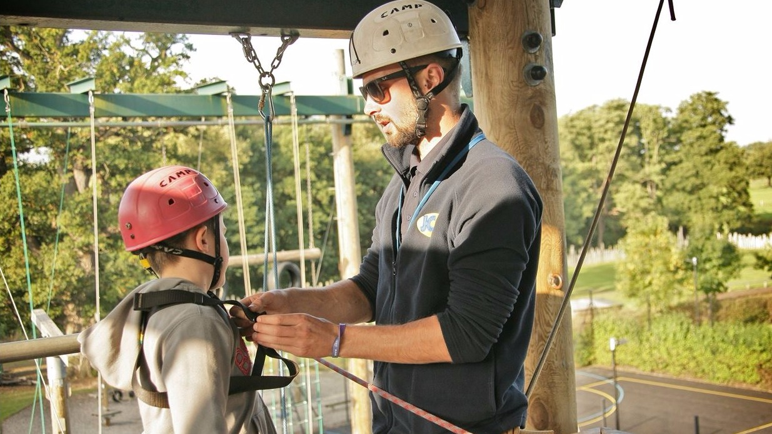
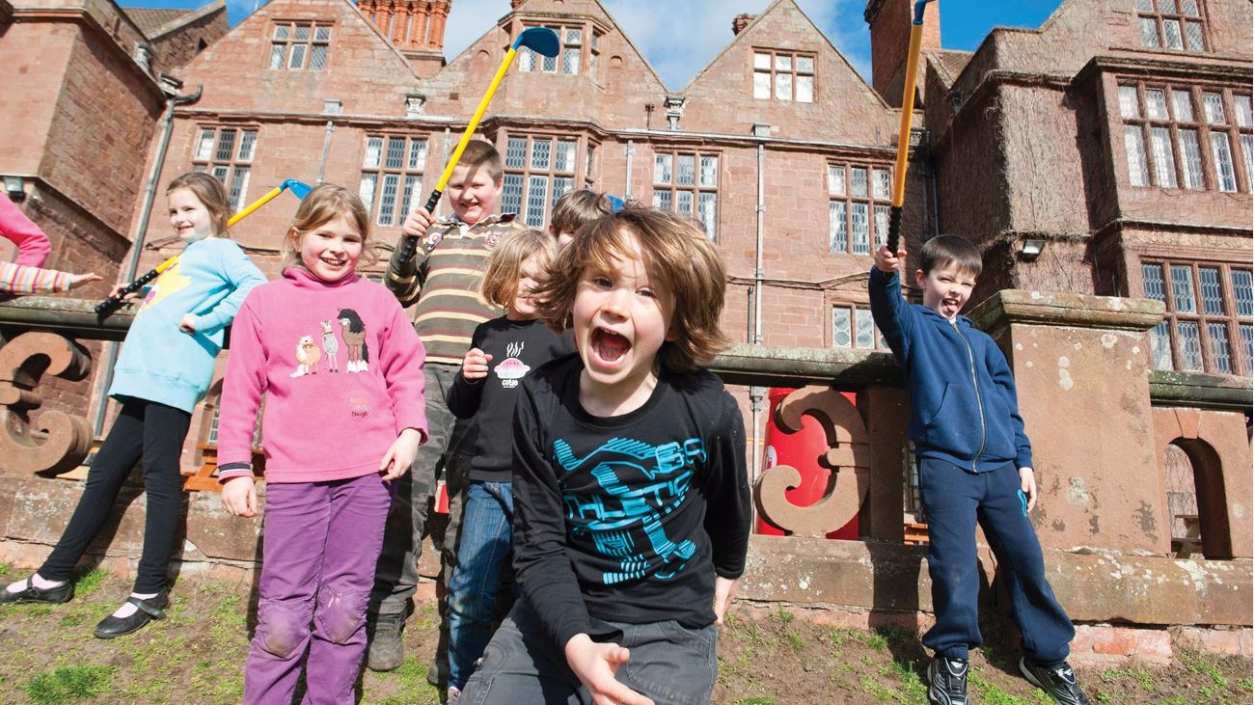
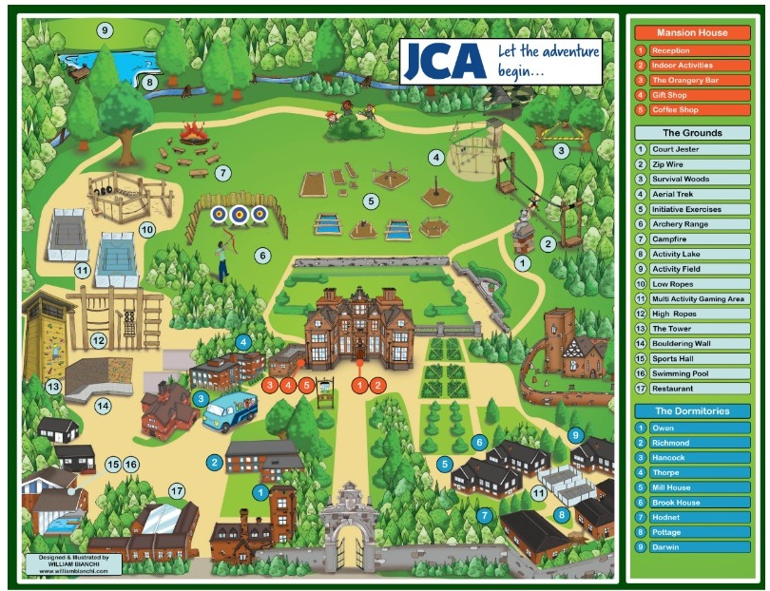
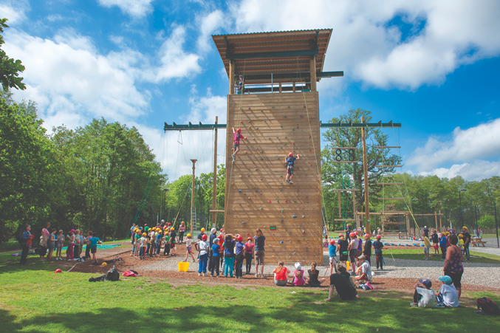
Condover Hall
9th – 11th Nov

Slide 2
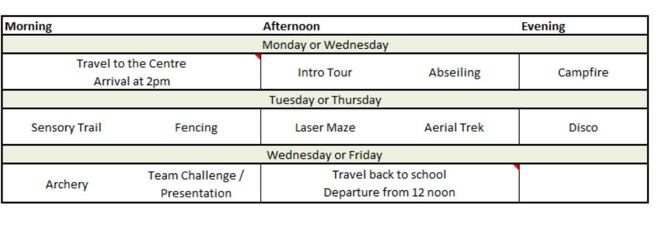
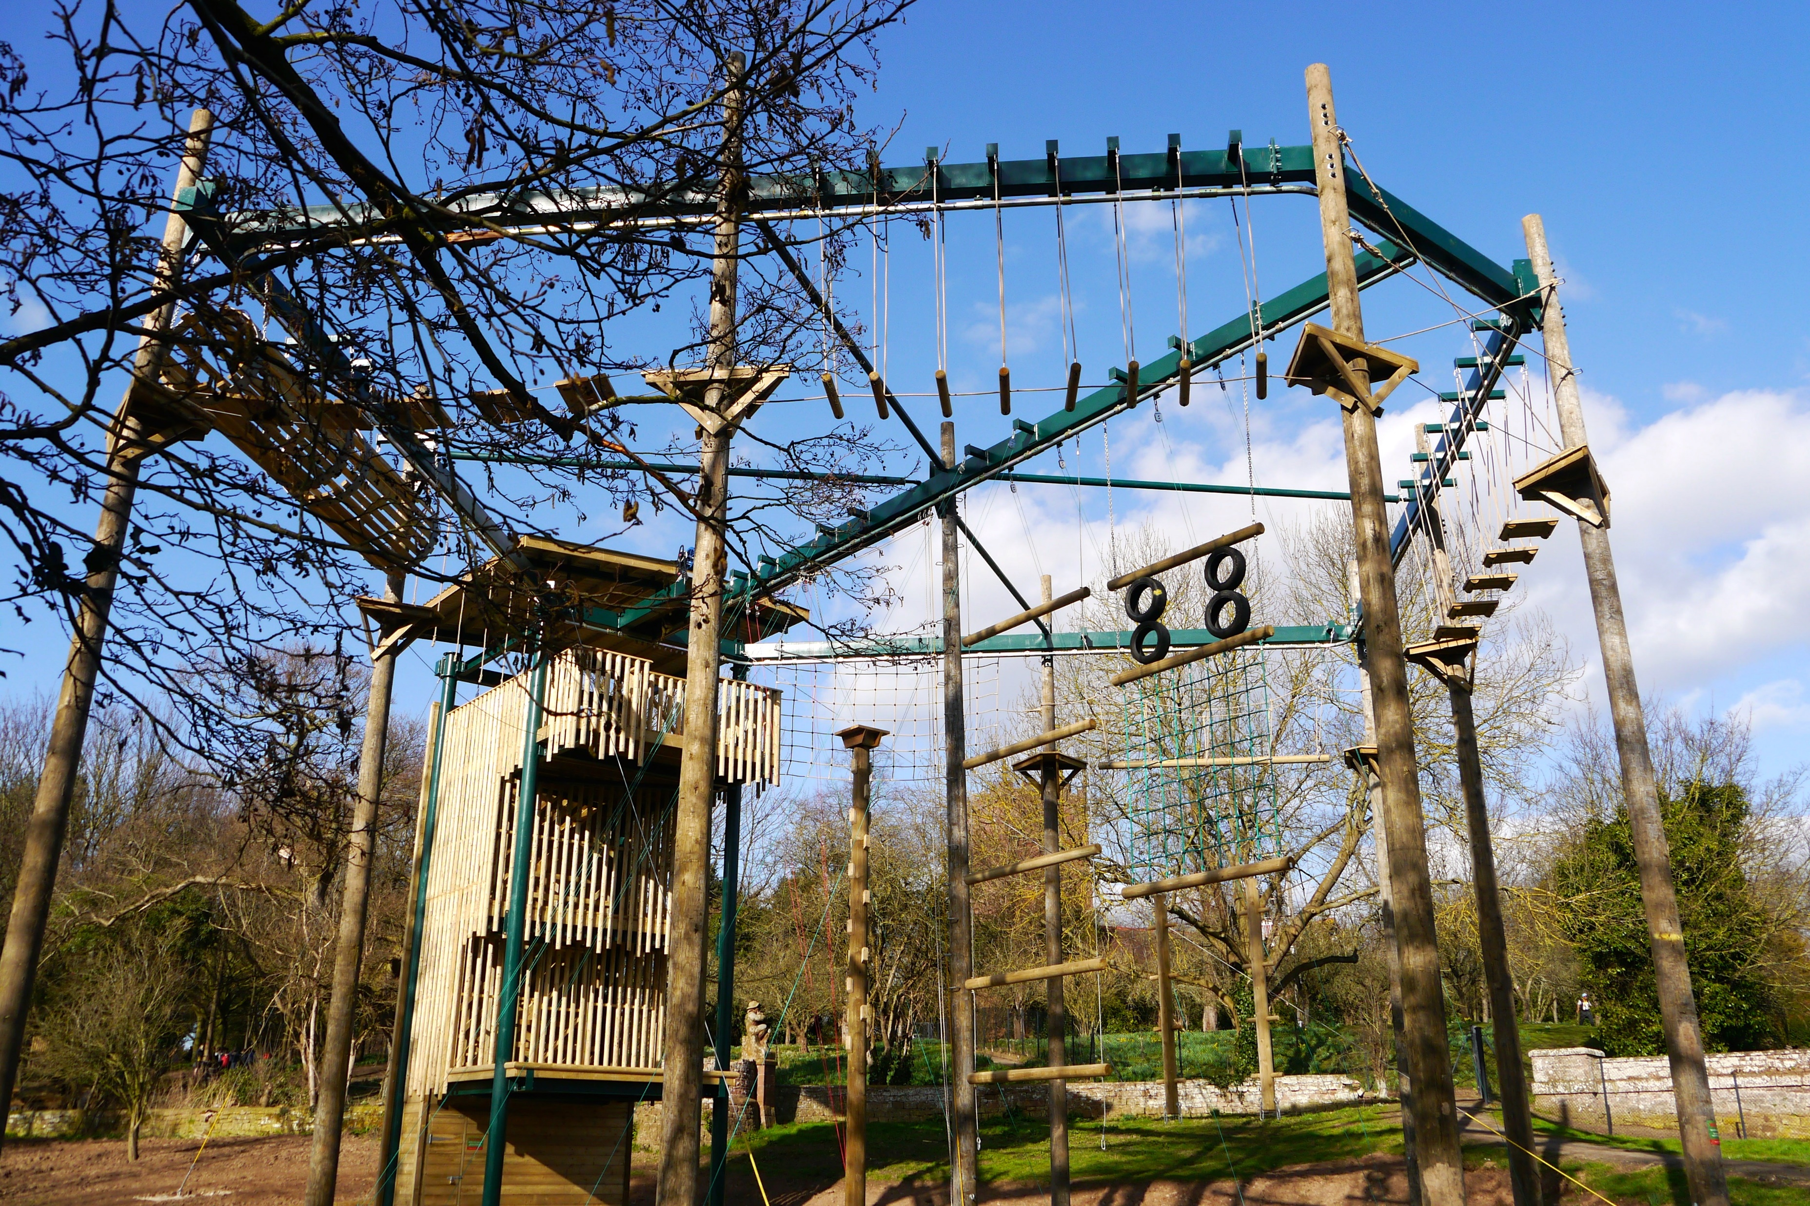
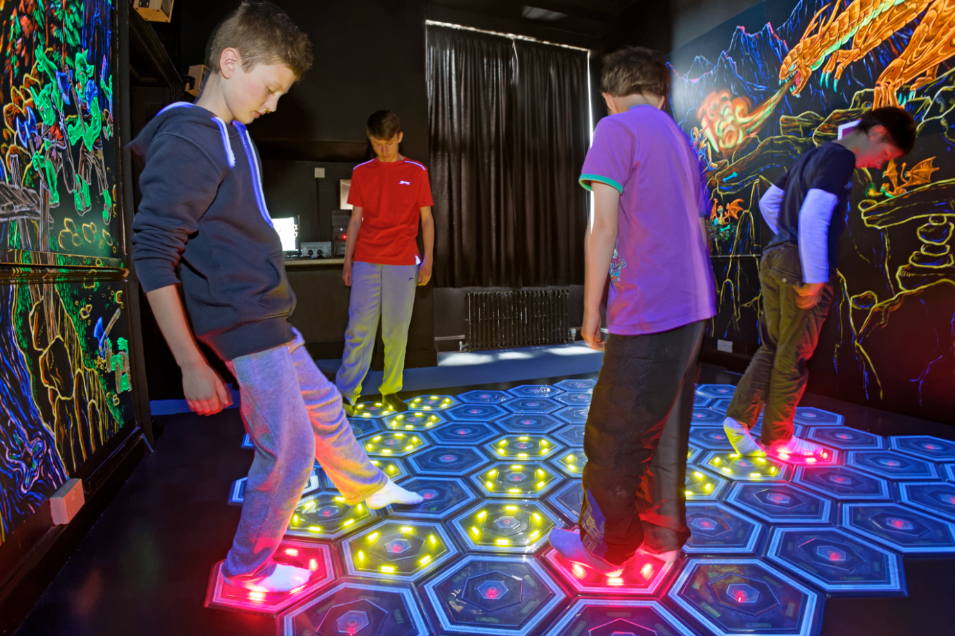
Note: we won’t be participating in waters sports
Sample timetable
Early arrival – for lunch with additional activity
Lunch prior to departure
problem-solving
self-esteem
resilience
confidence
agility
teamwork
independence
communication
co-operation

Slide 3
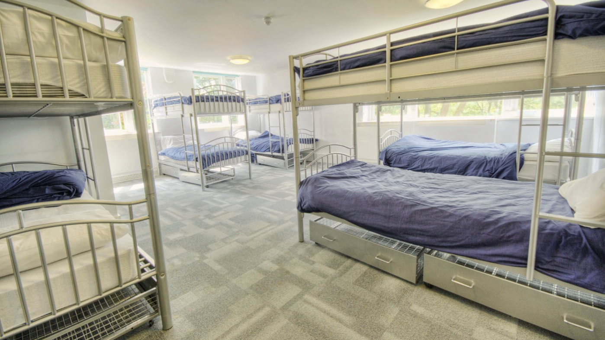
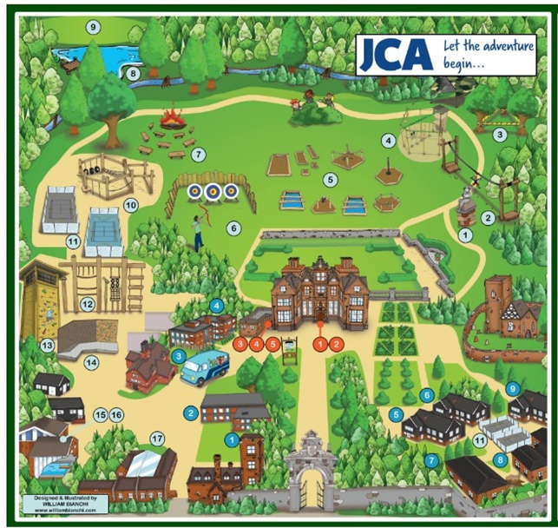
Dormitories and Activity Groupings
Dormitories come in various sizes with between 4 and 12 beds.
Some have en-suite facilities others are shared with another dorm.
School will be assigned the dorms once our numbers are finalised with the centre.
Children will only share dorms with other children from Ursuline.
When grouping the children, we spend a lot of time considering the best configuration for all children.
The children will receive a form to go home, and they will have the opportunity to nominate 3 children who they wish to be with.
We will endeavour to place them with at least 1 child of their choice.
The dormitories and activities groupings may be different to each other, or they may overlap.
If you have any concerns, please speak to us beforehand as once the groups have been shared with the children, it is very difficult to change them.

Slide 4
Kit List
Another copy of the full Kit list has been emailed out, but we wanted to highlight some things:
The children are not allowed to bring items such as mobile phones, any type of cameras (including disposables), computer games, iPads/tablets, expensive watches etc.
Please ensure there are no cameras or recording facility on any watches.
All clothing should be suitable for use in an outdoor, and often muddy, environment. Old clothes are best, not new or expensive clothing.
Outdoor shoes/boots. Walking boots are great for this, but a strong pair of shoes would be suitable, and trainers would be ok but be aware they could get very muddy.
Jeans are not suitable for our activities, as they are cold and restrictive when wet and difficult to dry. Tracksuits or jogging bottoms are ideal, but other trousers would also be fine.
As we are going in November, please pack warm clothing with lots of layers for the children. They will need a hat, scarf and gloves. A spare of gloves may be useful
Please ensure, wherever possible, that items are marked with the child’s name. (Coats, jackets and jumpers especially) It is helpful if the school’s name can also be indicated.

Slide 5
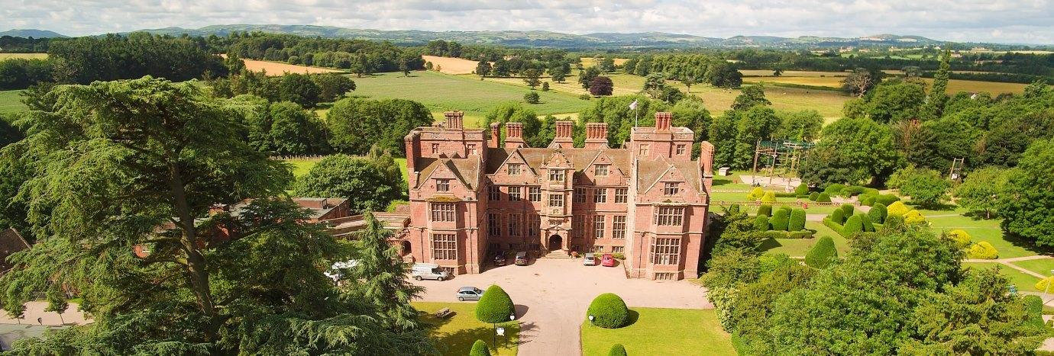
Deadline for confirmation numbers
In order for us to finalise details with Condover Hall, we need to have the final count of children who will be attending the residential this year.
The final payment of £195 is due by Friday 6th November 2026
If you have any questions, please do speak to either of us.

