Slide 1
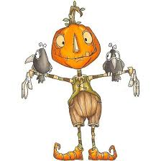







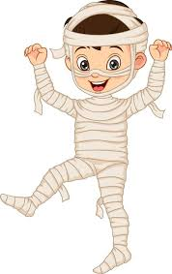
Alderley Edge Community Primary School
Church Lane, Alderley Edge, Cheshire, SK9 7UZ
thesquirrelclub@aecps.org Tel: 01625 704513 www.aecps.org
Monday 24th October
Spooky biscuit and cupcake decorating
Tuesday 25th October
Autumn pumpkin carving
Wednesday 26th October
Get in teams and build a scarecrow!
Thursday 27th October
Autumn walk, spooky stories and wreath making
Monday 31st October (Inset Day)
Fancy dress and Halloween mini disco and mummy wrapping competition
October
Holiday Club 2022
All children are welcome to attend aged 4 and above
Opening times Monday – Thursday 7.45am – 6.00pm
Full day £28.00 first child, siblings £26.00
Half day £17.00 first child, siblings £15.00
10% discount for weekly bookings
Could all children please bring their own morning snack and packed lunch
A healthy afternoon snack is included in the price
To make a booking please call Tel: 01625 704513 Email thesquirrelclub@aecps.org
For cancellations – please refer to TSC Terms and Conditions

