Slide 1





Beef Burger in a Bun with Potato Wedges and Green Salad or Peas | Lasagne with Garlic Bread and Sweetcorn or Side Salad | Roast Chicken Stuffing & Gravy with Roast Potatoes and Carrots or Broccoli | Chicken Wrap With Rice and Rainbow Slaw | Fish Fingers with Chips and Garden Peas or Baked Beans
Quorn Burger in a Bun with Potato Wedges and Green Salad or Peas | Vegetable Bolognese with Garlic Bread and Sweetcorn or Side Salad | Quorn Sausage Stuffing & Gravy with Roast Potatoes and Carrots or Broccoli | Cheesy Baked Bean Wrap With Rice and Rainbow Slaw | Vegetarian Vegetable Fingers with Chips and Garden Peas or Baked Beans
Jacket Potatoes and Pasta available daily | Jacket Potatoes and Pasta available daily | Jacket Potatoes and Pasta available daily | Jacket Potatoes and Pasta available daily | Jacket Potatoes and Pasta available daily
Chocolate Chip Cookie | Lemon Drizzle | Chocolate Brownie | Apple Flapjack | Ice Cream
WEEK COMMENCING:
21/04, 12/05, 20/05, 02/06, 16/06, 07/07, 01/09, 22/09, 13/10
Fresh Bread is available daily with a choice of Yoghurt, Jelly, and Fruit instead of dessert

Slide 2


Sausages & Onion Gravy with Mash and Peas or Carrots | Meat Feast Pizza with Rainbow Slaw and Sweetcorn | Honey Roasted Gammon with Roast Potatoes, Gravy and Cabbage or Broccoli | Chicken Tikka Masala With Rice and Carrots | Fish Fingers with Chips and Garden Peas or Baked Beans
Veggie Sausages & Onion Gravy with Mash and Peas or Carrots | Cheese & Tomato Pizza with Rainbow Slaw and Sweetcorn | Quorn Roast Stuffing & Gravy with Roast Potatoes and Carrots or Broccoli | Vegetable Korma With Rice and Carrots | Vegetable Nuggets with Chips and Garden Peas or Baked Beans
Jacket Potatoes and Pasta available daily | Jacket Potatoes and Pasta available daily | Jacket Potatoes and Pasta available daily | Jacket Potatoes and Pasta available daily | Jacket Potatoes and Pasta available daily
Orange Cookie | Fresh Fruit Salad | Chocolate Crunch | Syrup Sponge & Custard | Ice Cream
WEEK COMMENCING:
28/04, 06/05, 19/05, 09/06, 23/06, 14/07, 08/09, 29/09, 20/10
Fresh Bread is available daily with a choice of Yoghurt, Jelly, and Fruit instead of dessert

Slide 3
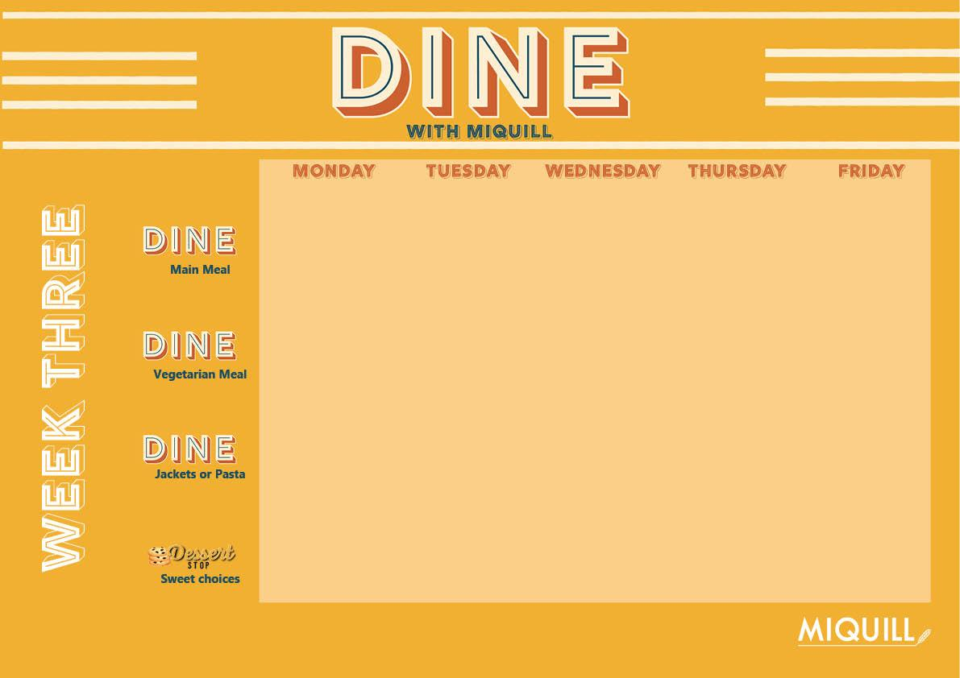
All Day Breakfast with Hash Browns and Baked Beans | Beef Bolognese with Penne Pasta Garlic Bread, Sweetcorn or Carrots | Roast Chicken Stuffing & Gravy with Roast Potatoes and Cabbage or Courgettes | Chicken Stir Fry With Rice and Leeks or Broccoli | Fish Fingers with Chips and Garden Peas or Baked Beans
Veggie All Day Breakfast with Hash Browns and Baked Beans | Vegetable Pasta Bake with Garlic Bread, Sweetcorn or Carrots | Quorn Roast Stuffing & Gravy with Roast Potatoes and Carrots or Broccoli | Vegetable Stir Fry with Leeks or Broccoli | Vegetable Fingers with Chips and Garden Peas or Baked Beans
Jacket Potatoes and Pasta available daily | Jacket Potatoes and Pasta available daily | Jacket Potatoes and Pasta available daily | Jacket Potatoes and Pasta available daily | Jacket Potatoes and Pasta available daily
Rainbow Cookies | Vanilla Iced Sponge | Shortbread | Carrot Cake | Ice Cream
WEEK COMMENCING:
05/05, 13/05, 28/05, 30/06,15/09, 06/10, 27/10
Fresh Bread is available daily with a choice of Yoghurt, Jelly, and Fruit instead of dessert

