Slide 1
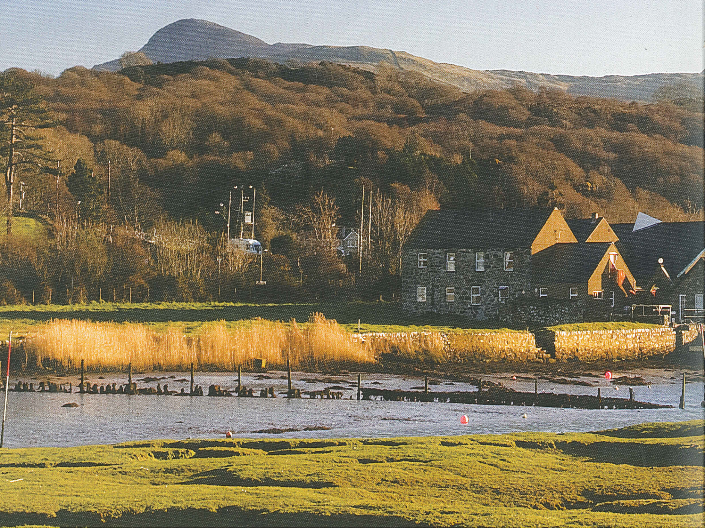
CMC
Pensarn Harbour
and Bryn-y-Moel
Please click on the link below to view a promotional video for CMC Pensarn Harbour that was filmed in 2019 – you may see some familiar faces!
https://www.youtube.com/watch?v=-2Jsz-xped0

Slide 2
Background re CMC...
  Founded in 1966
  Located in Snowdonia National Park
  Centre is split between two locations...
      Pensarn Harbour
      Bryn-y-Moel
  Llandanwg beach is a 10 minute walk

Slide 3
Background re CMC...
  original vision was to ‘develop their physical, mental and spiritual capabilities as individuals and members of society’
  all visitors are treated with gentleness and respect
  no visitors are forced to take part in activities
  staff are sensitive to individual needs

Slide 4
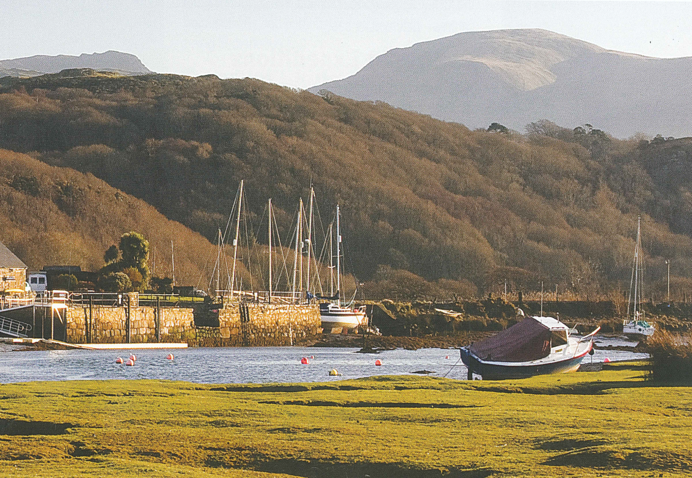
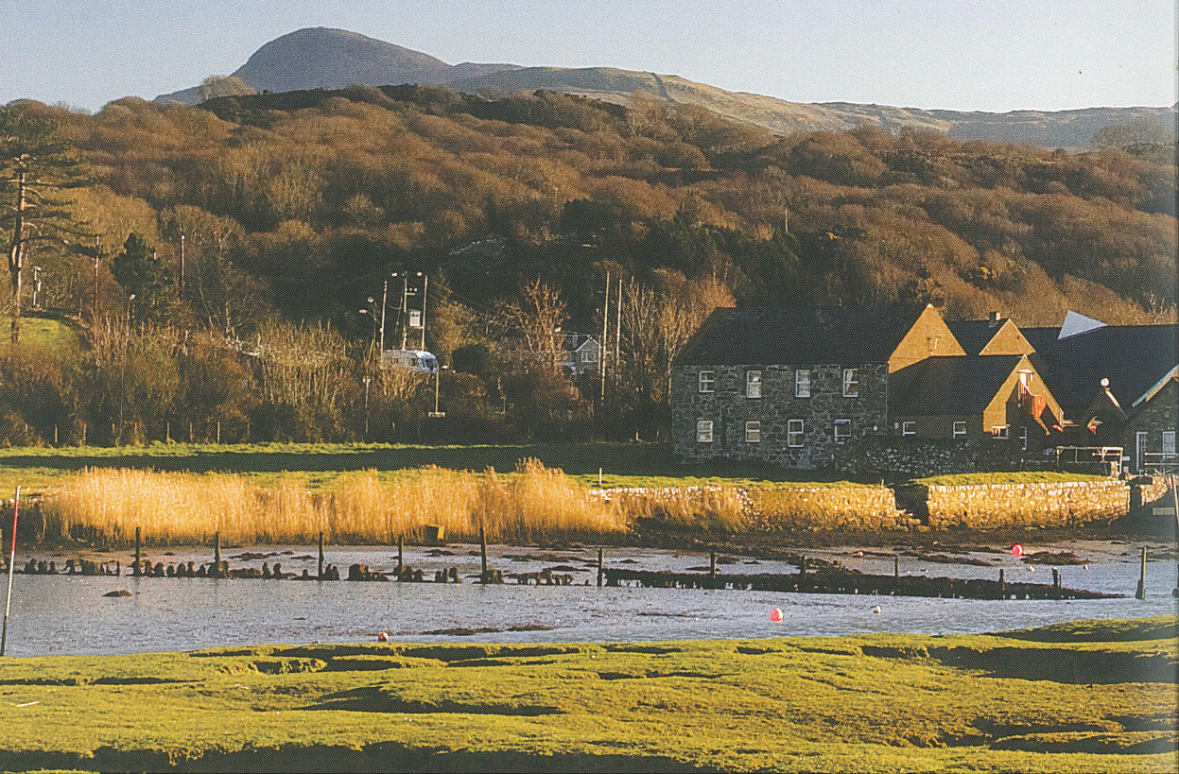

Slide 5
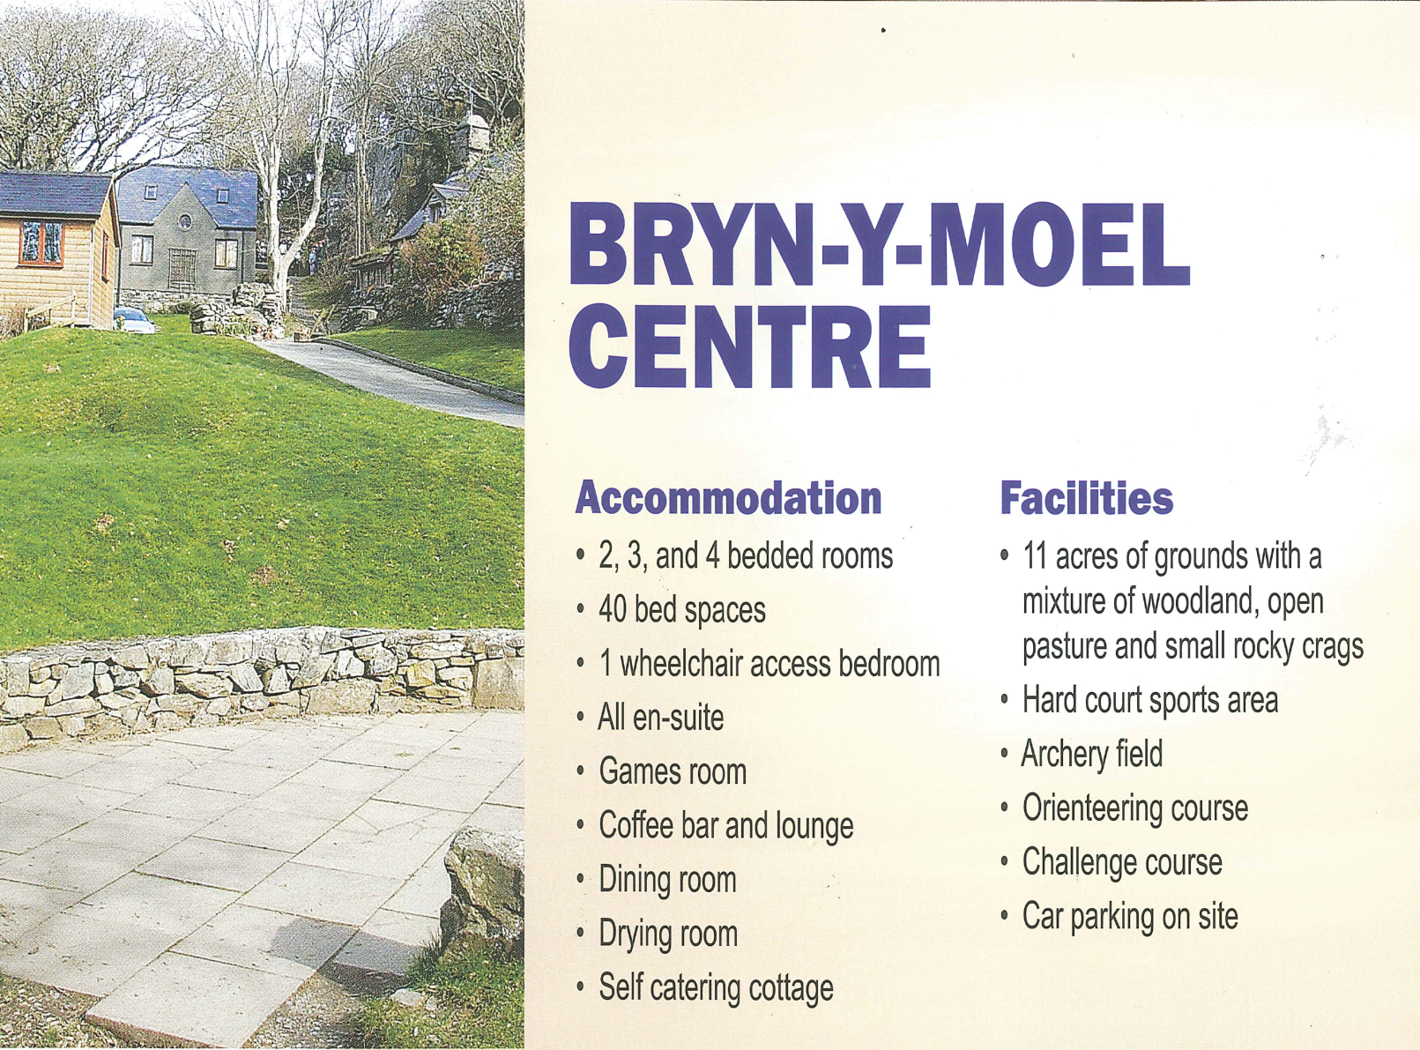
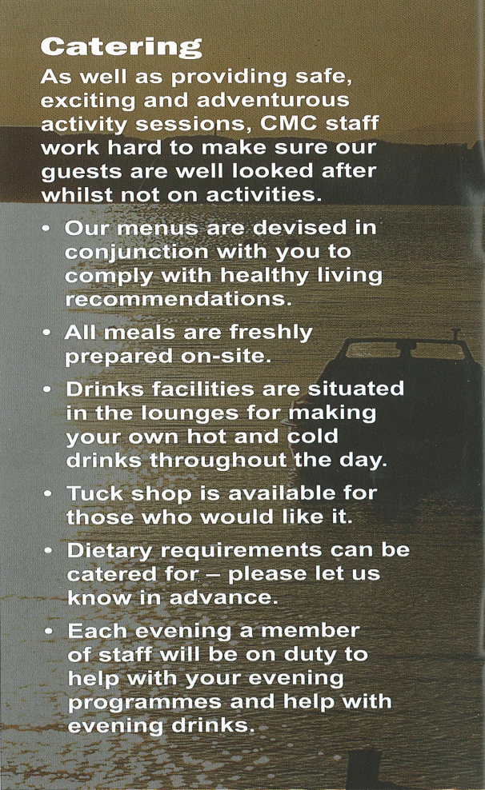

Slide 6
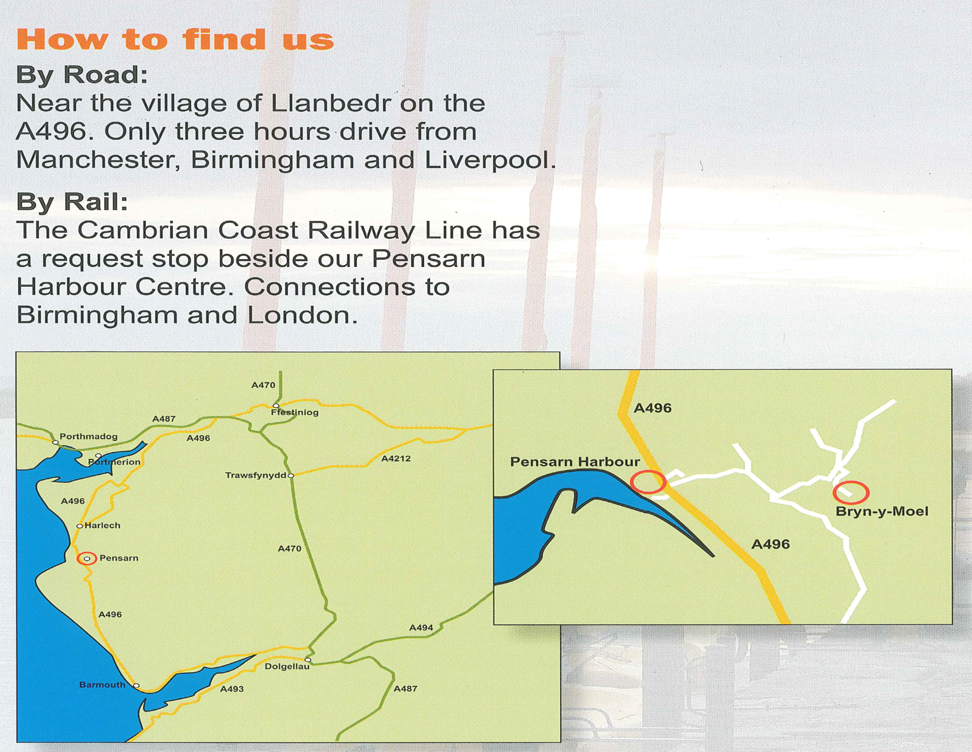

Slide 7
A wide range of activities available...
  Rock climbing
  Abseiling
  Gorge Walking
  Initiative exercises
  Orienteering
  Archery
  Challenge course
  Kayaking
  Open canoes
  Sailing
  Raft building

Slide 8
Safety and Risk Management...
  all staff are appropriately qualified for the activities they lead
  inspected by National Governing Bodies...
      Mountain Leader Training England
      British Canoe union
      Adventure Activities Licensing Authority (AALA)
      Institute for Outdoor Learning
  have licence through the AALA for all activities
  Risk Assessments have been carried out for all activities and are reviewed on a regular basis
  the centre employs highly qualified and experienced technical advisors to inspect and support the team

Slide 9
Information...
  Dates of visit – 20th-24th May 2024
  Cost for stay based on 2023 prices is approximately £450 and includes...
      all meals from evening meal on the first day to breakfast and a packed lunch on the last day
      accommodation – all en-suite
      all bed linen
      all activities
      contribution to additional staffing ratio
      coach travel
  Centre can provide boots, rucksacks, etc
  Notification of intent to join visit
  Payment by instalment available
  Last payment before end of March 2024

Slide 10
Information...
*** Yr 6 Residential Trip to Pensarn – 20th – 24th May***
Calculated costs based on 2023
The cost of the holiday will be approximately £390
The cost of the coach will be approximately £50
Contribution to additional staffing and treat £10
Payment can be made outright, or instalments, or on a weekly or monthly basis.
Please make a confidential appointment to speak to Mrs Walsh if you feel that you will need some advice or assistance towards the visit

Slide 11
Any questions?

