Slide 1

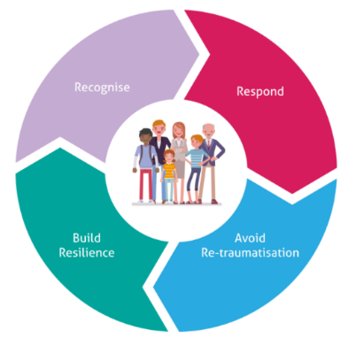
Our Way of Working Trauma Informed PEP Training
Trauma Informed PEPs
Agenda & Aims
Anna Johnson – Our Way of Working, a joined-up approach
Quick Quiz
Why do we want to write a Trauma Informed PEP
How do we write a Trauma Informed PEP?
Natalie Brotherton – Barriers to learning, EBSN
Breakout Groups for a Shared Language Activity
Sharing of an Exemplar OWoW PEP
Trauma Informed Checklist
Training Dates
Tuesday 1st March - 9.30am until 12pm
1pm until 3.30pm
Thursday 21st April – 9.30am until 12pm
1pm until 3.30pm
For Designated Teachers and Persons in schools and colleges

Slide 2
Aims of the session
To bring together the wealth of knowledge we have between us
all regarding OWOW and EBSN
To explore how we can use this knowledge and utilise strategies to write our PEPs through a Trauma Informed Lens using the shared language
To ensure each young person is at the very centre of their PEP,
demonstrating our understanding of their previous experiences
and how this can impact on their lives right now
For Designated Teachers and Persons in schools and colleges

Slide 3

Our Way of Working
Anna Johnson

Slide 4








Cognition
it can affect...
Language development
Brain development
Readiness to learn
Problem solving skills
Level of concentration
Academic outcomes
Physical Health
it can affect…
Sleep
Eating
Cardiovascular health
Immune system
Life span
Emotional & Mental Wellbeing
it can lead to...
Depression
Anxiety
Negative self-image
Self harm
PTSD
Suicidal thoughts
What is the impact of trauma?
Emotions
it can affect...
Response to stress
Recognition of emotions
Management of emotions
Coping skills
Feelings about self, eg guilt
Feelings of worry, hopelessness, helplessness
Level of self-belief
Presentation
it can affect...
Self regulation
Social skills
Response to a situation
Impulsivity
Risk taking, including alcohol, drugs and sexual activity
Relationships
it can affect…
Attachments
Understanding of social interactions
The forming of relationships with peers
Romantic relationships
Intergenerational cycles of abuse and neglect

Slide 5
What is the impact of Trauma?
The Triune Brain https://youtu.be/eVhWwciaqOE

Slide 6
Why do we want to write a Trauma Informed PEP?
To develop a shared understanding of trauma and how this impacts on a young person’s emotional wellbeing, education and outcomes
To build on the personal knowledge schools have of a young person and develop further the recording of information in a supportive way
To ensure that when the young person looks back as an adult, they can see there was a team in place to support them who understood their lived experiences and had their very best interests at heart
To write in line with the 7 Principles launched from the Children in Care Council, as already shared by Anna earlier.

Slide 7
How do we write a trauma informed PEP?
We write it directly to the young person
You tell us that lessons are fun and you like them all. In fact you say you enjoy everything about school, which is great!
We would like you to be able to blend the phase two sounds
that you have learned in phonics so far so that you can read
some CVC words.
JJ, in the past you have found learning a struggle because of
how you have been feeling due to the things that you have seen,
heard and experienced and the changes that have
taken place in the last year.
You preferred to stay in your lessons for most of the meeting today and you were happy for Mrs Steven’s to share your voice. It was lovely to see you when you joined us towards the end.
As this is a meeting early in the term, you haven’t had much
time to show us what you can do yet so we will continue
to watch and to listen to you and report on your progress in
your spring PEP.

Slide 8
How do we write a trauma informed PEP?
We write it in a positive and supportive way, whilst still acknowledging the challenges for this young person and detailing the support that is in place or planned.
We all agreed in your meeting today that the support which has been put into place for you this term has had a positive impact on your well-being and your readiness to learn.
To support your well-being and progress in learning, all staff in
school have a copy of your Individual Education Plan and are
aware of what can make you feel anxious and how they can
support you.
You are being supported with reminders to play gently with
other children at playtimes as sometimes other children can find
your play too rough.
You can sometimes become upset when people you are friends
with have friends other than you. This is something we
will talk about in your future ELSA activities and continue to
help you understand.
Staff from your school celebrated how you enjoyed a very
successful and planned move from primary school and
because of this, you are happy and have settled really well.

Slide 9
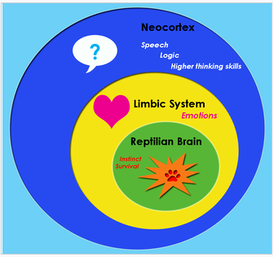
The scenario for Seb:
You have had 3 placement changes in the last year
You are 11 years old
You have had a school move half way through the Autumn term
You have family time with your parents once a month
You are struggling to maintain friendships with your peers
You are struggling to concentrate and stay on task
You are not meeting Age Related Expectations but are making small steps of progress
You are really enjoying Art and PE in school and at home you have joined the local Judo club.
The task:
Draft a short paragraph that could be written in the ‘How Do You Think I am Doing Now?’ section of a PEP form.
You will need to acknowledge how Seb is feeling, how his
feelings may be shown and why. Please try to detail some
strategies and interventions to support Seb.
How do we write a trauma informed PEP?
Let’s try…..

Slide 10
How do we write a trauma informed PEP?
By building upon our understanding of children and young people and our knowledge of shared language
You may think I am being ‘challenging’ but this could be because I am feeling…
Distressed
Anxious
Upset…
You may think I am ‘refusing’ to do something but this could be because…
I do not feel confident to try
I do not feel safe/secure to have a go
I need support with my self belief…
You may think I am ‘choosing’ to react in this way but…
What is this behaviour communicating?
What might be going on for me right now?
How have my lived experiences shaped me?

Slide 11
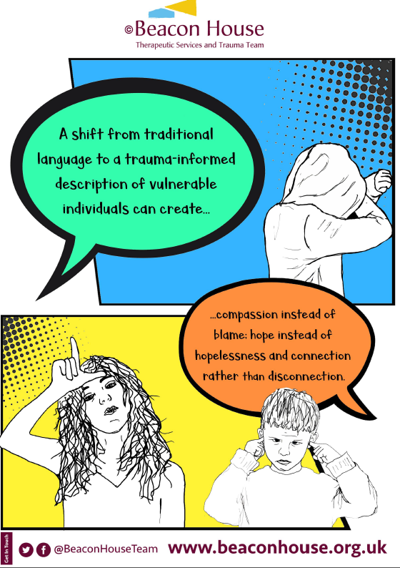
Using our shared language

Slide 12
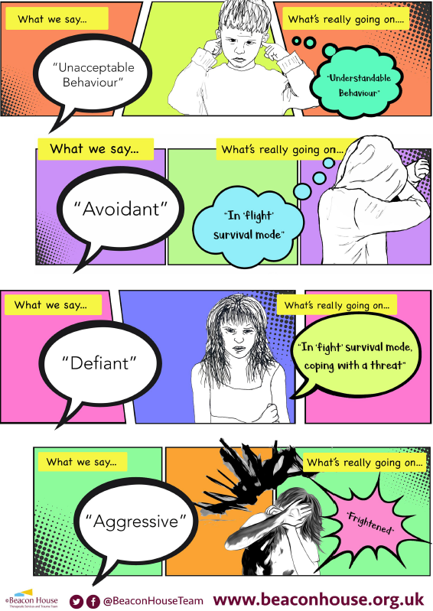
Using our shared language

Slide 13
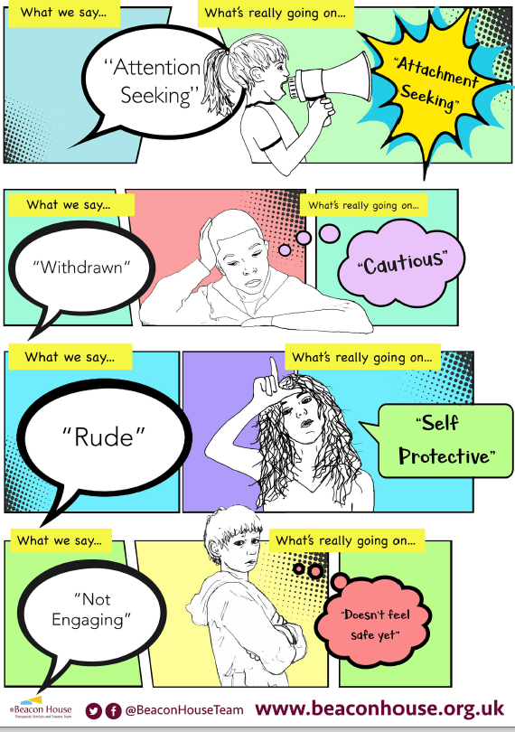
We use our shared language

Slide 14
Emotionally Based School Non- Attendance
Natalie Brotherton

Slide 15
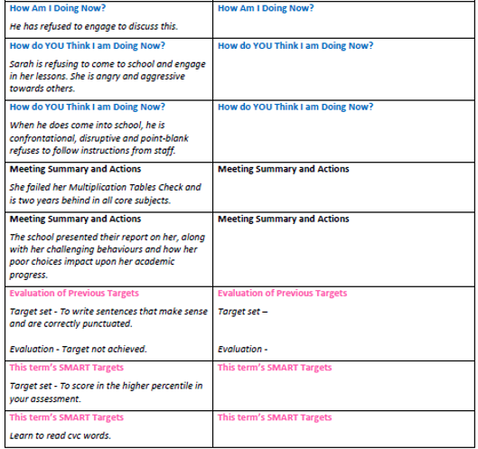
Let’s have a go….
Follow the link in the chat to gain access to this document below on the VS website.
Group Breakout Task
20 minutes
Comfort Break
5 minutes
Return for feedback

Slide 16
How did it go?
Feedback

Slide 17
Exemplar PEPs
We have created 10 exemplar PEP forms to support those involved in the PEP writing process.
These are now available on our Virtual School website
Cheshire West and Chester Virtual School: Exemplar PEPs (cheshirewestvirtual.school)

Slide 18
Points to remember
All sections of the PEP must be written “to” the child/young person
DTs to disseminate the shared language with all staff who will contribute to or write the PEPs.
DTs must ensure that all staff are aware of the audience they are
writing to and everyone is mindful that the PEP is a statutory
document shared with a wide range of people, including
Carers and Parents, OFSTED, the Local Authority, Social Care,
Education Leaders, Health Professionals and, most importantly,
the young person.
No other pupils’ names must be mentioned – refer to them
using their first initial.
It is good practice for DTs to quality assure the PEP before it is sent
to the Virtual school for screening.

Slide 19
Points to remember
For complex care planning situations that have an impact on the child/young person in school you do not need to detail the Care Planning discussions. You can reflect the discussions like so:
Your Care Planning Meeting was held alongside your PEP today and the team around you understands that what is happening at home will affect how you are feeling in school. We talked about how the adults in school can help you with this.
You can then add in strategies, support and actions relating directly to school.
Detailed discussions and actions relating to Care Planning are recorded on our social care system.

Slide 20

Reflection
and
Q&A
Thank you for your
ongoing support
Cheshire West and Chester Virtual School
(cheshirewestvirtual.school)
For further support or questions, please contact us:
Chester & Ellesmere Port Locality – Niki White, Nicola.white2@cheshirewestandchester.gov.uk
Northwich & Winsford Locality – Nikki Duffell,
Nicola.duffell@cheshirewestandchester.gov.uk
SEND Cohort with EHCP & Top Up Funding, Cheryl Stacey Cheryl.stacey@cheshirewestandchester.gov.uk

