Slide 1

The Importance of Self-Care
Presented by Anke Jones, The Virtual School’s Person-Centred Therapist
Cheshire West and Chester
March 2022

Slide 2
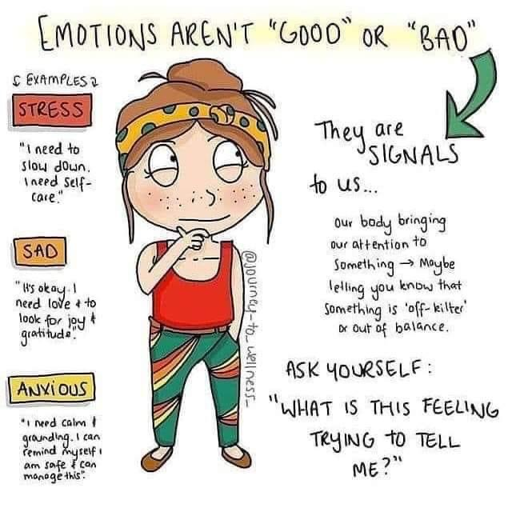

Slide 3
Objectives
To explore our awareness of the importance of self-care
To share some helpful information
To introduce you to self-care ideas and exercises
To explore how we can embed self-care strategies into our daily routine

Slide 4
An invitation to think about -
What do we already do to recharge our batteries?
Do we give ourselves time & permission to think, reflect and relax?
Do we believe that to be able to care for others, we need to care for ourselves first?
Are we able to switch off from our busy day OR do feelings, thoughts and lived experiences stay with us for quite some time?

Slide 5
The importance of self care
Sanderson (2020) refers to the importance of integrating self care strategies into our daily routines. This helps us to:
Be fully present
(present in the moment with ourselves & others around us)
Maintain a high level of self awareness & understanding of (compassion towards) self
Be empathic & compassionate
Transform the most challenging interaction into the most rewarding
(taking time out can help us feel more productive & effective when we are supporting others)
Have & maintain a balance

Slide 6
We are trying to avoid:
Burnout (as reported by WHO 2019)
and/or compassion fatigue, a loss of caring (Figley 1995 & 2002)
Depletion of energy
increased negative mindset, exhaustion (Maslach 2015)
Secondary traumatic stress
trauma like reactions (Yassen 1995)
Vicarious traumatisation
people who are transformed by reports of traumatic experiences leading to disruptions in their own process, meaning, purpose and spirituality (McCann & Pearlman 1990, Cortois 1993)

Slide 7
Food For Thought - Have we experienced any of the below?
Memory & concentration problems
Disorientation
Anxiety
Depression
Change in world view
Loss of confidence & competence
Somatic symptoms: sleep disturbance, recurring physical illness, suppressed immune system, changes in appetite & behaviour, increased reliance on self-medication (alcohol, drugs etc)

Slide 8
We matter!
Our own mental & emotional health is important
We want to care and support others effectively
We want to make decisions that have a positive impact on others & our own personal lives

Slide 9
An invitation to acknowledge that there is an impact of caring for others -
The Helping Process is an intense & deep engagement
You give a lot of yourself everyday and I would argue that you deserve time out to recharge your batteries!
Would it not be helpful if we could leave commitments to one side so that we feel refreshed for the next day?

Slide 10
Self Awareness is key
Golding 2020 -
Being in the moment – the 1st 2 stages:
2. Impact on you (check own response, PAUSE)
- Am I regulated, can I stay open & engaged?
- Am I becoming irritated? Do I feel useless?
- Do I need a break or can I go back to being open & engaged
- Can I be compassionate to myself (& the young person)?
Notice
What is happening?
Do I need to step in now?
What immediate steps do I need to take to ensure everyone’s safety?
Is the young person ready for my support?

Slide 11
Responding in a trauma informed & attachment friendly way:
We are:
By being mindful and aware – aiming to de-escalate, offering effective support & opportunity for a person-centred recovery
Young people pick up from the helping adult:
A transferring of care, calm & consistency, - being personalised & targeted in our offered support at a time where they are in turmoil & crisis
Working as part of a team that is supportive of one another – creating an environment where everyone matters
Embedding time into our day to reflect, recharge & plan ahead
Embedding time to learn from one another

Slide 12
Self-care to:
Be more mindful
Be aware that there is a cost to caring
Ensure we maintain a balance between “other-care” and “self-care”
Set appropriate boundaries
Nourish ones own creativity & spirituality (Rothschild 2006)
Develop an understanding of our own, individual process (increased awareness in self) to tackle signs of own symptoms of burnout, compassion fatigue, secondary traumatic stress and vicarious trauma
Make time to reflect & check in with ourselves
Be kind to ourselves first and then others

Slide 13
Let’s do this! Let’s connect with ourself & others around us!
Why not create our own support networks – to let one another know what I might need support with
Check-in at the beginning & check-out at the end of the day
Time in the day & resources to apply self-care strategies
Boundaries - taking breaks, having time off to recharge & ground ourselves
Time with family & friends
Time in nature
Laughter, fun & play
Daily physical release

Slide 14
Journaling
Sarkis (2020) reflects on the benefits of journaling in Psychology Today:
Journaling can result in: significant improvement in peoples’ mental health and wellbeing
Journaling can lead to a reduction in symptoms related to anxiety and depression
Invitation - In your own time: Two thoughts & feelings about your day today & what do you wish (one wish) for tomorrow

Slide 15
An invitation to take part in two exercises
I will keep my sound on to guide you through some exercises
Please, ensure you look after yourself and sit in a comfortable position
Thank you ☺

Slide 16
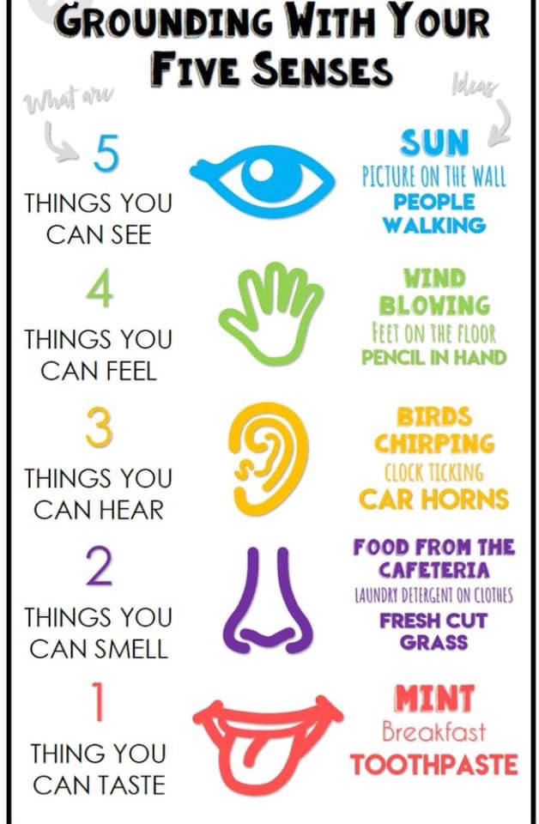
Grounding Technique idea:

Slide 17
Mindfulness Activity
.
1) Invitation to think about a relaxing word.
Think of a word/place that conjures up relaxing thoughts/feelings/memories.
2) Breathing (if you are comfortable, close your eyes).
Breathe in through the nose (if you can) to the count of 4.
Hold
Out to the count of 4
Now as you breathe in again, think of your relaxing word in more detail. As you breathe out, allow yourself to relax into your chair, into an open body language, allowing for all the oxygen to reach every part of your body.
4) Body Scan - Mindfulness

Slide 18








To extend my knowledge further:

Slide 19
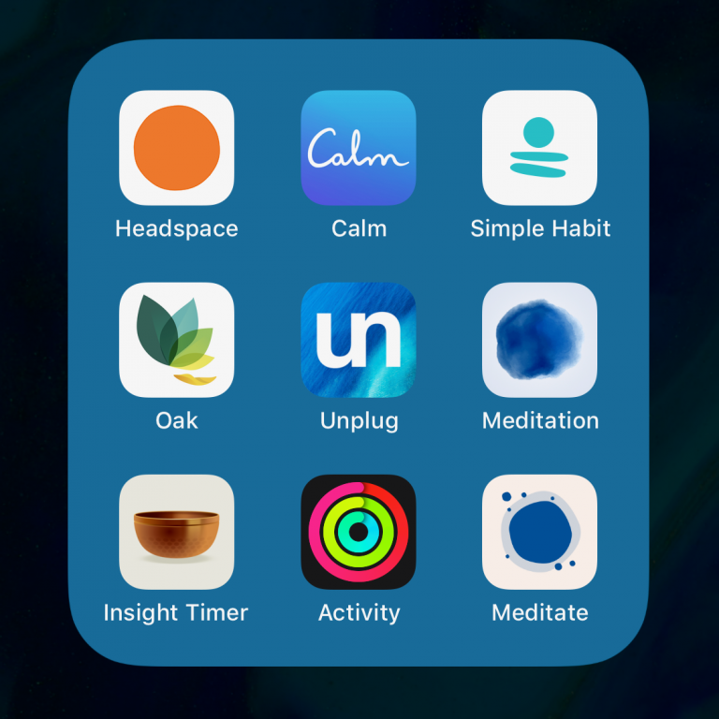


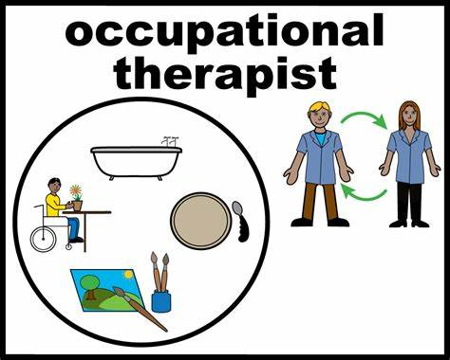

To extend my knowledge about self-care:

Slide 20
Helpful links:
https://www.youngminds.org.uk/
https://nopanic.org.uk/
https://thelossfoundation.org/
https://beaconhouse.org.uk/resources/
https://www.mind.org.uk/
https://www.mymind.org.uk/
https://www.minded.org.uk/
https://www.kooth.com/
https://www.england.nhs.uk/supporting-our-nhs-people/support-now/wellbeing-apps/
https://www.annafreud.org/schools-and-colleges/resources/

Slide 21
References:
Courtois C. A. (1993), Vicarious Traumatization of the Therapist, NCP Clinical Newsletter, 3 (2), 8-9
Figley C. R. (1995 & 2002),
Compassion Fatigue: Coping with Secondary Traumatic Stress Disorder in Those Who Treat the Traumatized, Ne York: Brunner / Mazel
Treating Compassion Fatigue, New York: Brunner / Mazel
Golding K. (2020), Presentation at ARC Conference – online event, CWAC
Maltsberger J. D. & Buie D. H. (1994), Countertransference and hate in the treatment of suicidal patients, Archives of General Psychiatry, 30 (5), 625-633
Maslach C. (2015), The Cost of Caring, Los Altos: Major Books
McCann I. L. & Pearlmann L. A. (1990), Vicarious traumatization: A framework for understanding the psychological effects of working with victims, Journal of Traumatic Stress, 3 (1), 131-149
Rothschild B. (2006), Help for the Helper: The Psychophysiology of Compassion Fatigue and Vicarious trauma, New York: Norton
Saakvitne K.W. & Pearlman L.A. (1996), Transforming the Pain: A Workbook on Vicarious Traumatization, New York: Norton
Sanderson C. (2013), Counselling Skills for working with Trauma, London: Jessica Kingsley
Sanderson C. (2020), The Cost of Caring In Context: The Magazine for Family Therapy and Systemic Practice in the UK, Edition 171, October 2020. pp 44-46
Sarkis S. (2020), Want to get a head start on New year’s resolution for 2021? Try Journaling, Today, December 1st 2020.
Skovholt T. M. (2016), The Resilient Practitioner: Burnout Prevention and Self-Care Stategies For Counsellors, Therapists, teachers and Health Professionals, 3rd Edition, New York / London: Routlegde
World Health Organisation (2019), International Classification of Diseases and Related Health Problems, 11th Edition (ICD-11), World Health Organisation
Yassen (1995), Preventing Secondary Traumatic Stress Disorder, In: C.R. Figley (ed.) Compassion fatigue: Coping with Secondary Traumatic Stress Disorder in Those who treat the Traumatized, New York: Brunner / Mazel

