Slide 1
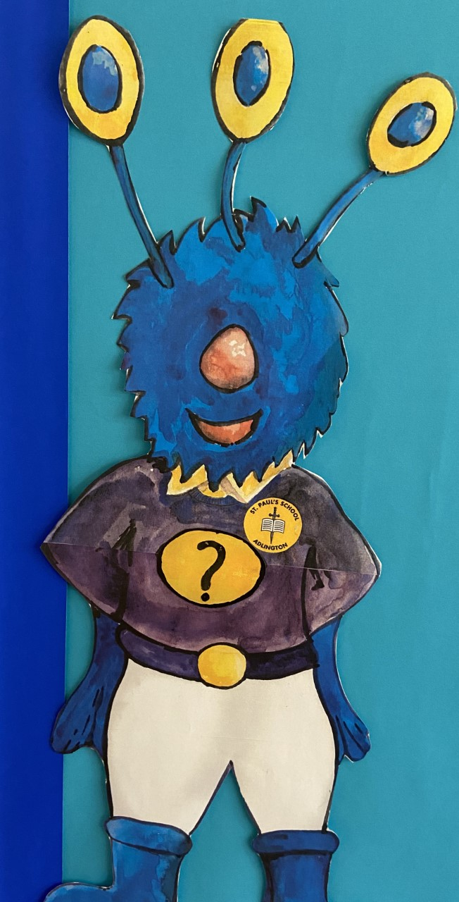
Meet captain conjecture

Slide 2
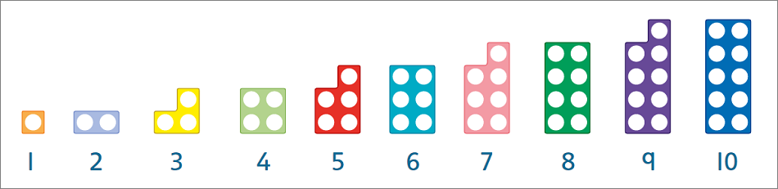
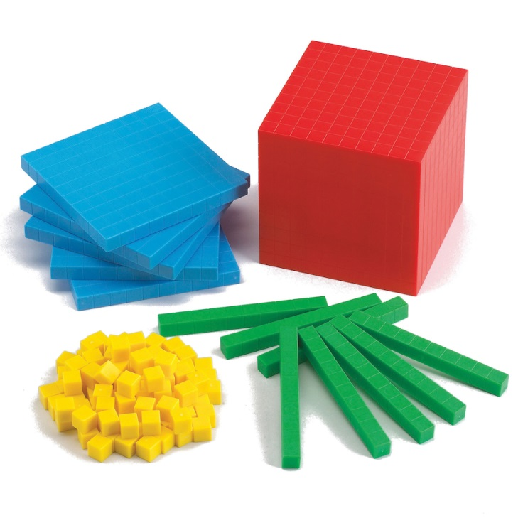
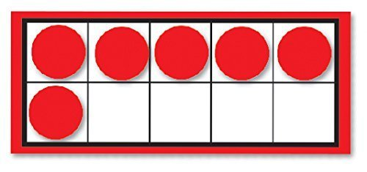
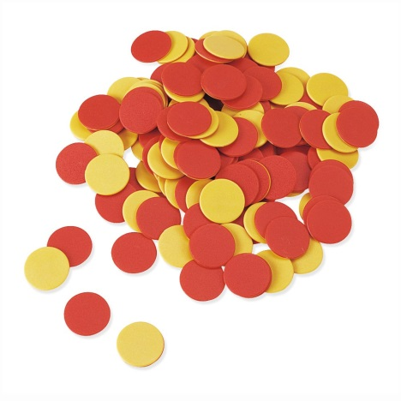
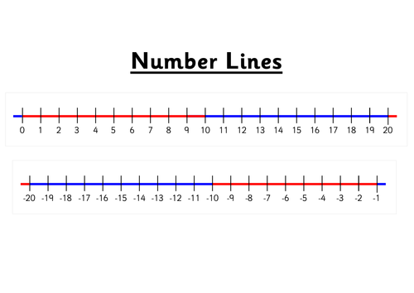

Slide 3
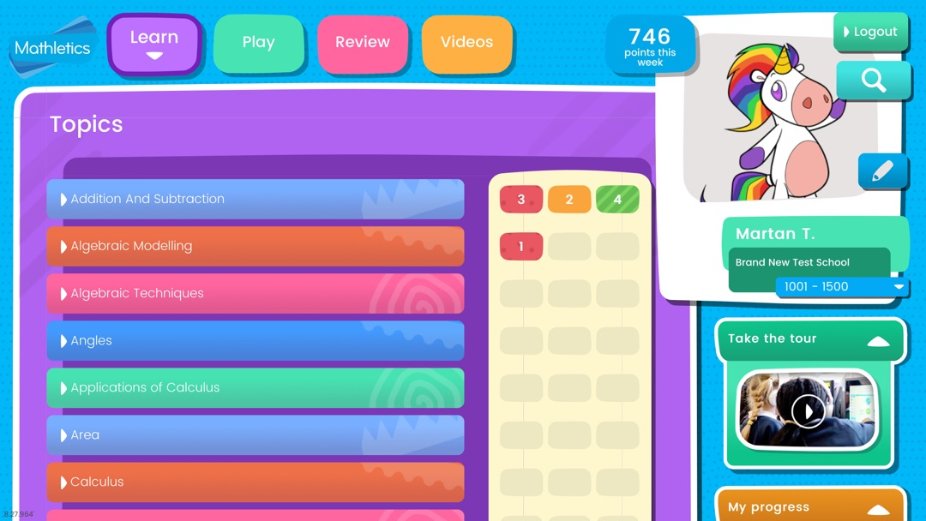

Slide 4
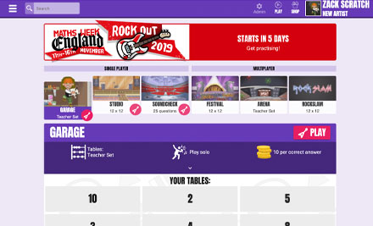

Slide 5
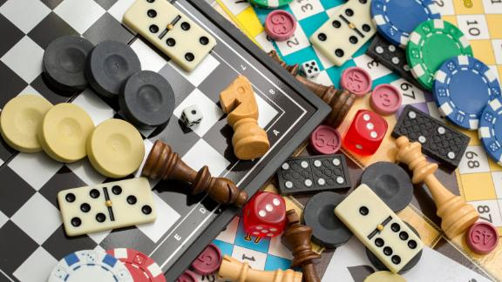
Children’s number skills can be supported in all sorts of fun ways at home. Board games are a great way of making them familiar with the number system and addition and subtraction. Children can really enjoy inventing their own.
Multiplication tables

Slide 6
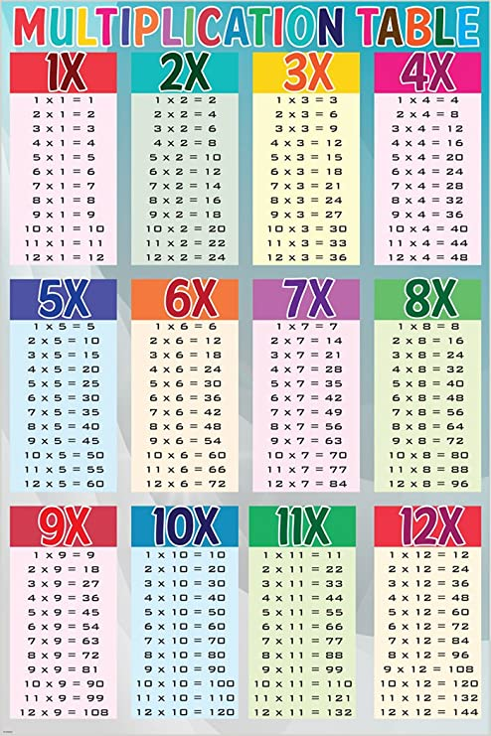
Helping your child to learn multiplication facts and regularly going over them will benefit them enormously. They should learn to recite them in order as well as give ‘quickfire’ answers when they are jumbled up (e.g. “What are seven eights?”, “How many nine’s make 81?”). This can be done on car journeys or whenever there is a spare 5 minutes.
By the time your child reaches Years 5 and 6 it is hoped that they will be familiar with all of their times tables (i.e. up to 12 x 12 by the end of Year 4). The focus now will not be on learning their times tables, but on cementing their confidence and knowledge of multiplication facts.

Slide 7
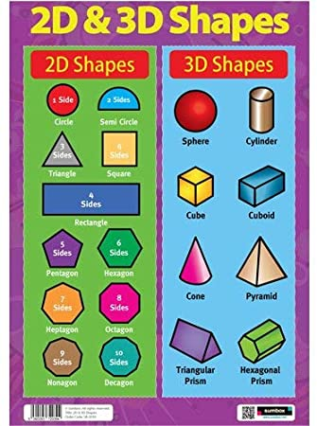
Shape
Encourage your child to spot shapes whenever you go out. As well as identifying 2D and 3D shapes, they should be able to spot lines of symmetry and begin to identify different sorts of angles, parallel and perpendicular lines.
Every day maths
An important part of children’s learning in maths involves applying their skills to everyday problems and situations. Encouraging them to practise their maths skills in daily life will benefit them enormously, and help to give their learning relevance.

Slide 8
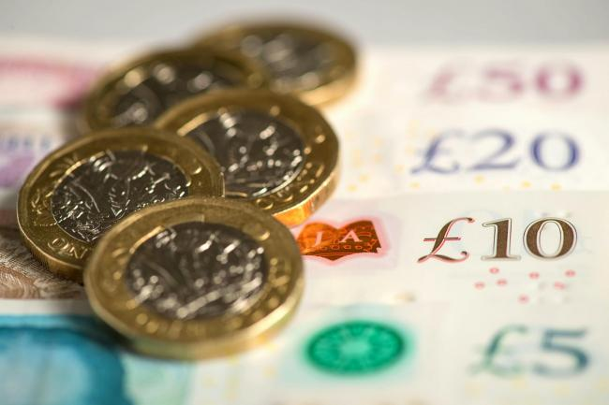
Money
Receiving (and spending!) pocket money can make children very keen learners in this area! Use any shopping trips, or a fantasy shopping spree at home, to encourage your child to be able to:
• Recognise all the coins
• Find totals and calculate change that should be given. Get your child to work out holiday spending money by using conversion charts in newspapers to convert pounds to foreign currency.
For older children, you could use the sales to help them practise their percentages (what is the price if there is 10% off etc).

Slide 9
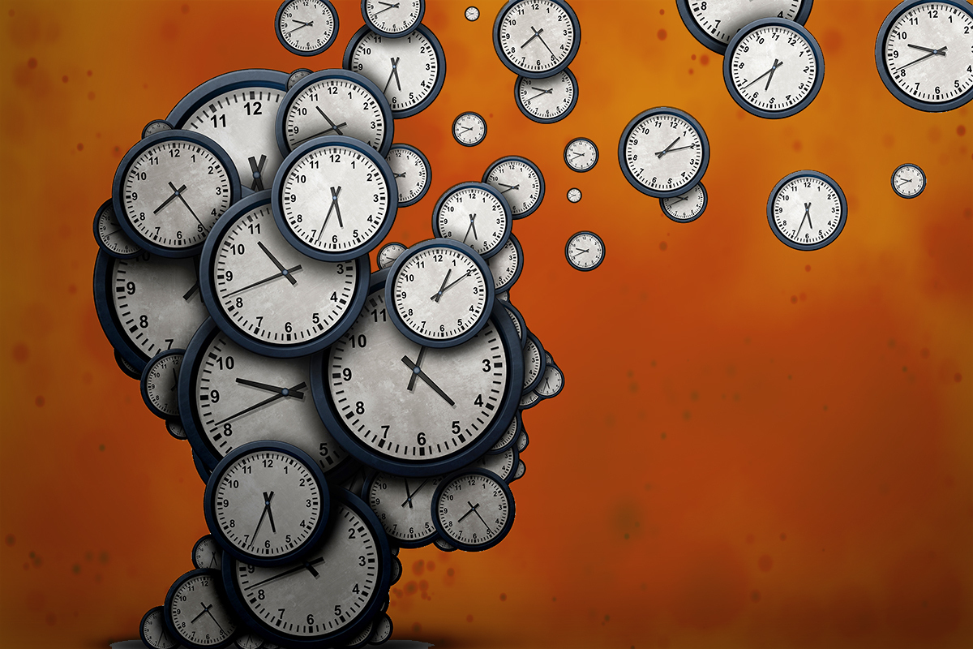
Time
Telling the time is an area that many children struggle with, so giving them plenty of opportunities to practise can be very beneficial. Make sure that there are both traditional and digital clocks around the house for your child to practise reading the time to the nearest minute.
Use timetables and TV guides to practise using a 24 hour clock and calculating time intervals. Give your child lots of time problems to solve. E.g. “Tea will be 45 minutes. What time will it be ready?”

Slide 10
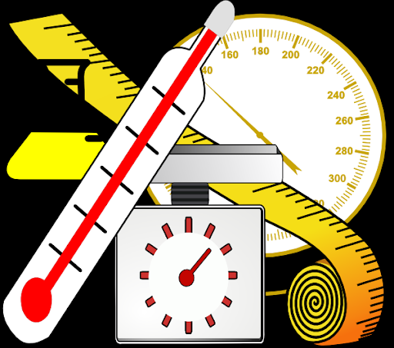
Measures
Get your child to help with the washing up! This is an ideal way to help them learn about the capacity of different containers. Cooking is great way of helping children practise how to measure in grams and kilograms. It also gives them a chance to learn how to accurately read scales and measure out capacities in litres and centilitres. Following recipes will also make them familiar with imperial measurements such as pints, pounds and ounces.

Slide 11
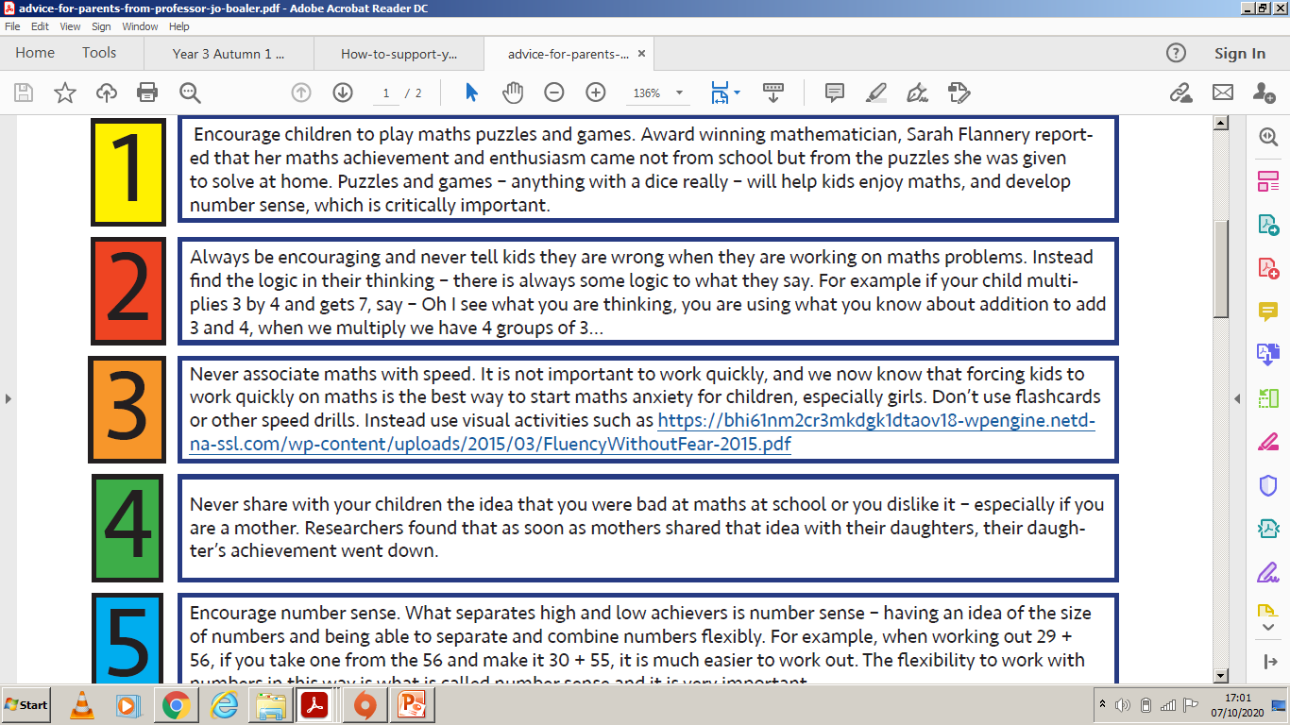

Slide 12
