Slide 1
KS2 Reading Workshop
September 2020

Slide 2
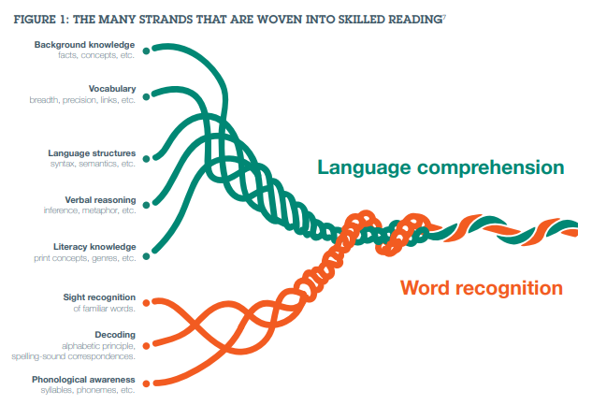

Slide 3



In KS2, we have:
Children in years 3 and 4 who are still accessing our Read Write Inc. programme
Children in years 5 and 6 who are accessing our Fresh start programme
Children in years 3,4,5 and 6 who are accessing our Language and Literacy programme
We also ensure:
Children have daily opportunities to read or be read to by an adult
Whole class reading sessions
A wide range of reading opportunities across the whole curriculum
Children receive additional support with reading where necessary

Slide 4
Home Reading
How can you help?

Slide 5
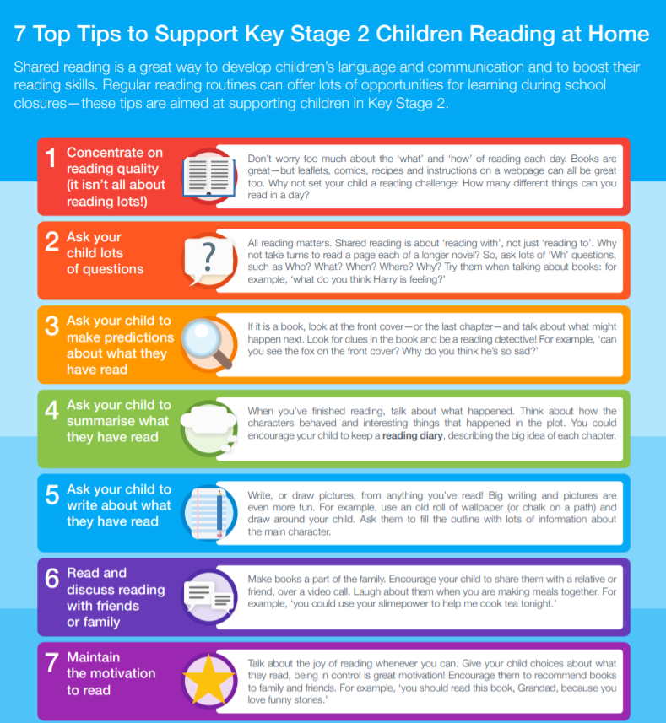

Slide 6
We would like you to:
Provide your child with the opportunity to read at home every day
Sign their reading record each day they read at home
Talk to your child about what they are reading; ask questions, discuss vocabulary and make connections with what they know already
Ensure they bring their book bag into school every Monday and Wednesday so that their home reading can be acknowledged and a new book given if necessary
Promote a love for reading
Model reading to your child

Slide 7

Each day your child reads, sign and date the pages they have read.
It is important you sign and date, as without this record, staff do not know whether the book has been read or needs to be changed.
Use may also use this to write down any information you would like to pass on about their reading.

Slide 8
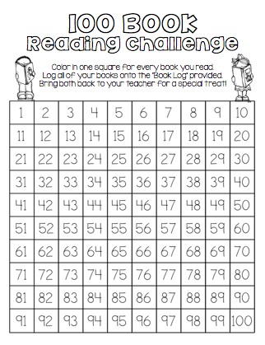
Every day your child reads at home, colour in a square on their chart in their reading record.
They will receive a certificate when they reach 100.

Slide 9
Books will be checked and changed on :
Monday’s and Wednesday’s
On these days, children can also pick a class library book to be read at home or one of Mrs Burger’s books.
All books that are returned to school will be quarantined before being put back on the shelves.

Slide 10

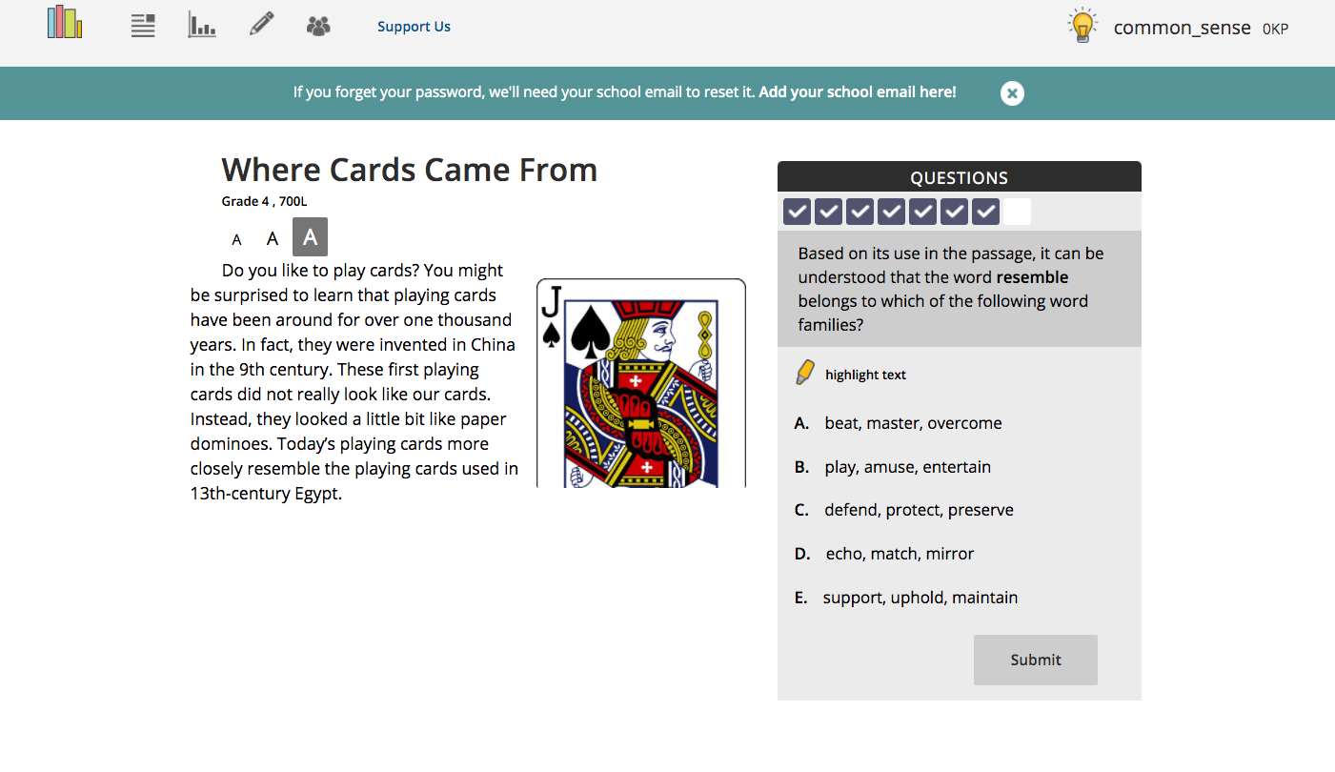
readtheory.org
Children log in and access a text at their level.
They answer comprehension questions and the programme moves them up or down depending on how many they get right.
The programme also offers explanations for any incorrect answers

Slide 11
All children will have:
A levelled reading book
A class library book they have chosen for themselves (this may not be at their level)
Children may also read their own books from home (please note this down in their reading record too)
A reading record (this is to be signed by a parent/carer every day they read)
Children on read write inc. book bag books are encouraged to read them 3 times for fluency before they are changed as part of the read write inc. programme.
If you have any questions about your child’s reading or require any additional support with their reading at home please contact your child’s class teacher on Dojo or contact the school office bursar@adlingtonstpauls.lancs.sch.uk

