Slide 1

Welcome to Havannah Primary School
Notes:
STEFANIE WILLIAMS- INTRO

Slide 2
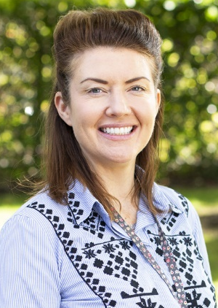
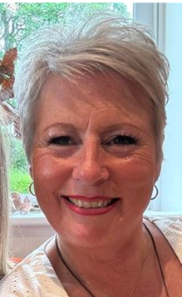
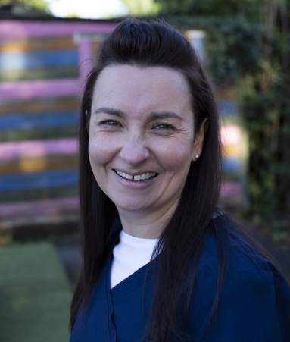
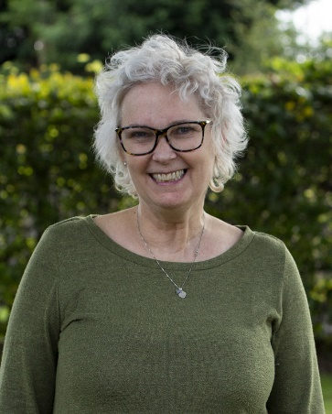
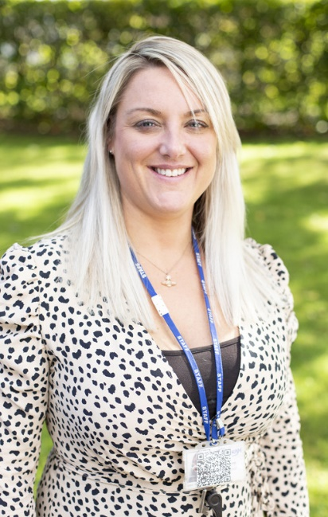
Staff at
Havannah
Mrs Slater-Baynes SENDCo
Mrs Ball
Business Manager
Mrs Williams
Head Teacher
Mrs Thornborrow
Early Years Lead
Mrs Worrall
Bursar
Notes:
stef

Slide 3
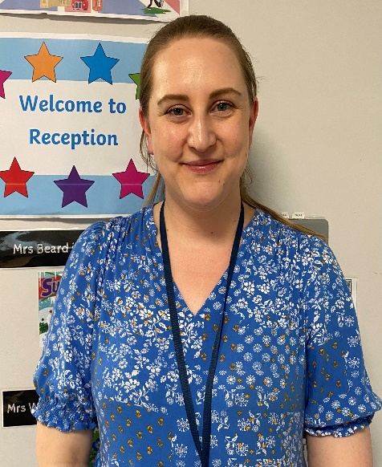
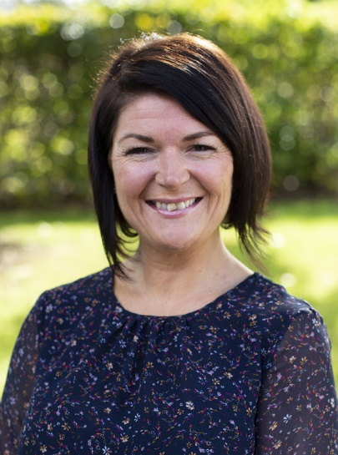
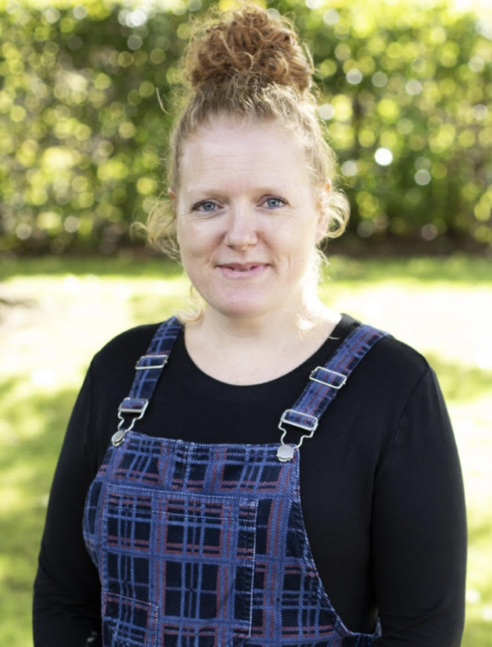
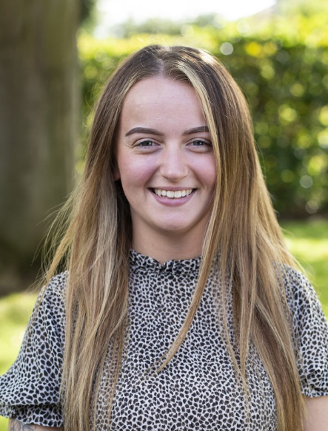
Early Years Staff
Mrs Coxhead Mrs Fearn Mrs Tagell
Miss Beresford
Mrs Fearn
Notes:
stef

Slide 4





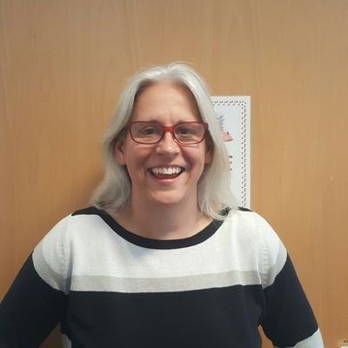

Special Educational Needs and Disability
Our School Nurse-
Emma Martin
Notes:
Soph the Emma

Slide 5
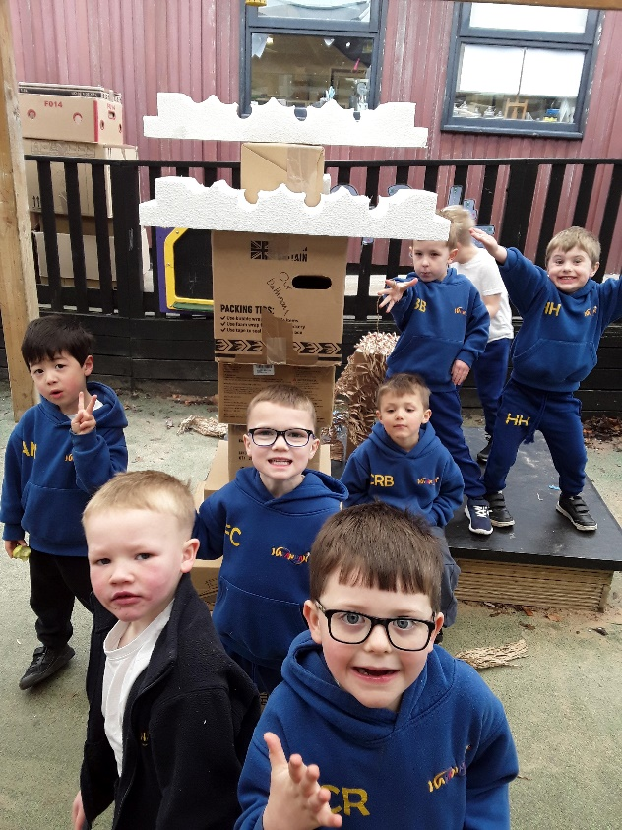
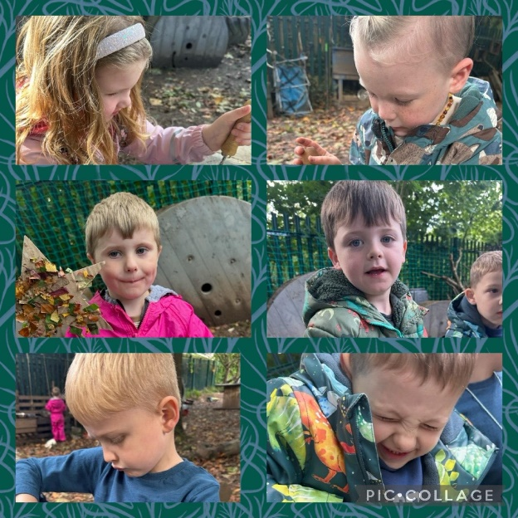
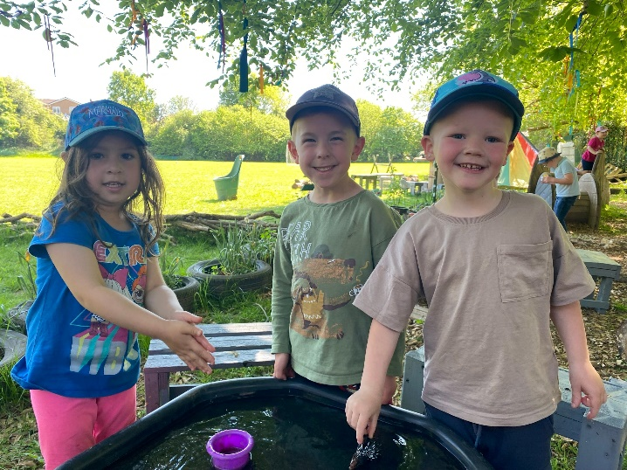
The transition to school
Nibbles and wine evening
Telephone conversations/handovers with nursery staff/key workers
Home visits
Stay and play sessions
Notes:
Em

Slide 6
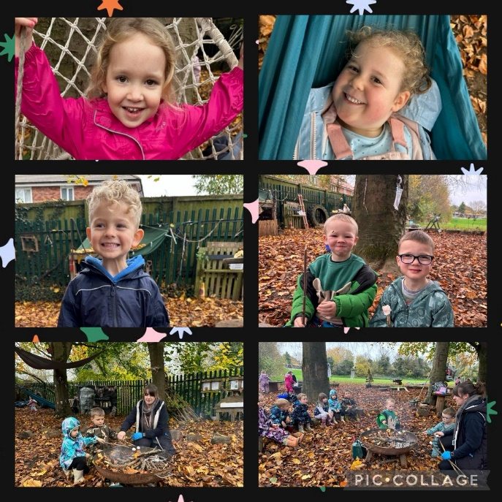
How best to prepare your child for Reception
Toilet trained and having a good go at self-care
Holding a pencil/ cutting with scissors
Fastening their coat, jumpers/cardigans on/ off
Eating with a knife and fork
Recognise and write their own name
Velcro shoes helps!
Encourage independence/ curiosity
Share stories
Share toys
Play games
Have outdoor adventures
NAME LABELS IN CLOTHES! In fact LABELS IN EVERYTHING! ☺
Notes:
Em

Slide 7

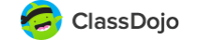
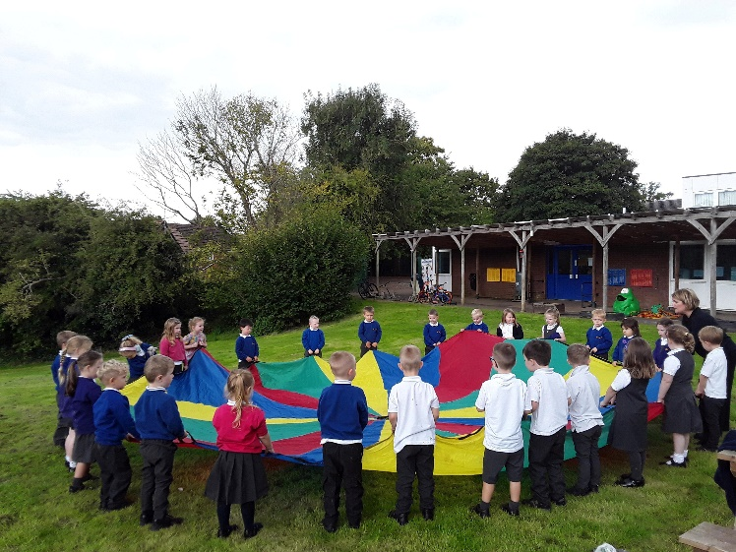
Communication
Class Dojo
Half-termly topic overviews
Termly Whole school newsletters
Termly Parents Evenings
Email- fearn@havannah.cheshire.sch.uk
EYFS staff available on the door to speak to every morning and afternoon.
Notes:
Em

Slide 8
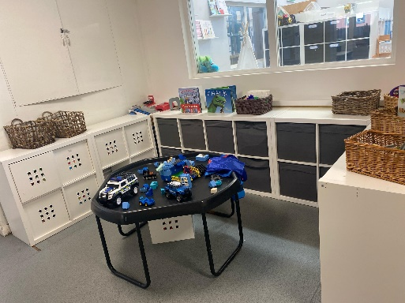
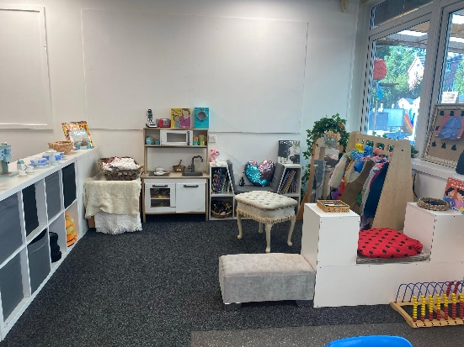
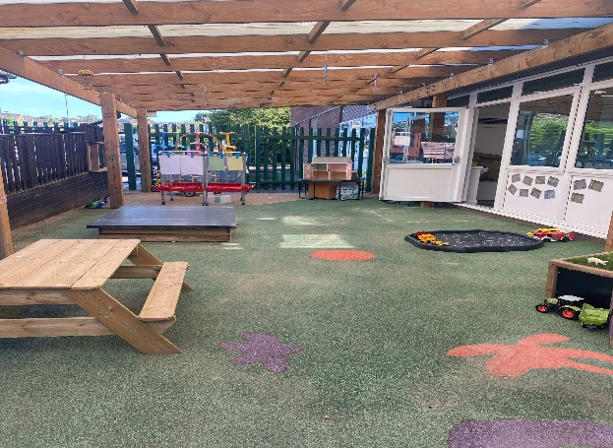
September 2025
School re-opens on Wednesday 3rd September. We will be on the door at 8.45am to welcome you in.
On the first week of school the children will do half days on the Wednesday, Thursday and Friday until 1:15pm.
Parents drop children off at 8:45am and pick them up from the same place at 1:15pm.
From Monday 8th September children will be doing full days – 8.45am-3.15pm
Please can the ‘All about me’ posters be brought into school by Friday 5th September so that they can be shared with the class. We cannot wait to learn all about your child. I will talk to you about the posters at your home visit.
Notes:
Em

Slide 9
What do children learn in reception?
3 Prime Areas
Specific Areas
Communication & Language
Personal, Social & Emotional Development
Physical Development
Literacy
Mathematics
Understanding the World
Expressive Art & Design
Notes:
Learn Vocabulary
Engage with stories, rhymes, non-fiction and poems
Develop relationships
Understand feelings
Manage emotions
Develop a positive sense of self
Take part in conversations, story-telling and role play
Develop gross and fine motor skills
Develop strength, co-ordination, balance and spatial awareness.
Play indoors and outdoors
Play with puzzles, small word activities, arts and crafts and practice using small tools
Develop a love of reading
Sound out unfamiliar words
Quickly recognise familiar words
Practice spelling and handwriting
Articulate ideas and structure them in speech, before writing
Learn to count accurately
Develop a deep understanding of the numbers 10 and beyond
Look for patterns and relationships
Develop spatial reasoning
‘Have a go’ and not be afraid to make mistakes.
Make sense of their physical world and their community
Explore, observe and find out about people, places technology and the environment
Explore and play with a variety of media and materials
Share their thoughts, ideas and feelings through a variety of activities in art, music, movement, dance, role-play and design and technology.

Slide 10



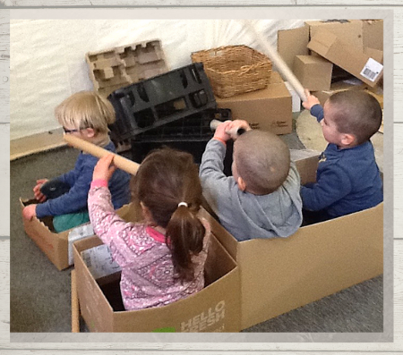


Play is not a swear word and we will be playing!
Notes:
Em

Slide 11
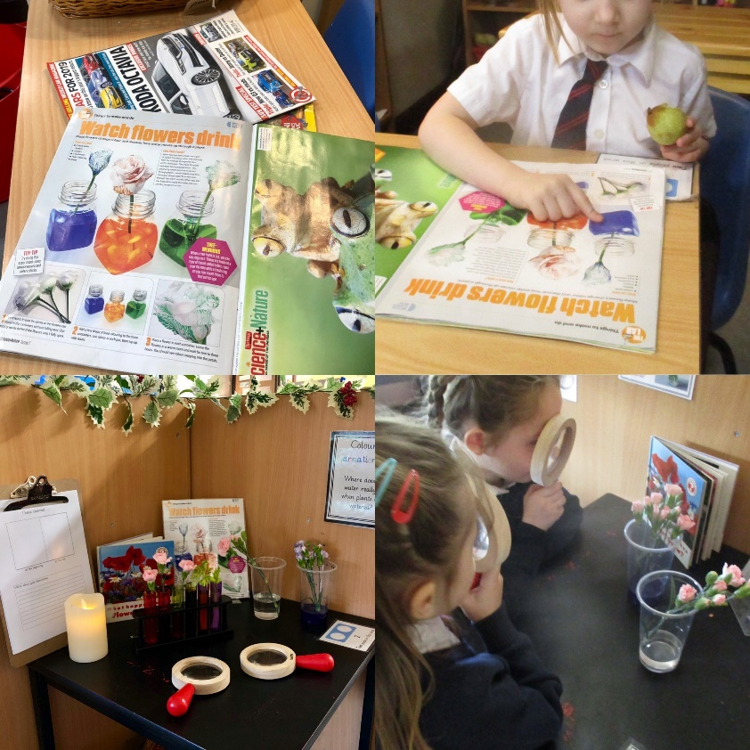

The love of reading!
Notes:
Em

Slide 12
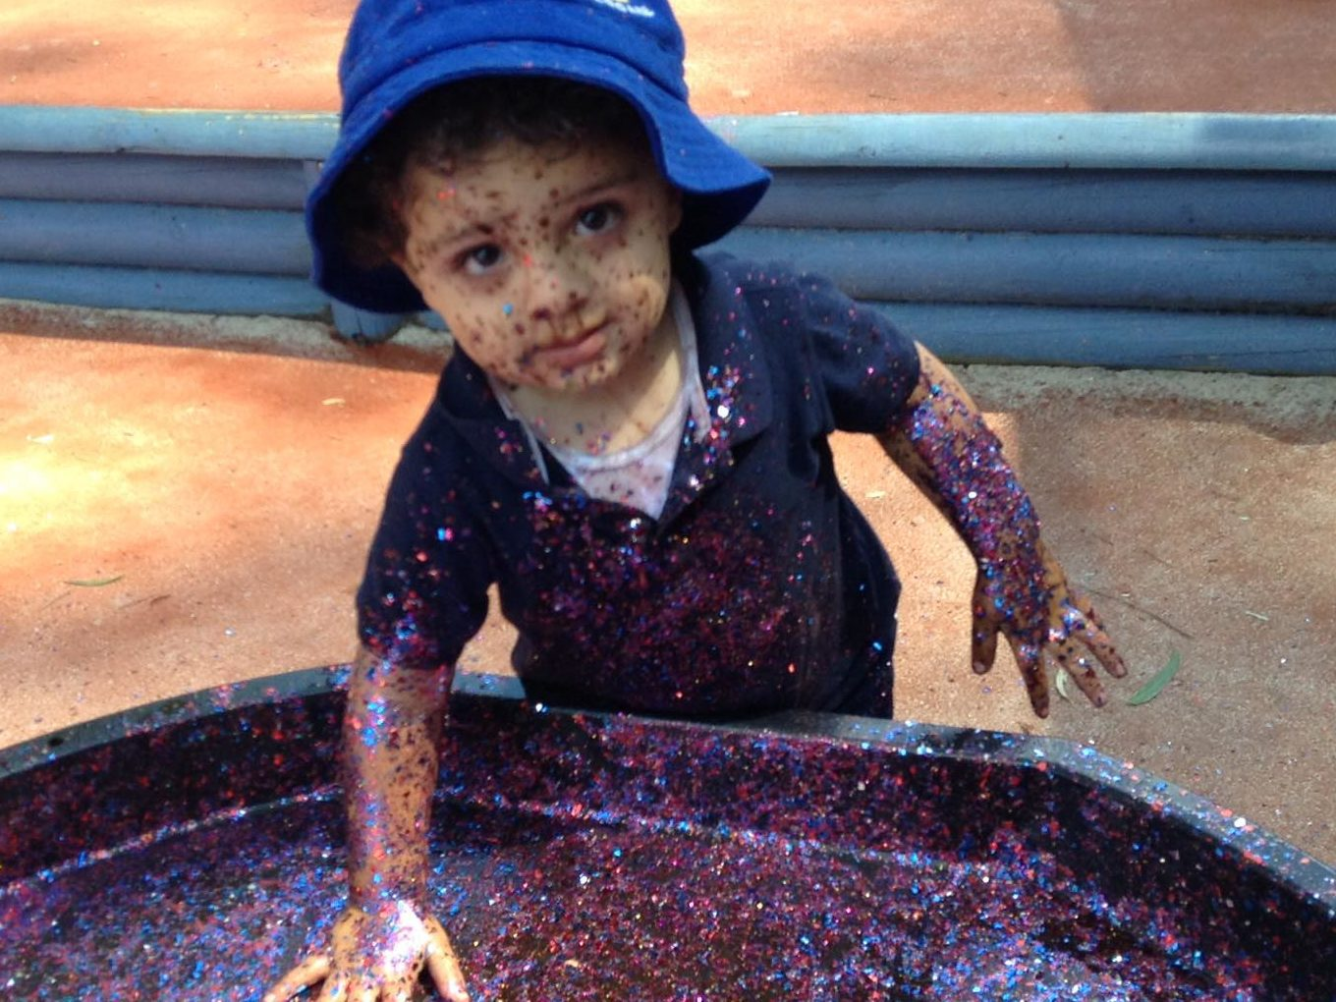

Notes:
Em

Slide 13
Don’t forget
Notes:
Stay and play
Home visit
Say hi to everyone
Eat cheese and drink wine!
Thank you

