Slide 1
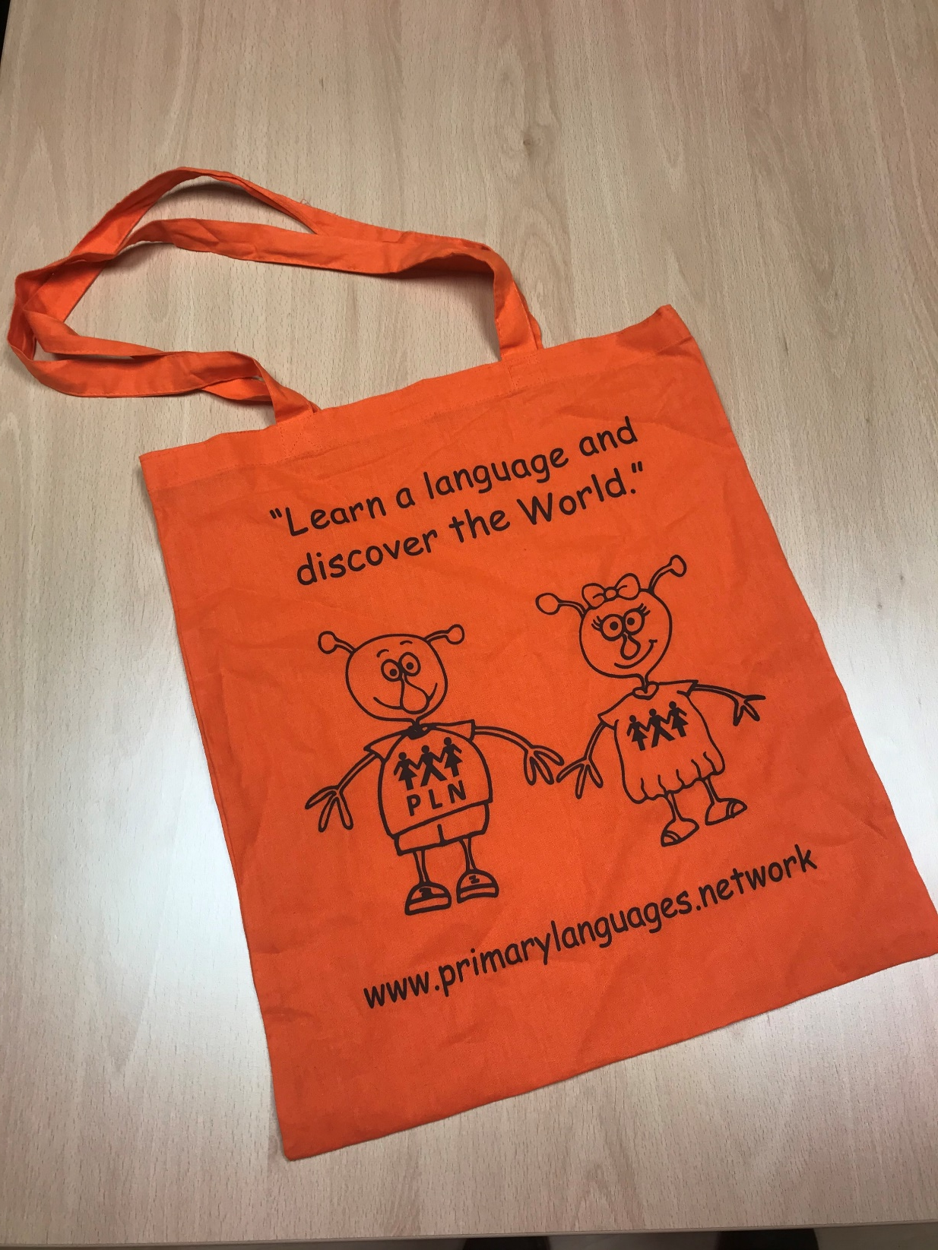

‘Tote bag’ Design Competition
‘One world for all’
We need your help!

Slide 2

2 years ago a student created this statement for the tote bag for the PLN conference.
Now we have run out of bags!
We would like your students to design the whole bag
Why do we want your ideas?

Slide 3

Competition rules
1 entry per student, you can send in as many student entries as you like
Needs student name, year and school somewhere visible for us to see (names of students are solely for identifying the competition winner and will not be shared)
Hand in by 15 June 2020
Prize for both school and student, to be presented at your school and/or conference
All entries will be judged by a panel of the PLN team, and a couple of students
Take a picture of entries and send by email to a.saulnier@woodfall.cheshire.sch.uk

Slide 4
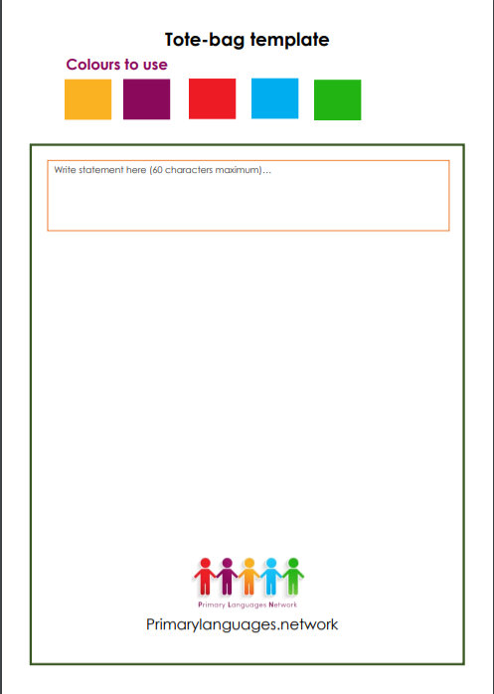
Bag design instructions
The theme of the bag should be about ‘One world for all’
Design on the template provided (in PDF), or draw on an A4/5 piece of paper
Design needs one statement with a maximum characters of 60 e.g. “Learn a language and discover the world”
Can only use the colours provided (black and white also)

Slide 5
Be as creative as you want to be.

