Slide 1


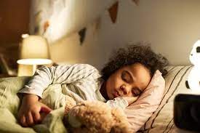

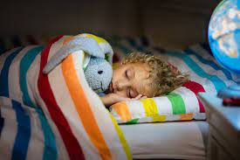
Children’s Sleep: Unlocking the Power of Rest
Charlotte Seston & Clare Dawkins, 2023

Slide 2



Is there really much to know about sleep?
Sleep is actually as important as being awake, but some of us struggle to get the right balance when it comes to getting asleep and staying asleep. This means that we can find that we are tired in the day and find it hard to concentrate, regulate our emotions, eat sensibly and make good/ healthy lifestyle choices.
So how much do we really know?

Slide 3
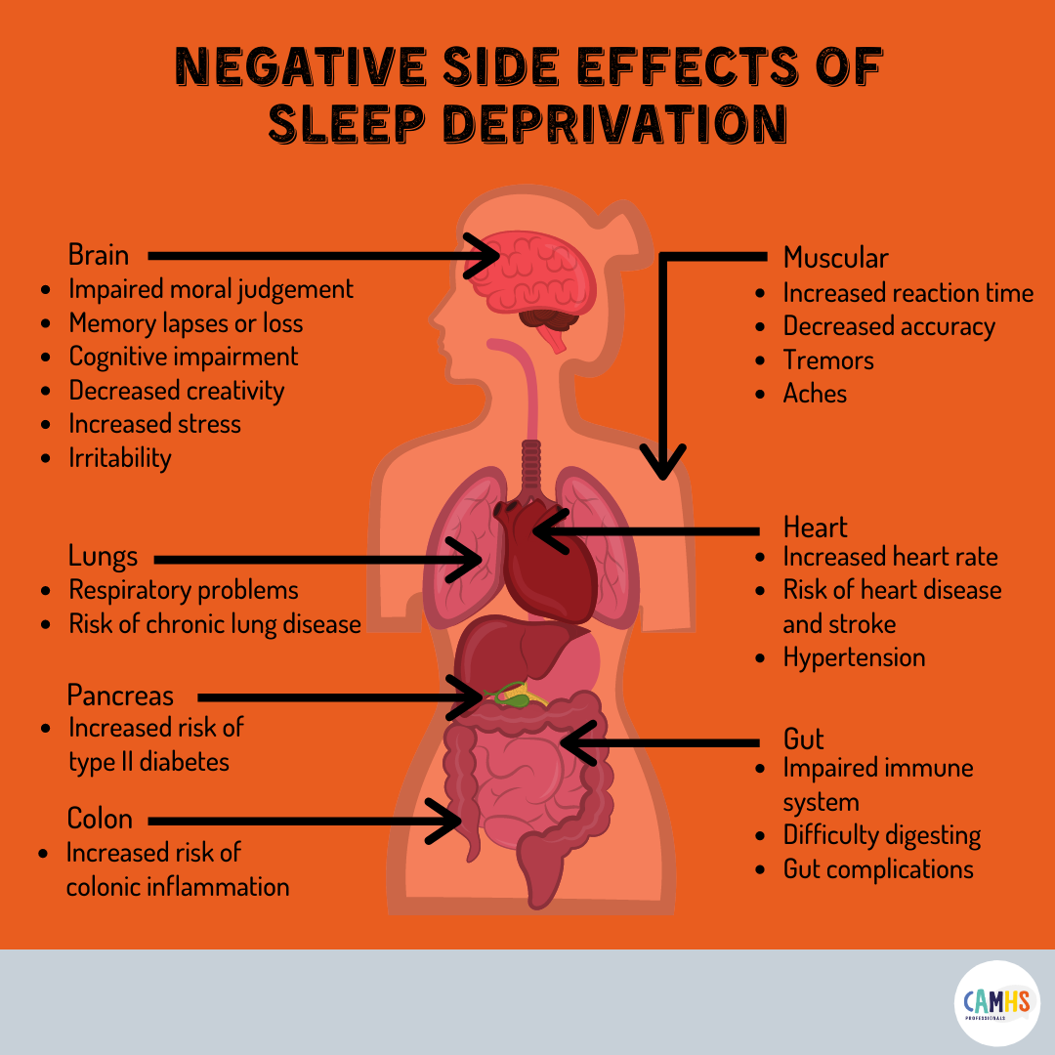

What happens to our body if we can’t sleep?
Sleepiness can affect your child's ability to concentrate, which will have an impact on their learning in school. Even minimal sleep restriction can affect a child's day to day life.
Research tells us that poor sleep in childhood has been linked to allergic rhinitis, problems with the immune system, anxiety and depression. There is also emerging data that shows poor sleep in childhood can carry future cardiovascular risks such as obesity, diabetes and high blood pressure.
The Sleep Foundation, 2023

Slide 4
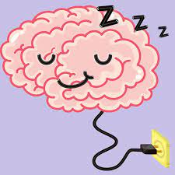
The Science of Sleep
Sleep has some incredible benefits and helps our body to regulate itself in ways which sometimes we don’t know about- take a look at the next slide

Slide 5
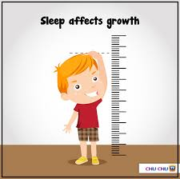

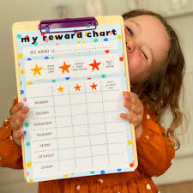

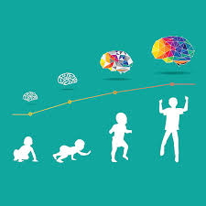


Growth hormone is at it’s highest level over night
Improved behaviour
and emotional regulation
Increases concentration
Reduction in irritability
Our energy increases
if we are sleeping well
Sleep encourages development
Immune system can
recuperate and
strengthen

Slide 6
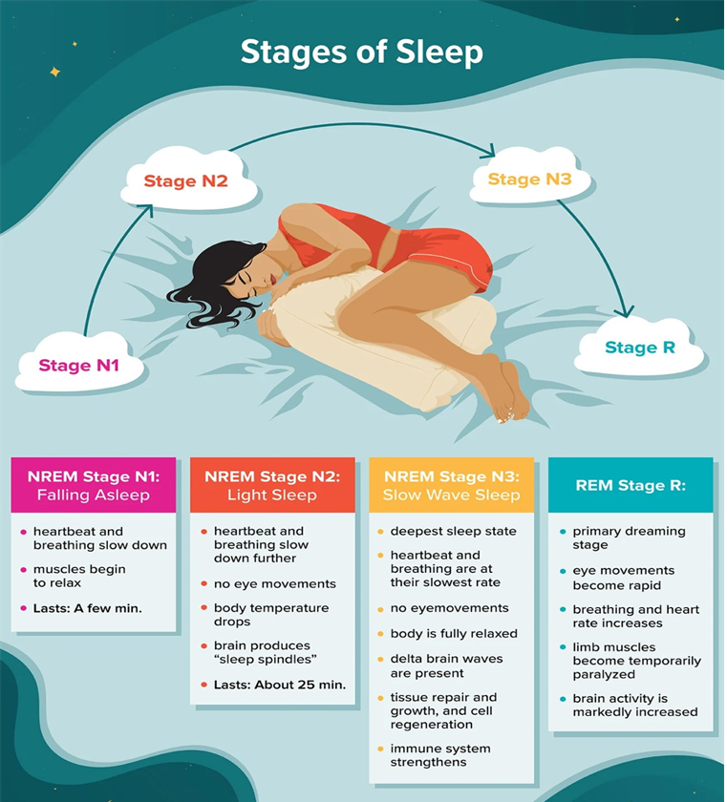
Are All Sleep Cycles the Same?
It is normal for sleep cycles to change as you progress through your nightly sleep. The first sleep cycle is often the shortest, ranging from 70 to 100 minutes, while later cycles tend to fall between 90 and 120 minutes. In addition, the composition of each cycle – how much time is spent in each sleep stage – changes as the night goes along.
Sleep cycles can vary from person to person and from night to night based on a wide range of factors such as age, recent sleep patterns, and alcohol consumption.
There are four sleep stages, including one for rapid eye movement (REM) sleep and three that form non-REM (NREM) sleep. These stages are determined based on an analysis of brain activity during sleep, which shows distinct patterns that characterize each stage.

Slide 7

Sleep Cycle
If anything has changed within our sleep environment this will cause us to wake.
This is why it is really important for sleep conditions to remain the same throughout the night.
For example, a child who falls asleep to music/TV is likely to need this when they wake in the night.
We all have an internal body clock – this is regulated by light.
It is important to strengthen the body clock by having a regular routine.

Slide 8
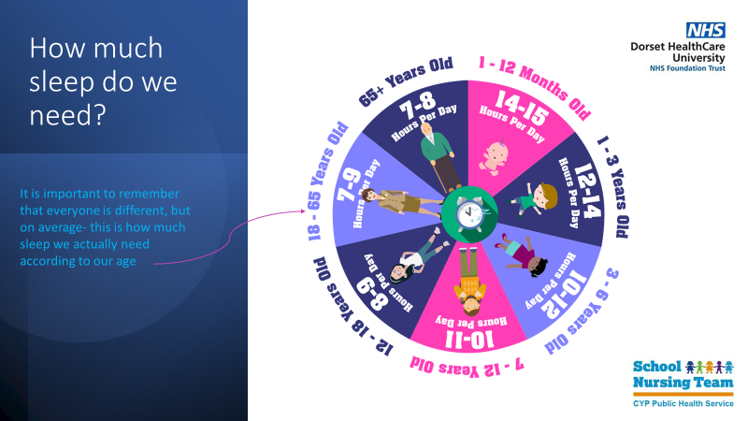

Slide 9
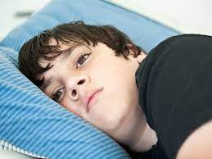

Sleep Challenges for children
Most of us have trouble with getting enough sleep at some
point. There are many reasons why your child might not be able to sleep, and these are different for everyone.

Slide 10
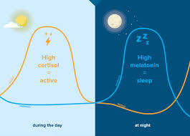
Melatonin and Cortisol
Cortisol is the hormone released for wakefulness.
Cortisol is stimulated by day light.
Cortisol is also released when you are anxious, fearful and hungry. This will interfere with sleep patterns
Melatonin is the hormone released to aid sleep.
The release of Melatonin is triggered by the dark.
It is a good idea to put your child to bed in a dark environment and dim the lights in the run up to bedtime.
Melatonin production is blocked by screen activities- this is why it is a good idea to avoid screen time in the hour leading up to bedtime.
It is important to spend time outside in the morning to balance cortisol and aid melatonin production

Slide 11


Do’s and Don’ts
Consistent bedtime routine
Sleep associations
Teaching to self settle
Limit bedtime behaviour and screen time
Be clear with your children about what is going to happen
Be consistent!
Falling asleep in parents bed
After school naps
Engaging with after bedtime activity
Screen time before bed
Sugary/ caffeine food/drink before bed

Slide 12
Creating a good sleep routine
Realistic bedtime
No screen time one hour before bed
Create some darkness to increase melatonin
Offer quiet activities for them to wind down- jigsaws, reading, colouring in, drawing, listening to calm music
Bath time! Ideally 30 mins before bed for temperature regulation
Get ready for bed in the same order- PJs, teeth, toilet
Once in bed- spend some relaxing time with your child. Reading a story is ideal. Try not to engage in conversation
Have a repetitive phrase that you use- ‘night night, time to go to sleep’
Wake them at the same time each morning to strengthen their body clock
If children have had the right amount of food and drink in the day- they shouldn’t be hungry or thirsty at night.

Slide 13
How to respond to common problems
Quick Return
Need to return child to bed as promptly as possible, ideally before they are out of their bedroom.
Could use a stair gate or ‘alarm’ system on the door (e.g. wind chimes).
If child gets up and calls out- leave for 5 minutes.
Go to child and take back to bed (DO NOT PICK UP). Say the chosen phrase ‘its time to go to bed’ and leave.
Repeat this as often as needed, but increase time that you leave them.
If child falls asleep on floor- pick up and return to bed.
Use a sleep diary to monitor when falling asleep.
Reward with star charts/certificates/incentives if they don’t call out.
Tell them this is what you are going to do.

Slide 14
Gentle approach
Do bedtime routine
Sit by side of bed and place hand on child, do this until they settle nicely (possibly3-4 nights)
Night 5- Sit next to bed with no touching
Night 8- Sit by bed with back to child
Next night, put to bed and leave room (may have to gradually get further away from the door)
It is ok to say ‘I’m going to make a cup of tea, I will check on you in 10 minutes’ but you MUST be back in 10 minutes to check
Each stage must be established before moving onto the next
If they wake during the night, the same technique should be used
Gradual Withdrawal

Slide 15
Summary
Bedtime routine is key- it must be the same every night
Consider a later bedtime if they are not getting off to sleep
If going to bed too late, the time must be brought forward gradually
Adjust behaviour in a repetitive way
Consider the sleep environment – are they sharing with siblings that disturb them
Examine the rest of the day- look at the whole picture
Consider reward for compliance with bedtime routine
Be honest and tell them what the routine is and what you are going to say to them
BE CONSISTENT, BE FIRM.

Slide 16
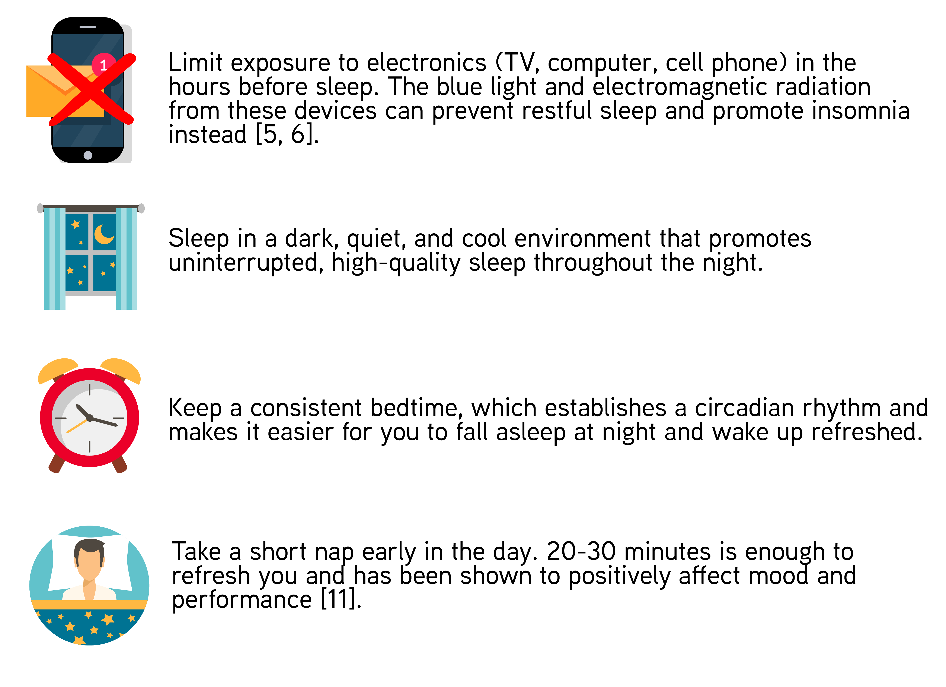
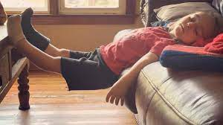

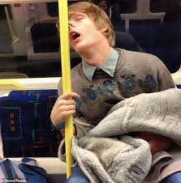
Where you sleep matters!
The environment where you sleep is also important for getting a good night’s sleep. If you sleep somewhere uncomfortable or noisy, for example, this may disturb your sleep or keep you awake.

Slide 17

Sweet dreams!!!

Slide 18
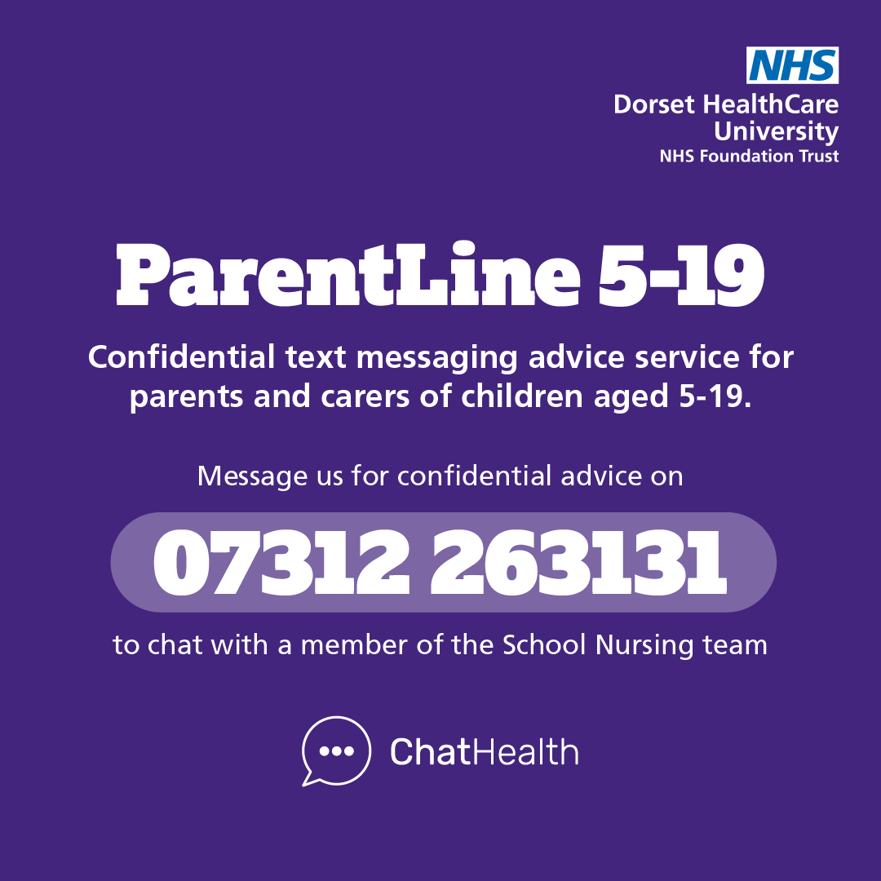
ParentLine is a confidential text messaging service providing parents and carers of 5-19 year olds in Dorset to seek advice from our School Nursing team about their child’s health and development via text message.
Podcasts
https://www.nothingmuchhappens.com/ Sleep stories great for nodding off to
https://getsleepy.com/
https://sleepwhispers.com/
Website resources
Dorset HealthCare :: School nursing
https://www.themix.org.uk/your-body/sleeping
Home – Kooth
Sleep Problems | Mental Health Support | YoungMinds
How does Sleep Work and WHY do we need it? - YouTube
Apps
https://www.calm.com/ Calm offers sleep stories and sleep meditations
https://www.headspace.com/meditation/sleep Headspace is a meditation app with programmes on sleep. The first ten sessions are free to use.
Parents and carers can seek advice via the 5-19 ParentLine service from 9am-4pm, Monday to Friday (excluding weekends, bank holidays and school holidays), with a member of the School Nursing team responding to messages within one working day.
If you send text outside these hours, you will receive an automated message with advice on where to get help if you need it urgently.

Slide 19
References
Associations between Sleep and Mental Health in Adolescents: Results from the UK Millennium Cohort Study - PMC (nih.gov)
Sleep Problems | Mental Health Support | YoungMinds
https://www.sleepfoundation.org/how-sleep-works
https://www.mind.org.uk/information-support/types-of-mental-health-problems/sleep-problems/tips-to-improve-your-sleep/?gclid=EAIaIQobChMIhNOexvSK_wIVIJRoCR2PSAJ-EAAYAiAAEgITkvD_BwE
https://thesleepcharity.org.uk/information-support/adults/sleep-hygiene/

