Slide 1

EYFS Class 2025
Parent and Carers Welcome Meetings
June and July 2025

Slide 2
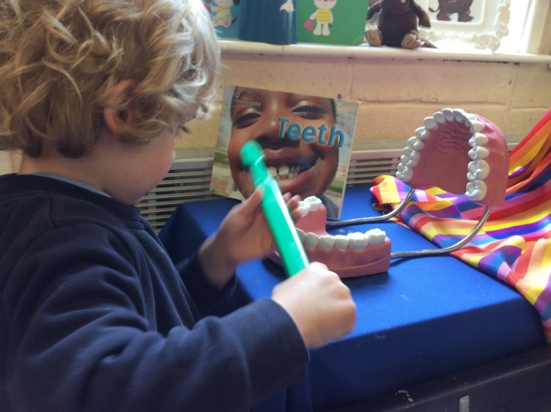
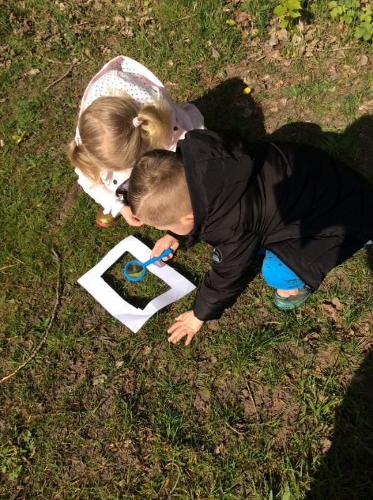
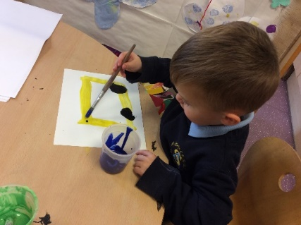
Our aims for this meeting
To introduce the SLT and the EYFS team
To share our school vision and values
To explain what the EYFS is
To inform you of assessment in the EYFS
To give you a brief overview of what your child will learn
To share an example day in the EYFS class
To inform you of what your child will need and what they will be given
To let you know how you can help
To provide you with the opportunity to ask any questions

Slide 3

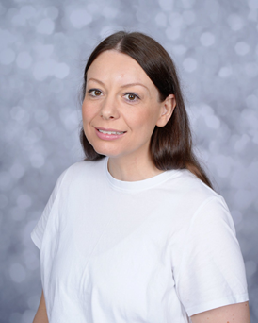
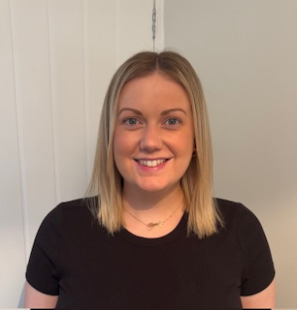
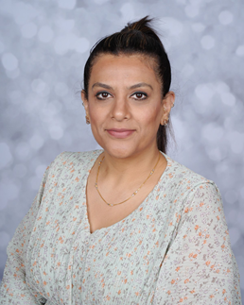
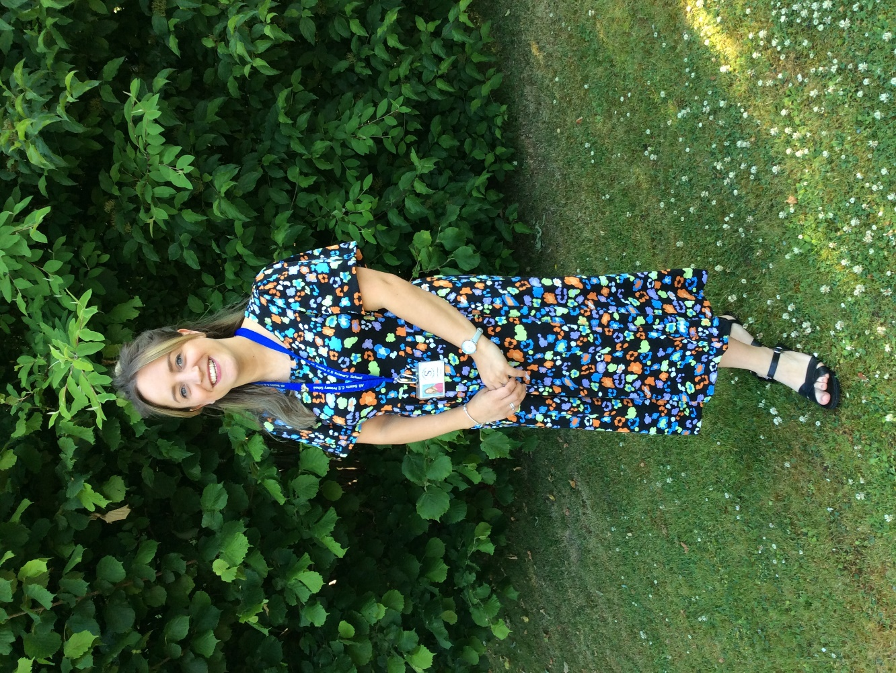
Mr Longworth
Head Teacher
Designated
Safeguarding
Lead
SLT (Senior Leadership Team)
Miss Gallagher
EYFS Lead
DSL
Mrs Fox
Deputy Head Teacher
and KS1 Lead
Deputy DSL
Mrs Pillitteri
SENCo and
Inclusion Lead
DSL
Mrs Seth
KS2 Lead and
Assessment Lead
DSL

Slide 4
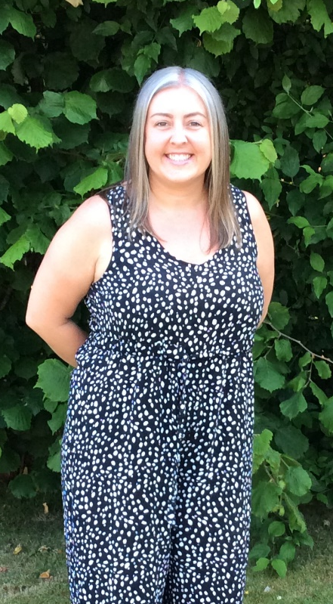
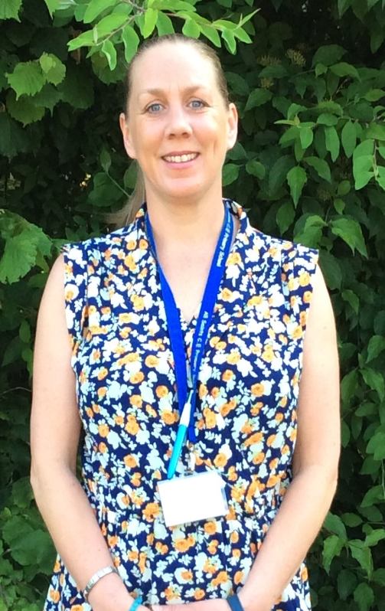
Miss Gallagher
Class Teacher
1. EYFS Team (Early Years Foundation Stage)
Mrs Bowling
Qualified Nursery Nurse / HLTA
Paediatric First Aider
Miss Colgan
Teaching Assistant
Paediatric First Aider

Slide 5
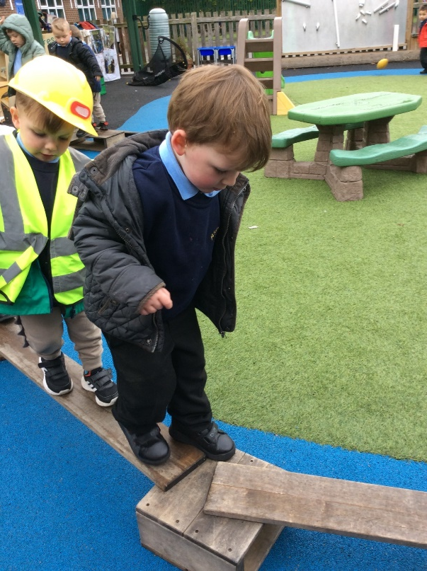

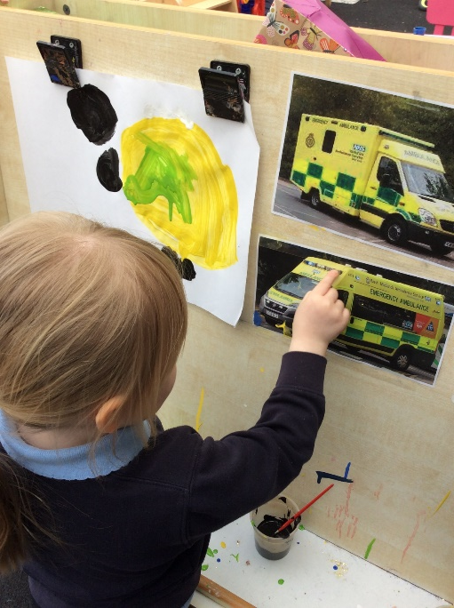
2. Our school vision and values
Our vision is to be a school where we help each other to learn, grow and to love through our Christian values, which are central to all aspects of school life.
Our 6 school values are:
Respect
Friendship
Happiness
Trust
Resilience
Forgiveness
These are centred around the core value of love, where we will be devoted to show unconditional love to all and look after everyone’s wellbeing.

Slide 6
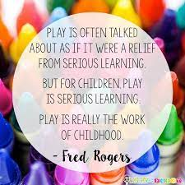
3. What is the EYFS?
Play, and more importantly, learning through play, is an essential part of the Early Years Foundation Stage.
The learning ethos behind the EYFS framework encourages learning through a mix of play-based and adult-led learning.
We support children's learning and development through discussions, modelling, scaffolding, direct and indirect teaching.
The Early Years Foundation Stage (EYFS) covers the education of children aged 0-5.
The statutory framework for the EYFS sets the standards for the learning, development and care of children from birth to 5 years in England.
All practitioners working in this stage of education must follow the statutory framework for the EYFS.
The statutory framework for EYFS places a stronger focus on 3 prime areas of learning
Communication and Language
Physical Development
Personal, Social, and Emotional Development
these are critical for the development of young children, and are fundamental to more structured learning as they get older.

Slide 7
4. Assessment in the EYFS
Statutory summative assessments that take place in the EYFS:
Two year Check
The statutory requirement for a progress check at two relates to those children who are attending early years settings. This will have been completed by their key worker. Each child should have a two year health and development review completed by the health visitor.
The Reception Baseline Assessment
A short assessment completed within the first 6 weeks of a child starting Reception Year. A score will be given for each child, which will be used to measure the relative progress of a cohort of children through primary school.
Early Years Foundation Stage Profile
At the end of Reception Year, each child’s level of development must be assessed against the 17 early learning goals (ELGs) set out in the EYFS.

Slide 8
4. Assessment in the EYFS
Assessments take place on a daily basis in the EYFS through the form of observations, rather than formal testing
We create a 'learning journey‘ for every child, the learning journey holds observations about the child throughout their time in the EYFS with us
We observe children as they play to understand their current attainment and their interests, and plan for their next steps accordingly. These observations form the majority of EYFS assessments and are shared with parents and carers
We use our bespoke curriculum plan to assess if a child is “on track” at the end of each term. If a child is “on track” then we believe they are making the progress needed to achieve the early learning goals at the end of Reception. If we feel a child needs more support to reach these goals, then we state they are “not on track”. This helps us focus on the children that need more support.

Slide 9
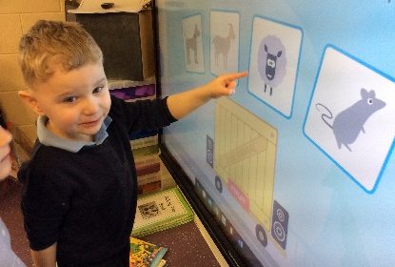
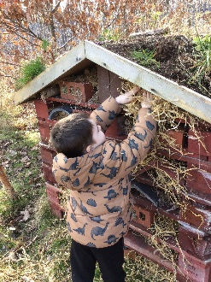
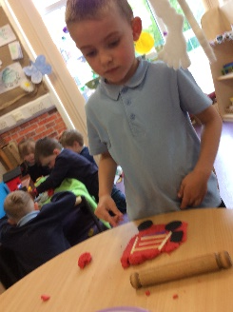
Prime Areas of Learning
Communication and language
Physical development
Personal, social and emotional development
Specific Areas of Learning
Literacy
Mathematics
Understanding the world
Expressive arts and design
5. What your child will learn
These are the core aspects of early child development which strongly influence learning in the Specific areas of learning and development.
The Prime Areas are the key focus of our Nursery.
The specific areas of learning and development provide children with knowledge and skills to flourish in society. Many aspects of these areas arise naturally for young children as they make sense of their experiences.

Slide 10






All Saints CE Primary School EYFS Curriculum Goals |  | Nursery | Reception
Autumn 1 “Once upon a time…” |  | I can retell a story using a story map. | I can describe the main settings, events and characters in a story.
Autumn 2 “Let’s celebrate…” |  | I can dance to a range of music and sing familiar songs. | I can make a decoration and talk about how I made it.
Spring 1 “Around the world in half a term…” |  | I can talk about the times of the day and know when different daily events happen. | I can sequence events and the days of the week, and talk about and measure time in simple ways.
Spring 2 “Creatures big and small…” |  | I can talk about what I know and use new vocabulary. | I can have a conversation about what I have learnt, using new vocabulary and answering questions.
Summer 1 “Our world, our home” |  | I can talk about how to stay safe when out in the community and know who can help me when needed. | I can talk about changes over time and tell you how we can care for ourselves and others.
Summer 2 “Wherever next…” |  | I can use a camera to take a photograph and then help create a fact file. | I can use the internet to find information and then create a fact file.

Slide 11



Nursery and Reception
Tales Toolkit storytelling lays strong foundations for the skills and characteristics of effective learning. It's proven to develop language, literacy, social skills, creativity, confidence, empathy, boys writing, problem solving, maths and lots more.
Enhance Language Skills
Boost Confidence & Engagement
Develop Core Language Skills
Foster Inclusivity
Creative Expression
Think Equal has designed a programme to teach social and emotional learning to early years pupils, using picture books and accompanying activities.

Slide 12




Reception
SCARF: Safety, Caring, Achievement, Resilience, Friendship
As a whole-school approach to develop children’s health & wellbeing through PSHE
Wiggle is a worm who likes to bring things to share with the children, like a thought-provoking object, a story, an action song and a craft, all connected around a Christian theme.
Using games and songs and other learning methods to help children explore numbers and discover how fascinating they can be.
Ready Steady Write is an evidence-based primary writing scheme, built around high-quality, language-rich literature, it provides a structured and sequenced approach that develops confident, independent writers.

Slide 13

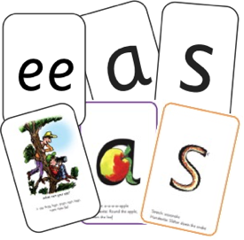



We teach the sounds in sets.
Children practice reading and spelling words containing these sounds.
Then we give children decodable books containing sounds and words they can read.
Phonics- Read, Write Inc
We use 44 sounds to make all the words that are in the English language.
However we only have 26 letters.
The 26 letters work singly, in pairs and sometimes in three’s to represent one sound.
We have to group letters together to write some sounds e.g. ‘igh’, ‘air’.

Slide 14

WellComm
A Speech and language toolkit that can be used with children from 6 months to 6 years of age.
We have been trained to carry out the short assessment activities which may identify areas of concern in language, communication and interaction.
Findings are shared with you so that we can support your child in the best way.
If there is little, or no progress in the areas following support from home and school we can gain further support from the speech therapy service.
Early support is key and by working together we can give your
child the best start.

Slide 15
6. An example school day
A typical Nursery session
Morning Nursery 8.30-11.30 | Whole class welcome and Breakfast Singing and Fit in Five Choosing- inside and out Nursery circle time Story and home time
Lunch Time | 11.30-12.00 Eating in the hall 12.00-12.30 Outdoor play in the EYFS area
Afternoon Nursery 12.00-3.00 | Nursery welcome and outdoor play Nursery circle time Choosing- inside and out Singing and Fit in Five Whole class end of day get together and Snack Story and home time

Slide 16
6. An example school day
A typical day in Reception
Morning | Whole class welcome and Breakfast Singing and Fit in Five Choosing- inside and out Reception Thinking and Finding Out time (Specific Areas of learning) Reception Phonics
Lunch | 11.30-12.00 Eating in the hall 12.00-12.30 Outdoor play in the EYFS area
Afternoon | Reception Circle Time (Prime Areas of Learning) Reception Maths Choosing- inside and out Singing and Fit in Five Whole class end of day get together and Snack Story and home time

Slide 17

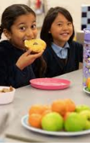
7. What your child will be given
Magic Breakfast
Magic breakfast is an opportunity for all children to have something to eat when they arrive at school in the morning. This is usually a ‘top up’ to their usual breakfast and items may include:
Half a slice of toast
Half of a large crumpet
Half a bagel
Magic Breakfast ensures that no child in school is too hungry to learn and thrive!

Slide 18

Book Bag
Your child needs to bring this with them everyday. Letters, their work, reading books, Talking Time books and other items will be inside so please check and remove the items daily.
Water Bottle
This is cleaned and filled up daily. It stays in school.

Slide 19


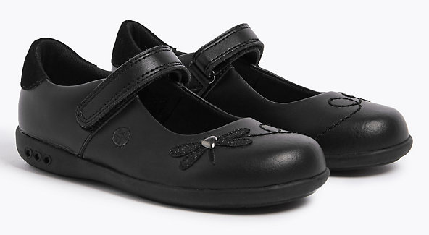
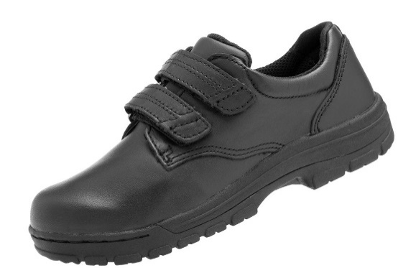
Navy Blue or black trousers, dresses, shorts, tunics or skirts
Blue checked dresses or skirts
A light blue polo neck shirt
A navy blue cardigan or jumper (preferably with the school’s logo)
Suitable black shoes, with Velcro straps.
Only laces/buckles if your child can do this independently
7. What your child will need
School Uniform
NAME
EVERYTHING
No jewellery may be worn in school. This includes chains and bracelets. If your child has pierced ears then studs may be worn but should not be worn for PE days.

Slide 20
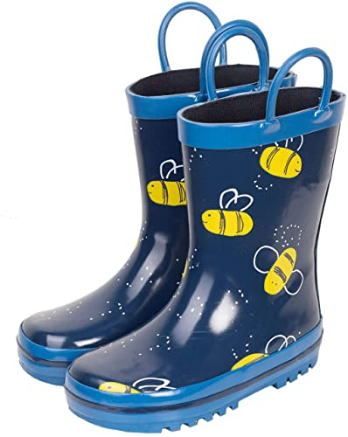
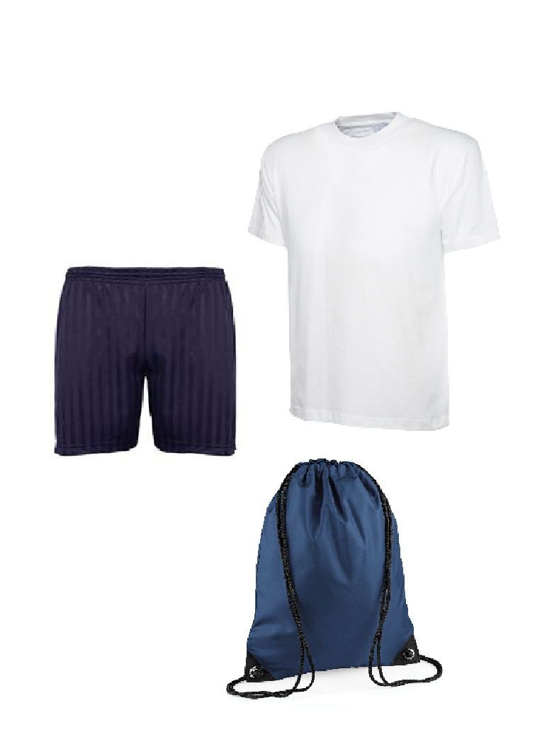
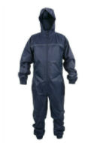
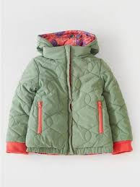
Wellies and a waterproof outfit/all in one
These will be kept in school. Please ensure you check they still fit and replace them when needed.
PE Kit in a drawstring bag
Black/Navy shorts, white t-shirt, Velcro trainers and a pair of pumps.
A coat
With a zip and a hood.
Weather appropriate items
Sunhat, sun cream, woolly hat, scarf, gloves.
NAME
EVERYTHING

Slide 21
Your child will eat their lunch in the school hall.
They will need a packed lunch or a school dinner. (Please order this at home)
Encourage them to be independent so that they are able to open their items and use their own cutlery.
Ensure packed lunches are healthy and nutritious.
This does not include
-jam and chocolate spread sandwiches
-sweets and several treats
Lunch Time

Slide 22

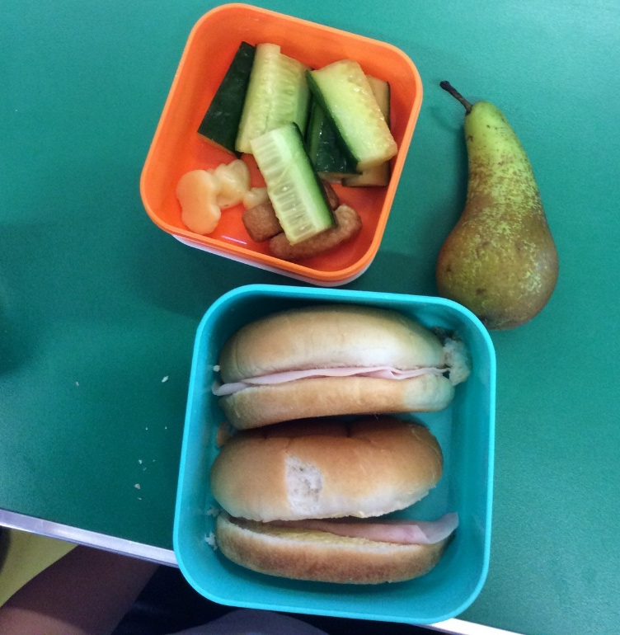
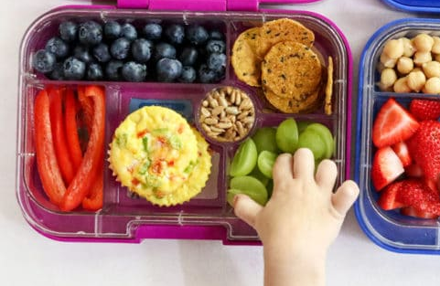
Lunch box examples…
Sandwich or wrap
Pasta or salad
Crackers
Meat, cheese
Fruit (please chop in half)
Veg sticks
Yoghurt- low in sugar
Jelly Pots- low in sugar
Mousse- low in sugar
Small cake, a couple of biscuits
Water
Squash

Slide 23
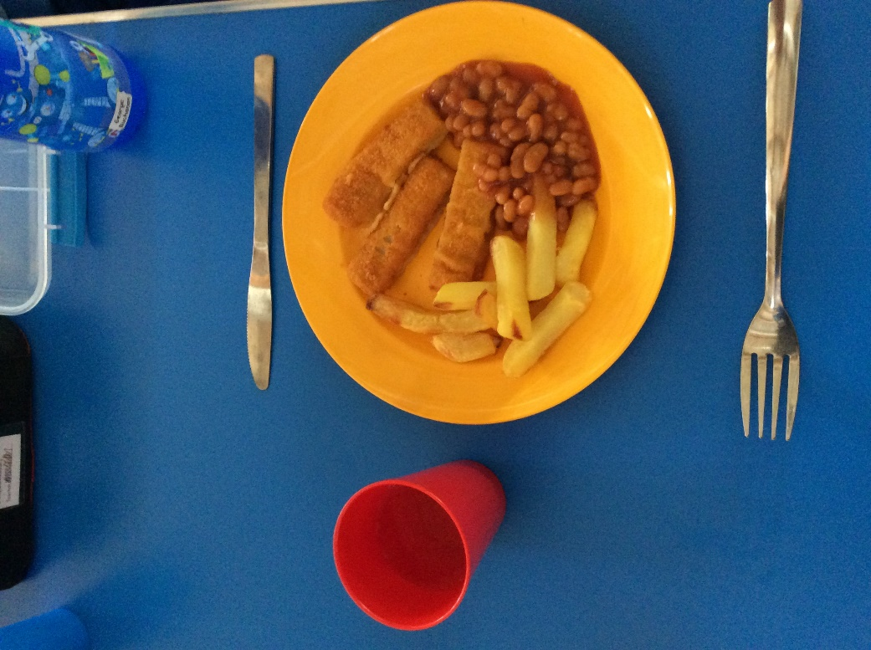
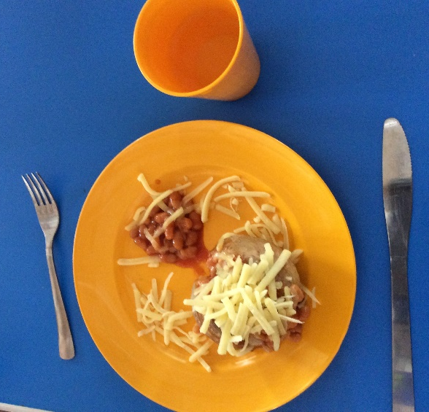
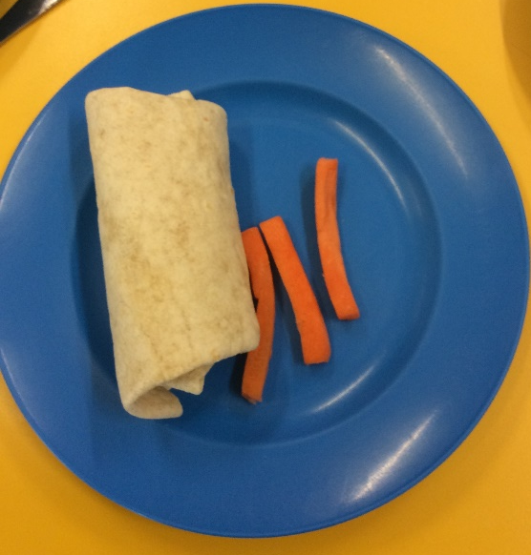
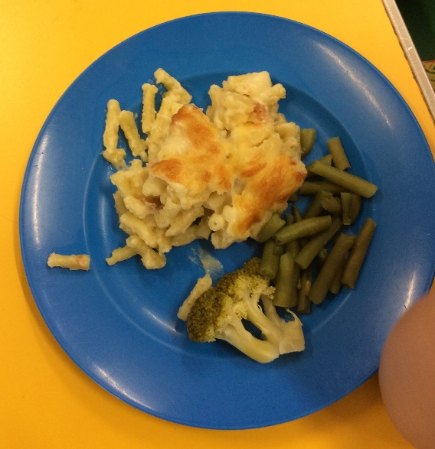
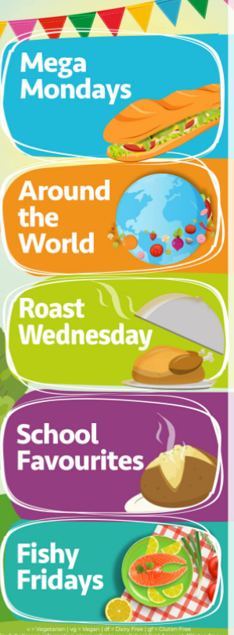
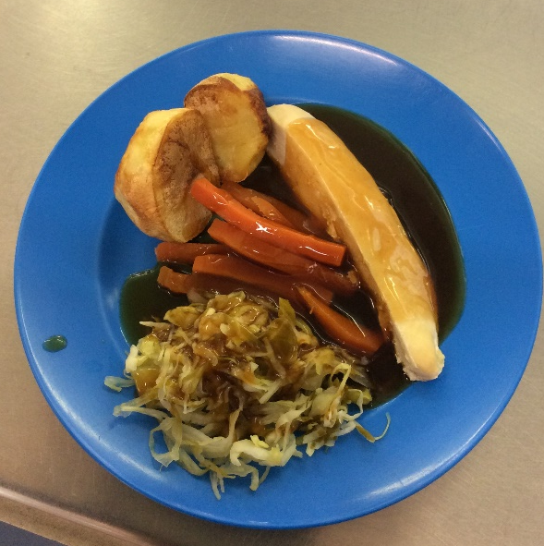
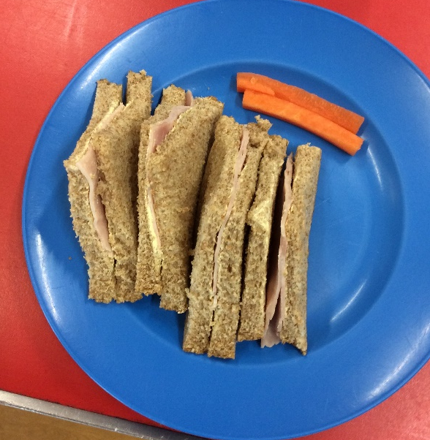
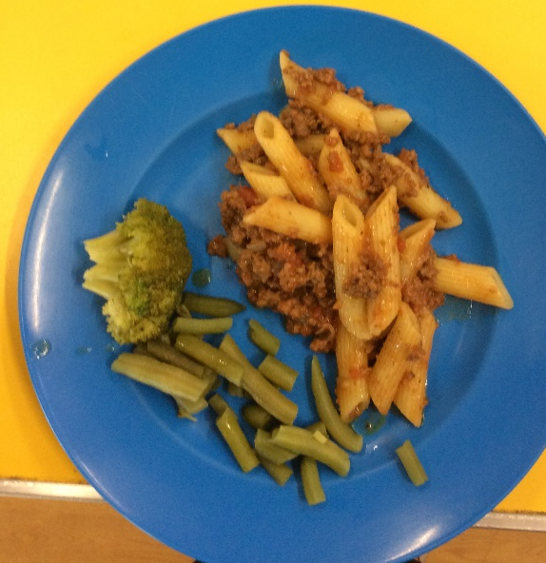
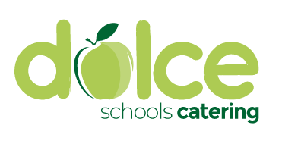
School Dinner examples…
Pre-order at
home
Look at the
menu online

Slide 24
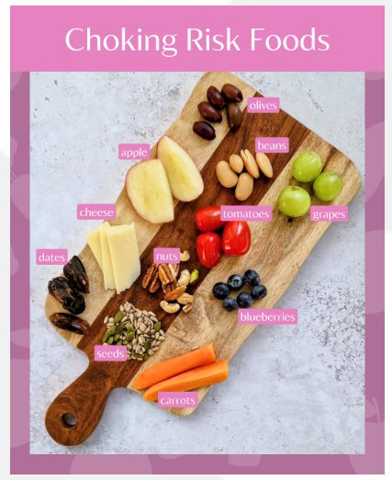
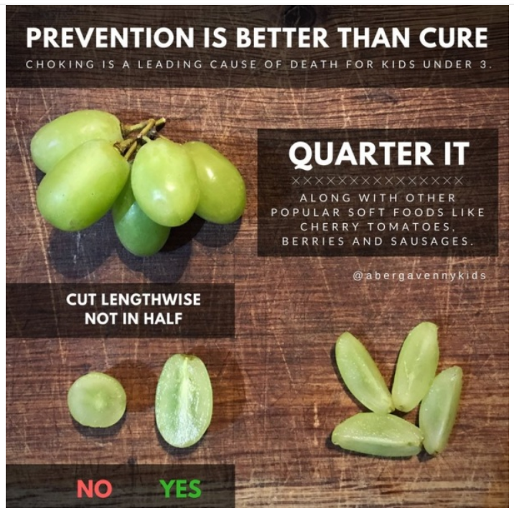
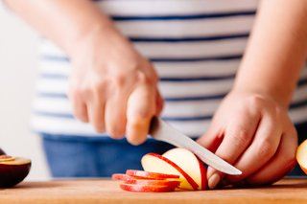
Cut fruit like melon and apples into slices instead of small chunks.

Slide 25
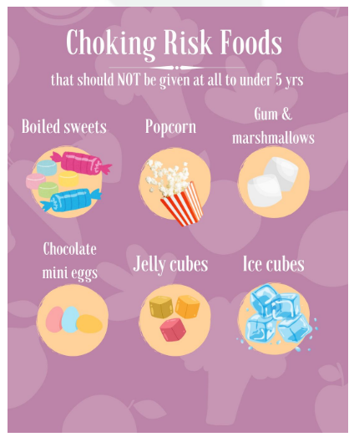
Toys from home
They may get lost or broken.
Sweets and Fizzy Drinks
We are working towards achieving the Tooth Safe Award.
This includes in lunchboxes and for birthdays.
Snacks/Drinks
Snack and water is provided. Children are entitled to free milk- please sign up!
8. How you can help
What not to bring

Slide 26

Tooth decay is an entirely preventable disease.
More than 1 in 5 children experiences dental decay before the age of 5.
Tooth decay in children under five years in the North West of England is higher than the England average
We are supporting your children to have good oral health by ensuring we are a ‘Tooth Safe Zone’.
The new EYFS statutory framework from September 2021 will require settings ‘to promote the good oral health of children’. Completion of this award scheme will support meeting this requirement and provide strong evidence of how this is being achieved.
We have toothbrushes, toothpaste and reward charts available- just ask if needed. ☺

Slide 27
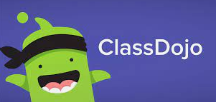
Class Dojo
Share photos and videos (consent to include your child is required)
Send and receive private messages with parents/carers
Share class and school news
Share Talking Time tasks and photos
Home/School learning opportunities
Talking Time
Challenge, activity or news task every two weeks.
Complete the task with your child and add any comments to the pages.
We would really appreciate any photographs or videos to support these tasks, you can add these to your child’s Class Dojo profile, we can then print and stick in any photos.
We share the talking time activities in small groups, these sessions are really important as they emphasise and support the development of good talking and listening skills.
Reading
Nursery and Reception: Library books
Reception Phonics: When ready, your child will bring home sound cards and words to practise as well as reading books when they become more fluent. Please read as much as possible at home. Even 5 minutes a night is better than nothing. It significantly helps their learning and development.
Information Pack- please return this completed

Slide 28
If there medical needs or other factors affecting this then speak to a member of the EYFS team and your Health Visitor.
Work with your child to prepare them for September. This includes pulling down and up their uniform and underwear, wiping themselves clean, flushing the chain and washing their hands with soap.
We do not provide nappies, baby wipes or nappy bags- you must bring these.
If your child still has accidents ensure they have clean underwear and clothing so they can change.
Toilet Training

Slide 29
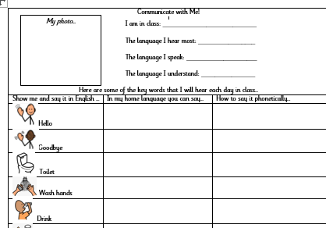
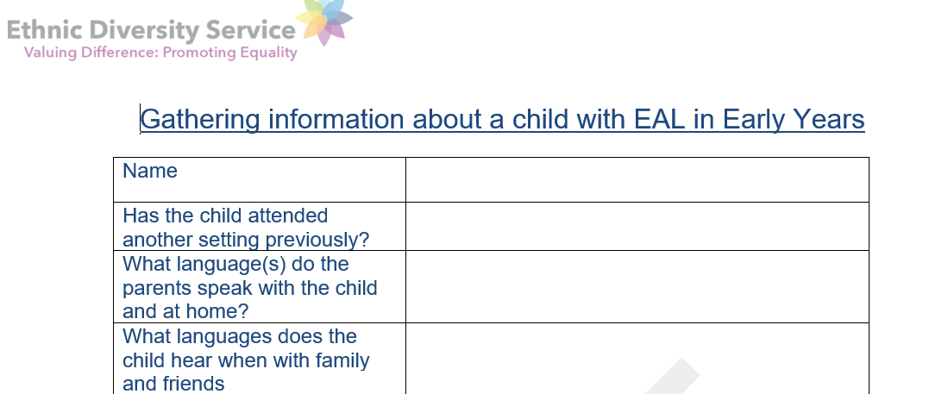
We celebrate every child in our class and know that some of our children are learning English as an additional language.
Please support us by completing the ‘Home Languages’ sheet so that we can support your child the best we can.
If you need any further support please speak to us, we are able to access translators and have a very helpful ethnic diversity and inclusion team.
English as an additional language

Slide 30
Thank you for coming!
9. Do you have any questions?

