Slide 1
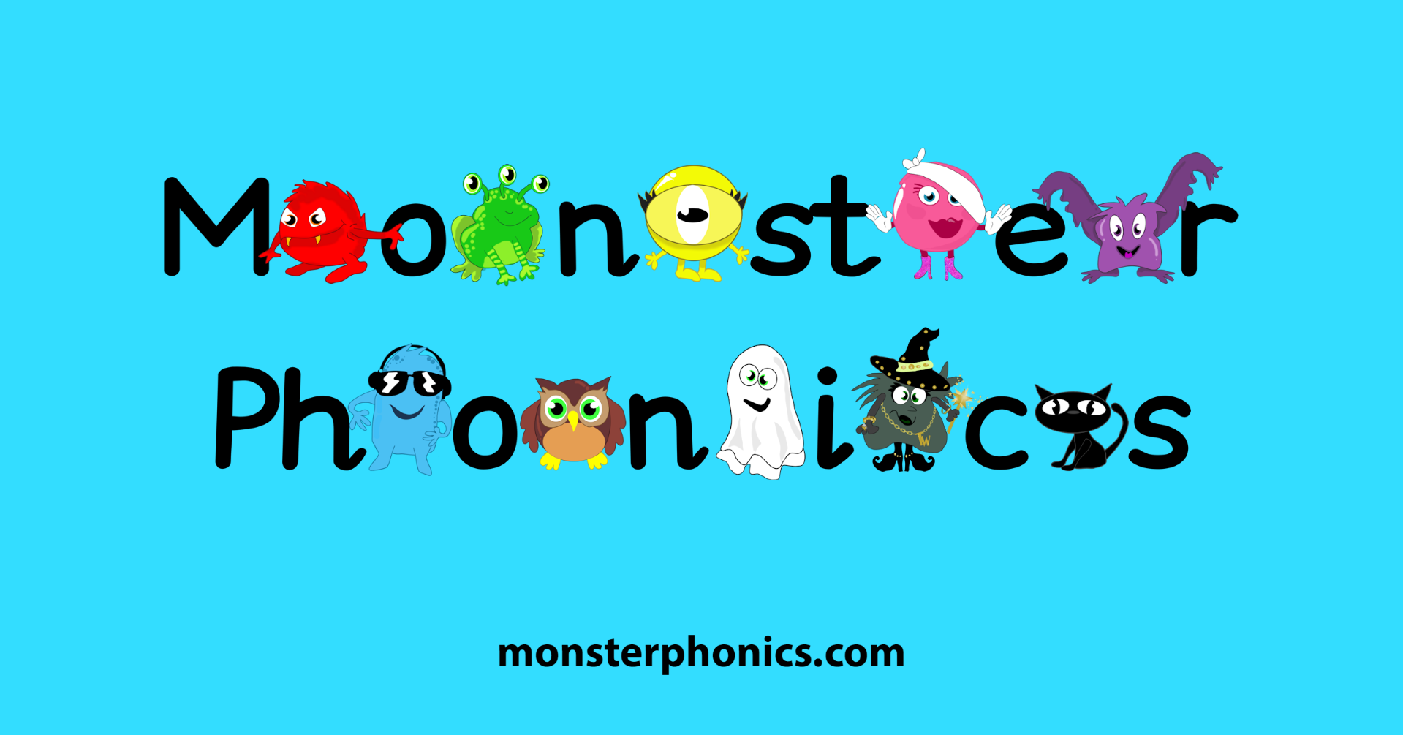
Phonics Workshop – Class R/1 - Miss Ollerton

Slide 2
What is Phonics?
Phonics is one method of teaching children how to read and write. It is all about sounds.
There are 44 sounds in the English language, which we put together to form words. Some of these sounds are represented by one letter, like 't', and some by two or more, such as 'ck' in duck and 'air' in chair.
Children are taught the sounds first, how to match them to letters, and then how to use the letter sounds for reading and spelling.
Synthetic phonics refers to 'synthesising', or blending, the sounds to read words.

Slide 3
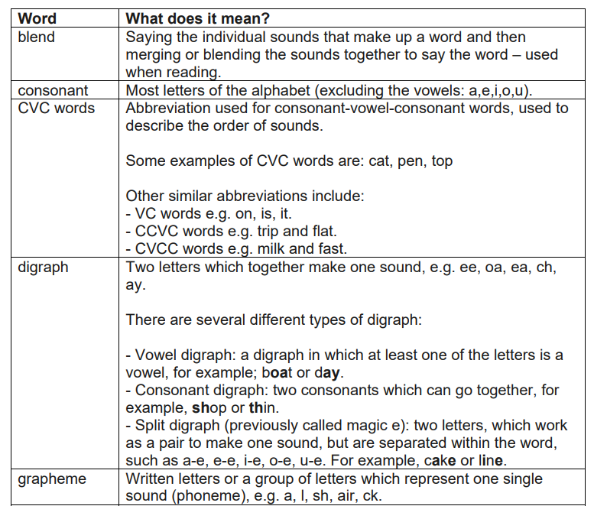
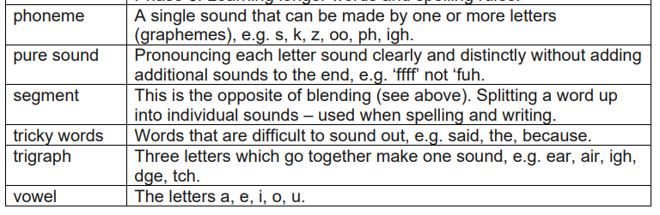
Phonics Glossary

Slide 4
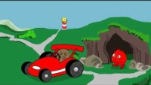
Meet the Monsters

Slide 5
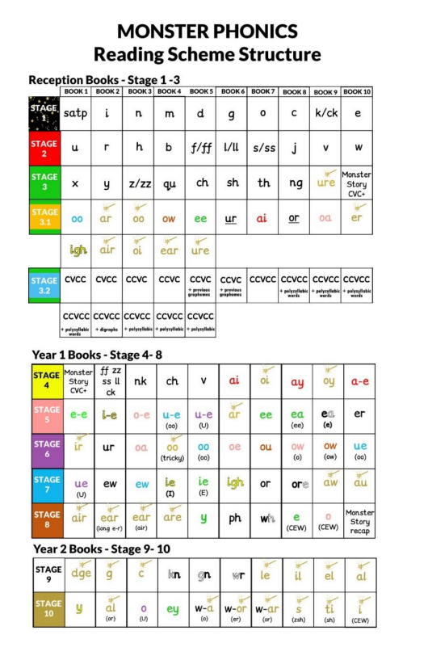
Stages 1, 2 and 3 focus on blending the letters and the consonant digraphs.
Stage 3.1 practises digraphs and trigraphs.
Stage 3.2 practises reading CVC+ words.
Stages 4, 5, 6, 7 and 8 focus on digraphs (including split digraphs) and trigraphs.
Stages 9 and 10 focus on digraphs and trigraphs.

Slide 6

Non-Fiction Books

Slide 7
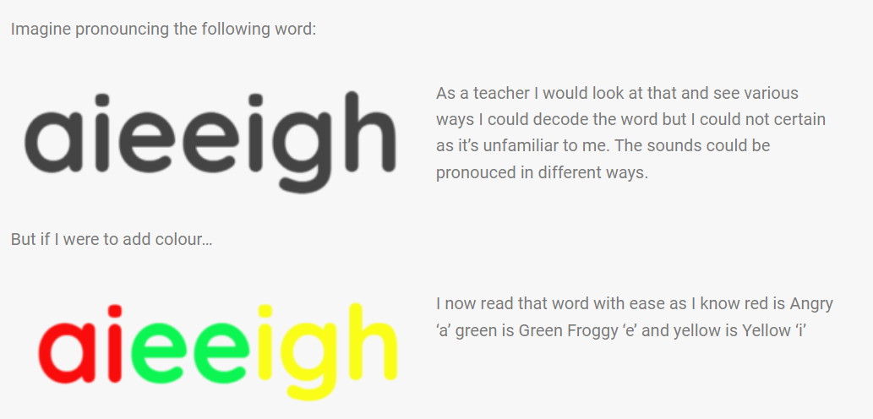
Should I colour code everything they read?
When reading non-colour coded books, simply ask your child to identify where the colours should be. If they have the sentence ‘It is May’ ask them to find Angry A, they will still apply colour and context visually without colour being on the page.

Slide 8
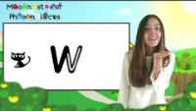
Pronunciation of sounds

Slide 9
Book Structure
Each Reception book also has an optional section for an adult to read at the bottom of each page. This text is not critical for the understanding of the story but adds further detail to bring the story to life.
The books gradually increase in length and complexity as the scheme progresses to match the reading level. This continues to support engagement and helps to captivate interest as children mature.
Keyword practice boxes at the start of each book give children an opportunity to practise decoding words from the story prior to reading it. This enables them to read the book with confidence.
Each book has a set of questions to develop comprehension skills. They encourage discussions around inference, vocabulary, and language comprehension.

Slide 10
cat
We don’t teach the traditional letter names when we are teaching our children to read.
c a t

Slide 11
sheep
We don’t teach the traditional letter names when we are teaching our children to read.
sh ee p

Slide 12
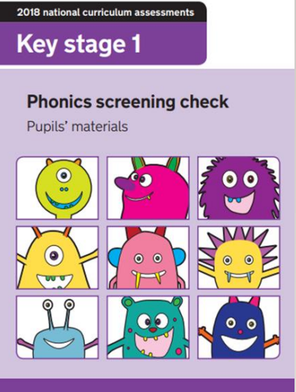
Y1 Phonics Screening Check
All Year 1 children sit the screening check in June each year.
• Children are given 40 words to decode and read.
• These 40 words include real and ‘alien’ words.
• Children must identify the sounds in the word and blend them together accurately.
• In previous years, the pass mark has been 32/40.
Pupils who do not meet the expected standard take the check again at the end of year 2, typically aged 7.

Slide 13
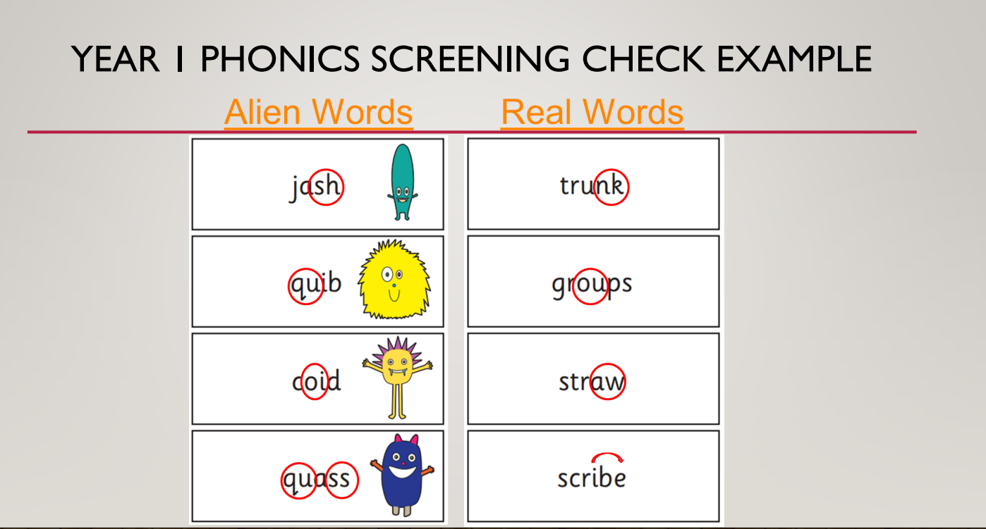

Slide 14

Y1 Screening Check Example

Slide 15
Supporting your child
If your child is not making progress with reading it could be for a variety of reasons.
Perhaps he/she does not enjoy reading yet.
Reading aloud to children can help them to enjoy stories they might struggle to read themselves. This helps reluctant readers by removing the pressure.
You can try sharing the reading, e.g. you read one line and then they read the next. Once your child’s confidence has begun to increase you could perhaps take turns at reading a page each.
Research shows that reading with your child is the most important thing you can do to help your child's education. Try to put aside some time every day as it is best to read little and often, i.e. just read a few pages rather than a whole book.
Try to ensure that you remain positive and praise your child for any attempts they make. It is important that it does not become a battle or both of you will be unhappy. If your child gets upset or is just not in the mood then leave it until another day when they are less tired and you are less stressed. The experience of reading should be an enjoyable one!

Slide 16
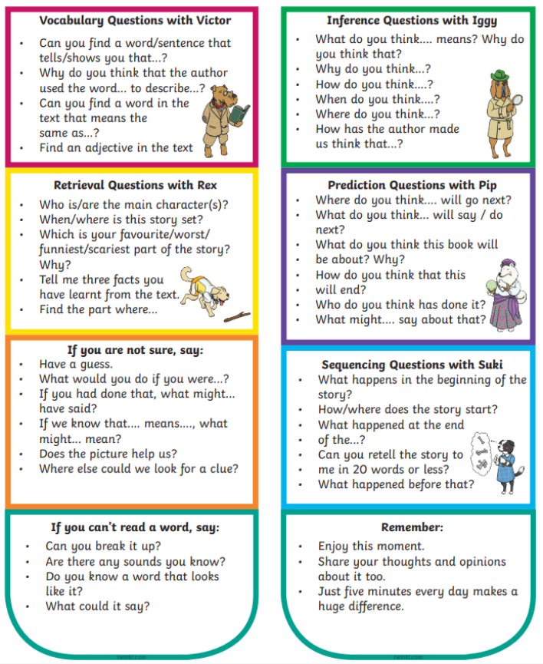

Slide 17


