Slide 1

Mathematics Workshop
2023

Slide 2
Y6 SATs - 2023
85% at the Expected Standard
73% National Average

Slide 3
Y6 SATs - 2023
32% at the Expected Standard + Greater Depth
11% National Average

Slide 4
St. Joseph’s Data - 2023
83% at the Expected Standard
20% at the Expected Standard + Greater Depth

Slide 5
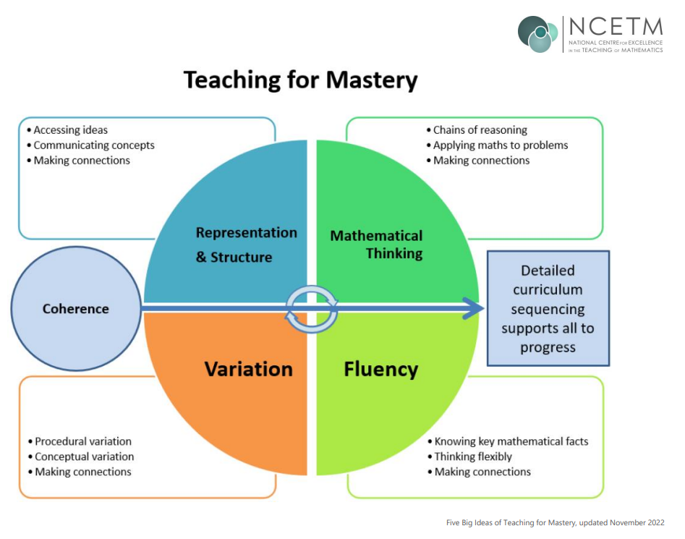
NCETM – Mastery of Maths

Slide 6
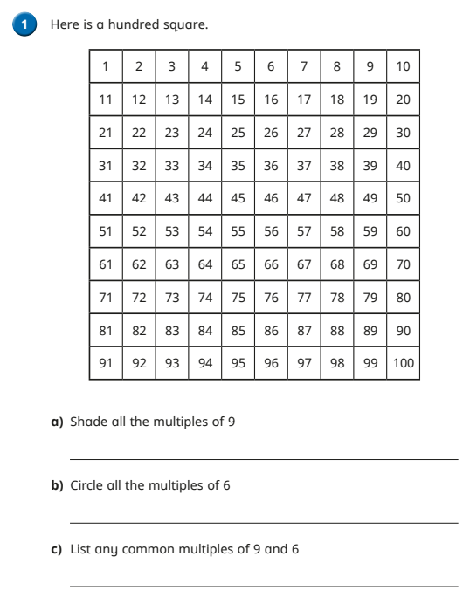
Year 6 – Lower Ability

Slide 7
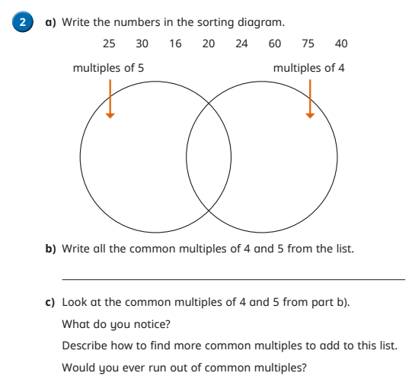
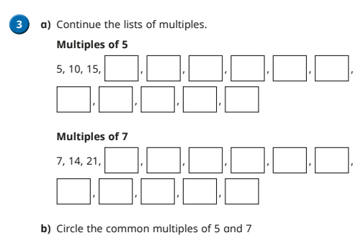
Year 6 – Lower Ability

Slide 8
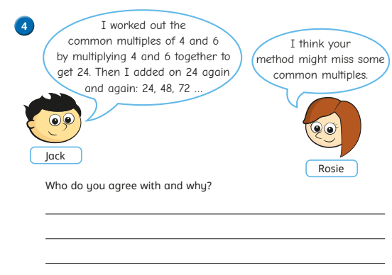
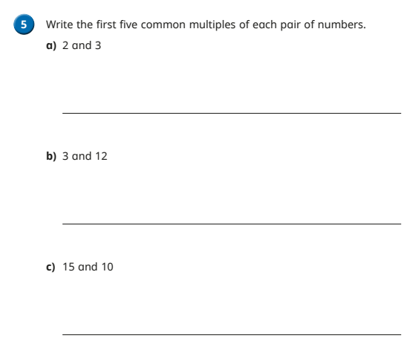
Year 6 – Middle Ability

Slide 9
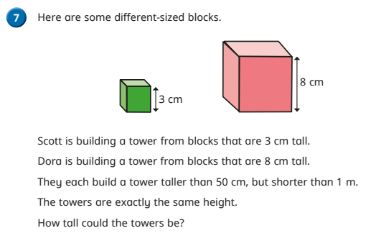
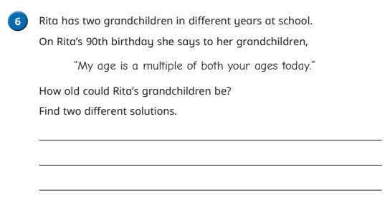
Year 6 – Greater Depth

Slide 10
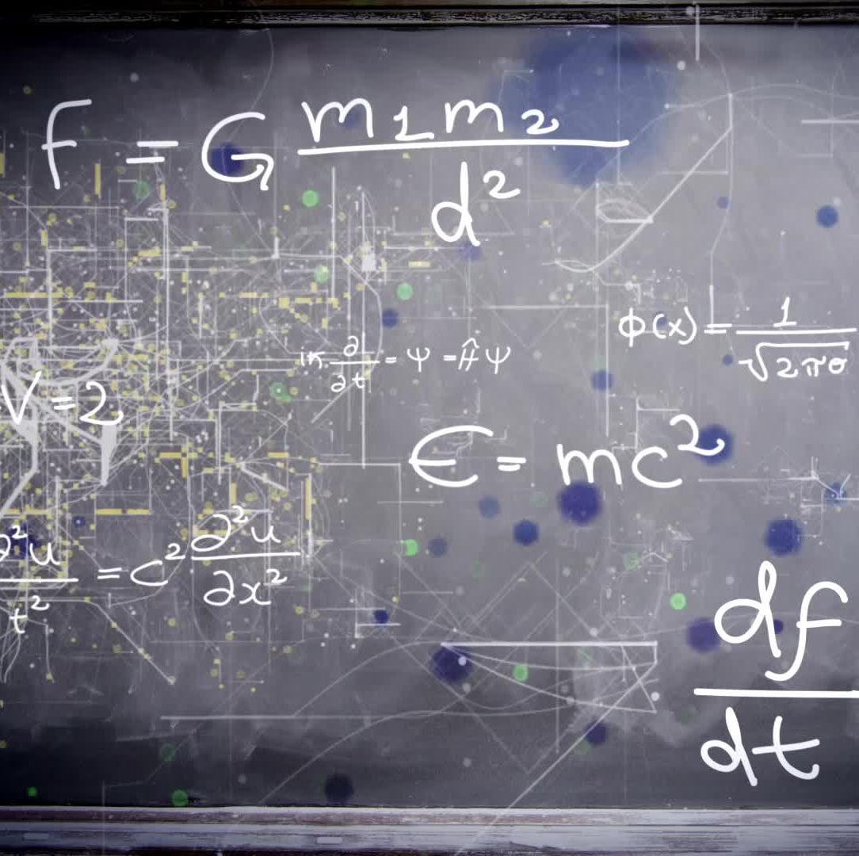
Scaffolding
If the child is strong at Maths, teach them something harder?
Y6 needs Y5
Y5 needs Y4
Y4 needs Y3
Etc Etc

Slide 11
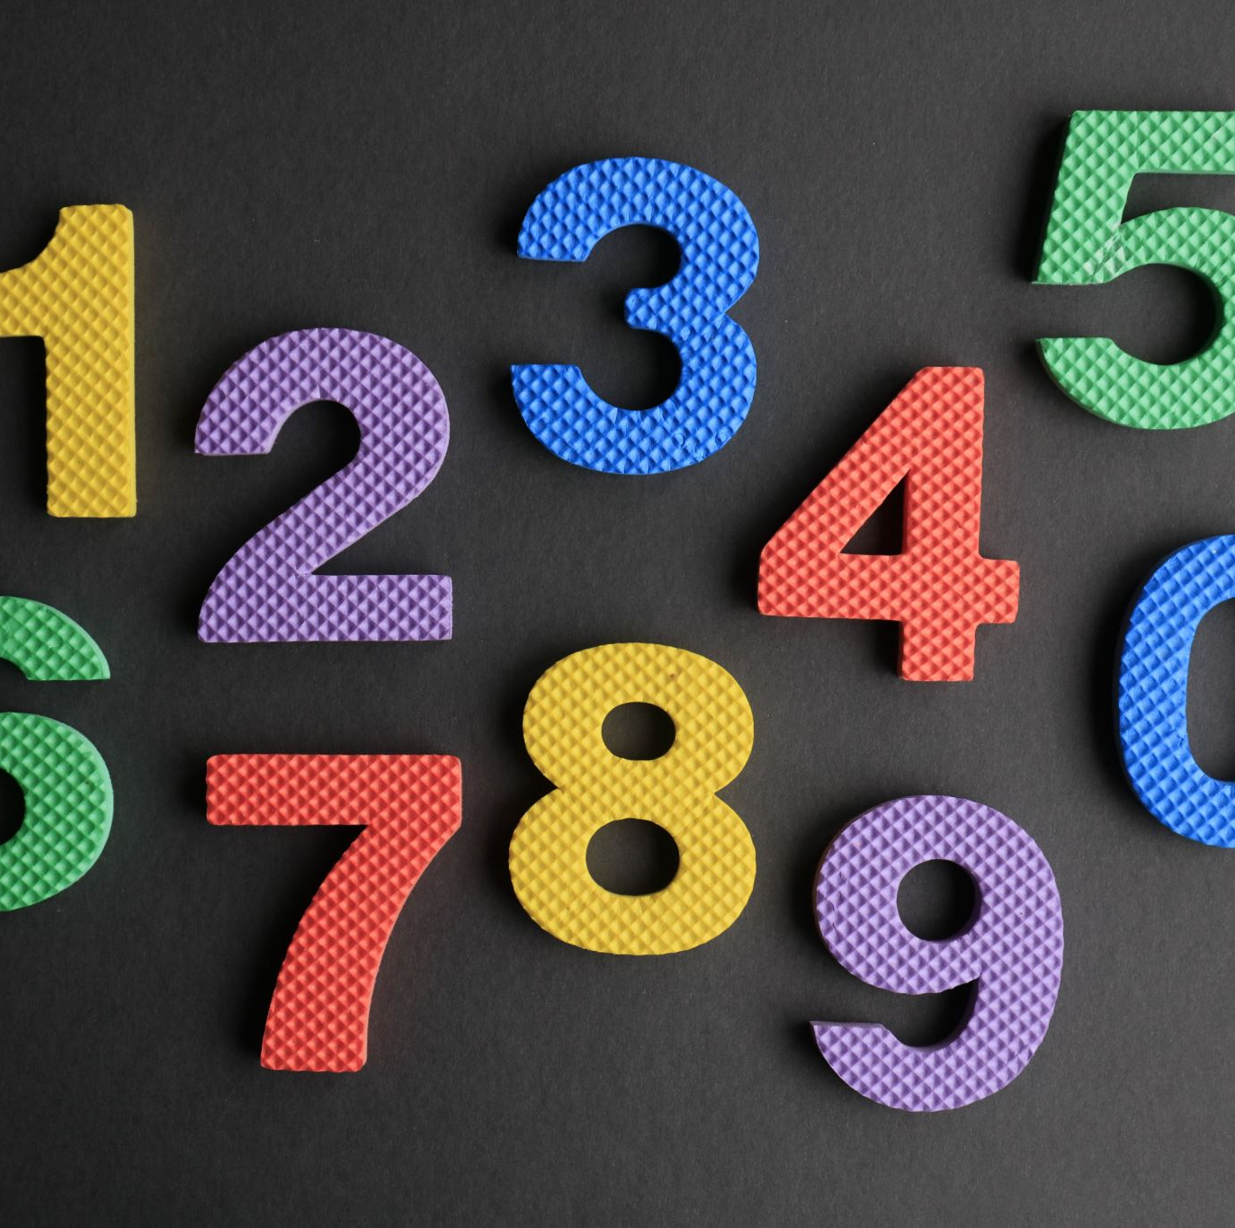
Reception
Numbers 1-9
1 more
1 less
How many?

Slide 12
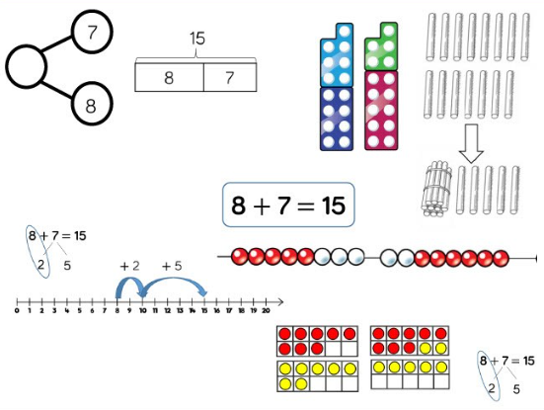
Y1 - Addition

Slide 13
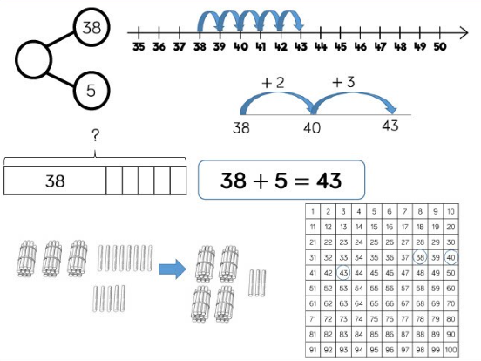
Y2 - Addition

Slide 14
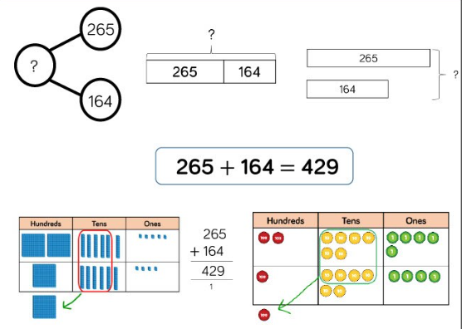
Y3 - Addition

Slide 15
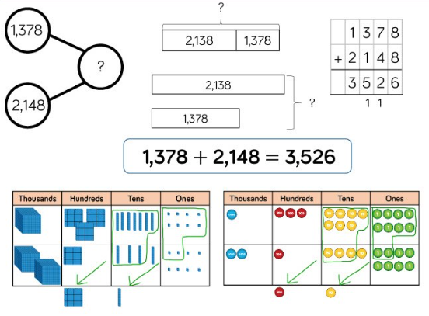
Y4 - Addition

Slide 16
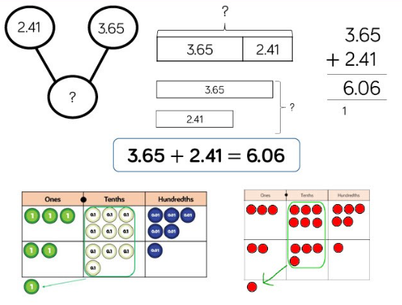
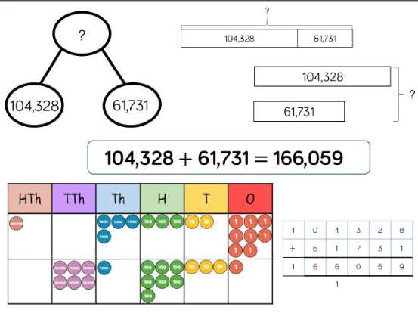
Y5 / Y6 - Addition

Slide 17
What Next?
More consistency modelling concrete resources across school
Correct vocabulary being used consistently through the school
Pace of lessons slowed to allow the developing of greater fluency

Slide 18

Thank you!
Questions?
Next time?

