Slide 1

Kingsley Community Primary and Nursery School
Team Pine
‘Meet the Teacher’
September 2025
Notes:
Test notes

Slide 2
Welcome to Pine!
We are a team consisting of Year 2 and Year 3 pupils
Mrs McColl is with Pine Monday, Wednesday and Friday am
Mrs Robinson is with Pine Tuesday and Thursday am
Miss Robinson teaches Pine on Tuesday and Wednesday pm
Mrs Harrison teaches Pine on Thursday pm
PE days – Monday and Thursday

Slide 3
Team Pine
Bring Kingsley Journals in each day
Keep PE kits in all half term
Homework will be checked and marked by the children each Friday
Spelling tests will take place each Friday
Notes:
Rec – Baseline Assessment & EYFSP
Year 1 – Phonic Screening
Year 4 – Timetable Tests
Year 6 SATs
Year1 - 6 – Whole school assessment

Slide 4
Celebrating Positive Behaviours
Verbal praise and encouragement
Smiles, positivity and strong role modelling by adults
Recognition board
House Points (1, 2 or 3 points)
Emails home
Head teacher awards

Slide 5
Celebrating Positive Behaviours
Celebration assembly certificates
House point winner – half term treat for house with winning house points - non-uniform day
Also… don’t forget… Birthday non-uniform day!

Slide 6
Overview of Topics
 | Autumn 1 | Autumn 2 | Spring 1 | Spring 2 | Summer 1 | Summer 2
Geography | Our World – naming the 7 continents and 5 oceans |  | Our weather and climate: Identifying hot and cold areas of the world and comparing them to the Equator and the N/S Poles. |  | Comparative study: Comparing the UK with another country.
History |  | Changes in Britain from Stone Age to Bronze Age |  | Ancient Egypt – Achievements of an early civilisation |  | Changes in Britain from Bronze Age to Iron Age
RE | Judaism: What do Jewish people believe about God? | Baha’i faith: What are followers of the Baha’i religion’s beliefs? | Christianity: Why is the Bible a special book for Christians? | Christianity: Who was Jesus? Why did he teach through stories and why is he important to Christians today? | Christianity: Why do people have faith? | Islam: What do Muslims believe happened on ‘The Night of Power’ and how do they worship?
Computing | Digital devices – how do they work? Inputs and outputs | Stop frame animation | Computer programming – using Scratch. Adding sounds | Branching databases (flowcharts) | Desktop publishing – using programmes such as Word, Publisher. Changing font etc. | Computer programming – using Scratch. Moving a Sprite

Slide 7
Overview of Topics
 | Autumn 1 | Autumn 2 | Spring 1 | Spring 2 | Summer 1 | Summer 2
Science | Animals including humans | Animals including humans | Rocks | Magnets | Plants | Light
French | A New Start | Calendar and celebrations | Animals | Carnival | The Hungry Giant | Going on a picnic in France
Music (Following Charanga) A mix of genres and eras | Harvest songs Writing music down: How does music bring us together? | Christmas songs Playing in a band: What stories does music tell us about the past? | Compose using imagination: How does music make the world a better place? | More musical styles:: How does music help us to get to know our community? | Enjoying improvisation: How does music make a difference to us everyday? | Opening night: How does music help us to connect with our planet
PE | Body management (gym) Cricket coaching | Dance – Interpretive Commitment challenge | Indoor Athletics Games - invasion | Gym – floor & flight Games – striking and fielding | Dance – performance Games – Striking & Fielding | Outdoor athletics Invasion games
Art/DT | Drawing using pen | Moving mechanism | Sculpture with clay | Painting with watercolours | Cooking & nutrition | Textiles/ printing

Slide 8
Home Learning
Reading
Minimum of 3 reads a week - please record this in journals
I will read with all children in a small group once a week – this won’t be recorded in the children’s journals
Reading books will come home weekly. Your child’s book swap day will be displayed at the top of their reading log for each half term.

Slide 9
Home Learning
Maths
-Times Tables Rockstars
-Short task in journals
Spelling
Level Up! A sheet will go at the back of journals.
Homework Club
Where children are not completing homework, they will be invited to join our homework clubs that will run on Friday lunch time.

Slide 10
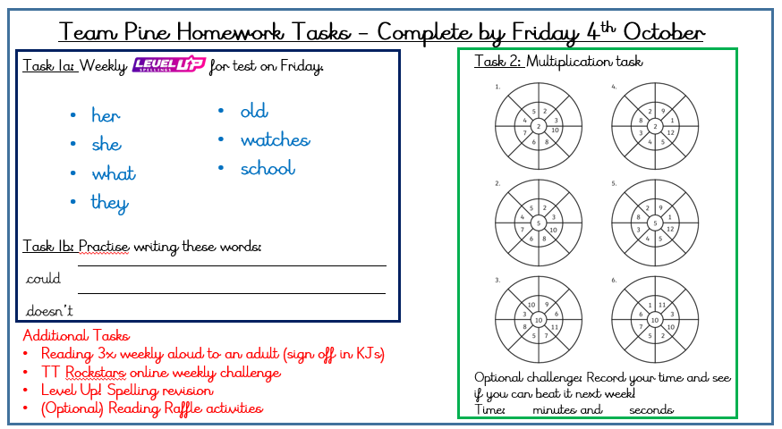
Home Learning

Slide 11


Specific Assessment for Team Pine
Weekly spelling test
RWI half termly assessments
Termly assessments – reading, spelling and grammar, maths
Reading fluency check – important to practice reading aloud for fluency and intonation
Monitoring of times tables
Notes:
Rec – Baseline Assessment & EYFSP
Year 1 – Phonic Screening
Year 4 – Timetable Tests
Year 6 SATs
Year1 - 6 – Whole school assessment

Slide 12
School Enhancements
Various after school clubs – Check half termly emails for updates)
Burwardsley Residential (Date TBC) – Team Pine
Christmas Journey workshop (Y2) (TBC)
Notes:
Trips, residential, visitors etc.

