Slide 1

Kingsley Community Primary and Nursery School
Team Chestnut – Meet the teacher
September 2025
Notes:
Test notes

Slide 2
Celebrating Positive Behaviours
D… Daring
R… Resilient
E… Enquiring
A… Ambitious
M… Motivated
Verbal praise and encouragement
Smiles, positivity and strong role modelling by adults
Recognition board
House Points (1, 2 or 3 points)
Postcards
Head teacher rewards
Birthday non-uniform day
Celebration assembly certificates – Using DREAM Values & Ready, Safe, Respect Rules
House point winner – winning house announced (scores kept and added to termly tally)
Half term treat for house with winning house points - half-term (non-uniform day with extra play)
House with highest points of the term has a special treat e.g. school visit/time in local park

Slide 3
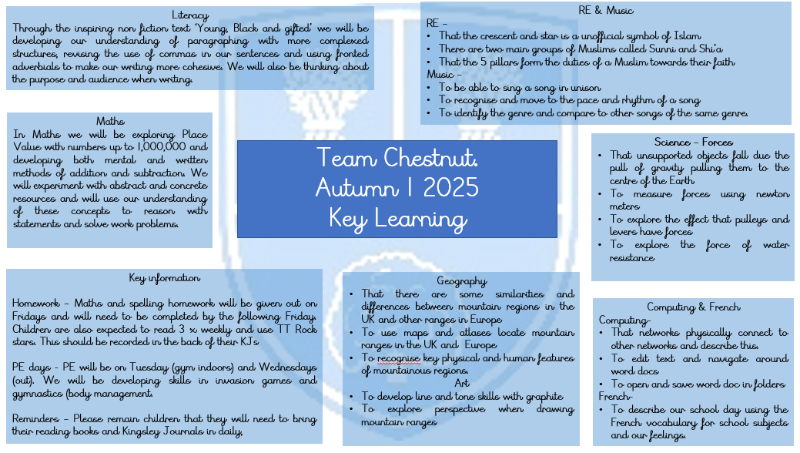
Overview of Topics – uploaded each term

Slide 4
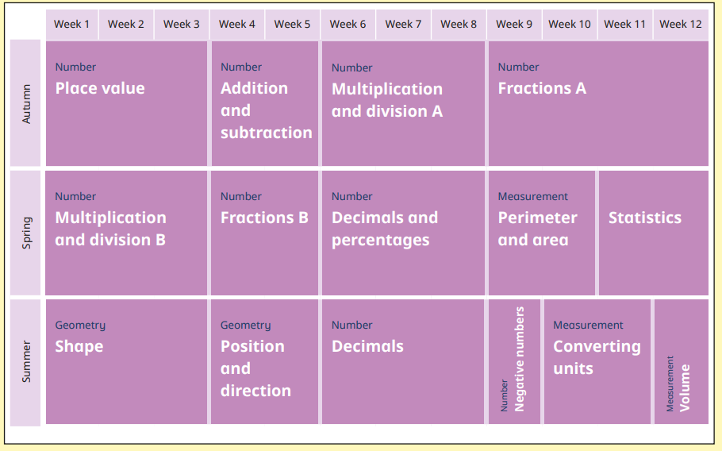
Maths Overview

Slide 5
Home Learning
In order for you to support your child with their learning, we have made our homework system as straight forward as possible
Reading
All children, despite their age or ability, are encouraged to read at least 3 times per week. Once they have read, please make sure you complete their reading log, ticking for each read and signing it.
Reading books will come home daily. Your child’s book swap day will be displayed at the top of their reading log for each half term. Longer novels/texts will be kept for more than a week

Slide 6
Home Learning
Maths
Weekly homework will be set linked to weekly learning. There are also weekly TT Rockstars to complete (parents to sign in KJ)
Spelling
All children will be given a list of ‘Level Up’ spellings on Friday, please support them by helping them to learn them; they will have a test the following Friday. Each week they will highlight the words they get correct on their homework sheets
Homework Club
Where children are not completing homework, they will be invited to join our homework club that will run on Friday lunch time. Teachers will be there to support the children

Slide 7
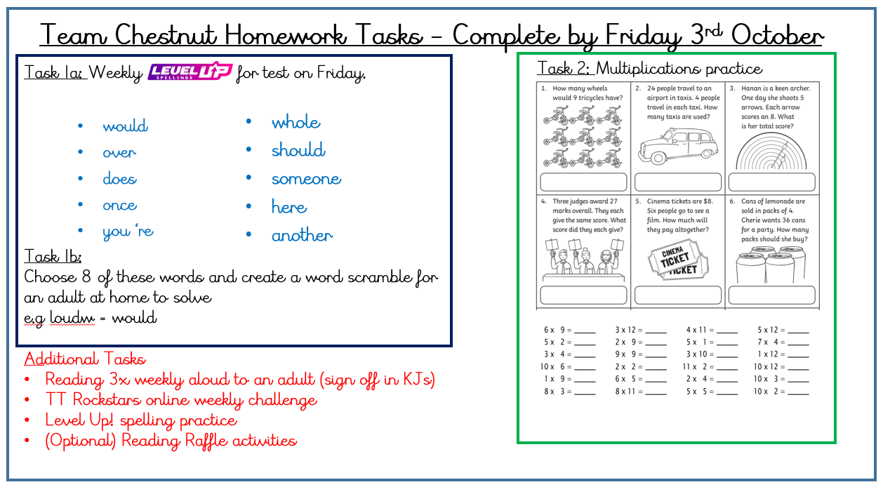
Home Learning

Slide 8
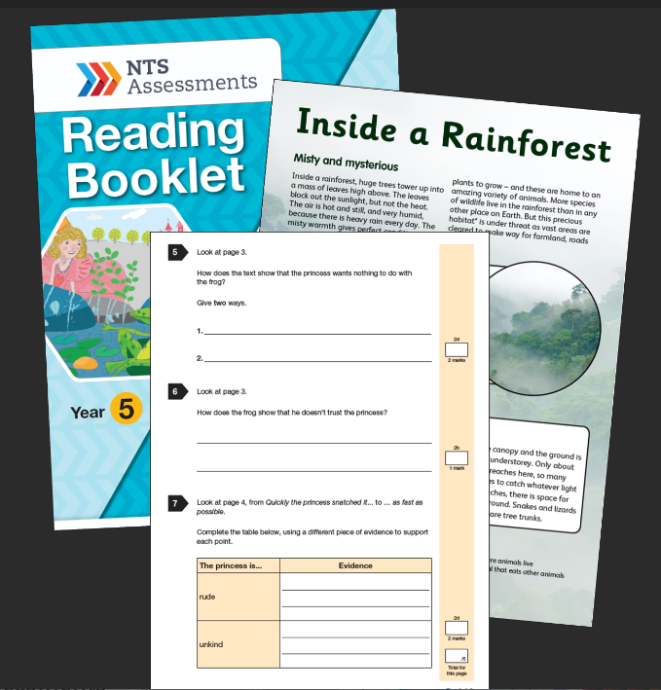
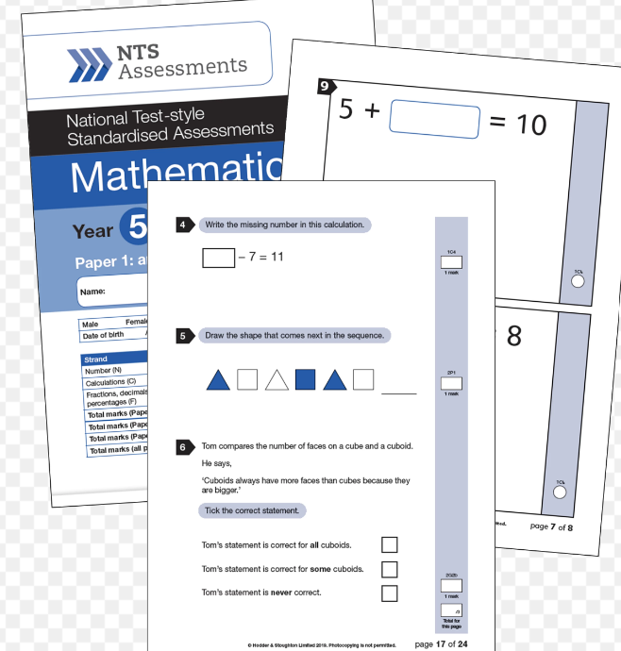
…Specific Assessment for your Year 5…
Reading fluency check – important to practice reading aloud for fluency and intonation
Level Up spelling check
Weekly multiplication facts timed challenge

Slide 9
School Enhancements
Various after school clubs – Check half termly emails for updates)
Visitor from Islamic community (date to be confirmed)
Bikeabilty course
Swimming
Easter Journey Story workshop (TBC)
Reviewing other curriculum enhancing trips
Notes:
Trips, residential, visitors etc.

