Slide 1







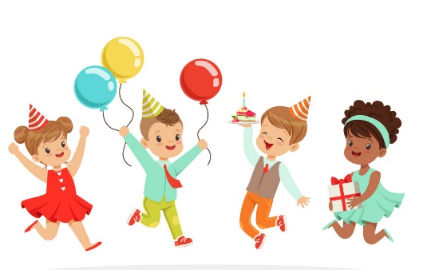
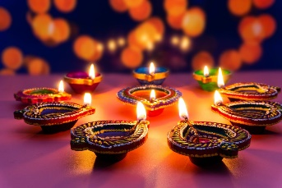
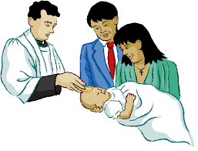

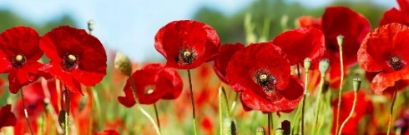
Autumn 2: Celebrations Nursery
Key Vocabulary
Celebrate party | Diwali Diva lamp, Rangoli patterns, Hindu, lights
Bonfire fireworks, fun, zoom, bang, noisy, crackle | Remembrance poppy, remember, 11th November
Baptism Church, Priest, holy water, candle | Christmas waiting, decorate, presents, family
Together gathering | Happy enjoy
I can…
Celebrate key events & celebrate one another
Take interest in our friends
Understand how others feel
Develop a sense of responsibility and membership of a community
Begin to understand why questions

