Slide 1

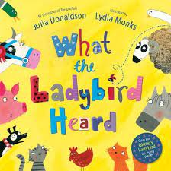
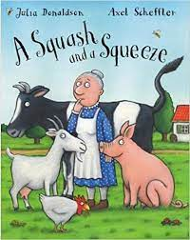
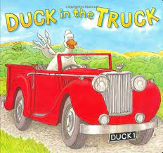

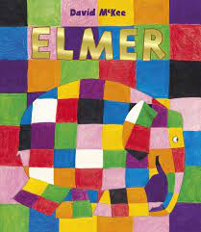
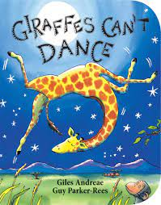
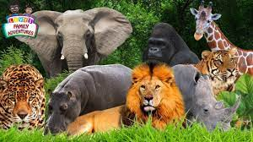
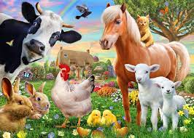
Summer 1: Animals around the World Nursery
Key Vocabulary
Farm animals: cow, pig, sheep, horse, goat, donkey, chickens, duck | Jungle animals: giraffe, lion, zebra, elephant, monkey, tiger, snake, crocodile
Calf, piglet, lamb, foal, chick, kid, duckling | Dairy
Tractor | Habitats
Africa | Fruit: pineapple, mango, avocado, guava, banana, passionfruit, orange.
I can…
Begin to remember rules and why we need to follow them
Begin to make healthy choices
Compare the features of animals from different countries
Consolidate understanding of rhyming words
Understand why and how questions
Improve my communication with others
Continue to become more independent in my self-care

