Slide 1







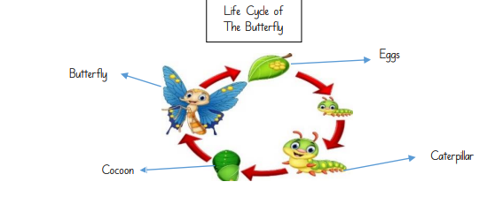


Spring 2: Plants & Life Cycles Nursery
Key Vocabulary
Soil | seed
Grow | Butterfly
Chrysalis | caterpillar
Egg | cocoon
plant | water
Sun | Life-cycle
I can…
Play co-operatively
Manage conflicts in an appropriate way
Take part in group activities
Use longer sentences and express a point of view
Sequence events
Understand what plants need to grow
Learn about the life cycle of a caterpillar

