Slide 1






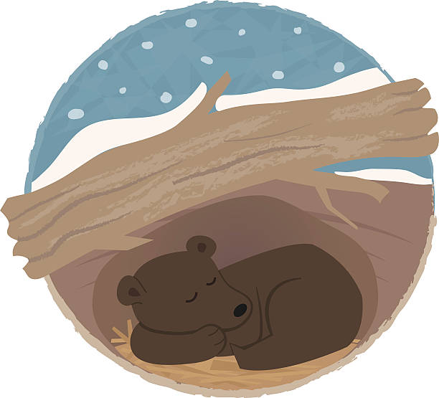

Spring 1: Day and Night Nursery
Key Vocabulary
Day
light, awake, sun
Night
dark, asleep, moon, stars
Friend
smile, kind, share, happy, helping
Habitat & Hibernate
sleep, warm, cosy, den, burrow, nocturnal
Animals
owl, owlet, bear, fox, badger, hedgehog
Chinese New Year
dragon, rabbit, Lunar New Year
Valentine’s Day
love, heart, special, care
I can…
Recognise how to be welcoming through words and actions.
Begin to understand the features of fiction & non fiction texts.
Learn about the habitats of different animals and understand that some animals hibernate for the winter.
Taste food from a different culture

