Slide 1

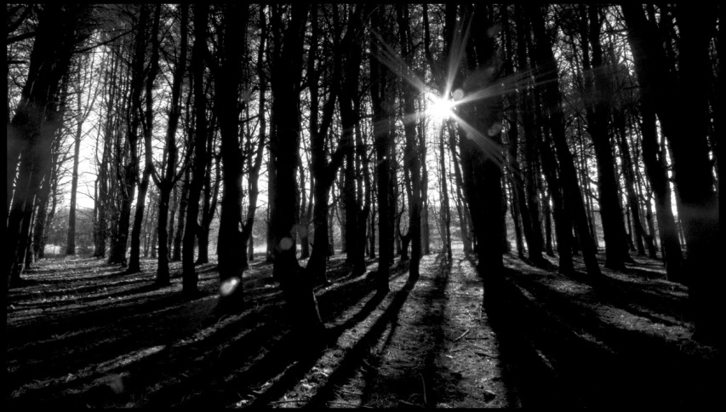
St George's
Dark Woods
Forest School

Slide 2
Why?
At St George's we are enhancing our early years outdoor environment through weekly 'Dark Woods' sessions. These sessions offer our youngest children the opportunity to develop in ALL areas of the Foundation stage curriculum whilst keeping the 'Characteristics of Effective Learning' at the heart of everything we do.
Being involved and concentrating.
To keep trying.
To enjoy achieving what they set out to
Having own ideas.
Making links
Choosing ways to do things.
Finding out and exploring.
Playing with what they know.
Being willing to have a go.

Slide 3


Be resourceful and independent.
Work Together - teamwork
Solve problems
Build and use our gross and fine motor skills
Take turns and wait our turn.
Explore
Learn.
In Dark woods
We can...
Develop and use language skills
Learn to take and manage risks.
Develop our confidence
Make choices
Develop our physical skills
learn about and care for our environment
Develop life skills
Test out our good ideas.
Develop our creativity
Have Fun!!!

Slide 4
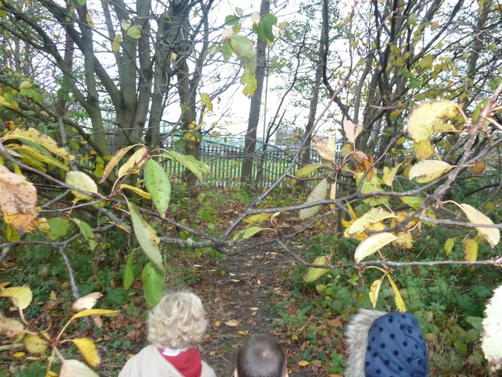
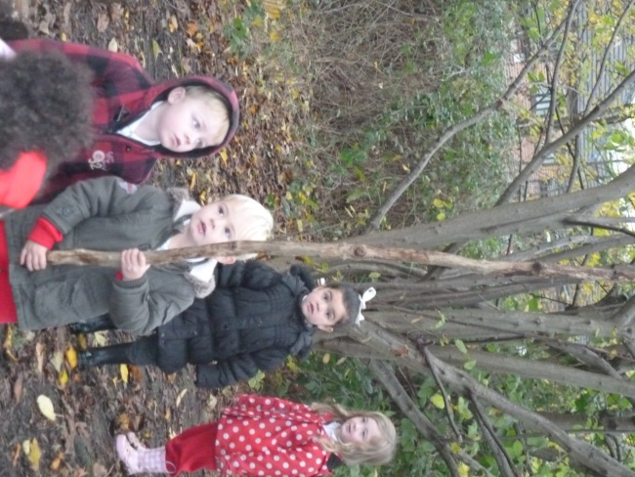
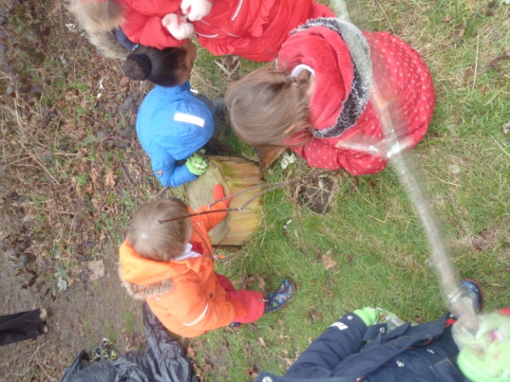


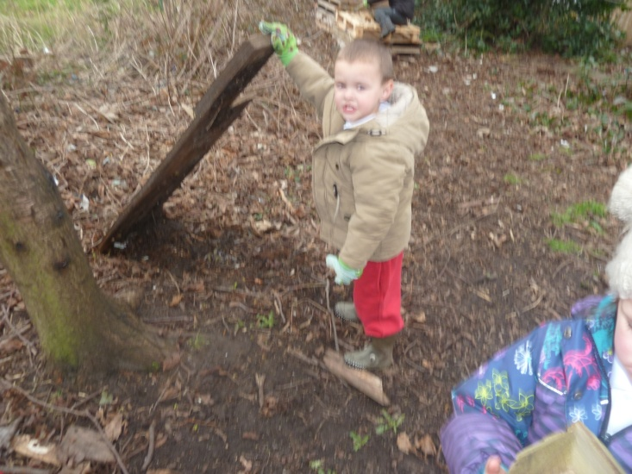
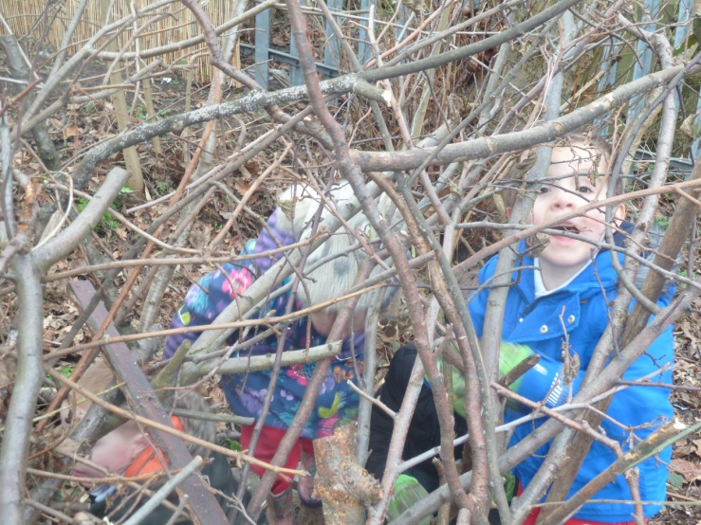


Slide 5
Although we are encouraging our children to take risks during our Dark Woods sessions, these risks have to be assessed and managed carefully. There are a few rules and 'things we need to remember' each session in order to maintain the safety of both children and staff.
Establishing Boundaries.
Picking up sticks and stones.
Tree climbing.
Rope and string use.
Toileting.
Eating and drinking.
Using tools
Lighting fires.
RISK!!!
These basic rules will be drawn up with
the children during their first
session in the woods and will be
re-visited at the start of each session.

Slide 6
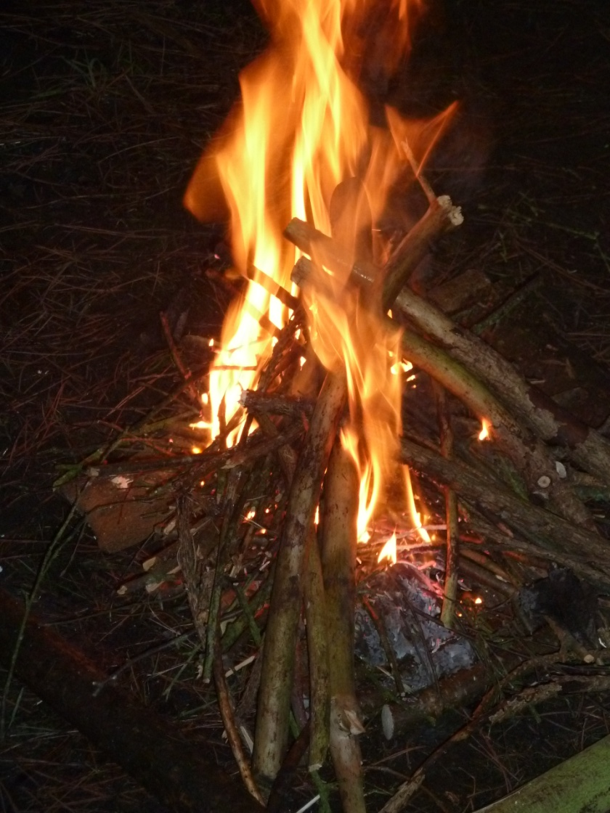
Clothing!
Weather!
Consent forms.
Sessions
Adult help
First aid
Any Questions?

