Slide 1
Swift Class
Meet The Teacher
Evening 2025

Slide 2
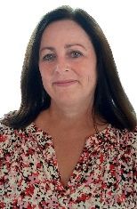
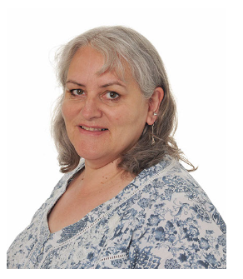
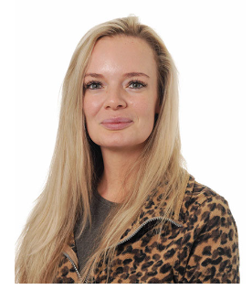
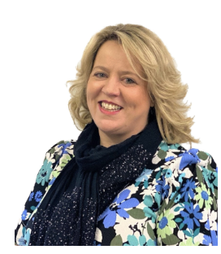
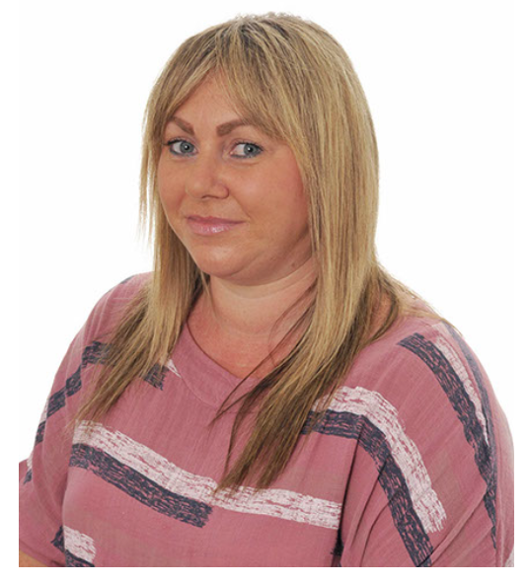
The Teachers
After morning Registration, Year 4 are taught by Mrs Rowland or Mrs Cornelia and Year 5 are taught by Miss Williams.
In the afternoons, Year 5 are joined by some Year 4 pupils to form Swift class.
Mrs Sisson covers SENCO time and PPA (planning time) on Tuesday and Wednesday afternoons. Mrs Senior covers Deputy Head time on Friday morning.

Slide 3

Friday – Arithmetic, Reading, Science and Music
Fridays are a little different. Swift class stay together for the morning. After Assembly, Years 4 and 5 are taught differentiated reading comprehension and arithmetic in their mixed classes.
On Friday afternoon, Year 4 and 5 are separate again. Year 4 have Guitar with Alex Hulme, then Science with Mrs Rowland. Year 5 have Science and Music with Miss Williams.

Slide 4

P.E.
Our PE days are Wednesday and Thursday (swimming) when the children should come in wearing their PE kit and trainers. As the weather gets colder, they will also need to wear navy long trousers and long-sleeved tops/hoodies for PE.
The PE uniform is plain or with school logos. They should not wear branded items or items with stripes etc.
Trainers should not be overly bright in colour.

Slide 5

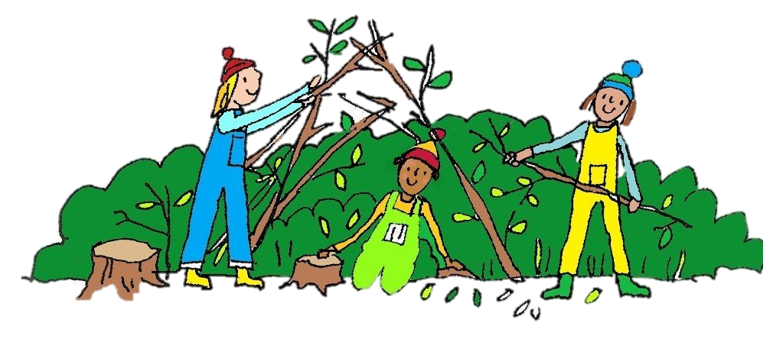
Forest School
Swimming
In Autumn Term, Years 3, 4 and 5 all go swimming on a Thursday afternoon, Kingfishers first then Swifts in the second slot.
The first session is 18th September. They have 10 weeks of swimming.
Children should wear PE Kit on Thursdays when it is swimming – it’s much faster to get changed.
We are doing Forest School activities after Christmas, and we will give you more details nearer the time.

Slide 6




English & Maths – Year 4
In English, we will continue to develop their writing skills with the Pathways to Write scheme of work.
Comprehension skills are taught on a Friday by Miss Williams.
We will be continuing with Maths No Problem, Year 4, starting with Place Value, then Addition and Subtraction, moving on to Multiplication and Division before Christmas.
There is a national Multiplication Check via an online test given to every Year 4 child in June. They are expected to know all times tables up to 12x12 fluently.

Slide 7





English & Maths – Year 5
In English, we will continue to develop their writing skills with the Pathways to Write scheme of work.
Comprehension skills are taught on a Friday.
We will be continuing with Maths No Problem, Year 5, starting with Place Value, then Addition and Subtraction, moving on to Multiplication and Division before Christmas.

Slide 8



R.E.
Year 4 and 5 are taught RE in the mornings. Year 4 by Mrs Cornelia and Mrs Rowland, and Year 5 by Miss Williams.
We are continuing with the new scheme that was introduced last year – The Vine and The Branches.

Slide 9
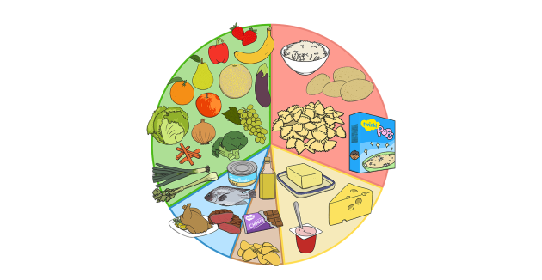

Science
Year 4 and 5 have separate Science lessons.
Mrs Rowland teaches Year 4 Science on a Friday afternoon.
Year 4 have begun with Sound, and will be able to make links to Guitar lessons, since they study pitch and dynamics in both.
Year 5 have begun with Properties and changes of Materials.

Slide 10
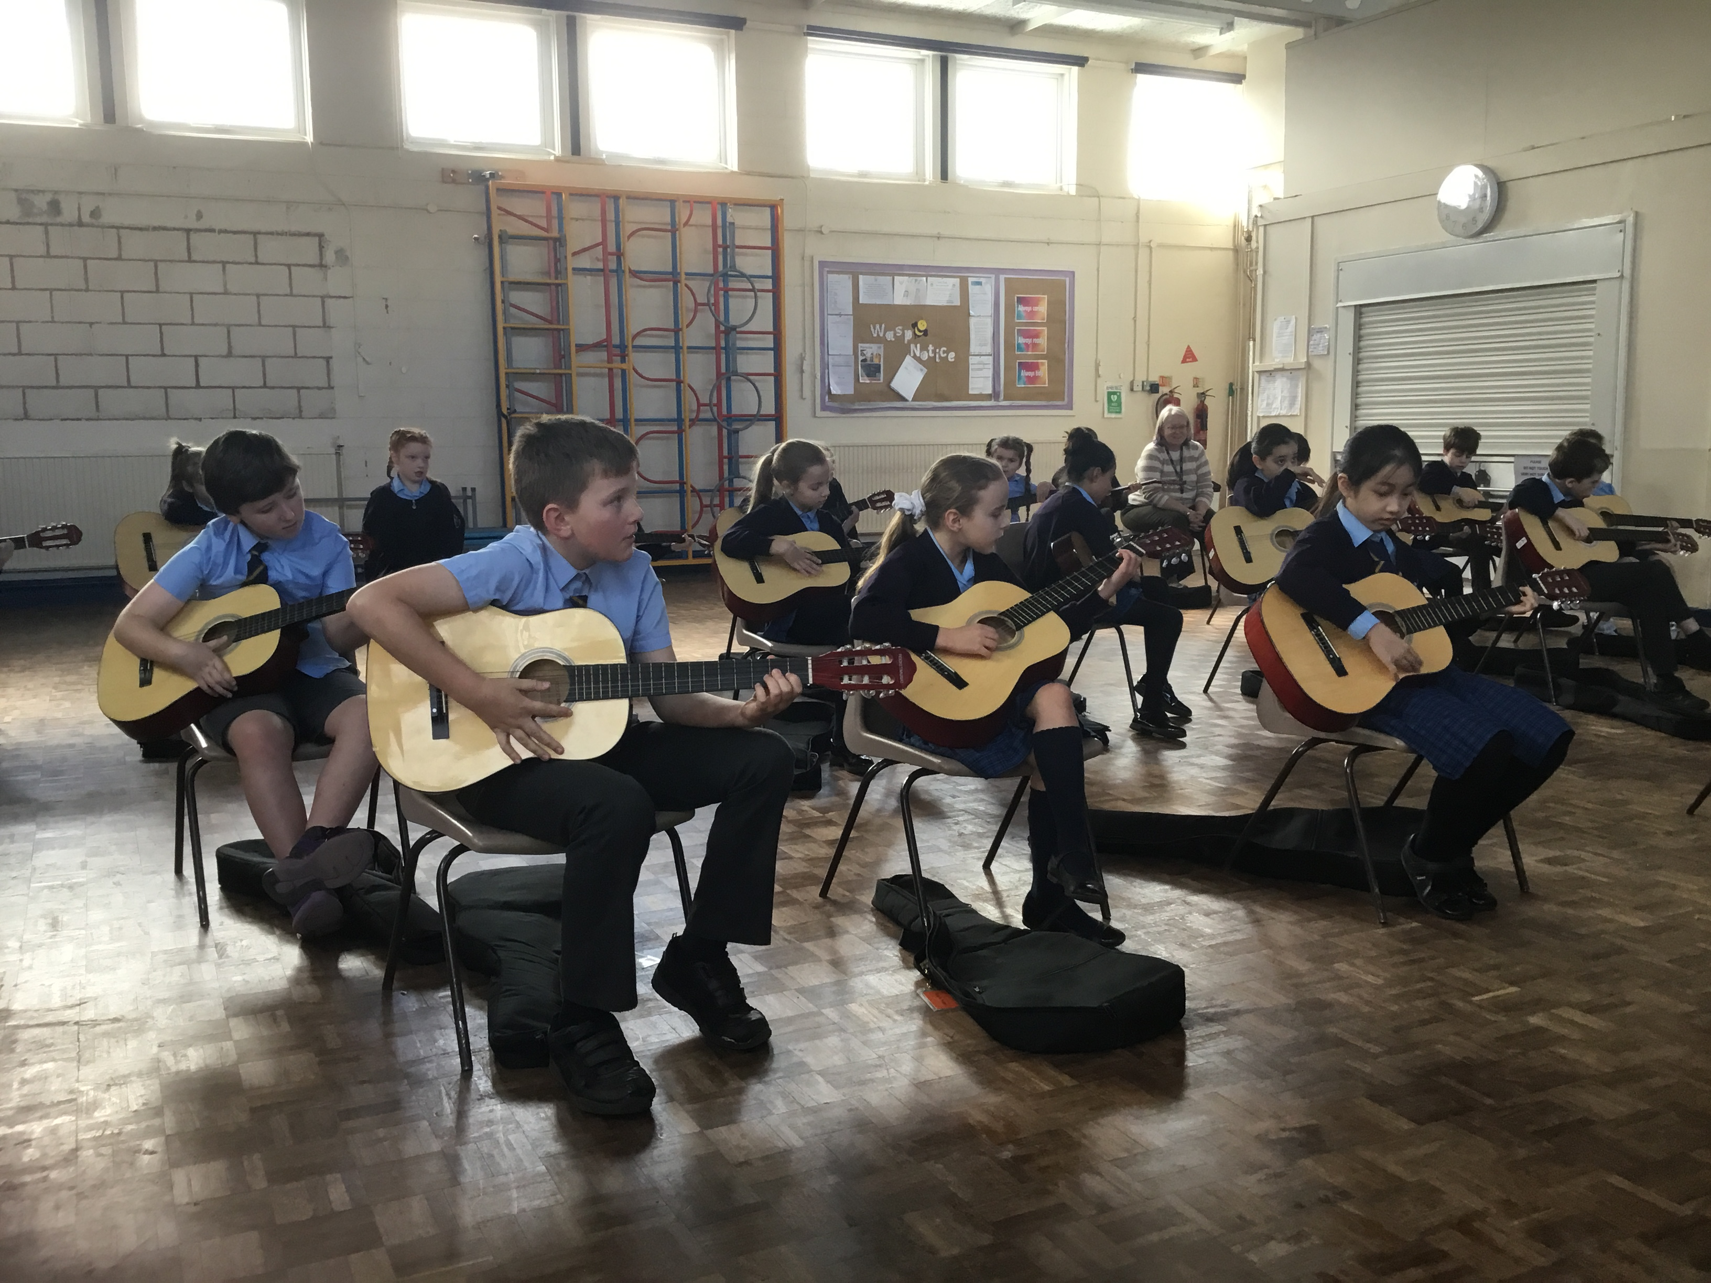
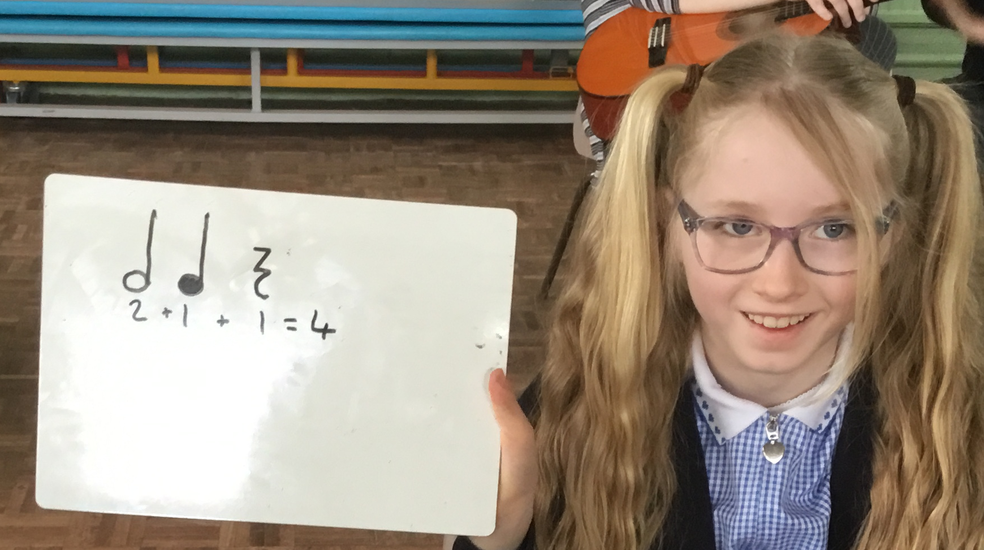
Music and Guitar
Year 4 have guitar lessons for an hour every Friday afternoon with Alex Hulme.
Year 5 continue with the Kapow music scheme, taught by Miss Williams.

Slide 11
Foundation Subjects – these are all taught in mixed classes (Kingfishers and Swifts)
In History, Years 4 and 5 are studying the Anglo-Saxons and Scots this term, and there will be a trip to Warrington Museum to support this. Geography topics will also be the same for Years 4 and 5.
In Art and DT everyone covers all skills, but not necessarily with the same topic. This way no-one repeats a topic.
French, Computing and PSHRE are taught in mixed classes with differentiation as required.

Slide 12

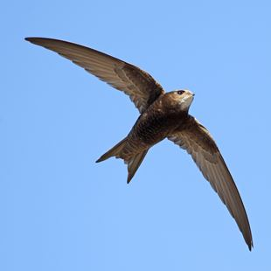
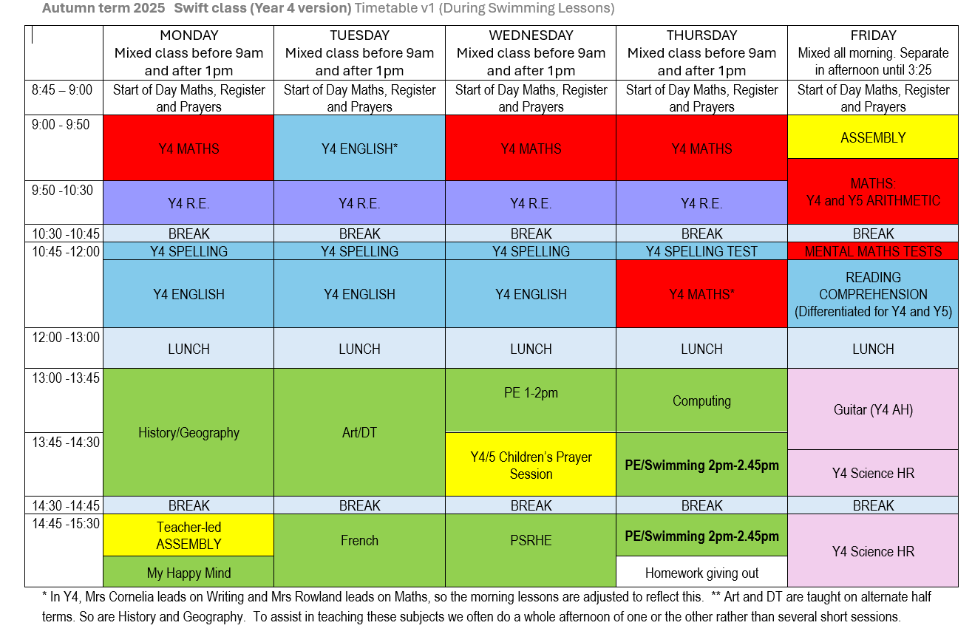



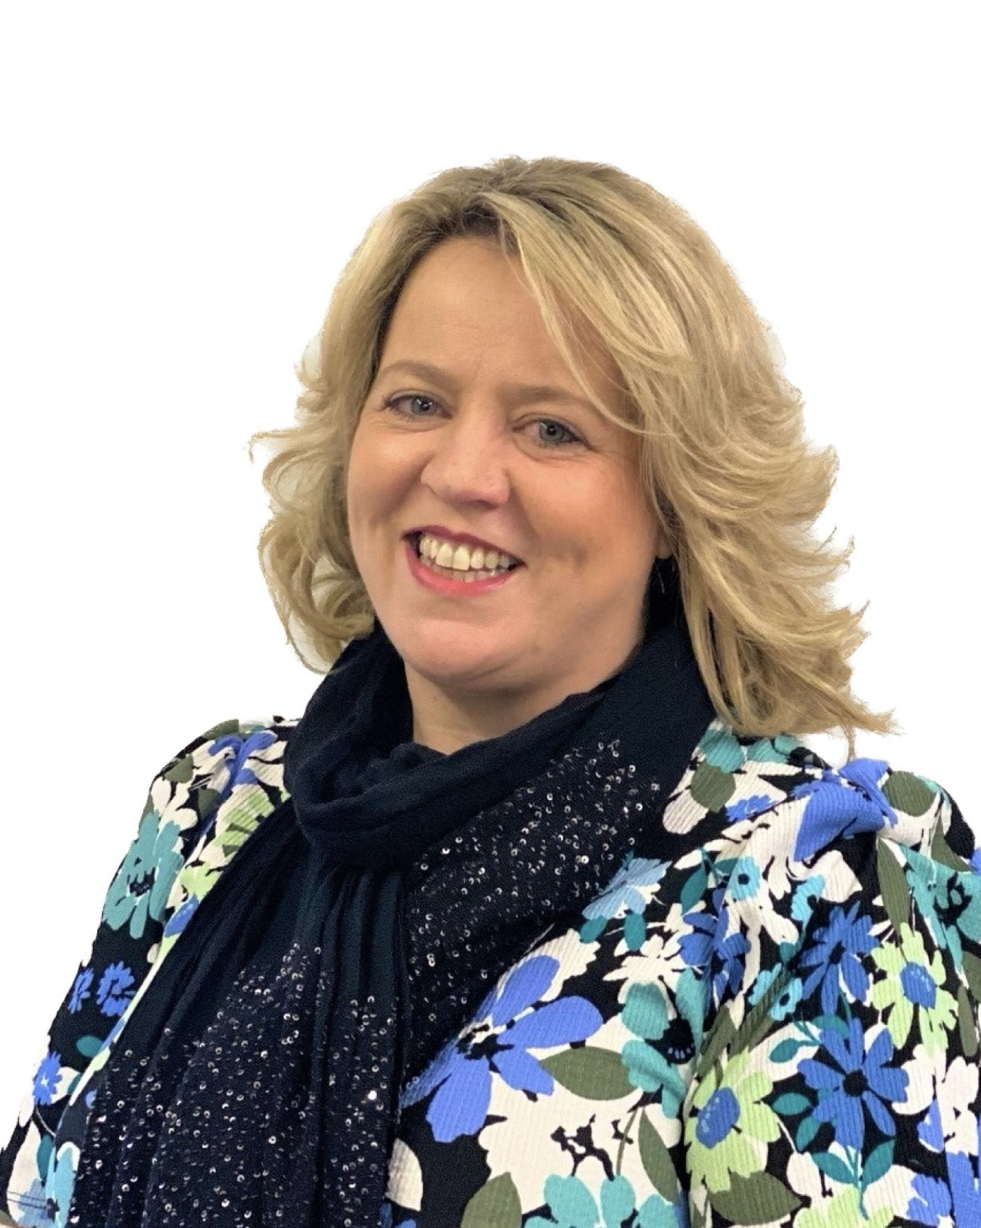

Welcome to Swift Y4
Swift (Year 4 Version) Autumn 1 Timetable
Welcome to Swift Class, and to a new school year!
Who are our staff?
Teachers: Miss Williams, Mrs Rowland and Mrs Cornelia.
HLTAs: Mrs Sisson and Mrs Senior
SEN TAs: Miss Service, Mrs Appleton, Mrs Dailey and Miss Potts
What will you need?
A water bottle, which you should take home each afternoon so it can be kept clean and fresh
Come in to school wearing PE kit on Wednesday and Thursday. You will need your swimming kit on a Thursday
A waterproof coat, even if you think it will be sunny all day. We go out to play in all but the heaviest rain
How can you help at home?
Homework is given on Google Classroom. It goes ‘live’ every Thursday. The spelling tests are on Thursdays and mental maths tests are the following Friday. Sometimes other homework is given which may have a different hand in date.
Reading: Hear your child read several times a week and ask them about their reading. Their reading record needs to be in their bag every day.
Spellings: There will be a spelling test each week on a Thursday
Times Tables Rockstars/Numbots: Children should access this several times a week for 10 minutes or so each time. There will be a weekly times tables test and a separate mental maths test, both on Friday.
Autumn Educational Enhancements
Swimming is on THURSDAYS starting 18th September.
Year 4 are going on our class residential to Tattenhall at the end of October.
There is a trip to Warrington Museum in October.

Slide 13




This half term we will be learning…
Swift Year 4
Art & Design
Sculpture and 3D
Interactive installation
English
Pathways to Write –
Focus on recounts / non chronological reports using the book Counting on Katherine as a focus.
On our Autumn 1 Bookshelf
Science
Sound
Religious Education
The Vine and the Branches: Creation & Covenant
History
The Anglo Saxons and Scots
Maths
Place Value
Addition and Subtraction
Times Tables
PSRHE
Ten:Ten: Religious Understanding
Calming the storm
Behaviour expectations and class building
PE & Swimming
Unit 1 Personal
React Positively to Challenge
Coordination: Ball Skills
Agility: Reaction/Response
Swimming
French
Welcome to School
Computing
Internet Safety
Music
Guitar Lessons
A1

Slide 14
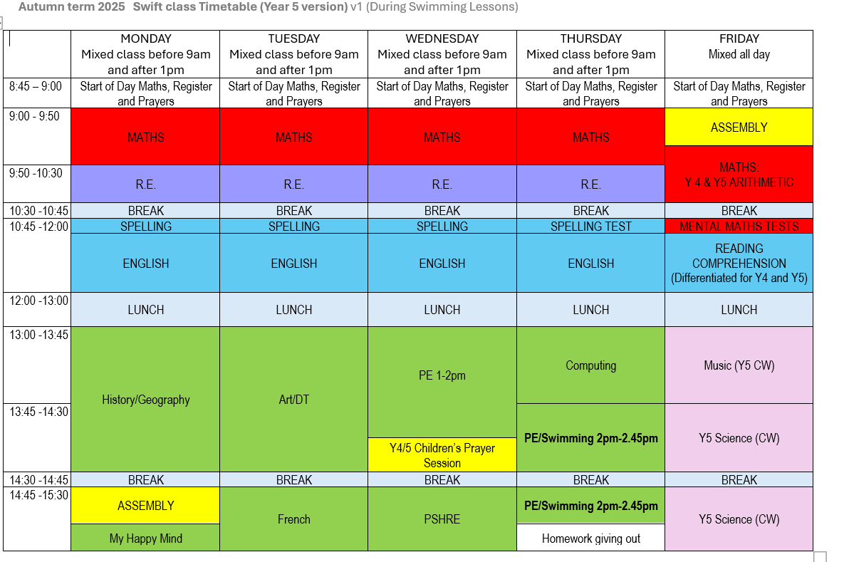

Welcome to Swift Y5
Swift (Y5 Version) Autumn 1 Timetable
Welcome to Swift Class, and to a new school year!
Insert screenshot of weekly timetable here
Who are our staff?
Miss Williams Mrs Sissons Mrs Senior
Class Teacher HLTA HLTA
Miss Service Mrs Appleton
SEN TA SEN TA
What will you need?
A water bottle, which you should take home each afternoon so it can be kept clean and fresh
Come in to school wearing PE kit on Wednesday and Thursday. You will need your swimming kit on a Thursday
A waterproof coat, even if you think it will be sunny all day. We go out to play in all but the heaviest rain
How can you help at home?
Homework is given on Google Classroom. It goes ‘live’ every Thursday after school. The spelling tests are on Thursdays and mental maths tests are the following Friday. Sometimes other homework is given which may have a different hand in date.
Reading: Hear your child read several times a week and ask them about their reading. Their reading record needs to be in their bag every day.
Spellings: There will be a spelling test each week on a Thursday.
Times Tables Rockstars/Numbots: Children should access this several times a week for 10 minutes or so each time. There will be a weekly times tables test and a separate mental maths test, both on Friday.
Autumn Educational Enhancements
Swimming September-December
Warrington Museum 06/10/25
Autumn 2
Bike Right 3rd November-7th November

Slide 15
This half term we will be learning…
Swift Year 5
English
The Lost Happy Endings by Carol Ann Duffy
Fiction: write a traditional tale with an alternative ending
On our Autumn
Bookshelf…
Art & Design
Sculpture and 3D
Interactive installation
Science
Properties and changes of Materials
Religious Education
Creation and Covenant
History
Anglo-Saxons and Scots
Maths
Number and Place Value:
Numbers to 1 000 000
Calculations:
Addition and Subtraction
PSRHE
Ten:Ten: Religious Understanding
Calming the storm
Behaviour expectations and class building
Music
Composition notation
Theme: Ancient Egypt
Computing
Internet Safety
French
Welcome to School
PE & Sport
Swimming
Unit 1 Personal
React Positively to Challenge
Coordination: Ball Skills
Agility: Reaction/Response
A1

Slide 16
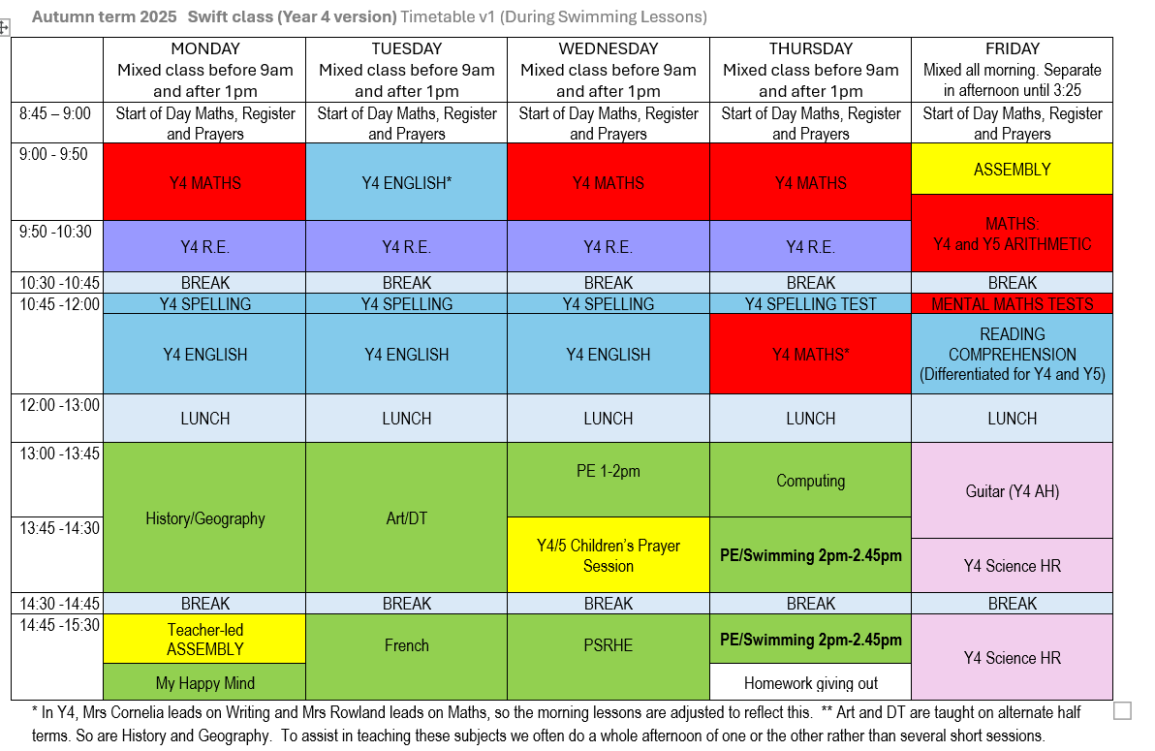

Slide 17
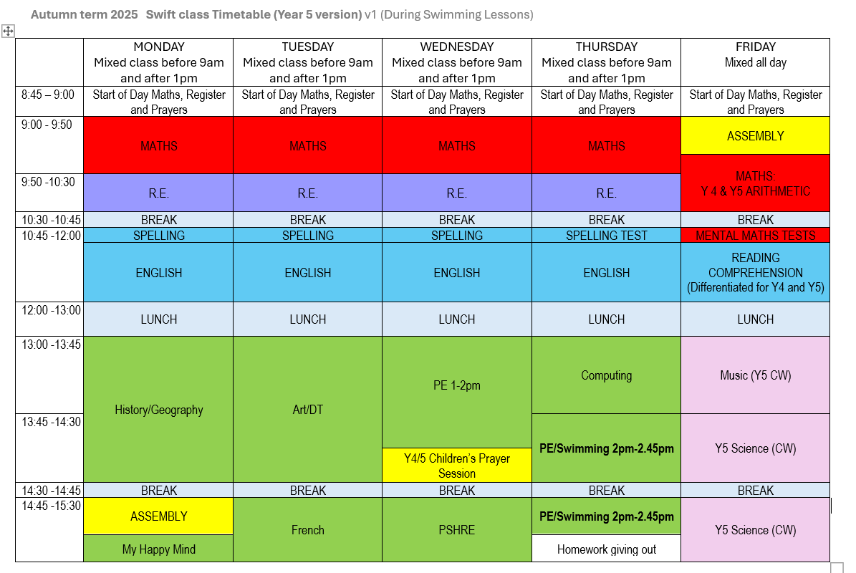

Slide 18
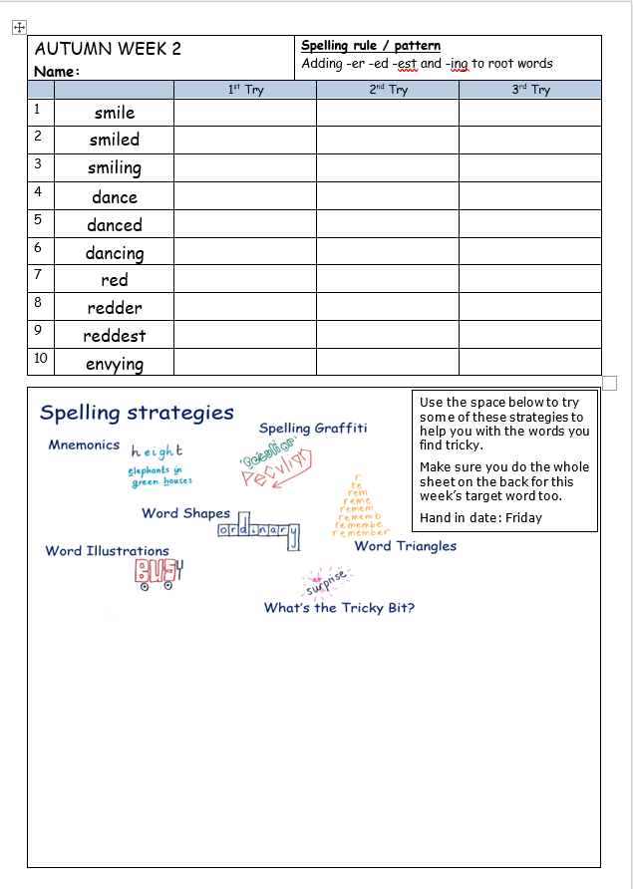

Homework 1
Spellings
These are given out on a Thursday and will be tested the following Thursday. They will be on Google classroom and a paper copy also comes home. Please encourage your child to practice little and often rather than all on Wednesday night or Thursday morning. They will retain them much better if they look at them and practice over several days.
Reading
Please read with your child three or more times a week. As they move up the reading bands, they are more likely to need help with understanding word meaning and inference, rather than ‘decoding’ words, but they still need support. Discuss the book with them, including characters, predictions of what will happen next, and finding evidence to support their ideas. The three aspects we take into account when allocating a book band are accuracy, reading speed/fluency, and comprehension.

Slide 19
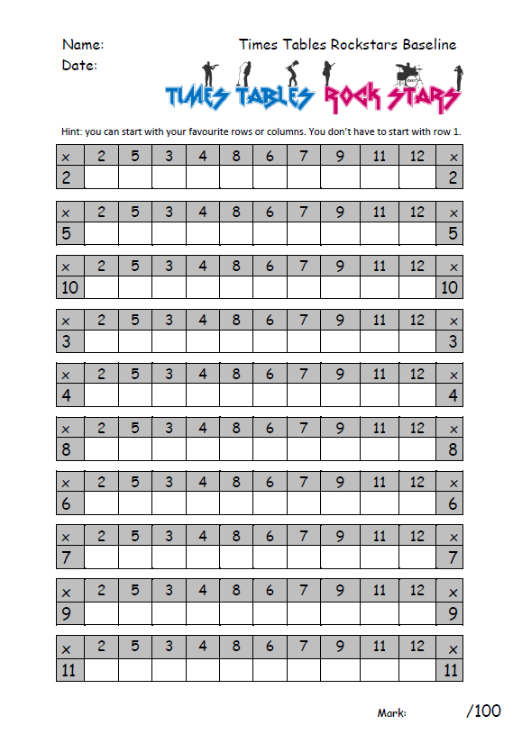

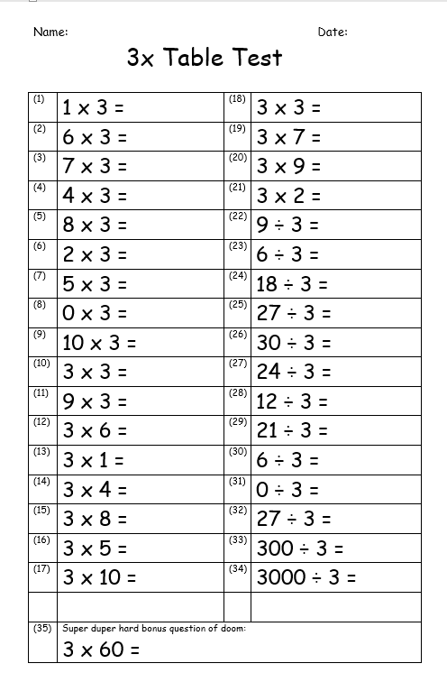


Homework 2
Mental Maths Tests
The focus for the following week’s mental maths test is given on Thursday for a 5 minute test the following Friday. Sometimes paper resources are sent home, and there will always be recommended resources on Google Classroom for that week.
If we’ve sent a paper revision sheet home, again there are 5 housepoints.

Slide 20
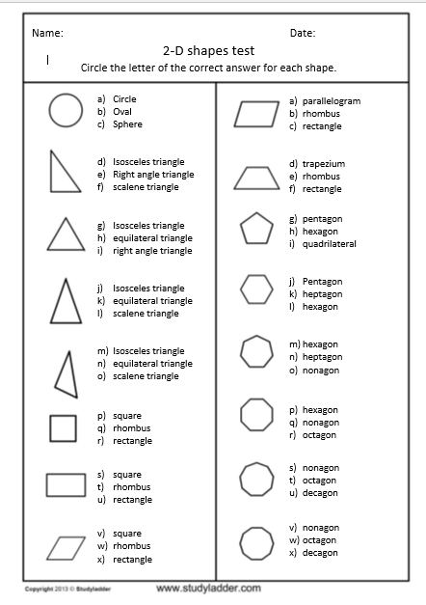
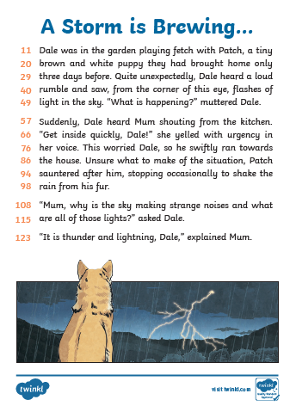
Homework 3
Maths or English
There will sometimes be a paper-based Maths or English activity. These are sometimes to be done or submitted online. If you have trouble getting online at home, please let us know and your child can do it in school on Thursday.
Creative Homework
About 3 or 4 times a year, your child will be given a creative homework assignment.

Slide 21

First Reconciliation (Year 5)
This will be undertaken as an after-school activity for those children who will be making their First Reconciliation.

Slide 22
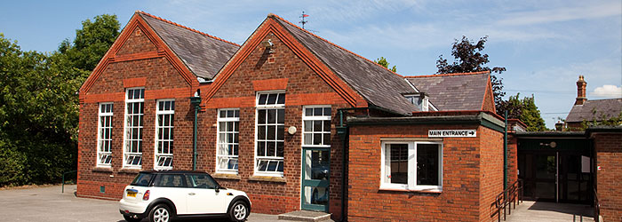
The Residential
Year 4 will be going to Tattenhall for their Residential in October, and the children will love the experiences they have there. There will be permission and medical forms coming out this week for you to fill in for us. It is really important that they come back as soon as possible. There will also be a slideshow available for parents to watch with their children, since there isn’t time tonight to cover everything.
On the forms given out today, there is a box to tick if you want to talk to us privately about any concerns you have about the residential – via email, phone call or meeting.

