Slide 1
Kingfisher Class
Meet The Teacher
Evening 2025

Slide 2
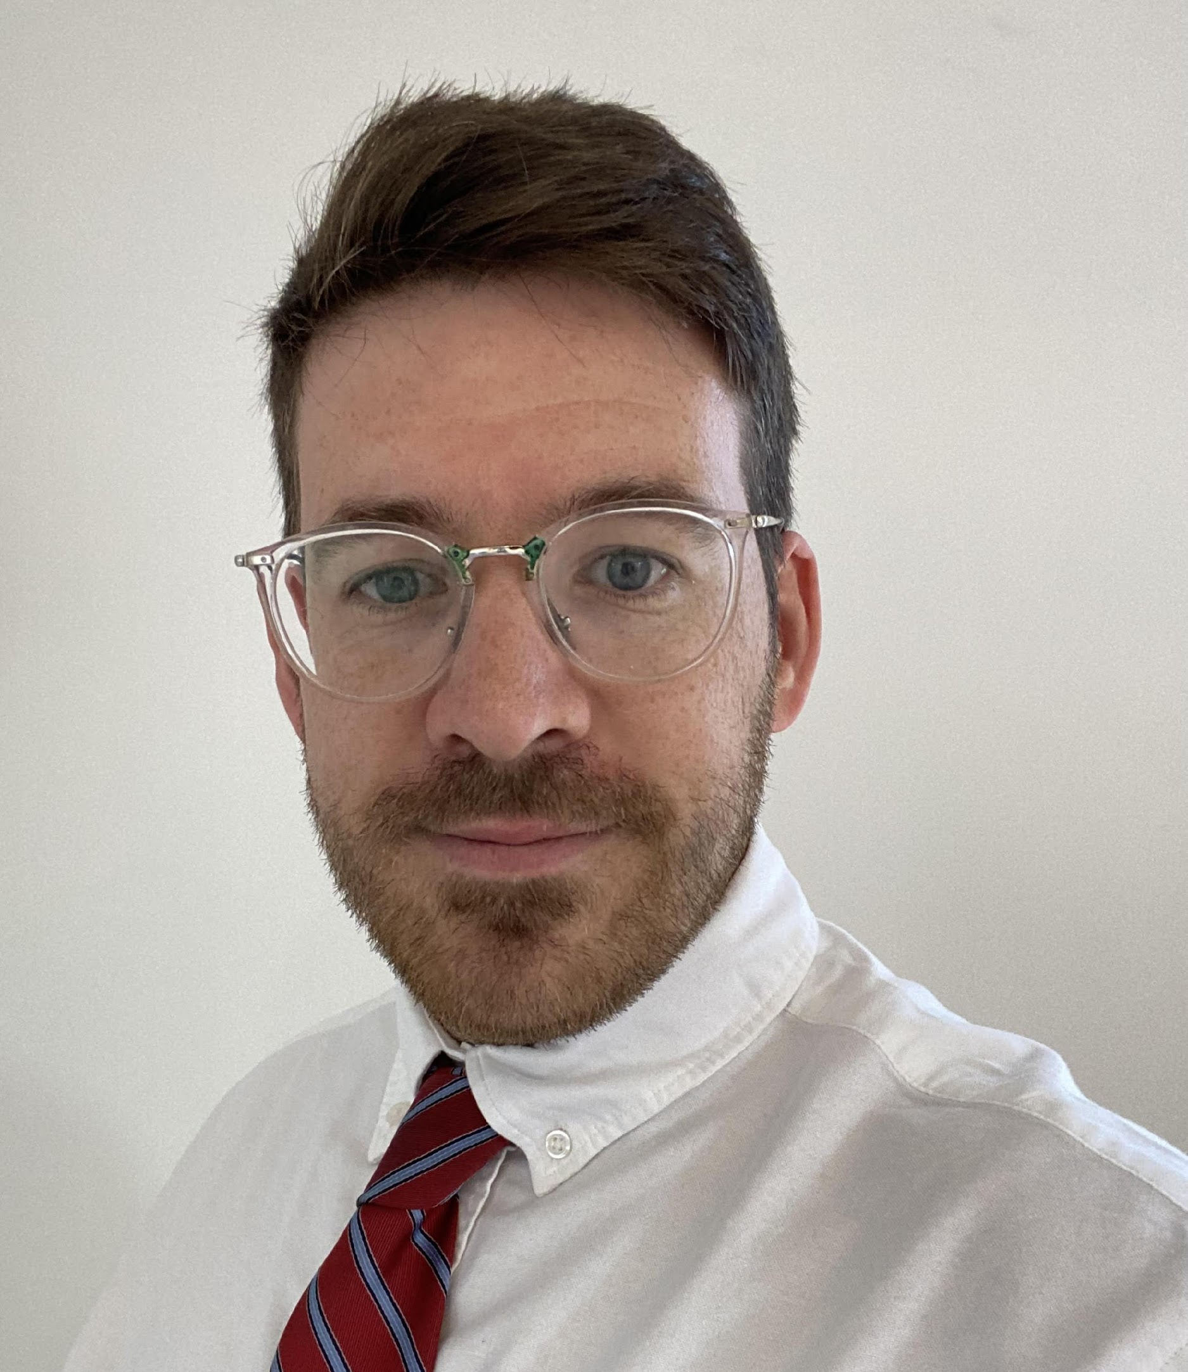
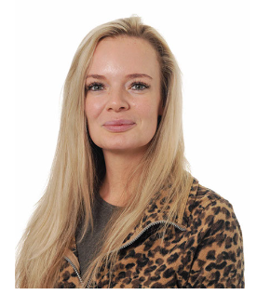
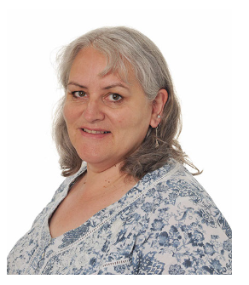
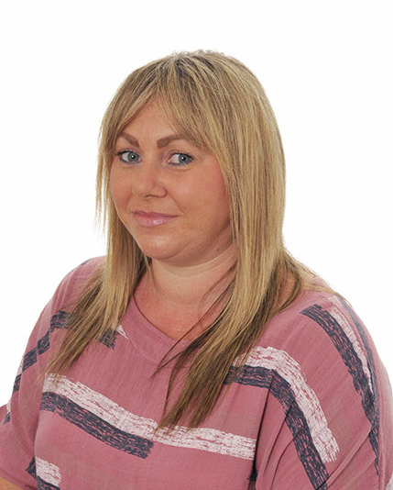
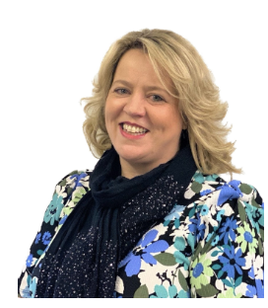
The Teachers
After morning Registration, Year 3 are taught by Mr Moore and Year 4 are taught by Mrs Cornelia or Mrs Rowland.
In the afternoons, some of Year 4 go to Swifts class and the rest of Year 4 are joined by Year 3 to form Kingfisher class.
Kingfisher class is taught by Mrs Cornelia on Monday and Tuesday and Mrs Rowland on Thursday and Friday. We teach on alternate Wednesdays.
Mrs Senior covers our PPA (planning time) for 1 hour 15 minutes each, on Tuesday and Thursday afternoons.

Slide 3

Friday – Arithmetic, Reading, Science and Music
Fridays are a little different. Kingfisher and Swift class stay together for the morning. After Assembly, Years 3, 4 and 5 are taught differentiated reading comprehension and arithmetic in their mixed classes.
On Friday afternoon, Year 3, 4 and 5 are separate again. Year 4 have Guitar with Alex Hulme, then Science with Mrs Rowland. Year 3 have Science with Mrs Rowland then Music with Mrs Sisson.

Slide 4

P.E.
Usually, our PE days are Monday and Tuesday when the children should come in wearing their PE kit and trainers. While Swimming is on, the main PE lesson is on Mondays, so it’s school uniform on Tuesday.
As the weather gets colder, they will also need to wear navy long trousers and long-sleeved tops/hoodies for PE.
The PE uniform is plain or with school logos. They should not wear branded items or items with stripes etc.
Trainers should not be overly bright in colour.

Slide 5

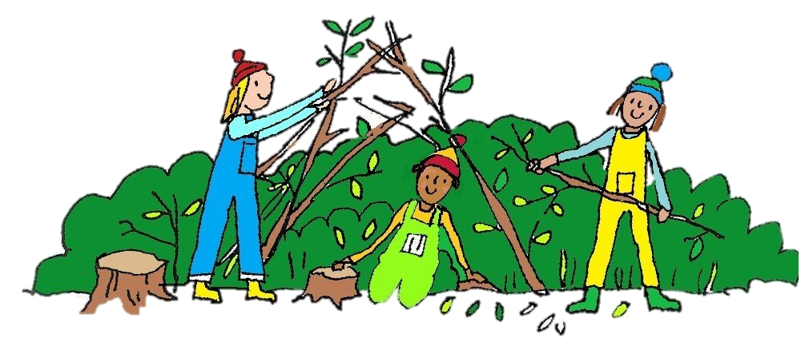
Forest School
Swimming
In Autumn Term, Years 3, 4 and 5 all go swimming on a Thursday afternoon, Kingfishers first then Swifts in the second slot.
The first session is 18th September. They have 10 weeks of swimming (in 2 blocks of 5), and then will return to PE on Mondays and Tuesdays.
Children should wear PE Kit on Thursdays when it is Swimming – it’s much faster to get changed.
We are doing Forest School activities after Christmas, and we will give you more details nearer the time.

Slide 6




English & Maths – Year 3
These are taught by Mr Moore
In English, he will continue to develop their writing skills and handwriting. We are continuing with the Pathways to Write scheme of work.
There will be weekly lessons developing reading comprehension skills with Mrs Rowland
We will be continuing with Maths No Problem, Year 3, starting with Place Value, then Addition and Subtraction, moving on to Multiplication and Division before Christmas.

Slide 7




English & Maths – Year 4
In English, we will continue to develop their writing skills with the Pathways to Write scheme of work.
Comprehension skills are taught on a Friday by Mrs Rowland
We will be continuing with Maths No Problem, Year 4, starting with Place Value, then Addition and Subtraction, moving on to Multiplication and Division before Christmas.
There is a national Multiplication Check via an online test given to every Year 4 child in June. They are expected to know all times tables up to 12x12 fluently.

Slide 8



R.E.
Year 3, 4 and 5 are taught RE in the mornings. Year 3 are taught by Mr Moore and Year 4 by Mrs Cornelia and Mrs Rowland.
We are continuing with the new scheme that was introduced last year – The Vine and The Branches.

Slide 9


Science
Year 3, 4 and 5 have separate Science lessons.
Mrs Rowland teaches Year 3 and then Year 4 Science on a Friday afternoon.
Year 3 have begun the term with Animals Including Humans and are looking at Nutrition first.
Year 4 have begun with Sound, and will be able to make links to Guitar lessons, since they study pitch and dynamics in both.

Slide 10
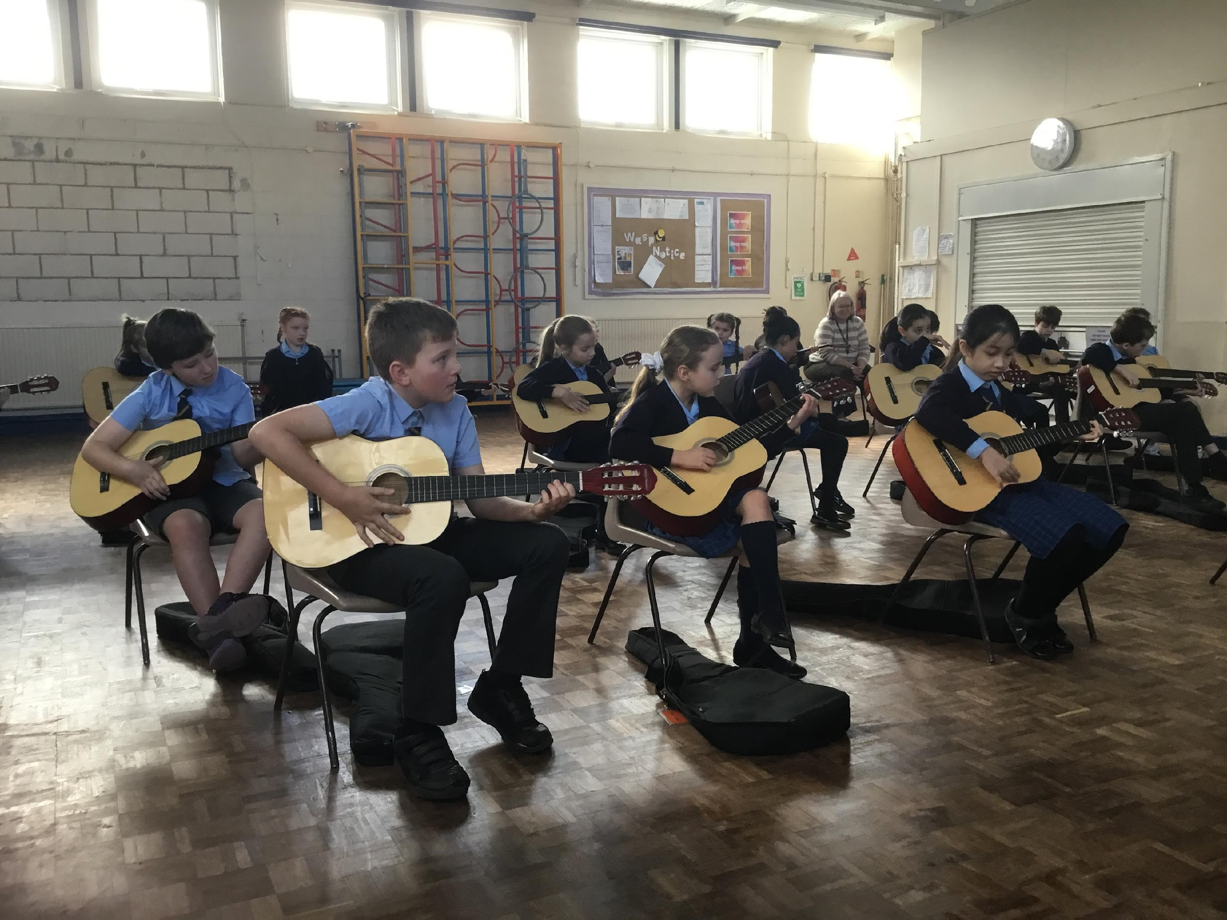
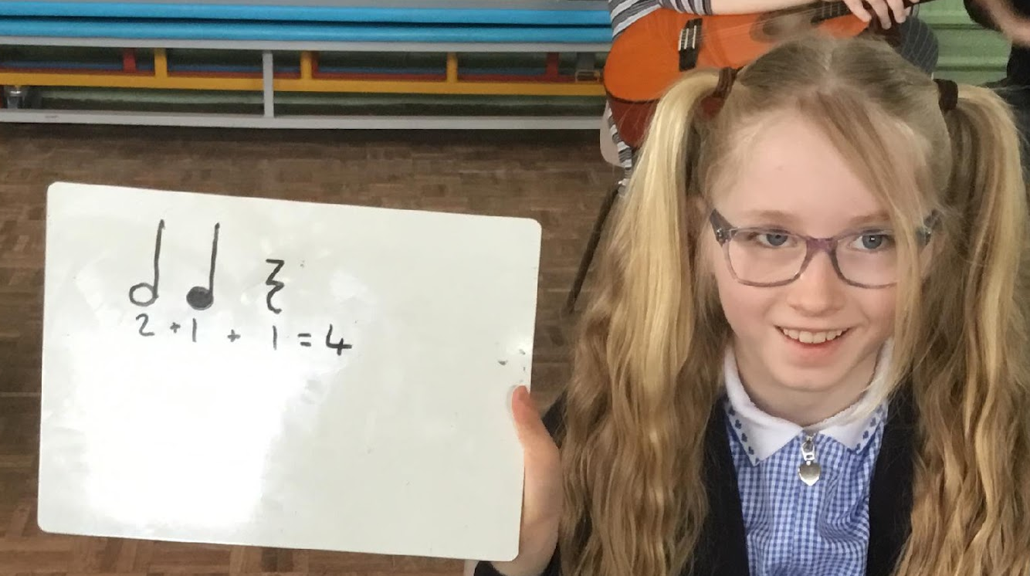
Music and Guitar
Year 4 have guitar lessons for an hour every Friday afternoon with Alex Hulme.
Year 3 continue with the Kapow music scheme, taught by Mrs Sisson.

Slide 11
Foundation Subjects – these are all taught in mixed classes (Kingfishers and Swifts)
In History, Years 3, 4 and 5 will all the studying the Anglo Saxons this term, and there will be a trip to Warrington Museum to support this. Geography topics will also be the same for all 3 year groups.
In Art and DT everyone covers all skills, but not necessarily with the same topic. This way no-one repeats a topic.
French, Computing and PSHRE are taught in mixed classes with differentiation as required.

Slide 12
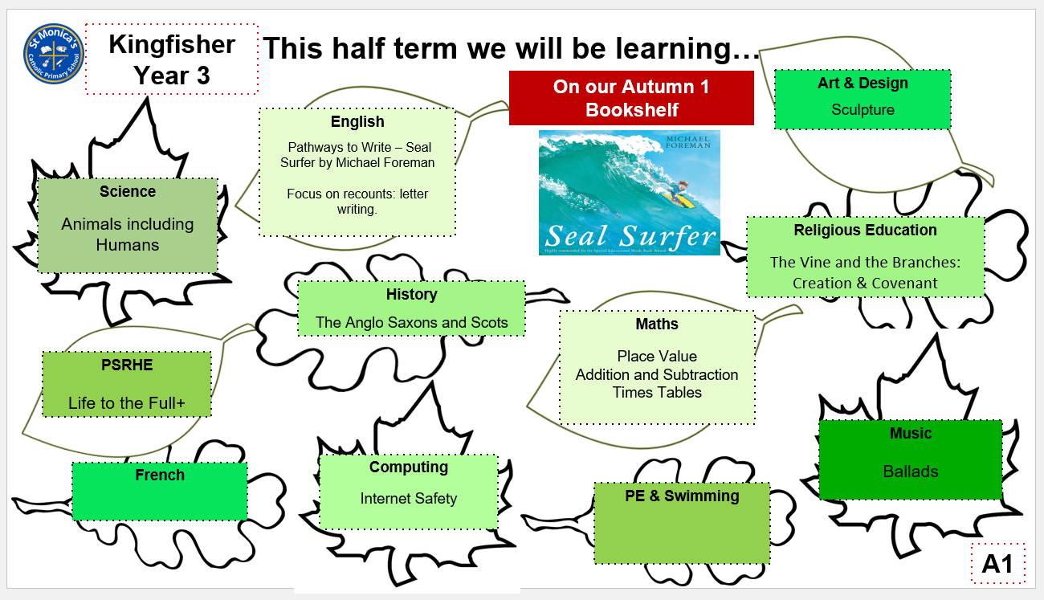
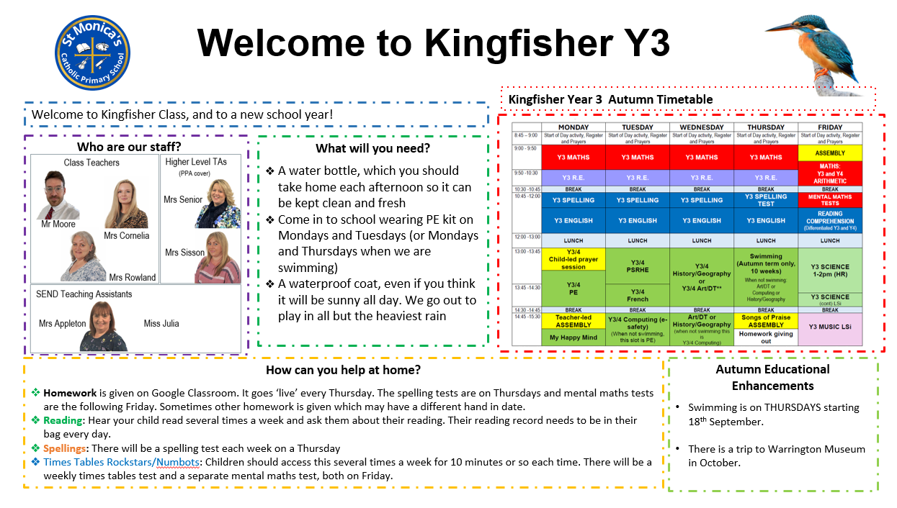
Class Information Sheets- available online and to take home in hard copy if you’d like one

Slide 13
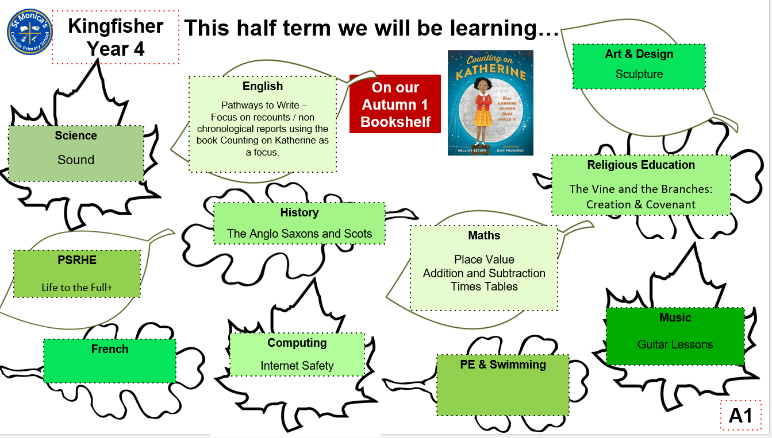
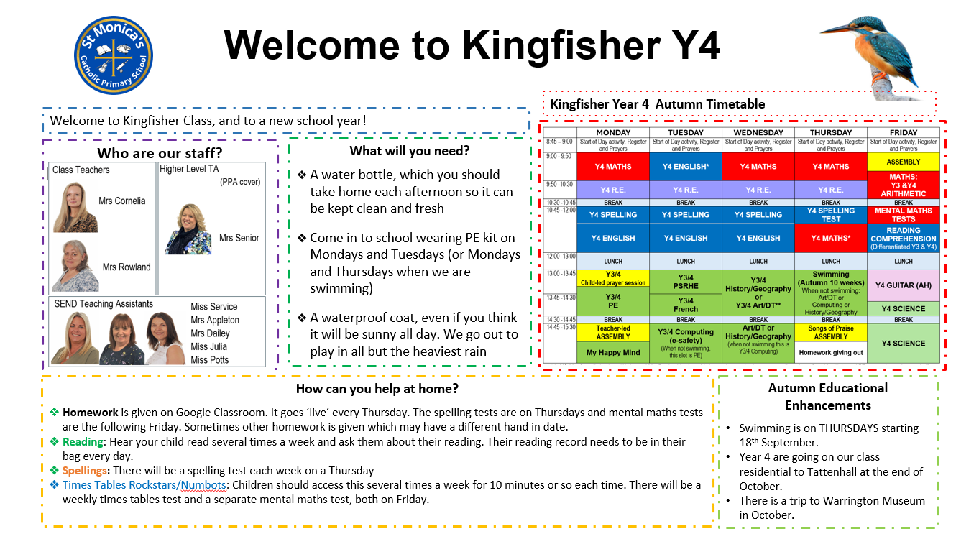

Slide 14
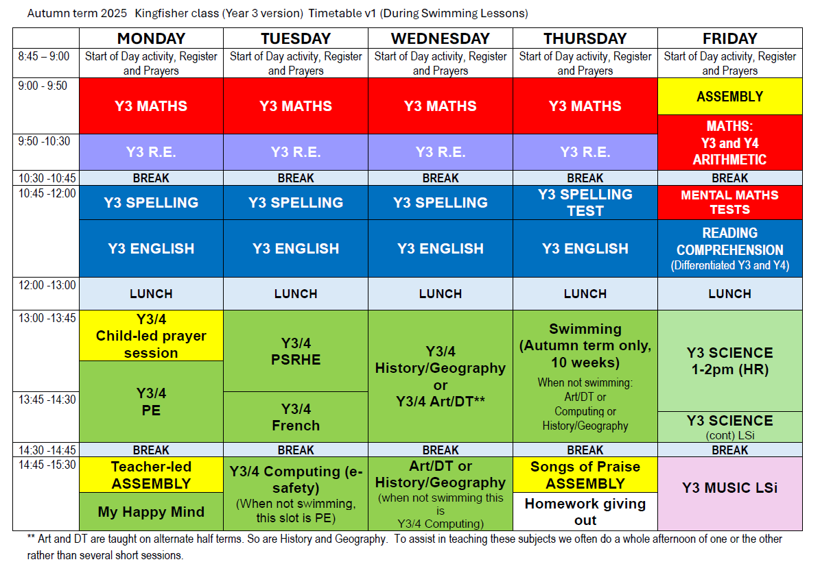

Slide 15
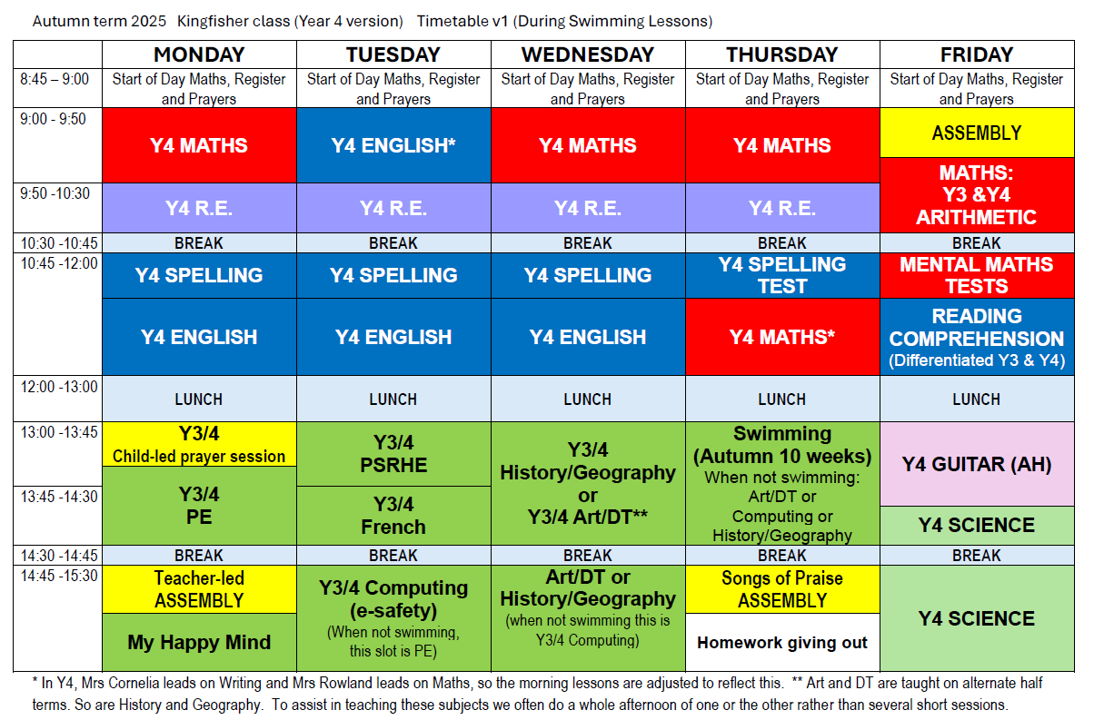

Slide 16
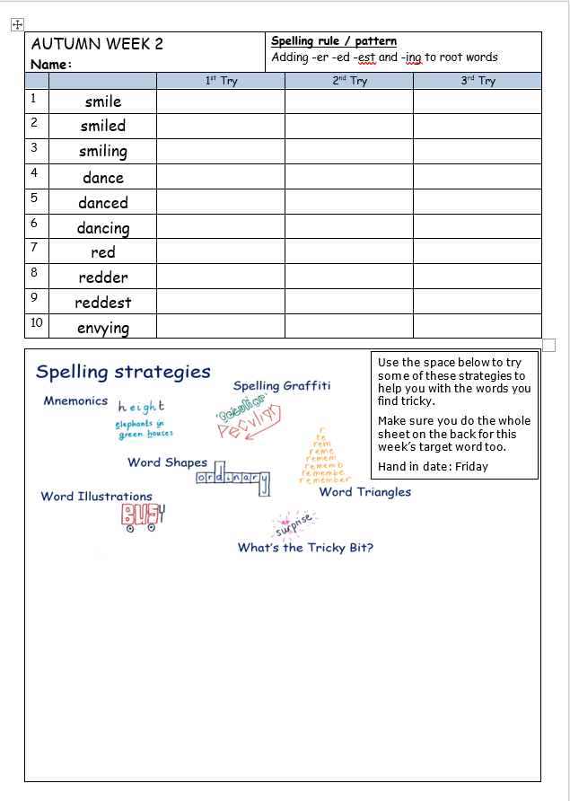

Homework 1
Spellings
These are given out on a Thursday and will be tested the following Thursday. They will be on Google classroom and a paper copy also comes home. Please encourage your child to practice little and often rather than all on Wednesday night or Thursday morning. They will retain them much better if they look at them and practice over several days.
Reading
Please read with your child three or more times a week. As they move up the reading bands, they are more likely to need help with understanding word meaning and inference, rather than ‘decoding’ words, but they still need support. Discuss the book with them, including characters, predictions of what will happen next, and finding evidence to support their ideas. The three aspects we take into account when allocating a book band are accuracy, reading speed/fluency, and comprehension.

Slide 17
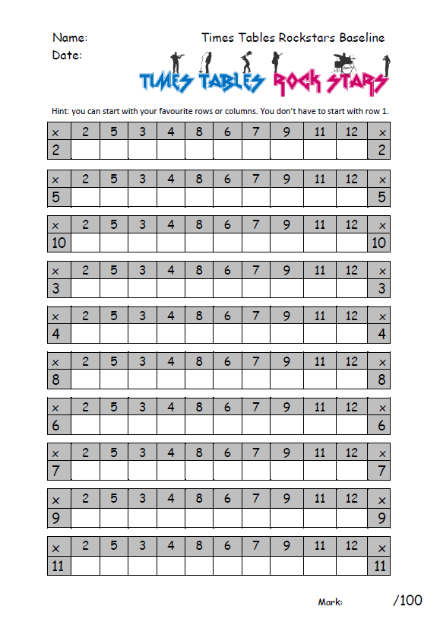

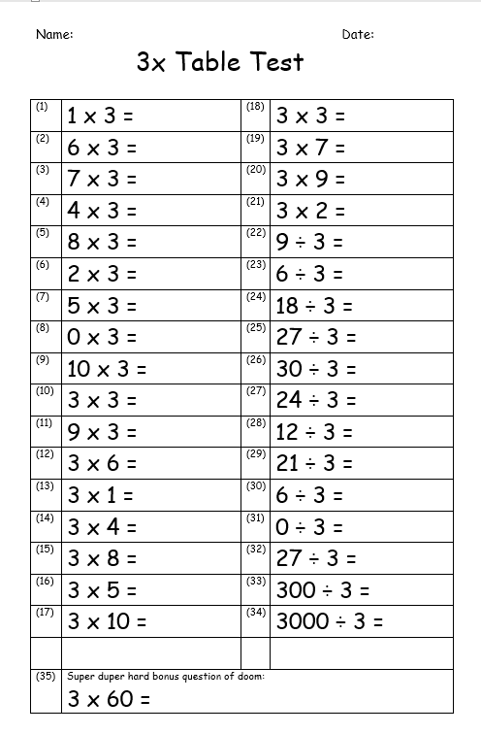


Homework 2
Mental Maths Tests
The focus for the following week’s mental maths test is given on Thursday for a 5 minute test the following Friday. Sometimes paper resources are sent home, and there will always be recommended resources on Google Classroom for that week.
If we’ve sent a paper revision sheet home, again there are 5 housepoints.

Slide 18
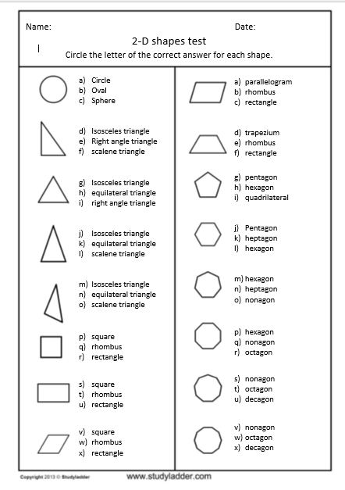
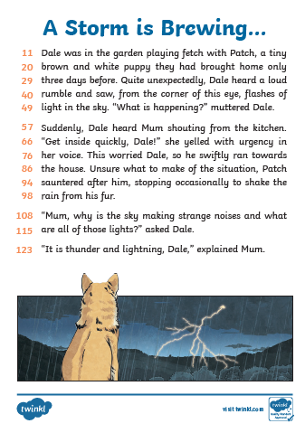
Homework 3
Maths or English
There will sometimes be a paper-based Maths or English activity. These are sometimes to be done or submitted online. If you have trouble getting online at home, please let us know and your child can do it in school on Thursday.
Creative Homework
About 3 or 4 times a year, your child will be given a creative homework assignment, usually over a holiday or two weeks of term time.

Slide 19

First Holy Communion and First Reconciliation
These will be undertaken as an after-school activity for those children who will be taking First Holy Communion (Year 3) and First Reconciliation (Year 5)

Slide 20
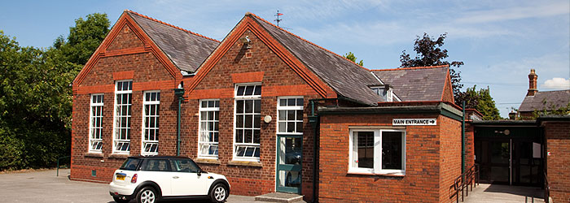
The Residential
Year 4 will be going to Tattenhall for their Residential in October, and the children will love the experiences they have there. There will be permission and medical forms coming out this week for you to fill in for us. It is really important that they come back as soon as possible. There will also be a slideshow available for parents to watch with their children, since there isn’t time tonight to cover everything.
On the forms given out today, there is a box to tick if you want to talk to us privately about any concerns you have about the residential – via email, phone call or a meeting.

