Slide 1


The ‘Big A’ Peer Support Pack
Using the Resource
The Big A Peer Support pack has been developed as a resource to use in schools with class groups that include someone who has a diagnosis of autism. The aims of ‘The Big A’ Peer Support Pack are;
  To develop an awareness of autism in the peers of students who have autism (including all conditions associated with the autism spectrum)
  To promote the inclusion of students who have autism through peer support and understanding
  To foster confidence in students who have autism through looking at the positive aspects of what it can mean and promoting these
  To improve the self esteem of students who have autism
Before ‘The Big A’ is used with groups it is important to get the parent/carer permission of the student who has autism and to discuss it with the student themselves. Some parents and individuals feel uncomfortable about autism being discussed, so sensitivity is needed.
The materials have been developed with KS2 students in mind, however, they can easily be differentiated up or down to use with other age groups.
The first part of the pack (pages 2-13) is designed to be used as a PowerPoint presentation, for a presentation/discussion session with a whole class group.
Following the presentation, the students can also have a copy of the slides (pages 2-13), as a booklet, which they can fill in themselves (the numbers you can see next to the animations will not appear on printed versions or be visible during PowerPoint presentations).
The activities section can be used either for whole group discussion points, or in smaller groups with Teaching Assistants. Activities can be rotated between groups.
Lastly, there is an evaluation sheet, which can be used to identify where to go next.

Slide 2
The ‘BIG A’
?
Thinking About … Autism

Slide 3
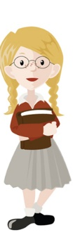





I Know Someone Who Has Autism
My school includes lots of people and they are all different! We all look different and have our own personalities, which means that we make friends with different people.
In my school there are many autistic students and that is a part of who they are.
Let me tell you all about it…

Slide 4
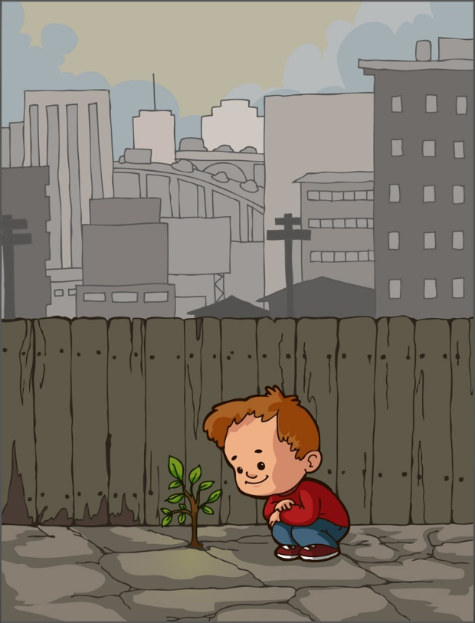
Different Ways of Looking at the World
Instead of looking at the ‘big picture’ autistic people might be more interested in bits of it, which can make them a bit ‘side-tracked’.
Sometimes we all get side-tracked. Things that get my attention and stop me from listening include…

Slide 5
Getting Someone’s Attention When They’re Sidetracked
People who have autism might need help in keeping their attention so it’s a good idea to…
Make sure you have their attention.
Give time for the person to answer (it might take longer than usual).
Repeat what you said.
Say the persons name before you start talking to them.

Slide 6
Talking to Other People
Talking to other people may be hard for someone who has autism and they might have trouble with…
My thoughts about talking are;
I like to talk to
I like to talk about
I don’t like talking about
I might be quiet because
Starting conversations.
Stopping conversations.
Talking too little.
Talking about the same thing all the time.
Talking too much.

Slide 7
What Do You Mean?
A lot of the time we say things that aren’t really what we mean, for example….. What do these pictures mean?
People who have autism might get things mixed up, so it’s important to say what you really mean!

Slide 8
Can You Think of Any More?

Slide 9
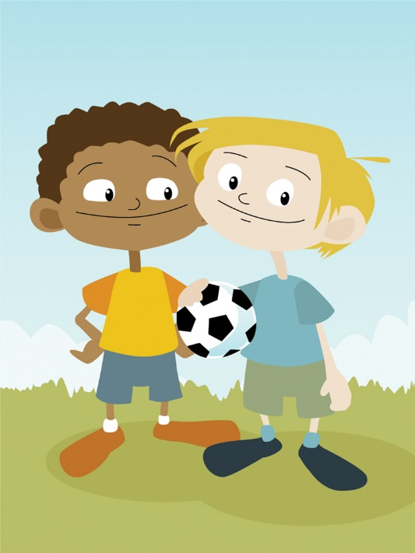
The Importance of Friends
Friends are important because they…..
My closest friends are called
Listen to our problems and try to help.
Make us feel included.
Stick up for us in times of trouble.
Share a laugh with us.
Play games together.
Are always there for us, even after we’ve argued.

Slide 10
Making Friends & Staying Friends
What could I do to help?
Autistic people want friends just like everybody else, but they might find it more difficult to make friends, so….
Give them help when they need it.
Sit with them at dinner time.
Listen when they are saying
something.
Include them in conversations –
even if they are talking about different
things to me.
Ask them to play with me and
my friends.

Slide 11

The Good Things About Autism
People with autism are interesting people.
People with autism don’t often tell lies.
People with autism can have terrific memories.
People with autism can make great friends.
People with autism have some great ideas.

Slide 12
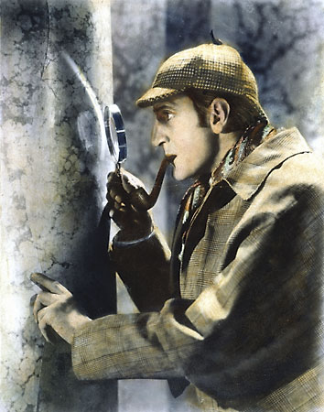

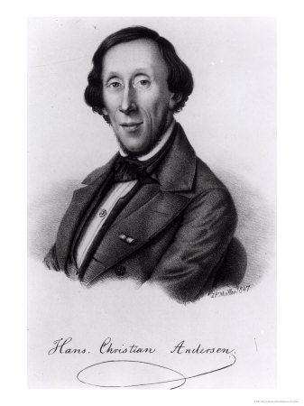
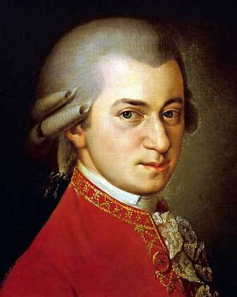
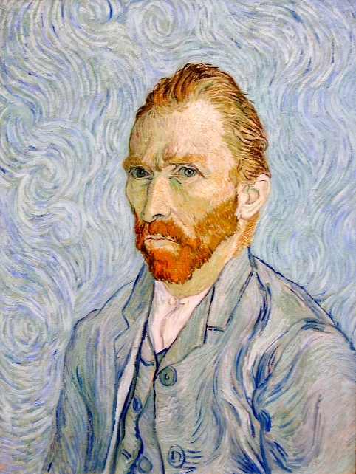
Historic famous people who might have been autistic
Have you heard of these people? It is thought that they had autism too!

Slide 13

Thanks for Taking Part

Slide 14
Activities
True & False Autism Cards
Making a Poster About Autism
Evaluation Sheets

Slide 15
True or False Cards About Autism
Autism is
invisible and no
one can see it?
Autism affects
the way people
think?
People who have
autism can’t do what
other people do?
Autism means that
people have
something wrong
with them?
Autism means that
people might do some
things differently
from me?
Autism means that
people might
have trouble
understanding
other people?

Slide 16
True or False Cards About Autism
People who have
autism have it
all their life?
Autism means
That people will
be really great at
some things?
People who have
autism don’t want to
join in?
Autism means that
making friends might
be difficult?
Autism means
that people won’t
be as clever as
other people?
Autism means that
people won’t be able
to make friends?

Slide 17
Make a Poster About Autism
Use the following pages to make a poster about the things you know about autism.
Autism means that…
People who have autism…
Something you need to know about autism is…
Autism can make people good at…

Slide 18
Get the Idea About Autism?
The Autism Spectrum
The best thing about autism is…
____________________________
____________________________
Top Tips
About
Autism

Slide 19
The Big A Evaluation
My name is
I liked the session about autism
I learned new things about autism
I liked talking to other people about autism
I have changed my mind about autism
I have learned how to be a better friend to someone who has autism
One thing I would like to know more about is…

