Slide 1
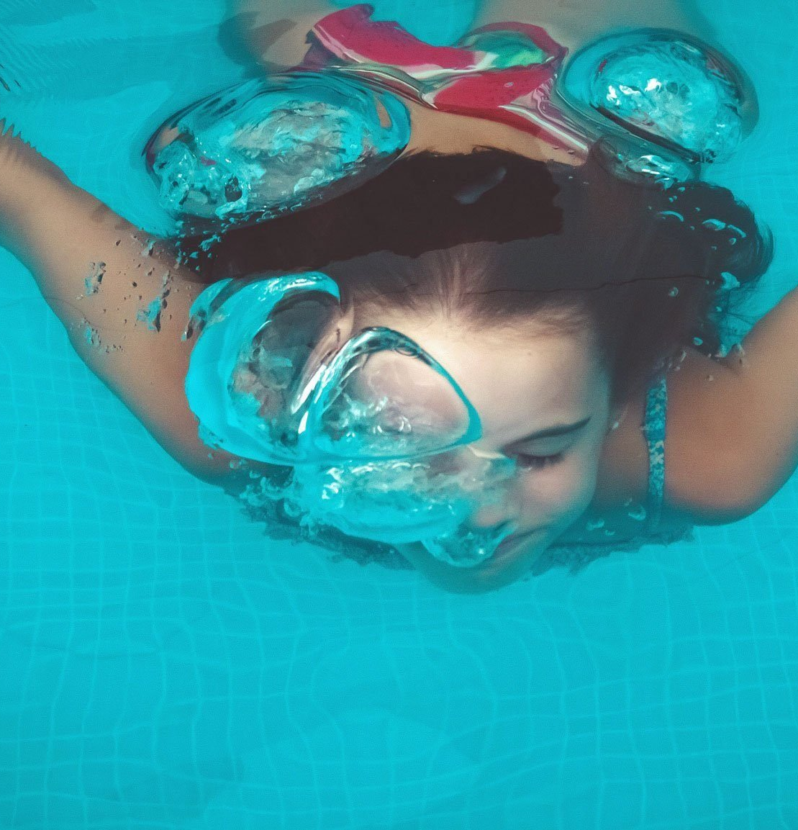
The Sheffield School Swimming Service
Every Sheffield Child a Successful Swimmer
We aim to work with Schools to achieve a shared vision.
Ensuring Children’s’ success is at the heart of everything we do.
Deliver programmes that are high quality, enjoyable, inclusive and rewarding.
Collaborating and responding positively to feedback, lessons learned, ideas and innovations.
Encouraging healthy lifestyle choices and pathways to lifelong participation.
Being accessible and providing value for money locally.

Slide 2
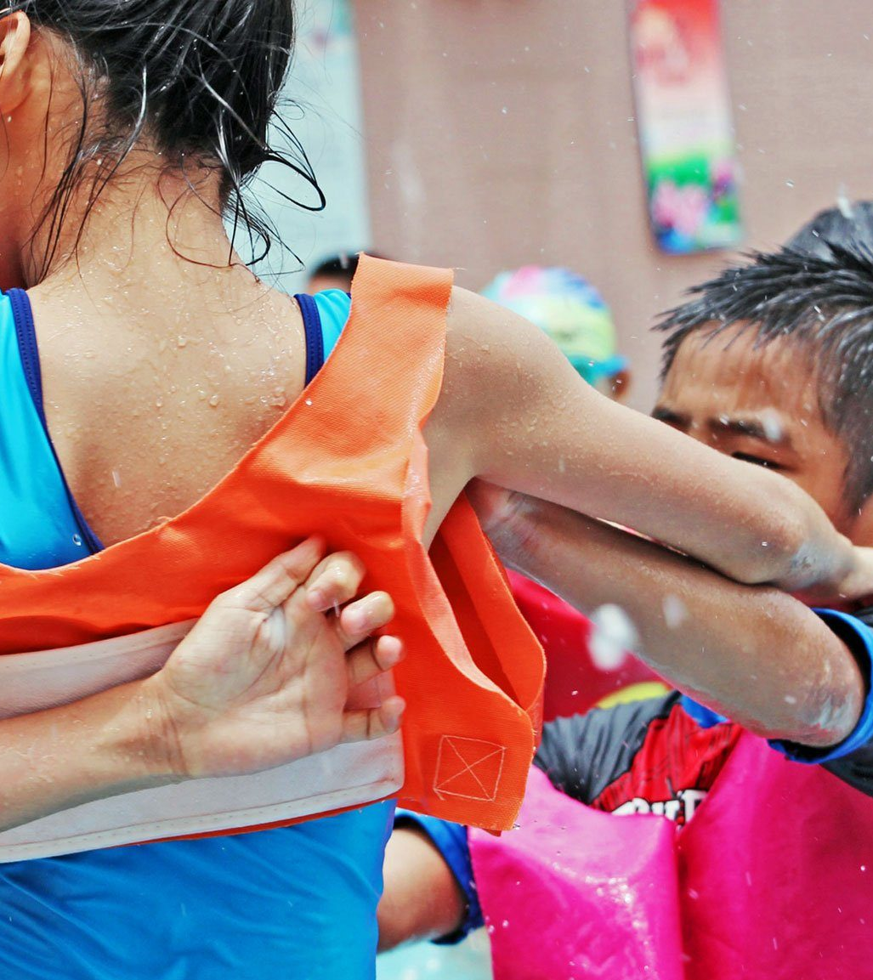
The National Curriculum
‘Since 1994, swimming and water safety has been a statutory element of the national curriculum for physical education in England.
Swimming is the only sport to be included within the national curriculum physical education programme of study.
All primary schools must provide swimming and water safety lessons in either Key Stage 1 or 2. Each pupil is required to be able to achieve the following 3 criteria.’

Slide 3
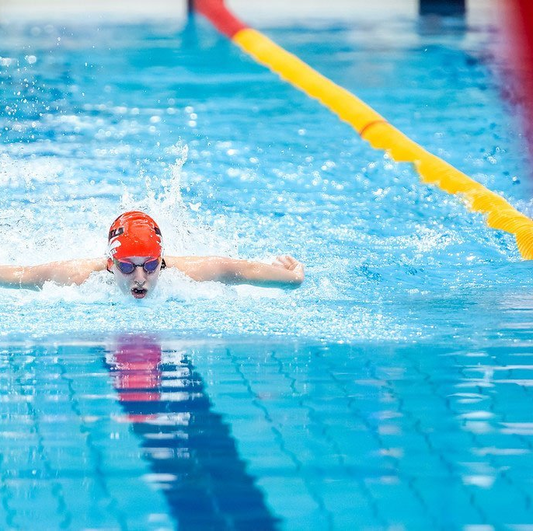



National Curriculum
Swim competently, confidently and proficiently over a distance of at least 25 metres
Perform safe self-rescue in different water based situations
Use a range of strokes effectively, for example, front crawl, backstroke and breaststroke

Slide 4
PUPIL PROGRESS
School Involvement
Time in the Water
Quality of the Lesson

Slide 5
But why is this IMPORTANT…
Drowning is one of the leading causes of accidental death in children in the UK

Slide 6
There are several ways to help your child be successful:
Familiarise pupils with the venue and lesson content by using the video links
Communicate with School. Ask about how your child is progressing and if there is anything you can practice at home or when you go swimming.
Make sure your child has everything they need to take part in their school swimming lessons. Maybe even try everything on so they feel comfortable to do it themselves.
Go swimming as a family before your child starts their lessons
Sign up to swimming lessons and continue these lessons during school swimming.
Practice swimming skills i.e. pointing toes, kicking legs, streamline position, stamina work – do this at home!!!
Helping to grow their water confidence will mean they progress quicker to gain skills that could save their life.
Get them to put their face in water and blow bubbles – Get wet and have FUN!!!
Talk about water safety with your child.

Slide 7
Water Safety
The dangers around water
Help them to make better decisions for their own safety
Know what to do in an emergency
With your help we aim to educate pupils about…
https://www.rlss.org.uk/Pages/Category/water-safety-information

Slide 8



Email: schoolswimming@sheffield.gov.uk
www.sheffieldschoolswimming.co.uk
Rachel Jones: 07896904914
rachel.jones@sheffield.gov.uk
Karen Sales: 07764836181
Karen.sayles@sheffield.gov.uk
Emma Banks: 07761058622
emma.banks@sheffiled.gov.uk
Sheffield School Swimming
@sheffschoolswim

