Slide 1

Art and Design Rationale &
Medium Term Planning
The Brow CP School

Slide 2
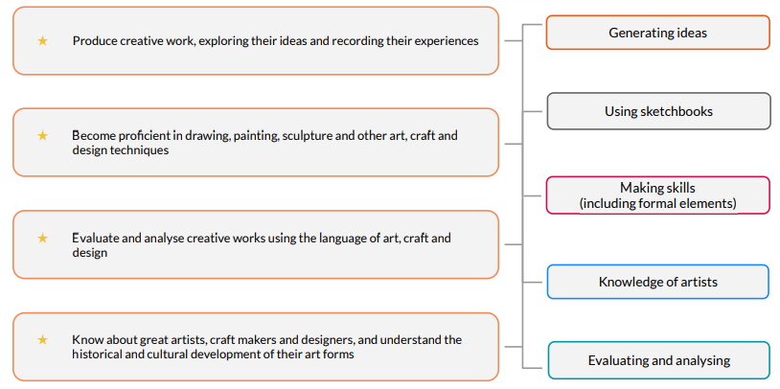
Statutory guidance for Art and design
Our scheme of work fulfils the statutory requirements outlined in the National Curriculum (2014).
The National Curriculum for Art and design aims to ensure that all pupils: Our National curriculum mapping document shows which of Kapow Primary’s units cover each of the National Curriculum Attainment targets as well as each of these five strands. National Curriculum links are also on each individual lesson plan, along with cross-curricular links to other subjects. The Art and design scheme of work has been designed as a spiral curriculum with the following key principles in mind:
Cyclical – pupils return to the key knowledge and skills again and again during their time in primary school.
Increasing depth – each time a skill is revisited, it is covered with greater complexity.
Prior knowledge – pupils build upon previous foundations rather than starting again.
National Curriculum 2014
Five threads

Slide 3
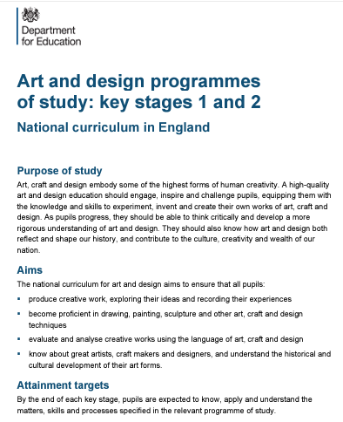
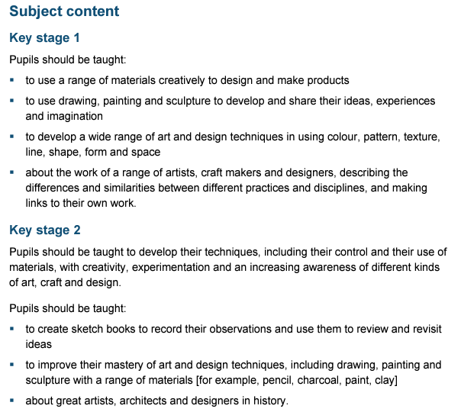
National Curriculum

Slide 4
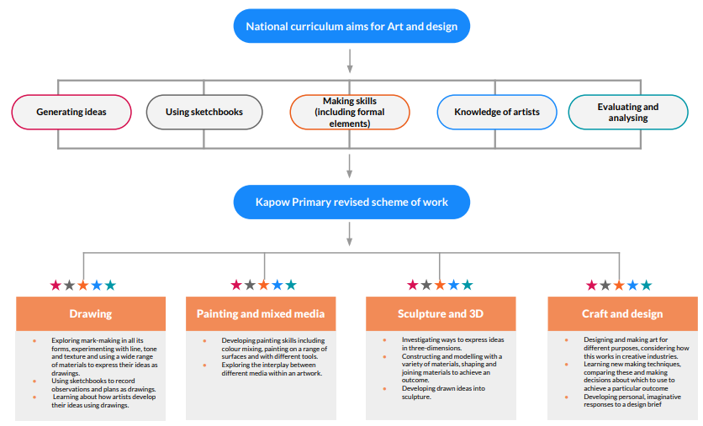
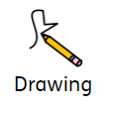
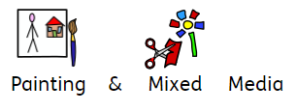
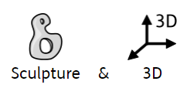
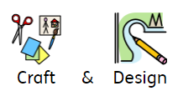

Slide 5
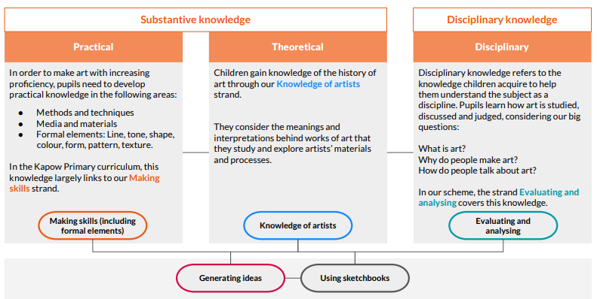
Types of knowledge in Art and design
The three domains of knowledge
Substantive Knowledge : Practical
Substantive Knowledge : Theoretical
Disciplinary Knowledge : Disciplinary
These interplay in all lessons and enable pupils to generate ideas and use sketchbooks to develop their own artistic identity.

Slide 6
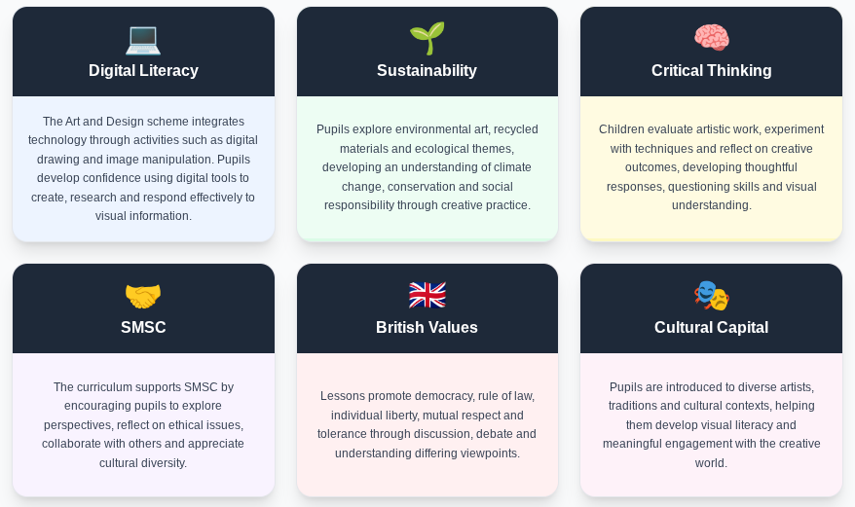

Slide 7
Curriculum organisation: Sequential lessons
The revised Art and design scheme has units divided into four core areas which are repeated in each year group. This provides teachers with greater clarity over knowledge and skills progression within the four areas. Lessons in the Art and Design scheme are sequential, so will be be taught in order. Each lesson builds on the previous one to provide opportunities for children to practice skills and apply their knowledge to consolidate learning.
The school feels confident that children are given opportunities to develop mastery by revisiting core subject knowledge and applying that knowledge practically in a range of contexts with growing complexity.
Broad and Balanced | Outcomes | Application skills and knowledge
The units within our scheme are designed so that children experience the fundamentals of art through broad and balanced units, including exploration of the work of a wide range of artists and makers. Units guide pupils in the skills required to explore, analyse and discuss art. They are encouraged to combine their knowledge of what constitutes ‘art’, specific artists and techniques with their own experiences to evaluate artworks and to inform their own creative practices. Each unit works towards all of the National curriculum attainment targets. This allows pupils to develop their knowledge and skills around the formal elements in a holistic way. | Our scheme encourages autonomy, with a greater emphasis on children developing their creativity through experimentation and individual responses. Units provide flexible options, enabling links to other topics and resulting in more creative outcomes | There is an emphasis on developing children’s use of sketchbooks as visual diaries throughout the scheme to apply skills and knowledge. Lessons provide opportunities to engage with sketchbooks throughout the whole process of creating art, including practising techniques learned as well as developing and evaluating their ideas towards an outcome.

Slide 8

Each year group features: The revised Art and design scheme has units divided into four core areas which are repeated in each year group. This provides teachers with greater clarity over knowledge and skills progression within the four areas.
Lessons in the Art and design scheme are sequential, so will be taught in order. All units contain 5 lessons unless stated otherwise. Each lesson builds on the previous one to provide opportunities for children to practice skills and apply their knowledge to consolidate learning.
Opportunities are planned so the children are given opportunities to develop mastery by revisiting core subject knowledge and applying that knowledge practically in a range of contexts with growing complexity.
EYFS
Year 2
Year 3
Year 4
Year 5
Year 6
Aut 1 | Aut 2 | Spr 1 | Spr 2 | Summ 1 | Summ 2
Painting and Mixed Media Paint my World Autumn Seasonal Craft: Salt Dough Decorations |  | Drawing Marvellous Marks Winter Seasonal Craft: Threading Snowflakes | Craft and Design Let's get Crafty Easter Seasonal Craft: Egg Threading | Sculpture and 3D Creation Station Summer Seasonal Craft: Salt Painting / Sun Catchers
Drawing Exploring line and shape Bridget Riley and Zaria Forman. | Sculpture and 3D Paper Play Louise Bourgeois | HPAN Project | Painting and Mixed Media Colour Splash Clarice Cliff and Jasper Johns. | Craft and Design Woven Wonders Cecilia Vicuña. | Whole school exhibition My Art gallery Linked to other subject drivers
Painting and Mixed Media Life in colour Romare Bearden | Sculpture and 3D Clay Houses Rachel Whiteread | HPAN Project | Drawing Understanding tone and texture | Craft and Design Map it Out | Whole school exhibition My Art gallery Linked to other subject drivers
EYFS
Year 1
Year 2
Year 5
Year 6

Slide 9
Aut 1 | Aut 2 | Spr 1 | Spr 2 | Summ 1 | Summ 2
Sculpture and 3D Abstract Shape and Space Anthony Caro and Ruth Asawa. | Drawing Developing drawing Skills Georgia O’Keefe and Maud Purd | HPAN Project | Painting and Mixed Media Prehistoric Painting | Craft and Design Ancient Scrolls | Whole school exhibition My Art gallery Linked to other subject drivers
Sculpture and 3D Mega Materials Barbara Hepworth and Sokari Douglas-Camp | Painting and Mixed Media Light and Dark | HPAN Project | Drawing Exploring tone, texture and proportion | Craft and Design Fabric of Nature Cecilia Vicuña. | Whole school exhibition My Art gallery Linked to other subject drivers
Sculpture and 3D Interactive Installations | Painting and Mixed Media Portraits | HPAN Project | Drawing Depth, emotion and movement | Craft and Design Architecture Zaha Hadid and Hundertwasser | Whole school exhibition My Art gallery Linked to other subject drivers
Drawing Expressing ideas | Painting and Mixed Media Artist Study | HPAN Project | Drawing Exploring tone, texture and proportion | Sculpture and 3D Making Memories | Whole school exhibition My Art gallery Linked to other subject drivers
Year 3
EYFS
Year 2
Year 3
Year 4
Year 5
Year 6
Year 4
Year 5
Year
Year 6
Year 6

Slide 10
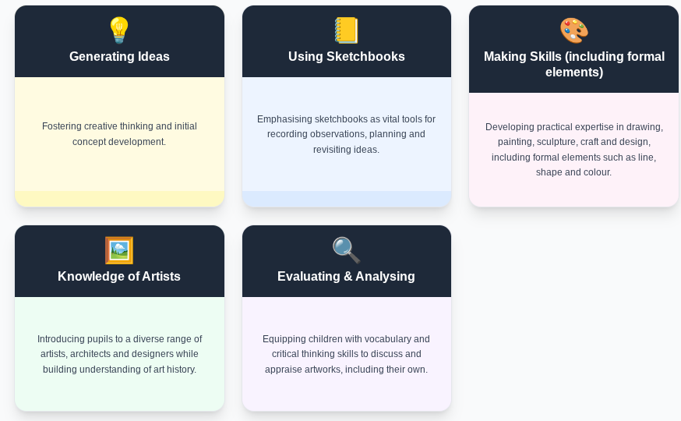
Art & Design Progression of Skills & Knowledge
EYFS • KS1 • KS2
Our scheme of work is built around five strands:

Slide 11
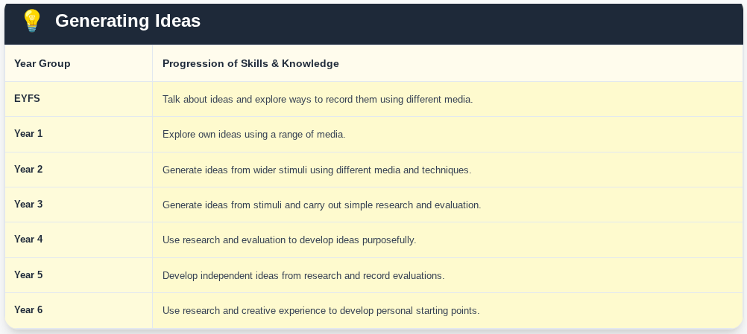
Art & Design Progression of Skills & Knowledge
EYFS • KS1 • KS2

Slide 12
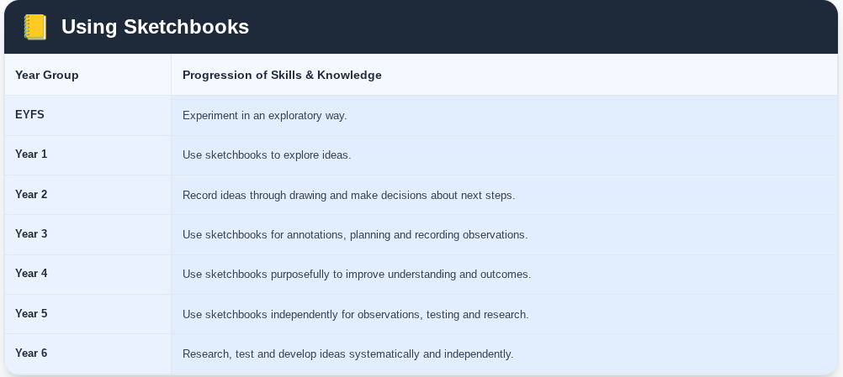

Slide 13
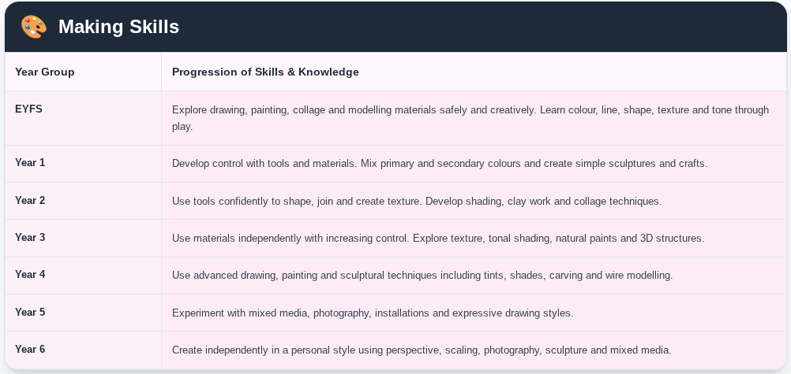

Slide 14
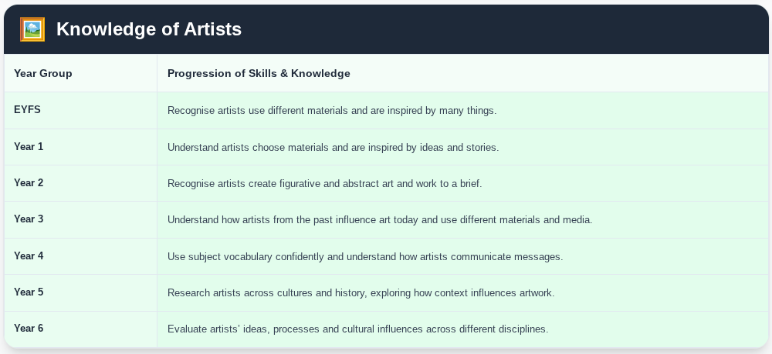

Slide 15
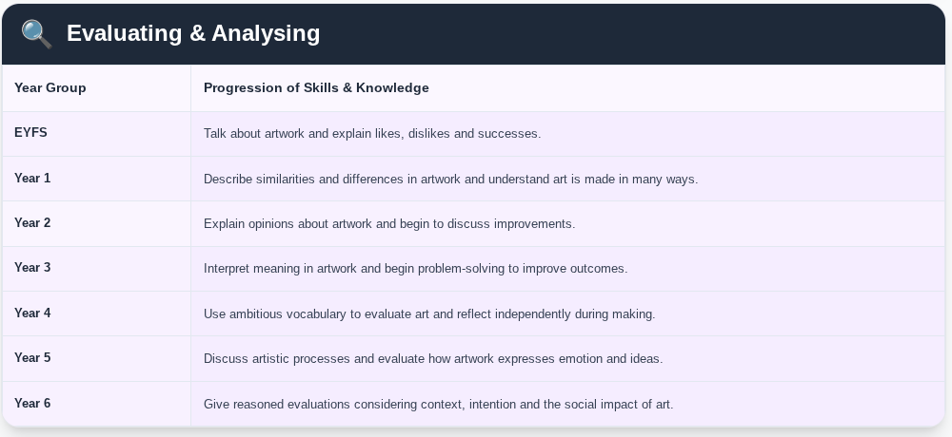

Slide 16
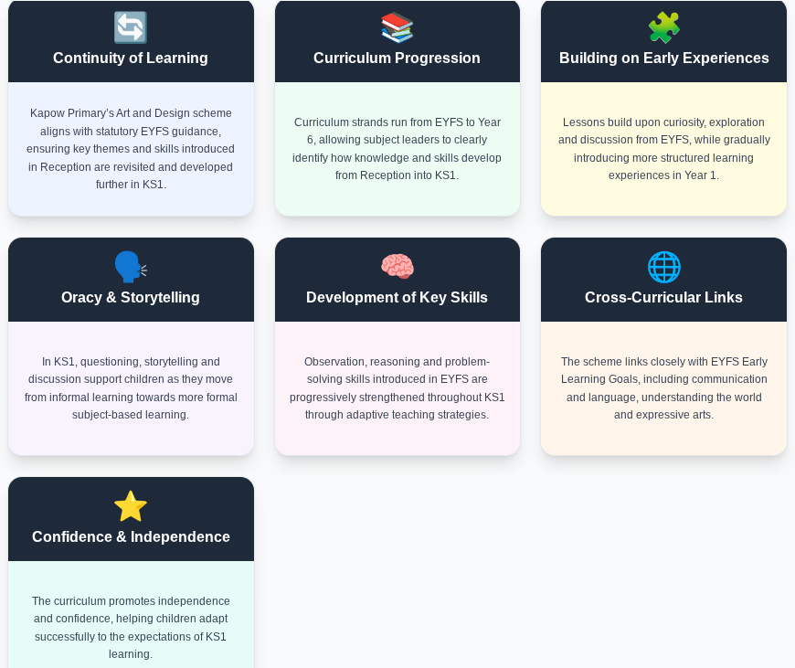
Transition from EYFS to KS1

Slide 17
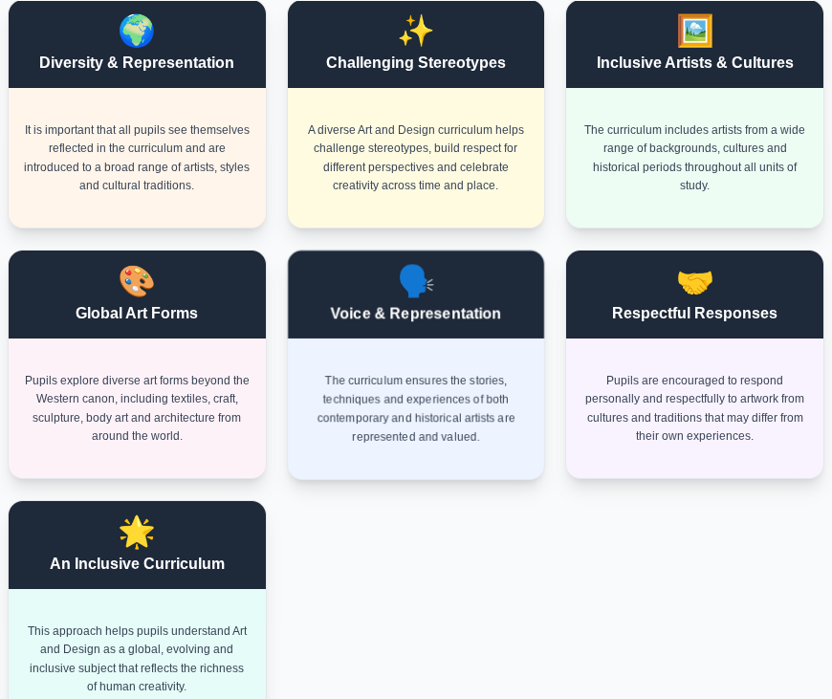
Inclusion and diversity

Slide 18
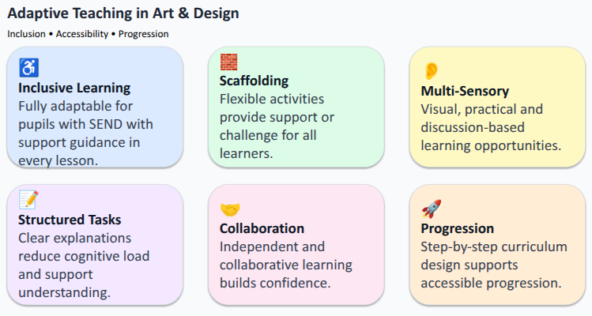

Slide 19
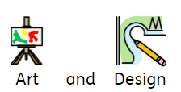
Rationale
In this strand, pupils will be introduced to a range of mark making in various forms and they will learn about line, tone and how to create textures. They will build on previous experiences of drawing tools and medias to express their own ideas and preferences through drawings. The pupils will record their ideas or plans in a sketchbook. They will come to view this as a visual diary, a place where they can develop their own artistic identity.The pupils will learn the importance of their sketchbooks as a fundamental aspect of the knowledge and skills of an artist. They will learn about how artists develop their ideas using drawings and annotations. The pupils will develop their critical thinking skills in line with our curriculum drivers.
Key Threads:
Generating Ideas
Using sketchbooks
Making skills: formal elements
Knowledge of artists
Evaluating and analysing
Curriculum Driver:
Critical Thinking
Cultural Capital

Slide 20
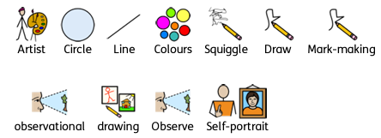
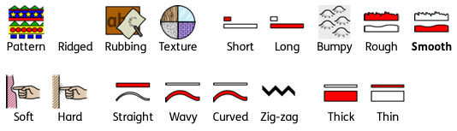
Reception; Spring 1 Marvellous Marks
Key Learning: Skills
Pupils can / will:
Explore making marks with wax crayons.
Investigate the marks and patterns made by different textures.
Explore making marks with felt tips.
Use a felt tip to make patterns with some accuracy
Explore making marks with chalk.
Make controlled large and small drawing movements
Explore mark making using pencils.
Create a simple observational drawings.
Use a variety of colours and materials to create a self-portrait.
Express their own self-image through art.
Vocabulary
Key Learning: Knowledge
Pupils will know/ can explain:
How to create pattern and texture using a crayon.
How to use wax crayons to make marks with accuracy.
How they used felt tips to make marks with some level of accuracy .
How to hold the felt tip using a tripod grip.
Can compare different ways of making marks and drawing. How to make large and small controlled movements using chalk.
Different drawing mediums used and talk about their preferences.
How to use their pencils to make small controlled movements.
The process of using their pencils to draw with a purpose
What an observational drawing is.
Ways they can represent their own self-image through their work and explain why it looks like them.
Why they choose particular colours carefully and talk about their decisions.
8. Pupils know what 'pitch' means.
Artists
Vincent Van Gogh
Hanoch Piven.
Evidence Opportunities/Interview Questions
Tell me about your patterns / textures.
Tell me what would happen if I held my crayon / felt tip like this.
Show me a curved / zigzag pattern.
Tell me about your portrait sketch.

Slide 21
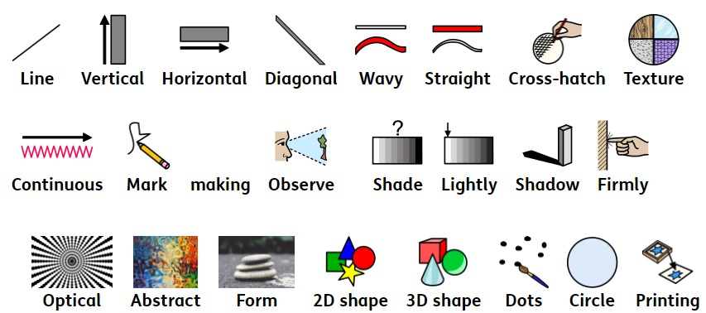
Year 1; Autumn 1 Make your Mark
Key Learning: Skills
Pupils can / will:
Generating ideas: Explore their own ideas using a range of media.
Using sketchbooks: To explore ideas.
Making skills: Develop some control when using a wide range of tools to draw, paint and create crafts and sculptures. Make choices about which materials to use to create an effect. Develop observational skills to look closely and reflect surface texture.
Knowledge of artists: Understand how artists choose materials based on their properties in order to achieve certain effects.
Evaluating and analysing:
Describe and compare features of their own and others’ artwork.
Evaluate art with an understanding of how art can be varied and made in different ways and by different people.
Vocabulary
Key Learning: Knowledge
Pupils will know/ can explain:
Formal elements:
Shape: A range of 2D shapes and confidently draw these.
Line: That drawing tools can be used in a variety of ways to create different lines. How lines can represent movement in drawings.
Texture: That texture means ‘what something feels like’. That different marks can be used to represent the textures of objects. How different drawing tools make different marks.
Making skills: A continuous line drawing is a drawing with one unbroken line. The properties of drawing materials eg; which ones smudge, which ones can be erased, which ones blend. How to hold and use drawing tools in different ways to create different lines and marks.
How to create marks by responding to different stimulus such as music.
How to overlap shapes to create new ones. How to use mark making to replicate texture. How to look carefully to make an observational drawing.
How to complete a continuous line drawing.
Knowledge of artists: Artists choose materials that suit what they want to make.
Evaluating and analysing: Art is made in different ways. That Art is made by all different kinds of people. An artist is someone who creates.
Artists
Renata Bernal
Ilya Bolotowsky
Zaria Forman
Wassily Kandinsky
Bridget Riley
Evidence Opportunities/Interview Questions
Show me some different lines you have drawn.
What drawing media coud I use if I wanted to smudge the line?
What do we call it when two shapes cross over each other?
What is cross hatching? Shoe me an example.
What do we call it when we make lots of different marks in our art?
Describe Bridget Riley’s art work to me?
What do you think an artist is?

Slide 22
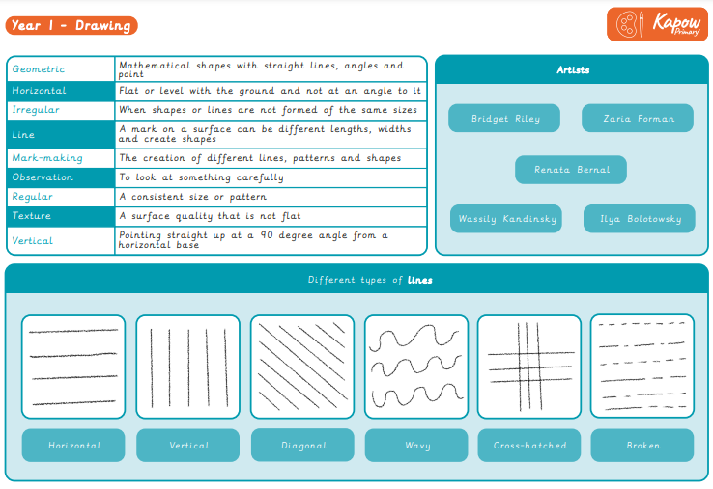

Slide 23
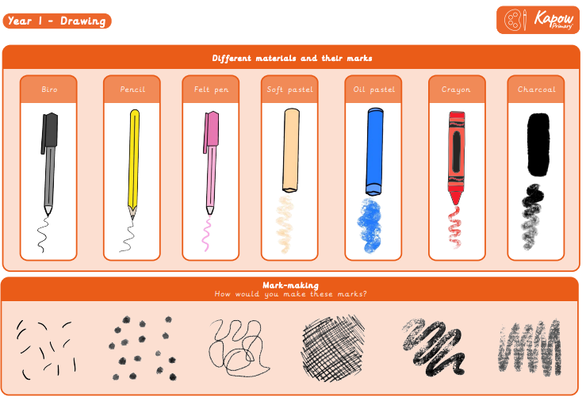

Slide 24
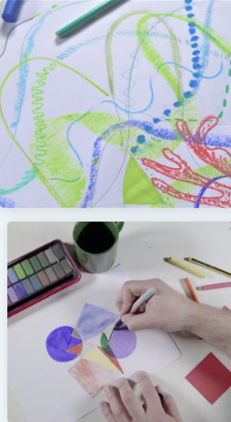
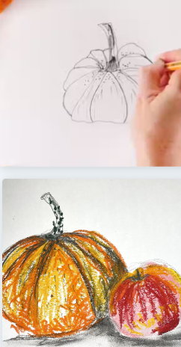
Year 1; Autumn 1 Make your Mark
Unit outcomes
Pupils who are secure will be able to:
Show knowledge of the language and literacy to describe lines.
Show control when using string and chalk to draw lines.
Experiment with a range of mark-making techniques, responding appropriately to music.
Colour neatly and carefully, featuring a range of different media and colours.
Apply a range of marks successfully to a drawing.
Produce a drawing that displays observational skill, experimenting with a range of lines and mark making.

Slide 25
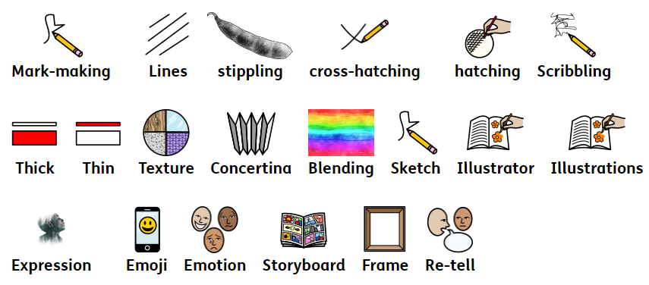
Year 2; Spring 2 Tell a Story
Key Learning: Skills
Pupils can / will:
Generating ideas: begin to generate ideas from a wider range of stimuli, exploring different media and techniques.
Using sketchbooks: Experiment in sketchbooks, using drawing to record ideas.
Making skills: Further demonstrate increased control with a greater range of media. Make choices about which materials and techniques to use to create an effect.
Develop observational skills to look closely and aim to reflect some of the formal elements of art (colour, pattern, texture, line, shape, form and space) in their work.
Knowledge of artists: Talk about art they have seen using some appropriate subject vocabulary.
Apply their own understanding of art materials learnt from artist work to begin purposefully choosing materials for a specific effect.
Evaluating and analysing: Explain their ideas and opinions about their own and others’ artwork, beginning to recognise the stories and messages within in and showing an understanding of why they may have made it.
Begin to talk about how they could improve their own work.
Vocabulary
Key Learning: Knowledge
Pupils will know/ can explain:
Formal elements:
Form: That ‘composition’ means how things are arranged on the page.
Line: Lines can be used to fill shapes, to make outlines and to add detail or pattern.
Pattern: Drawing techniques such as hatching, scribbling, stippling, and blending can make patterns.
Texture: Drawing techniques such as hatching, scribbling, stippling, and blending can create surface texture.
Making skills: How different marks can be used to represent words and sounds. That a combination of materials can achieve the desired effect.
That charcoal is made from burning wood. How to use charcoal to avoid snapping and to achieve different types of lines. How to use different materials and marks to replicate texture. Manipulate materials and surfaces to create textures. Eg scratching or blending with fingers. How to use marks and lines to show expression on faces. How to make a concertina book. How to use drawing to tell a story.
Knowledge of artists: Illustrators use drawn lines to show how characters feel.
Evaluating and analysing: People use art to tell stories. People make art for fun. People make art to help others understand something.
Artists
Quentin Blake
Evidence Opportunities/Interview Questions
What is charcoal?
What drawing effects can you create with charcoal?
Wat do we call it when we create art with dots and dashes – cross hatching or stippling?
Show me how to concertina a piece of paper. Describe what you are doing to the paper.
What is a an illustrator? Tell me about one famous llustrator.

Slide 26
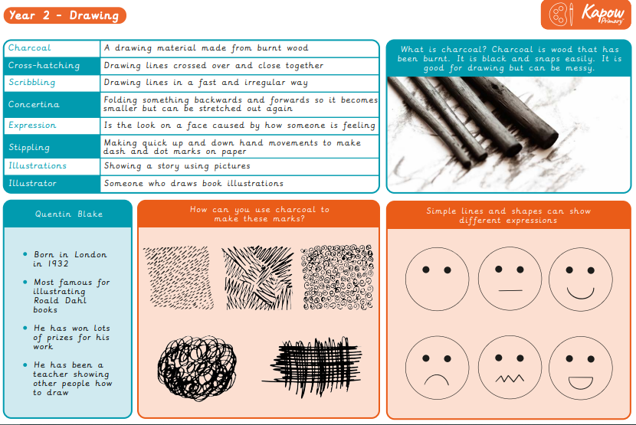

Slide 27
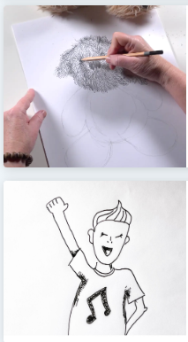
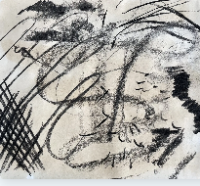
Year 2; Spring 2 Tell a Story
Unit outcomes
Pupils who are secure will be able to:
Suggest ways to draw a word through marks.
Use relevant language to describe how an object feels.
Suggest ways to create different textures through drawn marks.
Freely experiment with different tools, receiving encouragement when needed.
Describe and then draw shapes that make up an object.
Use good observational skills to add details to their drawing.
Use an interesting range of marks that show an understanding of how to draw different textures.
Make sketches, which may be of basic stick-like figures or may imply more shapes.
Develop sketches into a character, with some support, adding details to enhance their character.
Demonstrate an understanding of how drawing facial features in different ways conveys expressions.
Recount a story and select key events to draw.
Create scenes from their own imagination, with some support.

Slide 28
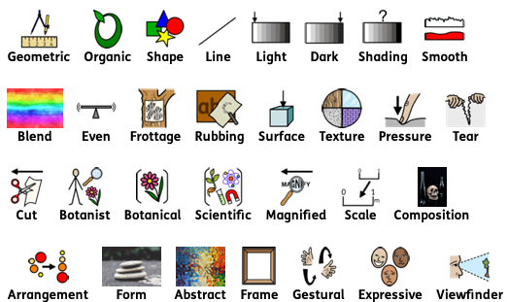
Year 3; Autumn 2 Growing Artists
Key Learning: Skills
Pupils can / will:
Generating ideas: Generate ideas from a range of stimuli and carry out simple research and evaluation as part of the making process.
Using sketchbooks:Use sketchbooks for a wider range of purposes, for example recording things using drawing and annotations, planning and taking next steps in a making process.
Making skills: Confidently use of a range of materials and tools, selecting and using these appropriately with more independence. Use hands and tools confidently to cut, shape and join materials for a purpose. Develop direct observation, for example by using tonal shading and starting to apply an understanding of shape to communicate form and proportion.
Knowledge of artists: Discuss how artists produced art in the past and understand the influence and impact of their methods and styles on art today, using their own experiences and historical evidence.
Evaluating and analysing: Discuss and begin to interpret meaning and purpose of artwork, understanding how artists can use art to communicate.
Key Learning: Knowledge
Pupils will know/ can explain:
Formal elements: Form: Three dimensional forms are either organic (natural) or geometric (mathematical shapes, like a cube).
Line: Using different tools or using the same tool in different ways can create different types of lines.
Pattern: Surface rubbings can be used to add or make patterns.
Texture: Texture in an artwork can be real (what the surface actually feels like) or a surface can be made to appear textured.
Tone: That ‘tone’ in art means ‘light and dark’. Shading helps make drawn objects look realistic. Some basic rules for shading when drawing, eg shade in one direction, blending tones smoothly and with no gaps. Shading is used to create different tones in an artwork and can include hatching, cross-hatching, scribbling and stippling.
Making skills: How to use shapes identified within in objects as a method to draw.
How to create tone by shading, achieve even tones when shading; make texture rubbings ; create art from textured paper and to tear and shape paper.
How to hold and use a pencil to shade and use paper shapes to create a drawing.
How to use drawing tools to take a rubbing.
How to make careful observations to accurately draw an object.an create abstract compositions to draw more expressively.
Knowledge of artists: Artists experiment with different tools and materials to create texture.
Artists can work in more than one medium.
Evaluating and analysing: People use art to help explain or teach things. People make art to explore big ideas, like death or nature.
Artists
Max Ernst
Carl Linnaeus
Georgia O’Keeffe
Maud Purdy
Evidence Opportunities/Interview Questions
How do shapes help us to draw and plan a composition?
How do we hold a pencil when… sketching / shading?
Tell me one of the four rules of shading.
What is frottage? Which famous artists used frottage in his sketching?
What does tone mean?
How would we use a viewfinder?
What is Georgia O’Keffe’s style when creating her flower artwork?

Slide 29
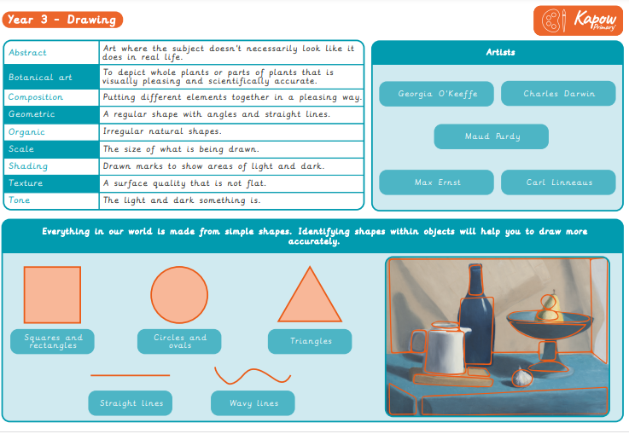

Slide 30
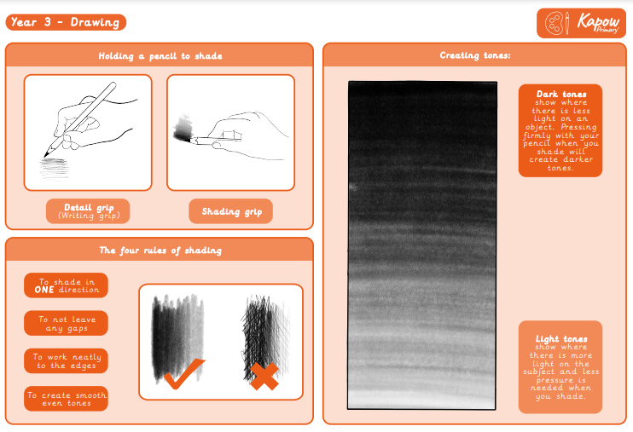

Slide 31
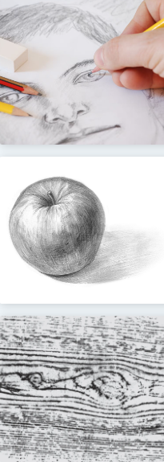
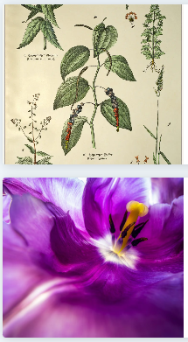
Year 3; Autumn 2 Growing Artists
Unit outcomes
Pupils who are secure will be able to:
Know the difference between organic and geometric shapes.
Use simple shapes to form the basis of a detailed drawing.
Use shading to demonstrate a sense of light and dark in their work.
Shade with a reasonable degree of accuracy and skill.
Blend tones smoothly and follow the four shading rules.
Collect a varied range of textures using frottage.
Use tools competently, being willing to experiment.
Generate ideas mostly independently and make decisions to compose an interesting frottage image.
Make considered cuts and tears to create their ideas.
Understand how to apply tone, with some guidance about where to use it.
Draw a framed selection of an image onto a large scale with some guidance.
Try a range of drawing materials, beginning to demonstrate expressive marks by trying tools in an interesting way.

Slide 32
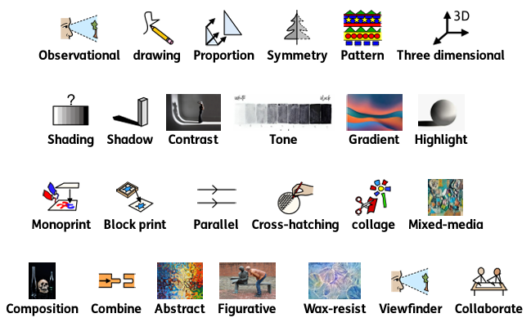
Year 4; Spring 2 Power Prints
Key Learning: Skills
Pupils can / will:
Generating ideas :Generate ideas from a range of stimuli, using research and evaluation of techniques to develop their ideas and plan more purposefully for an outcome.
Using sketchbooks: Use sketchbooks for a wider range of purposes, for example, recording things using drawing and annotations, planning and taking the next steps in a making process.
Making skills: Demonstrate greater skill and control when drawing and painting to depict forms, such as showing an awareness of proportion and being able to create 3D effects. Apply observational skills, showing a greater awareness of composition and demonstrating the beginnings of an individual style.
Knowledge of artists: Use subject vocabulary confidently to describe and compare creative works.
Evaluating and analysing: Use more complex vocabulary when discussing their own and others’ art.
Vocabulary
Key Learning: Knowledge
Pupils will know/ can explain:
Formal elements:
Shape: How to use basic shapes to form more complex shapes and patterns.
Line: Lines can be lighter or darker, or thicker or thinner and that this can add expression or movement to a drawing.
Pattern: Patterns can be irregular and change in ways you wouldn’t expect.
Making skills: How to use pencils of different grades to shade and add tone.
How to hold a pencil with varying pressure to create different marks.
How to use observation and sketch objects quickly. How to draw objects in proportion to each other.
How to use charcoal and a rubber to draw tone.
How to use scissors and paper as a method to ‘draw’.How to make choices about arranging cut elements to create a composition.
How to create a wax resist background. How to use different tools to scratch into a painted surface to add contrast and pattern.
How to choose a section of a drawing to recreate as a print.How to create a monoprint.
Knowledge of artists: Artists choose what to include in a composition, considering both what looks good together and any message they want to communicate.
Evaluating and analysing:
Artists evaluate what they make, and talking about art is one way to do this.
Artists
Fernando Botero
Alberto Giacometti
Henri Matisse
Henry Moore
Ed Ruscha
Georges Seurat
Evidence Opportunities/Interview Questions
What does a pencil grade tell us?
What grades shade darker tones?
What is it called when you draw obects alongisde others in the right size?
Which artists was famous for drawing with scissors?
Explain the steps when creating a wax resist background.
What is the techniqure called when you add detail into a wax resist background?

Slide 33
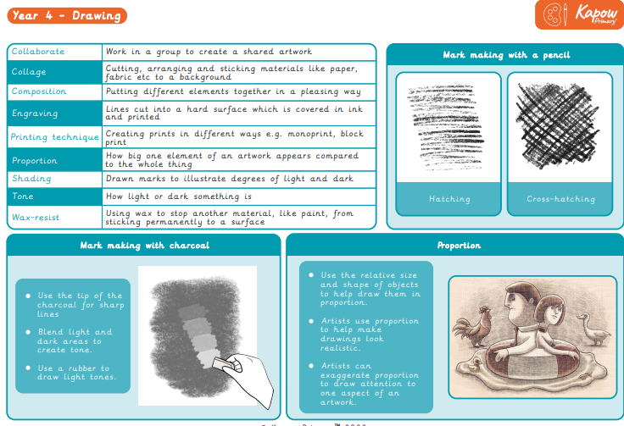

Slide 34
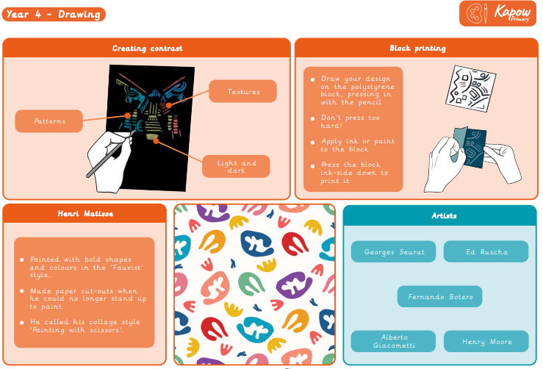

Slide 35
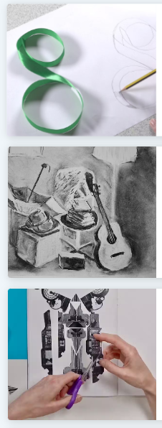
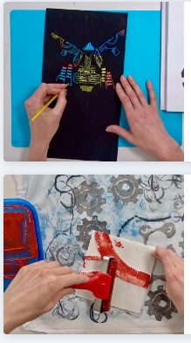
Year 4; Spring 2 Power Prints
Unit outcomes
Pupils who are secure will be able to:
Create several pencil tones when shading and create a simple 3D effect.
Explore the effect of holding a pencil in different ways and applying different pressures.
Use charcoal and rubber to show areas of light and dark in their drawings.
Demonstrate an awareness of the relative size of the objects they draw.
Use scissors with care and purpose to cut out images.
Try out multiple arrangements of cut images to decide on their composition.
Use different tools to create marks and patterns when scratching into a painted surface.
Show some awareness of how to create contrast by including areas with more and less marks.
Create an interesting finished drawing based on their original composition, including detail such as contrast and pattern.
Work co-operatively to create a joint artwork, experimenting with their methods.

Slide 36
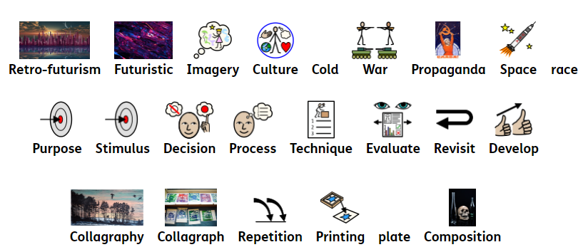
Year 5; Spring 2 I need Space
Key Learning: Skills
Pupils can / will:
Generating ideas: Develop ideas more independently from their own research. Explore and record their plans, ideas and evaluations to develop their ideas towards an outcome.
Using sketchbooks :Confidently use sketchbooks for purposes including recording observations and research, testing materials and working towards an outcome more independently.
Making skills: Work with a range of media with control in different ways to achieve different effects, including experimenting with the techniques used by other artists. Combine a wider range of media, e.g. photography and digital art effects. Create in a more sustained way, revisiting artwork over time and applying their understanding of tone, texture, line, colour and form.
Knowledge of artists: Research and discuss the ideas and approaches of artists across a variety of disciplines, being able to describe how the cultural and historical context may have influenced their creative work. Discuss how artists create work with the intent to create an impact on the viewer. Consider what choices can be made in their own work to impact their viewer.
Evaluating and analysing: Discuss the processes used by themselves and by other artists, and describe the particular outcome achieved. Use their knowledge of tools, materials and processes to try alternative solutions and make improvements to their work. Demonstrate growing independence, discussing ways to improve work.
Vocabulary
Key Learning: Knowledge
Pupils will know/ can explain:
Formal elements:
Shape: Shapes can be used to place the key elements in a composition.
Line: Lines can be used by artists to control what the viewer looks at within a composition, eg by using diagonal lines to draw your eye into the centre of a drawing.
Texture: How to create texture on different materials.
Making skills: To know what print effects different materials make.
How to analyse an image that considers impact, audience and purpose.
How to draw the same image in different ways with different materials and techniques.How to make a collagraph plate. How to make a collagraph print.How to develop drawn ideas for a print.
How to combine techniques to create a final composition. How to decide what materials and tools to use based on experience and knowledge.
Knowledge of artists: Artists are influenced by what is going on around them; for example, culture, politics and technology. Artists ‘borrow’ ideas and imagery from other times and cultures to create new artworks. Artists can choose their medium to create a particular effect on the viewer. Artists can combine materials; for example, digital imagery, with paint or print.
Evaluating and analysing: People make art to fit in with popular ideas or fashions.
People can explore and discuss art in different ways, for example, by visiting galleries, discussing it, writing about it, using it as inspiration for their own work or sharing ideas online. Talking about plans for artwork, or evaluating finished work, can help improve what artists create.
Artists
Teis Albers
Karen Rose
Evidence Opportunities/Interview Questions
What is retro-futurism?
What drawing materials or techniques would you use to create a piece of retrofuturistic art?
Show me where you have used the collography printing technique.
What is special about this printing technique?
Who created the artwork, Moonwalk?
What is the purpose of the sace race posters?

Slide 37
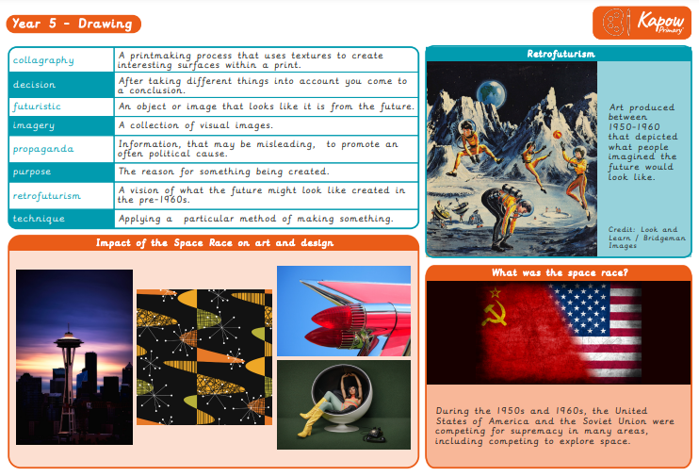

Slide 38
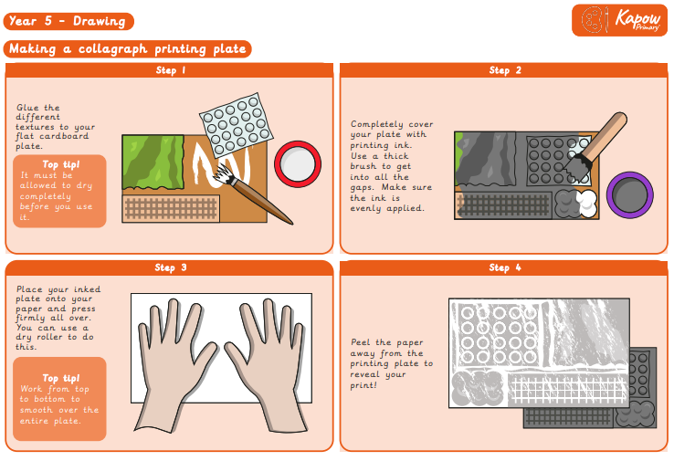

Slide 39
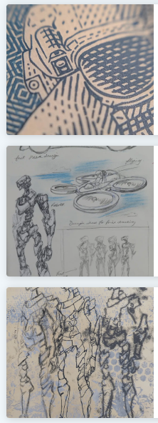
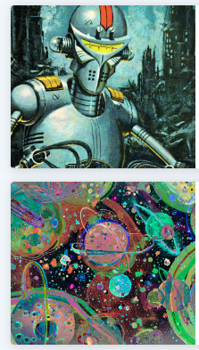
Year 5; Spring 2 I need Space
Unit outcomes
Pupils who are secure will be able to:
Understand and explain what retrofuturism is.
Participate in discussions and offer ideas.
Evaluate images using simple responses, sometimes using formal elements to extend ideas.
Provide plausible suggestions for how a piece was created.
Comfortably use different stimuli to draw from.
Use past knowledge and experience to explore a range of drawing processes.
Select and place textures to create a collagraph plate, applying an understanding of the material, which may be supported by testing.
Create a selection of drawings and visual notes that demonstrate their ideas using sketchbooks.
Generate a clear composition idea for a final piece that shows how it will be drawn.
Apply confident skills to make an effective collagraph print.
Independently select tools and drawing techniques, with some guidance.
Demonstrate growing independence, discussing ways to improve work.

Slide 40
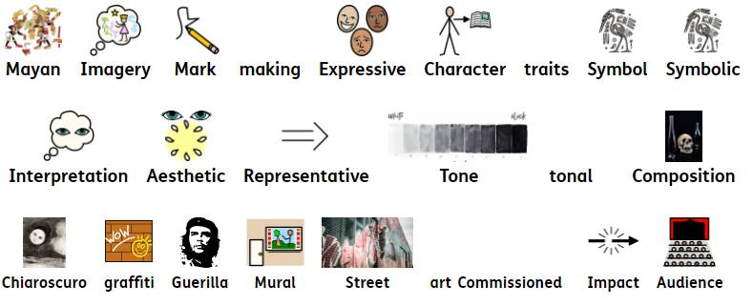
Year 6; Autumn 1 Make My Voice Heard
Key Learning: Skills
Pupils can / will:
Generating ideas:
Draw upon their experience of creative work and their research to develop their own starting points for creative outcomes.
Using sketchbooks:
Using a systematic and independent approach, research, test and develop ideas and plans using sketchbooks.
Making skills: Create expressively in their own personal style and in response to their choice of stimulus, showing the ability to develop artwork independently. Combine materials and techniques appropriate to fit with ideas. Work in a sustained way over several sessions to complete a piece, including working collaboratively on a larger scale and incorporating the formal elements of art.
Knowledge of artists: Describe, interpret and evaluate the work, ideas and processes used by artists across a variety of disciplines, being able to describe how the cultural and historical context may have influenced their creative work.
Evaluating and analysing: Give reasoned evaluations of their own and others’ work which takes account of context and intention. Discuss how art is sometimes used to communicate social, political, or environmental views. Explain how art can be created to cause reaction and impact and be able to consider why an artist chooses to use art in this way. Independently use their knowledge of tools, materials and processes to try alternative solutions and make improvements to their work.
.
Vocabulary
Key Learning: Knowledge
Pupils will know/ can explain:
Formal elements:
Colour: A ‘monochromatic’ artwork uses tints and shades of just one colour. Colours can be symbolic and have meanings that vary according to your culture or background, eg red for danger or for celebration.
Form: The surface textures created by different materials can help suggest form in two-dimensional art work.
Shape: How an understanding of shape and space can support creating effective composition.
Line: How line is used beyond drawing and can be applied to other art forms.
Tone: That chiaroscuro means ‘light and dark’ and is a term used to describe high-contrast images.
Making skills: To know gestural and expressive ways to make marks. To know the effects different materials make. To know the effects created when drawing on different surfaces. How to use symbolism as a way to create imagery. How to combine imagery into unique compositions. How to achieve the tonal technique called chiaroscuro. How to make handmade tools to draw with. How to use charcoal to create chiaroscuro effects.
Knowledge of artists: Artists can use symbols in their artwork to convey meaning. Sometimes artists add extra meaning to what they create by working in places where they don’t have permission to work. Artists find inspiration in other artists’ work, adapting and interpreting ideas and techniques to create something new. Art can be a form of protest. Artists use art to tell stories about things that are important to them; looking at artworks from the past can reveal thoughts and opinions from that time. Art sometimes creates difficult feelings when we look at it. Artists use techniques like chiaroscuro to create dramatic light and shade when drawing or painting.
Evaluating and analysing: Art doesn’t have to be a literal representation of something, it can sometimes be imagined and abstract.Art can represent abstract concepts, like memories and experiences. Sometimes people make art to express their views and opinions, which can be political or topical. Sometimes people make art to create reactions. People use art as a means to reflect on their unique characteristics. People can have varying ideas about the value of art. Art can be analysed and interpreted in lots of ways and can be different for everyone. Everyone has a unique way of experiencing art.
Artists
Banksy
Dan Fenelon
Diego Rivera
Leonardo Da Vinci
Evidence Opportunities/Interview Questions
Which Mexican artist was inspired by the Maya civilixation?
What does symbolic mean?
What italian term means light and dark?
Which artist is famous for using chiaroscuro in his artwork.
What is a mural?
What type of street art is considered illegal?

Slide 41
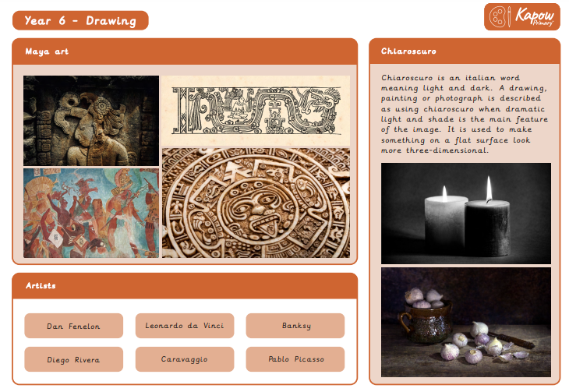

Slide 42
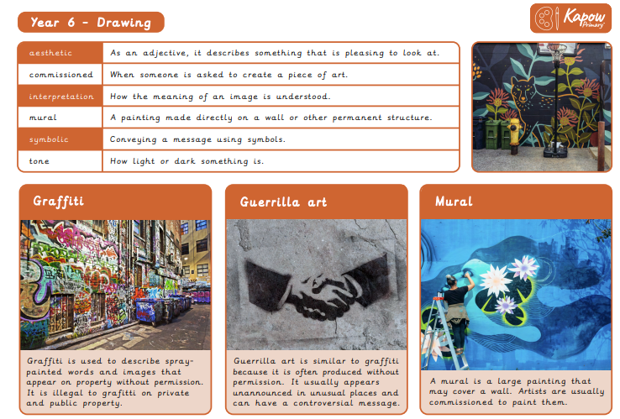

Slide 43
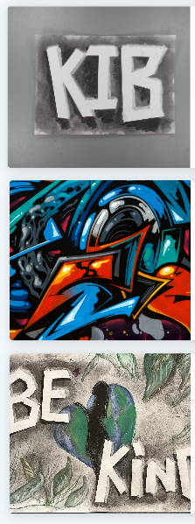

Year 6; Autumn 1 Make My Voice Heard
Unit outcomes
Pupils who are secure will be able to:
Collect a good range of imagery, adding annotated notes and sketches.
Make relevant comparisons between different styles of art.
Use tools effectively to explore a range of effects.
Respond to the meaning of a spirit animal through drawing.
Generate symbols that reflect their likes and dislikes with little support.
Create a tile that is full of pattern, symbols and colours that represents themselves.
Discuss ideas to create light and dark through drawing techniques.
Explain the term chiaroscuro.
Apply chiaroscuro to create light and form through a tonal drawing.
Understand the impact of using techniques for effect.
Participate in a discussion that examines the similarities and differences between different styles of art.
Form their own opinions about what art is, justifying their ideas.
Identify a cause and decide what message they want to convey.
Understand artist’s choices to convey a message.
Review sketchbook and creative work to develop a drawn image.
Review and revisit ideas to develop their work.

Slide 44
Rationale
In this concept, the children will be introduced to a range of painting skills which includes colour mixing, painting using different tools and painting on a range of surfaces. They will explore the interplay between different medias within an artwork. They will learn how famous artists use paint for colour choice, creating texture and when creating contrasts. They will compare different practices and disciplines making links to their own pieces of artwork. Children will develop their critical thinking skills in line with our curriculum drivers.
Key Concepts:
Generating Ideas
Using sketchbooks
Making skills: formal elements
Knowledge of artists
Evaluating and analysing
Curriculum Driver:
Critical Thinking
Cultural Capital

Slide 45

Reception; Autumn Colour Splash
Key Learning: Skills
Pupils can / will:
Explore paint through finger painting.
Describe the texture and colours of paint they choose.
To talk about their work
Create natural paintbrushes using found objects.
Use natural paint brushes and mud paint to create artwork.
Respond to music through the medium of paint.
Use paint to express ideas and feelings.
Make a child-led collages using mixed media.
Use loose parts to create a piece of transient art.
Create landscape collages inspired by the work of an artist.
Work collaboratively to create a large piece of group artwork based around fireworks.
Experiment with colour, design and painting techniques.
Vocabulary
Key Learning: Knowledge
Pupils will know/ can explain:
Whether their art it is abstract or figurative
How to use the paints to make a finger painting. What textures, feelings and colours they have used.
How to use natural objects to make a paintbrush
How to change the thickness and consistencies of (mud) paints.
How they have made the marks with the mud or observations about the process.
How they created their work. Which areas of their work influenced by different sections of the music.
Know that transient art is not fixed or permanent.
Which tools can be used to cut and stick mixed media to make a collage.
How they made considered selections when creating their transient art piece.
What some of the main features are of Megan Coyle’s work?
How their work is different to the photograph.
Which paint techniques they used when creating? How they achieved certain effects?
Artists
Megan Coyle
Evidence Opportunities/Interview Questions
I wonder what will happen if we mix these two colours?
I love that pattern. Can you tell or show me how you did it?
Name something I can paint with outside that is not paint.
What is collage? How is collage different to transient art?

Slide 46

Year 1; Spring 2 Colour Splash
Key Learning: Skills
Pupils can / will:
Generating ideas: Explore their own ideas using a range of media.
Using sketchbooks: Use sketchbooks to explore ideas.
Making skills: Develop some control when using a wide range of tools to draw, paint and create crafts and sculptures. Make choices about which materials to use to create an effect.
Knowledge of artists: Understand how artists choose colours and mix colours in order to achieve certain effects.
Evaluating and analysing: Describe and compare features of their own and others’ artwork.
Evaluate art with an understanding of how art can be varied and made in different ways and by different people.
Vocabulary
Key Learning: Knowledge
Pupils will know/ can explain:
Formal elements:
Colour: Know that the primary colours are red, yellow and blue.
Colour: Know primary colours can be mixed to make secondary colours:
  Red + yellow = orange
  Yellow + blue = green
  Blue + red = purple
Pattern: Know a pattern is a design in which shapes, colours or lines are repeated. Tone: Know that there are many different shades (or ‘hues’) of the same colour. Tone: Know that changing the amount of the primary colours mixed affects the shade of the secondary colour produced.
Making skills:
How to combine primary coloured materials to make secondary colours : How to mix secondary colours in paint. How to make a paint colour darker or lighter (creating shades) in different ways eg. adding water, adding a lighter colour.
How to choose suitable sized paint brushes.
How to clean a paintbrush to change colours.
How to print with objects, applying a suitable layer of paint to the printing surface.
How to overlap paint to mix new colours.
How to use blowing to create a paint effect.
Evaluating and analysing: Art is made in different ways. Art is made by all different kinds of people. An artist is someone who creates.
Artists
Clarice Cliff
Jasper Johns
Evidence Opportunities/Interview Questions
What are the three primary colours?
If I mix these two primary colours what new colour will I create?
What do we call the colours when we mix two together?
What is a hue / shade?
Show me a piece of work where you have used overlapping.
What else could I use to achieve a paint affect if I did not have a paintbrush.

Slide 47


Slide 48


Slide 49

Year 1; Spring 2 Colour Splash
Unit outcomes
Pupils who are secure will be able to:
Name the primary colours.
Explore coloured materials to mix secondary colours.
Mix primary colours to make secondary colours.
Apply paint consistently to their printing materials to achieve a print.
Use a range of colours when printing.
Mix five different shades of a secondary colour.
Decorate their hands using a variety of patterns.
Mix secondary colours with confidence to paint a plate.
Describe their finished plates.

Slide 50

Year 2; Autumn 1 Life in Colour
Key Learning: Skills
Pupils can / will:
Generating ideas: Begin to generate ideas from a wider range of stimuli, exploring different media and techniques.
Making skills:Further demonstrate increased control with a greater range of media. Make choices about which materials and techniques to use to create an effect. Use hands and tools with confidence when cutting, shaping and joining paper, card and malleable materials. Develop observational skills to look closely and aim to reflect some of the formal elements of art (colour, pattern, texture, line, shape, form and space) in their work.
Knowledge of artists: Talk about art they have seen using some appropriate subject vocabulary. Apply their own understanding of art materials learnt from artist work to begin purposefully choosing materials for a specific effect.
Evaluating and analysing: Explain their ideas and opinions about their own and others’ artwork, beginning to recognise the stories and messages within in and showing an understanding of why they may have made it. Begin to talk about how they could improve their own work. Talk about how art is made.
Vocabulary
Key Learning: Knowledge
Pupils will know/ can explain:
Formal elements:
Colour: Different amounts of paint and water can be used to mix hues of secondary colours. Colours can be mixed to ‘match’ real life objects or to create things from your imagination. Form: That ‘composition’ means how things are arranged on the page.
Shape: Collage materials can be shaped to represent shapes in an image.
Pattern: Patterns can be used to add detail to an artwork.
Texture: Collage materials can be chosen to represent real-life textures. Collage materials can be overlapped and overlaid to add texture. Drawing techniques such as hatching, scribbling, stippling, and blending can create surface texture. Painting tools can create varied textures in paint. Tone: Different amounts of paint and water can be used to mix hues of secondary colours.
Making skills: How to mix a variety of shades of a secondary colour. How to make choices about amounts of paint to use when mixing a particular colour. How to match colours seen around them.How to create texture using different painting tools. How to make textured paper to use in a collage. How to choose and shape collage materials eg cutting, tearing.
Knowledge of artists:Some artists create art to make people aware of good and bad things happening in the world around them. Art can be figurative or abstract.Artists try out different combinations of collage materials to create the effect they want.
Evaluating and analysing: People use art to tell stories. People make art about things that are important to them. People make art to share their feelings and help others understand something.
Artists
Romare Bearden
Evidence Opportunities/Interview Questions
Which of these colours is not a secondary colour – orange, purple, red.
Which word would we use to describe how a surface feels?
Which painting tools would help you to create texture?
Finish this sentece, Collage is …..
Name an artist that uses collage as their main artistic media.
What is the difference between figurative and abstract art?

Slide 51


Slide 52


Slide 53

Year 3; Spring 2 Prehistoric Painting
Key Learning: Skills
Pupils can / will:
Generating ideas: Generate ideas from a range of stimuli and carry out simple research and evaluation as part of the making process.
Using sketchbooks: Use sketchbooks for a wider range of purposes, for example recording things using drawing and annotations, planning and taking next steps in a making process.
Making skills: tonal shading and starting to apply an understanding of shape to communicate form and proportion. Confidently use a range of materials and tools, selecting and using these appropriately with more independence.
Knowledge of artists: Discuss how artists produced art in the past and understand the influence and impact of their methods and styles on art today, using their own experiences and historical evidence. Understand the limitations of tools and materials and be able to experiment within more than one medium and with tools to create textural effects.
Evaluating and analysing: Confidently explain their ideas and opinions about their own and others’ artwork, with an understanding of the breadth of what art can be and that there are many ways to make art. Discuss and begin to interpret meaning and purpose of artwork, understanding how artists can use art to communicate.
Key Learning: Knowledge
Pupils will know/ can explain:
Formal elements:
Colour: Paint colours can be mixed using natural substances, and that prehistoric peoples used these paints.
Shape: Negative shapes show the space around and between objects.
Line: Using different tools or using the same tool in different ways can create different types of lines.
Texture: Texture in an artwork can be real (what the surface actually feels like) or a surface can be made to appear textured.
Making skills: How to use simple shapes to scale up a drawing to make it bigger.
How to make a cave wall surface and paint on a rough surface.
How to make a negative and positive image. How to create a textured background using charcoal and chalk.
How to use natural objects to make tools to paint with. How to make natural paints using natural materials. How to create different textures using different parts of a brush. How to use colour mixing to make natural colours.
Knowledge of artists: Art from the past can give us clues about what it was like to live at that time. Artists have different materials available to them depending on when they live in history. Artists can make their own tools. Artists experiment with different tools and materials to create texture. Artists make decisions about how their work will be displayed.
Evaluating and analysing: Artists make art in more than one way. People use art to tell stories and communicate. People use art to help explain or teach things. One artwork can have several meanings.
Evidence Opportunities/Interview Questions
Why were coloured paints limited in pre-historic times?
Name 3 materials that could be used to create art in prehistoric times.
Name a colour that would not have been easy to mix in prehistoric times.
What is a pigment?
What happens to paint if you add more water?
When you make a drawing bigger, this is called…?

Slide 54


Slide 55


Slide 56

Year 3; Spring 2 Prehistoric Painting
Unit outcomes
Pupils who are secure will be able to:
Recognise the processes involved in creating prehistoric art.
Explain approximately how many years ago prehistoric art was produced.
Use simple shapes to build initial sketches.
Create a large scale copy of a small sketch.
Use charcoal to recreate the style of cave artists.
Demonstrate good understanding of colour mixing with natural pigments.
Discuss the differences between prehistoric and modern paint.
Make choices about equipment or paint to recreate features of prehistoric art, experimenting with colours and textures.
Successfully make positive and negative handprints in a range of colours.
Apply their knowledge of colour mixing to make natural colours.

Slide 57

Year 4; Autumn 2 Light and Dark
Key Learning: Skills
Pupils can / will:
Generating ideas: Generate ideas from a range of stimuli, using research and evaluation of techniques to develop their ideas and plan more purposefully for an outcome.
Using sketchbooks: Use sketchbooks for a wider range of purposes, for example, recording things using drawing and annotations, planning and taking the next steps in a making process.
Making skills: Demonstrate greater skill and control when drawing and painting to depict forms, such as showing an awareness of proportion and being able to create 3D effects.
Apply observational skills, showing a greater awareness of composition and demonstrating the beginnings of an individual style.
Knowledge of artists: Use subject vocabulary confidently to describe and compare creative works. Understand how artists use art to convey messages through the choices they make.
Evaluating and analysing :Use more complex vocabulary when discussing their own and others’ art. Discuss art, considering how it can affect the lives of the viewers or users of the piece. Evaluate their work more regularly and independently during the planning and making process.
Vocabulary
Key Learning: Knowledge
Pupils will know/ can explain:
Formal elements:
Colour: Adding black to a colour creates a shade.
Colour: Adding white to a colour creates a tint.
Form: Using lighter and darker tints and shades of a colour can create a 3D effect.
Tone: Using lighter and darker tints and shades of a colour can create a 3D effect.
Tone: Tone can be used to create contrast in an artwork.
Making skills:
How to mix a tint and a shade by adding black or white.
How to use tints and shades of a colour to create a 3D effect when painting.
How to apply paint using different techniques e.g. stippling, dabbing, washing.
How to choose suitable painting tools.
How to arrange objects to create a still-life composition.
How to plan a painting by drawing first.
How to organise painting equipment independently, making choices about tools and materials.
Evaluating and analysing:
Artists make choices about what, how and where they create art.
Artworks can fit more than one genre.
Art is influenced by the time and place it was made, and this affects how people interpret it.
Artists may hide messages or meaning in their work.
Artists
Audrey Flack
Clara Peeters
Georges Seurat
Evidence Opportunities/Interview Questions
How do you make a shade of a colour?
How do you make a tinit of a colour?
Why do artists use tints and shades in heir paintings?
Describe what the stipplinng process is when painting.
What paiting technique didthe artits Georges Seurat use in his paitings?
Composition means …?

Slide 58


Slide 59


Slide 60


Year 4; Autumn 2 Light and Dark
Unit outcomes
Pupils who are secure will be able to:
Share their ideas about a painting.
Describe the difference between a tint and a shade.
Mix tints and shades by adding black or white paint.
Discuss their real-life experiences of how colours can appear different.
Use tints and shades to paint an object in 3D.
Try different arrangements of objects for a composition, explaining their decisions.
Produce a clear sketch that reflects the arrangement of their objects.
Create a final painting that shows an understanding of how colour can be used to show light and dark, and therefore show three dimensions.
Paint with care and control to make a still life with recognisable objects.

Slide 61

Year 5; Autumn 2 Portraits
Key Learning: Skills
Pupils can / will:
Generating ideas: Develop ideas more independently from their own research. Explore and record their plans, ideas and evaluations to develop their ideas towards an outcome.
Using sketchbooks: Confidently use sketchbooks for purposes including recording observations and research, testing materials and working towards an outcome more independently.
Making skills: Work with a range of media with control in different ways to achieve different effects, including experimenting with the techniques used by other artists. Combine a wider range of media, e.g. photography and digital art effects.
Create in a more sustained way, revisiting artwork over time and applying their understanding of tone, texture, line, colour and form.
Knowledge of artists: Research and discuss the ideas and approaches of artists across a variety of disciplines, being able to describe how the cultural and historical context may have influenced their creative work. Discuss how artists create work with the intent to create an impact on the viewer. Consider what choices can be made in their own work to impact their viewer.
Evaluating and analysing: Discuss the processes used by themselves and by other artists, and describe the particular outcome achieved. Use their knowledge of tools, materials and processes to try alternative solutions and make improvements to their work.
Vocabulary
Artists
Chila Kumari Singh Burman
Derek O Boateng
Njideka Akunyili Crosby
Vincent van Gogh
Frida Kahlo
Evidence Opportunities/Interview Questions
What is a portrait?
When an artists makes a drawing of theself – what is this called?
What does mixed media mean?
What materials does the artist Chila Kumari Burman use to make mixed media artwork?
What can colour choices represent in a self portrait?
How could you use a photoraph in a mixed media self portrait?
Key Learning: Knowledge
Pupils will know/ can explain:
Formal elements:
Colour: Artists use colour to create an atmosphere or to represent feelings in an artwork, for example by using warm or cool colours.
Pattern: Artists create pattern to add expressive detail to art works, for example Chila Kumari Singh Burman using small everyday objects to add detail to sculptures.
Tone: Tone can help show the foreground and background in an artwork.
Making skills:
How to develop a drawing into a painting .How to create a drawing using text as lines and tone. How to experiment with materials and create different backgrounds to draw onto.
How to use a photograph as a starting point for a mixed-media artwork. How to take an interesting portrait photograph, exploring different angles. How to adapt an image to create a new one. How to combine materials to create an effect. How to choose colours to represent an idea or atmosphere. How to develop a final composition from sketchbook ideas.
Knowledge of artists: Artists are influenced by what is going on around them; for example, culture, politics and technology. Artists use self-portraits to represent important things about themselves. Artists can choose their medium to create a particular effect on the viewer. Artists can combine materials; for example, digital imagery, with paint or print.
Evaluating and analysing: People make art to portray ideas about identity.
Talking about plans for artwork, or evaluating finished work, can help improve what artists create. Comparing artworks can help people understand them better.

Slide 62


Slide 63


Slide 64


Year 5; Autumn 2 Portraits
Unit outcomes
Pupils who are secure will be able to:
Outline a portrait drawing with words, varying the size, shape and placement of words to create interest.
Try a variety of materials and compositions for the backgrounds of their drawings.
Communicate to their partner what kind of photo portrait they want.
Show that they are making decisions about the position of a drawing on their background, trying multiple ideas.
Create a successful print.
Use some Art vocabulary to talk about and compare portraits.
Identify key facts using a website as a reference.
Explain their opinion of an artwork.
Experiment with materials and techniques when adapting their photo portraits.
Create a self-portrait that aims to represent something about them.
Show they have considered the effect created by their choice of materials and composition in their final piece.

Slide 65

Year 6; Autumn 2 Artist Study
Key Learning: Skills
Pupils can / will:
Generating ideas :Draw upon their experience of creative work and their research to develop their own starting points for creative outcomes.
Using sketchbooks: Using a systematic and independent approach, research, test and develop ideas and plans using sketchbooks.
Making skills: Create expressively in their own personal style and in response to their choice of stimulus, showing the ability to develop artwork independently.
Combine materials and techniques appropriate to fit with ideas. Work in a sustained way over several sessions to complete a piece, including working collaboratively on a larger scale and incorporating the formal elements of art.
Knowledge of artists: Describe, interpret and evaluate the work, ideas and processes used by artists across a variety of disciplines, being able to describe how the cultural and historical context may have influenced their creative work. Recognise how artists use materials to respond to feelings and memory and choose materials, imagery, shape and form to create personal pieces .
Evaluating and analysing :Give reasoned evaluations of their own and others’ work which takes account of context and intention. Discuss how art is sometimes used to communicate social, political, or environmental views. Independently use their knowledge of tools, materials and processes to try alternative solutions and make improvements to their work.
.
Vocabulary
Key Learning: Knowledge
Pupils will know/ can explain:
Formal elements:
Colour: Colours can be symbolic and have meanings that vary according to your culture or background, eg red for danger or for celebration.
Line: How line is used beyond drawing and can be applied to other art forms.
Pattern: Pattern can be created in many different ways, eg in the rhythm of brushstrokes in a painting (like the work of van Gogh) or in repeated shapes within a composition.
Texture: Applying thick layers of paint to a surface is called impasto, and is used by artists such as Claude Monet to describe texture.
Making skills: How to use sketchbooks to research and present information. How to develop ideas into a plan for a final piece. How to make a personal response to the artwork of another artist. How to use different methods to analyse artwork such as drama, discussion and questioning.
Knowledge of artists: Artists can use symbols in their artwork to convey meaning.
Art can be a form of protest. Artists use art to tell stories about things that are important to them; looking at artworks from the past can reveal thoughts and opinions from that time.
Art sometimes creates difficult feelings when we look at it. Artists can use materials to respond to a feeling or idea in an abstract way.
Evaluating and analysing: Art doesn’t have to be a literal representation of something; it can sometimes be imagined and abstract. Art can represent abstract concepts, like memories and experiences. Sometimes people make art to express their views and opinions, which can be political or topical. People can have varying ideas about the value of art. Art can be analysed and interpreted in lots of ways and can be different for everyone. Everyone has a unique way of experiencing art.
Artists
Frank Bowling
Richard Brackenburg
David Hockney
Lubaina Himid
Fiona Rae
Paula Rego
John Singer Sargent
Evidence Opportunities/Interview Questions
When artwork is desrcibed as using a narrative, what does this mena?
What are you trying to find out f you are interpreting artwork?
Materials used to create artwork as called the …?
What paint medium does the artists Fiona Rae prefer to use?
Show me a painting or piece of your artwork where impasto technique has been used.

Slide 66


Slide 67


Slide 68


Year 6; Autumn 2 Artist Study
Unit outcomes
Pupils who are secure will be able to:
Understand a narrative and use descriptive language to tell a story.
Suggest ideas for the meaning behind a picture.
Identify different features within a painting and use the formal elements to describe it.
Be creative and imaginative in finding their own meaning in a painting.
Use their own art or personal experiences to justify their ideas.
Read a picture well and see beyond the first glance, analysing and evaluating it successfully.
Reflect on personal experiences to convey through their own piece of abstract art.
Contribute to discussions to either the class, group or talk partner.
Understand and choose a meaningful message to convey through imagery, creating some different composition ideas.
Select an appropriate artist.
Collect a range of information that is presented in an interesting and pleasing way in sketchbooks.
Generate an idea for a final piece, demonstrating some inspiration from their chosen artist.
Produce a final piece of work, selecting appropriate tools and materials to create an intended effect.
Experiment and revisit ideas, drawing on creative experiences.
Work in a sustained way to complete a piece, making evaluations at each stage.

Slide 69
Rationale
In this concept, the children will investiagte ways to express their creative ideas in three dimensions. They will be introduced to a range of materials and experiement with basic joining techniques. The children will construct and model with a wide range of materials, shaping and manipulating them in order to achieve an outcome. Children will develop their ideas and imagination to develop drawn ideas into finished sculptures. Children will develop their critical thinking skills in line with our curriculum drivers.
Key Concepts:
Generating Ideas
Using sketchbooks
Making skills: formal elements
Knowledge of artists
Evaluating and analysing
Curriculum Driver:
Critical Thinking
Cultural Capital

Slide 70

Reception; Summer Creation Station
Key Learning: Skills
Pupils can / will:
Explore clay and its properties.
Explore playdough and its properties.
Use tools safely.
Create natural 3D landscape pictures using found objects
Generate inspiration and conversation about sculpture art and artists.
Create a design for a 3D animal sculpture
Make a 3D clay sculpture using the design plans.
Share their creation, explaining the processes they have used.
Vocabulary
Key Learning: Knowledge
Pupils will know/ can explain:
That clay comes from underground and it is thick like mud.
The movements or force used to manipulate the clay e.g. push, squash, pinch and say how the clay has changed shape.
Name tools that can achieve a desired effect – rolling pin to flatten, rolling to create a ball, knife to cut.
Name the movement or force they are using to manipulate the playdough e.g. push, squash, pinch?
How to use craft tools safely.
Choices of natural materials e.g. using leaves to create the floor].
How to persevere a piece of transient art ( PVA/ sticky backed plastic/ laminate)
How to use a glue spreader to competently stick down the objects.
About the main features and style of sculpture artists’ work and talk about the things they like and dislike.
How to add real features to their design for a sculpture.
How they manipulated the clay to give a desired effect as detailed on their plans.
The reasons why they chose particular colours.
Name colours of paint. How secondary and tertiary colours were mixed. What they like and dislike about their finished work?
Artists
Beth Cavener
Julie Wilson
Chie Hitotsuyama
Nick Bibby.
Evidence Opportunities/Interview Questions
Tell me three different ways you can manipulate the clay and affect its shape.
Tell me what are the similarities and differences between clay and playdough?
I wonder if I should my hands or a …tool to create a ball / flat shape with the playdough?
Show me some of the different parts on your animal sculpture. How did you make that part?
Did you find it easy or difficult to follow your plan? Why?
Is there anything you would change about your model or your design?

Slide 71

Year 1; Autumn 2 Paper Play
Key Learning: Skills
Pupils can / will:
Generating ideas: Explore their own ideas using a range of media.
Using sketchbooks: Use sketchbooks to explore ideas.
Making skills: Develop some control when using a wide range of tools to draw, paint and create crafts and sculptures. Explore and analyse a wider variety of ways to join and fix materials in place.
Knowledge of artists: Understand how artists choose materials and in order to achieve certain effects.
Evaluating and analysing: Describe and compare features of their own and others’ artwork. Evaluate art with an understanding of how art can be varied and made in different ways and by different people.
Vocabulary
Key Learning: Knowledge
Pupils will know/ can explain:
Formal elements:
Form: Know paper can change from 2D to 3D by folding, rolling and scrunching it. Know that three dimensional art is called sculpture.
Shape: Know paper can be shaped by cutting and folding it.
Making skills:
How to roll and fold paper.
How to cut shapes from paper and card.
How to cut and glue paper to make 3D structures.
How to decide the best way to glue something.
How to create a variety of shapes in paper, eg spiral, zig-zag.
How to make larger structures using newspaper rolls.
Knowledge of artists:
Some artists are influenced by things happening around them.
Artists living in different places at different times can be inspired by similar ideas or stories.
Artists choose materials that suit what they want to make.
Evaluating and analysing:
Art is made in different ways. Art is made by all different kinds of people. An artist is someone who creates.
Artists
Louise Bourgeois
Chie Hitotsuyama
Marco Balich
Samantha Stephenson
Evidence Opportunities/Interview Questions
If I roll a piece of paper, what 3d shape can I achieve?
Flat shapes are called …? When something is not flat it is called …?
What is 3D art called? Drawing or sculpture?
Which artists is famous for making large spider sculptures?
Where might an artists get their ideas or inspiration from?

Slide 72


Slide 73


Slide 74

Year 2; Autumn 2 Clay Houses
Key Learning: Skills
Pupils can / will:
Generating ideas: Begin to generate ideas from a wider range of stimuli, exploring different media and techniques.
Using sketchbooks: Experiment in sketchbooks, using drawing to record ideas.Use sketchbooks to help make decisions about what to try out next.
Making skills: Further demonstrate increased control with a greater range of media.Use hands and tools with confidence when cutting, shaping and joining paper, card and malleable materials.
Knowledge of artists: Talk about art they have seen using some appropriate subject vocabulary. Create and critique both figurative and abstract art, recognising some of the techniques used.
Evaluating and analysing: Explain their ideas and opinions about their own and others’ artwork, beginning to recognise the stories and messages within in and showing an understanding of why they may have made it.
Begin to talk about how they could improve their own work.
Talk about how art is made.
Vocabulary
Key Learning: Knowledge
Pupils will know/ can explain:
Formal elements:
Form: Pieces of clay can be joined using the ‘scratch and slip’ technique.
Form: A clay surface can be decorated by pressing into it or by joining pieces on.
Shape: Patterns can be made using shapes.
Making skills: How to smooth and flatten clay: roll clay into a cylinder or ball. How to make different surface marks in clay.
How to make a clay pinch pot.
How to mix clay slip using clay and water and join two clay pieces using slip.
How to make a relief clay sculpture.
How to use hands in different ways as a tool to manipulate clay. How to use clay tools to score clay.
Knowledge of artists: Art can be figurative or abstract.
Artists can use the same material (felt) to make 2D or 3D artworks.
Evaluating and analysing: People use art to tell stories. People make art about things that are important to them. People make art to share their feelings and to explore an idea in different ways.
Artists
Ranti Bam
Rachel Whiteread
Evidence Opportunities/Interview Questions
An artists who creates art with clay is called what?
What does socring help you to do with the clay?
What is slip?
How should I roll the clay to create these shapes - cyclinder? Ball?
What are Rachel Whiteread’s sculptures inspired by?

Slide 75


Slide 76


Slide 77


Year 2; Autumn 2 Clay Houses
Unit outcomes
Pupils who are secure will be able to:
Flatten and smooth their clay, rolling shapes successfully and making a range of marks in their clay.
Make a basic pinch pot and join at least one clay shape onto the side using the scoring and slipping technique.
Roll a smooth tile surface.
Join clay shapes and make marks in the tile surface to create a pattern.
Draw a house design and plan how to create the key features in clay.
Create a clay house tile that has recognisable features made by both impressing objects into the surface and by joining simple shapes.

Slide 78

Year 3; Autumn 1 Abstract Space and Shape
Key Learning: Skills
Pupils can / will:
Generating ideas: Generate ideas from a range of stimuli and carry out simple research and evaluation as part of the making process.
Making skills: Confidently use of a range of materials and tools, selecting and using these appropriately with more independence.
Use hands and tools confidently to cut, shape and join materials for a purpose.
Knowledge of artists: Consider how to display artwork, understanding how artists consider their viewers and the impact on them.
Evaluating and analysing: Confidently explain their ideas and opinions about their own and others’ artwork, with an understanding of the breadth of what art can be and that there are many ways to make art. Discuss and begin to interpret the meaning and purpose of artwork, understanding how artists can use art to communicate.
Key Learning: Knowledge
Pupils will know/ can explain:
Formal elements:
Colour: Using light and dark colours next to each other creates contrast.
Form: Three dimensional forms are either organic (natural) or geometric (mathematical shapes, like a cube).
Form: Organic forms can be abstract.
Shape: Negative shapes show the space around and between objects.
Shape: Artists can focus on shapes when making abstract art.
Making skills:How to join 2D shapes to make a 3D form.
How to join larger pieces of materials, exploring what gives 3D shapes stability.
How to shape card in different ways eg. rolling, folding and choose the best way to recreate a drawn idea.
How to identify and draw negative spaces.
How to plan a sculpture by drawing.
How to choose materials to scale up an idea.
How to create different joins in card eg. slot, tabs, wrapping.
How to add surface detail to a sculpture using colour or texture.
Display sculpture.
Knowledge of artists: Artists make decisions about how their work will be displayed.
Evaluating and analysing: Artists make art in more than one way. There are no rules about what art must be. Art can be purely decorative, or it can have a purpose. People use art to tell stories and communicate.
People make art for fun and to make the world a nicer place to be.
Artists
Ruth Asawa
Anthony Caro
Evidence Opportunities/Interview Questions
Art that is 3D, interactive, viewable from any side and made from different materials is a …. What?
Tell me what a sculptor does.
Space around an object is called… negative or positive space?
Tell me three different ways I can join materials together when forming a sculpture.
Describe Ruth Asawa’s wire sculptures to me.

Slide 79


Slide 80


Slide 81


Year 3; Autumn 1 Abstract Space and Shape
Unit outcomes
Pupils who are secure will be able to:
Try out different ways to make card shapes three dimensional, e.g. folding and curving the card or joining the flat shapes together.
Make a structure that holds its 3D shape.
Explain in simple terms the difference between 2D and 3D art.
Combine shapes together to make an interesting free-standing sculpture.
Try out more than one way to create joins between shapes.
Identify familiar 2D shapes in photographs.
Identify shapes in the negative space between objects.
Draw a cardboard model from different angles, focusing on shapes in the positive and negative space to achieve an abstract effect.
Plan an abstract sculpture based on play equipment.
Show that they have learned how to shape materials in more than one way (e.g. by folding and rolling).
Choose appropriate methods for joining elements in their sculptures.
Show that they have thought about how to improve their sculptures and made choices about what to add.
Work cooperatively in pairs to add detail to their artwork.

Slide 82

Year 4; Autumn 1 Mega Materials
Key Learning: Skills
Pupils can / will:Generating ideas:
Generate ideas from a range of stimuli, using research and evaluation of techniques to develop their ideas and plan more purposefully for an outcome.
Using sketchbooks:
Use sketchbooks for a wider range of purposes, for example, recording things using drawing and annotations, planning and taking the next steps in a making process.
Making skills:
Demonstrate greater skill and control when drawing and painting to depict forms, such as showing an awareness of proportion and being able to create 3D effects.
Use more complex techniques to shape and join materials, such as carving and modelling wire.
Knowledge of artists:
Use subject vocabulary confidently to describe and compare creative works.
Understand how artists use art to convey messages through the choices they make.
Evaluating and analysing:
Use more complex vocabulary when discussing their own and others’ art.
Discuss art, considering how it can affect the lives of the viewers or users of the piece.
Vocabulary
Artists
El Anatsui
Sokari Douglas-Camp
Barbara Hepworth
Magdelene Odundo
Jaume Plensa
Evidence Opportunities/Interview Questions
What is a cremacist?
What inspires sculptor Barabara Hepworth?
What is the process called when you shape a material using a tool?
Name the material that Jaume Plensa used to sculpt with.
Typography is …?
What materials does the sculptor El Anatsui use?
Key Learning: Knowledge
Pupils will know/ can explain:
Formal elements:
Form: Simple 3D forms can be made by creating layers, by folding and rolling materials.
Making skills:
How different tools can be used to create different sculptural effects and add details and are suited for different purposes, eg. spoon, paper clips for soap, pliers for wire.
How to use their arm to draw 3D objects on a large scale.
How to sculpt soap from a drawn design.
How to smooth the surface of soap using water when carving.
How to join wire to make shapes by twisting and looping pieces together.
How to create a neat line in the wire by cutting and twisting the end onto the main piece.
How to use a range of materials to make 3D artwork, e.g. manipulate light to make shadow sculpture, use recycled materials to make 3D artwork.
How to try out different ways to display a 3D piece and choose the most effective.
Knowledge of artists:
Art can communicate powerful statements about right and wrong.
Artists can choose particular materials to communicate a message.
Evaluating and analysing:
Artists make choices about what, how and where they create art.
Art can be all different sizes.
Art can be displayed inside or outside.
Art is interpreted differently depending on how it is displayed.
Artists make work to explore right and wrong and to communicate their own beliefs.
Art is influenced by the time and place it was made, and this affects how people interpret it.
Artists may hide messages or meaning in their work.

Slide 83


Slide 84


Slide 85


Year 4; Autumn 1 Mega Materials
Unit outcomes
Pupils who are secure will be able to:
Try drawing in an unfamiliar way and take risks in their work.
Use familiar shapes to create simple 3D drawings and describe the shapes they use.
Draw a simple design with consideration for how its shape could be cut from soap.
Transfer a drawn idea successfully to a soap carving.
Make informed choices about their use of tools.
Successfully bend wire to follow a simple template, adding details for stability and aesthetics.
Create a shadow sculpture using block lettering in the style of Sokari Douglas Camp.
Show they are considering alternative ways to display their sculpture when photographing it.
Explore different ways to join materials to create a 3D outcome, making considered choices about the placement of materials.
Describe how their work has been influenced by the work of El Anatsui.

Slide 86

Year 5; Autumn 1 Interactive Installation
Key Learning: Skills
Pupils can / will:
Generating ideas:
Develop ideas more independently from their own research. Explore and record their plans, ideas and evaluations to develop their ideas towards an outcome.
Using sketchbooks:
Confidently use sketchbooks for purposes including recording observations and research, testing materials and working towards an outcome more independently.
Making skills:
Work with a range of media with control in different ways to achieve different effects, including experimenting with the techniques used by other artists.
Knowledge of artists:
Research and discuss the ideas and approaches of artists across a variety of disciplines, being able to describe how the cultural and historical context may have influenced their creative work.
Discuss how artists create work with the intent to create an impact on the viewer.
Consider what choices can be made in their own work to impact their viewer.
Evaluating and analysing:
Discuss the processes used by themselves and by other artists, and describe the particular outcome achieved.
Consider how effectively pieces of art express emotion and encourage the viewer to question their own ideas.
Use their knowledge of tools, materials and processes to try alternative solutions and make improvements to their work.
Vocabulary
Artists
Cai Guo-Qiang
Evidence Opportunities/Interview Questions
Describe what most installation art looks like.
Installation artowrk is doing what?
What is the name of the Chinese artists who uses explosions as part of their installation artwork?
What is performance art?
How is installaion art different to sculpture?
Key Learning: Knowledge
Pupils will know/ can explain:
Formal elements:
Form: An art installation is often a room or environment in which the viewer ‘experiences’ the art all around them.
Form: The size and scale of three-dimensional artwork change the effect of the piece.
Making skills:
How to make an explosion drawing in the style of Cai Guo-Qiang, exploring the effect of different materials.
How to try out ideas on a small scale to assess their effect.
How to use everyday objects to form a sculpture.
How to transform and manipulate ordinary objects into sculpture by wrapping, colouring, covering and joining them.
How to try out ideas for making a sculpture interactive.
How to plan an installation proposal, making choices about light, sound and display.
Knowledge of artists:
Artists are influenced by what is going on around them; for example, culture, politics and technology.
How an artwork is interpreted will depend on the life experiences of the person looking at it.
Artists create works that make us question our beliefs.
Art can be interactive; the viewer becomes part of it, experiencing the artwork with more than one of the senses.
Evaluating and analysing:
Sometimes people disagree about whether something can be called ‘art’.
Art doesn’t always last for a long time; it can be temporary.
People make art to express emotion.
People make art to encourage others to question their ideas or beliefs.
People can explore and discuss art in different ways, for example, by visiting galleries, discussing it, writing about it, using it as inspiration for their own work or by sharing ideas online.
Some artists become well-known or famous, and people tend to talk more about their work because it is familiar.
Talking about plans for artwork, or evaluating finished work, can help improve what artists create.
Comparing artworks can help people understand them better.

Slide 87


Slide 88


Year 5; Autumn 1 Interactive Installation
Unit outcomes
Pupils who are secure will be able to:
Group images together, explaining their choices.
Answer questions about a chosen installation thoughtfully and generate their own questions.
Show that they understand what installation art means.
Justify their opinions of installation artworks.
Evaluate their box designs, considering how they might appear as full-sized spaces.
Suggest changes they could make if they repeated the activity to create a different atmosphere in the space.
Create an installation plan, model or space.
Describe their creations and the changes they made as they worked.
Describe how their space conveys a particular message or theme.
Make and explain their choices about materials used, arrangement of items in the space and the overall display of the installation.
Show they have considered options for how to display their installation best e.g. lighting effects.
Present information about their installation clearly in the chosen format.
Justify choices made, explaining how they improve the viewer experience or make it interactive.

Slide 89

Year 6; Spring 2 Making Memories
Key Learning: Skills
Pupils can / will:
Generating ideas:
Draw upon their experience of creative work and their research to develop their own starting points for creative outcomes.
Using sketchbooks:
Using a systematic and independent approach, research, test and develop ideas and plans using sketchbooks.
Making skills:
Create expressively in their own personal style and in response to their choice of stimulus, showing the ability to develop artwork independently.
Combine materials and techniques appropriate to fit with ideas.
Work in a sustained way over several sessions to complete a piece, including working collaboratively on a larger scale and incorporating the formal elements of art.
Knowledge of artists:
Describe, interpret and evaluate the work, ideas and processes used by artists across a variety of disciplines, being able to describe how the cultural and historical context may have influenced their creative work.
Recognise how artists use materials to respond to feelings and memory and choose materials, imagery, shape and form to create personal pieces.
Understand how art forms such as photography and sculpture continually develop over time as artists seek to break new boundaries.
Evaluating and analysing:
Give reasoned evaluations of their own and others’ work which takes account of context and intention.
Explain how art can be created to cause reaction and impact and be able to consider why an artist chooses to use art in this way.
Independently use their knowledge of tools, materials and processes to try alternative solutions and make improvements to their work.
Art doesn’t have to be a literal representation of something; it can sometimes be imagined and abstract.
Art can represent abstract concepts, like memories and experiences.
Sometimes people make art to create reactions.
People use art as a means to reflect on their unique characteristics.
Vocabulary
Artists
Judith Scott
Yinka Shinobare
Nicola Anthony
Louise Nevelson
Joseph Cornell
Evidence Opportunities/Interview Questions
What term best describes Jospeh Cornell’s artwork?
Describe assmeblage art.
What inspired Jospeh Cornell?
Pick three ways to change cardboard – folding srcunching moulding cutting carving
What name is given to 3D art that projects oout from a base?
Key Learning: Knowledge
Pupils will know/ can explain:
Formal elements:
Colour: Colours can be symbolic and have meanings that vary according to your culture or background, eg red for danger or for celebration.
Form: The surface textures created by different materials can help suggest form in two-dimensional art work.
Shape: How an understanding of shape and space can support creating effective composition.
Line: How line is used beyond drawing and can be applied to other art forms.
Pattern: Pattern can be created in many different ways, eg in the rhythm of brushstrokes in a painting (like the work of van Gogh) or in repeated shapes within a composition.
Making skills:
How to translate a 2D image into a 3D form.
How to manipulate cardboard to create 3D forms (tearing, cutting, folding, bending, ripping).
How to manipulate cardboard to create different textures.
How to make a cardboard relief sculpture.
How to make visual notes to generate ideas for a final piece.
How to translate ideas into sculptural forms.
Knowledge of artists:
Artists can use symbols in their artwork to convey meaning.
Art can be a form of protest.
Artists use art to tell stories about things that are important to them; looking at artworks from the past can reveal thoughts and opinions from that time.
Artists can use materials to respond to a feeling or idea in an abstract way.
Artists take risks to try out ideas; this can lead to new techniques being developed.
Artists can make work by collecting and combining ready-made objects to create ‘assemblage’.
Evaluating and analysing:
Art doesn’t have to be a literal representation of something; it can sometimes be imagined and abstract.
Art can represent abstract concepts, like memories and experiences. Sometimes people make art to express their views and opinions, which can be political or topical.
Sometimes people make art to create reactions.
People use art as a means to reflect on their unique characteristics.
Key vocabulary
assemblage
attribute
collection
composition
embedded
expression
identity
juxtaposition
literal
manipulate
originality
pitfall
relief
representation
sculpture
self
symbolic
tradition
Unit resources

Slide 90


Slide 91

Year 6; Spring 2 Making Memories
Unit outcomes
Pupils who are secure will be able to:
Discuss the work of artists that appreciate different artistic styles.
Create a sculpture to express themselves in a literal or symbolic way.
Reflect verbally or in writing about creative decisions.
Suggest ways to represent memories through imagery, shapes and colours.
Draw a composition of shapes developed from initial ideas to form a plan for a sculpture.
Competently use scissors to cut shapes accurately.
Talk about artists’ work and explain what they might use in their own work.
Produce a clear sketchbook idea for a sculpture, including written notes and drawings to show their methods and materials needed.
Successfully translate plans to a 3D sculpture.
Work mostly independently, experimenting and trying new things.
Identify and make improvements to their work.
Produce a completed sculpture demonstrating experimentation, originality and technical competence.
Competently reflect on successes and personal development.

Slide 92
Rationale
In this concept, the children will be designing and making art for different purposes and conside how this works in creative industries. They will learn new making and sfating techniques. They will compare crfating techniques and make decisions about which to use in order to acheiev a particualr outcome. They will develop a perosnal, imaginative response to a design brief and describe the differences and similiairites between practices and disciplines when talking about the work of craft makers, architects and designers. Children will develop their critical thinking skills in line with our curriculum drivers.
Key Concepts:
Generating Ideas
Using sketchbooks
Making skills: formal elements
Knowledge of artists
Evaluating and analysing
Curriculum Driver:
Critical Thinking
Cultural Capital

Slide 93

Reception; Spring 2 Lets get Crafty
Key Learning: Skills
Pupils can / will:
Develop scissor cutting skills ( using appropriate scissors tool – squeeze /left or right handed)
Cut different materials.
Develop threading skills.
Create a threading pattern.
Explore different ways in which we can join materials together .
Practise different joining techniques.
Fold, curl and cut paper to achieve a desired effect.
Design for a tissue paper flower
Create a tissue paper flower based upon design ideas.
Refine small motor skills through the use of drawing, cutting and manipulating paper.
Vocabulary
Key Learning: Knowledge
Pupils will know/ can explain:
How to hold the scissors correctly.
Hoe to use fine motor skills to create cuts in different patterns / materials including paper.
Cut a straight line / wavy or zig zagged line or simple 2D shape with scissors.
How to thread a bead or piece of pasta.
How to use a pipe cleaner or straw to thread through a hole.
That they need to hold their hand steady when threading.
When it is important to join things – crafting, making models.
Which joining techniques are suitable when joining specific materials.
How to join materials effectively using various techniques.
Manipulate the paper to achieve a described effect.
Name the ways they have manipulated the paper.
The difference between a design plan and a craft.
How to create a realistic design for their flower.
What a template is.
How to to tear, scrunch and glue the tissue paper to create a desired effect
How they followed their plans, choosing the correct colours and creating the same design.
Artists
Evidence Opportunities/Interview Questions
Tell me about your threading pattern.
Why do we need to hold the beads/pasta steady when we thread them onto the string?
Tell me how you would join paper /fabric / plastic bottles / card tubes?
Show me where you have used a flange / brace join.
How do adults join things such as bricks?
If I join some things together and they keep coming apart what could I do instead? Which has been your favourite and least favourite craft? Why?

Slide 94

Year 1; Summer 1 Woven Wonders
Key Learning: Skills
Pupils can / will:
Generating ideas: Explore their own ideas using a range of media.
Using sketchbooks: Use sketchbooks to explore ideas.
Making skills: Develop some control when using a wide range of tools to draw, paint and create crafts and sculptures. Make choices about which materials to use to create an effect. Explore and analyse a wider variety of ways to join and fix materials in place.
Knowledge of artists: Describe similarities and differences between practices in Art and design, eg between painting and sculpture, and link these to their own work.
Evaluating and analysing:
Describe and compare features of their own and others’ artwork.
Evaluate art with an understanding of how art can be varied and made in different ways and by different people.
Vocabulary
Key Learning: Knowledge
Pupils will know/ can explain:
Formal elements:
Form: Know that three dimensional art is called sculpture.
Making skills:What materials can be cut, knotted, threaded or plaited.
How to wrap objects/shapes with wool.
How to tie a knot, thread and plait.
How to make a box loom.
How to join using knots.
How to weave with paper on a paper loom.
How to weave using a combination of materials.
Knowledge of artists:
Some artists are influenced by things happening around them.
Sometimes artists concentrate on how they are making something rather than what they make.Artists can use everyday materials that have been thrown away to make art. Artists choose materials that suit what they want to make.
Evaluating and analysing:
Art is made in different ways. Art is made by all different kinds of people. Craft is making something creative and useful.
Artists
Judith Scott
Cecilia Vicuña
Evidence Opportunities/Interview Questions
What is it called when we wind threads toegther?
What would I use a knot for?
Look at these two materials – which is woven?
One you weaving can you show me the weft and the warp.
How does Cecilia Vicuna create her art? Describe her work to me.

Slide 95


Slide 96

Year 1; Summer 1 Woven Wonders
Unit outcomes
Pupils who are secure will be able to:
Give an opinion about whether an activity counts as ‘art’.
Listen attentively to a visitor describing their creative interests.
Draw and talk about a remembered experience of making something creative.
Independently choose and measure lengths of wool and join wool sections together.
Adjust their wrapping technique if something doesn’t work well.
Show that they are selecting colours thoughtfully.
Be open to trying out a new skill.
Show that they are choosing materials based on colour, thickness and flexibility.
Show resilience and keep going when things don’t go right the first time.
Join in with looking for key features of Cecilia Vicuña’s work (knots, plaits, weaving etc).
Weave with paper, achieving a mostly accurate pattern of alternating strips.
Describe their own weaving and compare it to Vicuna’s artwork.
Attach things securely to their box loom.
Remember the process needed for weaving and attach some elements in this way.
Discuss the choices they make and what they like about their finished work.

Slide 97

Year 2; Summer 1 Map it Out
Key Learning: Skills
Pupils can / will:
Generating ideas: Begin to generate ideas from a wider range of stimuli, exploring different media and techniques.
Using sketchbooks: Experiment in sketchbooks, using drawing to record ideas.
Making skills: Further demonstrate increased control with a greater range of media. Use hands and tools with confidence when cutting, shaping and joining paper, card and malleable materials.
Knowledge of artists: Talk about art they have seen using some appropriate subject vocabulary. Create work from a brief, understanding that artists are sometimes commissioned to create art. Create and critique both figurative and abstract art, recognising some of the techniques used.
Evaluating and analysing:
Explain their ideas and opinions about their own and others’ artwork, beginning to recognise the stories and messages within in and showing an understanding of why they may have made it. Begin to talk about how they could improve their own work. Talk about how art is made.
Vocabulary
Key Learning: Knowledge
Pupils will know/ can explain:
Formal elements:
Form: That ‘composition’ means how things are arranged on the page.
Shape: Shapes can be organic (natural) and irregular.
Making skills: How to draw a map to illustrate a journey. How to separate wool fibres ready to make felt. How to lay wool fibres in opposite directions to make felt. How to roll and squeeze the felt to make the fibres stick together. How to add details to felt by twisting small amounts of wool.
How to choose which parts of their drawn map to represent in their ‘stained glass’. How to overlap cellophane/tissue to create new colours. How to draw a design onto a printing polystyrene tile without pushing the pencil right through the surface. How to apply paint or ink using a printing roller. How to smooth a printing tile evenly to transfer an image.
Knowledge of artists: Art can be figurative or abstract.
Artists can use the same material (felt) to make 2D or 3D artworks. Artists and designers can create work to match a set of requirements; a ‘brief’ or ‘commission’.
Evaluating and analysing: People use art to tell stories. People make art about things that are important to them. People make art to share their feelings.
People make art to explore an idea in different ways. People make art for fun. People make art to decorate a space. People make art to help others understand something.
Artists
Josef Albers
Matthew Cusick
Eduardo Paolozzi
Kim Soon-Im
Susan Stockwell
Evidence Opportunities/Interview Questions
When making felt, which way should the fibres be laid?
What three things do you need to make felt?
What technique should you use to add details to the felt?
Explain the best techniques for press prinitng from a tile.
What does abstract art mean?
What is a composition?
Where could you display yur artwork?

Slide 98


Slide 99


Slide 100


Year 2; Summer 1 Map it Out
Unit outcomes
Pupils who are secure will be able to:
Sort map images into groups, explaining their choices.
Draw a map of their journey to school, including key landmarks and different types of mark-making.
Follow instructions to make a piece of felt that holds together and resembles their map.
Decide how to place ‘jigsaw’ pieces to create an abstract composition.
Make choices about which details from their map to include in a stained glass.
Cut cellophane shapes with care and arrange them into a pleasing composition.
Design a print with simple lines and shapes, making improvements as they work.
Follow a process to make and print from a polystyrene tile.
Choose a favourite artwork, justifying their choice.
Annotate their favourite artwork with relevant evaluation points.
Take an active part in decisions around how to display their artworks in the class gallery.

Slide 101

Year 3; Summer 1 Ancient Scrolls
Key Learning: Skills
Pupils can / will:
Generating ideas: Generate ideas from a range of stimuli and carry out simple research and evaluation as part of the making process.
Using sketchbooks:Use sketchbooks for a wider range of purposes, for example recording things using drawing and annotations, planning and taking next steps in a making process.
Making skills:Confidently use of a range of materials and tools, selecting and using these appropriately with more independence.
Use hands and tools confidently to cut, shape and join materials for a purpose.Develop direct observation, for example by using tonal shading and starting to apply an understanding of shape to communicate form and proportion.
Knowledge of artists: Discuss how artists produced art in the past and understand the influence and impact of their methods and styles on art today, using their own experiences and historical evidence.
Evaluating and analysing:Confidently explain their ideas and opinions about their own and others’ artwork, with an understanding of the breadth of what art can be and that there are many ways to make art.
Discuss and begin to interpret the meaning and purpose of artwork, understanding how artists can use art to communicate.
Key Learning: Knowledge
Pupils will know/ can explain:
Formal elements:
Pattern: Pattern can be man-made (like a printed wallpaper) or natural (like a giraffe’s skin).
Making skills:
Layering materials in opposite directions make the handmade paper stronger.
How to use a sketchbook to research a subject using different techniques and materials to present ideas.
How to construct a new paper material using paper, water and glue
How to use symbols to reflect both literal and figurative ideas.
How to produce and select an effective final design.
How to make a scroll.
How to make a zine.
How to use a zine to present information.
Knowledge of artists:
Art from the past can give us clues about what it was like to live at that time.
The meanings we take from art made in the past are influenced by our own ideas.
Artists have different materials available to them depending on when they live in history.
Artists can make their own tools.
Artists can work in more than one medium.
Evaluating and analysing:
Art can be purely decorative or it can have a purpose.
People use art to tell stories and communicate.
People can make art to express their views or beliefs.
People use art to help explain or teach things.
Evidence Opportunities/Interview Questions
Tell me one of the fetaures of Eygptian art.
What did Ancient Eygptians use to make their paper from?
How is a scroll different to a book?
What is a symbol?
What can a zine be used for?

Slide 102


Slide 103


Slide 104


Year 3; Summer 1 Ancient Scrolls
Unit outcomes
Pupils who are secure will be able to:
Recognise and discuss the importance of Ancient Egyptian art.
Consider the suitability of a surface for drawing.
Record colours, patterns and shapes through observational drawing.
Choose and use tools and materials confidently.
Begin to experiment with drawing techniques.
Create a selection of sketches that show idea exploration.
Produce a final design with a clear purpose.
Follow instructions with minimal support.
Discuss and evaluate the process and outcome of their work.
Produce a complete painted or drawn piece from a design idea.
Use colours and materials appropriately, showing an understanding of effective composition.
Have a clear idea of the subject of their zine, including a range of images and information.

Slide 105

Year 4; Summer 1 Fabric of Nature
Key Learning: Skills
Pupils can / will:
Generating ideas:
Generate ideas from a range of stimuli, using research and evaluation of techniques to develop their ideas and plan more purposefully for an outcome.
Using sketchbooks:
Use sketchbooks for a wider range of purposes, for example, recording things using drawing and annotations, planning and taking the next steps in a making process.
Making skills:
Demonstrate greater skill and control when drawing and painting to depict forms, such as showing an awareness of proportion and being able to create 3D effects.
Use growing knowledge of different materials, combining media for effect.
Apply observational skills, showing a greater awareness of composition and demonstrating the beginnings of an individual style.
Knowledge of artists:
Use subject vocabulary confidently to describe and compare creative works.
Work as a professional designer does by collating ideas to generate a theme.
Evaluating and analysing:
Use more complex vocabulary when discussing their own and others’ art.
Evaluate their work more regularly and independently during the planning and making process.
Vocabulary
Artists
Ruth Daniels
Senanayake
Megan Carter
William Morris
Evidence Opportunities/Interview Questions
What is a mood boeard used for?
What is the technique called to draw with hot wax on fabric?
What inspired Victorian artist and designer William Morris?
Describe what craftsmanship is.
When a pattern ir printed over and over again, it is called a ….pattern.
Show me a symmetrical pattern.
Key Learning: Knowledge
Pupils will know/ can explain:
Formal elements:
Shape: How to use basic shapes to form more complex shapes and patterns.
Pattern: Patterns can be irregular and change in ways you wouldn’t expect.
Pattern: The starting point for a repeating pattern is called a motif, and a motif can be arranged in different ways to make varied patterns.
Texture: How to use texture more purposely to achieve a specific effect or to replicate a natural surface.
Tone: Using lighter and darker tints and shades of a colour can create a 3D effect.
Making skills:
To know that a mood board is a visual collection which aims to convey a general feeling or idea.
To know that batik is a traditional fabric decoration technique that uses hot wax.
How to select imagery and use it as inspiration for a design project.
How to make a mood board.
How to recognise a theme and develop colour palettes using selected imagery and drawings.
How to draw small sections of one image to docs on colours and texture.
How to develop observational drawings into shapes and patterns for design.
How to transfer a design using a tracing method.
How to make a repeating pattern tile using cut and torn paper shapes.
How to use glue as an alternative batik technique to create patterns on fabric.
How to use materials, like glue, in different ways depending on the desired effect.
How to paint on fabric.
How to wash fabric to remove glue to finish a decorative fabric piece.
Knowledge of artists:
Designers can make beautiful things to try and improve people’s everyday lives.
Designers collect visual ideas from a wide range of sources, sometimes collecting these as a mood board.
Artists and designers sometimes choose techniques based on the time and money available to them.
Artists use drawing to plan ideas for work in different media.
Evaluating and analysing:
Artists make choices about what, how and where they create art.
Art can be created to make money; being an artist is a job for some people.
Art, craft and design affect the lives of people who see or use something that has been created
Artists evaluate what they make, and talking about art is one way to do this.

Slide 106


Slide 107

Year 4; Summer 1 Fabric of Nature
Unit outcomes
Pupils who are secure will be able to:
Describe objects, images and sounds with relevant subject vocabulary.
Create drawings that replicate a selected image.
Select imagery and colours to create a mood board with a defined theme and colour palette.
Complete four drawings, created with confident use of materials and tools to add colour.
Understand the work of William Morris, using subject vocabulary to describe his work and style.
Create a pattern using their drawing, taking inspiration from mood boards and initial research to develop it.
Identify and explain where a pattern repeats.
Follow instructions to create a repeating pattern, adding extra detail.
Understand different methods of creating printed fabric in creative industries.
Use sketchbooks to evaluate patterns.
Produce ideas to illustrate products using their designs.

Slide 108

Year 5; Summer 1 Architecture
Key Learning: Skills
Pupils can / will:
Generating ideas:
Develop ideas more independently from their own research. Explore and record their plans, ideas and evaluations to develop their ideas towards an outcome.
Using sketchbooks:
Confidently use sketchbooks for purposes including recording observations and research, testing materials and working towards an outcome more independently.
Making skills:
Work with a range of media with control in different ways to achieve different effects, including experimenting with the techniques used by other artists.
Create in a more sustained way, revisiting artwork over time and applying their understanding of tone, texture, line, colour and form.
Knowledge of artists:
Research and discuss the ideas and approaches of artists across a variety of disciplines, being able to describe how the cultural and historical context may have influenced their creative work.
Discuss how artists create work with the intent to create an impact on the viewer.
Consider what choices can be made in their own work to impact their viewer.
Evaluating and analysing:
Discuss the processes used by themselves, and by other artists, and describe the particular outcome achieved.
Vocabulary
Artists
Zaha Hadid
Friedensreich Hundertwasser
Evidence Opportunities/Interview
Questions
What word would we use to describe the designing of buildings and structures?
Would I use wax or a roller when monoprinting?
Which architetc designed the Glasgow Riverside Museum in Scotland?
Describe Zaha Hadid’s design style.
Which architetct designed layered, coloureful buidlings?
What is a monument?
Key Learning: Knowledge
Pupils will know/ can explain:
Formal elements:
Shape: Shapes can be used to place the key elements in a composition.
Line: Lines can be used by artists to control what the viewer looks at within a composition, eg by using diagonal lines to draw your eye into the centre of a drawing.
Making skills:
To know the steps to make a monoprint when a roller is sufficiently inked.
How to make an observational drawing of a house.
How to use shapes and measuring as methods to draw accurate proportions.
How to select a small section of a drawing to use as a print design.
How to develop drawings further to use as a design for print.
How to design a building that fits a specific brief.
How to draw an idea in the style of an architect that is annotated to explain key features.
How to draw from different views, such as a front or side elevation.
How to use sketchbooks to research and present information about an artist.
How to interpret an idea in into a design for a structure.
Knowledge of artists:
Artists are influenced by what is going on around them; for example, culture, politics and technology.
Artists ‘borrow’ ideas and imagery from other times and cultures to create new artworks.
Visual designs can represent big ideas like harmony with nature or peace.
Evaluating and analysing:
Art, craft and design can be functional and affect human environments and experiences.
People make art to portray ideas about identity.
People can explore and discuss art in different ways, for example, by visiting galleries, discussing it, writing about it, using it as inspiration for their own work or by sharing ideas online.
Some artists become well-known or famous, and people tend to talk more about their work because it is familiar.
Talking about plans for artwork, or evaluating finished work, can help improve what artists create.

Slide 109


Slide 110


Slide 111


Year 5; Summer 1 Architecture
Unit outcomes
Pupils who are secure will be able to:
Sketch a house from first-hand or second-hand observation.
Use basic shapes to place key features and form the composition, measuring to work out proportions.
Notice small details to incorporate into the drawing by observing.
Select a section of their drawing that creates an interesting composition, with a variety of patterns, lines and texture.
Follow steps to create a print with clear lines, with some smudging.
Purposefully evaluate their work, demonstrating what went well and what could be improved.
Create a building design based on a theme or set purpose.
Draw a plan view or front elevation of their building, annotating the key features.
Discuss Hundertwasser’s work and recognise his style.
Create a factual presentation about Hundertwasser in a visually pleasing way.
Show understanding of what a monument is for by designing a monument that symbolises a person or event.
Describe their monument and explain their choices.
Give constructive feedback to others about their monument designs.

Slide 112

Year 6; Spring 2 Photo Opportunity
Key Learning: Skills
Pupils can / will:
Generating ideas:
Draw upon their experience of creative work and their research to develop their own starting points for creative outcomes.
Using sketchbooks:
Using a systematic and independent approach, research, test and develop ideas and plans using sketchbooks.
Making skills:
Create expressively in their own personal style and in response to their choice of stimulus, showing the ability to develop artwork independently.
Knowledge of artists:
Describe, interpret and evaluate the work, ideas and processes used by artists across a variety of disciplines, being able to describe how the cultural and historical context may have influenced their creative work.
Recognise how artists use materials to respond to feelings and memory and choose materials, imagery, shape and form to create personal pieces.
Understand how art forms such as photography and sculpture continually develop over time as artists seek to break new boundaries.
Evaluating and analysing:
Give reasoned evaluations of their own and others’ work which takes account of context and intention.
Explain how art can be created to cause reaction and impact and be able to consider why an artist chooses to use art in this way.
Independently use their knowledge of tools, materials and processes to try alternative solutions and make improvements to their work.
.
Vocabulary
Artists
Derek O Boateng
Chuck Close
Albrecht Durer
Hannah Hoch
Graham Holland
Edvard Munch
Chris Plowman
Edward Weston
Evidence Opportunities/Interview Questions
Was does the term photomontage mean?
What is the technical term for a close up photograph?
How could I edit and change a digital photograph?
What is saturation?
What should I check before taking a good photograph?
What is digital art?
Key Learning: Knowledge
Pupils will know/ can explain:
Formal elements:
Colour: Colours can be symbolic and have meanings that vary according to your culture or background, eg red for danger or for celebration.
Shape: How an understanding of shape and space can support creating effective composition.
Line: How line is used beyond drawing and can be applied to other art forms.
Pattern: Pattern can be created in many different ways, eg in the rhythm of brushstrokes in a painting (like the work of van Gogh) or in repeated shapes within a composition.
Making skills:
To know how different materials can be used to produce photorealistic artwork.
To know that macro photography is showing a subject as larger than it is in real life.
How to create a photomontage.
How to create artwork for a design brief.
How to use a camera or tablet for photography.
How to identify the parts of a camera.
How to take a macro photo, choosing an interesting composition.
How to manipulate a photograph using photo editing tools.
How to use drama and props to recreate imagery.
How to take a portrait photograph.
How to use a grid method to copy a photograph into a drawing.
Knowledge of artists:
Artists can use symbols in their artwork to convey meaning.
Artists use art to tell stories about things that are important to them; looking at artworks from the past can reveal thoughts and opinions from that time.
Artists take risks to try out ideas; this can lead to new techniques being developed.
Evaluating and analysing:
Art doesn’t have to be a literal representation of something; it can sometimes be imagined and abstract.
Art can represent abstract concepts, like memories and experiences. Sometimes people make art to express their views and opinions, which can be political or topical.
Art can be a digital art form, like photography.
People use art as a means to reflect on their unique characteristics.
Art can change through new and emerging technologies that challenge people to discuss and appreciate art in a new way.
People can have varying ideas about the value of art.

Slide 113


Slide 114


Slide 115


Year 6; Spring 2 Photo Opportunity
Unit outcomes
Pupils who are secure will be able to:
Explain how a new image can be created using a combination of other images.
Understand what photomontage is and recognise how artists use photography.
Select relevant images and cut them with confidence and a level of control.
Demonstrate a competent knowledge of effective composition, discussing their ideas.
Use recording devices and available software with confidence.
Demonstrate a confident understanding of Edward Weston’s style through their artistic choices.
Discuss the features of a design, e.g. explaining what is effective about a composition.
Select a suitable range of props, considering the design brief and their initial ideas.
Use the viewfinder to set up an effective composition, thinking about the scale and positioning of objects.
Use editing software to change their image, reflecting an artist’s style.
Choose a suitable painting and suggest appropriate ways to recreate it photographically with props.
Set up a composition and think about a space that will provide good lighting levels.
Take a portrait that is focused and appropriately framed.
Draw an accurately measured grid, with some support, understanding how it can support them with their drawing.
Use the grid to translate a photograph to a drawn image that is mostly correctly proportioned.
Create a final painting or drawing with tonal differences that create a photo-realistic effect.

