Slide 1

Design and Technology
Rationale & Medium Term Planning
The Brow CP School

Slide 2
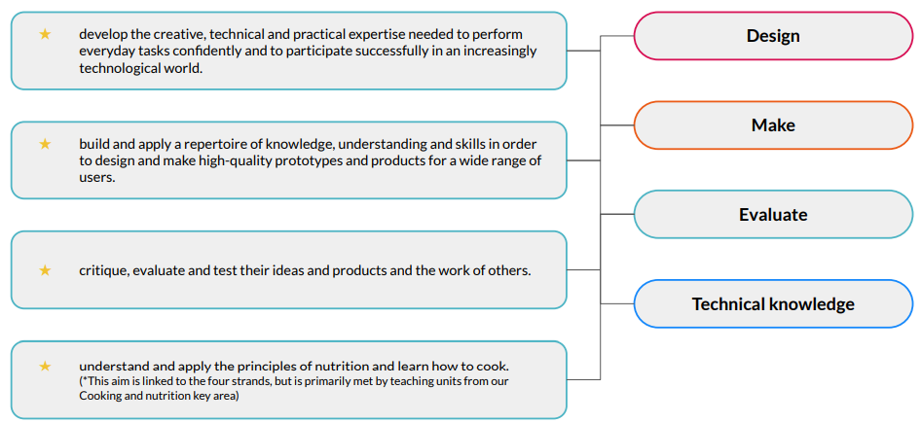
Statutory guidance for Design and Technology
Our scheme of work fulfils the statutory requirements outlined in the National Curriculum (2014).
The National Curriculum for Design and Technology aims to ensure that all pupils: Our National curriculum mapping document shows which of Kapow Primary’s units cover each of the National Curriculum Attainment targets as well as each of these four strands. National Curriculum links are also on each individual lesson plan, along with cross-curricular links to other subjects
From these aims, we have identified four threads which run throughout our scheme of work:
National Curriculum 2014
Four threads

Slide 3
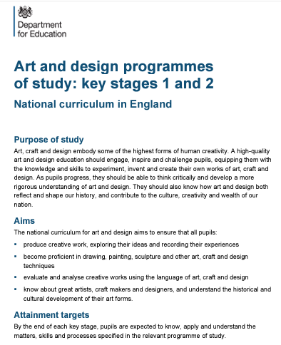

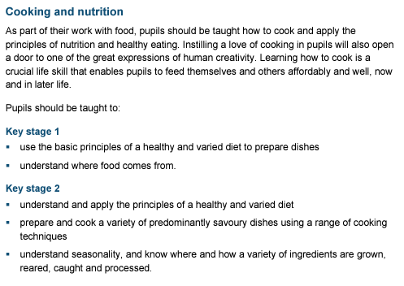
National Curriculum

Slide 4
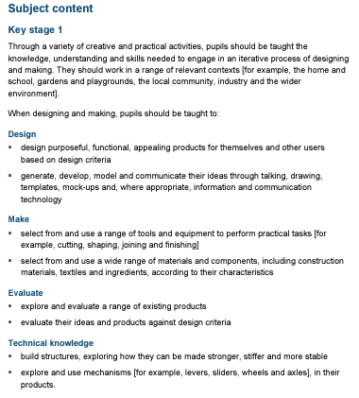
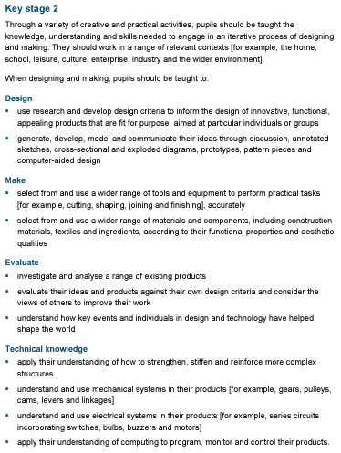
National Curriculum

Slide 5
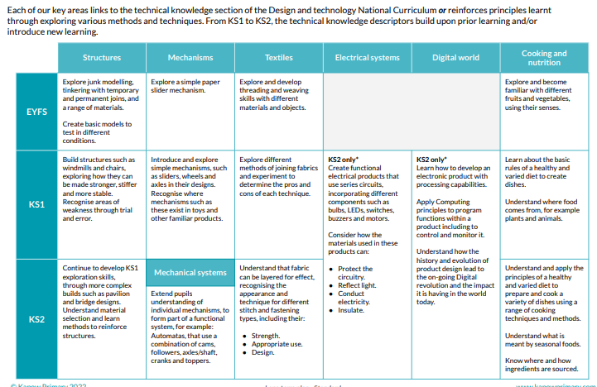

National Curriculum : How our scheme meets statutory guidance for D&T
The scheme of work has been designed as a spiral curriculum with the following key principles in mind:
✓ Cyclical: Pupils return to the key areas again and again during their time in primary school.
✓ Increasing depth: Each time a key area is revisited it is covered with greater complexity.
✓ Prior knowledge: Upon returning to each key area, prior knowledge is utilised so pupils can build upon previous foundations, rather than starting again.
Our Design and technology scheme of work is organised into units of four or six lessons. Within each unit, lessons must be taught in order as they build upon each other. Our school will adapt the planning to suit their core quality text or subject drivers and make use of cross-curricular links available.

Slide 6
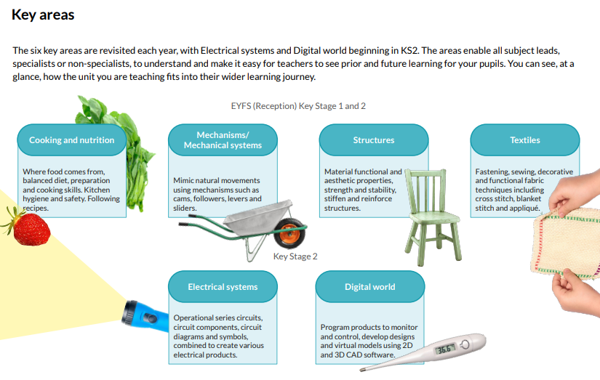
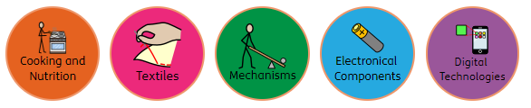
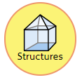

Slide 7
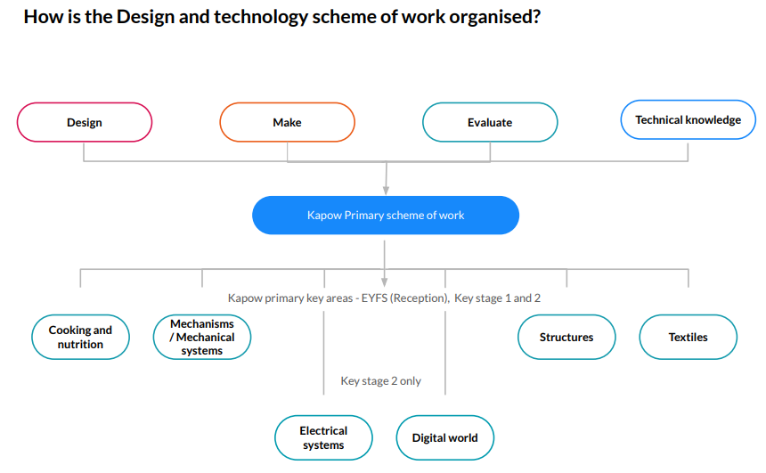

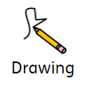
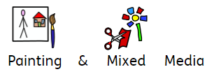

Slide 8
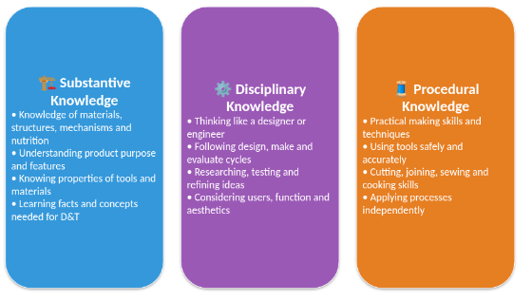
Types of knowledge in Design Technology
The three interrelated areas of knowledge
Substantive Knowledge : Factual and Conceptual understanding
Disciplinary Knowledge : Thinking processes used by designers
Procedural Knowledge : Practical skills and techniques to make effective products

Slide 9
Technical knowledge
In Kapow Primary’s D&T scheme, technical knowledge is one of the four curriculum strands (alongside Design, Make and Evaluate). It refers to the understanding of how and why products work, from mechanisms and materials to nutrition and digital systems.
However, technical knowledge is not a separate type of knowledge. Instead, it is built from a combination of:
Substantive knowledge – e.g. knowing what gears do.
Procedural knowledge – e.g. knowing how to assemble a gear system.
Disciplinary knowledge – e.g. knowing when and why a gear system would suit a particular design challenge.
Technical knowledge varies depending on the key area, such as structures, textiles or cooking and nutrition. It is always taught through practical, purposeful contexts that connect knowledge to real-world outcomes.

Slide 10
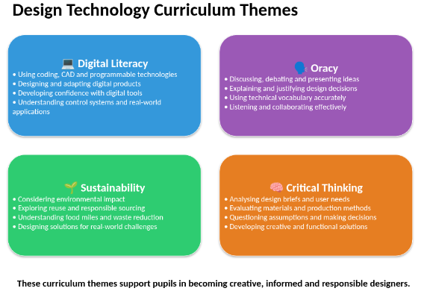

Slide 11
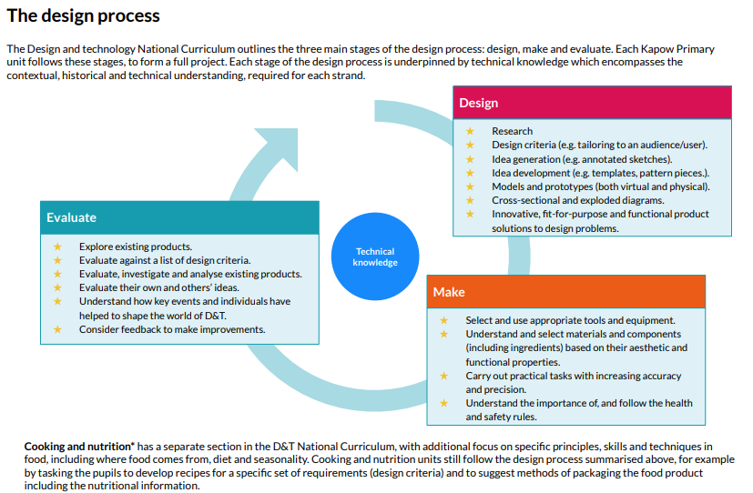

Slide 12
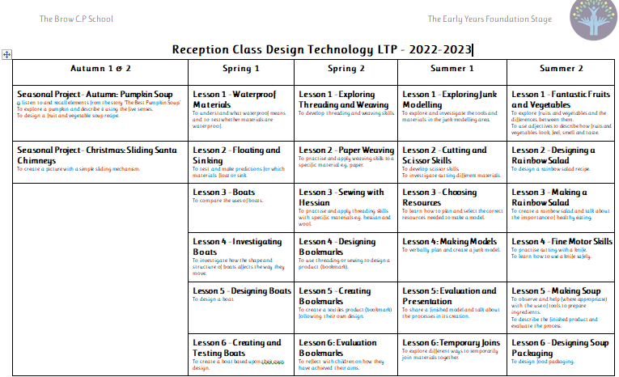
Early Years Foundation Stage
Child-led learning is integral to our Early Years curriculum. Supporting children in following and exploring their own interests allows for a greater depth of learning and understanding and much higher levels of wellbeing and engagement. Adults in the classroom will model how to use Design and technology to aid children in their pursuits and scaffold the learning so that they can reach a deeper level of understanding. We know that the difficulty with child-led Design and technology projects often arises when the pupils are not equipped to properly plan their creation or execute their ideas in the way that they wish, sometimes meaning that they will spend a very short amount of time at the workshop or junk modelling area before moving on. Planning, designing, making and developing skills and knowledge are all fundamental parts of our Design and technology scheme. The children will have plenty of opportunities to get to know each of these areas, as they explore different materials, processes and outcomes. When pupils are accessing these areas outside of lesson times, the teaching staff will support and scaffold their learning, offering suggestions or listening to their ideas.

Slide 13
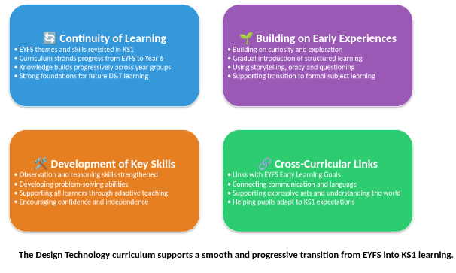
Transition from EYFS to KS1

Slide 14

Each year group features: The revised Design and Technology scheme has units divided into four core areas which are repeated in each year group. This provides teachers with greater clarity over knowledge and skills progression within the four areas.
Lessons in the scheme are sequential, so will be taught in order. All units contain 4 lessons unless stated otherwise. Each lesson builds on the previous one to provide opportunities for children to practice skills and apply their knowledge to consolidate learning.
Opportunities are planned so the children are given opportunities to develop mastery by revisiting core subject knowledge and applying that knowledge practically in a range of contexts with growing complexity.
EYFS
Year 2
Year 3
Year 4
Year 5
Year 6
Aut 1 | Aut 2 | Spr 1 | Spr 2 | Summ 1 | Summ 2
Seasonal Project Food and Nutrition :Pumpkin soup Seasonal Project : Sliding Santa Chimneys |  | Structures Boats |  | Textiles Easter Egg threading
Food and Nutrition Fruit and Vegetable Smoothies | Mechanisms Moving story books Or Matching Slider game | Textiles Puppets Optional Easter Themed Puppets Or Simple Stitches |  | Structures Windmills Or Stable Structures Pencil Pots | Mechanisms Wheels and axles vehicle Or Wheels and axles Pull along toy
Mechanisms Moving Monsters or Levers | Food and Nutrition A Balanced Diet | Textiles Pouches |  | Structures Baby Bear’s chair Or A Chair for Bear | Mechanisms Fairground Wheel
EYFS
Year 1
Year 2
Year 5
Year 6

Slide 15
Aut 1 | Aut 2 | Spr 1 | Spr 2 | Summ 1 | Summ 2
Structures Constructing a Castle or Product packaging | Mechanisms Pneumatic Toys OR Mechanical systems: Pneumatic toys | Electrical Systems Electric Poster | Cooking and Nutrition Eating Seasonally | Digital Technologies Wearable Technology | Textiles Egyptian Collars or Cushions
Cooking and Nutrition Adapting a recipe | Structures Pavilions OR Helmets | Electrical Systems Torches | Textiles Fastenings | Mechanisms Slingshot Cars OR Mechanical cars | Digital Technologies Mindful moments timer
Structures Bridges | Textiles Stuffed toys | Cooking and Nutrition What could be healthier? | Mechanisms Gears and Pulleys | Digital Technologies Digital monitoring Devices | Electrical Systems Doodlers OR Wobble Bots
Mechanisms Automata Toys | Cooking and Nutrition Come Dine with me | Structures Playgrounds | Textiles Waistcoats or Leavers Bags | Electrical Systems Steady Hand Games | Digital Technologies Navigating the World
Year 3
Year 3
EYFS
Year 2
Year 3
Year 4
Year 5
Year 6
Year
4
Year 4
Year 5
Year 5
Ye
Year 6
Year 6
Year 6

Slide 16
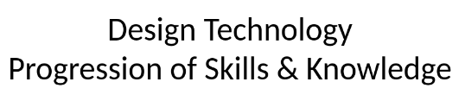
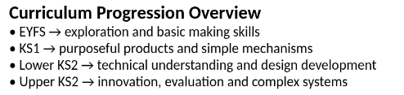
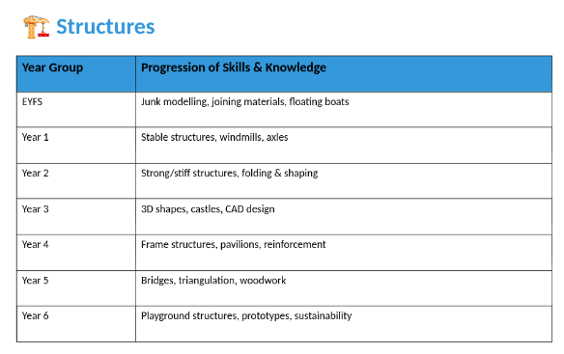

Slide 17
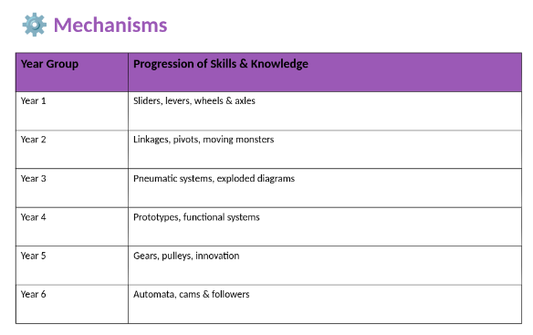

Slide 18
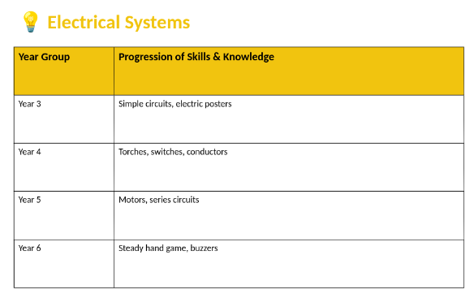

Slide 19
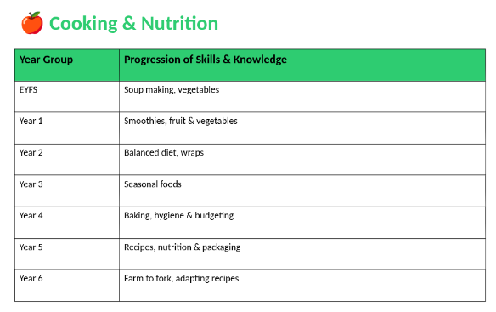

Slide 20
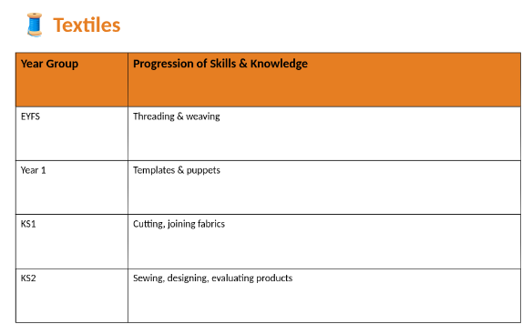

Slide 21
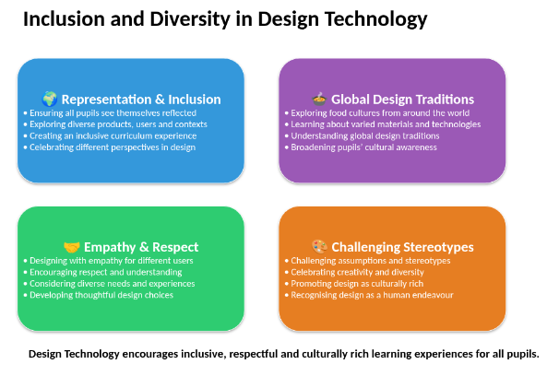
Inclusion and diversity

Slide 22
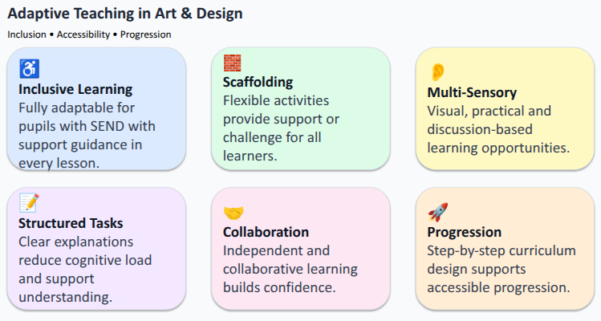
Adaptive Teaching in Design Technology

Slide 23

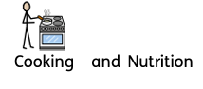
Rationale
In this strand, pupils will be introduced to a range of baking and cookery skills and apply the principles of nutrition and healthy eating. They will learn practical skills progressively and they will develop a love of cooking. They will build on previous experiences of cooking and use creativity and imagination to design a real life product. They will also solve real life problems in a range of contexts as learning how to cook is a fundamental life skill.The children will explore where world foods originate from and identify seasonal produce.They will know where a variety of ingredients are grown, reared and processed . The pupils will select from and use a wider range of tools and equipment to perform practical tasks [for example, cutting, shaping, joining and finishing], accurately select from and use a wider range of ingredients, according to their functional properties and aesthetic qualities. They will acquire a broad range of subject knowledge and draw on other disciplines such as Mathematics, Science, Computing and Art. The pupils will learn the importance of becoming prepared and organised, resourceful, innovative, enterprising and enable pupils to identify how to feed themselves and others affordably. They will be taught how to manage risks safely.
Key Threads:
Generating Ideas
Designing
Making skills
Evaluating and analysing
Developing and use of technical vocabulary
Curriculum Driver:
Critical Thinking
Cultural Capital

Slide 24
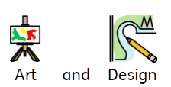
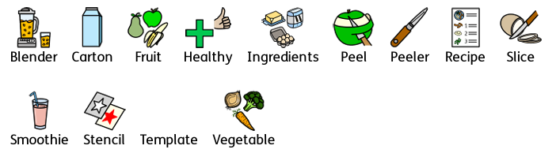
Year1; Autumn 1
Fruit and Vegetable Smoothies
Key Learning: Skills
Pupils can / will:
Design a smoothie carton packaging by-hand or on ICT software.
Chop fruit and vegetables safely to make a smoothie.
Identify if a food is a fruit or a vegetable.
Learn where and how fruits and vegetables grow.
Taste and evaluate different food combinations.
Describe appearance, smell and taste.
Suggest information to be included on packaging.
Vocabulary
Key Learning: Knowledge
Pupils will know/ can explain:
The difference between fruits and vegetables.
That some foods typically known as vegetables are actually fruits (e.g. cucumber).
That a blender is a machine which mixes ingredients together into a smooth liquid.
That a fruit has seeds and a vegetable does not.
That fruits grow on trees or vines.
That vegetables can grow either above or below ground.
That vegetables can come from different parts of the plant.
Chefs / bakers
Tesco From farm to plate
Food for Life
Evidence Opportunities/Interview Questions
Tell me the names of 3 fruits / vegetables
Describe a … - What are its tastes, smell, texture, and appearance?What will it look like if we peel or cut it in half?Which parts do we eat?What might I need to do before eating this?
What is the main difference between a fruit and vegetable?
Where do fruits and vegetables typically grow?
What is a smoothie?
What kind of food goes into smoothies?
Are smoothies good for your body?
Why is it important to wash the fruit and vegetables before we eat? Why do fruit and vegetables have skins? Describe how you prepared some of the fruits and vegetables.
Name some of the equipment you have used to chop, peel, slice and blitz the ingredients.
What does ‘peeling’ mean? How does the ‘claw grip’ us safe when cutting?

Slide 25
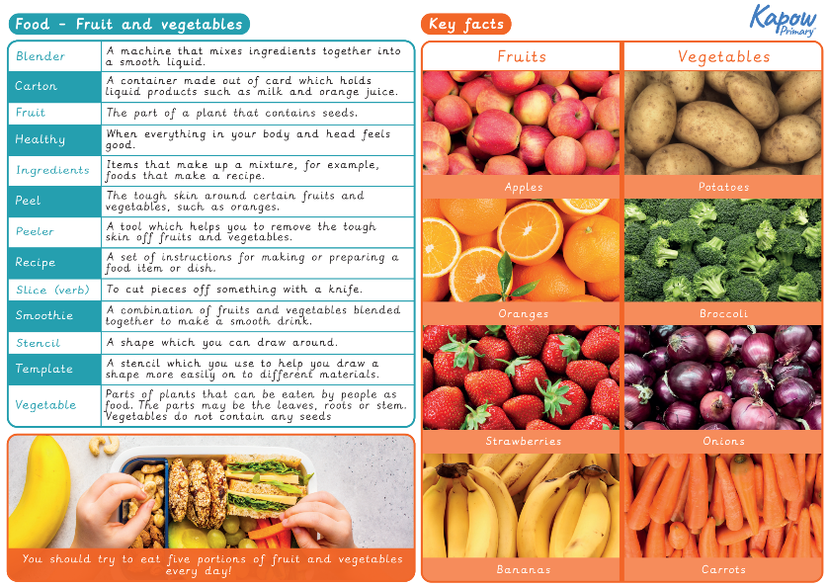

Slide 26
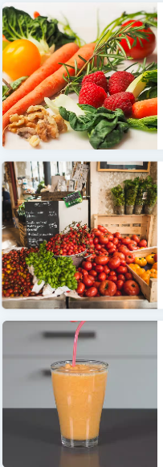
Year1; Autumn 1
Fruit and Vegetable Smoothies
Unit outcomes
Pupils who are secure will be able to:
Describe fruits and vegetables and explain why they are a fruit or a vegetable.
Name a range of places that fruits and vegetables grow.
Describe basic characteristics of fruit and vegetables.
Prepare fruits and vegetables to make a smoothie.

Slide 27
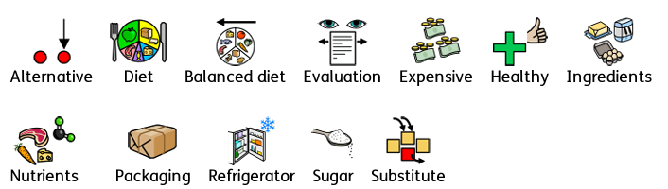
Year2 ; Autumn 2
A Balanced Diet
Key Learning: Skills
Pupils can / will:
Design a healthy wrap based on a food combination which works well together.
Slice food safely using the bridge or claw grip.
Construct a wrap that meets a design brief.
Describe the taste, texture and smell of fruit and vegetables.
Taste testing food combinations and final products.
Describe the information that should be included on a label.
Evaluate which grip was most effective.
Vocabulary
Key Learning: Knowledge
Pupils will know/ can explain:
That ‘diet’ means the food and drink that a person or animal usually eats.
What makes a balanced diet.
Where to find the nutritional information on packaging.
That the five main food groups are: Carbohydrates, fruits and vegetables, protein, dairy and foods high in fat and sugar.
That humans should eat a range of different foods from each food group, and roughly how much of each food group.
That nutrients are substances in food that all living things need to make energy, grow and develop.
That ‘ingredients’ means the items in a mixture or recipe,
That humans should only have a maximum of five teaspoons of sugar a day to stay healthy.
That many food and drinks we do not expect to contain sugar do; we call these ‘hidden sugars’.
Chefs / bakers
Jamie Oliver School Meals campaign
Fun Food Chef
Evidence Opportunities/Interview Questions
What is ‘hidden sugars’? What do you know about sugar.What do we consume that has sugar in it?Where does sugar come from?Where could you find the nutritional values / amount of sugars in food and drinks?
Which food group does…. belong to?
How do the sensory characteristics affect your liking the food?
What do we need to do before we prepare food?
Do we know anything about storing food?What do we need to store in the fridge?
What is the bridge grip best for?(round or curved foods that first need slicing in half)
Hat is the claw grip best for ? (long, more rigid foods that can be cut from one end to the other with the children’s fingertips well out of the way of the knife)

Slide 28
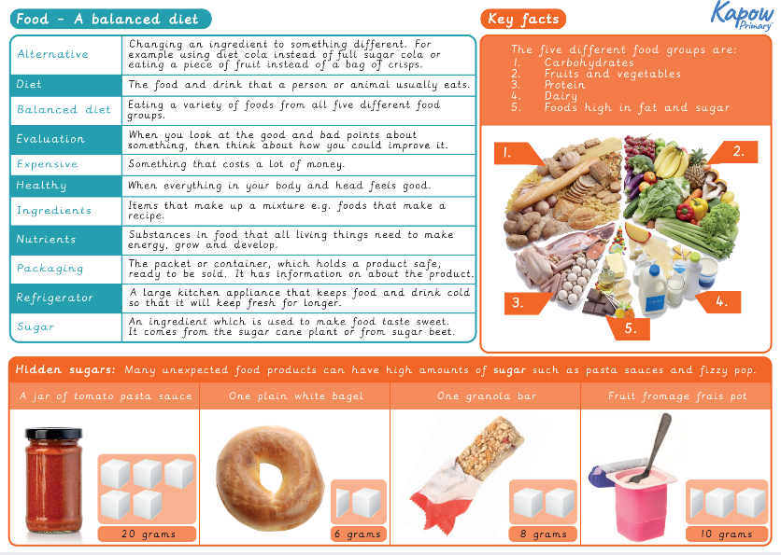

Slide 29
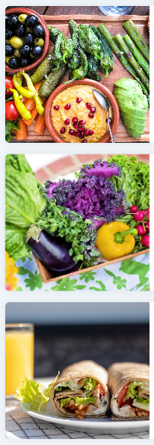
Year2 ; Spring 2
A Balanced Diet
Unit outcomes
Pupils who are secure will be able to:
Name the main food groups and identify foods that belong to each group.
Describe the taste, texture and smell of a given food.
Think of four different wrap ideas, considering flavour combinations.
Construct a wrap that meets the design brief and their plan.

Slide 30
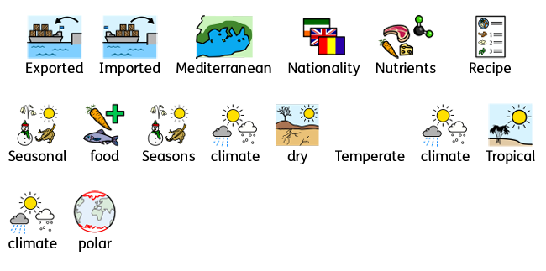
Year 3; Autumn 2
Eating Seasonally
Key Learning: Skills
Pupils can / will:
Create a healthy and nutritious recipe for a savoury tart using seasonal ingredients, considering the taste, texture, smell and appearance of the dish.
Prepare themselves and a workspace to cook safely in, learning the basic rules to avoid food contamination.
Follow the instructions within a recipe.
Establish and using design criteria to help test and review dishes.
Describe the benefits of seasonal fruits and vegetables and the impact on the environment.
Suggest points for improvement when making a seasonal tart.
Vocabulary
Key Learning: Knowledge
Pupils will know/ can explain:
That not all fruits and vegetables can be grown in the UK.
That climate affects food growth.
That vegetables and fruit grow in certain seasons.
That cooking instructions are known as a ‘recipe’.
That imported food is food that has been brought into the country.
Chefs / bakers
Jamie Oliver School Meals campaign
Fun Food Chef
Tesco From farm to plate
Evidence Opportunities/Interview Questions
Why do we think some ingredients are sourced from so far away?
What conditions do you think these foods need to grow?
Why do you think these foods cannot be grown in the UK?
What does the term ‘seasonal’ mean?
Where does the food in our supermarkets come from?
Is the food in the supermarket always seasonable in the UK?
Do we need to import food?
What are the effects of importing food?
.

Slide 31
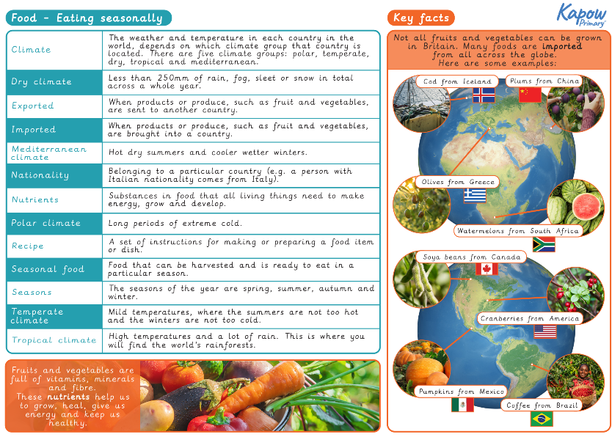

Slide 32
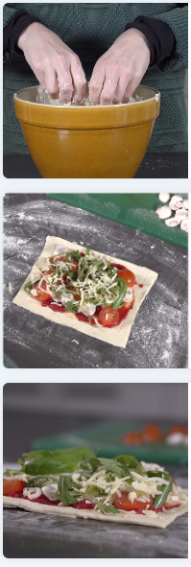
Year 3; Autumn 2
Eating Seasonally
Unit outcomes
Pupils who are secure will be able to:
Explain that fruits and vegetables grow in different countries based on their climates.
Understand that ‘seasonal’ fruits and vegetables are those that grow in a given season and taste best then.
Know that eating seasonal fruit and vegetables has a positive effect on the environment.
Design their own tart recipe using seasonal ingredients.
Understand the basic rules of food hygiene and safety.
Follow the instructions within a recipe.

Slide 33
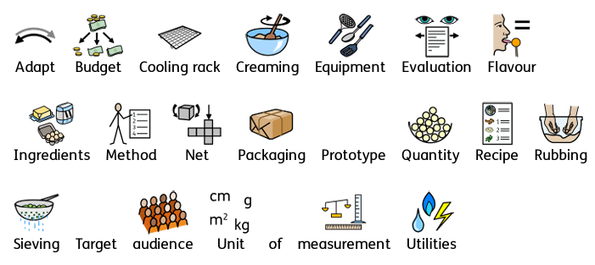
Year 4; Autumn 1
Adapting a recipe
Key Learning: Skills
Pupils can / will:
Design a biscuit within a given budget, drawing upon previous taste testing.
Follow a baking recipe.
Cook safely, following basic hygiene rules.
Adapt a recipe.
Evaluate a recipe, considering: taste, smell, texture and appearance.
Describe the impact of the budget on the selection of ingredients.
Evaluate and compare a range of products.
Suggest modifications.
Vocabulary
Key Learning: Knowledge
Pupils will know/ can explain:
The amount of an ingredient in a recipe is known as the ‘quantity’.
That it is important to use oven gloves when removing hot food from an oven.
The following cooking techniques: sieving, creaming, rubbing method, cooling.
The importance of budgeting while planning ingredients for biscuits.
Chefs / bakers
Jamie Oliver School Meals campaign
Fun Food Chef
Tesco From farm to plate
Evidence Opportunities/Interview Questions
What do you need to do before you start to cook? (Wash surfaces, equipment and hands, ensure sleeves and hair are pulled back).
What should the you be careful of when cooking? (The use of knives, cross-contamination of chopping boards, using electrical equipment with adult supervision).
Explain what we mean by these baking techniques - creaming, sieving and rubbing methods.
Describe your favourite biscuit to me - tastes like, ingredients, flavours, textures.
How would you modify my favourite biscuit recipe - digestive biscuit?
Tell me 3 different ingredients I could add to a basic biscuit recipe to improve my recipe.
What are the five different taste buds?

Slide 34
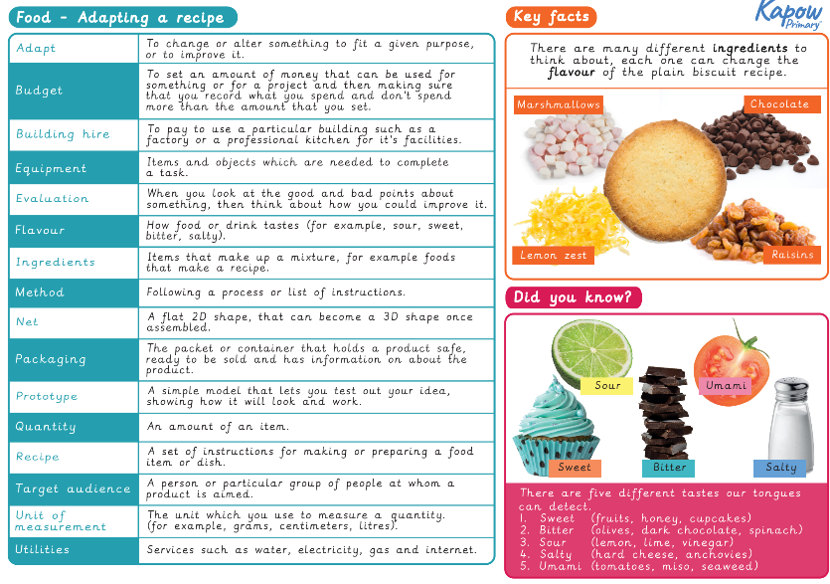

Slide 35
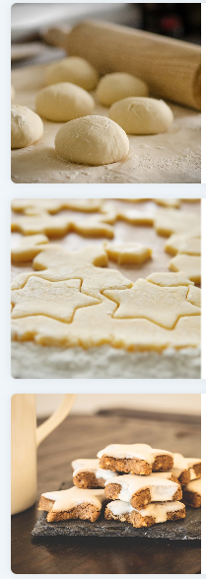
Year 4; Autumn 1
Adapting a recipe
Unit outcomes
Pupils who are secure will be able to:
Follow a recipe, with some support.
Describe some of the features of a biscuit based on taste, smell, texture and appearance.
Adapt a recipe by adding extra ingredients to it.
Plan a biscuit recipe within a budget.

Slide 36
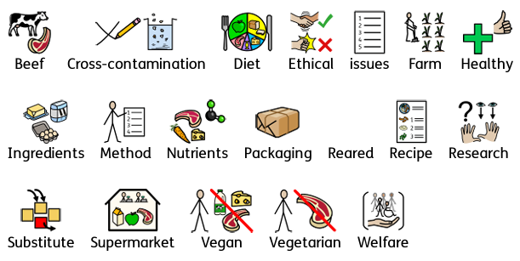
Year 5; Spring 1
What Could be Healthier?
Key Learning: Skills
Pupils can / will:
Adapt a traditional recipe, understand that the nutritional value of a recipe alters if you remove, substitute or add additional ingredients.
Write an amended method for a recipe to incorporate the relevant changes to ingredients.
Design appealing packaging to reflect a recipe.
Cut and prepare recipes safely.
Use equipment safely, including knives, hot pans and hobs.
Know how to avoid cross-contamination.
Follow a step-by-step method carefully to make a recipe.
Identify the nutritional differences between different products and recipes.
Identify and describe healthy benefits of food groups.
Vocabulary
Chefs / bakers
Jamie Oliver School Meals campaign
Fun Food Chef
Tesco From farm to plate
Evidence Opportunities/Interview Questions
How does the Eatwell Guide support people to eat a balanced diet?
What do need to eat the right amount of to help our bodies grow and develop? (Nutrients)
Explain what cross contamination is. Give me an example of where cross contamination in foods can occur.
Describe 4 of the Farm to Fork food production stages.
Tell one of the RSPCA’s 5 freedoms that every animal is entitled to freedom. Is it important that cattle and other animals we eat are well looked after? Why?
How would you use food packaging to decide if a food type was a healthier option or not?
Finish this sentences: A healthy meal should include…
(three portions of vegetables per serving, Be made from whole ingredients. Have as little added saturated fat, added salt or chemicals in as possible) In a nutritional table, which figures should be kept low and which can be higher? What is our recommended daily intake?
Key Learning: Knowledge
Pupils will know/ can explain:
Where meat comes from – learning that beef is from cattle and how beef is reared and processed, including key welfare issues.
That we can adapt a recipe to make it healthier by substituting ingredients.
That I can use a nutritional calculator to see how healthy a food option is.
That ‘cross-contamination’ means that bacteria and germs have been passed onto ready-to-eat foods and it happens when these foods mix with raw meat or unclean objects.

Slide 37
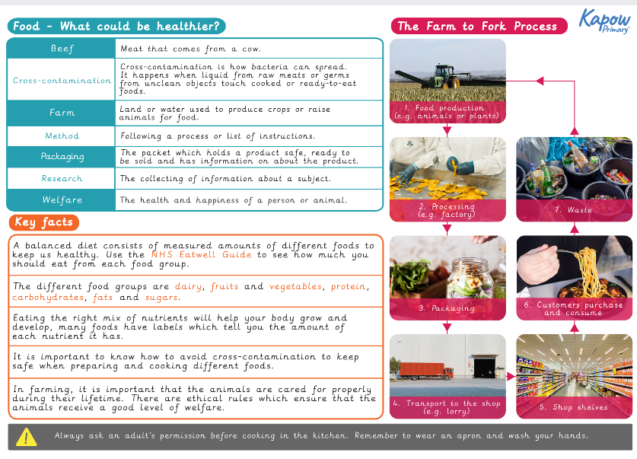

Slide 38
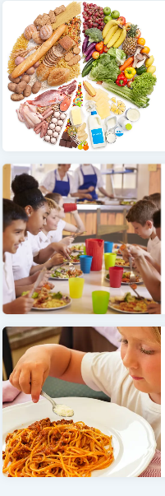
Year 5; Spring 1
What Could be Healthier?
Unit outcomes
Pupils who are secure will be able to:
Understand how beef gets from the farm to our plates.
Present a subject as a poster with clear information in an easy to read format.
Contribute ideas as to what a ‘healthy meal’ means.
Notice the nutritional differences between different products and recipes.
Recognise nutritional differences between two similar recipes and give some justification as to why this is.
Work as a team to amend a bolognese recipe with healthy adaptations.
Follow a recipe to produce a healthy bolognese sauce.
Design packaging that promotes the ingredients of the bolognese.

Slide 39
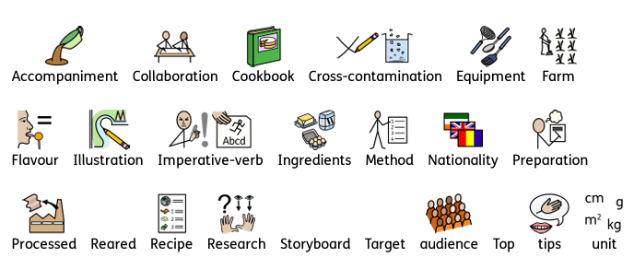
Year 6; Autumn 2
Come Dine with Me
Key Learning: Skills
Pupils can / will:
Write a recipe, explaining the key steps, method and ingredients.
Include facts and drawings from research undertaken.
Follow a recipe, including using the correct quantities of each ingredient.
Adapt a recipe based on research.
Work to a given timescale.
Work safely and hygienically with independence.
Evaluate a recipe, considering: taste, smell, texture and origin of the food group.
Taste test and score final products.
Suggest and write up points of improvements in productions. Evaluate health and safety in production to minimise cross contamination.
Vocabulary
Key Learning: Knowledge
Pupils will know/ can explain:
That ‘flavour’ is how a food or drink tastes.
That many countries have ‘national dishes’ which are recipes associated with that country.
That ‘processed food’ means food that has been put through multiple changes in a factory.
That it is important to wash fruit and vegetables before eating to remove any dirt and insecticides.
What happens to a certain food before it appears on the supermarket shelf (Farm to Fork).
Chefs / bakers
Great British Bake Off
Come Dine with Me
From Farm to Fork Project
Evidence Opportunities/Interview Questions
Name a traditional dish from the UK. / Another country.
What is an accompaniment in a meal?
Name 3 processed foods.
Do you have a recipe that is a family favourite or made on special occasions?
If you were creating a cookbook what information would be recorded?
Which units of measurement will be used/ ingredients be listed in order of quantity or method /include the quantities of each ingredient or just the ingredient / approximate preparation and cooking times/ Will the cookbook be organised into starters, mains, and desserts; or breakfasts, lunches and sweet treats; or by main ingredient – vegetables, chicken, fish; or by the country of origin – Spain, Italy, India, etc?

Slide 40
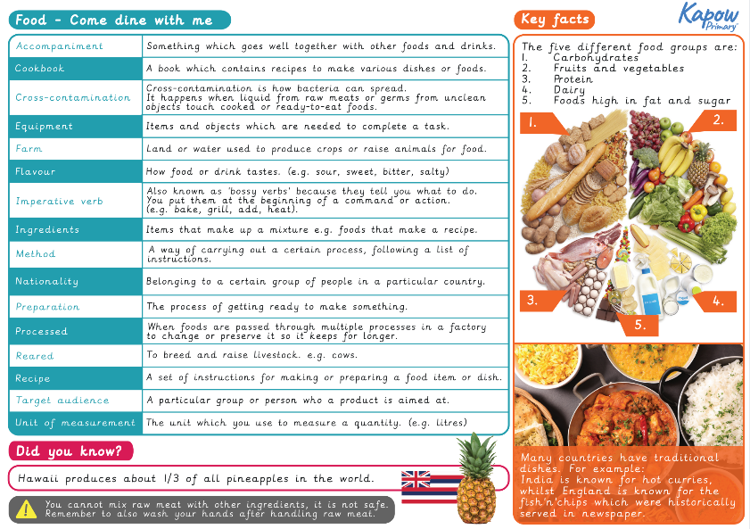

Slide 41
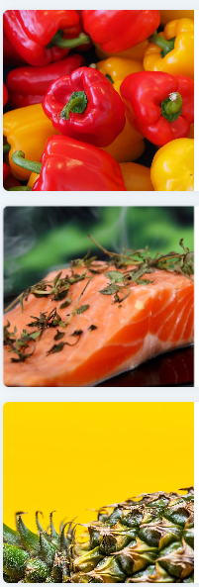
Year 6; Autumn 2
Come Dine with Me
Unit outcomes
Pupils who are secure will be able to:
Find a suitable recipe for their course.
Record the relevant ingredients and equipment needed.
Follow a recipe, including using the correct quantities of each ingredient.
Write a recipe, explaining the process taken.
Explain where certain key foods come from before they appear on the supermarket shelf.

Slide 42

Rationale
In this strand, pupils will be encouraged to design and make a variety of creative structures in a range of relevant contexts including local area, gardens, playground, industry, culture and historical structures. They will complete a variety of creative and practical activities and design innovative, purposeful, functional and appealing products. They will develop the creative, technical and practical expertise needed to perform everyday tasks in a technological world. Through the evaluation of past and present design and technology, pupils will develop a critical understanding of its impact on daily life and the wider world.The pupils will learn the importance of communicating their ideas through talking, drawing, annotated sketches,using templates and nets, prototypes. mock=ups, exploded diagrams and CAD technology as a fundamental aspect of the knowledge and skills of a designer. They will select from and use a range of tools and equipment to perform practical tasks including cutting, shaping and joining. They will also select and use a wide range of materials and components which will include construction materials when creating stronger, rigid and stable structures, reinforce complex structures and select according to their functional properties and aesthetic qualities. The pupils will develop their critical thinking skills in line with our curriculum drivers.and evaluate existing products and their ideas / products against design criteria.They will learn to consider the views of others to improve their work and understand how key events and individuals in design and technology have helped shape the world They will be taught how to manage risks safely.
Key Threads:
Generating Ideas
Designing
Making skills
Evaluating and analysing
Developing and use of technical vocabulary
Curriculum Driver:
Critical Thinking
Cultural Capital

Slide 43
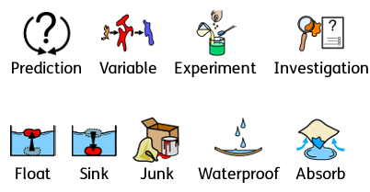
Year Reception; Spring 1
Boats
Key Learning: Skills
Pupils can / will:
Test whether materials are waterproof.
Test and make predictions for which materials float or sink.
Compare the uses of boats.
Investigate and describe the shape and structure of boats.
Design a boat.
Create a boat.
Vocabulary
Key Learning: Knowledge
Pupils will know/ can explain:
What waterproof means
Which objects are waterproof.
Which materials will float or sink in water.
How boats are used in daily life.
How the shape and structure of boats affects the way they move.
The features on their boat design.
How their design for a boat will be waterproof, float and move easily in the water.
What was successful with the design. What could be changed to improve the boat design.
Evidence Opportunities/Interview Questions
Why might it be helpful to have waterproof material?
How can they tell if a material is waterproof or not? Does the water leak through? Is the underside of the material wet or dry? Is the water absorbed?
If an object floats, what will we see? If it sinks, what will we see?
I wonder what would happen if we took the lid off the bottle? Would it still float? Would a ball of tin foil float as well as a flat piece?What might happen if we make the plasticine into a boat shape?
What do you think the Queen Mary 2 is for? What can boats carry on them?what is cargo? What are passengers?
Name some of the parts on your boat models.
Which shape boat moved best across the water? How did you join the parts of your boat together?
.
Designers / Architects
Jon Bannenberg.
John Beavor-Webb.
Thomas Harrison Butler.

Slide 44
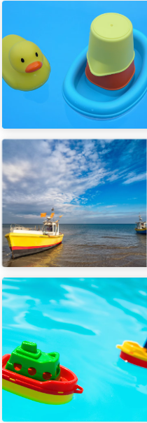
Year Reception; Spring 1
Boats
Unit outcomes
Pupils who are secure will be able to:
Describe what is meant by ‘waterproof’, ‘floating’ and ‘sinking’
Experiment and make predictions with various materials and carry out a series of tests
Describe the different features of boats and ships.
Investigating their shape and structures to build a boat.

Slide 45
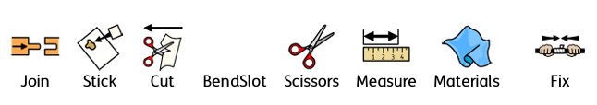
Year Reception; Summer 1
Junk Modelling
Key Learning: Skills
Pupils can / will:
Explore and investigate the tools and materials in the junk modelling area.
Develop small motor skills so that they can use a range of tools competently, safely and confidently.
Develop scissor skills.
Investigate cutting different materials.
Plan and select the correct resources needed to make a model.
Verbally plan and create a junk model.
Explore different ways to temporarily join materials together.
Vocabulary
Key Learning: Knowledge
Pupils will know/ can explain:
Which tools they will use to achieve a desired effect with a material.
How to use scissors safely.
Which materials are easier / more difficult to cut with scissors.
How to stay safe when using scissors.
The reasons why they selected materials to make a model.
The processes involved in a finished model creation.
Why we join things together.(make models, to create different shapes, to make something bigger or stronger )
The difference between permanent and temporary joins providing examples such as glue / paper clips.
Designers / Architects
Joan Miro
Evidence Opportunities/Interview Questions
Why do we join things together?What do we mean when we say ‘join’ the card together?
What can we use to stick materials together?
What tools can we use to change the shape of materials?
What could I use to make wheels for a model car?
What will happen if I cut paper with these two pairs of scissors - patterned scissors / straight bladed
Why do we need to be careful when using scissors?How can I stay safe with scissors?Tell me the scissor song.
Would sellotaping / paper clipping wheels to a car model work?What could I use to attach wheels so they can turn? Why do we plan before we make a model?
Tell me about your model and how you made it.What do you like about it?Were there any difficult parts that you would do differently next time?Which joins are easy o take apart?
.

Slide 46
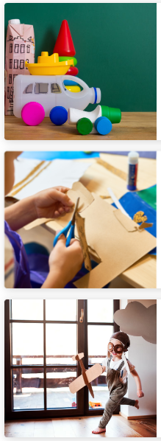
Year Reception; Summer 1
Junk Modelling
Unit outcomes
Pupils who are secure will be able to:
Describe various types of permanent and temporary joins.
Name and use of various craft tools and materials for junk modelling.
Manipulate materials to create different effects.
Experiment using a combination of materials.
Join materials and use a variety of joining techniques in the junk modelling area.

Slide 47


Year 1; Summer 1
Windmills
Key Learning: Skills
Pupils can / will:
Learn the importance of a clear design criteria.
Including individual preferences and requirements in a design.
Make stable structures from card, tape and glue.
Learn how to turn 2D nets into 3D structures.
Follow instructions to cut and assemble the supporting structure of a windmill.
Make functioning turbines and axles which are assembled into a main supporting structure.
Vocabulary
Designers / Architects
Persians in A.D. 500–800
James Blyth in Scotland 1887
Charles F. Brush in Cleveland, Ohio 1887
Evidence Opportunities/Interview Questions
What is a structure? (Something made or constructed, building, bridge, chair) What are structures for? Can you identify some structures in this room?
What is a windmill? (A structure with sails) What are the three key features of a windmill?Which part of the windmill am I describing the function of?
The part that makes the windmill stand up? supporting structure:
The pieces that move in the wind.Turbine or sails:
The point from which the turbine/sails move.Axle
What do these words mean and why are they important when designing a structure? Stable / Unstable/ Strong/Weak
What were windmills traditionally used for?What are they used for now?
What are turbines for? Why do windmills need turbines?
What is an axle and what is it for? What other products use axles? (Cars; toys. )
What does assemble mean?
Key Learning: Knowledge
Pupils will know/ can explain:
That the shape of materials can be changed to improve the strength and stiffness of structures.
That cylinders are a strong type of structure (and, therefore, they are the main shape used for windmills and lighthouses).
That axles are used in structures and mechanisms to make parts turn in a circle.
That different structures are used for different purposes.
A structure is something that has been made and put together.

Slide 48


Slide 49

Year 1; Summer 1
Windmills
Unit outcomes
Pupils who are secure will be able to:
Identify some features that would appeal to the client (a mouse) and create a suitable design.
Explain how their design appeals to the mouse.
Make stable structures, which will eventually support the turbine, out of card, tape and glue.
Make functioning turbines and axles that are assembled into the main supporting structure.
Say what is good about their windmill and what they could do better.

Slide 50

Year 1; Summer 1
Stable Structures Pencil Pots
Key Learning: Skills
Pupils can / will:
Design : Thinking about what others might want from a design.
Beginning to recognise how products and designs in the world around us solve certain needs.
Considering who they are designing for – identifying the user.
Stating what they intend to make and why – identifying the purpose.Talking about ideas, with purpose and user in mind.Talking about existing products when generating ideas. Using basic drawing skills to communicate ideas.
Make Choosing between a small number of materials, ingredients or components.Explaining their choices based on personal experiences. Requesting equipment appropriate to the purpose (e.g. scissors for cutting, glue for joining, etc.). Beginning to use objects with a fixed width or length to create even spacing of markings or cuts (e.g. a lolly stick). Refining their grip to cut competently and confidently. Cutting straight and evenly spaced lines Beginning to cut large shapes and thicker materials like card.
Evaluate: Discussing existing products, saying what they like about them. Comparing two products and discussing which is better for a specific purpose.
Saying what they like about their peers’ designs and products.
Accepting feedback and understanding it is meant to improve their work.
Technical knowledge:Recognising that different structures are used for different purposes. Exploring the features of structures.Describing structures as buildings or freestanding structures.Making stable structures from card. Creating supporting structures to aid stability. Using stable objects like cylinders to create structures.
Vocabulary
Designers / Architects
Gustave Eiffel Eiffel Tower 1832
Evidence Opportunities/Interview Questions
What is a structure? (Something made or constructed, building, bridge, chair - to be used or perform a job) What is the job of a structure?are structures for? Can you identify some structures in this room? What do all stable objects have in common - large bases / do not wobble.
What is a tower? (What shapes make the most stable towers? What worked well when building your towers?How could you make your tower even better?How did you and your team help each other while building?
What would happen if I let go of a straw when it is standing up? Is a bent straw more or less stable than the straight straw?How could you make the straw stand up on its own?How does a basketball hoop stay upright? Why is it important that this structure is stable in a playground?Why are roots and anchors important when improving stability?Who is the user for your product?How have you made your pot appealing to them?What did you add to your cardboard tube to make it more stable?Which method - glue tape - was the most suitable to create a strong hold for your product?What might happen if the cuts are not all the same length? What does assemble mean?
Key Learning: Knowledge
Pupils will know/ can explain:
Design know The user is the person who will use the product.
Different users may want different things from a design.
Who they are designing for makes a difference to what they design.The purpose is what something is for.
Existing products can help when deciding what to design. Drawings are a way to explain ideas.
Make To know:A plan is deciding what to do first and next.
Different equipment does different things.Names of common pieces of equipment. Some tools are sharp like scissors and knives. Spacing cuts or marks evenly can be useful. Different glue can be used to join different things.
Evaluate To know:Some products will be better than others. Their ideas or products can be made better.Their ideas can make someone else’s work better.Other people’s ideas can help make their work better.
Technical knowledge: To know:A structure is something that has been made and put together. Stable structures do not topple.
Shapes and structures with wide, flat bases or legs are the most stable. Adding weight to the base of a structure can make it more stable.

Slide 51


Slide 52

Year 1; Summer 1
Pencil Pots
Unit outcomes
Pupils who are secure will be able to:
Pupils who are secure will be able to:
Explain that structures are things that are built and have a purpose.
Understand that structures with a wider base are more stable than ones with a narrow base.
Explain that extra weight added to the base of a structure makes it more stable.
Design a product for a particular user.
Use a sketch to show ideas.
Choose the best method for joining the parts of the product.
Make evenly spaced cuts.
Use scissors to cut out a shape neatly and accurately.
Explain what they like and dislike about their final product.

Slide 53


Year 2 ; Summer 1
Baby Bear’s Chair
Key Learning: Skills
Pupils can / will:
Generate and communicate ideas using sketching and modelling.
Learn about different types of structures, found in the natural world and in everyday objects.
Make a structure according to design criteria.
Create joints and structures from paper/card and tape.
Build a strong and stiff structure by folding paper.
Explore the features of structures.
Compare the stability of different shapes.
Test the strength of their own structures.
Identify the weakest part of a structure.
Evaluate the strength, stiffness and stability of their own structure.
Vocabulary
Key Learning: Knowledge
Pupils will know/ can explain:
That shapes and structures with wide, flat bases or legs are the most stable.
That the shape of a structure affects its strength.
That materials can be manipulated to improve strength and stiffness.
That a structure is something which has been formed or made from parts.
That a ‘stable’ structure is one which is firmly fixed and unlikely to change or move.
That a ‘strong’ structure is one which does not break easily.
That a ‘stiff’ structure or material is one which does not bend easily.
Designers / Architects
Egyptian artisans
Charles and Ray Eames
Evidence Opportunities/Interview Questions
What do we mean by a client? ( person we design for)
What do we mean when we say design criteria?( a list of points to ensure the product meets the client’s needs and wants)
What is a structure ? Which shape of materials can be changed to improve the strength and stiffness of structures?
(Cylinders). Look around this room and tell me the names of different man-made and natural structures.
What are the three key features of a stable, free-standing structure? (low height/ wide base/ flat base). Is a sphere stable? Why/why not?
Would a chair with one leg be stable? Why / why not?
Tell me one example of the following words : Stability/ Strength/ Stiffness.
Which structure is stronger - pyramid or a sphere? Which is the weakest part of the structure? (The corners.) What are the advantages of a cylinder? (it does not have any corners.)
What does overlapping materials create? (improved stiffness). How can we improve the strength of paper? ( cylinder structure/ no corners / overlapping/dry)
Describe how you created a chair design that was ‘Just right.’

Slide 54


Slide 55

Year 2 ; Summer 1
Baby Bear’s Chair
Unit outcomes
Pupils who are secure will be able to:
Identify man-made and natural structures.
Identify stable and unstable structural shapes.
Contribute to discussions.
Identify features that make a chair stable.
Work independently to make a stable structure, following a demonstration.
Explain how their ideas would be suitable for Baby Bear.
Produce a model that supports a teddy, using the appropriate materials and construction techniques.
Explain how they made their model strong, stiff and stable.

Slide 56

Year 3 ; Autumn 1
Constructing a Castle
Key Learning: Skills
Pupils can / will:
Design a castle with key features to appeal to a specific person/purpose.
Draw and label a castle design using 2D shapes.
Design and/or decorate a castle tower on CAD software.
Construct a range of 3D geometric shapes using nets.
Create special features for individual designs.
Make facades from a range of recycled materials.
Evaluate own work and the work of others based on the aesthetic of the finished product and in comparison to the original design.
Suggest points for modification of the individual designs.
Vocabulary
Designers / Architects
The Normans
Evidence Opportunities/Interview Questions
What are the differences between Natural structures and Man-made structures?The most stable structures all have what features? (flat bases or legs / fixed) What affects the strength of a structure? (the shape)
What are castles for?Who lives in castles? Where do we see castles? Are all castles strong, stable and stiff? Why are these properties important for structures? Why? (For example, some are bouncy, soft, strong, big, small and have a variety of purposes.) What makes these castles different or the same? (Many of them still include various key castle features – towers, turrets, battlements.) Are these man-made or natural structures?
Why are the features of a castle important? What did they do for the people living inside them? (protect the people living inside them and keep the enemies away to defend the land.)
Why were a castle’s stability and strength important? How can we make a model of a 3d shape? What is a net? How can we make bigger 3d shapes using nets? Why do we need to cut the tabs / edges of the net carefully?scoring the edges with a ruler and scissors ? Use enough glue on the tabs?
Tell me 3 points from your class design criteria for a castle design. Are there any other features you would like to include? How did you attach façades? Give me your reasons for why they kept to the original design or why they changed/evolved their castles?
Key Learning: Knowledge
Pupils will know/ can explain:
That wide and flat based objects are more stable.
The importance of strength and stiffness in structures.
Some of the following features of a castle: flags, towers, battlements, turrets, curtain walls, moat, drawbridge and gatehouse – and their purpose.
That a façade is the front of a structure.
That a castle needed to be strong and stable to withstand enemy attack.

Slide 57


Slide 58

Year 3 ; Autumn 1
Constructing a Castle
Unit outcomes
Pupils who are secure will be able to:
Draw and label a simple castle that includes the most common features.
Recognise that a castle is made up of multiple 3D shapes.
Design a castle with key features which satisfy a given purpose.
Score or cut along lines on the net of a 2D shape.
Use glue to securely assemble geometric shapes.
Utilise skills to build a complex structure from simple geometric shapes.
Evaluate their work by answering simple questions.

Slide 59

Year 4 ; Autumn 2
Pavilions
Key Learning: Skills
Pupils can / will:
Design a stable pavilion structure that is aesthetically pleasing Select materials to create a desired effect.
Build frame structures designed to support weight.
Create a range of different shaped frame structures.
Make a variety of free-standing frame structures of different shapes and sizes.
Select appropriate materials to build a strong structure and for the cladding.
Reinforce corners to strengthen a structure.
Create a design in accordance with a plan.
Create different textural effects with materials.
Vocabulary
Designers / Architects
Zhou dynasty (1046–256 BCE)
Evidence Opportunities/Interview Questions
What is the purpose of a pavilion? (A light, flexible space which can be permanent but is often temporary.)How might these structures have been constructed? Can you name a famous pavilion in France? (Eiffel Tower.)What is a frame structure? ( A house, church, barn, windmill, Ferris wheels, e.g. the London Eye, suspension bridge)
What do we call …
Shapes with three dimensions: width, height and depth?
How an object or product looks?– aesthetic.
Something different that uses new methods or ideas? innovative.
A decorative building or structure for leisure activities? – pavilion.
A set of instructions or requirements for a project ?– design criteria.
A person or a particular group of people at whom a product is aimed? – target audience.
When we make a structure or material stronger, especially by adding another material or element to it? – reinforce
What might a well-made structure might look like? (Neat, strong joints and accurate angles.)
Why might corner triangles be an excellent idea to use in a structure?
How could the weight of the cladding affect the structure? (Heavy material could weigh the whole structure down, possibly causing it to collapse.)
Key Learning: Knowledge
Pupils will know/ can explain:
What a frame structure is.
That a ‘free-standing’ structure is one that can stand on its own.
That a pavilion is a decorative building or structure for leisure activities.
That cladding can be applied to structures for different effects.
That aesthetics are how a product looks.

Slide 60


Slide 61

Year 4 ; Autumn 2
Pavilions
Unit outcomes
Pupils who are secure will be able to:
Produce a range of free-standing frame structures of different shapes and sizes.
Design a pavilion that is strong, stable and aesthetically pleasing.
Select appropriate materials and construction techniques to create a stable, free-standing frame structure.
Select appropriate materials and techniques to add cladding to their pavilion.

Slide 62

Year 5 ; Autumn 1
Bridges
Key Learning: Skills
Pupils can / will:
Design a stable structure that is able to support weight.
Create a frame structure with focus on triangulation.
Make a range of different shaped beam bridges.
Use triangles to create truss bridges that span a given distance and support a load.
Build a wooden bridge structure.
Independently measure and mark wood accurately.
Select appropriate tools and equipment for particular tasks. Use the correct techniques to saw safely.
Identify where a structure needs reinforcement and using card corners for support.
Explain why selecting appropriate materials is an important part of the design process.
Understand basic wood functional properties.
Adapt and improve own bridge structure by identifying points of weakness and reinforcing them as necessary.
Suggesting points for improvements for own bridges and those designed by others.
Vocabulary
Designers / Architects
The Romans
Isambard Kingdom Brunel
Evidence Opportunities/Interview Questions
What three aspects are important when designing structures? Hat should you reinforce to strengthen a structure (corners / materials) .Why are Aesthetics important? A bridge …. …can affect its strength. What is the difference between a beam and arch bridge? Which part of the bridge is the beam?How are Truss bridges constructed? ( use multiple tessellated beams in a triangle formation) How did your truss bridge compare to the beam and arch bridges? What factors made your bridge stronger/weaker? What difficulties or problems did you come across? How did you solve them? What could we used to strengthen corners and joins? Name a strong heavy wood - Hardwood / oak. Name a wood from a fast growing tree - softwood pine.
Key Learning: Knowledge
Pupils will know/ can explain:
Some different ways to reinforce structures.
How triangles can be used to reinforce bridges.
That properties are words that describe the form and function of materials.
Why material selection is important based on their properties.
The material (functional and aesthetic) properties of wood.

Slide 63


Slide 64

Year 5 ; Autumn 1
Bridges
Unit outcomes
Pupils who are secure will be able to:
Identify stronger and weaker shapes.
Recognise that supporting shapes can help increase the strength of a bridge, allowing it to hold more weight.
Identify beam, arch and truss bridges and describe their differences.
Use triangles to create simple truss bridges that support a load (weight).
Cut beams to the correct size, using a cutting mat.
Smooth down any rough cut edges with sandpaper.
Follow each stage of the truss bridge creation as instructed by their teacher.
Complete a bridge, with varying ranges of accuracy and finish, supported by the teacher.
Identify some areas for improvement, reinforcing their bridges as necessary.

Slide 65

Year 6 ; Summer 1
Playgrounds
Key Learning: Skills
Pupils can / will:
Design a playground featuring a variety of different structures, giving consideration to how the structures will be used.
Consider effective and ineffective designs.
Build a range of play apparatus structures drawing upon new and prior knowledge of structures.
Measure, mark and cut wood to create a range of structures.
Use a range of materials to reinforce and add decoration to structures.
Improve a design plan based on peer evaluation.
Test and adapt a design to improve it as it is developed.
Identify what makes a successful structure.
Vocabulary
Designers / Architects
Friedrich Froebel
Evidence Opportunities/Interview Questions
Name 5 playground structures.
List five design criteria points that a playground should meet
Which tools have been used to cut, shape or join the materials?Why is it important to measure accurately before cutting?
What are the advantages and disadvantages to using PVA or low melt glues when attaching parts?
What does ‘brace’ your model mean?
Describe some ways to add decorate details to the playground frame. ( cladding / weaving)
Key Learning: Knowledge
Pupils will know/ can explain:
That structures can be strengthened by manipulating materials and shapes.
What a ‘footprint plan’ is.
That in the real world, design can impact users in positive and negative ways.
That a prototype is a cheap model to test a design idea.

Slide 66


Slide 67

Year 6 ; Summer 1
Playgrounds
Unit outcomes
Pupils who are secure will be able to:
Create five apparatus designs, applying the design criteria to their work.
Make suitable changes to their work after peer evaluation.
Make roughly three different structures from their plans using the materials available.
Complete their structures, improving the quality of their rough versions and applying some cladding to a few areas.
Secure their apparatus to a base.
Make a range of landscape features using a variety of materials which will enhance their apparatus.

Slide 68

Rationale
In this strand, pupils will be introduced to a range of sewing and applique techniques. They will work in a range of relevant contexts including home, school. gardens, local community and the wider world within a historical context. . They will build on previous experiences of fabrics and joining techniques. They will design purposeful, functional, appealing products for themselves and other users based on design criteria generate, develop, model and communicate their ideas through talking, drawing, templates and mock-ups. They will select from and use a range of sewing tools and equipment to perform practical tasks for example, cutting, shaping, joining and finishing. They will select from and use a wide range of materials and components, including textiles according to their characteristics, functional properties and aesthetic qualities. The pupils will develop their critical thinking skills in line with our curriculum drivers.
Key Threads:
Generating Ideas
Designing
Making skills
Evaluating and analysing
Developing and use of technical vocabulary
Curriculum Driver:
Critical Thinking
Cultural Capital

Slide 69

Reception ; Summer 2
Bookmarks
Key Learning: Skills
Pupils can / will:
Explore making marks with wax crayons.
Investigate the marks and patterns made by different textures.
Explore making marks with felt tips.
Use a felt tip to make patterns with some accuracy
Explore making marks with chalk.
Make controlled large and small drawing movements
Explore mark making using pencils.
Create a simple observational drawings.
Use a variety of colours and materials to create a self-portrait.
Express their own self-image through art.
Vocabulary
Designers
Thomas Stevens
Evidence Opportunities/Interview Questions
What do you need to do with your hands when you are threading?keep them steady.
What could we weave with?
How do we weave paper? Under. Over
How can we make a weaning pattern with paper?
What tool do we need to use the help us weave threads through hessian? Needle
What is a stitch?
What did you add to your bookmark design?
What was difficult when you were sewing?
Does the fabric bookmark look like your design on paper? If not, what is different?
Key Learning: Knowledge
Pupils will know/ can explain:
How to create pattern and texture using a crayon.
How to use wax crayons to make marks with accuracy.
How they used felt tips to make marks with some level of accuracy .
How to hold the felt tip using a tripod grip.
Can compare different ways of making marks and drawing. How to make large and small controlled movements using chalk.
Different drawing mediums used and talk about their preferences.
How to use their pencils to make small controlled movements.
The process of using their pencils to draw with a purpose
What an observational drawing is.
Ways they can represent their own self-image through their work and explain why it looks like them.
Why they choose particular colours carefully and talk about their decisions.

Slide 70

Reception ; Summer 2
Bookmarks
Unit outcomes
Pupils who are secure will be able to:
Develop and practise threading techniques.
Develop weaving techniques using various materials and objects.
Talk about the history of the bookmark from Victorian times versus modern-day styles.
Apply their knowledge and skills to design and sew their own bookmarks.

Slide 71


Year 1 ; Spring
Puppets
Key Learning: Skills
Pupils can / will:
Use a template to create a design for a puppet.
Cut fabric neatly with scissors.
Use joining methods to decorate a puppet.
Sequence steps for construction.
Reflect on a finished product, explaining likes and dislikes.
Vocabulary
Key Learning: Knowledge
Pupils will know/ can explain:
That ‘joining technique’ means connecting two pieces of material together.
That there are various temporary methods of joining fabric by using staples, glue or pins.
That different techniques for joining materials can be used for different purposes.
That a template (or fabric pattern) is used to cut out the same shape multiple times.
That drawing a design idea is useful to see how an idea will look.
Designers
Giuseppe Fiando
Bill Baird
Jim Henson
Evidence Opportunities/Interview Questions
Tell me three different ways to join fabrics. Pinning.Stapling.Glueing.
What do we need to think about when using safety pins / stapler / glue spreaders?
When is it best to use pins/staples / glue to join fabrics? Which joining technique do you like best, and why?What is a template?How did you keep you template still on the fabric?
How did you join yout two puppet parts? Why did you use this method?What did you need to decorate your puppet to make it look like your character?
How did you attach your decorations to your puppet? Did you need to make any changes to your design?

Slide 72


Slide 73

Year 1 ; Spring
Puppets
Unit outcomes
Pupils who are secure will be able to:
Join fabrics together using pins, staples or glue.
Design a puppet and use a template.
Join their two puppets’ faces together as one.
Decorate a puppet to match their design.

Slide 74

Year 1 ; Spring
Simple Stitches
Key Learning: Skills
Pupils can / will:
Design Stating what they intend to make and why – identifying the purpose.
Talking about ideas, with purpose and user in mind.
Using basic drawing skills to communicate ideas.
Make Choosing between a small number of materials, ingredients or components.
Explaining their choices based on personal experiences.
Explaining in simple terms why certain tools must be handled carefully.
Following and recalling simple safety instructions.
Using a straightedge to draw a straight line.
Beginning to use objects with a fixed width or length to create even spacing of markings or cuts. (e.g. a lolly stick).
Using a large plastic needle and large-weave embroidery fabric to begin to create a running stitch.
Applying masking tape to fix something in place or join to edges.
Adding texture to create visual interest.
Evaluate Saying what they like about their peers’ designs and products.
Accepting feedback and understanding it is meant to improve their work.
Technical knowledge Discussing fabric properties. Threading large needles.
Rehearsing sewing techniques with large needles and thick thread, like wool.
Sewing a running stitch in large-weave embroidery fabric or hessian.
Creating patterns and following them with stitching.
Spacing stitches evenly.
Vocabulary
Evidence Opportunities/Interview Questions
What is fabric? How is it made? What is fabric used to make? What information can we find on a clothes label?How is a weaving made? What was difficult about weaving? What fabric items can you think of that are made of human-made materials? (Answers may include: rain jackets; umbrellas; tents.) Which materials are better for the planet? (Natural materials.) Why might human-made materials harm the planet? (They can pollute the land or oceans and harm animals.)
Where will you find stitches?Why do we need a needle to make stitches? (To pull the thread through the fabric as the thread is bendy.)Why does the needle have an eye? (The eye holds the thread to carry it through the fabric.) Why does the needle have a point?
Why do we need to be careful when using needles?
What is the trickiest part about making stitches? Should stitches always be in a straight line? What would straight / uneven stitches look like?
Can you see anything with stitched designs? ( school logo on jumpers)What ideas do you have for your bunting design?How did you make sure it was not too tricky? Why is it important to create a design before making something?What advice would you give to someone else to help them with their stitching? How has stitching your design made you feel? Why is it helpful to use different styles of stitches? (To make patterns or blocks of colour; to make the design more interesting.)
How could different styles of stitches make your bunting better?
Key Learning: Knowledge
Pupils will know/ can explain:
Design To know: Drawings are a way to explain ideas.
Make To know: Choosing different materials or components will affect what the product does or looks like.The names of common pieces of equipment.
Following instructions helps with safety.
Spacing cuts or marks evenly can be useful.
Texture is how something feels.
Evaluate
To know:Their ideas or products can be made better.
Their final product might be different to their original idea. Their ideas can make someone else’s work better.Other people’s ideas can help make their work better.
Technical knowledge; To know:Evenly spaced stitches help when following a pattern.

Slide 75

Year 1 ; Spring
Simple Stitches
Unit outcomes
Pupils who are secure will be able to:
Pupils who are secure will be able to:
Name some objects made of fabric.
Describe the look and feel of different fabrics.
Thread a needle.
Make a series of stitches that match each other in embroidery fabric.
Choose colours and shapes for a design.
Explain their ideas to others verbally and with a sketch.
Choose materials based on their texture.
Follow the general position of the lines of a design with stitches.
Say what they like about someone else’s stitching and what could be made better.

Slide 76


Slide 77


Year 2 ; Spring
Purses and Pouches
Key Learning: Skills
Pupils can / will:
Design a pouch.
Select and cut fabrics for sewing.
Decorate a pouch using fabric glue or running stitch.
Thread a needle.
Sew running stitch, with evenly spaced, neat, even stitches to join fabric.
Neatly pin and cut fabric using a template.
Troubleshoot scenarios posed by teacher.
Evaluate the quality of the stitching on others’ work.
Discuss as a class, the success of their stitching against the success criteria.
Identify aspects of their peers’ work that they particularly like and why.
Vocabulary
Designers
5000 years ago a pouch worn by a man, Ötzi the Iceman
Louis Vuitton
Evidence Opportunities/Interview Questions
What is this called? (A needle). How do I thread it? What can I do if I have trouble? Which direction am I sewing in? What is the name of the stitch? Which sides of the pouch needed to be sewn together or left open? What will this piece of fabric do?What do we need to consider when we sew?How did you attached your fabric decorations to your pouch. What was difficult about making the pouches. Do you have any ideas for how they would do things differently if they had the chance.
Key Learning: Knowledge
Pupils will know/ can explain:
That sewing is a method of joining fabric.
That different stitches can be used when sewing.
The importance of tying a knot after sewing the final stitch.
That a thimble can be used to protect my fingers when sewing.

Slide 78


Slide 79

Year 2 ; Spring
Purses and Pouches
Unit outcomes
Pupils who are secure will be able to:
Sew a running stitch with regular-sized stitches and understand that both ends must be knotted.
Prepare and cut fabric to make a pouch from a template.
Use a running stitch to join the two pieces of fabric together.
Decorate their pouch using the materials provided.

Slide 80


Year 3 ; Summer 2
Cushions OR Egyptian Collars
Key Learning: Skills
Pupils can / will:
Design and make a template for an Eygptian collar /cushion and apply individual design criteria.
Follow their design criteria to create an Egyptian collar/cushion.
Select and cut fabrics with ease using fabric scissors.
Design and make a template from an existing cushion and apply individual design criteria.
Follow design criteria to create a cushion.
Complete design ideas with stuffing and sewing the edges.
Thread needles with greater independence.
Tye knots with greater independence.
Sew cross stitch to decorate or join fabric.
Decorate fabric using appliqué, beads (or other embellishments), ribbon and pinking scissors.
Evaluate an end product.
Vocabulary
Designers
7000BC in Mesopotamia civilizations.
2670–2195 B.C. Egyptian artisans
Evidence Opportunities/Interview Questions
What is the difference between cross-stitch and appliqué? Give an example of a textiles/fabric product and its function? ( ‘My school jumper keeps me warm and shows which school I go to with our school emblem’.)
What is the tool used for sewing called? How do I thread a needle?
What can I do if I make a mistake when sewing?
What are Egyptian usekhs/wesekhs? (Ancient collars or necklaces that symbolised a person’s importance in Ancient Egyptian society.)
How could we improve on the traditional Egyptian collar design, and why?
How can I push the stuffing into a cushion without damaging my stitching? (Slowly put small bunches of stuffing in and push it all the way to the back.) How can we make my stitches stronger?On your collar/cushion design show me where you have used cross-stitch, running stitch and parts that are appliquéd. Why are material properties useful to know when designing a fabric product? Name 3 different fabrics and describe them. What do we mean by ‘pinking’ fabric? How do templates help when designing a product?
Key Learning: Knowledge
Pupils will know/ can explain:
That appliqué is a way of mending or decorating a textile by applying smaller pieces of fabric.
That a product’s function relies on material choices.
Some materials and explain their aesthetic and/or functional properties.
When two edges of fabric have been joined together it is called a seam.
That it is important to leave space on the fabric for the seam.
That some products are turned inside out after sewing so the stitching is hidden.

Slide 81


Slide 82


Slide 83


Year 3 ; Summer 2
Cushions OR Egyptian Collars
Unit outcomes
Pupils who are secure will be able to:
COLLARS : Demonstrate their ability to use cross-stitch as a decorative feature or to join two pieces of fabric together.
Develop appliqué designs based on design criteria.
Design, cut and shape their template for an usekh/wesekh collar, with increasing accuracy.
Decorate their Egyptian collar using a variety of techniques such as appliqué, cross-stitch, beads, buttons and pinking.
Measure and attach a ribbon with a running stitch.
Recognise different types and qualities of fabrics.
Explain the aesthetic and/or functional properties of some of their material choices.
CUSHIONS;
Use a cross-stitch to join two pieces of fabric together.
Design and cut the template for a cushion.
Use cross-stitch and appliqué to decorate a cushion face.
Make a cushion that includes appliqué and cross-stitch.

Slide 84

Year 4 ; Spring 2
Fastenings
Key Learning: Skills
Pupils can / will:
Write design criteria for a product, articulating decisions made.
Design a personalised book sleeve.
Make and test a paper template with accuracy and in keeping with the design criteria.
Measure, mark and cut fabric using a paper template.
Select a stitch style to join fabric.
Sew neatly using small regular stitches.
Incorporate a fastening to a design.
Test and evaluate an end product against the original design criteria.
Vocabulary
Designers
Whitcomb L. Judson 1892
Evidence Opportunities/Interview Questions
What is it called when two edges of fabric have been joined together? A seam.
Name 3 different types of fabric fastenings.
What does a fastening do?How does it fasten the two pieces of fabric? How secure is it? How easy is it to do up?
When you last picked a jacket, did you look at how it did up? What about a bag? Lunchbox? Purse or wallet?
How did you join the pieces of your book sleeve?
What are the advantages and disadvantages of the envelope / jacket style sleeves?
What did you have to consider when sewing?
.
Key Learning: Knowledge
Pupils will know/ can explain:
That a fastening is something that holds two pieces of material together.
That different fastening types are useful for different purposes.
That creating a mock-up (prototype) of their design is useful for checking ideas and proportions.

Slide 85


Slide 86


Year 4 ; Spring 2
Fastenings
Unit outcomes
Pupils who are secure will be able to:
Identify the features, benefits and disadvantages of a range of fastening types.
Write design criteria and design a sleeve that satisfies the criteria.
Make a template for their book sleeve.
Assemble their case using any stitch they are comfortable with.

Slide 87

Year 5 ; Autumn 2
Stuffed Toys
Key Learning: Skills
Pupils can / will:
Designing a stuffed toy considering the main component shapes required and creating an appropriate template.
Considering the proportions of individual components.
Creating a 3D stuffed toy from a 2D design.
Measuring, marking and cutting fabric accurately and independently.
Creating strong and secure blanket stitches when joining fabric.
Threading needles independently.
Using appliqué to attach pieces of fabric decoration.
Sewing blanket stitch to join fabric.
Applying blanket stitch so the spaces between the stitches are even and regular.
Testing and evaluating an end product and giving points for further improvements.
Vocabulary
Designers
Jeremy Scott
Margarete Steiff GmbH
The Great British Teddy Bear Company Jessup family
Evidence Opportunities/Interview Questions
How is a stuffed toy similar to a cushion?
Name three different stitch types.
How is a blanket stitch different to cross and running stitches?
At detail could be added to the osft toy using a decorative stitch? Eyes / mouth
Why is it important to ensure we don’t leave loose stitching?(Stitching would come undone, stuffing would fall out, toys would fall apart)
What can they do to avoid this? (Keep stitches small and neat; use a secure knot at the beginning; tie the thread off securely at the end.)Which parts of creating your stuffed toy did you find difficult or easy?
How similar is your final product to your design?
How neat is your stitching, and does it hold the stuffing?
How happy are you with your finished toy?
How would you improve your toy?
Key Learning: Knowledge
Pupils will know/ can explain:
That blanket stitch is useful to reinforce the edges of a fabric material or join two pieces of fabric.
That it is easier to finish simpler designs to a high standard.
That soft toys are often made by creating appendages separately and then attaching them to the main body.
That small, neat stitches which are pulled taut are important to ensure that the soft toy is strong and holds the stuffing securely.

Slide 88


Slide 89

Year 5 ; Autumn 2
Stuffed Toys
Unit outcomes
Pupils who are secure will be able to:
Design a stuffed toy, considering the main component shapes of their toy.
Create an appropriate template for their stuffed toy.
Join two pieces of fabric using a blanket stitch.
Neatly cut out their fabric.
Use appliqué or decorative stitching to decorate the front of their stuffed toy.
Use blanket stitch to assemble their stuffed toy, repairing when needed.
Identify what worked well and areas for improvement.

Slide 90

Year 6 ; Spring 2
Waistcoats OR Leavers T Shirts
Key Learning: Skills
Pupils can / will:
Designing a waistcoat in accordance with a specification and design criteria to fit a specific theme.
Annotating designs.
Using a template when pinning panels onto fabric.
Marking and cutting fabric accurately, in accordance with a design.
Sewing a strong running stitch, making small, neat stitches and following the edge.
Tying strong knots.
Decorating a waistcoat – attaching objects using thread and adding a secure fastening.
Learning different decorative stitches.
Sewing accurately with even regularity of stitches.
Evaluating work continually as it is created.
Vocabulary
Designers
King Charles II October 1666 decreed it to be part of an Englishman's correct dress.
Evidence Opportunities/Interview Questions
What materials will work best? ( properties of materials by considering whether the fabric needs to be waterproof, warm, thin, soft, etc.)
How practical would it be to wear? (It should be comfortable and secure and not scratch the wearer.)
Explain how you modified the template in your design plans.
When you cut out their shapes, why is it important to remember to leave the 1 cm gap on the edges?
Why do you need to leave an overlap of fabric at the front?(attach a fastening)
What patterns and materials are included in your design? How did you replicate this?
Key Learning: Knowledge
Pupils will know/ can explain:
That it is important to design clothing with the client/target customer in mind.
That using a template (or clothing pattern) helps to accurately mark out a design on fabric.
The importance of consistently sized stitches.

Slide 91


Slide 92

Year 6 ; Spring 2
Waistcoats OR Leavers T Shirts
Unit outcomes
Pupils who are secure will be able to:
Consider a range of factors in their design criteria and use this to create a waistcoat design.
Use a template to mark and cut out a design.
Use a running stitch to join fabric to make a functional waistcoat.
Attach a secure fastening, as well as decorative objects.
Evaluate their final product.

Slide 93

Rationale
In this strand, pupils will be encouraged to design and make a variety of products which harness smart technologies. They will design and produce products in a range of relevant contexts including industry, health and wellbeing and mathematics. They will complete a variety of creative and practical activities and design innovative, purposeful, functional and appealing products. They will develop the creative, technical and practical expertise needed to perform everyday tasks in a technological world. Through the evaluation of past and present design and technology, pupils will develop a critical understanding of its impact on daily life and the wider world.The pupils will learn the importance of communicating their ideas through talking, drawing, annotated sketches,using templates and nets, prototypes. mock=ups, exploded diagrams and CAD technology as a fundamental aspect of the knowledge and skills of a designer. They will select from and use a range of tools and equipment to perform practical tasks including cutting, shaping and joining. They will also select and use a wide range of materials and components which will include Microbits and using coding software. They will select from a range of sustainable materials when creating stronger, rigid and stable housing and casings and select according to their functional properties and aesthetic qualities. The pupils will develop their critical thinking skills in line with our curriculum drivers.and evaluate existing products and their ideas / products against design criteria.They will learn to consider the views of others to improve their work and understand how key events and individuals in design and technology have helped shape the world They will be taught how to manage risks safely.
Key Threads:
Generating Ideas
Designing
Making skills
Evaluating and analysing
Developing and use of technical vocabulary
Curriculum Driver:
Critical Thinking
Cultural Capital

Slide 94

Year 3 ; Summer 1
Wearable Technology
Key Learning: Skills
Pupils can / will:
Problem solve by suggesting potential features on a micro:bit and justifying my ideas.
Draw and manipulate 2D shapes, using computer-aided design, to produce a point of sale badge.
Develop design ideas through annotated sketches to create a product concept.
Develop design criteria to respond to a design brief.
Follow a list of design requirements.
Write a program to control (button press) and/or monitor (sense light) that will initiate a flashing LED algorithm.
Analyse and evaluate an existing product
Vocabulary
Key Learning: Knowledge
Pupils will know/ can explain:
That, in programming, a ‘loop’ is code that repeats something again and again until stopped.
That a micro:bit is a pocket-sized, codeable computer.
That a simulator is able to replicate the functions of an existing piece of technology.
What the ‘Digital revolution’ is and features of some of the products that have evolved as a result.
What is meant by ‘point of sale display.’
That CAD stands for ‘Computer-aided design’.
What a focus group is by taking part in one.
Designers
George Theiss
Pulsar
Casio 1974
Steve Mann
Evidence Opportunities/Interview Questions
Name some examples of smart technology. What is the digital world/‘digital revolution? Compare these watches : analogue watch and digital broadcast signals What is the same and what is different about the products? What clues are there that this is a digital product? (The display, buttons, touchscreen.)
Why is knowing how many steps you have done in a day helpful?Why might it be useful to see text messages on your watch?
What is virtual reality? Have you ever experienced it?
What is a micro:bit? (A programmable computer.)What are some of the micro:bit features? (LEDs, buttons, sensors.)Which features might be important to your design? (LEDs, buttons.)Could the flashing light be improved to appeal more to children? (It could be changed into a pattern.)How could being able to change the shape of the flashing LEDs make the product more appealing to children? (The pattern could be recognisable to children like a character or an emoji.) describe what these programming blocks do - green flag block /show block /forever block?
Which fastenings did you find were the most suitable for your product?What is the same and what is different about drawing on a computer compared to a tablet?What is the purpose of a point of sale display? What are the features of an eye catching point of sale advertisement?What can you achieve with CAD that you can’t with pencil and paper drawings?

Slide 95


Year 3 ; Summer 1
Wearable Technology
Unit outcomes
Pupils who are secure will be able to:
Give a brief explanation of the digital revolution and/or remember key examples.
Suggest a feature from the virtual micro:bit that is suitable for the product.
Write a program that initiates a flashing LED panel, or another pattern, on the virtual micro:bit when a button is pressed.
Identify errors, if testing is unsuccessful, by comparing their code to a correct example.
Explain the basic functionality of their finished program.
Suggest key features for a way to attach the product to the user, with some consideration for the overall theme and the user.
Create annotated diagrams to help illustrate how their product is worn.
Describe what is meant by ‘point of sale display’ with an example.
Follow basic design requirements using computer-aided design, drawing at least one shape with a text box and bright colours, following a demonstration.
Evaluate their design using a focus group.

Slide 96

Year 4
Mindful Moments Timer
Key Learning: Skills
Pupils can / will:
Write design criteria for a programmed timer (micro:bit).
Explore different mindfulness strategies.
Apply the results of research to further inform my design criteria. Develop a prototype case for a mindful moment timer.
Use and manipulate shapes and clipart by using computer-aided design (CAD), to produce a logo.
Follow a list of design requirements.
Create a 3D using modelling materials.
Programme a micro:bit in the Microsoft micro:bit editor, to time a set number of seconds/minutes upon button press.
Investigate and analyse a range of timers by identifying and comparing their advantages and disadvantages. Evaluate a program against points on a design criteria and amend them to include any changes made. Document and evaluate a project.
Understand what a logo is and why they are important in the world of design and business. Test a program for bugs (errors in the code). Find and fix bugs (debug) in code. Use an exhibition to gather feedback.Gathering feedback from the user to make suggested improvements to a product.
Vocabulary
Designers
Samuel Watson (fl. c. 1635-c. 1710) Stop watch
Evidence Opportunities/Interview Questions
Give me some synonyms of the word product? (Object, item, thing, device, gadget, creation, invention.What do we mean by a product? (An object or service designed and made for sale.)
Who is your product for? What do they want it to do? What features of the micro:bit might be useful? (The LED screen can show numbers, it can be programmed.)Explain if you think using bright colours in this design would met the clients brief or not. If the timer has started but someone wasn’t ready what could be added to make the timer start again? (A reset button, a restart button.)
What is a prototype and why are the advantages of designers using them? Why is brand identify and logos an important part of designing and selling a new product?
Key Learning: Knowledge
Pupils will know/ can explain:
What variables are in programming.
Some of the features of a micro:bit.
That an algorithm is a set of instructions to be followed by the computer.
That it is important to check code for errors (bugs).
That a simulator can be used as a way of checking code works before installing it onto an electronic device.
The terms ‘ergonomic’ and ‘aesthetic’.
That a prototype is a 3D model made out of cheap materials, that allows us to test design ideas and make better decisions about size, shape and materials.
That an exhibition is a way for companies to showcase products, meet potential new customers and gather feedback from users.

Slide 97


Slide 98

Year 4
Mindful Moments Timer
Unit outcomes
Pupils who are secure will be able to:
State and/or describe the advantages and disadvantages of existing products (timers).
Understand how virtual micro:bit features could be used as part of a design idea.
Use research to inform design criteria.
Write a program that displays a timer on the virtual micro:bit based on their chosen seconds/minutes.
Suggest where the errors are, if testing is unsuccessful, by comparing the correct code to their own.
State key functions in the program editor (e.g. loops).
Evaluate the immediate appeal of the virtual micro:bit timer and how it might function.
Express which stages of the project they enjoyed or found more challenging.
Explain the need for a company to stand out against competition and/or state the importance of logos in business.
Recall and describe the name and use of key tools used in Sketchpad (CAD) software.
Fulfil the design requirements of the logo.
Evaluate the product using feedback from the user.

Slide 99

Year 5 ; Summer 1
Digital Monitoring Devices
Key Learning: Skills
Pupils can / will:
Research (books, internet) for a particular animal’s needs.
Develop design criteria based on research.
Generate multiple housing ideas using building bricks.
Understand what a virtual model is and the pros and cons of traditional and CAD modelling.
Place and manoeuvre 3D objects, using CAD.
Change the properties of, or combining one or more, 3D objects using CAD.
Understand the functional and aesthetic properties of plastics.
Programme to monitor the ambient temperature and code an (audible or visual) alert when the temperature moves out of a specified range.
State an event or fact from the last 100 years of plastic history.
Explain how plastic is affecting planet Earth and suggest ways to make more sustainable choices.
Explain key functions in my program (audible alert, visuals).
Explain how my product’s programmed features would be useful for an animal carer.
Vocabulary
Designers
Galileo Galilei
Daniel Gabriel Fahrenheit
Anders Celsius
Evidence Opportunities/Interview Questions
What is a monitoring device? Name some examples and explain how they work.How have thermometers evolved since 1709? How do monitoring devices gather their data?(sensors)Define the keywords ‘monitor’, ‘sensor’, ‘electronic’ and ‘device. Why are monitoring devices essential?
How did your monitoring device improve the life of an animal?
What must your program do to be successful? (Monitor the ambient temperature and respond with an alert when the temperature rises above or falls below the specified optimal temperature range.) Why was your animal research important ? What does your program do that an animal cannot? (Inform the owner when it is too hot or cold to feel comfortable or remain healthy.) Explain what a program comment is and why it is useful (To label and explain key functions within your program.)
What are plastics? (Plastics are man-made, synthetic materials.) How has the way we use plastic changed? (We have single-use plastic products) How can we improve our habits to avoid throwing away plastic?
What did we model, why and with what? (Various micro:bit case, stand and holder ideas for the animal monitor by repurposing/reusing building bricks.)
Key Learning: Knowledge
Pupils will know/ can explain:
That a ‘device’ means equipment created for a certain purpose or job and that monitoring devices observe and record.
That a sensor is a tool or device that is designed to monitor, detect and respond to changes for a purpose.
That conditional statements (and, or, if booleans) in programming are a set of rules which are followed if certain conditions are met.

Slide 100


Slide 101

Year 5 ; Summer 1
Digital Monitoring Devices
Unit outcomes
Pupils who are secure will be able to:
Describe what is meant by monitoring devices and provide an example.
Explain briefly the development of thermometers from thermoscopes to digital thermometers.
Research a chosen animal’s key information to develop a list of design criteria for an animal monitoring device.
Write a program that monitors the ambient temperature and alerts someone when the temperature moves from a specified range.
Identify errors (bugs) in the code and ways to fix (debug) them.
State one or two facts about the history and development of plastic, including how it is now affecting planet Earth.
Build a variety of brick models to invent Micro:bit case, housing and stand ideas, evaluating the success of their favourite model.
Explain key pros and cons of virtual modelling vs physical modelling.
Recall and describe the name and use of key tools used in Tinkercad (CAD) software.

Slide 102


Year 6 ; Summer 2
Navigating the World
Key Learning: Skills
Pupils can / will:
Write a design brief from information submitted by a client.
Develop design criteria to fulfil the client’s request.
Develop a product idea through annotated sketches.
Place and manoeuvre 3D objects, using CAD.
Change the properties of, or combine one or more 3D objects, using CAD.
Consider materials and their functional properties, especially those that are sustainable and recyclable (for example, cork and bamboo).
Explain material choices and why they were chosen as part of a product concept.
Programme a N,E, S,W cardinal compass.
Explain how a program fits the design criteria and how it would be useful as part of a navigation tool.
Develop an awareness of sustainable design.
Explain the key functions and features of a navigation tool to the client as part of a product concept pitch.
Demonstrate a functional program part of a product concept.
Vocabulary
Key Learning: Knowledge
Pupils will know/ can explain:
That accelerometers can detect movement.
That sensors can be useful in products as they mean the product can function without human input.
That designers write design briefs and develop design criteria to enable them to fulfil a client’s request.
That ‘multifunctional’ means an object or product has more than one function.
That magnetometers are devices that measure the Earth’s magnetic field to determine which direction you are facing.
Designers
Roger L. Easton
Ivan A. Getting
John Harwood
Chuck Hull
Evidence Opportunities/Interview Questions
How could a new smart product improve the weight of a person’s load for their adventure?
What do we mean by form /function / multifunctional?
What is a magnetometer?Tell me what an accelerometer can do. What does a pedometer measure?Why are sensors a fundamental part of monitoring devices?
What is a concept? What was your design concept - explain. Name and explain some of the programming blocks / inputs you used. Name the key functions in your program?What is a product pitch and its purpose?
What key information should be included in a product pitch?

Slide 103


Slide 104

Year 6 ; Summer 2
Navigating the World
Unit outcomes
Pupils who are secure will be able to:
Incorporate key information from a client’s design request such as ‘multifunctional’ and ‘compact’ in their design brief.
Write a program that displays an arrow to indicate cardinal compass directions with an ‘On start’ loading screen.
Identify errors (bugs) in the code and suggest ways to fix (debug) them.
Self and peer evaluate a product concept against a list of design criteria with basic statements.
Identify key industries that use 3D CAD modelling and why.
Recall and describe the name and use of key tools used in Tinkercad (CAD) software.
Combine more than one object to develop a finished 3D CAD model in Tinkercad.
Complete a product pitch plan that includes key information.

Slide 105

Rationale
In this strand, pupils will be encouraged to design and make a variety of products which harness smart technologies. They will design and produce products in a range of relevant contexts including industry, leisure, enterprise and health and wellbeing. They will use research to help develop design criteria and design innovative, purposeful, functional and appealing products which are fit for purpose. They will develop the creative, technical and practical expertise needed to perform everyday tasks in a technological world. Through the evaluation of past and present design and technology, pupils will develop a critical understanding of its impact on daily life and the wider world.The pupils will learn the importance of communicating their ideas through talking, drawing, annotated sketches,using templates and nets, prototypes. mock=ups, exploded diagrams and CAD technology as a fundamental aspect of the knowledge and skills of a designer.
They will select from and use a range of tools and equipment to perform practical tasks. They will also select and use a wide range of materials and electrical components which will include motors and buzzers. Pupils will understand and use electrical systems in their products and apply their understanding of computing to program, monitor and control their products.The pupils will develop their critical thinking skills in line with our curriculum drivers.and evaluate existing products and their ideas / products against design criteria.They will learn to consider the views of others to improve their work and understand how key events and individuals in design and technology have helped shape the world They will be taught how to manage risks safely.
Key Threads:
Generating Ideas
Designing
Making skills
Evaluating and analysing
Developing and use of technical vocabulary
Curriculum Driver:
Critical Thinking
Cultural Capital

Slide 106

Year 3 ; Spring 1
Electronic Poster
Key Learning: Skills
Pupils can / will:
Carry out research based on a given topic (e.g. The Romans) to develop a range of initial ideas.
Generate a final design for the electric poster with consideration for the client’s needs and design criteria.
Plan the position of the bulb (circuit component) and its purpose.
Mount the poster onto corrugated card to improve its strength and withstand the weight of the circuit on the rear.
Measure and mark materials out using a template or ruler.Fit an electrical component (bulb).
Learn ways to give the final product a higher quality finish (e.g. framing to conceal a roughly cut edge).
Learn to give and accept constructive criticism on own work and the work of others.
Test the success of initial ideas against the design criteria and justify opinions.
Revisit the requirements of the client to review developing design ideas and check that they fulfil their needs.
Vocabulary
Designers
Alessandro Volta first electric circuit in 1800
Evidence Opportunities/Interview Questions
Why is it important to write a design criteria list?How does research help you with your initial ideas?
What is an electrical system / product? What features do electrical products have in common?
Why did you use corrugated card for the poster design?
Name 3 electrical components you used in the circuit.
Why is information design important? Give me an example.
What is the design cycle? (The stages you go through to develop a product.)
What is the difference between an initial idea and the final design? Explain what you like and would improve about your electric poster.
Key Learning: Knowledge
Pupils will know/ can explain:
That an electrical system is a group of parts (components) that work together to transport electricity around a circuit.
Common features of an electric product (switch, battery or plug, dials, buttons etc.)
Examples of common electric products (kettle, remote control etc.)
That an electric product uses an electrical system to work (function).
The name and appearance of a bulb, battery, battery holder and crocodile wire to build simple circuits

Slide 107


Slide 108

Year 3 ; Spring 1
Electronic Poster
Unit outcomes
Pupils who are secure will be able to:
Explain what ‘information design’ is and understand its impact, considering what could happen if we had no signage, posters, or written communication in public places of interest.
Research and choose a specific Ancient Roman topic on which to base their initial poster ideas.
Complete design criteria based on a client’s request.
Roughly sketch four initial poster ideas, indicating where a bulb will be located for each.
Review their initial ideas against the design criteria and peer feedback, developing a final design.
Assemble an electric poster, including a functional simple circuit with a bulb, following a demonstration.
Acknowledge, with a brief explanation, the need to mount the poster using corrugated card.
Test that the simple circuit works by adding a battery.
Evaluate their electric posters in a letter to a client.

Slide 109


Slide 110

Year 4 ; Spring 1
Torches
Key Learning: Skills
Pupils can / will:
Design a torch, giving consideration to the target audience and creating both design and success criteria focusing on features of individual design ideas.
Make a torch with a working electrical circuit and switch.
Use appropriate equipment to cut and attach materials.
Assemble a torch according to the design and success criteria.
Evaluate electrical products.
Test and evaluate the success of a final product.
Vocabulary
Designers
David Misell 1899
Alessandro Volta first electric circuit in 1800
Evidence Opportunities/Interview Questions
What is electricity?Names some electrical devices in this room. How does electricity arrive in this room? Does all electricity travel to a device through wires? ive me an example or portable electricity.
What type of diagram is this ( show electrical circuit scientific symbols). What is a conductor / insulator? What is a resistor? Give me a material example. How is a series circuits different to a parallel circuit?Tell me 3 electrical safety tips. How can electricity be dangerous?
What is the purpose of a torch? (To create directional light – this makes the difference between this and a lamp more obvious.)Does the torch light up?
Can the torch be switched on and off? How did you ensure that the circuit remain securely in place when carrying the torch.
How does your torch work? (It has a circuit inside.)What features does your torch have?
Key Learning: Knowledge
Pupils will know/ can explain:
That electrical conductors are materials which electricity can pass through.
That electrical insulators are materials which electricity cannot pass through.
That a battery contains stored electricity that can be used to power products.
That an electrical circuit must be complete for electricity to flow.
That a switch can be used to complete and break an electrical circuit.

Slide 111

Year 4 ; Spring 1
Torches
Unit outcomes
Pupils who are secure will be able to:
Identify electrical products and explain why they are useful.
Help to make a working switch.
Identify the features of a torch and how it works.
Describe what makes a torch successful.
Create suitable designs that fit the success criteria and their own design criteria.
Create a functioning torch with a switch according to their design criteria.

Slide 112

Year 5 ; Summer 2
Doodlers
Key Learning: Skills
Pupils can / will:
Identify factors that could be changed on existing products and explain how these would alter the form and function of the product.
Develop design criteria based on findings from investigating existing products.
Develop design criteria that clarifies the target user.
Alter a product’s form and function by tinkering with its configuration.Make a functional series circuit, incorporating a motor. Construct a product with consideration for the design criteria.
Break down the construction process into steps so that others can make the product. Carry out a product analysis to look at the purpose of a product along with its strengths and weaknesses. Determine which parts of a product affect its function and which parts affect its form. Analyse whether changes in configuration positively or negatively affect an existing product. Peer evaluate a set of instructions to build a product.
Vocabulary
Designers
Frank Julian Sprague electric motor
Michael Faraday
Alessandro Volta first electric circuit in 1800
Evidence Opportunities/Interview Questions
What do we mean by electrical analysis? What would happen if there was a break in an electrical series circuit?
A motor converts what type of energy?Name a motorised device?What type of movement does a motor create? How are a bicycle and a desk fan operated differently?
Explain a change you made as a team to the Doodler that improved it/ caused it a problem (e.g. it may have become unstable with fewer pens).
Which drawing implements (e.g. pencil crayons) were most effective and why? Did the drawing implement work best at an angle or upright?
Did the number of drawing implements affect the Doodler’s stability? Why?Did you come across any problems when testing configurations for your Doodler? How did you fix them?
What is the purpose of the motor in the Doodler? (To shake and spin the Doodler on the drawing tools.)What is the purpose of the Doodler? (To generate scribbles using an electrical product.) Is your Doodler design fit for purpose (does it function as it should)? Why?Is there anything you could change about your Doodler design? What and why?
Key Learning: Knowledge
Pupils will know/ can explain:
That, in a series circuit, electricity only flows in one direction.
When there is a break in a series circuit, all components turn off.
That an electric motor converts electrical energy into rotational movement, causing the motor’s axle to spin.
That a motorised product is one which uses a motor to function.

Slide 113


Slide 114

Year 5 ; Summer 2
Doodlers
Unit outcomes
Pupils who are secure will be able to:
Identify simple circuit components (battery, bulb and switch) with a basic explanation of their function.
Explain that a series circuit is assembled in a loop to allow the electricity to flow along one path.
Describe a motor as a circuit component that changes electrical energy into movement.
Provide examples of motorised products that use movement to rotate or spin different parts.
Remove and replace different parts of a Doodler, as part of a team.
Suggest ways to switch the configuration to amend the form or function of the Doodler.
Explain, in an investigation report, each of the changes they made and the effect this had on the Doodler’s ability to draw scribbles (function) and appearance (form).
Develop design criteria with consideration for the target user, the purpose of their Doodler, a key function and the Doodler’s form and final appearance (e.g. fun, bright, soft).
Explain simply why their Doodler has a certain configuration based on the findings of their investigation (e.g. I used four pens because the Doodler would fall over with two).
Create a functional Doodler that creates scribbles on paper with or without a switch.
Identify and list each of the required materials, tools and circuit components required to build a Doodler.
Explain simply the steps to assemble a Doodler as part of a set of instructions (or storyboard).
Write instructions to build a functional circuit, explaining how to identify if it is functional or not.
Provide suggestions to improve a peer’s set of instructions after testing how effective they are at guiding someone.

Slide 115

Year 6 ; Summer 1
Steady Hand Games
Key Learning: Skills
Pupils can / will:
Design a steady hand game, identifying and naming the components required.
Draw a design from three different perspectives.
Generate ideas through sketching and discussion.
Model ideas through prototypes.
Understand the purpose of products (toys), including what is meant by ‘fit for purpose’ and ‘form over function’.
Construct a stable base for a game.
Accurately cut, fold and assemble a net. Decorate the base of the game to a high-quality finish.
Make and test a circuit.Incorporating a circuit into a base.
Test their own and others’ finished games, identify what went well and make suggestions for improvement.
Gather images and information about existing children’s toys.
Analyse a selection of existing children’s toys.
Vocabulary
Designers
Robert (Bob) Scrimshaw 1953
John Spinello in 1962. ‘Operation’
Evidence Opportunities/Interview Questions
What is product analysis?What do we mean by form over function?What is a buzzer/LED?What is the tool called we can carefully cut and trim wire with?
Series circuit don’t have any ….?
Can a toy (product) have more than one function?
Does the form of a toy (product) matter? (Encourage the children to think about points to agree and disagree with.)
What makes the buzzer sound? (When the handle touches the wire, it closes the circuit, which allows the electricity to flow into the buzzer and make a noise.)What components did you use?
How could you make the game more difficult or easier to complete?
What would a good quality base look like?
How did you make the buzzer sound or make the bulb light up?
Who was the target audience for this product?
Key Learning: Knowledge
Pupils will know/ can explain:
That ‘form’ means the shape and appearance of an object.
The difference between ‘form’ and ‘function’.
That ‘fit for purpose’ means that a product works how it should and is easy to use.
That ‘form over purpose’ means that a product looks good but does not work very well.
The importance of ‘form follows function’ when designing: the product must be designed primarily with the function in mind.
The diagram perspectives ‘top view’, ‘side view’ and ‘back’.

Slide 116

Year 6 ; Summer 1
Steady Hand Games
Unit outcomes
Pupils who are secure will be able to:
Explain simply what is meant by ‘form’ (the shape of a product) and ‘function’ (how a product works).
State what they like or dislike about an existing children’s toy and why.
Learn about skills developed through play and apply this knowledge in a survey of one or more children’s toys.
Identify the components of a steady hand game.
Design a steady hand game of their own according to their design criteria, using four different perspective drawings.
Create a secure base for their game, with neat edges, that relates to their design.
Make and test a functioning circuit and assemble it within a case.

Slide 117


Slide 118
Year 6 ; Summer 1
Steady Hand Games
Unit outcomes
Pupils who are secure will be able to:
Explain simply what is meant by ‘form’ (the shape of a product) and ‘function’ (how a product works).
State what they like or dislike about an existing children’s toy and why.
Learn about skills developed through play and apply this knowledge in a survey of one or more children’s toys.
Identify the components of a steady hand game.
Design a steady hand game of their own according to their design criteria, using four different perspective drawings.
Create a secure base for their game, with neat edges, that relates to their design.
Make and test a functioning circuit and assemble it within a case.

Slide 119

Rationale
In this strand, pupils will be encouraged to design and make a variety of products which include mechanical systems such as levers, sliders, wheels and axles, pulleys, cams, levers and linkages. They will design and produce products in a range of relevant contexts including industry, health and the widr environment. They will use research to complete a variety of creative and practical activities and design innovative, purposeful, functional and appealing products that are fit for purpose. The pupils will learn the importance of communicating their ideas through talking, drawing, annotated sketches,using templates and nets, prototypes. mock=ups, exploded diagrams and CAD technology as a fundamental aspect of the knowledge and skills of a designer. They will select from and use a range of tools and equipment to perform practical tasks including cutting, shaping and joining and finishing. They will also select and use a wide range of materials and components which will include construction materials. according to their functional properties and aesthetic qualities. The pupils will evaluate, investigate and analyse a range of existing products before evaluating their ideas and products against their own design criteria and consider the views of others to improve their work.. The pupils will develop their critical thinking skills in line with our curriculum drivers.They will understand how key events and individuals in design and technology have helped shape the world They will be taught how to manage risks safely.
Key Threads:
Generating Ideas
Designing
Making skills
Evaluating and analysing
Developing and use of technical vocabulary
Curriculum Driver:
Critical Thinking
Cultural Capital

Slide 120

Year 1 ; Autumn 2
Moving Story Books
Key Learning: Skills
Pupils can / will:
Explain how to adapt mechanisms, using bridges or guides to control the movement.
Design a moving story book for a given audience.
Follow a design to create moving models that use levers and sliders.
Test a finished product, seeing whether it moves as planned and if not, explaining why and how it can be fixed.
Review the success of a product by testing it with its intended audience.
Vocabulary
Key Learning: Knowledge
Pupils will know/ can explain:
That a mechanism is the parts of an object that move together.
That a slider mechanism moves an object from side to side.
That a slider mechanism has a slider, slots, guides and an object.
That bridges and guides are bits of card that purposefully restrict the movement of the slider.
Evidence Opportunities/Interview Questions
What is a slider mechanism - describe two directions they can move?
What is a slot? What do guides help the slider to do?
Using a slider picture - describe the movement of the …. What is happening behind the sliding picture? What do you think will move? How will you make it move? Which part of the mechanism will move? In what way will it move?
What movement might there be in this part of the story?
Where might that part of the story be set? What would the background look like?How will we put our design on paper?
What details might we want to record on our design plans?
What bit do you like best and why?
What was easy / more difficult to make and why?
Did you find cardboard easy to work with or would you have liked to have used a different material?

Slide 121


Slide 122

Year 1 ; Autumn 2
Moving Story Books
Unit outcomes
Pupils who are secure will be able to:
Identify whether a mechanism is a side-to-side slider or an up-and-down slider and determine what movement the mechanism will make.
Clearly label drawings to show which parts of their design will move and in which direction.
Make a picture, which meets the design criteria, with parts that move purposefully as planned.
Evaluate the main strengths and weaknesses of their design and suggest alterations.

Slide 123

Year 1 ; Autumn 2
Matching Slider Game
Key Learning: Skills
Pupils can / will:
Think about what others might want from a design.Recognise how products and designs in the world around us solve certain needs.
Consider who they are designing for, by identifying the user.State what they intend to make and why, by identifying the purpose.
Talk about ideas with purpose and the user in mind. Talk about existing products when generating ideas.Create mock-ups to communicate designs.
Plan more than one step ahead.
Choose between a small number of materials, ingredients or components.
Explain their choices based on personal experiences.
Request equipment appropriate to the purpose (e.g. scissors for cutting, glue for joining).
Explain in simple terms why certain tools must be handled carefully.Follow and recall simple safety instructions.
Use objects with a fixed width or length to create even spacing of markings or cuts (e.g. a lolly stick). Refine their grip to cut competently and confidently. Cut straight lines and evenly spaced lines. Begin to cut large shapes and thicker materials like card.Puncture holes.
Apply masking tape to fix something in place or join the edges.
Use tools, like scissors, to create shapes.
Discuss existing products, saying what they like about them.Discuss how their products could be improved based on personal preferences.Say what they like about their peers’ designs and products
Recognise and exploring everyday objects that have mechanisms.
Recognise everyday objects that use a slider mechanism (e.g. drawers, sliding doors, paper trimmer).
Vocabulary
Evidence Opportunities/Interview Questions
What is a slider mechanism - describe two directions they can move?
What is a slot? What do guides help the slider to do?
Using a slider picture - describe the movement of the …. What is happening behind the sliding picture? What do you think will move? How will you make it move? Which part of the mechanism will move? In what way will it move?
What movement might there be in this part of the story?
Where might that part of the story be set? What would the background look like?How will we put our design on paper?
What details might we want to record on our design plans?
What bit do you like best and why?
What was easy / more difficult to make and why?
Did you find cardboard easy to work with or would you have liked to have used a different material?
Key Learning: Knowledge
Pupils will know/ can explain:
The user is the person who will use the product.Different users may want different things from a design.
Designers usually design and make something to solve a problem.
Who they are designing for makes a difference to what they design.The purpose is what something is for.A mock-up is a model of how something works.
Choosing different materials or components will have an effect on what their product does or looks like. Different equipment does different things.Names of common pieces of equipment.
Some tools are sharp like scissors and knives.Following instructions helps with safety.Cutting in a straight line can be helpful when making.
Some products will be better than others. Their ideas or products can be made better.
Many things that move have parts inside to help them work.
Mechanisms usually limit unwanted movement.
A slider mechanism moves an object in a straight line (e.g. left/right, up/down).
Sliding mechanisms are designed to keep movement in one direction (e.g. using guides/rails, etc.)

Slide 124


Slide 125

Year 1 ; Autumn 2
Matching slider game
Unit outcomes
Pupils who are secure will be able to:
Pupils who are secure will be able to:
Understand that products all around us are designed and identify products that use mechanisms.
Describe the movement of sliding mechanisms as up and down, left and right or forwards and backwards.
Think about the needs of the user.
Communicate ideas.
Work independently to make a working slider mechanism.
Use a range of tools with increasing accuracy to cut and join materials.
Understand the benefits of using different materials and explain choices.
Explain what went well and what to improve about their product.

Slide 126

Year 1 ; Summer 2
Wheels and Axles: wheeled vehicle
Key Learning: Skills
Pupils can / will:
Design a vehicle that includes wheels, axles and axle holders, which will allow the wheels to move.
Create clearly labelled drawings that illustrate movement.
Adapt mechanisms.
Test mechanisms, identifying what stops wheels from turning, knowing that a wheel needs an axle in order to move.
Vocabulary
Key Learning: Knowledge
Pupils will know/ can explain:
That wheels need to be round to rotate and move.
That for a wheel to move it must be attached to a rotating axle.
That an axle moves within an axle holder which is fixed to the vehicle or toy.
That the frame of a vehicle (chassis) needs to be balanced.
Some real-life items that use wheels.
Designers
True potter's wheels, Mesopotamia (Iraq) by 4200–4000 BCE.
Karl Benz 1885 Car called Benz Motorwagen
Henry Ford
Evidence Opportunities/Interview Questions
How does a pram / bike move?To what the wheels are attached.
How the wheels are attached.
Where the wheels are placed in relation to the shape of the body
What items do you know that use wheels?
Where can we find wheels in our school? (You may want to go for a walk to see this.)
Why do we use wheels?
Look at this car - i has triangle wheels. What is not working?
How do you know?
What should it be doing?
What would you need to change/fix to get it to work?
What is a wheel? Axle? Axle holder?chassis?
How have car esigns changed /stayed the same over time? (There is a roof on the modern car; windows all the way around; wing mirrors.) (Wheels and axles; steering wheel; windscreen; lights.)

Slide 127


Slide 128

Year 1 ; Summer 2
Wheels and Axles
Unit outcomes
Pupils who are secure will be able to:
Explain that wheels move because they are attached to an axle.
Recognise that wheels and axles are used in everyday life, not just in cars.
Identify and explain vehicle design flaws using the correct vocabulary.
Design a vehicle that includes functioning wheels, axles and axle holders.
Make a moving vehicle with working wheels and axles.
Explain what must be changed if there are any operational issues.

Slide 129

Year 1 ; Summer 2
Wheels and Axles: Pull Along Toy
Key Learning: Skills
Pupils can / will:
Vocabulary
Key Learning: Knowledge
Pupils will know/ can explain:
Designers
True potter's wheels, Mesopotamia (Iraq) by 4200–4000 BCE.
Karl Benz 1885 Car called Benz Motorwagen
Henry Ford
Evidence Opportunities/Interview Questions
How does a pram / bike move?To what the wheels are attached.
How the wheels are attached.
Where the wheels are placed in relation to the shape of the body
What items do you know that use wheels?
Where can we find wheels in our school? (You may want to go for a walk to see this.)
Why do we use wheels?
Look at this car - i has triangle wheels. What is not working?
How do you know?
What should it be doing?
What would you need to change/fix to get it to work?
What is a wheel? Axle? Axle holder?chassis?
How have car esigns changed /stayed the same over time? (There is a roof on the modern car; windows all the way around; wing mirrors.) (Wheels and axles; steering wheel; windscreen; lights.)

Slide 130


Slide 131

Year 1 ; Summer 2
Wheels and Axles: Pull Along Toy
Unit outcomes
Pupils who are secure will be able to:
Pupils who are secure will be able to:
Choose and use the most suitable tool for cutting out different shapes accurately.
Test and compare wheels of different shapes, thicknesses and smoothness.
Estimate the middle of a circle.
Design, draw and label a product that uses a simple mechanism.
Identify the needs of the user.
Make and finish a simple pull-along toy.
Evaluate a product against simple design criteria and provide feedback.

Slide 132

Year 1 ; Summer 2
Wheels and Axles Pull along toy
Key Learning: Skills
Pupils can / will:
Design
Thinking about what others might want from a design.
Beginning to recognise how products and designs in the world around us solve certain needs.
Considering who they are designing for – by identifying the user.
Stating what they intend to make and why – by identifying the purpose.
Talking about ideas with purpose and user in mind.
Talking about existing products when generating ideas.
Using basic drawing skills to communicate ideas.
Make
Planning more than one step ahead.
Choosing between a small number of materials, ingredients or components.
Explaining their choices based on personal experiences.
Requesting equipment appropriate to the purpose (e.g. scissors for cutting and glue for joining).
Explaining in simple terms why certain tools must be handled carefully.
Following and recalling simple safety instructions.
Finding the middle of an object.
Refining their grip to cut competently and confidently.
Cutting straight lines and evenly spaced lines.
Beginning to cut large shapes and thicker materials like card.
Puncturing holes.
Recognising the edges of paper and card need to be stuck firmly using a glue stick.
Using tools, like scissors, to create shapes.
Beginning to use controlled painting or colouring techniques to finish a product.
Adding texture to create visual interest.
Evaluate
Discussing existing products, saying what they like about them.
Comparing two products and discussing which is better for a specific purpose.
Discussing how their products could be improved based on personal preferences.
Comparing their finished products with their original designs.
Saying what they like about their peers’ designs and products.
Accepting feedback and understanding it is meant to improve their work.
Technical
Recognising and exploring everyday objects that have mechanisms.
Vocabulary
Designers
True potter's wheels, Mesopotamia (Iraq) by 4200–4000 BCE.
Karl Benz 1885 Car called Benz Motorwagen
Henry Ford
Evidence Opportunities/Interview Questions
What shape are the wheels? (Answers may include round, circles or circular.)What do the wheels help the toy do? (Answers may include move or roll.)What do the wheels do when the toy is pulled? (Answers may include turn, spin or rotate.)What other things use wheels to move? (Answers may include cars, toy cars, bicycles, pushchairs/prams, scooters, shopping trolleys or wheelchairs.)
Why do some things have wheels? (To allow them to move/roll.)
Order the three shapes (triangle, square and many-sided shape) from best to worst for a wheel. (The triangle and square are both poor choices; the many-sided shape will make the best wheel.)
Why do you think your chosen shape is best? (It has the most sides so it will turn instead of sliding.)Which tool should you choose to cut out the wheel shapes? (Scissors.) Why is this tool the right choice? (Scissors are sharp, easy to control and therefore safe to use.What safety tips would you gove someone else about holding and using scissors?Which is the best choice (wooden dowel, pipe cleaner or plastic spoon) for attaching the two wheels together and why? Which is best for attaching your axle to the base and why? What do the wheels need to be able to do to make the base move? (Turn.)Do the triangle/square/many-sided shape wheels slide or turn?What problems were there with the wheels? (Answers may include the wheels were wobbly; the wheels fell off; the wheels did not turn; the wheels did not turn smoothly.)What shape are all the wheels? (Answers may include round, circles or circular.)
What else do they have in common? (Answers may include that they are all joined to the object by an axle; they all help the object move; they can all turn.)
What differences are there? (Answers may include that they are made from different materials like wood, plastic or metal; there are different numbers of wheels on different objects.)
How could we make our wheels better? (Answers may include making them from different materials like wood; making them rounder, thicker or smoother.)What is causing the strange movement? (The hole is not in the middle of a wheel so it moves wobbly. Which are better, the round wheels or the many-sided shape wheels? (The round wheels because they turn more smoothly.)
Which is turning, the wheels or the axle? (The wheels).
How can we stop the wheels from falling off or wobbling around? (Stick them to the axle.What happens when the wheels and axle are fixed? (The wheels slide instead of turning.)
If the wheels cannot turn, what has to turn instead? (The axle).
Are the wheels or axle fixed? (The axle.)
Which turns, the wheel or the axle? (The wheels.)
What happens if the axle and wheels are fixed together? (Neither can turn so the base cannot roll.)
Name some toys that have wheeled parts to help them move. Who is the user your product was designed for?What are the problems with using cardboard for your toy?What would be a good material to use and why?What are some things you liked about the toys?What could you do to make your toy better?
Key Learning: Knowledge
Pupils will know/ can explain:
To know:Many things that move have parts inside to help them work. Mechanisms usually limit unwanted movement.
An axle allows the wheel to turn without falling off.

Slide 133


Slide 134

Year 1 ; Summer 2
Wheels and Axles Pull along toy
Unit outcomes
Pupils who are secure will be able to:
Pupils who are secure will be able to:
Choose and use the most suitable tool for cutting out different shapes accurately.
Test and compare wheels of different shapes, thicknesses and smoothness.
Estimate the middle of a circle.
Design, draw and label a product that uses a simple mechanism.
Identify the needs of the user.
Make and finish a simple pull-along toy.
Evaluate a product against simple design criteria and provide feedback.

Slide 135

Year 2 ; Autumn 1
Moving Monsters
Key Learning: Skills
Pupils can / will:
Create a design criteria for a moving monster as a class.
Design a moving monster for a specific audience in accordance with a design criteria.
Make linkages using card for levers and split pins for pivots.
Experiment with linkages adjusting the widths, lengths and thicknesses of card used.
Cut and assemble components neatly.
Evaluate own designs against design criteria.
Use peer feedback to modify a final design.
Vocabulary
Key Learning: Knowledge
Pupils will know/ can explain:
That mechanisms are a collection of moving parts that work together as a machine to produce movement.
That there is always an input and an output in a mechanism.
That an input is the energy that is used to start something working.
That an output is the movement that happens as a result of the input.
That a lever is something that turns on a pivot.
That a linkage mechanism is made up of a series of levers.
Evidence Opportunities/Interview Questions
What is a mechanism? (A collection of parts that work together to create a movement, for example, a bicycle.)
What is an input and an output? (An input is something that starts a system, for example: pushing a bicycle; an output is the result of the input, for example, bicycle wheels turning.)
What is a lever? (Something that turns on a pivot, for example, a door handle.)
What is a linkage? (A system of levers, for example, a skeleton.)
What are levers and linkages used for?
Can you name any products that use levers and linkages? (Scissors; seesaw; wheelbarrow)
What is a pivot? Which materials are suitable for creating a moving picture?
What changes did you make to improve your linkage design? (such as the thickness and width of card). Why did you make these changes? What length/width of the card strip made for the strongest linkage?Did the thickness of the card make a difference in how sturdy the linkage was?

Slide 136


Slide 137

Year 2 ; Autumn 1
Moving Monsters
Unit outcomes
Pupils who are secure will be able to:
Identify the correct terms for levers, linkages and pivots.
Analyse popular toys with the correct terminology.
Create functional linkages that produce the desired input and output motions.
Design monsters suitable for children, which satisfy most of the design criteria.
Evaluate their two designs against the design criteria, using this information and the feedback of their peers to choose their best design.
Select and assemble materials to create their planned monster features.
Assemble the monster to their linkages without affecting their functionality.

Slide 138


Year 2 ; Summer 2
Ferris Wheel
Key Learning: Skills
Pupils can / will:
Select a suitable linkage system to produce the desired motions.
Design a wheel.
Select appropriate materials based on their properties.
Select materials according to their characteristics.
Follow a design brief.
Evaluate different designs.
Test and adapt a design.
Vocabulary
Designers
George Washington Gale Ferris Jr 1893
True potter's wheels, Mesopotamia (Iraq) by 4200–4000 BCE.
Evidence Opportunities/Interview Questions
Name 3 design criteria points for a ferris wheel.
Explain what a strong frame is important when designing a ferris wheel.
Explain which materials you selected to make the wheel / pods/frame. Why did you select these materials?
How did you attach the wheel to the frame?
Tell me a safety rule for when i am using wood.
What is a fair test?
After constructing your wheel : Does the wheel hold the required number of people?Does the wheel spin?Does the frame holding the wheel stand up by itself?Do the pods rotate?
Did you have any difficulties when constructing your ferris wheel?
Key Learning: Knowledge
Pupils will know/ can explain:
That different materials have different properties and are therefore suitable for different uses.
What the features of a Ferris wheel include the wheel, frame, pods, a base, an axle and an axle holder.
That it is important to test a design as we go along so that we can solve any problems that may occur.

Slide 139


Slide 140

Year 2 ; Summer 2
Ferris Wheel
Unit outcomes
Pupils who are secure will be able to:
Design and label a wheel.
Consider the designs of others and make comments about their practicality or appeal.
Consider the materials, shape, construction and mechanisms of their wheel.
Label their designs.
Build a stable structure with a rotating wheel.
Test and adapt their designs as necessary.
Follow a design plan to make a completed model of the wheel.

Slide 141

Year 3 ; Autumn 2
Pneumatic Toys
Key Learning: Skills
Pupils can / will:
Design a toy that uses a pneumatic system.
Develop design criteria from a design brief.
Generate ideas using thumbnail sketches and exploded diagrams.
Learn that different types of drawings are used in design to explain ideas clearly.
Create a pneumatic system to create a desired motion.
Build secure housing for a pneumatic system.
Use syringes and balloons to create different types of pneumatic systems to make a functional and appealing pneumatic toy.
Select materials due to their functional and aesthetic characteristics.
Manipulate materials to create different effects by cutting, creasing, folding and weaving.
Use the views of others to improve designs.
Test and modifying the outcome, suggesting improvements.
Understanding the purpose of exploded-diagrams through the eyes of a designer and their client.
Vocabulary
Designers
Otto von Guericke
William Murdoch
Evidence Opportunities/Interview Questions
When a car or bike tyres are pumped up, what happens? (Air is pushed into the tyres and is compressed so that it can hold up your weight.) Why are most car tyres called ‘pneumatic’? (Car tyres are filled with compressed air.)
What is compressed air? (Air squeezed together into a small space.)
What happens when the air escapes a tyre? (It becomes flat.)
Is electricity needed to make all machines work? (No, as human energy or the energy from wind and water can also make machines work.) How did machines work before electricity was discovered? (Wind, water or humans.)
Do you think air has power? Does water have power?
How is most electricity made? (From something moving, for example, water, wind, steam, which moves turbines. )
What are turbines?( are big drums that water, wind or steam turn to make electricity.)
What happens when the plunger is lifted on the syringe? (The syringe fills with air.) What happens when you let the plunger go? (The plunger shoots back up and then stops.)
What will happen if the size of one of those syringes is changed?
How are thumbnail sketches and exploded diagrams different?What is a pneumatic system? (A system that forces air over a distance to create movement.) Describe the three different ways to create a pneumatic system? How can you use pneumatic systems with linkage systems to create motion? (A creature’s mouth – opening and closing.)
What products use pneumatic systems? What do we mean by ‘housing’?
Key Learning: Knowledge
Pupils will know/ can explain:
How pneumatic systems work.
That pneumatic systems can be used as part of a mechanism.
That pneumatic systems operate by drawing in, releasing and compressing air.

Slide 142


Slide 143

Year 3 ; Autumn 2
Pneumatic Toys
Unit outcomes
Pupils who are secure will be able to:
Draw accurate diagrams with correct labels, arrows and explanations.
Correctly identify definitions for key terms.
Identify five appropriate design criteria.
Communicate two ideas using thumbnail sketches.
Communicate and develop one idea using an exploded diagram.
Select appropriate equipment and materials to build a working pneumatic system.
Assemble their pneumatic system within the housing to create the desired motion.
Create a finished pneumatic toy that fulfills the design brief.

Slide 144

Year 4 ; Summer 1
Slingshot Cars
Key Learning: Skills
Pupils can / will:
Design a shape that reduces air resistance.
Draw a net to create a structure from.
Choose shapes that increase or decrease speed as a result of air resistance.
Personalise a design.
Measure, mark, cut and assemble with increasing accuracy.
Make a model based on a chosen design.
Evaluate the speed of a final product based on: the effect of shape on speed and the accuracy of workmanship on performance.
Vocabulary
Designers
Charles Goodyear
Galileo Galilei
Evidence Opportunities/Interview Questions
What an input and output is.
How might your life change if cars didn’t exist?
Can you identify any types of mechanisms that you know of in a car?
How are cars fuelled? Can you think of more eco-friendly alternatives? (electric, solar, etc.)
slingshot cars will work by storing what type of energy? (kinetic energy ) Where is the energy stored? ( in the elastic band before launching)
What is air resistance? Why might larger objects move more slowly through the air than smaller ones?
What is a panel? How did you attach the chassis without affecting the mechanism?
Tell me a safety rule when using low melt glue guns.
Did you encounter any design problems when constructing your model? How did you overcome this?
How would you change or modify your design plans for future slingshot cars?
Key Learning: Knowledge
Pupils will know/ can explain:
That all moving things have kinetic energy.
That kinetic energy is the energy that something (object/person) has by being in motion.
That air resistance is the level of drag on an object as it is forced through the air.
That the shape of a moving object will affect how it moves due to air resistance.

Slide 145


Slide 146

Year 4 ; Summer 1
Slingshot Cars
Unit outcomes
Pupils who are secure will be able to:
Work independently to produce an accurate, functioning car chassis.
Design a shape that is suitable for the project.
Attempt to reduce air resistance through the design of the shape.
Produce panels that will fit the chassis and can be assembled effectively using the tabs they have designed.
Construct car bodies effectively.
Conduct a trial accurately and draw conclusions and improvements from the results.

Slide 147

Year 5 ; Spring 2
Pop Up Books
Key Learning: Skills
Pupils can / will:
Design a pop-up book which uses a mixture of structures and mechanisms.
Name each mechanism, input and output accurately.
Storyboard ideas for a book.
Follow a design brief to make a pop up book, neatly and with focus on accuracy.
Make mechanisms and/or structures using sliders, pivots and folds to produce movement.
Use layers and spacers to hide the workings of mechanical parts for an aesthetically pleasing result.
Feedback on own work.
Suggest points for improvement.
Vocabulary
Designers
Lothar Meggendorfer
Evidence Opportunities/Interview Questions
How is a pop up book different to other story books?
What mechanisms can be used to make parts of the picture move? (sliders, pivots and folds to produce movement)
What is motion?
What do we need layers and spacers for?
Who stuck to their plan and who deviated? Why?
Why do designers create prototypes?
Was your practical work better than their original designs? Why?
Can you think of what you need to do to improve your designs next time?
Have you produced the outputs you planned?
What might a client expect a good quality pop-up book to look like?
Key Learning: Knowledge
Pupils will know/ can explain:
That mechanisms control movement.
That mechanisms can be used to change one kind of motion into another.
How to use sliders, pivots and folds to create paper-based mechanisms.
That a design brief is a description of what I am going to design and make.
That designers often want to hide mechanisms to make a product more aesthetically pleasing.

Slide 148


Slide 149

Year 5 ; Spring 2
Pop Up Books
Unit outcomes
Pupils who are secure will be able to:
Produce a suitable plan for each page of their book.
Produce the structure of the book.
Assemble the components necessary for all their structures/mechanisms.
Hide the mechanical elements with more layers using spacers where needed.
Use a range of mechanisms and structures to illustrate their story and make it interactive for the users.
Use appropriate materials and captions to illustrate the story.

Slide 150

Year 6 ; Autumn 1
Automata Toys
Key Learning: Skills
Pupils can / will:
Experiment with a range of cams, creating a design for an automata toy based on a choice of cam to create a desired movement.
Understand how linkages change the direction of a force.
Make things move at the same time.
Understand and draw cross-sectional diagrams to show the inner-workings of my design.
Measure, mark and check the accuracy of the jelutong and dowel pieces required.
Measure mark and cut components accurately using a ruler and scissors.
Assemble components accurately to make a stable frame.
Understand that for the frame to function effectively the components must be cut accurately and the joints of the frame secured at right angles.
Select appropriate materials based on the materials being joined and the speed at which the glue needs to dry/set.
Evaluate the work of others and receiving feedback on own work.
Apply points of improvement to their toys.
Describe changes they would make/do if they were to do the project again.
Vocabulary
Designers
Joseph Merlin
Evidence Opportunities/Interview Questions
What do mechanisms control ?(movement and one kind of motion into another. What is a frame structure?
How should we carry and use a saw safely.? Can you share a health and safety rule for using a tool? ( hand drill, bench hook, sand or glass paper and scissors.)
Why are exploded diagrams important for a designer and their client? (good communication through visual methods such as diagrams, sketches and thumbnail drawings / illustrates how different parts of a product fit together, giving a clear idea of how to make it/A diagram which shows all of the internal and external parts of a product – exploded diagram.)
Describe how to measure and mark wood accurately.
Can you define the word ‘accurate’? (Neat and correct to the intended measurements.)Why do the automata frame components need to be accurate?
What is a temporary fix? How is it useful? When assembling the automata, what difficulties did you come across? How did you resolve these difficulties?Can you think of a toy or product with inner workings (electronics, mechanisms, springs, magnets)? What is a cross-sectional diagram? What is a cam? Cam profile? Follower? Follower topper? Follower base? Explain how the cam profile affects the follower. What are the advantages and disadvantages of having a mechanical shop window display? (For example, it may need to be operated by a staff member to function.)
Key Learning: Knowledge
Pupils will know/ can explain:
That the mechanism in an automata uses a system of cams, axles and followers.
That different shaped cams produce different outputs.
That an automata is a hand-powered mechanical toy.
That a cross-sectional diagram shows the inner workings of a product.

Slide 151

Year 6 ; Autumn 1 : Automata Toys
Unit outcomes
Pupils who are secure will be able to:
Mark, saw and cut out the components and supports of their toy with a varying degree of accuracy to the intended measurements.
Follow health and safety rules, taking care with the equipment.
Attempt a partial assembly of their toys using an exploded-diagram, following a teacher’s demonstration.
Develop a design idea with some descriptive notes.
Explore different cam profiles and choose three for their follower toppers with an explanation of their choices.
Create neat, decorated follower toppers with some accuracy.
Measure and cut panels that fit with some inaccuracies to conceal the inner workings of the automata.
Decorate and finish the automata to meet the design criteria and brief.
Evaluate their finished product, making descriptive and reflective points on function and form.

