Slide 1

Emotional Wellbeing

Slide 2

ANXIETY IN SCHOOL AGE CHILDREN
Just like adults, children and young people feel worried and anxious at times.
Children tend to feel anxious about different things at different ages. Many of these worries are a normal part of growing up.
But if your child's anxiety is starting to affect their wellbeing, they may need some help to overcome it.

Slide 3
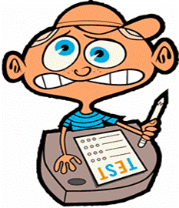
What makes children anxious?
From about eight months to three years, for example, it's very common for young children to have something called separation anxiety. They may become clingy and cry when separated from their parents or carers. This is a normal stage in children's development and tends to ease off at around age two to three.
It's also common for pre-school children to develop specific fears or phobias. Common fears in early childhood include animals, insects, storms, heights, water, blood, and the dark. These fears usually go away gradually on their own.
Throughout a child's life there will be other times when they feel anxiety. Lots of children feel anxious when going to a new school, for example, or before tests and exams. Some children feel shy in social situations and may need support with this.

Slide 4
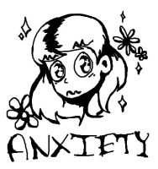
When is anxiety a problem for children?
We all get anxious at times and that is normal. Anxiety becomes a problem for children when it starts to get in the way of their day-to-day life.
Severe anxiety like this can harm children's mental and emotional wellbeing, affecting their self-esteem and confidence. They may become withdrawn and go to great lengths to avoid things or situations that make them feel anxious.

Slide 5
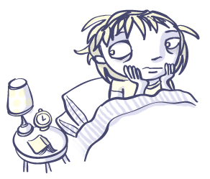
Signs of anxiety in children
When young children feel anxious, they cannot always understand or express what they are feeling. You may notice that they:
become irritable, tearful or clingy
have difficulty sleeping
wake in the night
start wetting the bed
have bad dreams

Slide 6

In older children you might notice they:
lack the confidence to try new things or seem unable to face simple, everyday challenges
find it hard to concentrate
have problems with sleeping or eating
are prone to angry outbursts
have negative thoughts going round and round their head, or keep thinking that bad things are going to happen
start avoiding everyday activities, such as seeing friends, going out in public or attending school

Slide 7
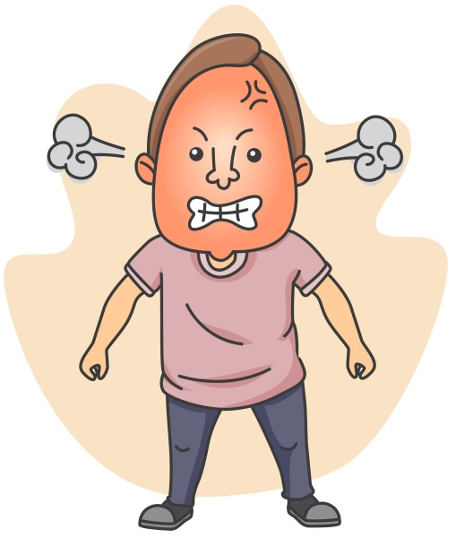
Angry outbursts and anxiety
Anxiety does not always show itself in the way we would expect, which makes it difficult to identify.
At times of severe anxiety, children can display challenging, aggressive or disruptive behaviour.
WHY???

Slide 8
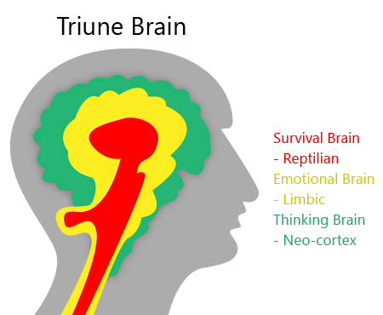
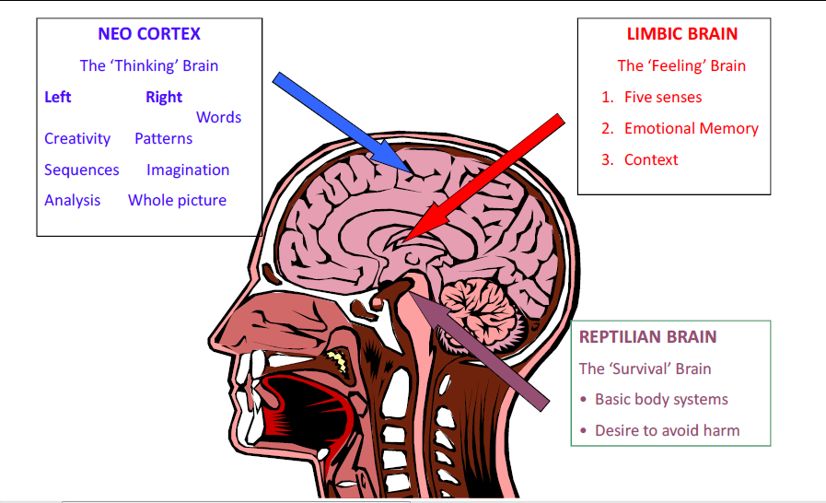
The Science Bit!

Slide 9
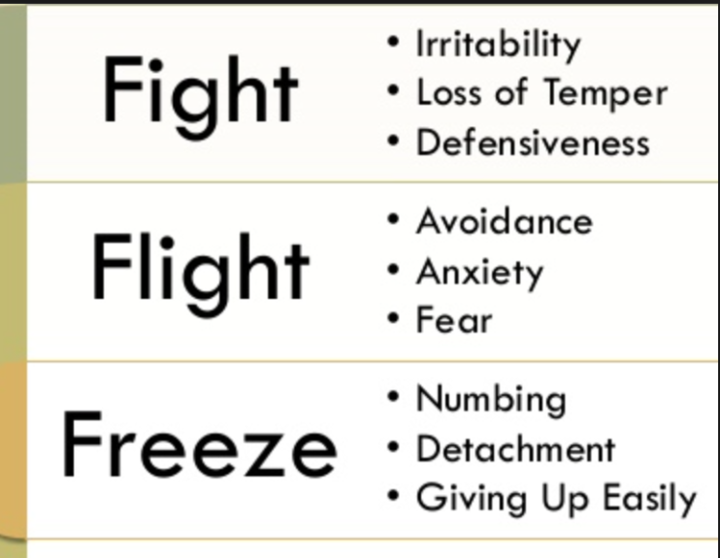
Reptilian brain – instinct, survival, temperature, breathing, swallowing, heartbeat, startle response)
If physical or emotional well-being is threatened – including self-esteem, Reptilian brain is stimulated and results in one of 3 responses – fight, flight or freeze. This is to preserve self. E.g. child who has low self-esteem e.g. maths related, asked to answer a question, could cause confrontation to avoid, could flee – toilet, run out etc., or freeze.

Slide 10

When the reptilian brain is over activated it separates the child from other parts of the brain and functioning. System is flooded with cortisol – causes stress response.
Immune system suffers from prolonged exposure to cortisol, even at low levels.
Impact on….emotional well-being,
attendance, health, achievement,
conduct, relationships….
I can’t remember!
I can’t think!
I don’t know!

Slide 11

Physical symptoms of anxiety
dizziness
tiredness
muscle aches and tension
trembling or shaking
dry mouth
excessive sweating
shortness of breath
stomach ache
feeling sick
headache
pins and needles
difficulty falling or staying asleep

Slide 12

Why is my child anxious?
Some children are more prone to worries and anxiety than others.
Children often find change difficult and may become anxious following a house move or when starting a new school.
Children who have had a distressing or traumatic experience, such as a car accident or house fire, may suffer with anxiety afterwards.
Family arguments and conflict can also leave children feeling insecure and anxious.

Slide 13

How can I help my child?
WHAT IS IN THEIR EMOTIONAL BACKPACK?
It's important to talk to your child about their anxiety or worries. Reassure them and show them you understand how they feel.
If your child is old enough, it may help to explain what anxiety is and the physical effects it has on our bodies. It may be helpful to describe anxiety as being like a wave that builds up and then ebbs away again.
As well as talking to your child about their worries and anxieties, it's important to help them find solutions.

Slide 14

Teach your child to recognise signs of anxiety in themselves and to ask for help when it strikes.
Children of all ages find routines reassuring so try to stick to regular daily routines where possible.
If your child is anxious because of distressing events, such as a bereavement or separation, see if you can find books or films that will help them understand their feelings.
If you know a change, such as a house move is coming up, prepare your child by talking to them about what is going to happen and why.
Try not to become anxious yourself or overprotective – rather than doing things for your child or helping them to avoid anxiety-provoking situations, encourage your child to find ways to manage them.

Slide 15

Staying calm…not always easy
When they are overwhelmed emotionally (meltdown) that is not the time to reason, ask them to remember what they’ve learned, talk at them etc. – that will be like pouring petrol on fire.
That is the time to show you can cope with them – ‘I’m here, I can see you’re not coping so I’m going to give you a little bit of time to come back’. ‘Radiator sitting technique’.
You may feel like they are a different child when like this– a child may have no recollection of what has happened. When they are ‘up there’ language is ineffective, it just adds to the emotional overload. It’s your tone that matters- e.g. when a baby/toddler is upset- rocking, ‘there there’, patting, stroking back etc.- it’s not what you say it’s how you say it.
It’s all about finding the calm in the chaos

Slide 16
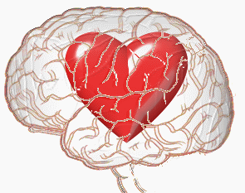
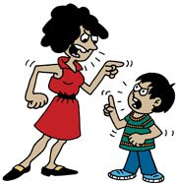
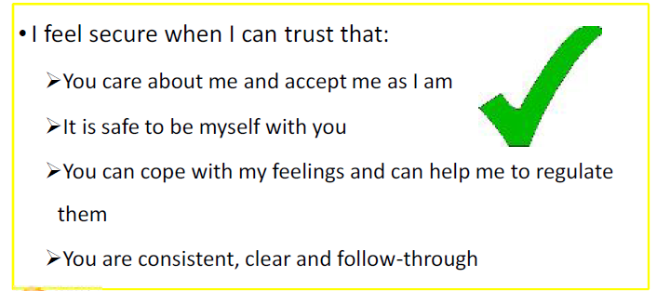

Make sure they know you love them and are proud of them. Even when things are busy or stressful, and it feels like you are in survival mode, a word or a hug can reassure them a huge amount. Praise them for what they do well, and encourage them to try new things.
Be honest about your feelings - you don’t have to be perfect. We all get things wrong and shout or say unkind things from time to time. If this happens, say sorry to your child afterwards and explain why it happened, They will learn from you that it’s OK to make mistakes and that it doesn’t make you a bad person.
Be clear about what is and isn’t acceptable - and tell them why. Children need to know what is OK and what isn’t, and what will happen if they cross the line. Follow through on what you say as otherwise they may get confused or stop respecting the boundaries.
Own your own role - you are the parent, so don’t be afraid to take tough decisions. If your child sees you are scared of their reaction and always give in to them, it can make them feel very powerful, which can be frightening. Children need to know that you are there to keep them safe.

Slide 17

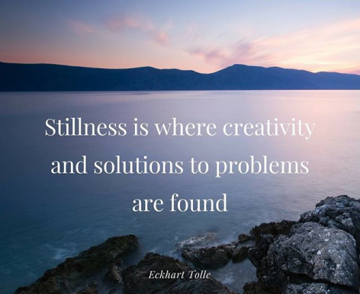

Practice simple relaxation techniques with your child, such as taking three deep, slow breaths, breathing in for a count of three and out for three. You'll find more relaxation techniques for children on the Moodcafe website.
Distraction can be helpful for young children. For example, if they are anxious about going to nursery, play games on the way there, such as seeing who can spot the most red cars.
Turn an old tissue box into a "worry" box. Get your child to write down or draw their worries and post them into the box. Then you can sort through the box together at the end of the day or week.
Walk together, go to the park – green spaces have a hugely positive impact on our emotional well-being.
Don’t forget to look after your own emotional well-being!

Slide 18
Sit less, move more…
KEEP IT SIMPLE…
https://www.youtube.com/watch?v=kYPRV-Ynilk

Slide 19


