Slide 1




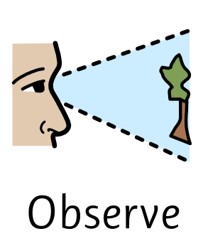


Science
S1: What are Models of our Solar System?
B: Recognise that the Sun, Earth and Moon are objects in space. W: With support, describe simple features of the Solar System using a model. A: Explain the heliocentric model and use a model to represent the Solar System. G: Compare different historical models of the Solar System and explain why scientific ideas changed.
Sticky Knowledge:
The Solar System is heliocentric, meaning the planets orbit the Sun
Spring 1:
Forces and Space – Earth and Space
Sticky Knowledge:
The Moon orbits the Earth and reflects light from the Sun.
S4: Why do we have Day and Night?
B: Recognise that day and night happen on Earth. W: With support, describe how Earth’s movement causes day and night. A: Explain how Earth’s rotation causes day and night using diagrams. G: Explain day and night using scientific vocabulary and accurate labelled diagrams.
S3: What is the Moon and how does it Move?
B: Recognise the Moon as a natural satellite of the Earth.
W: With support, describe how the Moon moves around the Earth.
A: Explain the movement of the Moon and its relationship with the Earth.
G: Use diagrams and scientific language to explain the Moon’s orbit and phases.
S2: How is our Solar System Structured?
B: Name some planets in the Solar System.
W: With support, describe the order of the planets from the Sun.
A: Describe the structure of the Solar System, including planets and their orbits.
G: Explain how gravity keeps planets in orbit around the Sun.
Sticky Knowledge:
The Solar System is made up of the Sun, planets, moons and other celestial bodies held together by gravity.
Sticky Knowledge:
Satellites orbit the Earth and collect data used for communication, navigation and climate science.
S5: How Do We Measure Time?
B: Recognise that time can be measured. W: With support, use simple equipment to measure time. A: Describe how time is measured using sundials and modern methods. G: Evaluate the accuracy of different time-measuring methods.
Sticky Knowledge:
Time can be measured using different tools, including sundials that rely on the Sun’s position.
.
S6: How Do Satellites Help Us?
B: Recognise that satellites are used in space. W: With support, describe what satellites do. A: Explain how satellites are used for communication, GPS and weather forecasting. G: Use scientific evidence to explain how satellites help us understand climate change.

