Slide 1




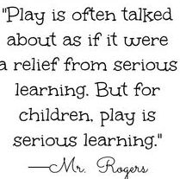
Welcome to Reception!
All Saints Catholic Primary School

Slide 2
Our EYFS team!
EYFS Lead - Mrs Farrell
EYFS Teachers - Miss Adderly and Mrs Goggins
EYFS Teaching Assistant - Miss Anderson
We are all so excited to be working as an Early Years unit from September!

Slide 3
Transition
New to school -
Stay and play visits to your new classroom
Sharing information with Nurseries
Nursery visits
All Saint’s Nursery
Classroom visits during Nursery hours
Teacher visits to Nursery

Slide 4
Starting school
Here is a little bit of information about starting school:
Our first week – Term starts on Tuesday 2nd September.
Doors open at 8.30am and will close at 8.45am prompt for
registration.
If you arrive after 8.45am, please take your child to the office to be signed in.
School finishes at 3pm. Children can be picked up from Early Years door, on the infant playground.
Children must be picked up by an adult known to the teacher. We must be informed of any changes.
If your child is ever absent, please inform the school as soon as possible.
Breakfast Club is available onsite from 8am every day. £2.50 per child per day or £2 per day for siblings.

Slide 5
What is the Early Years Foundation Stage?
The Early Years Foundation Stage (E.Y.F.S.) is the stage of education for children from birth to the end of the Reception year.
It is based on the recognition that children learn best through play and active learning.
.

Slide 6
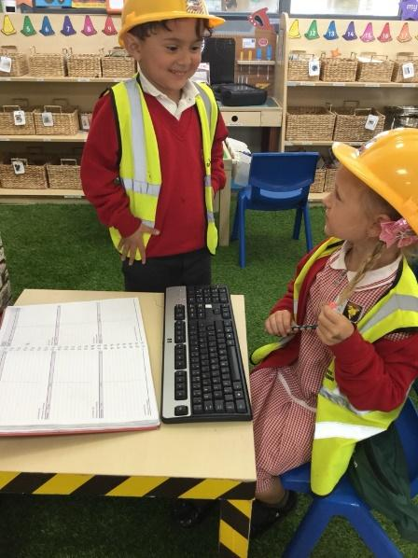
Our Curriculum
The Early Years curriculum is different from the National Curriculum.
We have 7 areas of learning and development in Reception:
Personal, Social and Emotional Development – developing friendships and developing ourselves.
Physical Development - Developing skills through PE and holding writing tools correctly.
Communication and Language – Listening to others, communicating clearly and showing a good understanding.
Literacy – learning to read, write and understand stories.
Mathematics – developing maths skills such as, counting, recognising numbers and adding.
Understanding the World – learning about the world around us – animals, growing,
community, history.
Expressive Arts and Design – being creative and using our imagination – art and music.

Slide 7
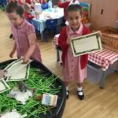
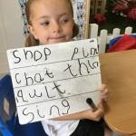

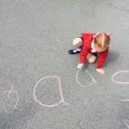
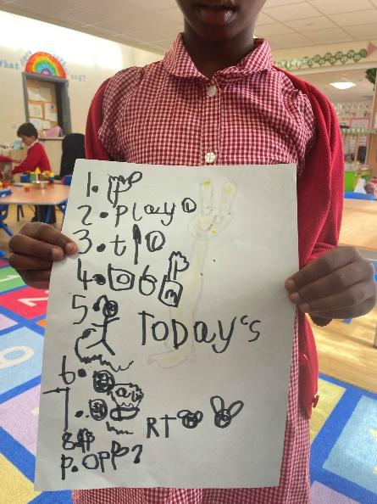
A day in the life of Reception!

Slide 8
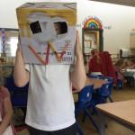
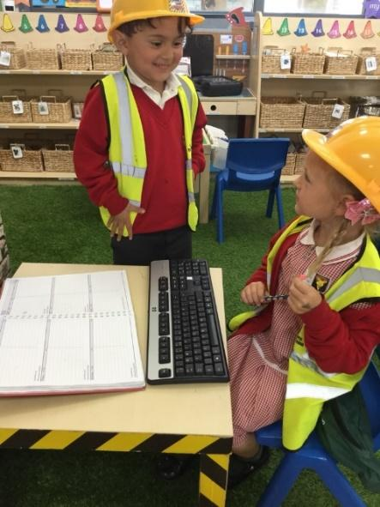
In the morning…
Morning Challenge
Register and visual timetable
Phonics – short, whole class session using a programme called ‘Read Write Inc’
Free-flow play
Adult-focussed activities
Self-service snack
Whole class activity
Lunch – Staff are always present to support children. A choice of hot dinner, jacket potato or sandwich is available.

Slide 9
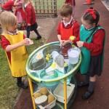
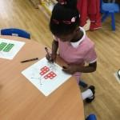
In the afternoon…
Register and visual timetable
Maths – short, whole class session followed by Maths challenges
Free-flow play
Adult-focussed activities
Readers
Gather as a class (story/ collective worship/ singing)
Home time - 3pm
During the Reception day the children will access the 7 areas of learning through structured play to work independently and demonstrate the skills they have learnt.

Slide 10
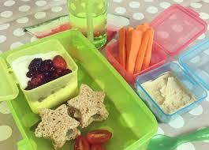
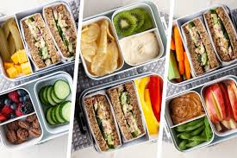
Lunch
Lunchtime 11.30am-12.30pm. Our EYFS team will look after your child during the lunch break.
All EYFS children are entitled to a free school meal. The children will eat together in the hall then play on the playground.
Children should only change from hot dinners to packed lunches or vice versa, at the start of a new half term. You must inform the school office of any changes.
We are a Healthy School so we encourage healthy packed lunches with limited treats. Plain water or milk only.
No sweets, chocolate bars or products that contain nuts.
Grapes must be cut into halves/quarters as they are a choking hazard.

Slide 11
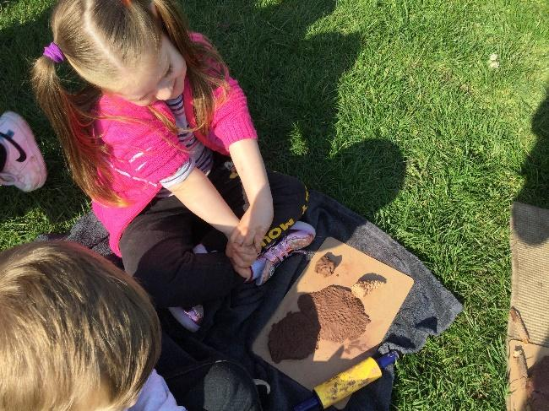
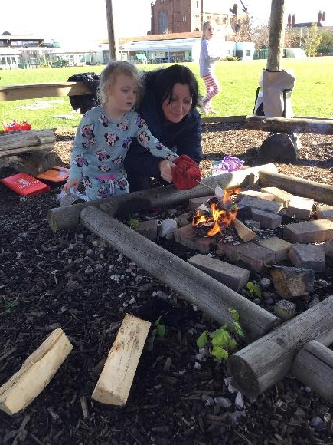
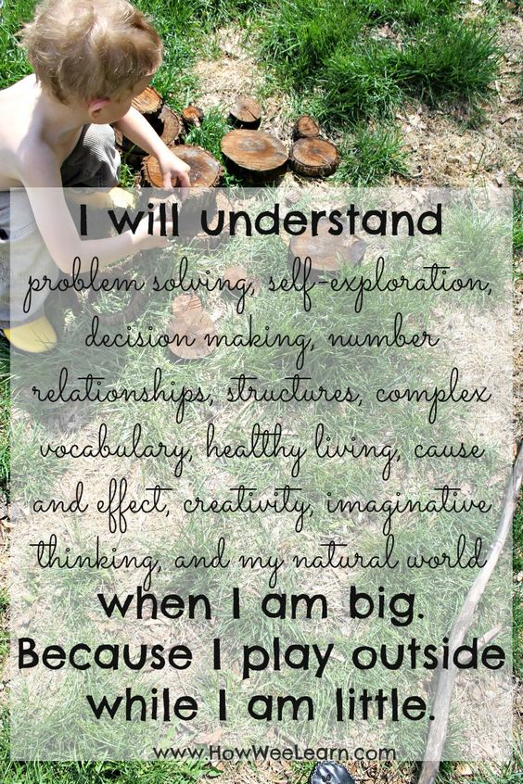
Outdoor Learning
Children discover how they learn best by:
• developing their personal, social and emotional skills
• challenging themselves and become self motivated.
• working through practical problems alongside their peers
• experiencing success and achievement
• supporting mental health and wellbeing
• developing their communication and language skills
• improving their fine motor and gross motor skills
• exploring the world through all their senses
• improving well being and spirituality
• providing children with a sense of belonging

Slide 12
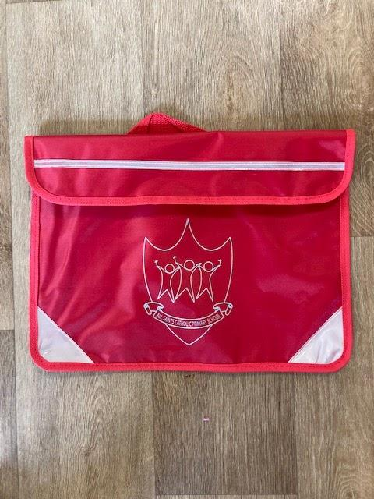
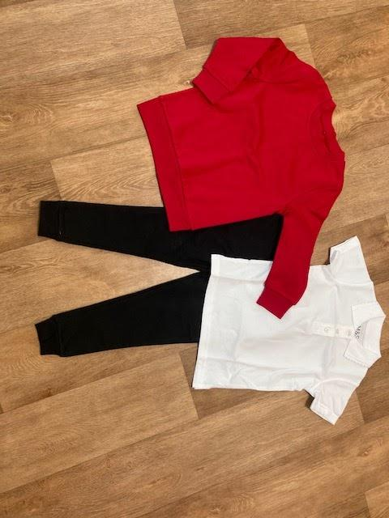
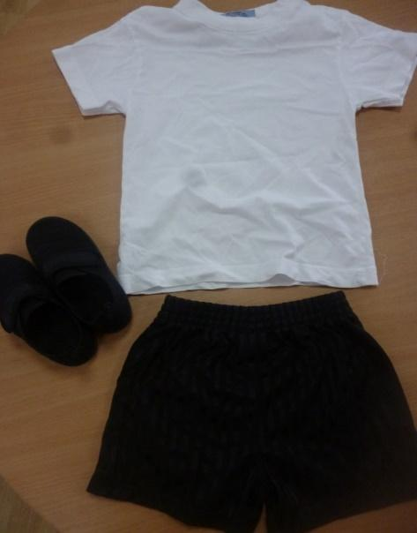
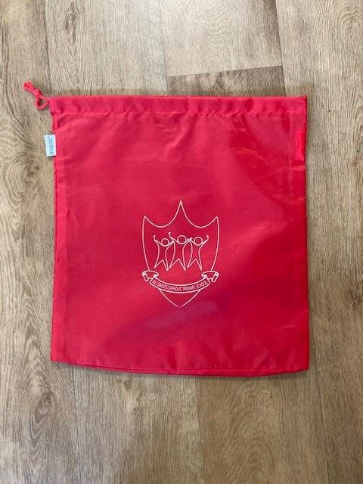
Uniforms
PE Kit
White t-shirt, black shorts, black pumps
Book bag
Winter Uniform
White polo shirt, black jogging bottoms, red sweatshirt, black shoes
Summer Uniform
White polo shirt, black shorts
School supply a first free set of uniform free of charge
We ask for all school uniform – including PE kits, coats and shoes – to be labelled.
PE bag - £3.50

Slide 13
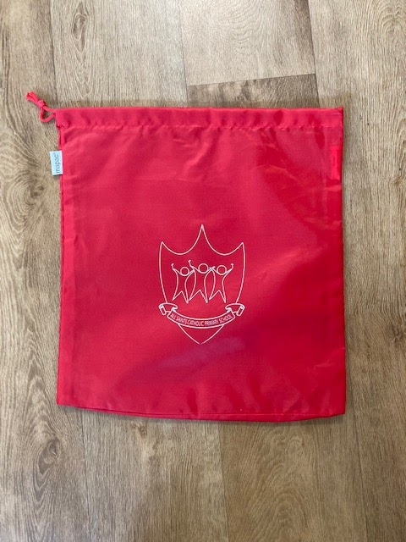
Toileting issues
If your child has any toileting issues, please let us know.
Please provide a bag containing named, spare school uniform, underwear and wipes. The bag will be left in school so that your child always has his/her own clothing available.

Slide 14


What can I do to help my child prepare for Reception?
Sharing nursery rhymes and songs
Playing sharing and taking turn games
Sharing bedtime stories
Going to the toilet independently - including wiping
Getting dressed and undressed - especially shoes and coats!
Using a knife and fork
Recognising own name - uniform labels
Using letter sounds not names
Rhyming games
Listening out for sounds
Encouraging mark-making
Developing fine motor skills - Lego, play dough
Phase 1 Phonics games
Share information about your child using Tapestry!

Slide 15


Home- School Communication
We use Tapestry, an online journal, to celebrate your child’s achievements by sharing photographs and videos with you. You can also use to share their home achievements to show to the rest of their class on Tapestry Tuesday!
This is how we will contact you electronically with any important information about your child so it is important to be signed up to SchoolSpider.
The school website and Twitter/X is updated regularly with school information, class information, photographs etc.
Please ensure if your contact details change, you let the school office know as soon as possible.
It is essential that we are able to get in touch with you or another family member at all times should your child become unwell or have an accident.

Slide 16
Please fill in any forms before you leave and return to us
We are really looking forward to getting to know you and your children and we hope you are excited too!
Thank You!
Any questions?

