Slide 1
AUTISM
Louise Tweedie
Parent and Governor
St John the Evangelist Primary School
18.03.2024

Slide 2

Agenda
What is Autism?
What doesn’t help?
What helps?
Discussion

Slide 3
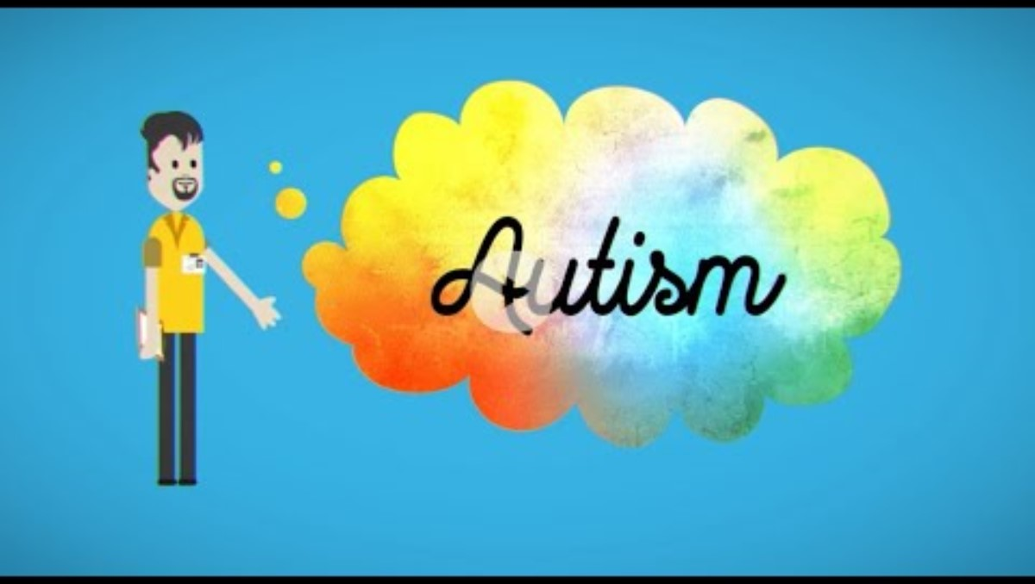
Why Autism is a Difference, not a Deficit (youtube.com)

Slide 4
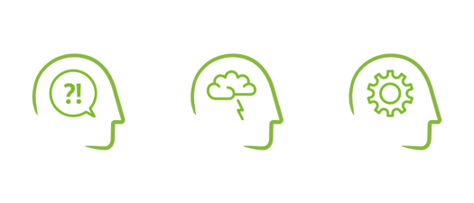
What is Autism?
Being autistic does not mean you have an illness or disease
It means your brain works in a different way from other people.
Autism is not a medical condition with treatments or a "cure". Autism is a processing difference that can have an impact on many areas of a person’s life.
Autistic people will experience differences in three key areas
Social Understanding and Communication
Autistic people have differences in the way they communicate, understand and use language. They engage in social life from a different perspective (Milton, 2011). This leads to differences in how the person interacts and develops relationships.
Sensory Processing and Integration
Sensory differences can include hyper (high) or hypo (low) sensitivity in relation the eight senses of sight, hearing, touch, taste and smell, interoception (internal sensations), balance (vestibular) and body awareness (proprioception). These differences will vary from person to person and can actually fluctuate in their responsiveness depending on a number of different factors for example the time of day or the environment.
Flexible Thinking, Information Processing and Understanding
Autistic people have differences in their attention, interests and how they learn. This can include being very focused on particular interests. They have a different way of being flexible, so often feel safer and more comfortable with routines and structure as this lessens uncertainty.

Slide 5
DSM 5 diagnostic criteria: ASD
B1 Repetitive motor movements, use of objects or speech
B2 Insistence on sameness
B3 Restricted or fixated interests with atypical intensity or focus
B4 Over-or-under sensitive to sensory input
C Present in childhood
Symptoms must be present in childhood (but may not be noticed until social demands exceed an individual’s limited capacity)
D Functional impairment
Symptoms cause significant impairment in social, occupational or other important areas of functioning.
E Not due to other conditions
The above differences are not better explained by intellectual ability or global developmental delay.
B Restrictive and Repetitive Behaviours
A Social Communication
A1 Social-emotional reciprocity
A2 Non-verbal communication for social-interaction
A3 Developing, maintaining and understanding relationships

Slide 6
WHAT DOES NOT HELP?

Slide 7
“Don’t”s! (NB we have all done these!!)
Shouting
Negative language - ‘what’s wrong with you?’ / Autism as an illness
Making your child make eye contact
Ignoring anxiety / upset
Not acknowledging sensory differences
Assuming your child knows what to do in a social situation
Changing routines without warning / surprises / ‘right, we’re going now!’
Focussing on the behaviour rather than the underlying cause
Continuing to ask questions when your child is having a meltdown / becomes dysregulated
Reactive behaviours versus proactive strategies

Slide 8

“Autism isn’t an illness. It’s a different way of being ... to help them, we don’t need to change or fix them. We need to work to understand them, and then change what we do”
Dr Barry M. Prizant PhD “Uniquely Human” (2015: 4)

Slide 9
WHAT DOES HELP?

Slide 10
“Do”s! 1 STRATEGIES TO SUPPORT ASD CHILDREN
Stay calm and regulated (or walk away until you can!)
Give extra time to process information, gain attention before communicating, keep language simple, reduce questions
Celebrate neurodiversity and differences – highlight strengths, include their interests, follow their lead.
Acknowledge your child’s feelings – name their feelings, teach emotional literacy; feelings chart, zones of regulation, 5-point anger scale
Sensory ‘diet’: reduce unwanted sensory input / distractions and allow sensory seeking behaviours where these help your child to keep calm.
ABC (Antecedent Behaviour Consequence) / STAR charts to identify the circumstances around a behaviour and understand it better. Home-school books help!

Slide 11
“Do”s! 2 STRATEGIES TO SUPPORT ASD CHILDREN
Give clear expectations
Use of Social Stories and Comic Strip Conversations (Carol Gray).
Modelling cooperative play and turn-taking.
LEGO therapy (LeGoff)
Social communication groups (e.g. Talkabout (Alex Kelly), Socially Speaking (Alison Schroeder), Friendship Terrace (Blacksheep Press)
Visuals: Visual timetable, Now / Next board, Traffic Lights, reward charts, Listening Rules
Pre-warnings of any changes
Time out / safe, calm space / fidget toys
If behaviours do escalate, have a plan to help your child – talk about what happened and why after the recovery period

Slide 12
Note about strategies
This list of strategies is not exhaustive
What works / does not work will vary from child to child. Use trial and error to find out what works.
‘Classic’ ASD strategies may not work if your child has very demand avoidant behaviours, dual diagnosis of ADHD etc.
Parents know their child best, teachers know their school / class best – we need to work together.
Finally, be kind to yourself and give yourself a break. It’s tricky applying strategies and adapting for our children all of the time.

Slide 13



Discussion
- any questions?

Slide 14
Helpful links
Advice and Guidance at NAS website www.autism.org.uk
Autism Education Trust https://www.autismeducationtrust.org.uk/resources
Support groups and classes at Space4Autism www.space4autism.com
Support groups and sensory centre at Ruby’s Fund www.rubysfund.co.uk
Information in AU kids magazine www.aukids.co.uk
East Cheshire NHS Trust: SALT website https://services.eastcheshire.nhs.uk/childrens-speech-and-language-therapy
East Cheshire NHS Trust: OT website https://services.eastcheshire.nhs.uk/paediatric-physiotherapy/childrens-occupational-therapy see Sensory Advice
CEAT https://www.cheshireeast.gov.uk/livewell/local-offer-for-children-with-sen-and-disabilities/education/supporting-send-in-education/pupils-with-asc/autism.aspx
“Making sense of Sensory Behaviour” www.falkirk.gov.uk/services/social-care/disabilities/young-people-with-disability.aspx

Slide 15




Thank you

