Slide 1

Hale CE Primary
Courageous Advocacy

Slide 2
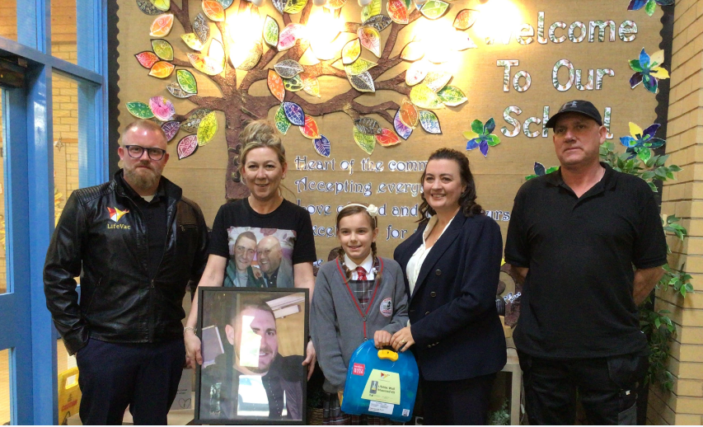
Erin (Year 5)
Erin has been working with a charity that is raising funds to provide every school with LifeVac kit. She is doing this in memory of her cousin, who sadly passed away from choking. Erin helped to provide Hale CE Primary with the first LifeVac kit in Merseyside.

Slide 3

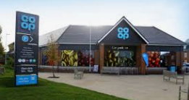
Arabella (Year 5)
Arabella has been helping her dad collect food from a range of supermarkets including the co-op. This is then given to those who need it in order to cut down the amount of waste food going to landfill. Arabella is very passionate about contributing to zero waste food in Merseyside.

Slide 4
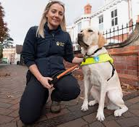

Year 2
During a Picture News assembly, children in Year 2 felt compelled to raise funds the Guide dogs for the blind. The children created ‘doggie treats’ and sold them to local community. This resulted in a visit from Margaret and her guide dog and the children were excited to choose a dog that they have helped to provided training for two years. The Black Labrador was named Milly.

Slide 5
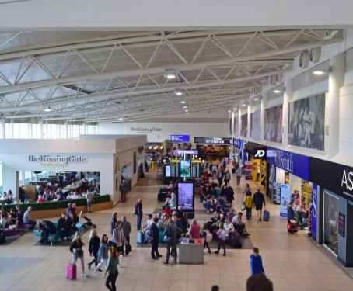
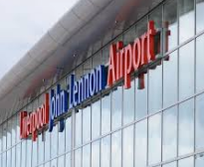
Key Stage Two
Over the years, Key Stage Two have gone to sing at Liverpool John Lennon Airport to spread God’s message and wish travellers a safe journey during the Christmas period.

Slide 6
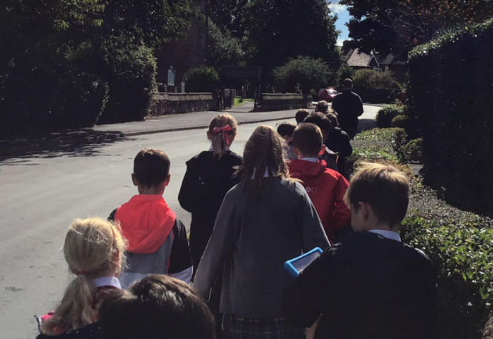
Whole school
Each year, we hold a community day. This was developed by several child to combat loneliness, something that was a huge impact from Covid Lockdowns. The children write prayers, give cards and hot chocolate to all of the neighbours of Hale CE Primary. It has provided light to many through dark times. We have received lots of letters of thanks from neighbours in the community.

Slide 7
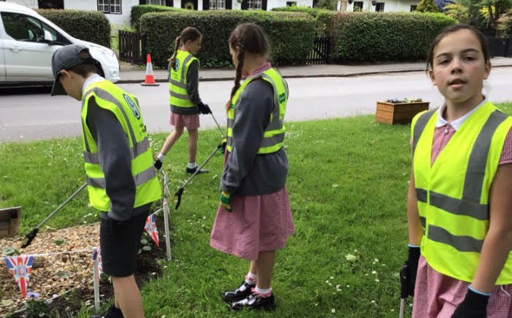
Whole school
For the King’s Coronation, pupils wanted to support with King Charles’ passion to protect the planet. Each class went out into Hale, completing a community clean up project! The Hale Community were really happy to see the younger generation taking responsibility in keeping the community tidy!

Slide 8
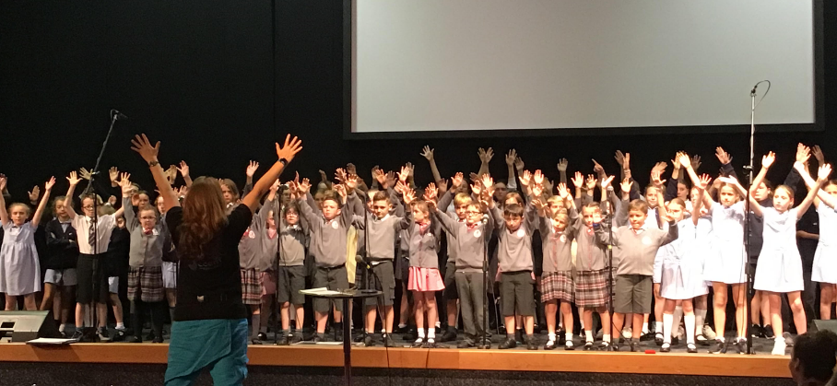
Year 4
Last year, Year 4 took part in Gospel Choir for the academic year. The children carried out three performances across the year, leading to a final performance with several other Halton Schools. Our focus was ‘Being the Light’

Slide 9
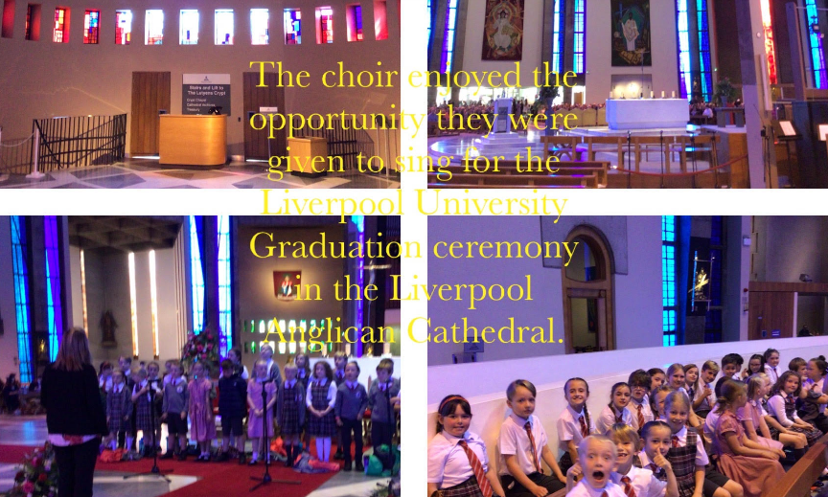
School Choir
The school choir were asked to sing at the Graduation ceremony in Liverpool Anglican Cathedral. This was a perfect opportunity to celebrate how people have ‘Let their light shine’ and aspired to be the light.

Slide 10
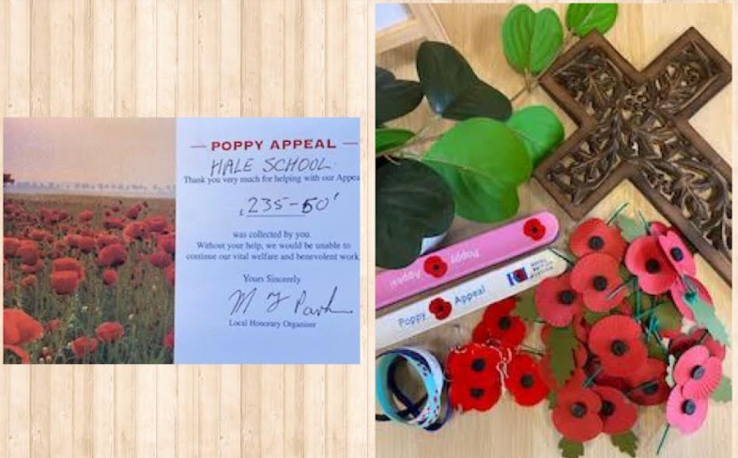
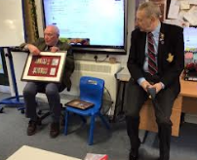
Whole school
We raised money for our Poppy appeal and invited the British Legion in to speak with children, sharing how these funds will help those in the darkest of times…

Slide 11
Coming soon…
Several of the children in Year 5 have asked to create a ‘community fridge’ to support with zero waste and also families in Need. Responding to this, we have asked a local carpenter in creating a ‘Community Larder’ that will be launched in January 2024…

