Slide 1

Year 1
Curriculum and
Expectations

Slide 2
Parent Partnership
Children are expected to attend school in their whole school uniform. This includes ties, no trainers and school book bags. Please ensure all of the children’s belongings have their name on.
Wellies will be needed for outdoor play in wet weather. They will also be used in Forest school sessions that will take place throughout the year.
Homework
Homework will be given out every Friday and is to be returned on Wednesdays.
Homework includes; Reading their phonics book, Reading on Big Cat Ebooks, Numbots and a piece of writing and a picture about the book they are reading that week. Occasionally there may be an extra piece if handwriting practice is needed.

Slide 3
Core Subjects
English, Reading, Mathematics and Science

Slide 4

Phonics In Year 1
We started the Little Wandle Phonics scheme last year. We will
continue to teach Phase 3 and work through to Phase 5 by the
end of the school year.
Children will have a daily Little Wandle Phonics lesson and will read an appropriate reading book three times a week with an adult in school.
At the end of Year 1, all of the children will take the phonics screening check in which we test the children's ability to segment and blend words. There will be a parent meeting after Christmas to give further details.

Slide 5
Reading in Year 1
Reading Practice Sessions
In addition to daily phonics, the children will be taught to read three times a week in ‘Reading Practise Sessions’. The sessions will focus on 3 main areas as well as developing the children’s reading fluency.
Decoding
Prosody
Comprehension
After the third read to an adult in school the children will bring the book home to read to an adult at home. We expect this book to be shared each night. The children should be able to read this book with at least 90% accuracy. Reading books will be changed once a week.
We expect all Reading Books to be looked after at home. If a book is lost or damaged you will be charged to buy a new book.

Slide 6
Reading Books
Each week the children will be bring home a phonics book:
The phonics book which is selected for them and used within our reading practice sessions will be changed every Friday (it is essential that this is returned to school by Wednesday the following week).
The children will also have access to the Big Cat Collins Online library which we expect them to access in addition to their phonics book.

Slide 7
Writing in Year 1
Recounts including diaries
Use some simple description
Write in 1st person based on experiences
Write in past tense
Begin to link events using and
Write events in order
Open with Dear Diary
Stories
Use some story language
Include and describe a character
Include and describe the setting
Write simple sentences in sequence
Include a beginning, middle and end

Slide 8
Writing in Year 1
Letters
Write in 1st person
Write simple sentences in sequence
Begin to link events using and
Instructions
Write simple, clear sentences
Start sentences with a command
Keep to the correct order of the steps to be followed
Non-Fiction
Write simple sentences linked to the topic
Write in the present tense
Link ideas through subject or pronoun e.g. Bats are black. They fly at night.

Slide 9







Autumn
Spring
Summer

Slide 10
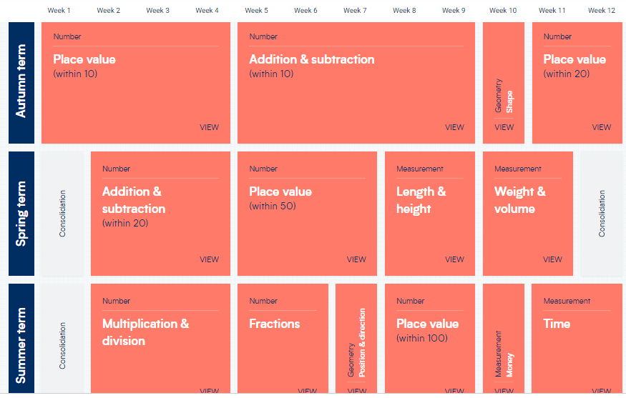
Mathematics in Year 1

Slide 11


Mathematics in Year 1
In Year 1 we will focus on 5 main areas of mathematics and we will revisit topics like place value and addition and subtraction multiple times as the numbers increase.
Number and Place Value
Addition and Subtraction
Multiplication and Division
Fractions
Measure
The children all have a NUMBOTS login it is expected that they access this regularly at home.

Slide 12
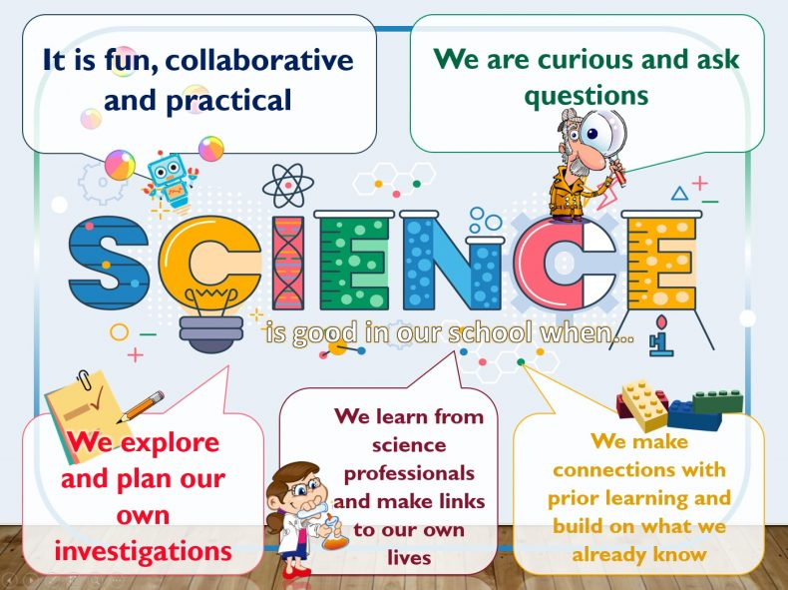
Science in Year 1
The children will have an afternoon a week of science. In these lessons, children will have a mixture of knowledge based lessons as well as investigations which promote scientific enquiry.
Our topics this year are;
Autumn
Animals including humans - About Me
Seasonal Changes
Spring
Uses of everyday materials
Exploring everyday materials
Summer
Animals including humans – About Animals
Introduction to plants

Slide 13
Foundation Subjects
PSHE, Art, DT, Music, PE, Computing

Slide 14
Creative Arts in Year 1
Creative arts are extremely important at Hale and we encourage children to be confident, creative and artistic in all aspects of their learning.
ART
Children will explore a range of artists and produce work that reflects that particular artist and their techniques. Children will have sketchbooks to develop their ideas and reflect on their learning.
DT
As with art, DT will take a similar approach, encouraging children to plan, design, make, create and evaluate their learning. Children will make their own moving picture book, build a chair for baby bear and make a fruit kebab.
Music
Children will have 1 music lesson per week linked to Charanga as well as additional music lessons led by music specialists across the academic year.

Slide 15

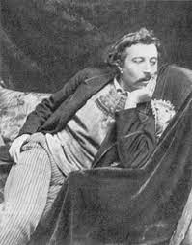
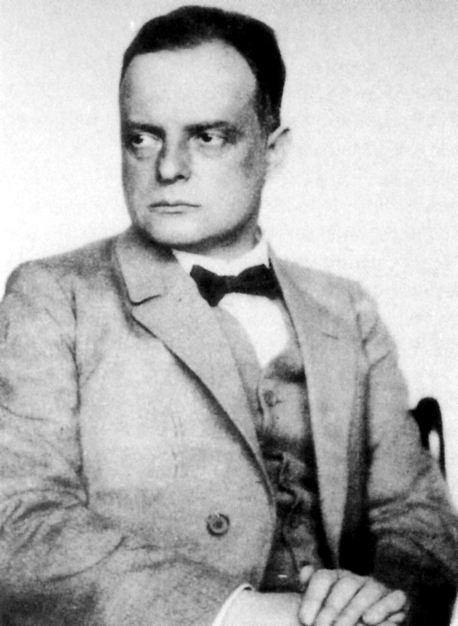
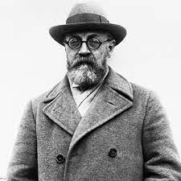
Autumn 1- Alma Thomas
Spring 1- Henri Mattice
Spring 2 – Paul Klee
Summer 2- Paul Gauguin

Slide 16

PSHE in Year 1
Last year, we introduced our Jigsaw scheme and pupils have really valued these lessons.
Children will study PSHE for 1 hour per week but also take part in assemblies linked to British Values and Picture News.
PSHE is vital in developing positive relationships, celebrating differences and promoting diversity.
We will hold special events across the year including; Black History Month, Anti-Bullying Week, Careers Fair and Enterprise.

Slide 17

PE in Year 1
Children will take part in two PE sessions every week, both with the teacher as well as specialist sports coaches.
It is suggested that PE kits come into school at the start of each half term and will be brought home for washing at the end.
Please ensure your child has the correct PE kit for indoor and outdoor lessons. The PE uniform can be checked on the school website.

Slide 18
Computing in Year 1
Technology has become part of every day life and it is our mission at Hale to ensure children can use technology safely and responsibly.
Children use the Knowsley scheme for computing and the children will have 1 hour per week of computing but children will have access to technology for other aspects of the curriculum.
Autumn 1 | Autumn 2 | Spring 1 | Spring 2 | Summer 1 | Summer 2
My Online Life | Modern Tales | News Presenter | Mini Beasts | What is a computer? | My Friend the Robot

Slide 19
Religious Education in Year 1
Religious Education is at the heart of all that we do at Hale Primary. Children will have RE lessons every week as well as class and whole school assemblies.
Our new RE scheme encourages discussions around ‘What do people say about God?’ In these lessons, children will learn about stories from the bible, linking these to our Christian Values as well as learning about other religions such as Islam, Judaism and Hinduism.
Children will have many visits to St Mary’s Church across the academic year.
Each half-term, children will be selected to be Worship Ambassadors and parents will be invited in to take part in these assemblies.

Slide 20
Attendance and Punctuality
Attendance is vital. If a child misses one week of school, this can impact on their future learning, as children can miss key development points within the curriculum.
Punctuality is also of vital importance. Early Bird work and interventions will take place between 8:40am and 9am.
This work will be areas of subjects that children are struggling to grasp and where they will be given additional adult support.

Slide 21
Any questions….

