Slide 1
Reception
Open evening

Slide 2
Welcome to Redcastle Family School
This presentation aims to provide an introduction to Redcastle Family School and includes initial information which we hope you will find useful. Should you have any further questions, staff will be happy to discuss these with you.
The school website https://www.redcastleschool.org.uk/ is kept up to date with the latest news and events and has lots more information about our school.

Slide 3

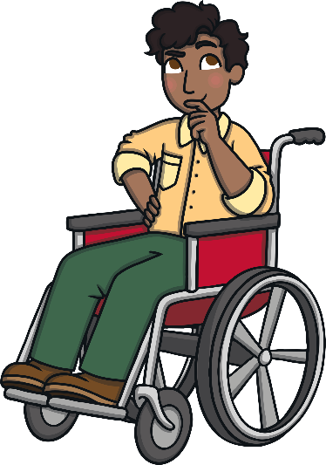

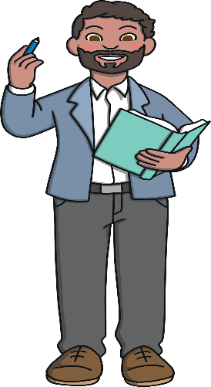

Who’s Who in Reception Class
Reception class staff members
Mrs Paynter- Class Teacher & Assistant Head
Mrs Wright – HLTA
Mrs Lund - TA

Slide 4
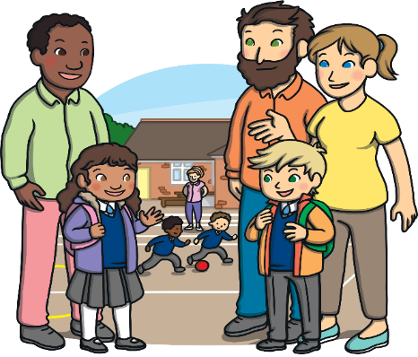
On Your Child’s First Day in Reception Class
We will start school on Thursday 3rd September 2026
You will be sent an email regarding which settling session your child will be attending.
Morning (9:00am-11:00am) or Afternoon (12:30pm-2:30pm) session.
•On Friday 4th September your child will attend the morning session and stay for lunch which will be 8:45am -1:40pm.
If your child is settled they will be able to start full time
8:45am -3.10pm the next week 7th September

Slide 5

Daily Timetable
Daily Timetable:
School starts for EYFS at 8.45 am and finishes at 3.10 pm
Children are to be on time in the morning so that they do not receive a late mark in the register and miss out on their learning.
If you are unable to pick up your child from school please let the office know who will picking them up instead.

Slide 6
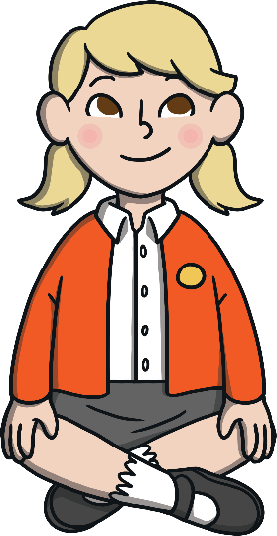

Clothing
Clothing: At Redcastle Family School all children wear a school uniform. This consists of school trousers, skirt or dress. (black, grey or navy) White polo shirt or shirt and a school jumper or cardigan. School jumpers and cardigans can be purchased from school using our online service called School money.
P.E. Kits: Children will also require clothes and shoes to be worn during Physical Education lessons and activities. Your child will need: their team coloured t-shirt, shorts or sports trousers and trainers. Trainers ideally Velcro. They must come to school in their P.E. Clothes.
Please ensure that all clothing that your child wears or brings into school, is clearly named.

Slide 7


Food and Drink
Lunch:
All early years and key stage 1 children are entitled to a free school meal each day. At lunchtime your child can have a packed lunch prepared at home and brought into school, or a school dinner. Lunchtime is between 12.30 pm to 1.30 pm. There will be a selection of different meals available each day for your child to choose from. Vegetarian options are always available. Please let us know if your child has any other dietary restrictions or requirements. You will be able to select your child’s food option through school money.
Packed lunches should support our school’s healthy eating policy. Please note that FIZZY DRINKS/SWEETS/CHOCOLATE are not allowed in school lunches.
Snacks: Children will receive a FREE PIECE OF FRUIT/HEALTHY SNACK during the morning as well as a cup of milk.
Drinks: Water is available throughout the day, including lunchtimes. Children can also bring a drink to school – remembering that no fizzy drinks or squash are allowed.

Slide 8

Helping Your Child to Settle
School Readiness
These are a few ways that you can prepare your child for the first few weeks at school:
Your child’s journey to school starts at home
Growing independence:
Ensure that they can dress and undress themselves
Help them to master basic cutlery skills.
Help them to be independent with their toileting skills.
Holding a pencil to write their name.
Counting to 10 independently.
Encourage them to sit and listen to stories.
Taking part in imaginative play (e.g Role play)

Slide 9
Helping Your Child to Settle
School Readiness
Building relationships and communicating:
Help them to develop the confidence to communicate
with new people.
Practise sharing and taking turns.
Talking to your child about how they are feeling and why.
Encouraging to set boundaries for themselves and others.(e.g. knowing how to say no)
Recognising their name so they can find it on their locker or uniform.
Paying attention for a period of time.
Listening to and following simple instructions.

Slide 10
Helping Your Child to Settle
School Readiness
Physical development:
Walking up and down steps independently.
Climbing, running and jumping and playing.
Doing simple puzzles and craft activities, strengthening their grip with cutting and sticking.
Healthy routines:
Going to bed around the same time each night.
Limiting screen time.
Eating healthy diet and trying new foods.

Slide 11
Early Years Curriculum
Activities in Reception class are carefully planned and organised in order to provide a range of learning experiences.
There are 7 Areas of Learning in the Early Years Foundation Stage (EYFS), which activities are planned around:
Personal, Social and Emotional Development
Physical Development
Communication and Language
Literacy
Mathematics
Understanding the World
Expressive Arts and Design
Throughout the EYFS, children will be working towards the Early Learning Goals. These describe the level of attainment expected at the end of your child’s reception year in school.

Slide 12
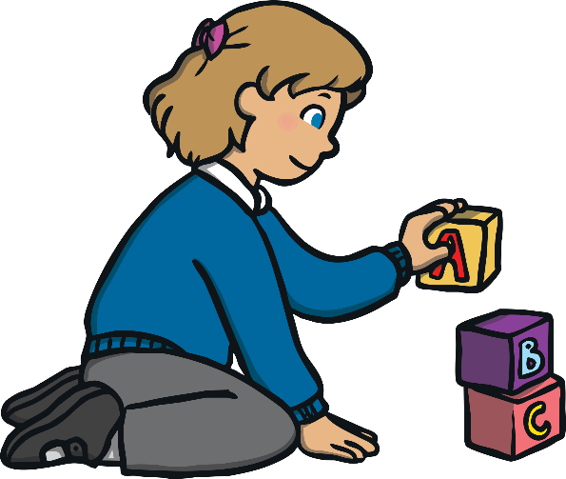
Reception Baseline Assessment
This is a statutory assessment for all reception children in the country, covering Literacy, Communication & Language and Maths. It comprises short, practical activities for the children to complete with their teacher. The children will not be aware that they are completing an assessment and it is not something that they can prepare for in advance, so please do not worry!
It is used to measure progress between entering reception and leaving year 6 and you will receive a summary of your child’s assessment during the Autumn term.

Slide 13

Learning Journeys/Journals and Reports
Throughout the year, staff will record your child’s learning on our online journal called Tapestry. This will form a unique record of your child’s learning and development. It will contain samples of work, photographs and staff observations. These online folders enable staff to track your child’s progress and attainment, and also plan future activities.

Slide 14

Home Learning
We understand and value the support you provide for your child at home. Early years staff would love to hear about what you and your child have been doing at home. We encourage you to share your child’s learning, achievements and experiences with staff, as this helps us to build a more complete picture of your child.
Homework
Daily reading (books changed three times a week)
Sound sheets
Topic homework

Slide 15

We hope that this presentation is useful. Should you have any questions, please feel free to speak to a member of staff.
We aim to ensure that your children’s experience in Redcastle Family School is a happy and rewarding one. We look forward to working with both you and your children.

